Slide 1
(2 Peter 2:4-11)
“The Doom of False Teachers”

Slide 2
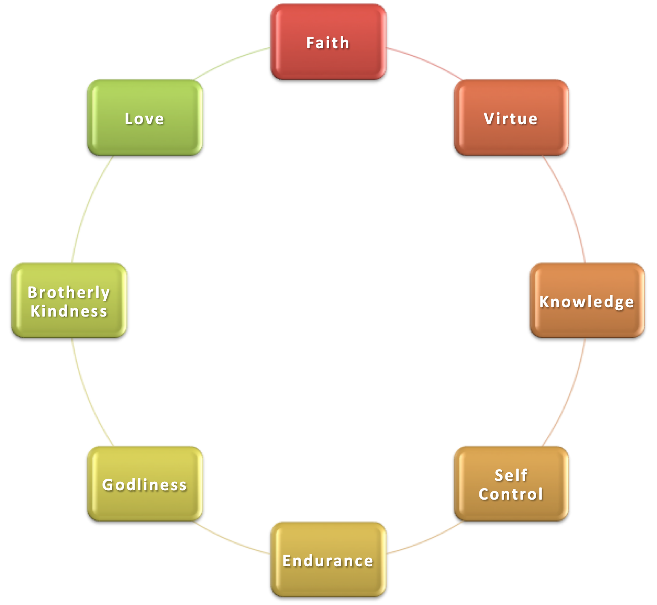
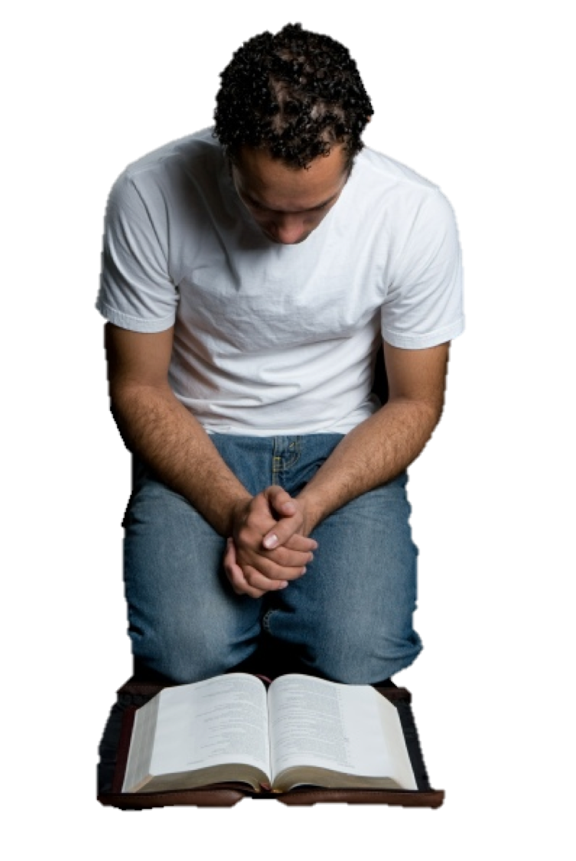
“The Doom of False Teachers”
To make our calling and election sure, we MUST GIVE ALL DILIGENCE to GROW?
2 Peter 1:5-10 (NKJV) ⁵ giving all diligence, add to your . . . ¹⁰ Therefore, brethren, be even more diligent to make your call and election sure,
God has given us what we need to grow into fruitful Christians (1:1-4)

Slide 3
“The Doom of False Teachers”
To make our calling and election sure, we MUST GIVE ALL DILIGENCE to GROW?
2 Peter 1:5-10 (NKJV) ⁵ giving all diligence, add to your . . . ¹⁰ Therefore, brethren, be even more diligent to make your call and election sure,
Great effort is required on our part in order to be fruitful Christians (1:5,10)

Slide 4
“The Doom of False Teachers”
To make our calling and election sure, we MUST GIVE ALL DILIGENCE to GROW?
2 Peter 1:5-10 (NKJV) ⁵ giving all diligence, add to your . . . ¹⁰ Therefore, brethren, be even more diligent to make your call and election sure,
The reward = security & entrance into God’s everlasting kingdom (1:8,11)

Slide 5
“The Doom of False Teachers”
To make our calling and election sure, we MUST GIVE ALL DILIGENCE to GROW?
2 Peter 1:5-10 (NKJV) ⁵ giving all diligence, add to your . . . ¹⁰ Therefore, brethren, be even more diligent to make your call and election sure,
If we fail to grow we will fall & be in danger of being eternally lost (1:9; 2:20-22)

Slide 6
“The Doom of False Teachers”
IN OUR LAST LESSON (2:1-3)
False teachers will exist: “there were also false prophets among the people" (2:1)
False teachers will HAVE ‘SUCCESS’: “And many will follow their destructive ways" (2:2)
False teachers will Be DESTROYED: “their destruction does not slumber" (2:3)

Slide 7
“The Doom of False Teachers”
IN This LESSON (2:4-11)
The destruction of false teachers is CERTAIN
History gives ample verification that God will judge false teachers and others who sin against Him and His Word.
Lest, the false teachers and their follows scoff at the strong statements made by Peter, he gives three historical proofs.

Slide 8
“The Doom of False Teachers”
2 Peter 2:4–11 (NKJV)
⁴ For if God did not spare the angels who sinned, but cast them down to hell and delivered them into chains of darkness, to be reserved for judgment; ⁵ and did not spare the ancient world, but saved Noah, one of eight people, a preacher of righteousness, bringing in the flood on the world of the ungodly; ⁶ and turning the cities of Sodom and Gomorrah into ashes, condemned them to destruction, making them an example to those who afterward would live ungodly; ⁷ and delivered righteous Lot, who was oppressed by the filthy conduct of the wicked ⁸ (for that righteous man, dwelling among them, tormented his righteous soul from day to day by seeing and hearing their lawless deeds)—

Slide 9
“The Doom of False Teachers”
2 Peter 2:4–11 (NKJV)
⁹ then the Lord knows how to deliver the godly out of temptations and to reserve the unjust under punishment for the day of judgment, ¹⁰ and especially those who walk according to the flesh in the lust of uncleanness and despise authority. They are presumptuous, self-willed. They are not afraid to speak evil of dignitaries, ¹¹ whereas angels, who are greater in power and might, do not bring a reviling accusation against them before the Lord.

Slide 10
“The Doom of False Teachers”
God’s Track Record
“if God did not spare the angels who sinned" (2:4)
God has always condemned and punished sin. Therefore, all the examples in the Old Testament are relevant examples for all time (Romans 15:4; 1 Corinthians 10:1-11).
These angels, including whatever the devil might have originally been, fell into sin because of pride and arrogance (Jude 6; 1 Tim. 3:6).
Other passages confirm spiritual beings have sinned and will end up lost (Mat 25:41; 1 Cor. 6:3; 2 Cor. 12:7; Gal 1:8; Rev 12:7,9; Heb 2:16).
2 Peter 2:4 (NKJV)
⁴ For if God did not spare the angels who sinned, but cast them down to hell and delivered them into chains of darkness, to be reserved for judgment;

Slide 11
“The Doom of False Teachers”
God’s Track Record
“if God did not spare the angels who sinned" (2:4)
God has created all things, both material and immaterial (Colossians 1:16).
The devil and his angels are created beings, and, since all of God’s creation was originally good, we must conclude that originally they stood in a right relationship with God, and later decided to rebel.
“Cast them down to hell,” GK., “Tartarus” - in Greek Mythology, the abyss beneath Hades in which fallen immortals are punished.’
Peter uses the word to identify the temporary condition of fallen angels awaiting judgment.
2 Peter 2:4 (NKJV)
⁴ For if God did not spare the angels who sinned, but cast them down to hell and delivered them into chains of darkness, to be reserved for judgment;

Slide 12
“The Doom of False Teachers”
God’s Track Record
“and did not spare the ancient world" (2:5)
‘and did not spare’-The repetition of this phrase (2:4) is an attack upon the false teachers insistence upon ‘grace’ being a reprieve from being justly punished.
‘Grace’ didn’t cover the angels, and grace didn’t save Noah’s contemporaries. God did not spare. - Therefore God will not spare the apostate preacher who teaches error and does not repent (Eze. 5:11; 7:4, 9; Jude 14–15)
Ancient world (3:6; Job 22:15, 16. Mat. 24:37–39. Lu. 17:26, 27. He. 11:7)
2 Peter 2:5 (NKJV)
⁵ and did not spare the ancient world, but saved Noah, one of eight people, a preacher of righteousness, bringing in the flood on the world of the ungodly;

Slide 13
“The Doom of False Teachers”
God’s Track Record
“but saved Noah, one of eight people, a preacher of righteousness," (2:5)
Here, against the background of judgment on a rebellious and wicked world we find God’s salvation depicted (1 Pet. 3:20; Heb. 11:7).
Noah preached the truth, and he was only able to save seven other people! (1 Pet. 3:20)
The false teachers might have many followers, but the majority has always been on the wrong side of salvation (Deut 28:62; Ex. 23:2; Mat. 7:13-14).
2 Peter 2:5 (NKJV)
⁵ and did not spare the ancient world, but saved Noah, one of eight people, a preacher of righteousness, bringing in the flood on the world of the ungodly;

Slide 14
“The Doom of False Teachers”
God’s Track Record
“and turning the cities of Sodom and Gomorrah into ashes" (2:6)
These two cities really existed and was really destroyed was confirmed by other prophets, including Jesus (Gen. 19; Isaiah 1:9-10; Ezek. 16:48-56; Luke 17:28-32).
“Making them an example …” - Every example in the Old Testament and New Testament is relevant for our time (Rom. 15:4; 1 Cor. 10:1-11).
Just as these cities were destroyed by God’s wrath, so will all those who live ungodly in any and every generation. (Jude 7; Rev. 21:8).
2 Peter 2:6 (NKJV)
⁶ and turning the cities of Sodom and Gomorrah into ashes, condemned them to destruction, making them an example to those who afterward would live ungodly;

Slide 15
“The Doom of False Teachers”
God’s Track Record
2 Peter 2:7–8 (NKJV)
⁷ and delivered righteous Lot, who was oppressed by the filthy conduct of the wicked ⁸ (for that righteous man, dwelling among them, tormented his righteous soul from day to day by seeing and hearing their lawless deeds)—
“and delivered righteous Lot" (2:7,8)
Lot made mistakes which made his life much more difficult (Get. 13:8-13)
Lot tried to do the right thing and his soul was vexed by the evil that surrounded him (2:7,8; Gen. 19:1-7).
Lot found that he had no positive influence upon those surrounding him they despised him (Gen. 19:7-8).
He could not save his son-in-laws (19:14).
He lost his wife - after she was initially saved, she looked back (19:17,26; Luke 17:32)

Slide 16
“The Doom of False Teachers”
God’s Track Record
2 Peter 2:7–8 (NKJV)
⁷ and delivered righteous Lot, who was oppressed by the filthy conduct of the wicked ⁸ (for that righteous man, dwelling among them, tormented his righteous soul from day to day by seeing and hearing their lawless deeds)—
“oppressed by the filthy conduct of the wicked" (2:7,8)
Filthy conduct: ’unbridled lust, excess, shamelessness’ (Thayer p. 79). ‘absence of restraint, indecency’ (Vine p. 310).
‘these indulged in gross immorality and went after strange flesh’ (Jude 7).
It is clear that the sins of these two cities included homosexuality (Genesis 19:5-7).
Let us be impressed that homosexual practices didn’t turn the inhabitants into peace-loving and gentle people (Genesis 19:9).

Slide 17
“The Doom of False Teachers”
God’s Track Record
2 Peter 2:7–8 (NKJV)
⁷ and delivered righteous Lot, who was oppressed by the filthy conduct of the wicked ⁸ (for that righteous man, dwelling among them, tormented his righteous soul from day to day by seeing and hearing their lawless deeds)—
“oppressed by the filthy conduct of the wicked" (2:7,8)
HOW DOES A RIGHTEOUS PERSON respond to sin, and in this context, the sin of homosexuality? — A righteous man or woman is tormented, vexed, wearied, and distressed in their soul by such behavior.
Lot may have lived in this region for about 20 years, but he never allowed such practices to desensitize his conscience and diminish his hatred for sin!
How can we endorse “filthy conduct,” and claim to be righteous in the sight of God?

Slide 18
“The Doom of False Teachers”
God’s Track Record
“the Lord knows how to deliver the godly out of temptations" (2:9)
God knows how to save a single individual (Lot) or a few out of millions (Noah and his family) — God knows exactly who is godly and who isn’t (2 Tim. 2:19).
Christianity is no insurance policy against the trials of life…the examples of Noah and Lot are instructive for showing how God delivers the godfearing — trials must be endured before being delivered (1 Pet. 5:10).
God preserves us through faith — (1 Pet. 1:5; 1 Cor. 10:13; Heb. 11)
2 Peter 2:9 (NKJV)
⁹ then the Lord knows how to deliver the godly out of temptations and to reserve the unjust under punishment for the day of judgment,

Slide 19
“The Doom of False Teachers”
God’s Track Record
“and to reserve the unjust under punishment for the day of judgment," (2:9)
God knows how to deal with the ungodly — punishment is certain and unavoidable (Rom. 1:24,26,28; 2:5-11; Job 21:30; Pr. 16:4; Jude 14, 15).
Just as the rebellious angels are being held (tērein, “keeps under guard”) for judgment, the same is true for rebellious human beings (cf. 3:7; Luke 16:22b-31; Rev. 20:11–15)
2 Peter 2:9 (NKJV)
⁹ then the Lord knows how to deliver the godly out of temptations and to reserve the unjust under punishment for the day of judgment,

Slide 20
“The Doom of False Teachers”
DESCRIPTION OF FALSE TEACHERS
2 Peter 2:10 (NKJV)
¹⁰ and especially those who walk according to the flesh in the lust of uncleanness and despise authority. They are presumptuous, self-willed. They are not afraid to speak evil of dignitaries,
Jude 8 (NKJV)
⁸ Likewise also these dreamers defile the flesh, reject authority, and speak evil of dignitaries.

Slide 21
“The Doom of False Teachers”
DESCRIPTION OF FALSE TEACHERS
2 Peter 2:11 (NKJV)
¹¹ whereas angels, who are greater in power and might, do not bring a reviling accusation against them before the Lord.
Jude 9 (NKJV)
⁹ Yet Michael the archangel, in contending with the devil, when he disputed about the body of Moses, dared not bring against him a reviling accusation, but said, “The Lord rebuke you!”

Slide 22
“The Doom of False Teachers”
HOW CAN WE SPOT A FALSE TEACHER?
If They:
Minimize the Need for Authority
Depend on human wisdom
Minimize the need to OBEY God
Teach that God’s love & grace permits a continuance in sin
Reject examination
If WE Know & Grow in the Truth! (3:18,19)

Slide 24
(2 Peter 2:4-11)
Charts by Don McClain
Preached December 13 - PM
West 65th Street church of Christ / P.O. Box 190062 / Little Rock AR 72219
501-568-1062 / 501-749-6928 / Email – donmcclain@sbcglobal.net
Prepared w/ Keynote More lessons: http://w65stchurchofchrist.org/coc/sermons/
“The Doom of False Teachers”

Slide 25
Jeremiah 23:11–20 (NKJV)
¹¹ “For both prophet and priest are profane; Yes, in My house I have found their wickedness,” says the Lord. ¹² “Therefore their way shall be to them Like slippery ways; In the darkness they shall be driven on And fall in them; For I will bring disaster on them, The year of their punishment,” says the Lord. ¹³ “And I have seen folly in the prophets of Samaria: They prophesied by Baal And caused My people Israel to err.

