Slide 1
“Saved Through The Resurrection of Jesus”
(1 Peter 3:18-22)

Slide 2
Our Living Hope
We are but “pilgrims” (vs. 1), implying there is a destination - a goal - a HOMELAND! — Heb 11:13-16
This HOMELAND is spoken of as a LIVING HOPE which Peter points to as a means of encouraging us to ENDURE — 1:6-9,13,13; 5:9-11

Slide 4
1 Peter 3:1-7
A God Honoring Marriage
“heirs together of the grace of life”

Slide 5
“Don’t Allow Suffering To Rob You of Your Blessing”
1 Peter 3:8-17
Remember - You Are Blessed If You Suffer For Christ (3:14,17)
Sanctify The Lord In Your Hearts (3:14-15)
Always Be Ready To Give A Defense (3:15)
Keep Your Conscience Clean (3:16)
¹⁷ For it is better, if it is the will of God, to suffer for doing good than for doing evil. (1 Peter 3:17)

Slide 6
¹⁷ For it is better, if it is the will of God, to suffer for doing good than for doing evil. (1 Peter 3:17)
We Are Saved Through The Suffering & Resurrection of Jesus (18)
Those who suffer with Christ will be victorious (19-22)

Slide 7
1 Peter 3:18–22 (NKJV)
¹⁸ For Christ also suffered once for sins, the just for the unjust, that He might bring us to God, being put to death in the flesh but made alive by the Spirit, ¹⁹ by whom also He went and preached to the spirits in prison, ²⁰ who formerly were disobedient, when once the Divine longsuffering waited in the days of Noah, while the ark was being prepared, in which a few, that is, eight souls, were saved through water.

Slide 8
1 Peter 3:18–22 (NKJV)
²¹ There is also an antitype which now saves us—baptism (not the removal of the filth of the flesh, but the answer of a good conscience toward God), through the resurrection of Jesus Christ, ²² who has gone into heaven and is at the right hand of God, angels and authorities and powers having been made subject to Him.

Slide 9
Saved Through The Suffering of Jesus
THE EXAMPLE OF JESUS (3:18)
Jesus Christ Also Suffered (18)
“Christ also suffered once” - i.e., once for all, in contrast with the Old Testament yearly sacrifice on the Day of Atonement and declares the complete sufficiency of Christ’s death(cf. Rom. 6:10; Heb. 9:26, 28; 10:10)
"The JUST” - Jesus was innocent (18; 2:22; Is. 53:9; 2 Cor. 5:21)
“For the unjust” Jesus died for men guilty of sin (Rom. 3:23; 5:8-10; Jn. 3:16; 2 Co 5:14,15; Hb 2:9; 1 Jn 2:2)
1 Peter 3:18 (NKJV)
¹⁸ For Christ also suffered once for sins, the just for the unjust, that He might bring us to God, being put to death in the flesh but made alive by the Spirit,

Slide 10
Saved Through The Suffering of Jesus
THE EXAMPLE OF JESUS (3:18)
Jesus Christ Also Suffered (18)
“that He might bring us to God” - (1:18; Ro. 5:6–8; 8:3; 2 Co. 5:21; Ga. 1:4; 3:13; Tit. 2:14; He. 9:26, 28)
“put to death in the flesh” - Jesus experienced physical death on the cross (Mt. 27:50; Phili. 2:8; Heb. 2:9)
“but made alive by (in) the Spirit” -Jesus was resurrected from the dead (Ac. 2:24, 32, 33; Rom. 8:11)
Jesus’s enemies were not victorious when they crucified Him, nor will ours (Rom. 8:11-39; Phili. 3:20,21)
1 Peter 3:18 (NKJV)
¹⁸ For Christ also suffered once for sins, the just for the unjust, that He might bring us to God, being put to death in the flesh but made alive by the Spirit,

Slide 11
Saved Through The Suffering of Jesus
THE EXAMPLE OF NOAH (3:19-20)
“By whom He went and preached to spirits in prison” (19)
Not fallen angelic spirits (4:6)
Not spirits stuck in limbo ~ needing to have Christ revealed to them unto salvation (Hebrews 9:27)
But to the spirits of disobedient antediluvians who rejected the preaching of Noah (2 Peter 2:5)
When did this preaching occur and how? The preaching and disobedience occurred at the same time.
1 Peter 3:19,20a (NKJV)
¹⁹ by whom also He went and preached to the spirits in prison, ²⁰ who formerly were disobedient, when once the Divine longsuffering waited in the days of Noah, while the ark was being prepared

Slide 12
Saved Through The Suffering of Jesus
THE EXAMPLE OF NOAH (3:19-20)
“By whom He went and preached to spirits in prison” (19)
Jesus, by the Spirit, preached to those spirits, (imprisoned at the time of Peter’s epistle), through Noah during the period of God’s long-suffering, prior to their death, which preaching they rejected.
This interpretation seems to fit the context — i.e., remaining faithful while suffering unjust persecution (3:13–22)
Noah is presented as an example.
1 Peter 3:19,20a (NKJV)
¹⁹ by whom also He went and preached to the spirits in prison, ²⁰ who formerly were disobedient, when once the Divine longsuffering waited in the days of Noah, while the ark was being prepared

Slide 13
Saved Through The Suffering of Jesus
THE EXAMPLE OF NOAH (3:19-20)
“By whom He went and preached to spirits in prison” (19)
Noah was faithful before God, even though it meant enduring harsh ridicule.
Noah and seven others were victorious and vindicated, i.e., they were SAVED from the evil world that then existed.
Those who rejected the call of repentance perished and were at the time of Peter’s epistle awaiting the final judgment (Jn 5:28,29)
1 Peter 3:19,20a (NKJV)
¹⁹ by whom also He went and preached to the spirits in prison, ²⁰ who formerly were disobedient, when once the Divine longsuffering waited in the days of Noah, while the ark was being prepared

Slide 14
Saved Through The Suffering of Jesus
THE EXAMPLE OF NOAH (3:19-20)
“In the Ark, Eight Souls were saved through water” (20)
Noah, and his family, were physically delivered from God’s judgment upon a wicked world through the flood in the ark ( Ge. 7:1–7, 13, 23; 8:1, 18; 2 Pet. 2:5)
Noah’s salvation was by grace, (Gen. 6:8), through faith (Heb. 11:7)
The ark Noah built by faith and the waters God sent upon the earth were both necessary to save Noah from the wicked world.
1 Peter 3:20 (NKJV)
²⁰ who formerly were disobedient, when once the Divine longsuffering waited in the days of Noah, while the ark was being prepared, in which a few, that is, eight souls, were saved through water.

Slide 15
Saved Through The Suffering of Jesus
“Baptism Now Saves Us” (3:21)
“Noah’s Salvation Serves As A “TYPE” of our Salvation (3:21)
Noah’s physical deliverance in the ark through water serves as a prefigure to the spiritual reality of our salvation in baptism through the resurrection of Christ (Acts 2:38; 22:16; Rom. 6:3-6,16-18; Col. 2:12,13; Gal. 3:26,27)
Why do so many professing to be preachers of Christ reject Peter’s clear statement “baptism now saves us?”
1 Peter 3:21 (NKJV)
²¹ There is also an antitype which now saves us—baptism (not the removal of the filth of the flesh, but the answer of a good conscience toward God), through the resurrection of Jesus Christ,

Slide 16
Saved Through The Suffering of Jesus
“Baptism Now Saves Us” (3:21)
““not the removal of the filth of the flesh” (3:21)
Baptism is “Not A Ceremonial Cleansing” (Heb. 9:9-14)
Baptism is “… the answer of a good conscience toward God”
1 Peter 3:21 (NKJV)
²¹ There is also an antitype which now saves us—baptism (not the removal of the filth of the flesh, but the answer of a good conscience toward God), through the resurrection of Jesus Christ,
Hebrews 10:22 (NKJV)
²² let us draw near with a true heart in full assurance of faith, having our hearts sprinkled from an evil conscience and our bodies washed with pure water.

Slide 17
Saved Through The Suffering of Jesus
“Baptism Now Saves Us” (3:21)
(not the removal of the filth of the flesh, but the answer of a good conscience toward God),
Thayer Definition: - G1906 – epero tema
1) an enquiry, a question
2) a demand
3) earnestly seeking
3a) craving, an intense desire

Slide 18
Saved Through The Suffering of Jesus
“Baptism Now Saves Us” (3:21)
(not the removal of the filth of the flesh, but the answer of a good conscience toward God),
Arndt & Gingrich.
Baptism is “an appeal to God for a clear conscience” (Greek Lexicon, p. 285).
Kittel’s Theological Dictionary (Abridged),
the rendition is this: “Baptism does not confer physical cleansing but saves as a request for forgiveness . . .” (p. 262).

Slide 19
Saved Through The Suffering of Jesus
“Baptism Now Saves Us” (3:21)
(not the removal of the filth of the flesh, but the answer of a good conscience toward God),
Johnson, Barton W.
… ”Inquiry” would be still better. The soul seeking the forgiveness of sins "inquires" What shall I do to remove the sense of unforgiven sins and make my conscience void of offense? The answer is "Repent and be baptized," etc. See Acts 2:38. He who obeys the word of the Lord has the "inquiry" answered in baptism.

Slide 20
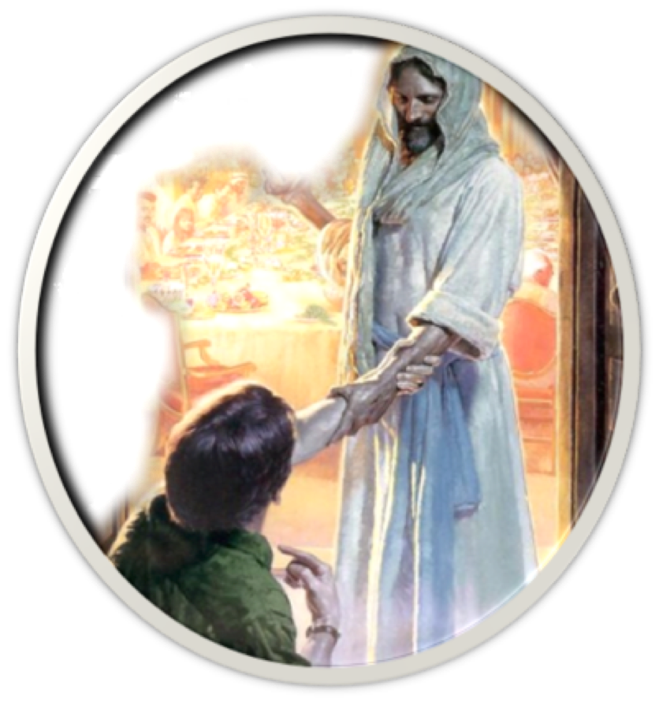
Saved Through The Suffering of Jesus
“Baptism Now Saves Us” (3:21)
(not the removal of the filth of the flesh, but the answer of a good conscience toward God),
Hebrews 10:22
Acts 2:21-38
Rom 10:13-16
Acts 22:16

Slide 21
Saved Through The Suffering of Jesus
“Baptism Now Saves Us” (3:21)

Slide 22
Saved Through The Suffering of Jesus
“Baptism Now Saves Us” (3:21)
Saved (Mk 16:16; 1 Pet 3:21)
Sins Remitted (Acts 2:38).
Sins Washed Away (Acts 22:16)
Contact the death of Christ (Rom 6:3).
United In Christ’s Resurrection (Rom 6:4-6)
Form of Doctrine (Rom 6:16,17)
In Christ (Gal 3:27).
Faith In The Working of God (Col 2:11-13).
Born Again (John 3:5).
Regenerated (Tit 3:5).
Cleansed Conscience - (Heb 10:22; 1 Pet 3:21)

Slide 23
¹⁷ For it is better, if it is the will of God, to suffer for doing good than for doing evil. (1 Peter 3:17)
We Are Saved Through The Suffering & Resurrection of Jesus (18)
Those who obey Him & suffer with Christ will be victorious (19-22)

Slide 24
Our Living Hope
We are but “pilgrims” (vs. 1), implying there is a destination - a goal - a HOMELAND! — Heb 11:13-16
This HOMELAND is spoken of as a LIVING HOPE which Peter points to as a means of encouraging us to ENDURE — 1:6-9,13,13; 5:9-11

Slide 26
We Are Saved Through The Suffering & Resurrection of Jesus
Charts by Don McClain
Preached September 13, 2020 PM
West 65th Street church of Christ - P.O. Box 190062 - Little Rock AR 72219 - Phone — 501-568-1062 — Email – donmcclain@sbcglobal.net
Prepared using Keynote / More Keynote, PPT & Audio Sermons:
www.w65stchurchofchrist.com

Slide 27
Acts 2:32–41 (NKJV)
³² This Jesus God has raised up, of which we are all witnesses. ³³ Therefore being exalted to the right hand of God, and having received from the Father the promise of the Holy Spirit, He poured out this which you now see and hear. ³⁴ “For David did not ascend into the heavens, but he says himself: ‘The Lord said to my Lord, “Sit at My right hand, ³⁵ Till I make Your enemies Your footstool.” ’ ³⁶ “Therefore let all the house of Israel know assuredly that God has made this Jesus, whom you crucified, both Lord and Christ.”

Slide 28
Acts 2:32–41 (NKJV)
³⁷ Now when they heard this, they were cut to the heart, and said to Peter and the rest of the apostles, “Men and brethren, what shall we do?” ³⁸ Then Peter said to them, “Repent, and let every one of you be baptized in the name of Jesus Christ for the remission of sins; and you shall receive the gift of the Holy Spirit. ³⁹ For the promise is to you and to your children, and to all who are afar off, as many as the Lord our God will call.”

Slide 29
Acts 2:32–41 (NKJV)
⁴⁰ And with many other words he testified and exhorted them, saying, “Be saved from this perverse generation.” ⁴¹ Then those who gladly received his word were baptized; and that day about three thousand souls were added to them.

