Slide 1
(Matthew 22:1-14; Ephesians 5:22-33; 2 Corinthians 11:2; Revelation 19:2,9)
Revelation 19:7 (NKJV)
⁷ Let us be glad and rejoice and give Him glory, for the marriage of the Lamb has come, and His wife has made herself ready.”

Slide 2
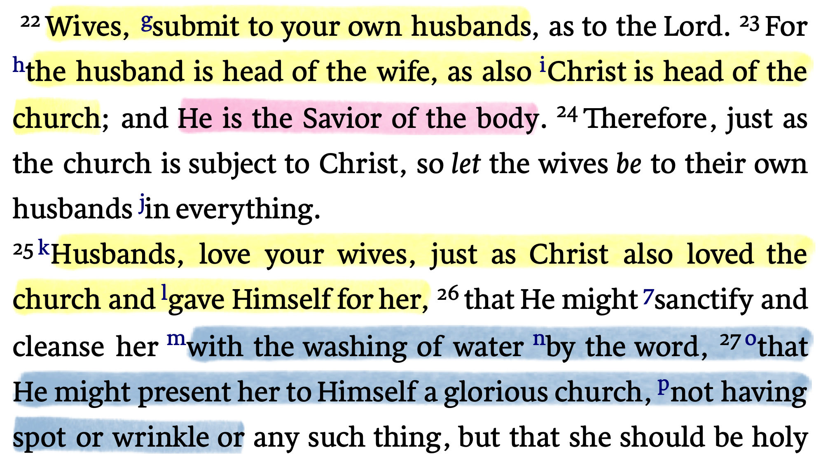
EPHESIANS 5:22-33

Slide 3
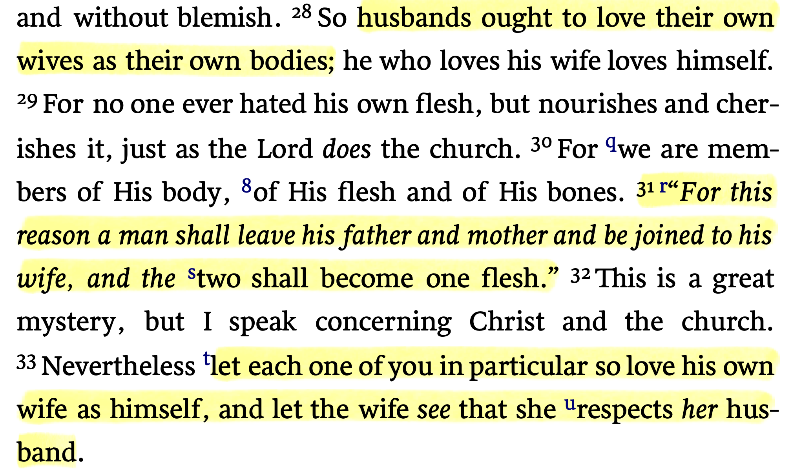
EPHESIANS 5:22-33

Slide 4
MARRIAGE & the CHURCH
Marriage, as presented in God’s word, is meant to be a “picture” of the church of Christ.
If we understand the teaching of scripture regarding marriage, this metaphor it will help better understand the Lord’s church.
The church submits / prepares / is cleansed / is set apart (holy) / beloved / and will be gloriously rewarded …

Slide 5
The Use of Biblical Metaphors
WARNING: MUST NOT force every detail of a metaphor to have some important meaning or application.
INSTRUCTION: SEEK for the main lesson and intended application of the metaphor.
APPLICATION: PRINCIPLES applied from the metaphor are to be applied in harmony with other Biblical teaching.

Slide 6
Jewish wedding customs At The Time of Christ
Stage one: the “ketubbah” (betrothal) (2 Corinthians 11:2) | Stage two: “chuppah” (consummation) (Matthew 25:1-13) | Stage three: the wedding feast: (John 2:1-11)
The bridegroom and the father of the bride agree to terms and sign the “ketubbah” - The couple is legally married. (betrothed) (Matthew 1:18–19) | After the groom fulfilled his dowry and the father of the bride consents the groom and his wife consummate the union. (Gen 29:21-30) | The wedding feast occurred in the home of the groom as seen in the parable of the wedding feast. (Matt 22:1-14;)
Initial salvation We come into covenant with Christ (Rom. 6:3-6) | Second Coming Jesus returns for his bride (1 Thes. 4:16-18) | Heaven wedding feast in heaven (Revelation 19:7-9)

Slide 7
JESUS THE BRIDEGROOM
HE LOVED US:
Left the glories of heaven and became human (John 1:1,2,14; 3:13, 31,32; 6:33; Phili. 2:5-9)
He suffered temptations and trials (Mat. 4:1-11; Heb. 2:18; 4:15)
He gave His life to redeem us from our sins (Mat. 20:28; Rev. 1:5)
Our merciful High Priest & Advocate (Heb. 4:15; 1 Tim. 2:5; 1 Jn 2:1,2)

Slide 8
JESUS THE BRIDEGROOM
God’s Son: He left the glories of heaven to redeem God’s people (Isaa. 62; Jn 3:13-17, 29-31; Rom 9:5)
LORD of all: He has been raised & seated on the right hand of the Father & has all authority in heaven & earth (Mt. 28:18; Jn 17:5; Co 1:13-18; 1 Cor. 15:21-28; Eph. 1:22,23; 5:23).
Provider: Gives us all things (Eph. 3:8; Rom. 8:32; Jam. 2:5; Rev. 21:7)

Slide 9
THE CHURCH / BRIDE of CHRIST
The SAVED: (Eph. 5:23) those having been betrothed to Christ (2 Cor. 11:2; Acts 2:38,47)
SUBMITS: (Eph. 5:24) We only honor Christ if we obey Him (Luke 6:46-49; Jn 13:13-17; 1 Pt 3:6; 4:17-19).
SANCTIFIED & CLEANSED: (Eph. 5:26,27) the church is holy - therefore to be the church we must be holy! (1 Pet. 1:13-23; 2 Cor. 6:14-7:1)

Slide 10
THE CHURCH / BRIDE of CHRIST
VIRTUOUS: (2 Pet. 1:5ff) Moral excellence, purity (Prov. 12:4; 31:10,29; Ruth 3:11; Gal. 5:22,23).
FAITHFUL: (Rev. 2:10) Trusting, obedient and loyal (James 4:4; 1 Jn 2:15-17; 5:21; 1 Cor. 10:7,14; 11:2-4).
ADORNED: (Eph. 5:27) having put off the sinful man, we must put on Christ, being clothed in righteousness (Rev. 21:2; Col. 3:12-17; Rev. 19:8)

Slide 11
THE CHURCH / BRIDE of CHRIST
Colossians 3:12–17 (NKJV)
¹² Therefore, as the elect of God, holy and beloved, put on tender mercies, kindness, humility, meekness, longsuffering; ¹³ bearing with one another, and forgiving one another, if anyone has a complaint against another; even as Christ forgave you, so you also must do. ¹⁴ But above all these things put on love, which is the bond of perfection.

Slide 12
THE CHURCH / BRIDE of CHRIST
Colossians 3:12–17 (NKJV)
¹⁵ And let the peace of God rule in your hearts, to which also you were called in one body; and be thankful. ¹⁶ Let the word of Christ dwell in you richly in all wisdom, teaching and admonishing one another in psalms and hymns and spiritual songs, singing with grace in your hearts to the Lord.

Slide 13
THE CHURCH / BRIDE of CHRIST
Colossians 3:12–17 (NKJV)
¹⁷ And whatever you do in word or deed, do all in the name of the Lord Jesus, giving thanks to God the Father through Him.

Slide 14
THE CHURCH / BRIDE of CHRIST
THE UNBLEMISHED CHURCH WILL BE PRESENTED TO CHRIST:
Ephesians 5:27 (NKJV)
²⁷ that He might present her to Himself a glorious church, not having spot or wrinkle or any such thing, but that she should be holy and without blemish.

Slide 15
THE CHURCH / BRIDE of CHRIST
THE UNBLEMISHED CHURCH WILL BE PRESENTED TO CHRIST:
2 Corinthians 11:2 (NKJV)
² For I am jealous for you with godly jealousy. For I have betrothed you to one husband, that I may present you as a chaste virgin to Christ.

Slide 16
THE CHURCH / BRIDE of CHRIST
THE UNBLEMISHED CHURCH WILL BE PRESENTED TO CHRIST:
Revelation 19:7–8 (NKJV)
⁷ Let us be glad and rejoice and give Him glory, for the marriage of the Lamb has come, and His wife has made herself ready.” ⁸ And to her it was granted to be arrayed in fine linen, clean and bright, for the fine linen is the righteous acts of the saints.

Slide 17
THE CHURCH / BRIDE of CHRIST
THE UNBLEMISHED CHURCH WILL BE PRESENTED TO CHRIST:
Revelation 21:2 (NKJV)
² Then I, John, saw the holy city, New Jerusalem, coming down out of heaven from God, prepared as a bride adorned for her husband.

Slide 18
THE CHURCH / BRIDE of CHRIST
THE UNBLEMISHED CHURCH WILL BE PRESENTED TO CHRIST:
Revelation 21:9 (NKJV)
⁹ Then one of the seven angels who had the seven bowls filled with the seven last plagues came to me and talked with me, saying, “Come, I will show you the bride, the Lamb’s wife.” …

Slide 19
THE GLORIFIED BRIDE / CHURCH
Revelation 21:10-27:
Its glory is from God (10,11; Eph. 5:27)
Founded upon the teaching of the apostles (12; 14; Ep 2:20; 1 Cor. 3:9-15)
Entered into through the access God has provided (12,13; Rom. 10:1-17; Jon 14:6; Mat. 11:28-30)
Complete, glorious, valuable and beautiful (16-21)
Illuminated by God Himself - the “Lamb is its light” (22,23)

Slide 20
THE GLORIFIED BRIDE / CHURCH
Revelation 21:10-27:
²⁷ But there shall by no means enter it anything that defiles, or causes an abomination or a lie, but only those who are written in the Lamb’s Book of Life.

Slide 21
Jewish wedding customs At The Time of Christ
Dowry
(Paid)
Gifts
the “ketubbah”
(betrothal)
Stage two: “chuppah”
(consummation)
Stage three:
the wedding feast:
GIFTS
LABOR
(Mat 1:18–19)
(Gen 29:21-30)
LIVE TOGETHER
The church as the bride of Christ
Dowry
(Paid)
Gifts
our “conversion”
(betrothal)
Second Coming
Jesus returns for bride
Heaven
wedding feast
BLOOD of JESUS
(2 Cor 11:2)
(John 14:1-6)
LIVE TOGETHER
(Rom. 6:3-19)
(1 Thes. 4:16-18)
(John 14:2,3)

Slide 22
ARE YOU READY FOR JESUS TO RETURN FOR HIS BRIDE?
Jesus, the Bridegroom is worthy! (Jn 3:29; Mat. 22:1-14; 2 Cor. 5:14,15))
The church is betrothed to Christ and must remain faithful to Him (2 Cor. 11:2-4; Rev. 2:10; 2 Tim. 2:11-13)
The church submits to Christ, following His direction (Eph. 5:22-33; Col. 3:17)
ONLY the unblemished church will be presented to Christ (2 Cor. 11:2; Eph. 5:26-27; Rev. 19:7; 21:2,9)

Slide 23
ARE YOU READY FOR JESUS TO RETURN FOR HIS BRIDE?
Have you been betrothed to Him? (Believed, repented, confessed, baptized) (John 8:24; Romans 10:9,10; Acts 2:38; Gal. 3:26,27)
Are you submitting to Him (Luke 6:46; Mat. 7:21-27; Eph. 5:23,24)
Please do not be one of the many who will hear Him say, “depart from me” … (Mat. 7:23; 25:12; Luke 13:25)

Slide 24
(Matthew 22:1-14; Ephesians 5:22-33; 2 Corinthians 11:2; Revelation 19:2,9)
Revelation 19:7 (NKJV)
⁷ Let us be glad and rejoice and give Him glory, for the marriage of the Lamb has come, and His wife has made herself ready.”

Slide 26
(Matthew 22:1-14; Ephesians 5:22-33; 2 Corinthians 11:2; Revelation 19:2,9)
Charts by Don McClain / Preached April 26, 2020 AM
West 65th Street church of Christ - P.O. Box 190062 - Little Rock AR 72219 - Phone — 501-568-1062 — Email – donmcclain@sbcglobal.net
Prepared using Keynote / More Keynote, PPT & Audio Sermons:
www.w65stchurchofchrist.com

