Slide 1
“The Church of Christ - His KINGDOM”
(Daniel 2:44; Mark 9:1; Acts 2:29-47; Colossians 1:13; 1 Corinthians 15:24,25)

Slide 2
“The Church of Christ - His KINGDOM”
(Daniel 2:44; Mark 9:1; Acts 2:29-47; Colossians 1:13; 1 Corinthians 15:24,25)
KING & KINGDOM - A Common Biblical Concept
"I will exalt you, my God the King; I will praise your name for ever and ever.” (Psalm 145:1)
"You, O God, are my king from of old…." (Psalm 74:12)
"For the Lord is the great God, the great King above all gods.” (Psalm 95:3)
"Shout for joy before the LORD, the King.” (Psalm 98:6)

Slide 3
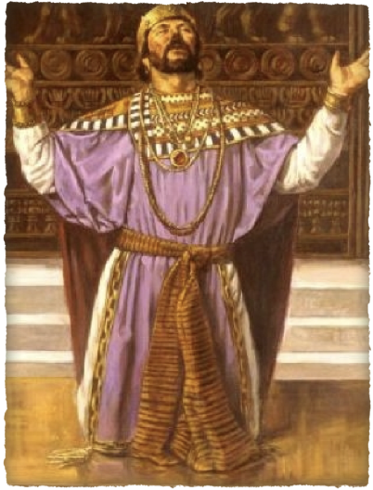
“The Church of Christ - His KINGDOM”
(Daniel 2:44; Mark 9:1; Acts 2:29-47; Colossians 1:13; 1 Corinthians 15:24,25)
KING & KINGDOM - A Common Biblical Concept
"The LORD will reign for ever and ever.” -(Exodus 15:18)
"O King of the nations." - (Jeremiah 10:7)
"But the LORD is the true God; he is the living God, the eternal King.” - (Jeremiah 10:10)
"The LORD, the King of Israel, is with you...." - (Zephaniah 3:15)
"The LORD will be king over the whole earth...." - (Zechariah 14:9)

Slide 4
“The Church of Christ - His KINGDOM”
(Daniel 2:44; Mark 9:1; Acts 2:29-47; Colossians 1:13; 1 Corinthians 15:24,25)
GOD PROMISED A KING TO RULE HIS PEOPLE
The Old Testament prophesied that a descendant of David would sit on David’s throne and rule forever (2 Sam 7:12-16; 1 Chron 17:11-15).
Ethan the Ezrahite lamented that the Lord had not fulfilled His promise (Psalm 89:3-4,28-39, 49).
The Old Testament foretold of a King & Kingdom that WAS yet to come (Is 9:6; Dan 2:44).

Slide 5
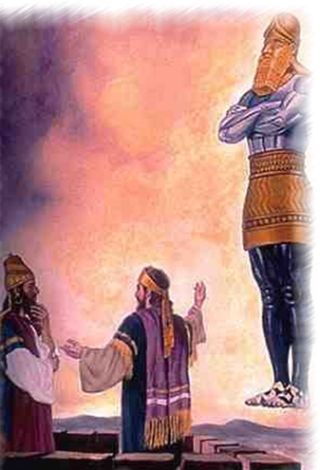
“The Church of Christ - His KINGDOM”
(Daniel 2:44; Mark 9:1; Acts 2:29-47; Colossians 1:13; 1 Corinthians 15:24,25)
GOD PROMISED A KING TO RULE HIS PEOPLE
Daniel 2:44–45 (NKJV)
⁴⁴ And in the days of these kings the God of heaven will set up a kingdom which shall never be destroyed; and the kingdom shall not be left to other people; it shall break in pieces and consume all these kingdoms, and it shall stand forever. ⁴⁵ Inasmuch as you saw that the stone was cut out of the mountain without hands, and that it broke in pieces the iron, the bronze, the clay, the silver, and the gold—the great God has made known to the king what will come to pass after this. The dream is certain, and its interpretation is sure.”

Slide 6
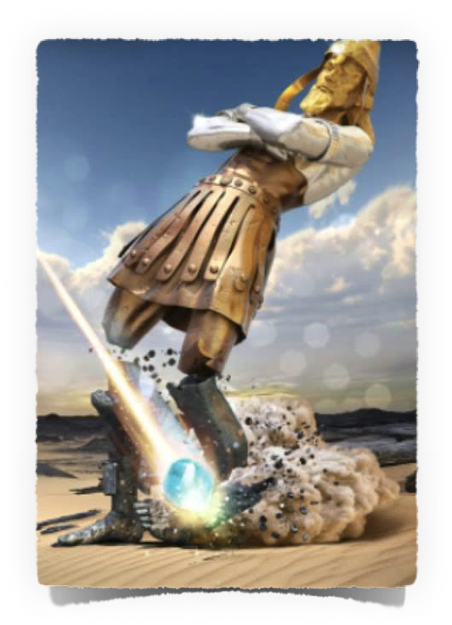
“The Church of Christ - His KINGDOM”
(Daniel 2:44; Mark 9:1; Acts 2:29-47; Colossians 1:13; 1 Corinthians 15:24,25)
GOD PROMISED A KING TO RULE HIS PEOPLE
Babylonian Empire 605 B.C. - 536 B.C.
Medo-Persian Empire 536 B.C. - 330 B.C.
Grecian Empire 330 B.C. - 30 B.C.
Roman Empire 30 B.C. - 337 A.D.
Head of Gold
Breast and arms of silver
Belly and Thighs of brass
Legs iron & feet of clay & iron mixed
“The days of these kings,” Daniel 2:44
a stone was cut out without hands

Slide 7
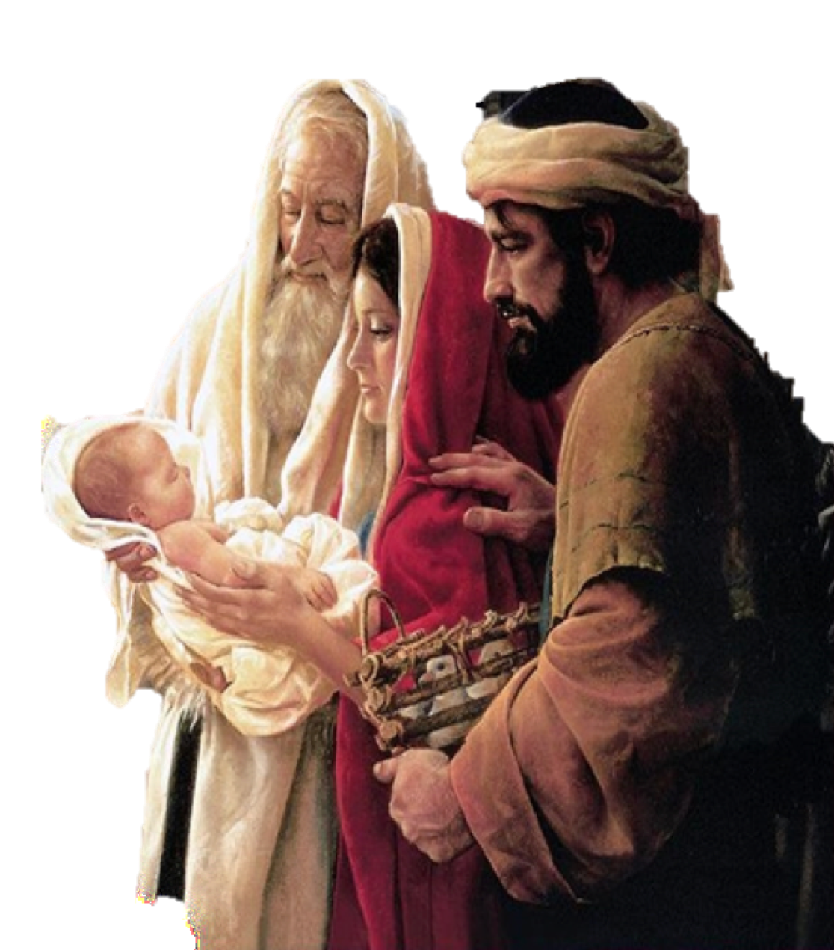
“The Church of Christ - His KINGDOM”
(Daniel 2:44; Mark 9:1; Acts 2:29-47; Colossians 1:13; 1 Corinthians 15:24,25)
JESUS IS KING of kings NOW
Born to be KING …
The angel Gabriel, “you will . . . bring forth a son, and you shall call His name Jesus . . . He will be great, and will be called the Son of the Highest; and the Lord God will give Him the throne of His father David” (Lk 1:26-33)
The wise men from the east – “Where is He who is born, King of the Jews?” – (Mat 2:1-6; cf Mic.5:2)
Jesus said to Pilate – “I am a king, for this cause was I born . . .” (John 18:37)

Slide 8
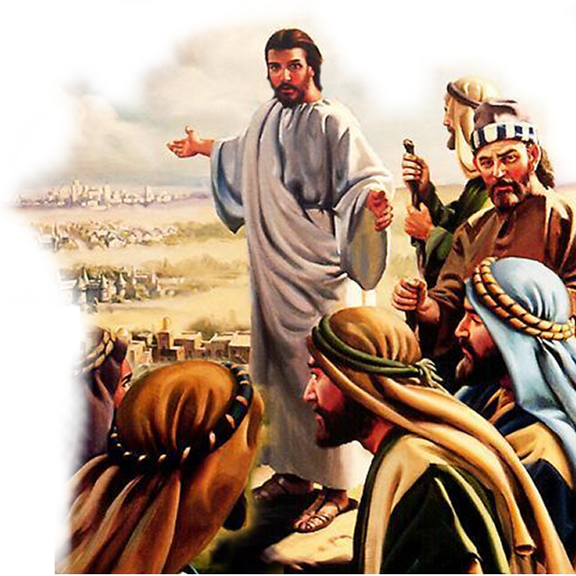
“The Church of Christ - His KINGDOM”
(Daniel 2:44; Mark 9:1; Acts 2:29-47; Colossians 1:13; 1 Corinthians 15:24,25)
JESUS IS KING of kings NOW
His kingdom was “at hand” while He was on earth …
The preaching of John - "Repent, for the kingdom of heaven is at hand!" (Mat. 3:2)
The preaching of Jesus – ‘Jesus began to preach and to say, "Repent, for the kingdom of heaven is at hand.“’ (Mat. 4:17)
The the LIMITED commission – “And as you go, preach, saying, 'The kingdom of heaven is at hand.‘” (Mat 10:7)

Slide 9
“The Church of Christ - His KINGDOM”
(Daniel 2:44; Mark 9:1; Acts 2:29-47; Colossians 1:13; 1 Corinthians 15:24,25)
JESUS IS KING of kings NOW
His kingdom was “at hand” while He was on earth …
Matthew 16:28 (NKJV)
²⁸ Assuredly, I say to you, there are some standing here who shall not taste death till they see the Son of Man coming in His kingdom.”

Slide 10
“The Church of Christ - His KINGDOM”
(Daniel 2:44; Mark 9:1; Acts 2:29-47; Colossians 1:13; 1 Corinthians 15:24,25)
JESUS IS KING of kings NOW
His kingdom was “at hand” while He was on earth …
Mark 9:1 (NKJV)
¹ And He said to them, “Assuredly, I say to you that there are some standing here who will not taste death till they see the kingdom of God present with power.”

Slide 11
“The Church of Christ - His KINGDOM”
(Daniel 2:44; Mark 9:1; Acts 2:29-47; Colossians 1:13; 1 Corinthians 15:24,25)
JESUS IS KING of kings NOW
His kingdom was “at hand” while He was on earth …
Luke 9:27 (NKJV)
²⁷ But I tell you truly, there are some standing here who shall not taste death till they see the kingdom of God.”

Slide 12
“The Church of Christ - His KINGDOM”
(Daniel 2:44; Mark 9:1; Acts 2:29-47; Colossians 1:13; 1 Corinthians 15:24,25)
JESUS IS KING of kings NOW
Coronated KING at His resurrection
Had received “ALL authority” before ascending to heaven (Mat 28:18-20)
The kingdom CAME with POWER in Acts 2 (Mark 9:1; Luke 24:46-49; Acts 1:5,8)
Peter proclaims Jesus HAD ascended to sit upon David’s throne (Acts 2:29-36; cf. 2 Sam 7:12-16; 1 Chron 17:11-15; Lk 1:26-33)

Slide 13
“The Church of Christ - His KINGDOM”
(Daniel 2:44; Mark 9:1; Acts 2:29-47; Colossians 1:13; 1 Corinthians 15:24,25)
JESUS IS KING of kings NOW
Coronated KING at His resurrection
Acts 2:29–36 (NKJV)
²⁹ “Men and brethren, let me speak freely to you of the patriarch David, that he is both dead and buried, and his tomb is with us to this day. ³⁰ Therefore, being a prophet, and knowing that God had sworn with an oath to him that of the fruit of his body, according to the flesh, He would raise up the Christ to sit on his throne,
2 Sam 7:12-16;
1 Chron 17:11-15;
Luke 1:26-33

Slide 14
“The Church of Christ - His KINGDOM”
(Daniel 2:44; Mark 9:1; Acts 2:29-47; Colossians 1:13; 1 Corinthians 15:24,25)
JESUS IS KING of kings NOW
Coronated KING at His resurrection
Acts 2:29–36 (NKJV)
³¹ he, foreseeing this, spoke concerning the resurrection of the Christ, that His soul was not left in Hades, nor did His flesh see corruption. ³² This Jesus God has raised up, of which we are all witnesses. ³³ Therefore being exalted to the right hand of God, and having received from the Father the promise of the Holy Spirit, He poured out this which you now see and hear.
“He would raise up the Christ to sit on his throne”
(verse 30)

Slide 15
“The Church of Christ - His KINGDOM”
(Daniel 2:44; Mark 9:1; Acts 2:29-47; Colossians 1:13; 1 Corinthians 15:24,25)
JESUS IS KING of kings NOW
Coronated KING at His resurrection
Acts 2:29–36 (NKJV)
³⁴ “For David did not ascend into the heavens, but he says himself: ‘The Lord said to my Lord, “Sit at My right hand, ³⁵ Till I make Your enemies Your footstool.” ’ ³⁶ “Therefore let all the house of Israel know assuredly that God has made this Jesus, whom you crucified, both Lord and Christ.”

Slide 16
“The Church of Christ - His KINGDOM”
(Daniel 2:44; Mark 9:1; Acts 2:29-47; Colossians 1:13; 1 Corinthians 15:24,25)
JESUS IS KING of kings NOW
Coronated KING at His resurrection
He is BOTH Lord & King “NOW” (Acts 2:36; Phili. 2:5-11; 1 Tim 6:15; Rev. 1:4, 5; 17:14;19:16; Zec 6:12,13)
Christians are citizens of His kingdom NOW!! (Col. 1:13; Heb 12:28; Rev. 1:6-9)

Slide 17
“The Church of Christ - His KINGDOM”
(Daniel 2:44; Mark 9:1; Acts 2:29-47; Colossians 1:13; 1 Corinthians 15:24,25)
NT Presence
When:
Days of Roman kings – Dan. 2:44
“At hand” in Jesus’ day – Mt. 4:17
In Jesus’ generation – Mk. 9:1
Where:
Law going from Jerusalem – Isa. 2:3
King coming to Jerusalem – Zec. 9:9
Tarry in Jerusalem – Lk. 24:49
Not depart from Jerusalem – Ac. 1:4
Established
First Pentecost after the resurrection of Jesus Christ from the dead
Acts 2
The right time & place
After Acts 2 the language changes from “AT HAND” to “The kingdom is preached”
David prophesied God “would raise up the Christ to sit on his throne” (Acts 2:25-31).
“This Jesus God has raised up…being exalted…has made this Jesus…Lord” (2:32-36)

Slide 18
“The Church of Christ - His KINGDOM”
(Daniel 2:44; Mark 9:1; Acts 2:29-47; Colossians 1:13; 1 Corinthians 15:24,25)
JESUS IS KING of kings NOW
The Nature of His Kingdom
Luke 17:20–21 (NKJV)
²⁰ Now when He was asked by the Pharisees when the kingdom of God would come, He answered them and said, “The kingdom of God does not come with observation; ²¹ nor will they say, ‘See here!’ or ‘See there!’ For indeed, the kingdom of God is within you.”

Slide 19
“The Church of Christ - His KINGDOM”
(Daniel 2:44; Mark 9:1; Acts 2:29-47; Colossians 1:13; 1 Corinthians 15:24,25)
JESUS IS KING of kings NOW
The Nature of His Kingdom
John 18:33–37 (NKJV)
³³ Then Pilate entered the Praetorium again, called Jesus, and said to Him, “Are You the King of the Jews?” … ³⁶ Jesus answered, “My kingdom is not of this world. If My kingdom were of this world, My servants would fight, so that I should not be delivered to the Jews; but now My kingdom is not from here.”

Slide 20
“The Church of Christ - His KINGDOM”
(Daniel 2:44; Mark 9:1; Acts 2:29-47; Colossians 1:13; 1 Corinthians 15:24,25)
JESUS IS KING of kings NOW
The Nature of His Kingdom
John 18:33–37 (NKJV)
³⁷ Pilate therefore said to Him, “Are You a king then?” Jesus answered, “You say rightly that I am a king. For this cause I was born, and for this cause I have come into the world, that I should bear witness to the truth. Everyone who is of the truth hears My voice.”

Slide 21
“The Church of Christ - His KINGDOM”
(Daniel 2:44; Mark 9:1; Acts 2:29-47; Colossians 1:13; 1 Corinthians 15:24,25)
The Kingdom of Christ & His Church
THE TERMS USED INTERCHANGEABLY
Matthew 16:18–19 (NKJV)
¹⁸ And I also say to you that you are Peter, and on this rock I will build My church, and the gates of Hades shall not prevail against it. ¹⁹ And I will give you the keys of the kingdom of heaven, and whatever you bind on earth will be bound in heaven, and whatever you loose on earth will be loosed in heaven.”

Slide 22
“The Church of Christ - His KINGDOM”
(Daniel 2:44; Mark 9:1; Acts 2:29-47; Colossians 1:13; 1 Corinthians 15:24,25)
The Kingdom of Christ & His Church
THE TERMS USED INTERCHANGEABLY
Jesus built His “ecclesia” by adding saved people to His body — Acts 2:38-41, 47; 1 Cor. 12:13
By means of the preaching of the gospel, the doors into the kingdom were opened - people came under the authority of Jesus - (Acts 2:36, 38, 39; 3:16-20; 4:12; 10:34-43; Col. 1:13).

Slide 23
“The Church of Christ - His KINGDOM”
(Daniel 2:44; Mark 9:1; Acts 2:29-47; Colossians 1:13; 1 Corinthians 15:24,25)
The Kingdom of Christ & His Church
Notes:
BEGINNING PLACE — Isa 2:3; Lk 24:44-49; Ac 2 :14-47
SAME BEGINNING TIME — Mark 9:1; Acts 1:8; 2:1-4; Mat 16:18,19; Luke 24:44-49; Acts 2:14-47
SAME AUTHORITY — Acts 2:36-38; Col. 1:13,18; Eph. 1:22.23
PURCHASED WITH THE SAME THING (the blood of Christ) — Rev. 5:9-10; Acts 20:28.
BOTH HAVE THE SAME MEMORIAL:
The Lord's table in the kingdom ... Matt. 26:29.
But the Lord's Table in the church ... I Cor. 11:20-27.

Slide 24
“The Church of Christ - His KINGDOM”
(Daniel 2:44; Mark 9:1; Acts 2:29-47; Colossians 1:13; 1 Corinthians 15:24,25)
The Kingdom of Christ & His Church
THE SAME MEMBERSHIP:
The Colossians were in Christ...Col. 1:2, which is equal to being in the church... Rom. 6:4 ; Gal.3:27 ; I Cor. 12:13.
The Colossians had been translated into the kingdom of Christ ... Col. 1:13; as have all who are in His body.
THE SAME TERMS of ENTRANCE:
Born of water and the Spirit - John 3:3-5
By one Spirit baptized into one body, (the church) — 1 Cor. 12:13; Titus 3:5; Gal. 3:26,27; Acts 2:36-41,47

Slide 25
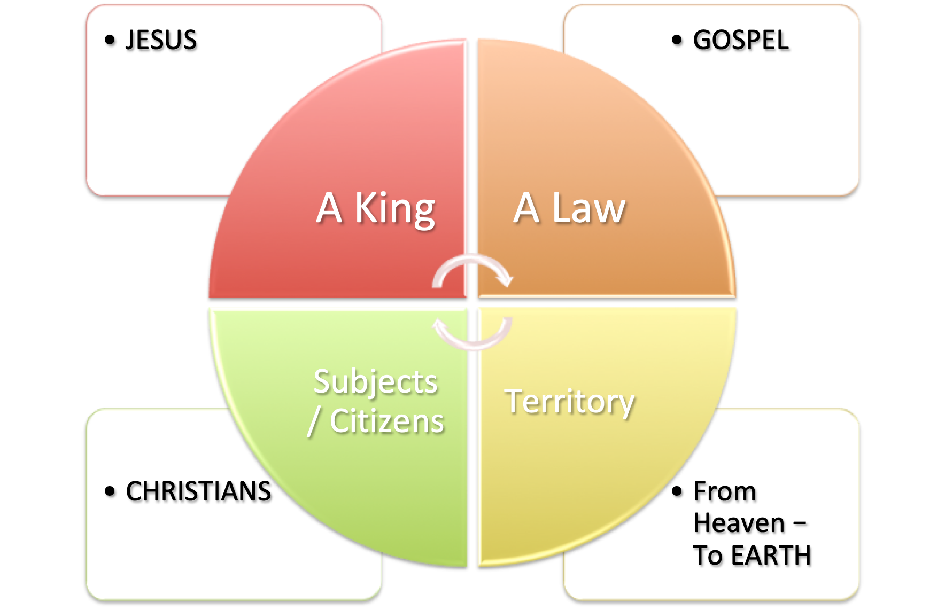
“The Church of Christ - His KINGDOM”
(Daniel 2:44; Mark 9:1; Acts 2:29-47; Colossians 1:13; 1 Corinthians 15:24,25)
The Kingdom of Christ & His Church
Luke. 1:32-33 ;
Eph. 1:18-23 ;
Matt. 28:18 ;
I Tim. 6:15 ;
I Peter 3:22
John 12:48 ; 17:8;
Mat. 28:18,19
I Cor. 9:21 ;
I John 4:6;
James 1:25
Acts 2:36-47
Col. 1:13-18
Rev. 1:9; 5:10
Matthew 28:19-20
Mark 16:15,16
Acts 10:34

Slide 26
“The Church of Christ - His KINGDOM”
(Daniel 2:44; Mark 9:1; Acts 2:29-47; Colossians 1:13; 1 Corinthians 15:24,25)
The Kingdom of Christ & His Church
IMPLICATIONS
Not a democracy (Mat 28:18; Acts 2:36; Col. 1:13-18; 3:17)
Singularity / Unity (Dan. 2:44; Is. 9:6; Col. 1:13)
Requires submission to the KING or be in rebellion (Mat. 7:21-23; Luke 6:46; 2 Jn 9)
The nature & power of OUR KING provides security & peace / should also engender the greatest loyalty (Col. 1:13; Rev 1:5,6)
Denotes accountability (Mat. 18:22-35; 22:1-14; 25:31-45)

Slide 27
“The Church of Christ - His KINGDOM”
(Daniel 2:44; Mark 9:1; Acts 2:29-47; Colossians 1:13; 1 Corinthians 15:24,25)
Four Perspectives of The Kingdom
OT Prophecy
NT Imminence
NT Presence
Future Glory
GOD WILL:
Gen. 49:10
2 Sam. 7:12-16
Dan. 2:44; 7:13-14
Isa. 9:7
Ezek. 21:25-27
Zech. 9:9
AT HAND / NIGH
Angels - Luke 1:32-33
J.B. – Mt. 3:2
Apostles – Mt. 10:7; Lk. 9:2
70 disciples – Luke 10:9
Jesus – Mt. 4:17, 23; 5:1- 7:21; 9:35; 13:11-52; 16:19, 28; Mark 9:1; Etc, -
ESTABLISHED
Acts 8:12; 19:8; 20:25; 28:23, 31
Called “into kingdom” by the gospel (2 Thess. 2:14; 1 Thess. 2:12).
“translated into kingdom” — (Col. 1:13).
“in the…kingdom…of Jesus Christ” (Rev. 1:9).
1 Cor. 15:24–25 (NKJV)
²⁴ Then comes the end, when He delivers the kingdom to God the Father, when He puts an end to all rule and all authority and power. ²⁵ For He must reign till He has put all enemies under His feet.

Slide 28
The kingdom was prophesied for thousands of years — Gen. 49:10; 2 Sam. 7:12-16; Dan. 2:44; 7:13-14; Isa. 9:7; Ezek. 21:25-27; Zech. 9:9
The kingdom was established on Pentecost in Acts 2
There is one kingdom in existence today w/ one King — Acts 2:36; 1 Pet. 3:22; Rev. 19:16
The kingdom will be delivered to the Father in the end — 1 Cor. 15:24-26;
“The Church of Christ - His KINGDOM”
(Daniel 2:44; Mark 9:1; Acts 2:29-47; Colossians 1:13; 1 Corinthians 15:24,25)

Slide 29
“The Church of Christ - His KINGDOM”
(Daniel 2:44; Mark 9:1; Acts 2:29-47; Colossians 1:13; 1 Corinthians 15:24,25)
ARE YOU IN THE KINGDOM
“Most assuredly, I say to you, unless one is born again, he cannot see the kingdom of God…Most assuredly, I say to you, unless one is born of water and the Spirit, he cannot ENTER the kingdom of God” (John 3:3-5).
To be born of the Spirit means to be born of the teachings of the Spirit...I Cor. 12:13 ; James 1:18 ; I Peter 1:2 ; I Cor. 4:15.
To be born of the water is to be buried in baptism ... Rom. 6:4 ; Gal. 3:26-27 ,29.

Slide 30
“The Church of Christ - His KINGDOM”
(Daniel 2:44; Mark 9:1; Acts 2:29-47; Colossians 1:13; 1 Corinthians 15:24,25)
“Not everyone who says to Me, ‘Lord, Lord,’ shall ENTER the kingdom of heaven, but he who does the will of My Father in heaven” (Matt. 7:21).

Slide 31
Philippians 2:10,11
“The Church of Christ - His KINGDOM”
(Daniel 2:44; Mark 9:1; Acts 2:29-47; Colossians 1:13; 1 Corinthians 15:24,25)

Slide 33
“The Church of Christ - His KINGDOM”
(Daniel 2:44; Mark 9:1; Acts 2:29-47; Colossians 1:13; 1 Corinthians 15:24,25)
Charts by Don McClain / Preached May 17, 2020 AM
West 65th Street church of Christ - P.O. Box 190062 - Little Rock AR 72219 - Phone — 501-568-1062 — Email – donmcclain@sbcglobal.net
Prepared using Keynote / More Keynote, PPT & Audio Sermons:
www.w65stchurchofchrist.com

