Slide 1
Does It Really Matter What We Believe?
Why should we be concerned about false doctrine?
Why MUST false doctrine be exposed?

Slide 2
Why is it so DANGEROUS to believe DOCTRINAL ERROR?

Slide 3
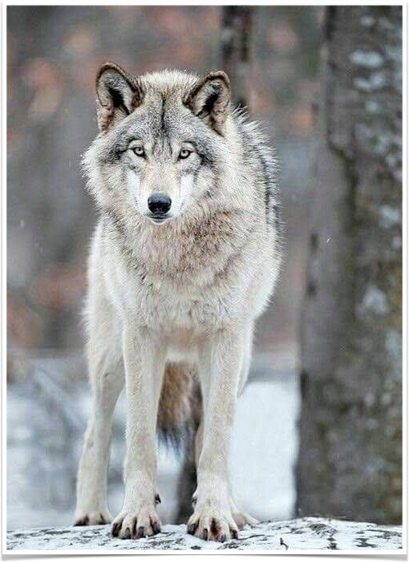
Jeremiah 23:16 (NKJV)
¹⁶ Thus says the Lord of hosts: “Do not listen to the words of the prophets who prophesy to you. They make you worthless; They speak a vision of their own heart, Not from the mouth of the Lord.

Slide 4
Matthew 7:15 (NKJV)
¹⁵ “Beware of false prophets, who come to you in sheep’s clothing, but inwardly they are ravenous wolves.

Slide 5
Matthew 15:8–9 (NKJV)
⁸ ‘These people draw near to Me with their mouth, And honor Me with their lips, But their heart is far from Me. ⁹ And in vain they worship Me, Teaching as doctrines the commandments of men.’

Slide 6
2 Corinthians 11:3 (NKJV)
³ But I fear, lest somehow, as the serpent deceived Eve by his craftiness, so your minds may be corrupted from the simplicity that is in Christ.
(vs. 4,13,14)

Slide 7
Ephesians 4:13–14 (NKJV)
¹³ till we all come to the unity of the faith and of the knowledge of the Son of God, to a perfect man, to the measure of the stature of the fullness of Christ; ¹⁴ that we should no longer be children, tossed to and fro and carried about with every wind of doctrine, by the trickery of men, in the cunning craftiness of deceitful plotting,

Slide 8
Ephesians 5:6–7 (NKJV)
⁶ Let no one deceive you with empty words, for because of these things the wrath of God comes upon the sons of disobedience. ⁷ Therefore do not be partakers with them.

Slide 9
Colossians 2:8 (NKJV)
⁸ Beware lest anyone cheat you through philosophy and empty deceit, according to the tradition of men, according to the basic principles of the world, and not according to Christ.

Slide 10
2 Peter 2:19 (NKJV)
¹⁹ While they promise them liberty, they themselves are slaves of corruption; for by whom a person is overcome, by him also he is brought into bondage.

Slide 11
2 Peter 3:14–18 (NKJV)
¹⁴ Therefore, beloved, looking forward to these things, be diligent to be found by Him in peace, without spot and blameless; ¹⁵ and consider that the longsuffering of our Lord is salvation—as also our beloved brother Paul, according to the wisdom given to him, has written to you,

Slide 12
2 Peter 3:14–18 (NKJV)
¹⁶ as also in all his epistles, speaking in them of these things, in which are some things hard to understand, which untaught and unstable people twist to their own destruction, as they do also the rest of the Scriptures.

Slide 13
2 Peter 3:14–18 (NKJV)
¹⁷ You therefore, beloved, since you know this beforehand, beware lest you also fall from your own steadfastness, being led away with the error of the wicked; ¹⁸ but grow in the grace and knowledge of our Lord and Savior Jesus Christ. To Him be the glory both now and forever. Amen.

Slide 14
Eve believed error (Gen. 3:1-7)
A young prophet who believed error (1 Kings 13)
The Lord permitted a lying spirit to convince Ahab to go to Ramoth Gilead (1 Kings 22:22,23)
The Jewish leaders had been deceived and deceived others (John 8:44)
Those who “love not the truth” will believe error and be lost (2 Thess. 2:10-12)

Slide 15
What Should Be Our RESPONSE to False Doctrine?

Slide 16
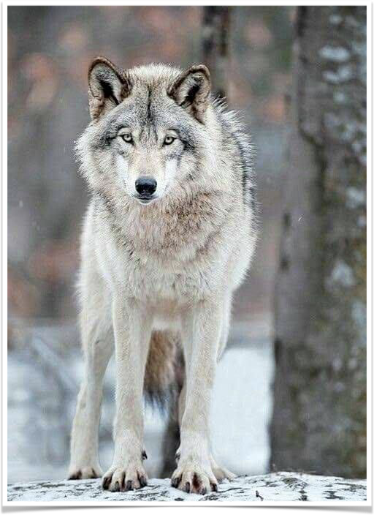
ERROR MUST BE EXPOSED & REFUTED
Jude 3 (NKJV)
³ Beloved, while I was very diligent to write to you concerning our common salvation, I found it necessary to write to you exhorting you to contend earnestly for the faith which was once for all delivered to the saints.

Slide 17
ERROR MUST BE EXPOSED & REFUTED
Romans 16:17 (NKJV)
¹⁷ Now I urge you, brethren, note those who cause divisions and offenses, contrary to the doctrine which you learned, and avoid them.

Slide 18
ERROR MUST BE EXPOSED & REFUTED
Jesus exposed the errors of the Scribes and Pharisees on a regular basis (Mat. 12:38-45; 15:1-12; 16:1-4; 22:23-33; 23)
Peter and John disputed with the Sanhedrin in Acts 4:1-24
Steven disputed with the Jews in Acts 7
Paul disputed with the Hellenists in Acts 9:29

Slide 19
ERROR MUST BE EXPOSED & REFUTED
Acts 9:29 (NKJV)
²⁹ And he spoke boldly in the name of the Lord Jesus and disputed against the Hellenists, but they attempted to kill him.

Slide 20
ERROR MUST BE EXPOSED & REFUTED
Acts 15:2 (NKJV)
² Therefore, when Paul and Barnabas had no small dissension and dispute with them, they determined that Paul and Barnabas and certain others of them should go up to Jerusalem, to the apostles and elders, about this question.

Slide 21
ERROR MUST BE EXPOSED & REFUTED
Galatians 2:4–5 (NKJV)
⁴ And this occurred because of false brethren secretly brought in (who came in by stealth to spy out our liberty which we have in Christ Jesus, that they might bring us into bondage), ⁵ to whom we did not yield submission even for an hour, that the truth of the gospel might continue with you.

Slide 22
ERROR MUST BE EXPOSED & REFUTED
1 Timothy 1:18–20 (NKJV)
¹⁸ This charge I commit to you, son Timothy, according to the prophecies previously made concerning you, that by them you may wage the good warfare, ¹⁹ having faith and a good conscience, which some having rejected, concerning the faith have suffered shipwreck, ²⁰ of whom are Hymenaeus and Alexander, whom I delivered to Satan that they may learn not to blaspheme.

Slide 23
ERROR MUST BE EXPOSED & REFUTED
2 Timothy 2:17–18 (NKJV)
¹⁷ And their message will spread like cancer. Hymenaeus and Philetus are of this sort, ¹⁸ who have strayed concerning the truth, saying that the resurrection is already past; and they overthrow the faith of some.

Slide 24
THE PERVASIVENESS OF ERROR
TRUTH PERFECTLY HARMONIZES.
If we ALTER one aspect of the TRUTH, that one alteration will affect every other aspect of truth to some degree.
UNITY
CONNECTION
HARMONY

Slide 25
THE PERVASIVENESS OF ERROR
Calvinism
The nature of humanity: No free will / totally depraved / totally incapable of choosing God /
The nature of salvation: All of God / men have no part … (can’t believe w/out HS / baptism not essential / OSAS …)
The nature of God: Partial / determiner of every mans fate irrespective of their choices or deeds / original cause of all evil …
TRUTH PERFECTLY HARMONIZES.
If we ALTER one aspect of the TRUTH, that one alteration will affect every other aspect of truth to some degree.

Slide 26
THE PERVASIVENESS OF ERROR
Realized Eschatology
The second coming of Jesus and the judgment happened in 70 AD: All passages speaking of these events must fit within this paradigm.
The resurrection occurred in 70 AD: All resurrection passages must fit this narrative - 1 Cor. 15 CANNOT be a bodily or personal resurrection but a purely spiritual, corporate and historical one.
TRUTH PERFECTLY HARMONIZES.
If we ALTER one aspect of the TRUTH, that one alteration will affect every other aspect of truth to some degree.

Slide 27
THE PERVASIVENESS OF ERROR
Realized Eschatology
Forced to twist other doctrines:
The nature of the church: Prior to 70 AD there were 2 bodies, Jew & Gentile / post 70 AD the church entered its final state of glory …
The nature of the salvation: no actual forgiveness or New birth prior to 70 AD. No death after …?
The nature of the atonement provided by the cross: No full salvation before 70 AD … After, are all saved?
TRUTH PERFECTLY HARMONIZES.
If we ALTER one aspect of the TRUTH, that one alteration will affect every other aspect of truth to some degree.

Slide 28
THE PERVASIVENESS OF ERROR
TRUTH PERFECTLY HARMONIZES.
If we ALTER one aspect of the TRUTH, that one alteration will affect every other aspect of truth to some degree.
A single error does not exist in a vacuum -
To defend error, one MUST pervert or twist scripture – 2 Peter 2:1-3; 3:16; Psalm 56:5; Gal 1:6-9; Acts 13:10; 1 Tim. 4:1-3
Error contradicts both truth & error – BUT, truth never contradicts itself!

Slide 29
THE PERVASIVENESS OF ERROR
TRUTH PERFECTLY HARMONIZES.
If we ALTER one aspect of the TRUTH, that one alteration will affect every other aspect of truth to some degree.
A single error does not exist in a vacuum -
Catholicism …
Deism …
Premillennialism …
Seventh Day Adventism …
Oneness Pentecostalism …
Universalism …
Denominationalism …

Slide 30
THE PERVASIVENESS OF ERROR
TRUTH PERFECTLY HARMONIZES.
If we ALTER one aspect of the TRUTH, that one alteration will affect every other aspect of truth to some degree.
UNITY
CONNECTION
HARMONY

Slide 31
THE PROGRESSIVE NATURE OF ERROR
The Law of LOGICAL EXTENSION

Slide 32
Hopefully we all see WHY DOCTRINAL ERROR so DANGEROUS!

Slide 33
Will result in the perversion of other scriptures resulting in the acceptance of more and more error.
2 Tim. 3:13

Slide 34
Will make one’s worship & service to God unacceptable.
Matt. 15:7-9

Slide 35
Will lead to ungodly living.
We will NEVER live above our beliefs
Rom. 1:18-32

Slide 36
The adherence to doctrinal error brings bondage and death.
2 Thes. 2:10-12
2 Pet. 2:18-22
John 8:32-34

Slide 37
It Really DOES Matter What We Believe!
We should be VERY concerned about false doctrine!
False doctrine MUST be exposed!

Slide 38
2 Peter 3:17–18 (NKJV)
¹⁷ You therefore, beloved, since you know this beforehand, beware lest you also fall from your own steadfastness, being led away with the error of the wicked; ¹⁸ but grow in the grace and knowledge of our Lord and Savior Jesus Christ. To Him be the glory both now and forever. Amen.

Slide 39
THE WAY OF SALVATION!
HEAR THE TRUTH: Rom. 10:13-17
BELIEVE THE TRUTH: John 8:32; 20:30,31; Rom. 10:13-16
REPENT: Lk 13:3,5; Acts 17:30
CONFESS: Mt. 10:32; Ro 10:9,10;
BE BAPTIZED: Acts 2:38; 1 Pet. 3:21
BE FAITHFUL: 1 Cor. 15:58; Rev. 2:10
Colossians 1:5 (NKJV)
⁵ because of the hope which is laid up for you in heaven, of which you heard before in the word of the truth of the gospel,

Slide 41
Charts by Don McClain
Preached February 9, 2020 AM
West 65th Street church of Christ - P.O. Box 190062 - Little Rock AR 72219 - Phone — 501-568-1062 — Email – donmcclain@sbcglobal.net
Prepared using Keynote / More Keynote, PPT & Audio Sermons:
www.w65stchurchofchrist.com

Slide 42
Jeremiah 23:16–22 (NKJV)
¹⁶ Thus says the Lord of hosts: “Do not listen to the words of the prophets who prophesy to you. They make you worthless; They speak a vision of their own heart, Not from the mouth of the Lord. ¹⁷ They continually say to those who despise Me, ‘The Lord has said, “You shall have peace” ’; And to everyone who walks according to the dictates of his own heart, they say, ‘No evil shall come upon you.’ ”

Slide 43
Jeremiah 23:16–22 (NKJV)
¹⁸ For who has stood in the counsel of the Lord, And has perceived and heard His word? Who has marked His word and heard it? ¹⁹ Behold, a whirlwind of the Lord has gone forth in fury— A violent whirlwind! It will fall violently on the head of the wicked. ²⁰ The anger of the Lord will not turn back Until He has executed and performed the thoughts of His heart. In the latter days you will understand it perfectly.

Slide 44
Jeremiah 23:16–22 (NKJV)
²¹ “I have not sent these prophets, yet they ran. I have not spoken to them, yet they prophesied. ²² But if they had stood in My counsel, And had caused My people to hear My words, Then they would have turned them from their evil way And from the evil of their doings.

