Slide 1
Judges 6 & 7
Hebrews 11:32

Slide 2
Hebrews 11:32–35 (NKJV)
³² And what more shall I say? For the time would fail me to tell of Gideon and Barak and Samson and Jephthah, also of David and Samuel and the prophets: ³³ who through faith subdued kingdoms, worked righteousness, obtained promises, stopped the mouths of lions, ³⁴ quenched the violence of fire, escaped the edge of the sword, out of weakness were made strong, became valiant in battle, turned to flight the armies of the aliens. ³⁵ Women received their dead raised to life again. Others were tortured, not accepting deliverance, that they might obtain a better resurrection.

Slide 3
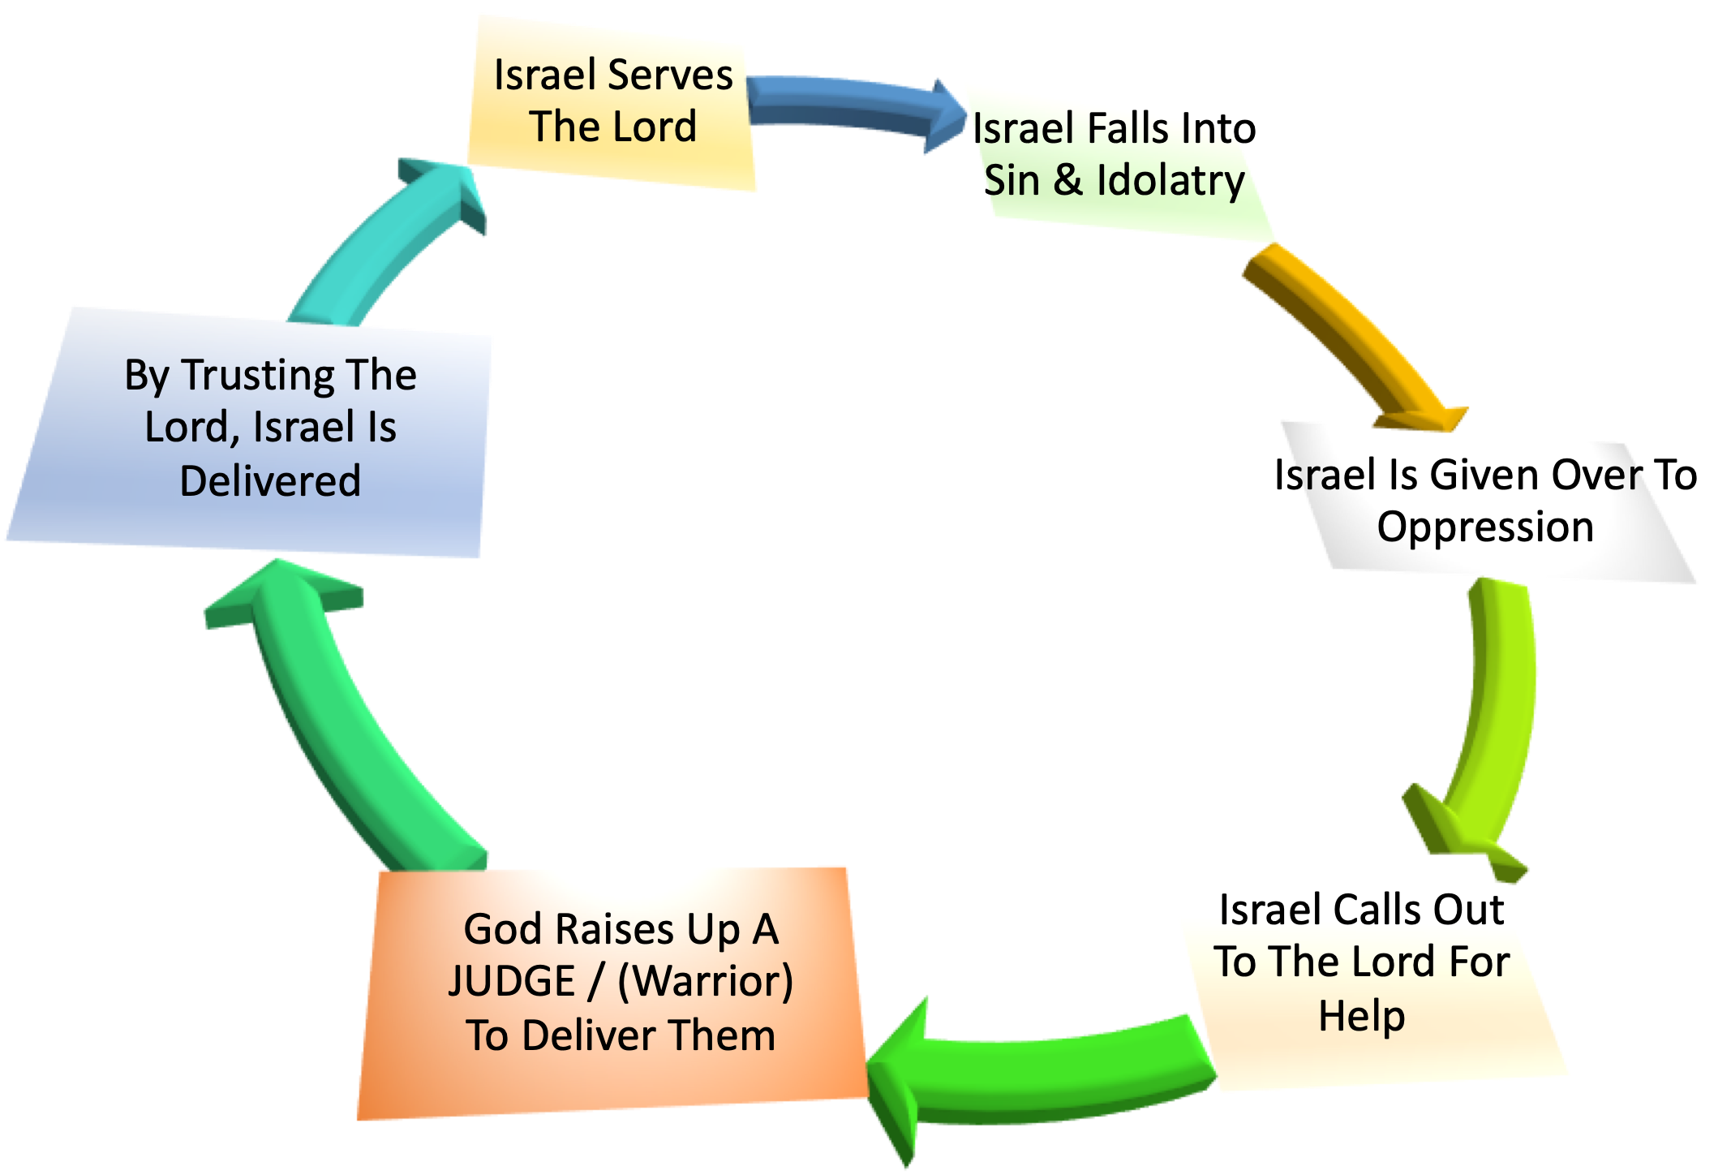
The Repeated Cycle of SIN, OPPRESSION & DELIVERANCE of God’s People In The Book of Judges.

Slide 4
Othniel (3:7–11)
Ehud (3:12-30)
Shamgar (3:31)
Deborah (4,5)
Gideon (6-8)
Tola (10:1,2)
Jair (10:3-5)
Jephthah (11:1-12:7)
Ibzan (12:8-10)
Elon (12:11,12)
Abdon (12:13-18)
Samson (13-16)

Slide 6
The story of Gideon occurs a little over 215 years after Israel entered the promise land (ap 1191 BC)
Israel again did evil & the Lord delivered them into the hands of Midian (6:1)
Israel was greatly impoverished by the Midianites (6:6)
Israel had repeatedly ignored God’s previous warning (6:10)
God calls Gideon to deliver Israel from the Midianites (6:11-7:25)

Slide 7
GOD CALLS GIDEON TO DELIVER ISRAEL
Judges 6:11–12 (NKJV)
¹¹ Now the Angel of the Lord came and sat under the terebinth tree which was in Ophrah, which belonged to Joash the Abiezrite, while his son Gideon threshed wheat in the winepress, in order to hide it from the Midianites. ¹² And the Angel of the Lord appeared to him, and said to him, “The Lord is with you, you mighty man of valor!”

Slide 8
GIDEON’s LACK OF FAITH
Questioned God (6:13)
“If the Lord is with us”
“why has all this happened to us?”
“where are all His miracles … ‘Did not the Lord bring us up from Egypt?’”
“But now the Lord has forsaken us and delivered us into the hands of the Midianites.”

Slide 9
GIDEON’s LACK OF FAITH
Inferiority complex (6:15)
I can’t - “O my Lord, how can I save Israel?
I don’t have what it takes - “Indeed my clan is the weakest in Manasseh, and I am the least in my father’s house.”
Gideon was right, but it was NOT his strength that would bring victory (6:16; cf. Num. 13,14; 2 Cor. 3:4,5; Phil. 4:13; etc.)

Slide 10
GIDEON’s LACK OF FAITH
Needed A LOT of reassurance (6:15)
The sign of the offering (6:17-23)
Obeyed God in the dark (6:25-27)
The Sign of the Fleece (6:36-40)
The overhearing of the Midianite’s dream (7:9-15)
God patiently reassured Gideon (6:14,16, 40, 7:9)

Slide 11
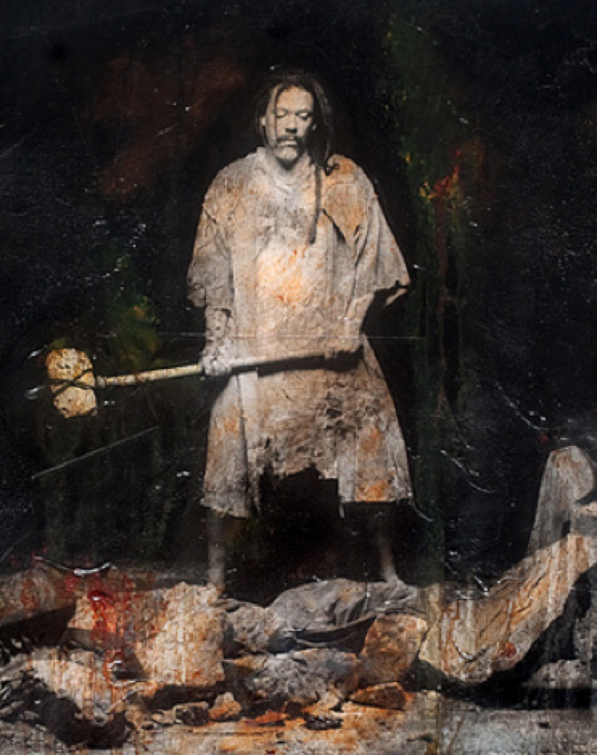
GIDEON’s RESPONSE of FAITH
FIRST: Destroyed the altar of Baal and it’s image (6:25-32)
Repentance demands the destruction of sin (6:36-40)
We MUST purify ourselves before we can be of service to God (2 Cor. 6:14-7:1; 2 Tim 2:4, 19-21)
Must replace our idols with obedience (6:26,28)
Gideon amassed an army of 32,000 men (6:34, 7:3)

Slide 12
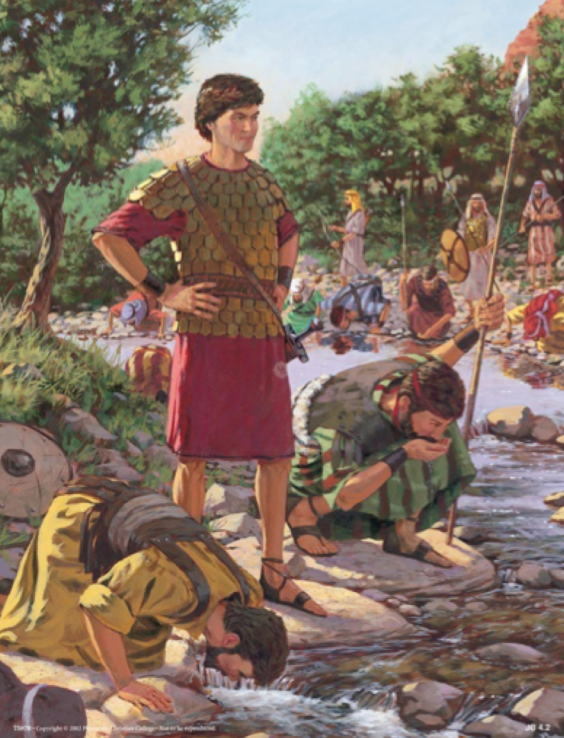
GIDEON’s RESPONSE of FAITH
Gideon OBEYS the Lord when told to reduce the size of his army (7:1-8)
Judges 7:2 (NKJV)
² And the Lord said to Gideon, “The people who are with you are too many for Me to give the Midianites into their hands, lest Israel claim glory for itself against Me, saying, ‘My own hand has saved me.’ … ⁴ But the Lord said to Gideon, “The people are still too many; bring them down to the water, and I will test them for you there.

Slide 13
GIDEON’s RESPONSE of FAITH
Gideon OBEYS the Lord when told to reduce the size of his army (7:1-8)
God tells Gideon to send away those afraid [22k] (7:3)
The 10,000 men who were left were still too many so God has him reduce the number even further (7:4-6)
God chooses the 300 who lapped water with their hands to their mouth – (their heads were still up) - 7:6

Slide 14
GIDEON’s RESPONSE of FAITH
Gideon OBEYS the Lord when told to reduce the size of his army (7:1-8)
At the first, there were
135,000 Midianites and Amalekites
VS. 32,000 Israelites (4 to 1)
THEN:
135,000 Midianites and Amalekites
VS. 10,000 Israelites (13 to 1)
THEN:
135,000 Midianites and Amalekites
VS. 300 Israelites (450 to 1)

Slide 15
GIDEON’s RESPONSE of FAITH
Gideon’s OBEDIENCE to the Lord results in a resounding victory (7:15-35)
Gideon divides the 300 men into 3 groups (7:16)
They surround the Midianite camp and follow Gideon’s instructions (17-21)
300 men defeat an army of 135,000 men with trumpets, empty pitchers & torches - crying - “The sword of the Lord and of Gideon!” (7:22)

Slide 16
GIDEON’s RESPONSE of FAITH
Gideon’s OBEDIENCE to the Lord results in a resounding victory (7:15-35)
Judges 7:21–22 (NKJV)
²¹ And every man stood in his place all around the camp; and the whole army ran and cried out and fled. ²² When the three hundred blew the trumpets, the Lord set every man’s sword against his companion throughout the whole camp; and the army fled to Beth Acacia, toward Zererah, as far as the border of Abel Meholah, by Tabbath.

Slide 17
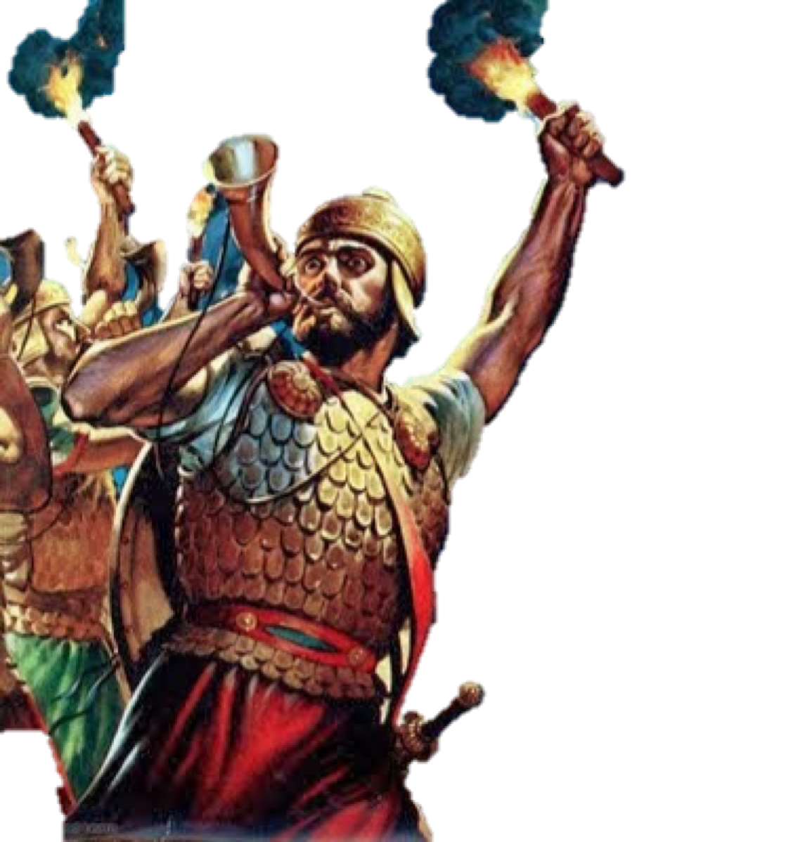
GOD BLESSES FAITH WITH VICTORY!
Gideon was a man of humble origins - victory is NOT predicated upon our strength, but God’s (6:15,16; Eph 6:10-18; Phili 4:13)
We cannot fully serve God until we first destroy our Baal’s (6:25-32; Col. 3:5-17; Gal 5:24; Rom 6:2-13, 16-18)
The armies amassed against the people of God will ultimately lose (6:33-35; 8:28)

Slide 18
GOD BLESSES FAITH WITH VICTORY!
We should be trusting of God’s word - but God is patient with us, desiring that our hearts be assured before Him (6:17-20; 36-40; 1 Thes 3:13; 1 Jn 3:19-21)
Numbers, Size, Human Strength, etc. are not important factors in fighting God’s battles - (cf. Ps. 33:16; 1 Sam 14:6), but humility, faith, courage, obedience, zeal & endurance - 1 Sam 17:26-51, (esp, vs. 47); Rom 8:31

Slide 19
GOD BLESSES FAITH WITH VICTORY!
God has given us sufficient evidence to believe, (Rom 1:18ff; 10:17), but as we continue to believe, obey & serve - God grants more evidence - our faith grows - our service grows - our usefulness grows (Mat 13:12; 25:29; John 15:2-5; 2 Pet 1:5-15)
God’s ways are often unconventional, contrary to human wisdom! (Is 55:8,9; 2 Kings 5; Mark 16:16; Rom 1:16; 1 Cor. 1:18-25; 2 Cor 10:4) - [Salvation / the church (work, organization, / Spiritual warfare etc.)]

Slide 20
GOD BLESSES FAITH WITH VICTORY!
Each one had to have tremendous faith - they were out numbered 450-1? (Heb 11:32; Rom 8:31)
How many of us would have volunteered for this ???
It takes courage to stand up for the truth in an ungodly world! - Josh. 1:6-9,18; Acts 5:20; cf. Acts 4:13; 20:20,27; 1 Cor 16:13.

Slide 21
GOD BLESSES FAITH WITH VICTORY!
Each man stood in their place (7:21)
TOGETHER - There is strength in unity! (Ecc 4:12; John 17:20,21)
The devil knows the power of unity - and that we are vulnerable when divided! (Mark 3:24,25)
It’s not JUST UNITY that is of GREAT importance - but WE MUST BE united with God - upon His Word (Phili 1:27; 2:1-5; Eph 4:1-6; 1 Cor 1:10-13)

Slide 22
GOD BLESSES FAITH WITH VICTORY!
Each man stood in their place (7:21)
Submission to Christ’s authority results in unity and brings REAL success! (1 Cor. 1:10; Eph 4:1-6; Col. 2:19; 3:17; 2 Jn 1:9; Mt 7:24-27; Eph 6:10-18)
The growth and success of this congregation is directly related to each and every member getting actively involved (Eph 4:11-16; 1 Cor. 12:12-26)

Slide 23
GOD BLESSES FAITH WITH VICTORY!
1 John 5:4 (NKJV)
⁴ For whatever is born of God overcomes the world. And this is the victory that has overcome the world—our faith. ⁵ Who is he who overcomes the world, but he who believes that Jesus is the Son of God?

Slide 24
GOD BLESSES FAITH WITH VICTORY!
FAITH GIVES US VICTORY OVER …
Our Enemies!
False teachers & doctrine!
Temptations!
Sin!
Trials!
Even Death!

Slide 25
GOD BLESSES FAITH WITH VICTORY!
They Overcame By Faith - Heb 11:32
Believed God – 7:13-15
Obeyed instructions – 7:16-21
Gained the victory – 7:22-8:12
We CAN Overcome by FAITH
Believe – John 8:24
Obey instructions – Acts 2:38; Rom 10:8-17
Gain the victory – Acts 2:41,42

Slide 27
Judges 6 & 7
Hebrews 11:32
Charts by Don McClain
Preached November 29
West 65th Street church of Christ / P.O. Box 190062 / Little Rock AR 72219
501-568-1062 / 501-749-6928 / Email – donmcclain@sbcglobal.net
Prepared w/ Keynote More lessons: http://w65stchurchofchrist.org/coc/sermons/

Slide 28
1 John 4:20–5:5 (NKJV)
²⁰ If someone says, “I love God,” and hates his brother, he is a liar; for he who does not love his brother whom he has seen, how can he love God whom he has not seen? ²¹ And this commandment we have from Him: that he who loves God must love his brother also. ¹ Whoever believes that Jesus is the Christ is born of God, and everyone who loves Him who begot also loves him who is begotten of Him. ² By this we know that we love the children of God, when we love God and keep His commandments.

Slide 29
1 John 4:20–5:5 (NKJV)
³ For this is the love of God, that we keep His commandments. And His commandments are not burdensome. ⁴ For whatever is born of God overcomes the world. And this is the victory that has overcome the world—our faith. ⁵ Who is he who overcomes the world, but he who believes that Jesus is the Son of God?

