Slide 1
WHY Are We NOT Growing?
Text: Nehemiah 13

Slide 2
How Are We Going To Grow?
The church CAN grow in an ungodly world!
(see the book of Acts)
Text: Nehemiah 13

Slide 3
How Are We Going To Grow?
The church CAN grow in an ungodly world!
(see the book of Acts)
Ignorant — Jews (Acts 2:23; 3:17)
False teacher — Simon (Acts 8:9-13)
Religiously wrong — Saul (Acts 8:3; 9:1-2; 1 Tim. 1:15)
Non-Religious — Jailor (Acts 16:31-33)
Idolaters — Thessalonians (Acts 17:3,4; 1 Thes. 1:9)
Worldly — Corinthians ( Acts 18:8; 1 Cor. 6:9-11)
Text: Nehemiah 13

Slide 4
THOSE AROUND US ARE
Wealthy / materialistic / self sufficient / comfortable (Mt. 19:24; Lk 12:19)
Given to sinful pleasure / entertainment (2 Th. 2:10-12)
Filled with pride & selfishness (2 Tim. 3:1-7)
Seeking only what they want to hear (2 Tim. 4:3,4)
Deceived by false teachers (Titus 1:10,11; 2 Pet. 2)

Slide 5
THOSE AROUND US ARE
Wealthy / materialistic / self sufficient / comfortable (Mt. 19:24; Lk 12:19)
Given to sinful pleasure / entertainment (2 Th. 2:10-12)
Filled with pride & selfishness (2 Tim. 3:1-7)
Seeking only what they want to hear (2 Tim. 4:3,4)
Deceived by false teachers (Titus 1:10,11; 2 Pet. 2)
COULD IT BE WE ARE …
Wealthy / materialistic / self sufficient / comfortable? (Rev. 3:14-22)
Given to sinful pleasure / entertainment? (Jam. 4:1-4)
Filled with pride & selfishness? (Rom. 2:17-24)
Sharing only what others want to hear? (John 12:42)
To busy fighting amongst ourselves? (1 Cor. 1:10; Jn 17:21)

Slide 6
Honey I Shrunk the Church
Part 2 - The Chicken or the Egg?
by Allen Ratta
”The oft recited, ‘which came first, the chicken or the egg,’ riddle is easy for those who understand biblical creationism. God made chickens first. . . . If the sequencing is right, things have a way of taking care of themselves. For example, when one has healthy chickens there will be no shortage of eggs or those to hatch them.”

Slide 7
Judah was in Babylon 70 years because of their idolatry (Jer. 29:10)
539 BC. Cyrus the Great conquered Babylon & released the Jews as foretold by Isaiah. (Isa. 44:28; 45:1-4 [150 years before Cyrus])
Zerubbabel leads the first wave back to Jerusalem to reestablish the priesthood and sacrificial system — Ez 3:1-8 (538 BC)
The temple is rebuilt under the leadership of Zerubbabel — Ez 3:8-6:18 (537-516 BC)
Ezra returns to teach and lead the people in worship & service according to the Law — Ez 7:1-10 (457,458 BC)
Nehemiah leads another group back to direct the reconstruction of the wall – Neh. 1:1-7:15 (25th of Elul ~ Sept 20, 444 BC)
Notes:
O God, You are my God; early will I seek You;
My soul thirsts for You; my flesh longs for You
In a dry and thirsty land where there is no water.
(Psalm 63:1)
ALTHOUGH OUR NEED FOR GOD IS VERY REAL, WE DON’T ALWAYS RECOGNIZE THAT NEED. And if we spend our lives pursuing other things, we may explain that by saying we don’t need God as much as others do, but that explanation doesn’t do justice to the truth. It would be more accurate to say that we don’t recognize our need. The objective existence of our need and our subjective feeling of it are two very different things. And the great challenge we face is to bring these two into harmony. Having a need for God, as every human being does, we need to feel that need. As the years go by, we should more truthfully understand, lovingly feel, and honestly acknowledge that we need our God.
David spoke of his “thirst” for God: “My flesh longs for You in a dry and thirsty land.” What does it mean to thirst for God? Does it not mean we recognize our inadequacy without Him? Yes, it means this and more. It means we confess Him to be our Creator (Romans 1:21) and admit the impossibility of our existence without His sustaining grace (Colossians 1:17). It means we reverently and gratefully turn our hearts toward Him and come to the point where we love the thought of Him. It means we long for fellowship with Him and, above all, we recognize that without redemption from the sins we have committed against Him, we are hopelessly lost and undone (Acts 16:30).
In regard to our physical bodies, we objectively need such things as vitamin D and exposure to sunlight. If we don’t get these two things, we develop rickets. A person with rickets may or may not understand what it is that he is lacking; yet the deficiency and its consequences are very real. And so it is with the needs of our spirits. “The soul is a never ending sigh after God” (Theodore Christlieb). If we don’t recognize our need for what it is and attend to its truthful satisfaction, in time the dry and thirsty land in which we live will take its toll.
“Our nature hungers for God even when it broke with him long ago, perhaps the more intensely the longer ago it was. It experiences a sort of famine. But the devil rides it and spurs it on, to distract it from its own need. He changes its hunger into haste. That is why people today are in such a hurry. Their speed is to distract their hunger” (Louis Evely).
Gary Henry

Slide 8
Principles of Rebuilding & Revival
The first 7 chapters of the book of Nehemiah deal with his return to the ancient site, and the rebuilding of the walls of the city.
Chapters 8 - 12 deal with the reading of the law, and the efforts to restore a faithful observance of it.

Slide 9
Principles of Rebuilding & Revival
WE MUST CARE
WE MUST PRAY
WE MUST TRUST GOD
WE MUST BE HONEST
WE MUST BE PATIENT
WE MUST BE DILIGENT
WE MUST BE REVERENT

Slide 10
Principles of Rebuilding & Revival
In Neh 13:4ff, Nehemiah returns to Jerusalem to find the house of God in disarray and the Levites not receiving their rightful portions.
These leaders previously signed a document promising before the Lord & the people that they would never again let this happen (Neh. 9:38; 10:14–29, 35, 37, 39).
They said specifically, “We will not neglect the house of our God” (10:39b).

Slide 11
BY CORRECTING OUR OURSELVES
Nehemiah 13:11 (NKJV)
¹¹ So I contended with the rulers, and said, “Why is the house of God forsaken?” And I gathered them together and set them in their place.

Slide 12
DISRESPECT FOR GOD’S HOUSE
Residency was given to the enemy, Tobiah (13:4)
Eliashib, the high priest in Judah (cf. 3:1, 20; 13:28), had prepared a room in the temple for Tobiah the Ammonite (2:10; 4:3; 6:1; also cf 13:1-3).
Tobiah was an enemy of Nehemiah along with Sanballat (2:10–19;4:3,7; 6:1,12,17,19)

Slide 13
DISRESPECT FOR GOD’S HOUSE
Holy Things Replaced By Enemies Things - 13:5
The room he occupied had been one of the temple storerooms (13:4–5). There Tobiah could oppose God’s work while posing to assist it!
In order to make room for Tobiah - the things commanded by God had to be removed. (vs 8)

Slide 14
DISRESPECT FOR GOD’S HOUSE
The temple needed to be “cleansed” - 13:6-9
Required ALL things “common” cast out (vs. 8; 2 Ch. 29:5, 15–19; Mar. 11:15–17; Jno. 2:13–17; 1 Cor 5; 11:21,22,34; Lev 10:1-4).
Required the temple articles and offerings that belonged there be restored. (9; 10:37; 12:47)

Slide 15
DISRESPECT FOR GOD’S HOUSE
Worldly & common things have been given residency in MANY churches claiming to belong to Christ (1 Cor 11:34)
While taking up residency under the guise of “expedients” - they are in fact undermining & destroying God’s people & work. (Mt 13:22; 1 Tim 5:16; 2 Cor. 10:4)

Slide 16
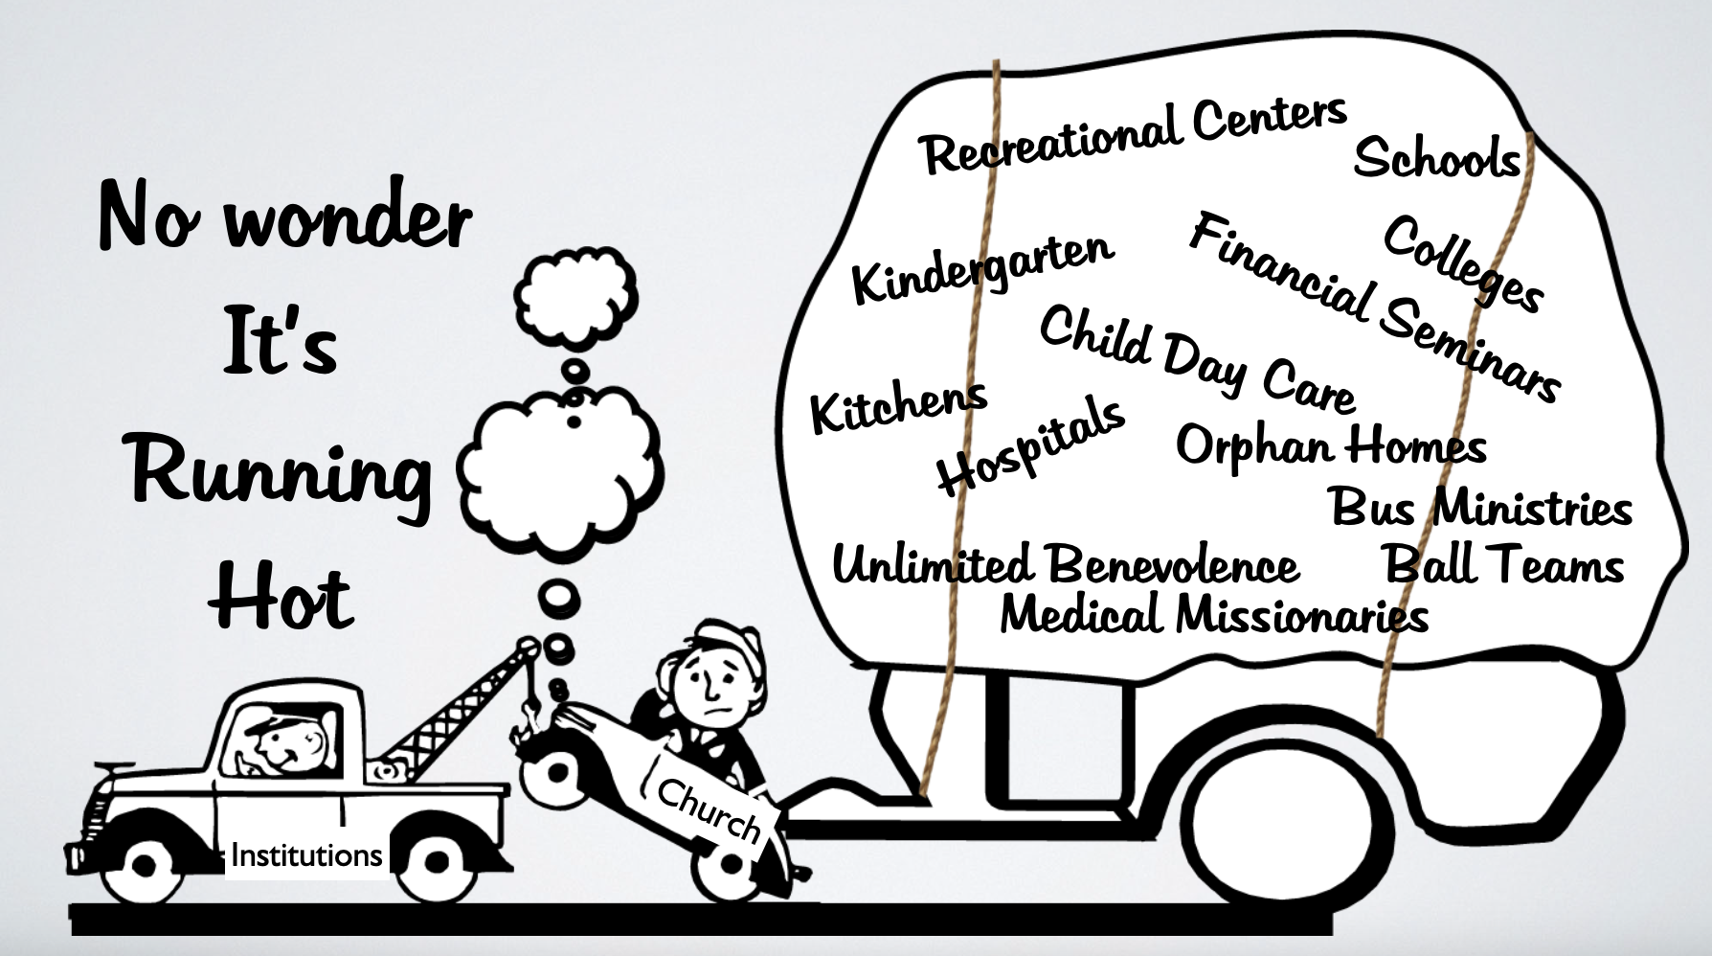
DISRESPECT FOR GOD’S HOUSE

Slide 17
RESPECT GOD’S HOUSE
We need the same zeal Nehemiah & our Lord had for God’s house! (Jn. 2:13–17)
The church needs to be cleansed from all things common, (human institutions, carnal pleasures, enticements, & doctrines of men) (2 Cor. 6:14-7:1)
The church’s spiritual worship & work needs to be restored! (1 Tim 3:15; Jn 4:24)

Slide 18
MATERIALISTIC PRIORITIES
Neglected support for those serving - 13:10-14
The Levites had to leave the Temple and work their lands for substance. (10; Deut 25:4; Mat 10:10; 1 Cor. 9:7-9)
Nehemiah 13:10 (NKJV)
¹⁰ I also realized that the portions for the Levites had not been given them; for each of the Levites and the singers who did the work had gone back to his field.

Slide 19
MATERIALISTIC PRIORITIES
Neglected support for those serving - 13:10-14
The Levites had to leave the Temple and work their lands for substance. (10; Deut 25:4; Mat 10:10; 1 Cor. 9:7-9)
To neglect those who labor in God’s house is to neglect God’s house! - (11; Mal 3:8-11; 1 Tim 5:17,18; 1 Cor 9:14)
Nehemiah 13:11 (NKJV)
¹¹ So I contended with the rulers, and said, “Why is the house of God forsaken?” And I gathered them together and set them in their place.

Slide 20
MATERIALISTIC PRIORITIES
Neglected support for those serving - 13:10-14
Nehemiah set out to correct the problem. (cf. 13:11-14).
The people complied (12)
Levites placed at their posts - four men to oversee the distribution of the tithes (12,13; cf. v. 5; 10:39).
Also Nehemiah prayed for God’s help in the matter (13:14).
Nehemiah 13:11 (NKJV)
¹¹ So I contended with the rulers, and said, “Why is the house of God forsaken?” And I gathered them together and set them in their place.

Slide 21
MATERIALISTIC PRIORITIES
Neglected Worship 13:15-22
Spiritual things were put on the back burner to material things (13:15-22)
Another commitment Israel had made in writing, but had broken, was to keep God’s laws regarding the Sabbath (10:31).
Nehemiah 13:11 (NKJV)
¹¹ So I contended with the rulers, and said, “Why is the house of God forsaken?” And I gathered them together and set them in their place.

Slide 22
MATERIALISTIC PRIORITIES
Neglected Worship 13:15-22
They were working on the Sabbath as other days of the week. (Treading grapes in winepresses, & transporting wine, grain, grapes, figs, merchandise, into Jerusalem to sell it).
They also were buying fish and other items from people of Tyre who resided in Jerusalem.
Nehemiah 13:15 (NKJV)
¹⁵ In those days I saw people in Judah treading wine presses on the Sabbath, and bringing in sheaves, and loading donkeys with wine, grapes, figs, and all kinds of burdens, which they brought into Jerusalem on the Sabbath day. And I warned them about the day on which they were selling provisions.

Slide 23
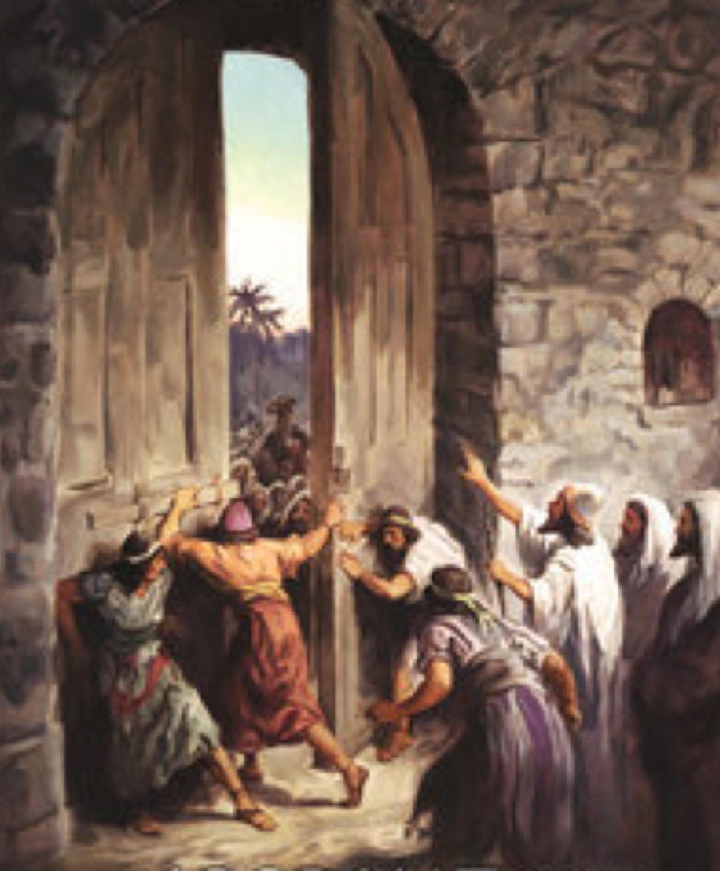
MATERIALISTIC PRIORITIES
Neglected Worship 13:15-22
Nehemiah met the problem with both rebuke & action (17-22; cf. vv. 11–13).
Called it what it was - EVIL - one of the sins for which they were exiled (17,18; cf. Jer. 17:19–27)
Had the doors to the city shut on the Sabbath (19)
Nehemiah 13:17 (NKJV)
¹⁷ Then I contended with the nobles of Judah, and said to them, “What evil thing is this that you do, by which you profane the Sabbath day?

Slide 24
MATERIALISTIC PRIORITIES
Neglected Worship 13:15-22
Guards were posted to keep merchandise out (19)
Some merchants stayed all night outside the walls. Nehemiah threatened to use force. (20,21)
He had Levites help guard the gates (30; cf. 7:1; 11:19).
He asked for God’s help (22)
Nehemiah 13:17 (NKJV)
¹⁷ Then I contended with the nobles of Judah, and said to them, “What evil thing is this that you do, by which you profane the Sabbath day?

Slide 25
SPIRITUAL PRIORITIES
God’s house and work should be more valuable & important to us than material things & worldly pleasures (Mat 6:33; 2 Cor 8,9)
Preachers & elders, who stand for & teach the truth, need to be supported (1 Tim 5:17,18; 1 Cor 9:14)
Nehemiah 13:17 (NKJV)
¹⁷ Then I contended with the nobles of Judah, and said to them, “What evil thing is this that you do, by which you profane the Sabbath day?

Slide 26
SPIRITUAL PRIORITIES
The first day of the week is the Lord’s day - and Christians are to come together to worship God, edify & encourage one another (Acts 20:7; 1 Cor 16:1,2; Heb 10:24,25)
Do we view Sunday as JUST another day? (working when not absolutely necessary, golfing, fishing, shopping, family outings, yard work, TV)

Slide 27
SPIRITUAL PRIORITIES
Can a Christian truly have their priorities and values where they ought to be while neglecting worship and service to God? (Mark 12:29-31; Heb 10:24,25; Mat 6:19-24; 1 Jn 2:15-17)
If we are to grow in a way that pleases the Lord, we will have to put the Lord, His people, and His work first! (Eph. 4:12-16; Mat. 28:19)

Slide 28
HEARTS CORRUPTED BY THE WORLD
Married To The Enemy (13:23-29)
The children of Israel had intermarried with the Philistines, Ammonites & Moabites, (23 - people they were specifically forbidden to marry - Ex. 34:12–16; Deut. 7:1–5)
Half the children spoke the language of Ashdod & not able to speak Hebrew (24)

Slide 29
HEARTS CORRUPTED BY THE WORLD
Married To The Enemy (13:23-29)
Nehemiah “struck them and pulled out their hair” making them swear before God to not continue in this sin. (25)
He reminded them of Solomon (26; cf. 1 Ki 11:1–8).
This was wickedness, an act of unfaithfulness, for they had done “a great evil” (25-27)

Slide 30
HEARTS CORRUPTED BY THE WORLD
Married To The Enemy (13:23-29)
Eliashib’s grandson had married a daughter of Sanballat – thus Nehemiah put him out (28)
Nehemiah pleads with God to remember him for correcting those who had defiled the priesthood and the covenant of the priesthood (29)

Slide 31
HEARTS PURIFIED BY THE WORD
Beware of compromising companionships (Prov. 1:8ff; 4:14; Psa. 1:1;1 Cor. 15:33; 2 Cor 6:14-7:1; 1 Cor. 7:12-16)
It is vitally important for our children to be brought up in the nurture and admonition of the Lord (Eph. 6:1-4)
Too many children are not grounded in the scriptures - and are more familiar with the “worlds” language than God’s word (Eph 5:4-7; 1 Pet 4:11)

Slide 32
HEARTS PURIFIED BY THE WORD
By collectively retaining our distinction from the world and those in error (2 Cor. 6:14-7:1; 1 Pet 2:4-12)
By speaking as the oracles of God, i.e., preaching and teaching the word (2 Pet. 4:11; 2 Tim. 4:1-4)
By believing, teaching and practicing only those things authorized by God’s word (Col. 3:17; 2 Tim. 1:13)

Slide 33
By having deep abiding respect & zeal for His house - the church!
By truly focusing on & prioritizing spiritual things!
By maintaining our holy distinction from the world and false religions!
Text: Nehemiah 13

Slide 34
Ephesians 4:15–16 (NKJV)
¹⁵ but, speaking the truth in love, may grow up in all things into Him who is the head—Christ—
¹⁶ from whom the whole body, joined and knit together by what every joint supplies, according to the effective working by which every part does its share, causes growth of the body for the edifying of itself in love.

Slide 36
WHY Are We NOT Growing?
Charts by Don McClain
Preached January 3, 2021 AM
West 65th Street church of Christ - P.O. Box 190062 - Little Rock AR 72219 - Phone — 501-568-1062 — Email – donmcclain@sbcglobal.net
Prepared using Keynote / More Keynote, PPT & Audio Sermons:
www.w65stchurchofchrist.com
Text: Nehemiah 13

Slide 37
2 Timothy 4:1–5 (NKJV)
¹ I charge you therefore before God and the Lord Jesus Christ, who will judge the living and the dead at His appearing and His kingdom: ² Preach the word! Be ready in season and out of season. Convince, rebuke, exhort, with all longsuffering and teaching. ³ For the time will come when they will not endure sound doctrine, but according to their own desires, because they have itching ears, they will heap up for themselves teachers; ⁴ and they will turn their ears away from the truth, and be turned aside to fables. ⁵ But you be watchful in all things, endure afflictions, do the work of an evangelist, fulfill your ministry.

