Slide 1
The Importance of
RESPECTING GOD’S SILENCE
(1 Corinthians 4:6)
“… that you may learn in us not to think beyond what is written …”

Slide 2
“The Importance of Respecting God’s Silence”
1 Corinthians 4:6 (NKJV)
⁶ Now these things, brethren, I have figuratively transferred to myself and Apollos for your sakes, that you may learn in us not to think beyond what is written, that none of you may be puffed up on behalf of one against the other.

Slide 3
“The Importance of Respecting God’s Silence”
Most religious divisions arise out of what the Bible does not say., not from what the Bible says.
Most - NOT all (is baptism essential? Mark 16:16; 1 Pet. 3:21; Is division wrong? 1 Cor. 1:10; can women preach? 1 Cor. 14:34-37; 1 Tim 2:12,13; etc.)
For centuries, the matter of whether or not the “silence” of the Scriptures must be respected or ignored has been debated.

Slide 4
“The Importance of Respecting God’s Silence”
Tertullian (ca. A.D. 150-222) spoke of those who contended that “the thing which is not forbidden is freely permitted.” He replied: “I should rather say that what has not been freely allowed is forbidden” (Tertullian. 1995. Ante-Nicene Fathers).
Martin Luther (1483-1546) “What is not against Scripture is for Scripture, and Scripture for it” (Newman 1902, 308).
Ulrich Zwingli (1484-1531) contended that what is “not enjoined or taught in the New Testament should be unconditionally rejected” (Newman 1902, 308).

Slide 5
“The Importance of Respecting God’s Silence”
In the final analysis, the issue actually is: does the Bible itself sanction the idea that God’s silence is permissive?
It will be the contention of this lesson that both the Old Testament and New Testament amply demonstrate that silence itself is NOT permissive, but one MUST have positive scriptural authority to engage in any religious practice.

Slide 6
GOD’S SILENCE IS NOT PERMISSIVE
Old Testament Passages
Deuteronomy 4:1–2 (NKJV)
¹ “Now, O Israel, listen to the statutes and the judgments which I teach you to observe, that you may live, and go in and possess the land which the Lord God of your fathers is giving you. ² You shall not add to the word which I command you, nor take from it, that you may keep the commandments of the Lord your God which I command you.

Slide 7
GOD’S SILENCE IS NOT PERMISSIVE
Old Testament Passages
Deuteronomy 12:32 (NKJV)
³² “Whatever I command you, be careful to observe it; you shall not add to it nor take away from it.

Slide 8
GOD’S SILENCE IS NOT PERMISSIVE
Old Testament Passages
Deuteronomy 5:32–33 (NKJV)
³² “Therefore you shall be careful to do as the Lord your God has commanded you; you shall not turn aside to the right hand or to the left. ³³ You shall walk in all the ways which the Lord your God has commanded you, that you may live and that it may be well with you, and that you may prolong your days in the land which you shall possess.

Slide 9
GOD’S SILENCE IS NOT PERMISSIVE
Old Testament Passages
Joshua 1:7–8 (NKJV)
⁷ Only be strong and very courageous, that you may observe to do according to all the law which Moses My servant commanded you; do not turn from it to the right hand or to the left, that you may prosper wherever you go. ⁸ This Book of the Law shall not depart from your mouth, but you shall meditate in it day and night, that you may observe to do according to all that is written in it. For then you will make your way prosperous, and then you will have good success.

Slide 10
GOD’S SILENCE IS NOT PERMISSIVE
Old Testament Passages
Joshua 23:6 (NKJV)
⁶ Therefore be very courageous to keep and to do all that is written in the Book of the Law of Moses, lest you turn aside from it to the right hand or to the left,

Slide 11
GOD’S SILENCE IS NOT PERMISSIVE
Old Testament Passages
Proverbs 30:5–6 (NKJV)
⁵ Every word of God is pure; He is a shield to those who put their trust in Him. ⁶ Do not add to His words, Lest He rebuke you, and you be found a liar.

Slide 12
GOD’S SILENCE IS NOT PERMISSIVE
Old Testament Examples
Cain (Gen. 4:7) Heb 11:4
Nadab and Abihu (Lev. 10:1,2)
Moses (Num 20:8-24)
King Saul (1 Sam. 13 & 15)
David’s ox cart (1 Chr. 13:7-12; 15:2)
Jeroboam (1 Kings 12:25-33)
Uzziah (2 Chr. 26:16-23)
Romans 15:4 (NKJV)
⁴ For whatever things were written before were written for our learning, that we through the patience and comfort of the Scriptures might have hope.

Slide 13
GOD’S SILENCE IS NOT PERMISSIVE
New Testament Passages
1 Corinthians 4:6 (NKJV)
⁶ Now these things, brethren, I have figuratively transferred to myself and Apollos for your sakes, that you may learn in us not to think beyond what is written, that none of you may be puffed up on behalf of one against the other.

Slide 14
GOD’S SILENCE IS NOT PERMISSIVE
New Testament Passages
Colossians 3:16–17 (NKJV)
¹⁶ Let the word of Christ dwell in you richly in all wisdom, teaching and admonishing one another in psalms and hymns and spiritual songs, singing with grace in your hearts to the Lord. ¹⁷ And whatever you do in word or deed, do all in the name of the Lord Jesus, giving thanks to God the Father through Him.

Slide 15
GOD’S SILENCE IS NOT PERMISSIVE
New Testament Passages
1 Peter 4:11 (NKJV)
¹¹ If anyone speaks, let him speak as the oracles of God. If anyone ministers, let him do it as with the ability which God supplies, that in all things God may be glorified through Jesus Christ, to whom belong the glory and the dominion forever and ever. Amen.

Slide 16
GOD’S SILENCE IS NOT PERMISSIVE
New Testament Passages
2 John 9 (NKJV)
⁹ Whoever transgresses and does not abide in the doctrine of Christ does not have God. He who abides in the doctrine of Christ has both the Father and the Son.

Slide 17
GOD’S SILENCE IS NOT PERMISSIVE
New Testament Passages
Revelation 22:18–19 (NKJV)
¹⁸ For I testify to everyone who hears the words of the prophecy of this book: If anyone adds to these things, God will add to him the plagues that are written in this book; ¹⁹ and if anyone takes away from the words of the book of this prophecy, God shall take away his part from the Book of Life, from the holy city, and from the things which are written in this book.

Slide 18
GOD’S SILENCE IS NOT PERMISSIVE
New Testament Passages
2 Timothy 3:16–17 (NKJV)
¹⁶ All Scripture is given by inspiration of God, and is profitable for doctrine, for reproof, for correction, for instruction in righteousness, ¹⁷ that the man of God may be complete, thoroughly equipped for every good work.
SOURCE: GOD BREATHED The scriptures are from God
PURPOSE: OUR GUIDANCE in teaching, proving, correcting, instructing in what is right …
SUFFICIENT IN GUIDANCE Provides all God wants us to be, & equips for all He wants done.

Slide 19
GOD’S SILENCE IS NOT PERMISSIVE
New Testament Examples
Acts 15:6-24
The religious practice of circumcision?
James appealed to direct statements. vs. 14-19
Paul referenced how God exemplified His will. v. 12
Peter argued by the implications of what God did. vs. 7-11
The Judaizing teachers were acting without authority: “to whom we gave no such commandment.” v. 24

Slide 20
GOD’S SILENCE IS NOT PERMISSIVE
New Testament Examples
Hebrews 7:11-14
The Priesthood of Jesus?
¹² For the priesthood being changed, of necessity there is also a change of the law. ¹³ For He of whom these things are spoken belongs to another tribe, from which no man has officiated at the altar. ¹⁴ For it is evident that our Lord arose from Judah, of which tribe Moses spoke nothing concerning priesthood.
The Law specified the tribe of “Levi”
All other tribes excluded by silence.

Slide 21
GOD’S SILENCE IS NOT PERMISSIVE
New Testament Examples
Colossians
Warning Against Traditions of Men (2:8)
“lest anyone should deceive you with persuasive words” (2:4)
“established in the faith, as you have been taught” (2:7)
“intruding into those things which he has not seen” (2:18)
“These things indeed have an appearance of wisdom in self-imposed religion” (2:23)

Slide 22
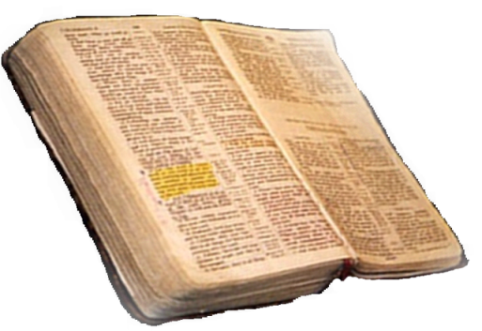
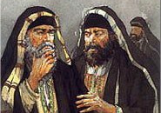
GOD’S SILENCE IS NOT PERMISSIVE
New Testament TEACHING
The baptism of John—where was it from? From heaven or from men?
Matthew 21:25-26
From Heaven
Mt. 21:23-27
1 John 4:4-6
Gal. 1:6-9
Col. 2:6-10
2 Thess. 2:15
Only Two Possible Sources
From Men
Mt. 15:1-9
1 Cor. 4:6
Gal. 1:10-17
Col. 2:8
2 Thess. 2:2-4

Slide 23
GOD’S SILENCE IS NOT PERMISSIVE
MAKING APPLICATION
UNDERSTANDING THE DISTINCTION BETWEEN AIDES & ADDITIONS
Heb 11:7 By faith Noah, being divinely warned of things not yet seen, moved with godly fear, prepared an ark for the saving of his household,
Specific authority:
Gopher wood (Gen 6:14)
Compartments (Gen 6:14)
450’ Long (Gen 6:15)
75’ Wide (Gen 6:15)
45’ Tall (Gen 6:15)
1 Window & Door (Gen 6:16)
3 Stories (Gen 6:16)
Generic & Specific:
Build an ark of gopher wood
Expedients
Tools & Size of material dependent upon specific need
Liberty:
Source and means of transporting materials
²²Thus Noah did; according to all that God commanded him, so he did. . . . 7:5 ⁵And Noah did according to all that the Lord commanded him.

Slide 24
GOD’S SILENCE IS NOT PERMISSIVE
MAKING APPLICATION
UNDERSTANDING THE DISTINCTION BETWEEN AIDES & ADDITIONS
Heb 11:7 By faith Noah, being divinely warned of things not yet seen, moved with godly fear, prepared an ark for the saving of his household,
Excluded / Unauthorized
Different wood
Different size
Another door
Additional boats
Incidental
Tools
Rope
Scaffolds
Help
²²Thus Noah did; according to all that God commanded him, so he did. . . . 7:5 ⁵And Noah did according to all that the Lord commanded him.

Slide 25
GOD’S SILENCE IS NOT PERMISSIVE
MAKING APPLICATION
The God of the O.T. and the God of the N.T. is the same God (Acts 5:1-11; Col. 3:17; Heb. 10:26-31).
If we truly respect, love & trust God we will believe, teach and practice only that which HE has said — (John 4:22-24; 2 Tim 3:16,17; 1 Cor. 4:6).

Slide 26
GOD’S SILENCE IS NOT PERMISSIVE
MAKING APPLICATION
(God’s silence is NOT permissive!)
We cannot know the mind of God except through revelation
1 Cor 2:10, 11,14
Eph 3:3-5
Isaiah 55:8,9
God has revealed everything He wants from us
2 Pet 1:3;
2 Tim 3:16,17
Jude 3
ROMANS 10:17
Faith comes by HEARING
Walking by faith means walking by what God has said
2 Cor. 5:7; 1 Cor. 4:6; Gal. 1:6-9

Slide 27
GOD’S SILENCE IS NOT PERMISSIVE
MAKING APPLICATION
Where does the Bible authorize:
An earthly universal bishop?
Denominationalism?
Sprinkling or pouring for baptism?
Pagan holiday observances?
Instrumental music in worship? (Piano - Orchestras - bands - etc)
Fund raising campaigns - Social programs – Recreational activities – Entertainment centers . . . .
Women preachers, deacons, elders?

Slide 28
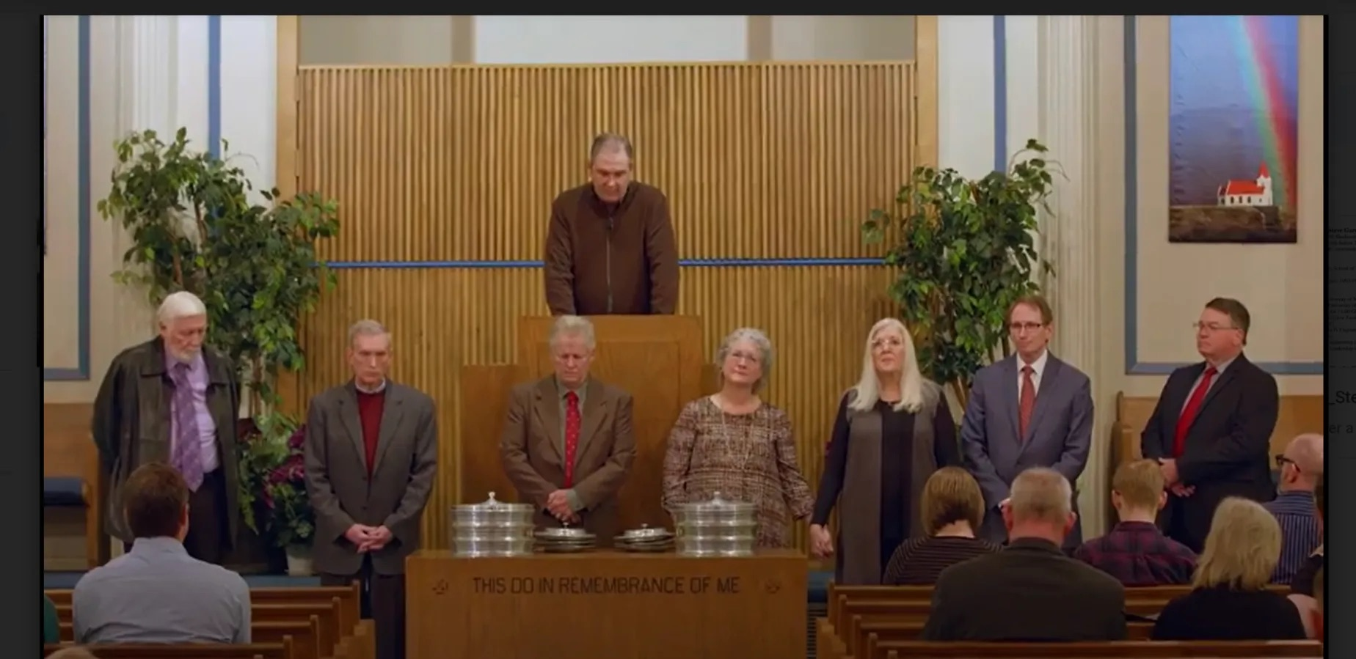
GOD’S SILENCE IS NOT PERMISSIVE
MAKING APPLICATION
Female Elders in a Church of Christ: Interviews, One Year Later
Date: December 8, 2020
Author: Steve Gardner
Minter Lane Church of Christ in Abilene, Texas, appointed two female elders
Cynthia Litton Cooke and Rendi Young Hahn, both long-time members, were ordained by the congregation during a December 8, 2019, service in which the preaching minister proclaimed, “the love of God is both masculine and feminine.

Slide 29
GOD’S SILENCE IS NOT PERMISSIVE
MAKING APPLICATION
UNDERSTANDING THE DISTINCTION BETWEEN AIDES & ADDITIONS
Aids & Expedients do not change, by either addition or subtraction, that which God commands! Additions do!
AIDES: Tools to build ark - (saws / ropes / etc.) Gen 6
UNAUTHORIZED: Changes in: size / number of stories / type of wood / more boats
In order for a thing to be an aide or expedient it must first be lawful!

Slide 30
GOD’S SILENCE IS NOT PERMISSIVE
MAKING APPLICATION
UNDERSTANDING THE DISTINCTION BETWEEN AIDES & ADDITIONS
Commands | Aids | Expedients | Additions
Assemble (Heb. 10:24-25) | House, Hall, Church Building, | Time on Sunday, , own, rent, how often … | Eat, Drink, be Merry, Social gospel, Politics,
Lord’s Supper (Mt. 26:26-29; Ac 20:7) | Cups, Plates, Table, Etc. | AM or PM, Homemade? Bought? | Day other than Sunday, Pizza, Coke, …
Give (1 Cor. 16:1-2) | Collection Baskets | Order in service, cash, checks, … | Raffles, Chili Suppers, Cake Walks, Etc.
Preaching (2 Tim. 4:2) | Mics, projectors, chalk boards … | Which Biblical subject, order in service … | Doctrines of men / Politics / Entertainers …
Sing (Eph. 5:19; etc.) | Song Book, PPT Leader, Pitch Pipe, | # of songs, which songs, On screen, book, memory / stand, sit … | Man made instruments / Praise bands / Clapping

Slide 31
GOD’S SILENCE IS NOT PERMISSIVE
MAKING APPLICATION
The organization of the church - Acts 14:23; 20:14,28; Phili 1:1; 1 Tim 3:1-8; etc.
The work of the church - (evangelism - 1 Thes. 1:8; edification - Eph. 4:11-16; Benevolence - Acts 11:29)
Worship of the church - (Praying - Acts 4:23-31; L.S. - Acts 20:7; Giving - 1 Cor. 16:1,2; Preaching - Acts 20:7; Singing - Eph 5:19; Col. 3:16)

Slide 32
GOD’S SILENCE IS NOT PERMISSIVE
MAKING APPLICATION
What is OUR attitude towards the need to establish authority for all that we do?
Is the NT the ONLY source for our faith, teaching & practice?
If we add to or take away from the teaching of the NT, are we walking by faith?
If we do only those things we know are authorized in the NT, how confident can we be that we are doing what is right?

Slide 33
GOD’S SILENCE IS NOT PERMISSIVE
MAKING APPLICATION
When our wants & desires are the standard for what we believe, teach and practice, we divert our service and worship away from God & to ourselves.
When we believe, teach and practice ONLY what is taught in the Bible, we KNOW we are pleasing to God!

Slide 34
GOD’S SILENCE IS NOT PERMISSIVE
MAKING APPLICATION
We cannot GO BEYOND what is written (1 Cor. 4:6; 2 Jn. 9-11)
We cannot ADD TO or TAKE FROM God’s revelation (Deut. 4:2; 12:32; Pr. 30:5-6; Gal. 3:15; Rev. 22:18-19; 1 Pet. 4:11)
We CANNOT believe, teach or practice that which God has NOT authorized by His revelation, (God’s silence is not permissive) (Col. 3:17; Rom. 10:17; 2 Cor. 5:7; Heb 7:11-14)

Slide 35
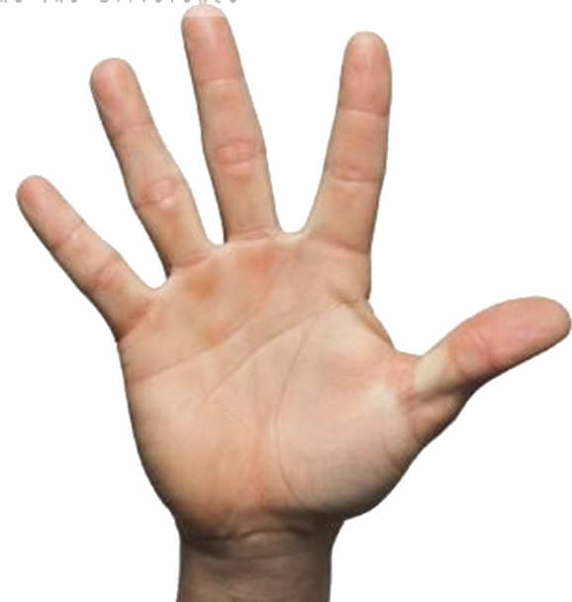
“The Importance of Respecting God’s Silence”
WHAT MUST I DO TO BE SAVED?
Luke 8:11; Rom. 10:17
John 8:24; Heb 11:6
Luke 13:3,5; Acts 17:30
Mat. 10:32,33; Rom 10:9
Acts 2:38; 22:16; 1 Pet 3:21
Heb 4:11; Col 1:23

Slide 36
Don McClain
W 65th St church of Christ / October 19, 2008

Slide 37
The Importance of
RESPECTING GOD’S SILENCE
(1 Corinthians 4:6)
Charts by Don McClain
Preached December 13, 2020 AM
West 65th Street church of Christ - P.O. Box 190062 - Little Rock AR 72219 - Phone — 501-568-1062 — Email – donmcclain@sbcglobal.net
Prepared using Keynote / More Keynote, PPT & Audio Sermons:
www.w65stchurchofchrist.com

