Slide 1
John 14:1-7
10 AM - Sunday, April 5, 2020

Slide 2
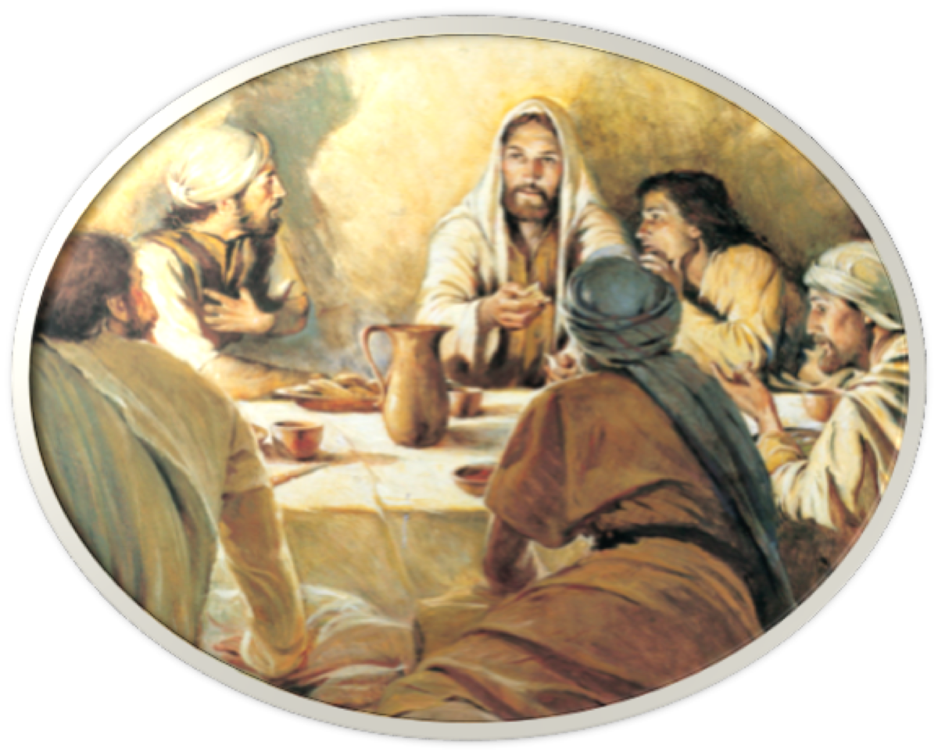
John 13–17 contain Jesus’ private words to His apostles on that fateful night in which He was arrested, the night before His death
JESUS PREPARES HIS DISCIPLES FOR THE DARKEST OF DAYS
Peter would disown Him 3 times (13:38),
Jesus teaches disciples humility by washing their feet - 13:1-20
Jesus was going away (7:34; 8:21; 12:8, 35; 13:33; 12:32–33),
One of the Twelve was a traitor (13:21),

Slide 3
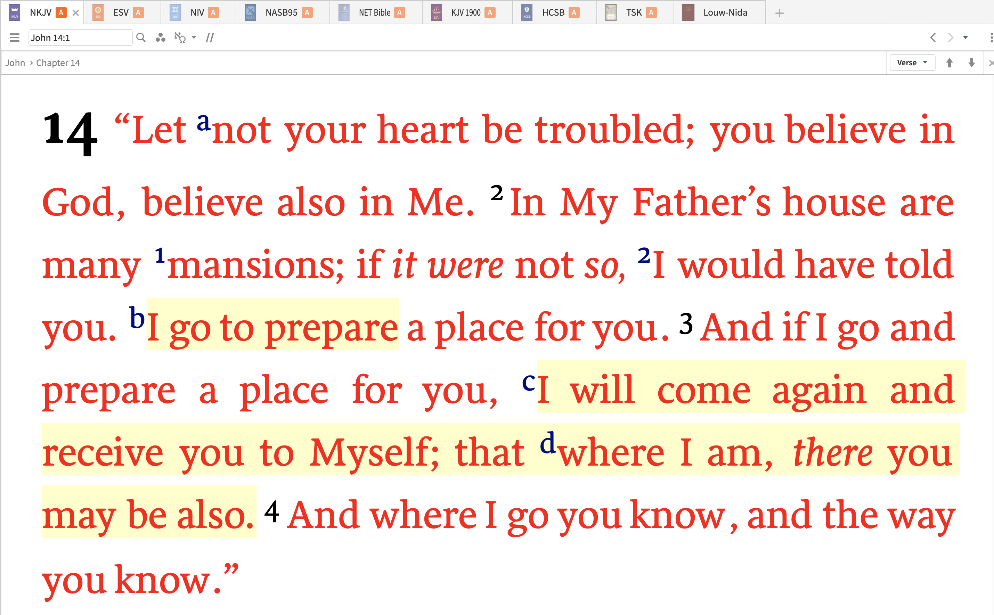
John 14:1–7 (NKJV)

Slide 4
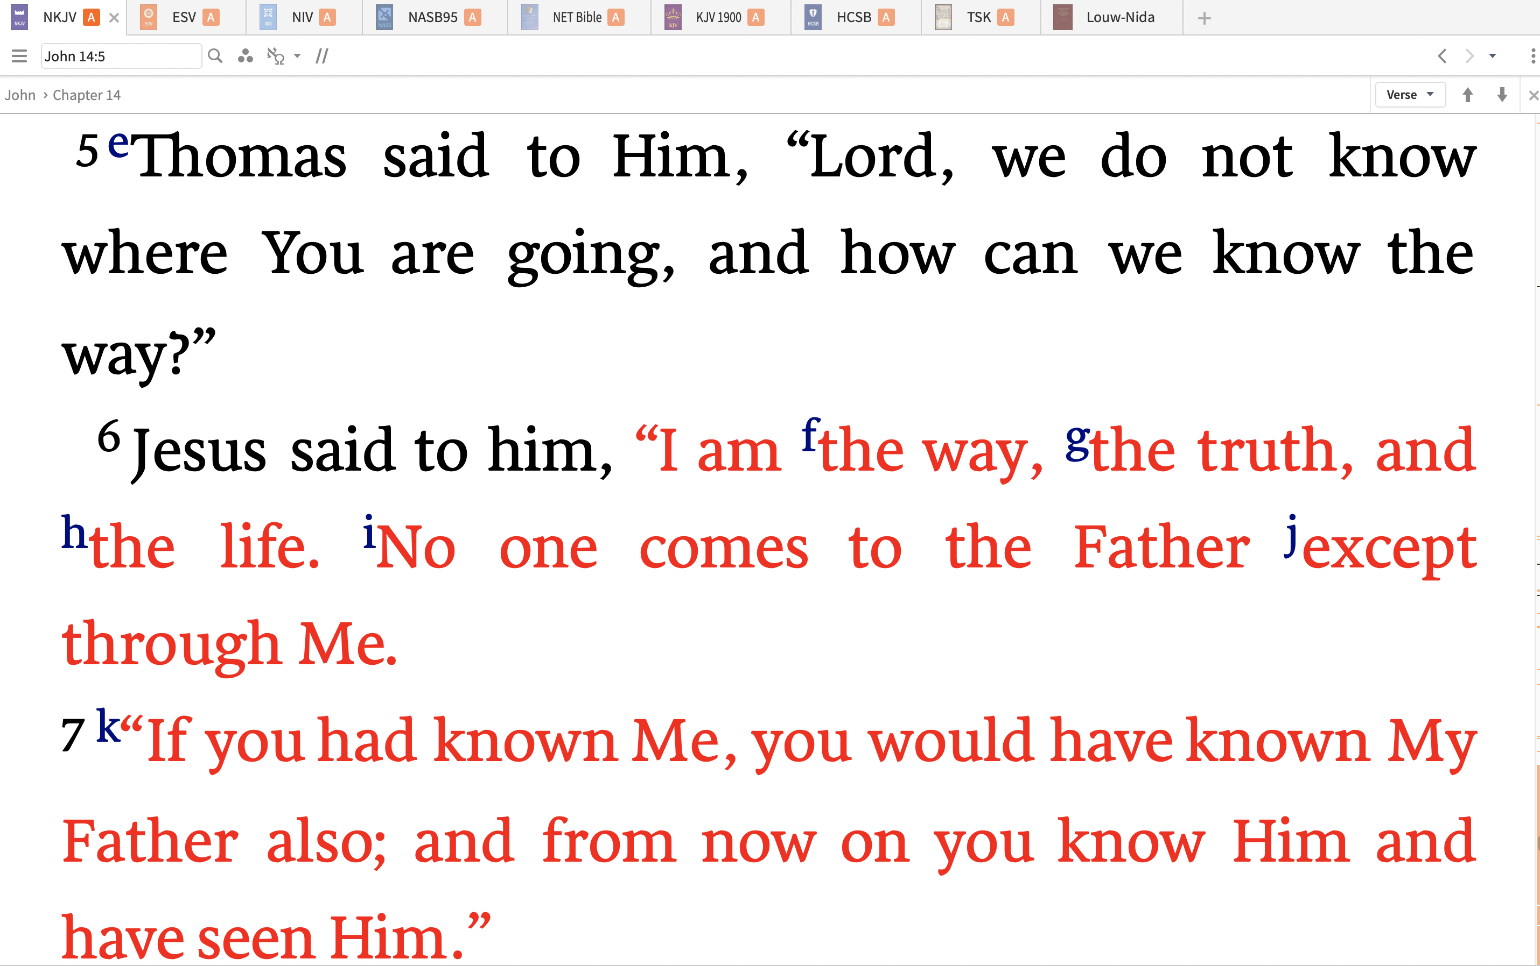
John 14:1–7 (NKJV)

Slide 5
THE THREAT OF & ANSWER TO FEAR
TROUBLED:
25.244 ταράσσω^{b}: “to cause acute emotional distress or turbulence—‘to cause great mental distress.” … (Jn 11:33;1 Pet 3:14) - [Lou Nida]
[5429] ταράσσω …met. to agitate, trouble the mind; with fear, to terrify, put in consternation, Mt. 2:3; 14:26; with grief, etc., affect with grief, anxiety, etc., Jn. 12:27; 13:21; with doubt, etc., to unsettle, perplex, Acts 15:24; Gal. 1:7 - [Mounce, W. D. (2006)]

Slide 6
THE THREAT OF & ANSWER TO FEAR
The THREAT of FEAR
Matthew 6:25 (NKJV)
²⁵ “Therefore I say to you, do not worry about your life, what you will eat or what you will drink; nor about your body, what you will put on. Is not life more than food and the body more than clothing?

Slide 7
THE THREAT OF & ANSWER TO FEAR
The CURE for FEAR
Romans 8:15 (NKJV)
¹⁵ For you did not receive the spirit of bondage again to fear, but you received the Spirit of adoption by whom we cry out, “Abba, Father.”

Slide 8
THE THREAT OF & ANSWER TO FEAR
The CURE for FEAR
Philippians 4:6–7 (NKJV)
⁶ Be anxious for nothing, but in everything by prayer and supplication, with thanksgiving, let your requests be made known to God; ⁷ and the peace of God, which surpasses all understanding, will guard your hearts and minds through Christ Jesus.

Slide 9
THE THREAT OF & ANSWER TO FEAR
The CURE for FEAR
2 Timothy 1:7 (NKJV)
⁷ For God has not given us a spirit of fear, but of power and of love and of a sound mind.

Slide 10
THE THREAT OF & ANSWER TO FEAR
The CURE for FEAR
1 John 4:17–18 (NKJV)
¹⁷ Love has been perfected among us in this: that we may have boldness in the day of judgment; because as He is, so are we in this world. ¹⁸ There is no fear in love; but perfect love casts out fear, because fear involves torment. But he who fears has not been made perfect in love.

Slide 11
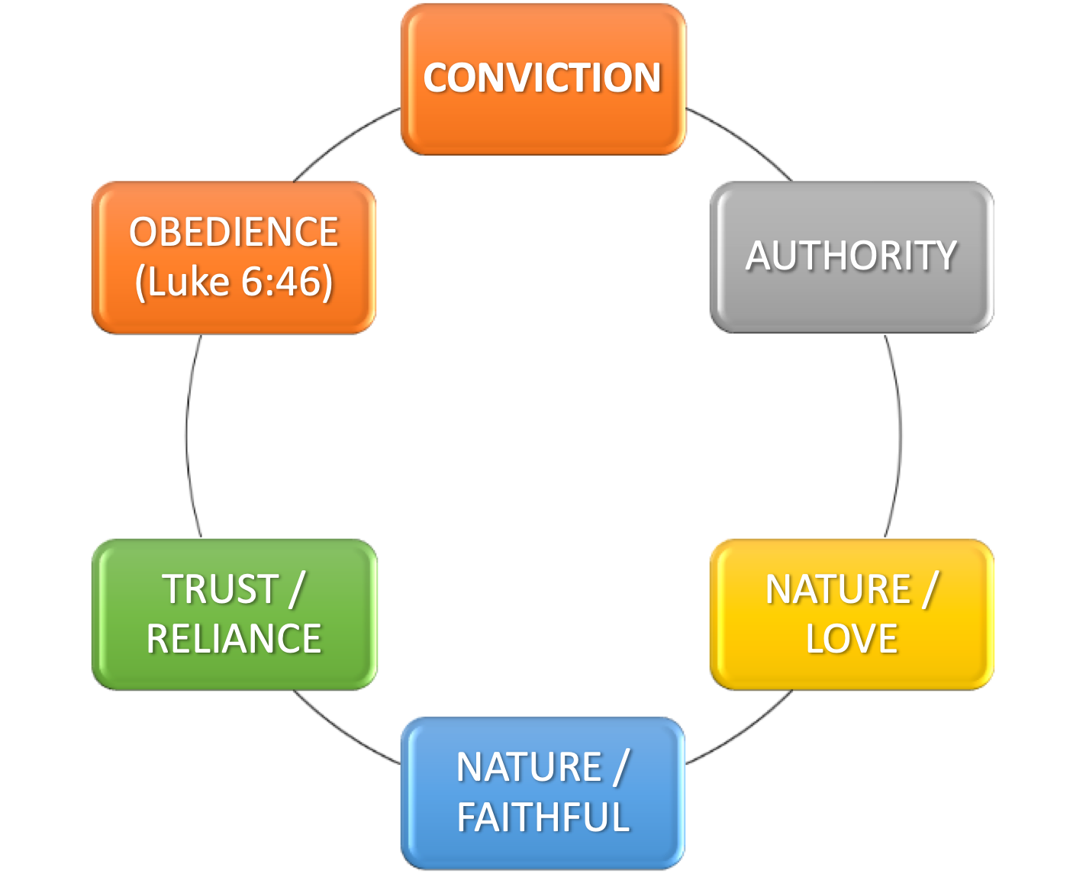
THE CURE FOR FEAR
BELIEVE:
An imperative - “Believe in God, believe also in Me.” - (NASB95). - (14:1)
cf. John 6:40; 12:44; 13:19; 8:24
Hebrews 11:6 (vs 1-31)
Romans 10:9-17
¹ “Let not your heart be troubled; you believe in God, believe also in Me.

Slide 12
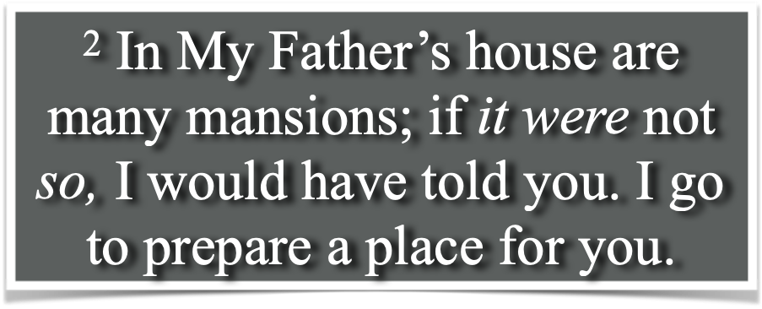
THE CURE FOR FEAR
BELIEVE:
“In My Father’s house are many mansions,” i.e., dwellings - (14:2; 2 Cor 5:1; Heb 11:10, 14-16; 1 Pet 1:4)
Divine integrity - (Ps 89:34-35; Jn 3:31-33; Tit 1:1-3; Heb 6:16-20).
“I go to prepare a place for you” - (13:36; 17:24; Heb 4:14; 10:19-23; Mat 25:34)

Slide 13
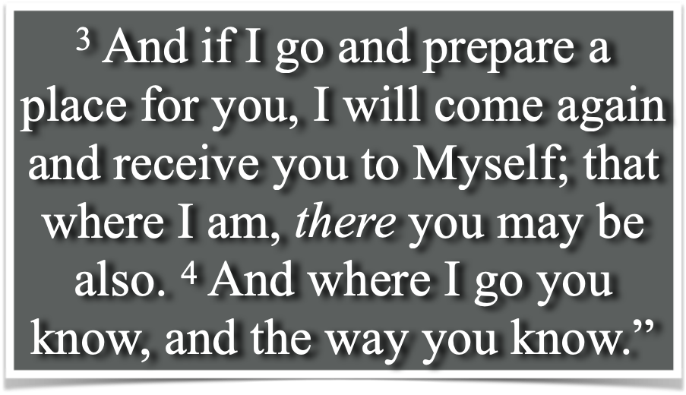
THE CURE FOR FEAR
BELIEVE:
Jesus often spoke of His departure with His disciples - (John 13:3-4, 33, 36; 14:2-4, 12, 28; 16:5-7, 17-18, 28).
Jesus promised to return - (cf. also John 14:18,28)
Jesus promised to receive His disciples to Himself - (1 Thes 4:13-18; [In heaven - 1 Pet 1:4]).

Slide 14
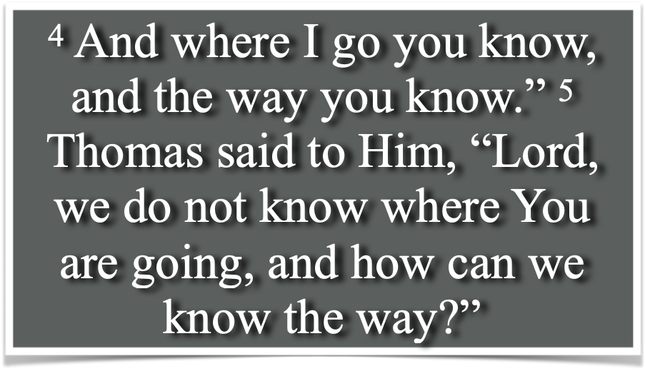
THE CURE FOR FEAR
BELIEVE:
They should have known where He was going. He had told them He had come down from the Father and would return there. - (8:14; 13:3; cf. 14:28; 16:28)
However, they were all perplexed - (Lk 24:25,26)
Thomas confesses his ignorance, & Jesus patiently explains - - -

Slide 15
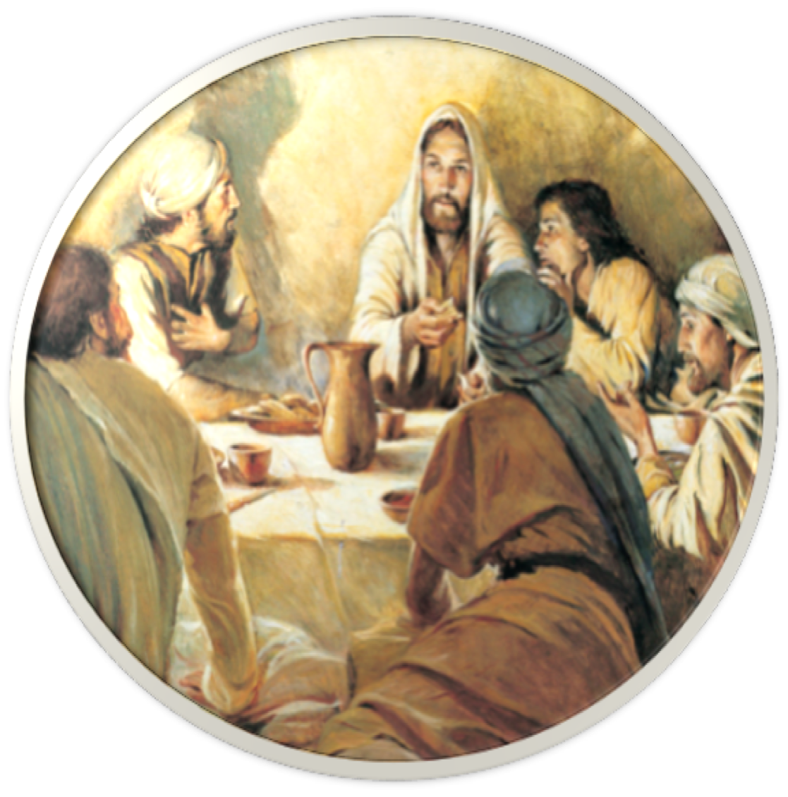
THE CURE FOR FEAR
⁶ Jesus said to him, “I am the way, the truth, and the life. No one comes to the Father except through Me.

Slide 16
THE CURE FOR FEAR
I AM …
He did not say "I will show you the way," but "I am the way."
He did not say "I have the truth," but "I am the truth."
The Lord did not say, "I lead unto life," but "I am the life."
⁶ Jesus said to him, “I am the way, the truth, and the life. No one comes to the Father except through Me.

Slide 17
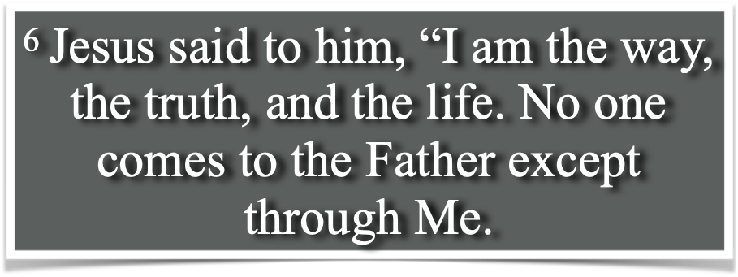
JESUS: The WAY, The TRUTH & The LIFE
The WAY …
There is no other way (Acts 4:12; 1 Tim 2:5;p Mat 7:13,14)
It is NO salvation in any and/or every other way - (Judaism, Islam, Buddhism, Hinduism, etc.)
This also applies to those who claim to believe in Christ, but reject his teaching (Mat 15:13,14; Lk 6:46; Jn 12:48-50; 2 Jn 9)

Slide 18
JESUS: The WAY, The TRUTH & The LIFE
The TRUTH …
The dominant worldview in secular and academic circles today is postmodernism - i.e, "truth" is determined subjectively by each person, & there is no such thing as objective, authoritative truth -

Slide 19
JESUS: The WAY, The TRUTH & The LIFE
The TRUTH …
Jesus not only spoke words of truth, but He is the very embodiment of truth (John 1:1,14, 17; 8:31,32; 15:1; 18:37; 1 John 5:20).
The words spoken by Jesus will judge us in the last day (Jn 12:48)

Slide 20
JESUS: The WAY, The TRUTH & The LIFE
The LIFE …
All life is from God (Gen. 1; Ps 36:9; Acts 17:24-29)
Jesus said, “I am the resurrection and the life: he that believes in Me, though he were dead, yet shall he live" (Jn 11:25)
Jesus is Life & all who are in Him will live forever - (Jn. 14:19; 1:4; 6:33; 10:28; etc).

Slide 21
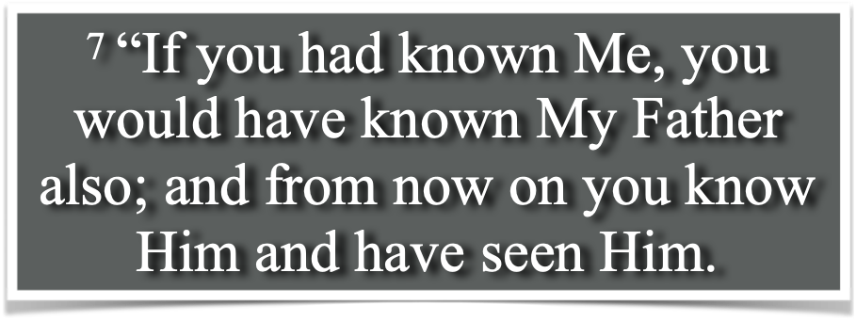
JESUS: The WAY, The TRUTH & The LIFE
Knowing JESUS…
15 “If you love Me, keep My commandments.
21 He who has My commandments and keeps them, it is he who loves Me. And he who loves Me will be loved by My Father, and I will love him and manifest Myself to him.”

Slide 22
JESUS: The WAY, The TRUTH & The LIFE
Knowing JESUS…
John 8:31–32 (NKJV)
³¹ Then Jesus said to those Jews who believed Him, “If you abide in My word, you are My disciples indeed. ³² And you shall know the truth, and the truth shall make you free.”

Slide 23
JESUS: The WAY, The TRUTH & The LIFE
Knowing JESUS…
You must believe what Christ tells you to believe, the truth, the gospel (Mk. 16:15; 1 Thess. 2:13)
You must confess Jesus as “the Christ, the Son of the Living God” (Rom. 10:9,10)
You must repent (Lk 13:3,5; Acts 17:30; etc.)

Slide 24
JESUS: The WAY, The TRUTH & The LIFE
Knowing JESUS…
You must obey Christ's command to be baptized:
"to be saved" (Mk. 16:16)
"for remission of sins" (Acts 2:38)
“sins washed away (Acts 22:16)
into His “death” (Rom 6:3)
"buried" with Him (Rom. 6:3-4)
"into Christ" (Gal. 3:27)

Slide 25
JESUS: The WAY, The TRUTH & The LIFE
Knowing JESUS…
Jesus is the true way; and He will add you to the church He established (Acts 2:41,47), not some denomination (Acts 20:29-39; Gal. 1:6-9)
We must worship the way Christ tells us to worship (John 4:23-24; Col 3:17).

Slide 26
JESUS IS THE ANSWER
Mark 4:39–41 (NKJV)
³⁹ Then He arose and rebuked the wind, and said to the sea, “Peace, be still!” And the wind ceased and there was a great calm. ⁴⁰ But He said to them, “Why are you so fearful? How is it that you have no faith?” ⁴¹ And they feared exceedingly, and said to one another, “Who can this be, that even the wind and the sea obey Him!”

Slide 27
Let NOT your heart be troubled (14:1)
Heaven is REAL & it’s accessible (14:2,3)
The way to heaven has been revealed and it is in & through Jesus Christ (John 14:5,6; Mark 16:16)
John 14:1-7
10 AM - Sunday, April 5, 2020

Slide 29
Charts by Don McClain / Preached April 5, 2020 AM
West 65th Street church of Christ - P.O. Box 190062 - Little Rock AR 72219 - Phone — 501-568-1062 — Email – donmcclain@sbcglobal.net
Prepared using Keynote / More Keynote, PPT & Audio Sermons:
www.w65stchurchofchrist.com
John 14:1-7
10 AM - Sunday, April 5, 2020

Slide 30
Philippians 4:4–13 (NKJV)
⁴ Rejoice in the Lord always. Again I will say, rejoice! ⁵ Let your gentleness be known to all men. The Lord is at hand. ⁶ Be anxious for nothing, but in everything by prayer and supplication, with thanksgiving, let your requests be made known to God; ⁷ and the peace of God, which surpasses all understanding, will guard your hearts and minds through Christ Jesus. ⁸ Finally, brethren, whatever things are true, whatever things are noble, whatever things are just, whatever things are pure, whatever things are lovely, whatever things are of good report, if there is any virtue and if there is anything praiseworthy—meditate on these things.

Slide 31
Philippians 4:4–13 (NKJV)
⁹ The things which you learned and received and heard and saw in me, these do, and the God of peace will be with you. ¹⁰ But I rejoiced in the Lord greatly that now at last your care for me has flourished again; though you surely did care, but you lacked opportunity. ¹¹ Not that I speak in regard to need, for I have learned in whatever state I am, to be content: ¹² I know how to be abased, and I know how to abound. Everywhere and in all things I have learned both to be full and to be hungry, both to abound and to suffer need. ¹³ I can do all things through Christ who strengthens me.

