Slide 1
OVERCOMING
FEAR & ANXIETY
Matthew 6:19–34

Slide 2
OVERCOMING
FEAR & ANXIETY
Ulcers
H.B.P. / Stroke
Heart Problems
ANXIETY causes MANY physical problems
Substance Abuse
Suicide

Slide 3
OVERCOMING
FEAR & ANXIETY
More Doubt
Distraction
Anger /Bitterness
ANXIETY INCREASES SPIRITUAL problems
No Joy / No Peace
Hopelessness

Slide 4
OVERCOMING
FEAR & ANXIETY
Psalm 56:3–4 (NKJV)
³ Whenever I am afraid, I will trust in You. ⁴ In God (I will praise His word), In God I have put my trust; I will not fear. What can flesh do to me?

Slide 5
OVERCOMING
FEAR & ANXIETY
Matthew 6:19–34 (NKJV)
¹⁹ “Do not lay up for yourselves treasures on earth, where moth and rust destroy and where thieves break in and steal; ²⁰ but lay up for yourselves treasures in heaven, where neither moth nor rust destroys and where thieves do not break in and steal. ²¹ For where your treasure is, there your heart will be also. ²² “The lamp of the body is the eye. If therefore your eye is good, your whole body will be full of light. ²³ But if your eye is bad, your whole body will be full of darkness. If therefore the light that is in you is darkness, how great is that darkness! ²⁴ “No one can serve two masters; for either he will hate the one and love the other, or else he will be loyal to the one and despise the other. You cannot serve God and mammon.

Slide 6
OVERCOMING
FEAR & ANXIETY
Matthew 6:19–34 (NKJV)
²⁵ “Therefore I say to you, do not worry about your life, what you will eat or what you will drink; nor about your body, what you will put on. Is not life more than food and the body more than clothing? ²⁶ Look at the birds of the air, for they neither sow nor reap nor gather into barns; yet your heavenly Father feeds them. Are you not of more value than they?

Slide 7
OVERCOMING
FEAR & ANXIETY
Matthew 6:19–34 (NKJV)
²⁷ Which of you by worrying can add one cubit to his stature? ²⁸ “So why do you worry about clothing? Consider the lilies of the field, how they grow: they neither toil nor spin; ²⁹ and yet I say to you that even Solomon in all his glory was not arrayed like one of these. ³⁰ Now if God so clothes the grass of the field, which today is, and tomorrow is thrown into the oven, will He not much more clothe you, O you of little faith?

Slide 8
OVERCOMING
FEAR & ANXIETY
Matthew 6:19–34 (NKJV)
³¹ “Therefore do not worry, saying, ‘What shall we eat?’ or ‘What shall we drink?’ or ‘What shall we wear?’ ³² For after all these things the Gentiles seek. For your heavenly Father knows that you need all these things. ³³ But seek first the kingdom of God and His righteousness, and all these things shall be added to you. ³⁴ Therefore do not worry about tomorrow, for tomorrow will worry about its own things. Sufficient for the day is its own trouble.

Slide 9
OVERCOMING
FEAR & ANXIETY
Matthew 6:19-24
Where Is Our Heart, Focus & Loyalty?
Are Our Priorities On Things That Will Last!!
Temporary
Eternal
Possessions?
Possessions?
Pleasure?
Pleasure?
Glory?
Glory?
Self Interest?
Self Interest?
Where is your Treasure?
Other People?
Other People?

Slide 10
OVERCOMING
FEAR & ANXIETY
If we prioritize, focus on, and pursue things of the world we will DESTROY our FAITH! — Mat. 13:20-22
Materialistic -19-21
Blinded - 22,23
Fruitless - 24
Anxious – 25-34

Slide 11
OVERCOMING
FEAR & ANXIETY
An unbelieving, (divided) heart produces doubt, guilt, fear & anxiety!
An unbelieving heart leaves one unequipped and unable to face the problems of life with confidence, contentment, hope and peace.
Produced By Materialistic Priorities

Slide 12
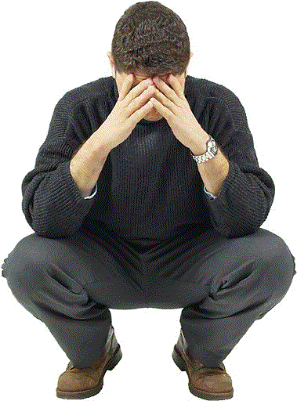
OVERCOMING
FEAR & ANXIETY
Jesus is NOT demanding:
We ignore problems.
Material things have no meaning, part or purpose in our lives.
Jesus is NOT forbidding:
Legitimate concerns.
Thoughtful planning.
Effort to make things better.

Slide 13
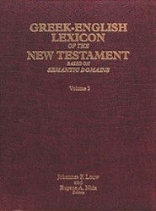
OVERCOMING
FEAR & ANXIETY
25.225 μεριμνάω: (derivative of μέριμνα ‘worry,’ 25.224) to have an anxious concern, based on apprehension about possible danger or misfortune—‘to be worried about, to be anxious about.’ τίς δὲ ἐξ ὑμῶν μεριμνῶν δύναται ἐπὶ τὴν ἡλικίαν αὐτοῦ προσθεῖναι πῆχυν; ‘can any of you live a bit longer by worrying about it?’ Lk 12:25; …
Louw Nida 25.225

Slide 14
OVERCOMING
FEAR & ANXIETY
“It is that anxious solicitude, that oppressive care, which springs from unbelieving doubts and misgivings, which alone is here condemned.”
Jamieson, R., Fausset, A. R., & Brown, D. (1997). Commentary Critical and Explanatory on the Whole Bible. Oak Harbor, WA: Logos Research Systems, Inc.

Slide 15
OVERCOMING
FEAR & ANXIETY
Be not anxious for your life (μη μεριμνατε τῃ ψυχῃ ὑμων [mē merimnate tēi psuchēi hūmōn]) . . . The verb μεριμναω [merimnaō] is from μερις, μεριζω [meris, merizō], because care or anxiety distracts and divides. It occurs in Christ’s rebuke to Martha for her excessive solicitude about something to eat (Luke 10:41).
Robertson, A. (1933). Word Pictures in the New Testament. Nashville, TN: Broadman Press.

Slide 16
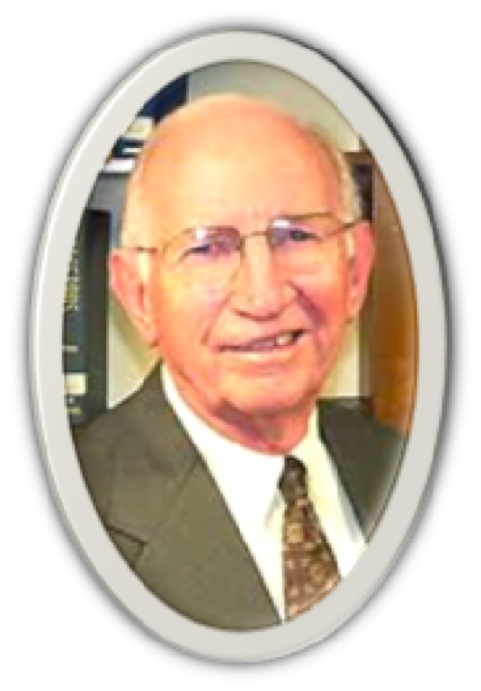
OVERCOMING
FEAR & ANXIETY
“Our fears, as affectively as our passions, have been allowed to consume our energies, dominate our lives, and steal away our hearts.”
[Paul Earnheart, “Invitation to A Spiritual Revolution” 106]

Slide 17
OVERCOMING
FEAR & ANXIETY
Matthew 13:22 (NKJV)
²² Now he who received seed among the thorns is he who hears the word, and the cares of this world and the deceitfulness of riches choke the word, and he becomes unfruitful.

Slide 18
OVERCOMING
FEAR & ANXIETY
Matthew 6:25 (NKJV)
²⁵ “Therefore I say to you, do not worry about your life, what you will eat or what you will drink; nor about your body, what you will put on. Is not life more than food and the body more than clothing?
“Therefore” -A connection between materialism and anxiety - cf. Luke 12:13-31 – (After the parable of the rich fool - Jesus taught on worry)
Anxiety reflects a lack of confidence in God! (Heb 13:5,6; Rom 8:28-38; 1 Pet 5:6,7; Phil 4:6-13)

Slide 19
OVERCOMING
FEAR & ANXIETY
Matthew 6:25 (NKJV)
²⁵ “Therefore I say to you, do not worry about your life, what you will eat or what you will drink; nor about your body, what you will put on. Is not life more than food and the body more than clothing?
Hebrews 13:5–6 (NKJV)
⁵ Let your conduct be without covetousness; be content with such things as you have. For He Himself has said, “I will never leave you nor forsake you.” ⁶ So we may boldly say: “The Lord is my helper; I will not fear. What can man do to me?”

Slide 20
OVERCOMING
FEAR & ANXIETY
Matthew 6:25 (NKJV)
²⁵ “Therefore I say to you, do not worry about your life, what you will eat or what you will drink; nor about your body, what you will put on. Is not life more than food and the body more than clothing?
Romans 8:28 (NKJV)
²⁸ And we know that all things work together for good to those who love God, to those who are the called according to His purpose.

Slide 21
OVERCOMING
FEAR & ANXIETY
Matthew 6:25 (NKJV)
²⁵ “Therefore I say to you, do not worry about your life, what you will eat or what you will drink; nor about your body, what you will put on. Is not life more than food and the body more than clothing?
Romans 8:28-38
Certainty of those justified being glorified (29-30).
If God is for us, who can be against us? (31)
God loved us and gave is Son that we may have eternal life (32-34).
Nothing can separate us from God’s love (35-39).
NOT EVEN DEATH (36,38).

Slide 22
OVERCOMING
FEAR & ANXIETY
Matthew 6:25 (NKJV)
²⁵ “Therefore I say to you, do not worry about your life, what you will eat or what you will drink; nor about your body, what you will put on. Is not life more than food and the body more than clothing?
1 Peter 5:6–7 (NKJV)
⁶ Therefore humble yourselves under the mighty hand of God, that He may exalt you in due time, ⁷ casting all your care upon Him, for He cares for you.

Slide 23
OVERCOMING
FEAR & ANXIETY
Matthew 6:25 (NKJV)
²⁵ “Therefore I say to you, do not worry about your life, what you will eat or what you will drink; nor about your body, what you will put on. Is not life more than food and the body more than clothing?
Philippians 4:6–7 (NKJV)
⁶ Be anxious for nothing, but in everything by prayer and supplication, with thanksgiving, let your requests be made known to God; ⁷ and the peace of God, which surpasses all understanding, will guard your hearts and minds through Christ Jesus.

Slide 24
OVERCOMING
FEAR & ANXIETY
Matthew 6:25 (NKJV)
²⁵ “Therefore I say to you, do not worry about your life, what you will eat or what you will drink; nor about your body, what you will put on. Is not life more than food and the body more than clothing?
Jesus repeated this command three times - Verses 25,31,34
Don’t worry about:
Food / drink - 25,31
Clothing - 25,31
Tomorrow - 34

Slide 25
OVERCOMING
FEAR & ANXIETY
Matthew 6:26 (NKJV)
²⁶ Look at the birds of the air, for they neither sow nor reap nor gather into barns; yet your heavenly Father feeds them. Are you not of more value than they?
"Look at the birds of the air . . ." - 26
An example of God's ability and willingness to provide through His providential workings in nature,
You are more valuable than birds!

Slide 26
OVERCOMING
FEAR & ANXIETY
Matthew 6:27 (NKJV)
²⁷ Which of you by worrying can add one cubit to his stature?
"Which of you by worrying can . . . ?" - 27
Illustrating The Helplessness Of Man (27)
Shows the absolute absurdity and futility of being fretful over things we have NO POWER TO CHANGE – Eccle. 1:15

Slide 27
OVERCOMING
FEAR & ANXIETY
Matthew 6:27 (NKJV)
²⁷ Which of you by worrying can add one cubit to his stature?
"Which of you by worrying can . . . ?" - 27
undo the past?
determine future events?
change the weather?
change another’s will?
make healthy what is sick?
stop aging?
stop the spread of a virus?

Slide 28
OVERCOMING
FEAR & ANXIETY
Matthew 6:28–29 (NKJV)
²⁸ “So why do you worry about clothing? Consider the lilies of the field, how they grow: they neither toil nor spin; ²⁹ and yet I say to you that even Solomon in all his glory was not arrayed like one of these.
"Consider the lilies of the field, how they grow" - 28,29
Again, an Argument For Confidence In The Providential Care Of God
"How They Grow..."?
"Will He Not Much More Clothe You?" - (Is He not able? Is He not willing?)

Slide 29
OVERCOMING
FEAR & ANXIETY
Matthew 6:30 (NKJV)
³⁰ Now if God so clothes the grass of the field, which today is, and tomorrow is thrown into the oven, will He not much more clothe you, O you of little faith?
"O You Of Little Faith?” (30)
More than just a vague principle - faith MUST be an active, practical force which affects the whole life – Mat 8:23-27
Faith enables us to see beyond the problem or threat - 2 Cor. 4:8-5:1

Slide 30
OVERCOMING
FEAR & ANXIETY
Matthew 6:31 (NKJV)
³¹ “Therefore do not worry, saying, ‘What shall we eat?’ or ‘What shall we drink?’ or ‘What shall we wear?’
Matthew 6:30 (NKJV)
³⁰ Now if God so clothes the grass of the field, which today is, and tomorrow is thrown into the oven, will He not much more clothe you, O you of little faith?

Slide 31
OVERCOMING
FEAR & ANXIETY
Matthew 6:32 (NKJV)
³² For after all these things the Gentiles seek. For your heavenly Father knows that you need all these things.
"For after all these things the Gentiles seek" - 32
Don't Worry About Food And Clothing (31-32)
People without God (the Gentiles) naturally worry about these things - WORRY fits their world view – “having no hope and without God in the world” - (Ep. 2:12)

Slide 32
OVERCOMING
FEAR & ANXIETY
Matthew 6:32 (NKJV)
³² For after all these things the Gentiles seek. For your heavenly Father knows that you need all these things.
A Faith problem – Do we not have enough faith in OUR GOD to provide –
Comfort in time of suffering?
Encouragement in the face of trials?
Support despite the circumstances?
Hope in the midst of despair?

Slide 33
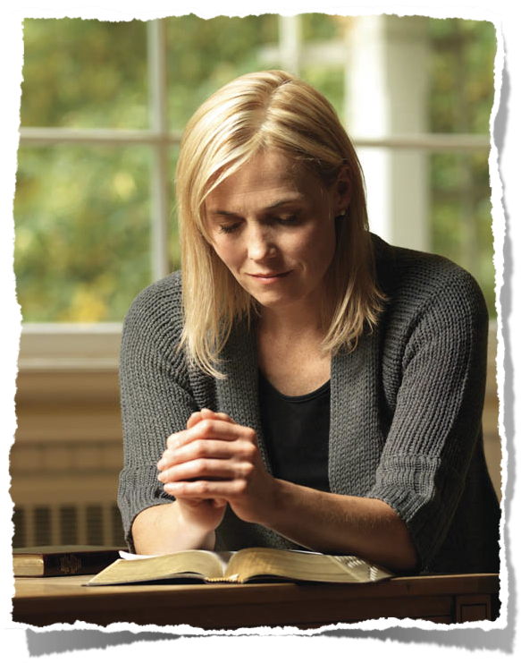
OVERCOMING
FEAR & ANXIETY
Externals lose their power over us when we, through the eyes of faith, focus upon the things of God!

Slide 34
OVERCOMING
FEAR & ANXIETY
Matthew 6:33 (NKJV)
³³ But seek first the kingdom of God and His righteousness, and all these things shall be added to you.
“Seek First The Kingdom Of God And His Righteousness” (33)
Only when the things of God truly become the most important things to us will we enjoy the true treasures and blessings of life! - Eccl. 12:13
If we seek the material first we will lose both it and eternity – Luke 18:18-23

Slide 35
OVERCOMING
FEAR & ANXIETY
Philippians 4:8–13 (NKJV)
⁸ Finally, brethren, whatever things are true, whatever things are noble, whatever things are just, whatever things are pure, whatever things are lovely, whatever things are of good report, if there is any virtue and if there is anything praiseworthy—meditate on these things.

Slide 36
OVERCOMING
FEAR & ANXIETY
Philippians 4:8–13 (NKJV)
⁹ The things which you learned and received and heard and saw in me, these do, and the God of peace will be with you. … ¹¹ Not that I speak in regard to need, for I have learned in whatever state I am, to be content: ¹² I know how to be abased, and I know how to abound.

Slide 37
OVERCOMING
FEAR & ANXIETY
Philippians 4:8–13 (NKJV)
Everywhere and in all things I have learned both to be full and to be hungry, both to abound and to suffer need. ¹³ I can do all things through Christ who strengthens me.

Slide 38
OVERCOMING
FEAR & ANXIETY
Philippians 4:6–13
PRAY (6)
BE THANKFUL (6)
SEEK GOD’S WILL (6)
DO RIGHT (7)
THINK RIGHT (8)
LEARN TO TRUST (9-13)

Slide 39
OVERCOMING
FEAR & ANXIETY
Matthew 6:34 (NKJV)
³⁴ Therefore do not worry about tomorrow, for tomorrow will worry about its own things. Sufficient for the day is its own trouble.
Today has enough trouble with which to concern yourself (34)
Let tomorrow take care of itself by trusting in God! – (James 4:13-17)
Live today for the Lord regardless of our circumstances (Heb 3:7-15; 4:6-9).

Slide 40
OVERCOMING
FEAR & ANXIETY
PLEASE - do not allow the concerns of today or tomorrow rob you of your eternal glory!

Slide 41
OVERCOMING
FEAR & ANXIETY
TODAY - Let us ALL Be MOST Concerned About & Focused On ETERNITY!!

Slide 42
OVERCOMING
FEAR & ANXIETY
Matthew 11:28–30 (NKJV)
²⁸ Come to Me, all you who labor and are heavy laden, and I will give you rest. ²⁹ Take My yoke upon you and learn from Me, for I am gentle and lowly in heart, and you will find rest for your souls. ³⁰ For My yoke is easy and My burden is light.”

Slide 43
OVERCOMING
FEAR & ANXIETY
Matthew 16:24–27 (NKJV)
²⁴ Then Jesus said to His disciples, “If anyone desires to come after Me, let him deny himself, and take up his cross, and follow Me. ²⁵ For whoever desires to save his life will lose it, but whoever loses his life for My sake will find it. ²⁶ For what profit is it to a man if he gains the whole world, and loses his own soul? Or what will a man give in exchange for his soul? ²⁷ For the Son of Man will come in the glory of His Father with His angels, and then He will reward each according to his works.

Slide 45
OVERCOMING
FEAR & ANXIETY
Charts by Don McClain / Preached March 15, 2020 AM
West 65th Street church of Christ - P.O. Box 190062 - Little Rock AR 72219 - Phone — 501-568-1062 — Email – donmcclain@sbcglobal.net
Prepared using Keynote / More Keynote, PPT & Audio Sermons:
www.w65stchurchofchrist.com

Slide 48
How Can I Have Peace?
With God
Hear Him, Believe Him, & Obey Him – Acts 2:38; 1 Pet 3:21
1st - be reconciled to God - then "pursue" peace with others - 1 Pe 3:8-12
Walk in the Spirit - Rom. 8:1; Gal. 5:16
With Others
With Self

Slide 49
Philippians 4:6–11 (NKJV)
⁶ Be anxious for nothing, but in everything by prayer and supplication, with thanksgiving, let your requests be made known to God; ⁷ and the peace of God, which surpasses all understanding, will guard your hearts and minds through Christ Jesus.

Slide 50
Philippians 4:6–11 (NKJV)
⁸ Finally, brethren, whatever things are true, whatever things are noble, whatever things are just, whatever things are pure, whatever things are lovely, whatever things are of good report, if there is any virtue and if there is anything praiseworthy—meditate on these things.

Slide 51
Philippians 4:6–11 (NKJV)
⁹ The things which you learned and received and heard and saw in me, these do, and the God of peace will be with you. ¹⁰ But I rejoiced in the Lord greatly that now at last your care for me has flourished again; though you surely did care, but you lacked opportunity. ¹¹ Not that I speak in regard to need, for I have learned in whatever state I am, to be content:

