Slide 1
Let The Bible Speak
“Answers To A Few Questions / Objections
Some Have Regarding The CHURCH of CHRIST”

Slide 2
Let The Bible Speak
“Answers To A Few Questions / Objections
Some Have Regarding The CHURCH of CHRIST”
1 Peter 3:15 (NKJV)
¹⁵ But sanctify the Lord God in your hearts, and always be ready to give a defense to everyone who asks you a reason for the hope that is in you, with meekness and fear;

Slide 3
The CHURCH of CHRIST
TEACHES …
BELIEVES …
IS …
FIRST …
TRUE or
The actual “church of Christ” has NO TEACHING / BELIEFS unique to itself apart from what the scriptures teach.
If a church teaches, believes and practices what the Bible teaches - then it is a church of Christ - if it does not, then it is NOT a church of Christ.

Slide 4
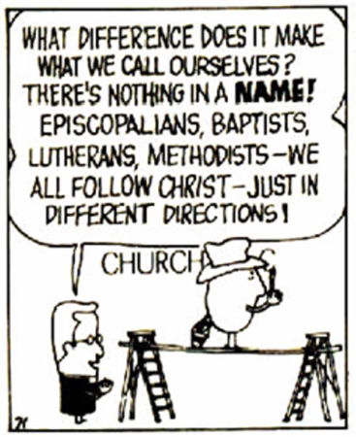
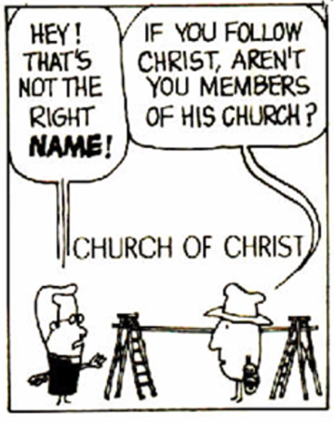
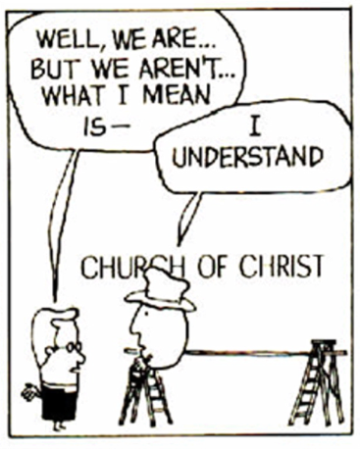
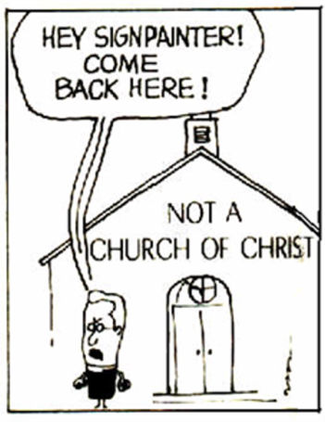
Theophilus
Don McClain
W. 65th St church of Christ

Slide 5
The CHURCH of CHRIST
TEACHES …
BELIEVES …
IS …
TRUE or
It has been a long standing practice for people to oppose, falsely accuse, misrepresent and even slander God's people.
Able (Genesis 4)
Job (Job 22:5-9)
David (Psalm 41:5-7; etc.)
Jesus (Matthew 12:9-45; etc.)
Paul (Romans 3:7,8; etc.)
The early church (Acts 19:9; 24:14)

Slide 6
The CHURCH of CHRIST
TEACHES …
BELIEVES …
IS …
Why We May falsely accuse other people?
Because we have a misunderstanding of the truth (John 7:41-44)
Because we have a misunderstanding of what one has said (Mat. 26:61,62; John 6:60-69)
Because we oppose the truth (John 5:31-59; 2 Thes. 2:10-12)
TRUE or

Slide 7
The CHURCH of CHRIST
TEACHES …
BELIEVES …
IS …
Unbelievers oppose truth
TRUE or
Acts 13:8–10 (NKJV)
⁸ But Elymas the sorcerer (for so his name is translated) withstood them, seeking to turn the proconsul away from the faith. ⁹ Then Saul, who also is called Paul, filled with the Holy Spirit, looked intently at him ¹⁰ and said, “O full of all deceit and all fraud, you son of the devil, you enemy of all righteousness, will you not cease perverting the straight ways of the Lord?

Slide 8
The CHURCH of CHRIST
TEACHES …
BELIEVES …
IS …
religious people often slander those who stand for the truth …
TRUE or
Acts 14:2 (NKJV)
² But the unbelieving Jews stirred up the Gentiles and poisoned their minds against the brethren.

Slide 9
The CHURCH of CHRIST
TEACHES …
BELIEVES …
IS …
Even this who profess to follow christ can be guilty of opposing the truth …
TRUE or
Galatians 5:11–12 (NKJV)
¹¹ And I, brethren, if I still preach circumcision, why do I still suffer persecution? Then the offense of the cross has ceased. ¹² I could wish that those who trouble you would even cut themselves off

Slide 10
“Answers To A Few Questions / Objections
Some Have Regarding The CHURCH of CHRIST”
False Accusation #1
The coC Teaches They Are The ONLY Ones Saved
“They think their denomination is better than all the rest”
“They think they are the ONLY ones who are right!”
“They demand you agree with them or be lost”
“When we get to heaven, don’t disturb them, they think they’re the only ones here.” LOL

Slide 11
“Answers To A Few Questions / Objections
Some Have Regarding The CHURCH of CHRIST”
False Accusation #1
The coC Teaches They Are The ONLY Ones Saved
Those who make statements such as this demonstrate they do not understand what the Bible teaches regarding the church. (Mat. 16:18; Acts 2:47; Eph. 5:23-25)
How can we get people to remove their "denominational glasses” and view the church from a scriptural perspective?

Slide 12
“Answers To A Few Questions / Objections
Some Have Regarding The CHURCH of CHRIST”
Those In Christ’s Church Are The Saved According To The Bible (Acts 2:47)
The church of the Bible knew nothing of “denominations” (Mt 16:18; Eph 1:22,23; 4:4-6; 5:23-25; 1 Cor. 1:10)
Let us appeal only to God, for He is right (Rom 3:4; 2 Tim. 2:15; 3:16,17; 1 Cor. 4:6)
I plead with people to believe & follow only the scriptures (Ac 17:11; 2 Tim 4:2)
Only those who abide in the teachings of Jesus will be in heaven (Mat 7:13,14, 21-23; 25:31-46; Heb 5:8.9; 2 Jn. 9)
Let The Bible Speak

Slide 13
“Answers To A Few Questions / Objections
Some Have Regarding The CHURCH of CHRIST”
False Accusation #2
The coC doesn’t believe in the Holy Spirit
“They deny the work of the Spirit in conversion”
“They deny the indwelling of the Holy Spirit”
“They deny miraculous gifts / they do not believe in miracles”
“They deny Holy Spirit baptism”

Slide 14
“Answers To A Few Questions / Objections
Some Have Regarding The CHURCH of CHRIST”
The Lord’s Church Believes In The Holy Spirit! (Acts 19:1-5)
The Holy Spirit converts through the gospel (Ac 2; 8; 10; 16; 18; Rom 10:4-17; 2 Thes 2:13,14; Eph 3:3-5)
The indwelling of the Holy Spirit is a relationship - not possession! (Rom 8; 1 John 2:24-28; etc)
Miracles were to confirm the truth and then cease (Mark 16:20; Hebrews 2:1-4; 1 Cor. 13:8-13)
Holy Spirit baptism occurred 2 times for a specific purpose (Acts 2 & 10; Eph 4:5)
Let The Bible Speak

Slide 15
“Answers To A Few Questions / Objections
Some Have Regarding The CHURCH of CHRIST”
False Accusation #3
The coC believes water saves people …
“They deny that it is the blood of Jesus that saves.”
“The thief on the cross wasn’t baptized”
“It is spiritual baptism that saves, not water baptism”
“Baptism doesn’t save”

Slide 16
“Answers To A Few Questions / Objections
Some Have Regarding The CHURCH of CHRIST”
The Bible teaches immersion in water is necessary unto salvation (Mark 16:16)
Jesus said “He who believes and is baptized will be saved” (Mark 16:16)
Peter said “baptism now saves us … through Jesus’s resurrection” (1 Pet 3:21)
The Bible teaches that when a believer is baptized he contacts the death, (blood) of Jesus (Rom 6:3-6, 16-18)
Peter told those on Pentecost to “repent and be baptized in the name of Jesus for the remission of sins” (Acts 2:38) and continued to be practiced …
Let The Bible Speak

Slide 17
Baptism in the name of Jesus was commanded and practiced after Jesus’s resurrection and part of the great commission (Mat. 28:19; Mark 16:16; Acts 2:38;
Examples
Pentecost – 2:14-41
Samaria – 8:5-13
Eunuch – 8:35-39
Saul – 9,22,26
Cornelius - 10:34-48
Lydia – 16:13-15
Jailor – 16:30-34
Corinthians - 18:8
Ephesians - 19:3-5
Believed
Implied
12
36,37
Implied
43
14
31
8
Implied
Repented
37,38
Implied
Implied
Implied
Implied
Implied
Implied
Implied
Implied
Confessed
Implied
Implied
37
Implied
Implied
Implied
Implied
Implied
Implied
Baptized
38,41
12,13
38
9:18
48
15
33
8
5

Slide 18
“Answers To A Few Questions / Objections
Some Have Regarding The CHURCH of CHRIST”
False Accusation #4
The coC Teaches “WORKS Salvation” …
“They do not believe we are saved by grace alone, through faith alone and Christ alone.”
“They don’t believe John 3:16 or Romans 5:1 or 10:9,10”
“They do not believe in the finished work of Christ.”

Slide 19
“Answers To A Few Questions / Objections
Some Have Regarding The CHURCH of CHRIST”
The Bible Teaches We Are Saved Through A Faith That Obeys (James 2:14-26)
Salvation by grace through faith does NOT eliminate divinely ordained conditions, such as baptism (Gen. 6:8ff; Jos. 6:2ff; Heb. 11:6,7,30; Acts 2:38)
What is received by an obedient faith is of faith (John 3:16; etc. Heb. 11:30)
The provision of salvation was made once for all, (Heb. 9:28; Rom. 6:10), but I must receive it through an obedient faith (Romans 6:16-18; James 2:14-26; Heb. 5:8,9; Luke 6:46; etc.)
Let The Bible Speak

Slide 20
The
of
The
Basis of
(Not of
WORKS)
God's Universal Kindness, Love &
Mercy.
The Gracious
Gift of God’s Son & The Gospel -
Salvation
The
Provision
of
(Not of
WORKS)
The
Conditions We MUST meet
(WORKS)
Faith – (Repent – Confess – Be baptized - Persevere)

Slide 21
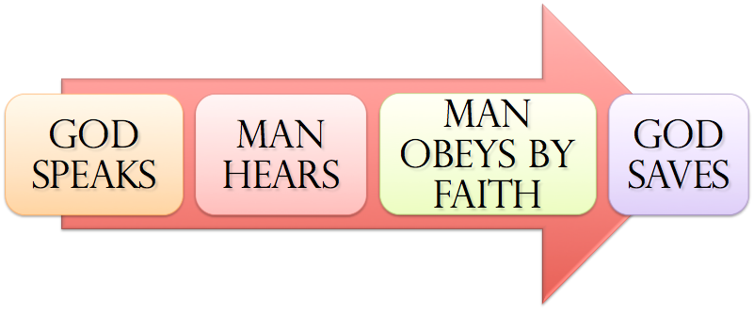
The
of
SAME principle In EVERY Age …
Noah - Gen. 6:8,13-17; 22; 7:5; Heb 11:7
Abraham – Gen 12:4; 15:6; 17:10,23; 22:3,16-18
Israel – Ex. 12:13; 14:30; Dt 30:15-19; Jos 6; 1 Cor 10:1-13
Us – Mark 16:16; Acts 2:38; 8:12,37; Rom 6:3-6; 10:9-13; Gal. 3:26,27; Col. 2:11-13; 1 Pet 3:21; 1 Jn 1:9

Slide 22
“Answers To A Few Questions / Objections
Some Have Regarding The CHURCH of CHRIST”
False Accusation #5
The coC Doesn’t Believe In Music …
“The Bible no where condemns musical instruments so the coC adds their prohibition to the Bible.”
“David used musical instruments in worship and that was OK, so the coC takes away from the Bible.”
“The coC has pews, song books, and all kinds of stuff that the Bible does not specifically mention”

Slide 23
“Answers To A Few Questions / Objections
Some Have Regarding The CHURCH of CHRIST”
The Bible Teaches Us To Sing
The Bible tells what God wants and it does not list everything He doesn’t (2 Tim. 3:16,17; 1 Cor. 4:6)
David also burned animal sacrifices according to the OT. We are not under the types and shadows of the OT - we are to worship according to the spiritual realities of the NC (Jn 4:24; Heb 9:9,10)
The NT authorizes singing, not playing (Eph. 5:19; Col. 3:16,17)
The church knew this for 1500 years.
Let The Bible Speak

Slide 24
“Answers To A Few Questions / Objections
Some Have Regarding The CHURCH of CHRIST”
More False Accusations & Misrepresentations
The church of Christ was started by Alexander Campbell … (So did Jesus build and add the saved to somebody else’s church? Mat. 16:18; Acts 2:47)
The church of Christ is legalistic and pharisaical … (Is obedience bad? Hypocrisy is bad - but obedience to Christ is not! Luke 6:46)
The church of Christ is a cult … (Be careful when using slander to destroy another - the truth will eventually win. Prov. 11:9)

Slide 25
ANY CHURCH BELONGING TO CHRIST
TEACHES …
BELIEVES …
IS …
Those in Christ’s church are the saved (Acts 2:47; Eph. 5:23-25)
The Holy Spirit convicts, converts and sanctifies men through the gospel (2 Thes. 2:13,14)
Immersion in water in obedience to Jesus is necessary unto salvation (Mark 16:16; Acts 2:38; Rom. 6:3-6; etc.)
We are saved through an obedient faith (Jam 2:14-26)
The Bible teaches us to sing (Eph. 5:19)
Faithful to Jesus (Eph. 5:24)
Let The Bible Speak

Slide 26
ANY CHURCH BELONGING TO CHRIST
TEACHES …
BELIEVES …
IS …
We should want to teach ONLY the things taught in the Scriptures.
We should desire to believe ONLY what is revealed in the Scriptures.
We should aspire to be ONLY what the scriptures instruct us to be.
Let The Bible Speak

Slide 27
Let The Bible Speak
“Answers To A Few Questions / Objections
Some Have Regarding The CHURCH of CHRIST”
1 Peter 3:15 (NKJV)
¹⁵ But sanctify the Lord God in your hearts, and always be ready to give a defense to everyone who asks you a reason for the hope that is in you, with meekness and fear;
Are you in Christ’s church?
Are you in Faithful To Christ?

Slide 29
Let The Bible Speak
“Answers To A Few Questions / Objections
Some Have Regarding The CHURCH of CHRIST”
Charts by Don McClain
Preached April 19, 2020 AM
West 65th Street church of Christ - P.O. Box 190062 - Little Rock AR 72219 - Phone — 501-568-1062 — Email – donmcclain@sbcglobal.net
Prepared using Keynote / More Keynote, PPT & Audio Sermons:
www.w65stchurchofchrist.com

Slide 30
1 Peter 3:13–17 (NKJV)
¹³ And who is he who will harm you if you become followers of what is good? ¹⁴ But even if you should suffer for righteousness’ sake, you are blessed. “And do not be afraid of their threats, nor be troubled.” ¹⁵ But sanctify the Lord God in your hearts, and always be ready to give a defense to everyone who asks you a reason for the hope that is in you, with meekness and fear; ¹⁶ having a good conscience, that when they defame you as evildoers, those who revile your good conduct in Christ may be ashamed. ¹⁷ For it is better, if it is the will of God, to suffer for doing good than for doing evil.

