Slide 1
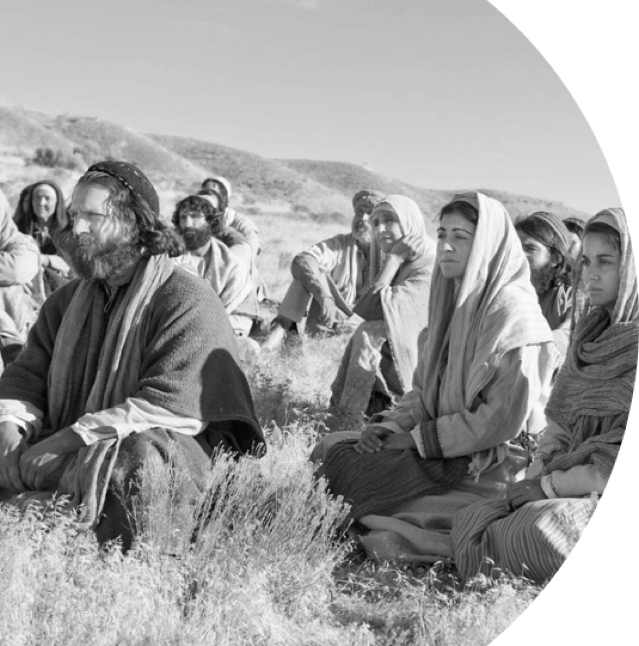
The Sermon On The Mount
And
MARRIAGE

Slide 2
The Sermon On The Mount
And
MARRIAGE
HOME
CHURCH
NATION
MARRIAGE
FOUNDATIONS

Slide 3
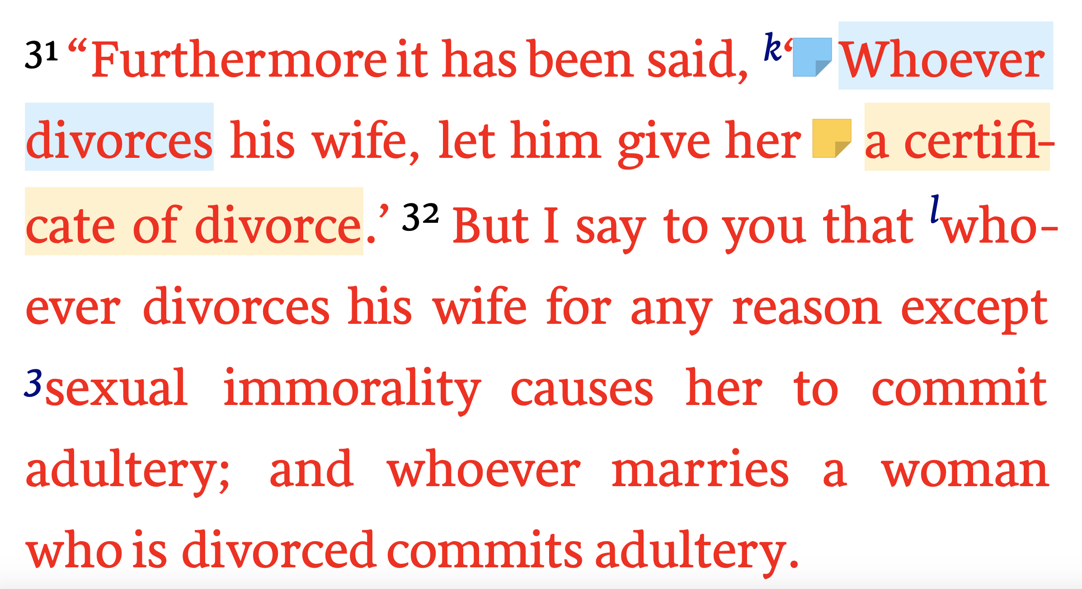
The Sermon On The Mount
And
MARRIAGE
Matthew 5:31–32 (NKJV)

Slide 4
The Sermon On The Mount
And
MARRIAGE
Sin Involved In Every Divorce (Mat. 5:31,32)
Dishonors God — (Gen 2:21-24; Mat 19:4-6; Prov. 14:2)
Violates the law of love — (Eph 5:25; Col. 3:19; 1 Pet 3:7; Tit. 2:4)
Harms put away spouse — (Mal. 2:14,16; Mat 5:31,32)
Harms self — (Is. 59,1,2; Gal 6:7-9)
Harms children — (Mal. 2:15)
Harms society as a whole — (Mal. 2:15; Prov. 14:34; Mat. 19:9)

Slide 5
The Sermon On The Mount
And
MARRIAGE
Genesis 2:18–24 (NKJV)
¹⁸ And the Lord God said, “It is not good that man should be alone; I will make him a helper comparable to him.” ¹⁹ Out of the ground the Lord God formed every beast of the field and every bird of the air, and brought them to Adam to see what he would call them. And whatever Adam called each living creature, that was its name. ²⁰ So Adam gave names to all cattle, to the birds of the air, and to every beast of the field. But for Adam there was not found a helper comparable to him. ²¹ And the Lord God caused a deep sleep to fall on Adam, and he slept; and He took one of his ribs, and closed up the flesh in its place. ²² Then the rib which the Lord God had taken from man He made into a woman, and He brought her to the man. ²³ And Adam said: “This is now bone of my bones And flesh of my flesh; She shall be called Woman, Because she was taken out of Man.” ²⁴ Therefore a man shall leave his father and mother and be joined to his wife, and they shall become one flesh.

Slide 6
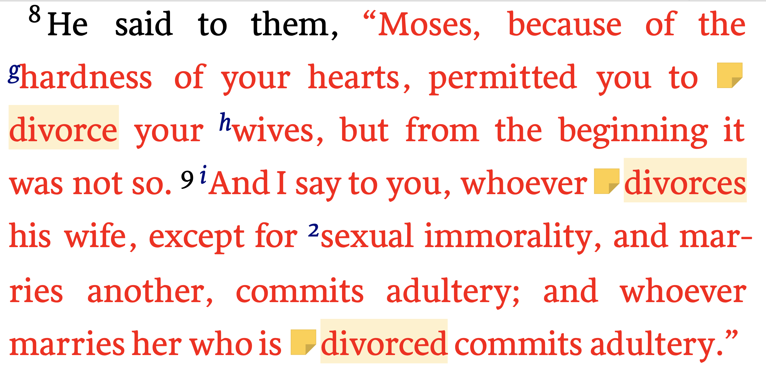
The Sermon On The Mount
And
MARRIAGE
Matthew 19:8–9 (NKJV)

Slide 7
The Sermon On The Mount
And
MARRIAGE
Malachi 2:14–16 (NKJV)
¹⁴ Yet you say, “For what reason?” Because the Lord has been witness Between you and the wife of your youth, With whom you have dealt treacherously; Yet she is your companion And your wife by covenant. ¹⁵ But did He not make them one, Having a remnant of the Spirit? And why one? He seeks godly offspring. “Therefore take heed to your spirit, And let none deal treacherously with the wife of his youth. ¹⁶ “For the Lord God of Israel says That He hates divorce, For it covers one’s garment with violence,” Says the Lord of hosts. Therefore take heed to your spirit, That you do not deal treacherously.”

Slide 8
The Sermon On The Mount
And
MARRIAGE
1 Corinthians 7:10–11 (NKJV)
¹⁰ Now to the married I command, yet not I but the Lord: A wife is not to depart from her husband. ¹¹ But even if she does depart, let her remain unmarried or be reconciled to her husband. And a husband is not to divorce his wife.
Hebrews 13:4 (NKJV)
⁴ Marriage is honorable among all, and the bed undefiled; but fornicators and adulterers God will judge.

Slide 9
The Sermon On The Mount
And
MARRIAGE
Ephesians 5:22–25 (NKJV)
²² Wives, submit to your own husbands, as to the Lord. ²³ For the husband is head of the wife, as also Christ is head of the church; and He is the Savior of the body. ²⁴ Therefore, just as the church is subject to Christ, so let the wives be to their own husbands in everything. ²⁵ Husbands, love your wives, just as Christ also loved the church and gave Himself for her,

Slide 10
The Sermon On The Mount
And
MARRIAGE
How To Have A BLESSED LIFE
True blessedness & success is ONLY achieved by the godly!
Our character and behavior will determine whether we will enjoy the fruit of true blessedness or the bitterness of ultimate failure!
IF a husband & wife apply the Lord’s teachings to their own lives, they will experience true success - including a successful life together!

Slide 11
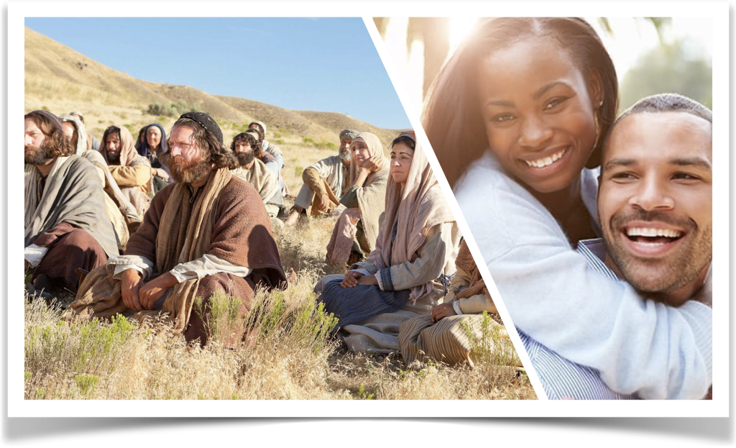
The Sermon On The Mount
And
MARRIAGE
How To Have A BLESSED MARRIAGE
Following Christ by developing godly attitudes & character - 5:1-12
Following Christ by seeking to please and honor God, not ourselves - 6:1-34
Following Christ by being Christ-like in how how we treat others - 5:13-48
Following Christ by focusing on conforming ourselves to God’s will - 7:1-27

Slide 12
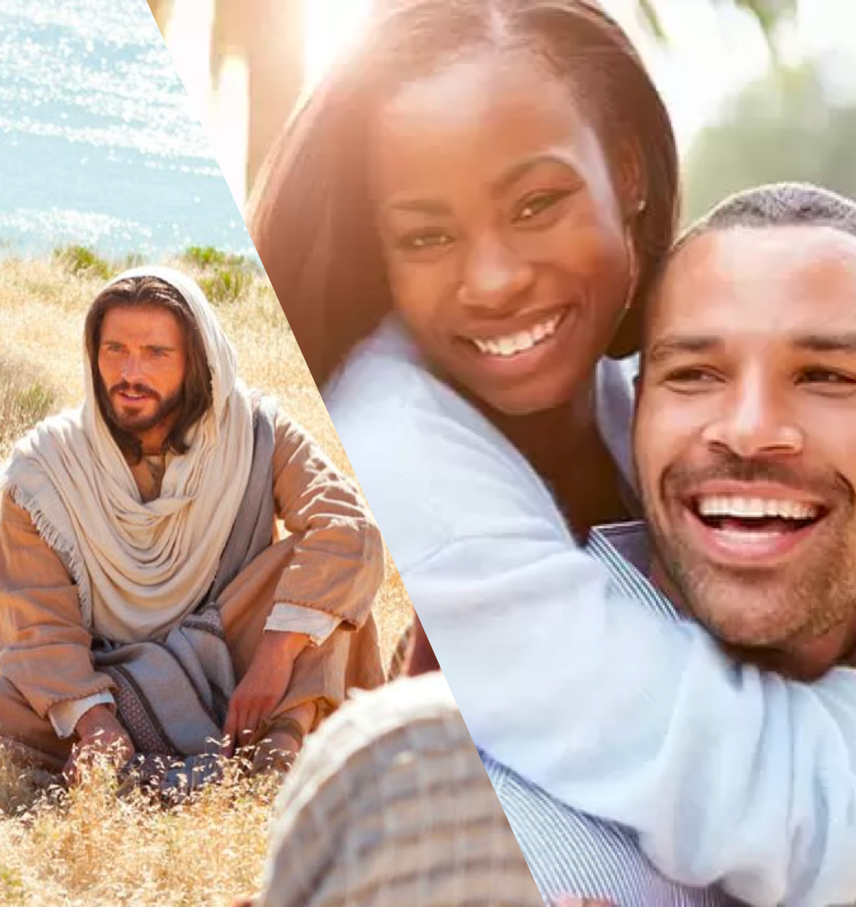
The Sermon On The Mount
And
MARRIAGE
developing godly attitudes & character (5:1-12)
Humility (3)
Sorrow for wrongs (4)
Submissive (5)
Seek righteousness (6)
Merciful, forgiving (7)
Purity, sincere, holy (8)
Seek path of peace (9)
Endurance (10-12)

Slide 13
The Sermon On The Mount
And
MARRIAGE
Christ-like In how We treat others - 5:13-48
Our influence (13-16)
Doing what is RIGHT from the heart (17-20)
Control anger (21-26)
Guard your thoughts, desires, and circumstances (27-30)
Protect your spouse (31-32)
Keep your promises (33-37)
Never retaliate (38-42)
LOVE [VALUE] them (43-48)

Slide 14
The Sermon On The Mount
And
MARRIAGE
seeking to please & honor GOD - 6:1-34
Charitable deeds (1-4)
Prayer / Forgiving (5-15)
Worship / Sacrifice (16-18)
Treasure / Focus / Loyalty / [1st God, then each other](19-24)
Don’t be anxious, TRUST God (25-32)
Put God first (33-34)

Slide 15
The Sermon On The Mount
And
MARRIAGE
conform ourselves to God’s will - 7:1-27
Refrain from critical judgment, blame and condescension, focus on SELF (7:1-6)
When problems arise, sincerely SEEK GOD’s HELP by applying His word to your life (7-11)
The GOLDEN RULE (12)
Seek and walk in truth (13,14)
Beware of LIARS (15-20)
Build your lives TOGETHER on Jesus Christ (21-27)

Slide 16
The Sermon On The Mount
And
MARRIAGE
conform ourselves to God’s will - 7:1-27
Submission to God’s order - (Eph. 5:21-31; 1 Pet. 3:1-7)
Learning contentment WITHIN God’s will – (Phili. 4:11-13; Ep. 5:21-31; 1 Pt 3:1-7)
Honoring our Promises, commitment, covenant – (Prov 2:17; Eccl. 5:4,5)

Slide 17
The Sermon On The Mount
And
MARRIAGE
Following Christ by developing godly attitudes & character - 5:1-12
Following Christ by being Christ-like in how how we treat others - 5:13-48
Following Christ by seeking to please and honor God, not ourselves - 6:1-34
Following Christ by focusing on conforming ourselves to God’s will - 7:1-27

Slide 18
The Sermon On The Mount
And
MARRIAGE
A Happy & Successful Marriage is not determined by the perfection of our partner, but the level of OUR COMMITMENT to the Lord & to them.

Slide 19
The Sermon On The Mount
And
MARRIAGE
Marriage Is A Divine Institution & Governed By The Laws Of God –
Marriage Is To Be A Life-Long Union Between One Man and One Woman -

Slide 20
The Sermon On The Mount
And
MARRIAGE
Serving God In Our Marriage Means That We Become The Husbands & Wives God Wants Us to Become.

Slide 22
The Sermon On The Mount
And
MARRIAGE
Charts by Don McClain / Preached August 2, 2020 AM
West 65th Street church of Christ - P.O. Box 190062 - Little Rock AR 72219 - Phone — 501-568-1062 — Email – donmcclain@sbcglobal.net
Prepared using Keynote / More Keynote, PPT & Audio Sermons:
www.w65stchurchofchrist.com

