Slide 1
“The Church of Christ - GOD’s TEMPLE”
(1 Peter 2:4-10; 1 Corinthians 3:16,17; 2 Corinthians 3:9-11; 6:14-7:1; Ephesians 2:20-22)

Slide 2
“The Church of Christ - GOD’s TEMPLE”
(1 Peter 2:4-10; 1 Corinthians 3:16,17; 2 Corinthians 3:9-11; 6:14-7:1; Ephesians 2:20-22)
The CHURCH Described In Different Ways
A BRIDE
A FLOCK
The CHURCH
A KINGDOM
A BODY
A TEMPLE

Slide 3
“The Church of Christ - GOD’s TEMPLE”
(1 Peter 2:4-10; 1 Corinthians 3:16,17; 2 Corinthians 3:9-11; 6:14-7:1; Ephesians 2:20-22)
1 Corinthians 3:16–17 (NKJV)
¹⁶ Do you not know that you are the temple of God and that the Spirit of God dwells in you? ¹⁷ If anyone defiles the temple of God, God will destroy him. For the temple of God is holy, which temple you are.

Slide 4
The TABERNACLE - MOSES
"Look that thou make them after their pattern, which was showed thee in the mount" (Exodus 25.)
Mobile / Temporary

Slide 5
SOLOMON’s PRE-EXHILIC TEMPLE
"All this, said David, the Lord made me understand in writing by his hand upon me, even all the works of this pattern” (1 Chronicles 28:11-19)
Solomon’s temple was begun in 966 BC (1 Kings 6:1) and was used for nearly 400 years until destroyed by Nebuchadnezzar in 586 BC 2 Kings 25:1-12).

Slide 6
POST-EXHILIC TEMPLE
Zerubbabel and Jeshua (Ezra 3:8-11) starting in 536 BC and finishing in 520 BC (Ezra 6:15). This temple was in use until about 20 BC.
³ ‘Who is left among you who saw this temple in its former glory? And how do you see it now?
Haggai 2:3; cf. Ezra 3:12

Slide 7
POST-EXHILIC TEMPLE
HEROD’s TEMPLE

Slide 9
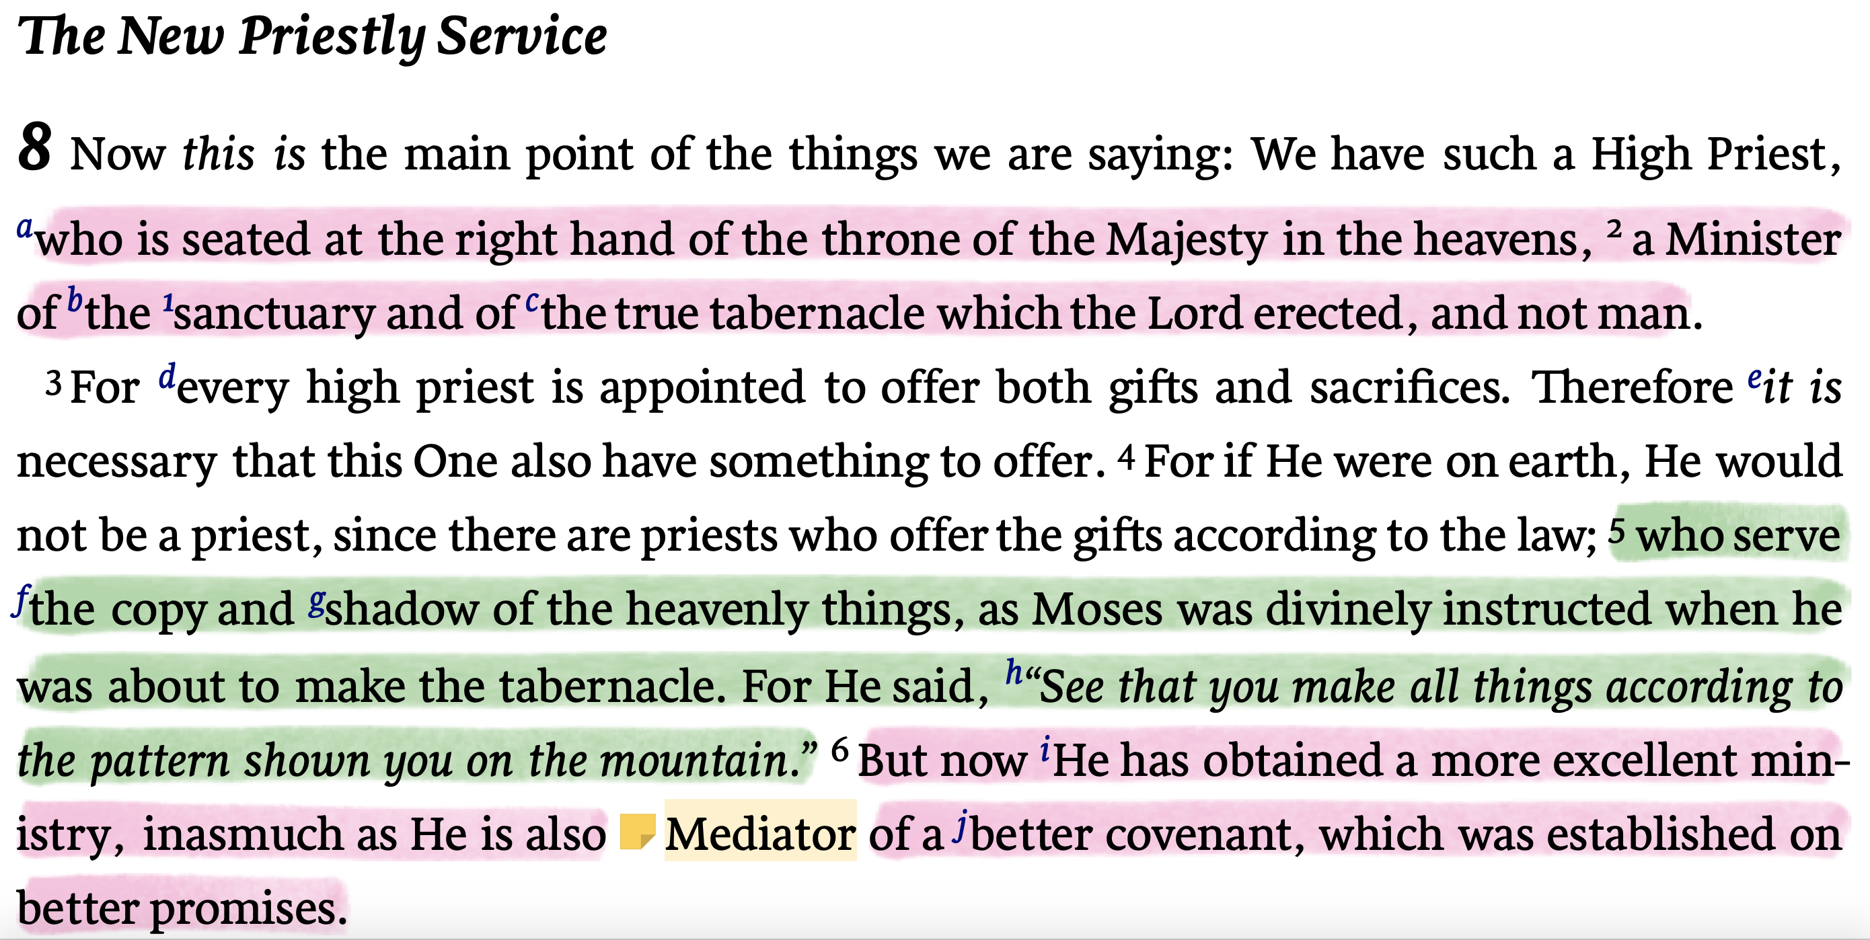
“The Church of Christ - GOD’s TEMPLE”
(1 Peter 2:4-10; 1 Corinthians 3:16,17; 2 Corinthians 3:9-11; 6:14-7:1; Ephesians 2:20-22)
JESUS THE BUILDER & OUR HIGH PRIEST
Hebrews 8:1-6 (NKJV)

Slide 10
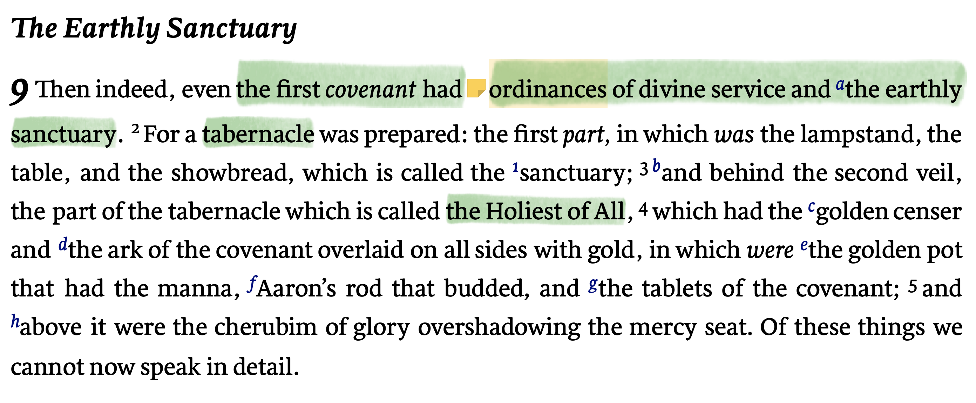
“The Church of Christ - GOD’s TEMPLE”
(1 Peter 2:4-10; 1 Corinthians 3:16,17; 2 Corinthians 3:9-11; 6:14-7:1; Ephesians 2:20-22)
JESUS THE BUILDER & OUR HIGH PRIEST
Hebrews 9:1-15 (NKJV)

Slide 11
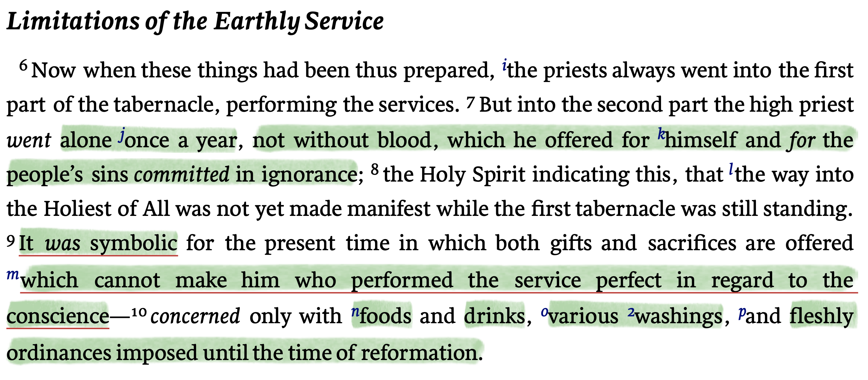
“The Church of Christ - GOD’s TEMPLE”
(1 Peter 2:4-10; 1 Corinthians 3:16,17; 2 Corinthians 3:9-11; 6:14-7:1; Ephesians 2:20-22)
JESUS THE BUILDER & OUR HIGH PRIEST
Hebrews 9:1-15 (NKJV)

Slide 12
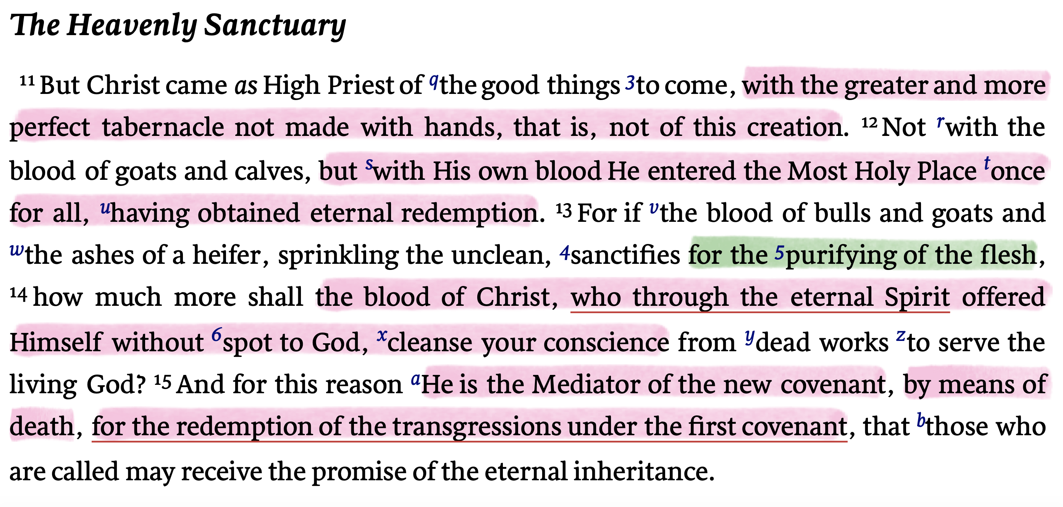
“The Church of Christ - GOD’s TEMPLE”
(1 Peter 2:4-10; 1 Corinthians 3:16,17; 2 Corinthians 3:9-11; 6:14-7:1; Ephesians 2:20-22)
JESUS THE BUILDER & OUR HIGH PRIEST
Hebrews 9:1-15 (NKJV)

Slide 13
“The Church of Christ - GOD’s TEMPLE”
(1 Peter 2:4-10; 1 Corinthians 3:16,17; 2 Corinthians 3:9-11; 6:14-7:1; Ephesians 2:20-22)
JESUS THE BUILDER & OUR HIGH PRIEST
The tabernacle & its furniture was a figure of that which was to come. (Heb 9:5)
The Levitical arrangements were designed to convey the idea that the true way to God was not found in them - but in something yet to come - Jesus - (Mt 27:51; Mk 15:38)
These were symbolic - outward signs without power - compare & contrast with 10:22 & 1 Pet 3:21.

Slide 14
“The Church of Christ - GOD’s TEMPLE”
(1 Peter 2:4-10; 1 Corinthians 3:16,17; 2 Corinthians 3:9-11; 6:14-7:1; Ephesians 2:20-22)
JESUS THE BUILDER & OUR HIGH PRIEST
The tabernacle, with all its furnishings & priestly services was itself an argument for its temporary nature.
These things had no power without the blood of Christ & His service - Col 2:14-17
The O.T. system was for a limited period & was ending - the time of reformation had come. - Mt 5:17,18; 19:28-30

Slide 15
“The Church of Christ - GOD’s TEMPLE”
(1 Peter 2:4-10; 1 Corinthians 3:16,17; 2 Corinthians 3:9-11; 6:14-7:1; Ephesians 2:20-22)
JESUS THE BUILDER & OUR HIGH PRIEST
His priesthood is in a greater tabernacle - (Hebrews 9:11-15)
Jesus, our High Priest - (2:17; 3:1; 4:14; 5:5,10; 6:20; 7:26-28; 8:1,2)
Christ has entered heaven itself - 8:2; 9:24; Rev 11:19; 15:5
By “His own blood He entered the Most Holy Place once for all” - He did not have to offer daily or yearly sacrifices - His one time sacrifice is sufficient for all time - 7:27; 9:26-28

Slide 16
“The Church of Christ - GOD’s TEMPLE”
(1 Peter 2:4-10; 1 Corinthians 3:16,17; 2 Corinthians 3:9-11; 6:14-7:1; Ephesians 2:20-22)
JESUS THE BUILDER & OUR HIGH PRIEST
His priesthood is in a greater tabernacle - (Hebrews 9:11-15)
Jesus willingly became flesh so He could give Himself for us that we can be saved from our sins & have eternal life (Jn 1:14; 3:16; Eph 2:1; Phili 2:6-8; Heb 2:9-18; 10:5)
He offered Himself without spot to God (1 Pet 1:18,19; 2:22-24; Heb 4:15; 7:26,27)
Without the death of Jesus there could be no remission of sins - no fellowship with God (Rom 3:23-25)

Slide 17
“The Church of Christ - GOD’s TEMPLE”
(1 Peter 2:4-10; 1 Corinthians 3:16,17; 2 Corinthians 3:9-11; 6:14-7:1; Ephesians 2:20-22)
JESUS THE BUILDER & OUR HIGH PRIEST
His priesthood is in a greater tabernacle - (Hebrews 9:11-15)
Had eternal life been possible through the OC there would have been no need for the NC (Heb 7:22; 8:6; 12:24)
Through the blood of Jesus we have “redemption” and through His “endless life” we have an inheritance that is “eternal” (Heb 9:12,15)
The endless life of Christ is placed in contrast with the perishable life of the priests & efficacy of OT sacrifices.

Slide 18
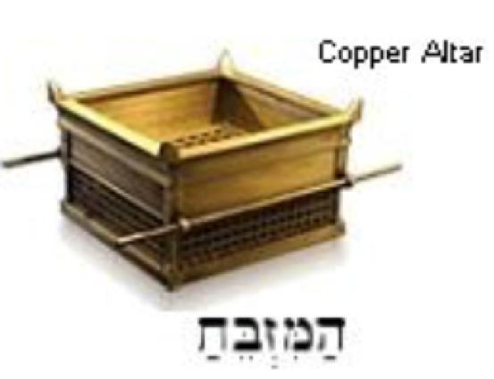
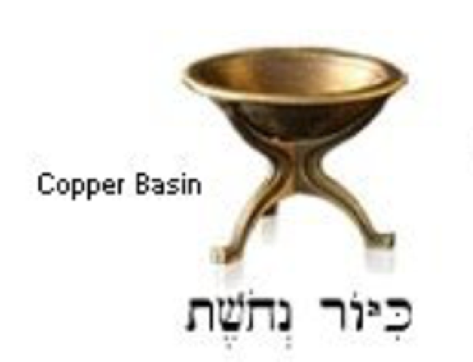
“The Church of Christ - GOD’s TEMPLE”
(1 Peter 2:4-10; 1 Corinthians 3:16,17; 2 Corinthians 3:9-11; 6:14-7:1; Ephesians 2:20-22)
JESUS THE BUILDER & OUR HIGH PRIEST
The furnishings of the tabernacle had typological value, but the author could not discuss these things in detail at the time (Heb. 9:5).
The SACRIFICE: Jesus died for our sins - the provision has been provided once for all (Heb 9:11-14, 23-28)
CLEANSING: The washing of regeneration, baptism unto the remission of sins necessary to enter (Acts 2:38; Rom. 6:3-6; Heb. 9:9,10 & 1 Pet 3:20,21)
Outside the tabernacle
Cleansing necessary to enter

Slide 19
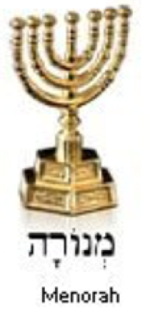
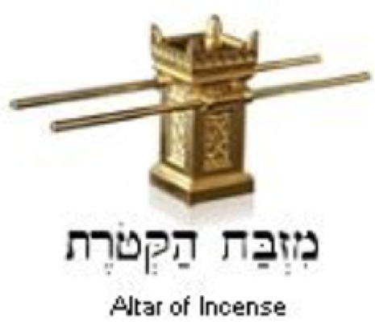
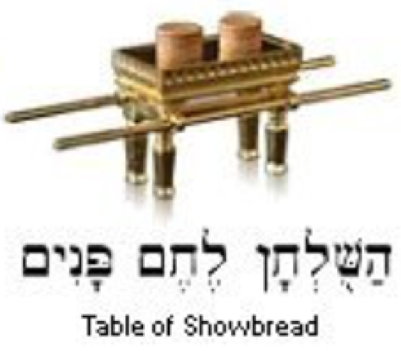
“The Church of Christ - GOD’s TEMPLE”
(1 Peter 2:4-10; 1 Corinthians 3:16,17; 2 Corinthians 3:9-11; 6:14-7:1; Ephesians 2:20-22)
JESUS THE BUILDER & OUR HIGH PRIEST
The furnishings of the tabernacle had typological value, but the author could not discuss these things in detail at the time (Heb. 9:5).
LIGHT: Christ gives light through His teachings revealed by the Spirit in the NT (Ps 119:105; Jn 6:63; Eph. 3:3-5; 1 Jn 1:5-9)
PROPITIATION: Jesus brought us near the Father. NOW our prayers, worship and lives are accepted (Heb. 10:20; 13:10,15; Rom 12:1,2; Rev. 5:8)
COMMUNION: We have fellowship with God through Christ (Mat 26:28; Ep. 2:16)

Slide 20
“The Church of Christ - GOD’s TEMPLE”
(1 Peter 2:4-10; 1 Corinthians 3:16,17; 2 Corinthians 3:9-11; 6:14-7:1; Ephesians 2:20-22)
JESUS THE BUILDER & OUR HIGH PRIEST
The furnishings of the tabernacle had typological value, but the author could not discuss these things in detail at the time (Heb. 9:5).
The NEW COVENANT: Mercy & salvation in Christ via the gospel (Rom 1:16,17)
Jesus is in heaven making intercession for us (Heb 4:15; 9:15)
We can enjoy God’s presence through the mediation of Christ (Heb. 2:17; 4:15; 1 Tim 2:5)
BEHIND THE VEIL

Slide 21
“The Church of Christ - GOD’s TEMPLE”
(1 Peter 2:4-10; 1 Corinthians 3:16,17; 2 Corinthians 3:9-11; 6:14-7:1; Ephesians 2:20-22)
1 Peter 2:4–5 (NKJV)
⁴ Coming to Him as to a living stone, rejected indeed by men, but chosen by God and precious, ⁵ you also, as living stones, are being built up a spiritual house, a holy priesthood, to offer up spiritual sacrifices acceptable to God through Jesus Christ.

Slide 22
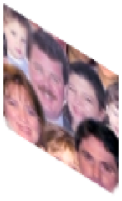
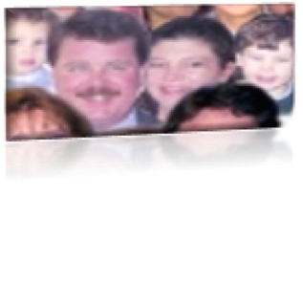
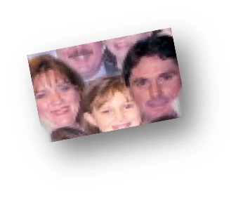
“The Church of Christ - GOD’s TEMPLE”
(1 Peter 2:4-10; 1 Corinthians 3:16,17; 2 Corinthians 3:9-11; 6:14-7:1; Ephesians 2:20-22)
MADE Alive in Christ:
Christians are “living stones,” part of the living building, the church, which is being built upon the solid foundation, i.e., Christ (cf. 1 Cor. 3:10-17; 1 Tim 3:15; Ep. 2:19-22)
A “spiritual building” in progress (Acts 2:47; 5:14; 6:7; 7:46,48; 9:31; 17:24; etc)
A stone in God’s spiritual house - 1 Cor 3:16; Ep. 2:19-22

Slide 23
“The Church of Christ - GOD’s TEMPLE”
(1 Peter 2:4-10; 1 Corinthians 3:16,17; 2 Corinthians 3:9-11; 6:14-7:1; Ephesians 2:20-22)
A SPIRITUAL HOUSE/ TEMPLE:
KEYWORD: SPIRITUAL! (1 Cor 3:16; Ep. 2:19-22)
Not a physical building
Not a social club
Not a hospital
Not a secular education center
Not a restaurant
Not a homeless shelter
Not an entertainment provider

Slide 24
“The Church of Christ - GOD’s TEMPLE”
(1 Peter 2:4-10; 1 Corinthians 3:16,17; 2 Corinthians 3:9-11; 6:14-7:1; Ephesians 2:20-22)
A SPIRITUAL HOUSE/ TEMPLE:
KEYWORD: SPIRITUAL! (1 Cor 3:16; Ep. 2:19-22)
John 2:15–17 (NKJV)
¹⁵ When He had made a whip of cords, He drove them all out of the temple, with the sheep and the oxen, and poured out the changers’ money and overturned the tables. ¹⁶ And He said to those who sold doves, “Take these things away! Do not make My Father’s house a house of merchandise!” ¹⁷ Then His disciples remembered that it was written, “Zeal for Your house has eaten Me up.”

Slide 25
“The Church of Christ - GOD’s TEMPLE”
(1 Peter 2:4-10; 1 Corinthians 3:16,17; 2 Corinthians 3:9-11; 6:14-7:1; Ephesians 2:20-22)
A HOLY PRIESTHOOD:
Every Christian is a “PRIEST!”
A royal priesthood (1 Peter 2:9)
Made kings & priest (Rev. 1:5-6)
We serve as a holy priesthood, offering spiritual sacrifices to God.
Our bodies (Ro 12:1-2)
Our “vocal” praise (Heb 13:15)
Doing good, sharing (He 13:16)
Even our deaths (2 Ti 4:6-8)

Slide 26
“The Church of Christ - GOD’s TEMPLE”
(1 Peter 2:4-10; 1 Corinthians 3:16,17; 2 Corinthians 3:9-11; 6:14-7:1; Ephesians 2:20-22)
IMPLICATIONS / LESSONS
God’s temple today, (the church), is the building which has been made according to the pattern (Heb. 8:5,6; Mat. 28:18; 2 Tim 1:13; Acts 2:41,42; Col. 3:17)
The importance of WORSHIP which MUST be according to the pattern (Lev. 10:3,4; John 4:24; Col. 3:16,17)
Singularity / Unity - one building fit together upon the one and only foundation (1 Cor. 3:9-11, 16; Eph. 2:20,21; 4:11-16)
Implies the necessity of holiness (2 Cor. 6:14-7:1; 1 Pet 1:13-16)

Slide 27
“The Church of Christ - GOD’s TEMPLE”
(1 Peter 2:4-10; 1 Corinthians 3:16,17; 2 Corinthians 3:9-11; 6:14-7:1; Ephesians 2:20-22)
IMPLICATIONS / LESSONS
God dwells with HIS people (2 Cor. 6:14-17; John 15:1-10; Rom. 8:9,11; 1 Cor. 3:16; Eph. 2:22; 3:17; Col. 1:19; 2:9; 2 Tim 1:14; Rev 7:15)
As the tabernacle was eventually replaced by the more permanent structure, the temple - so the current condition of God’s people will be replaced by the permanent and personal presence with the Lord (Rev. 21:3-22:5; 2 Cor. 5:1-8; Heb 9:15)
Implies the necessity of obedience or face God’s wrath (Jn 2:15-17; 1 Cor. 3:16,17)

Slide 28
“The Church of Christ - GOD’s TEMPLE”
(1 Peter 2:4-10; 1 Corinthians 3:16,17; 2 Corinthians 3:9-11; 6:14-7:1; Ephesians 2:20-22)
1 Corinthians 3:16–17 (NKJV)
¹⁶ Do you not know that you are the temple of God and that the Spirit of God dwells in you? ¹⁷ If anyone defiles the temple of God, God will destroy him. For the temple of God is holy, which temple you are.

Slide 29
“The Church of Christ - GOD’s TEMPLE”
(1 Peter 2:4-10; 1 Corinthians 3:16,17; 2 Corinthians 3:9-11; 6:14-7:1; Ephesians 2:20-22)
2 Corinthians 6:16–7:1 (NKJV)
¹⁶ And what agreement has the temple of God with idols? For you are the temple of the living God. As God has said: “I will dwell in them And walk among them. I will be their God, And they shall be My people.” ¹⁷ Therefore “Come out from among them And be separate, says the Lord. Do not touch what is unclean, And I will receive you.” ¹⁸ “I will be a Father to you, and you shall be My sons and daughters, says the Lord Almighty.” ¹ Therefore, having these promises, beloved, let us cleanse ourselves from all filthiness of the flesh and spirit, perfecting holiness in the fear of God.

Slide 30
“The Church of Christ - GOD’s TEMPLE”
(1 Peter 2:4-10; 1 Corinthians 3:16,17; 2 Corinthians 3:9-11; 6:14-7:1; Ephesians 2:20-22)
ARE YOU A STONE IN GOD’S TEMPLE?
Have you purified your soul in obeying the truth (1 Peter 1:22,23; Hebrews 10:22; Rom. 6:3-6,16-18)
Are you worshipping and serving God according to His revealed will? (Mat. 28:19; Heb. 8:5,6; Col. 3:17; Heb. 12:28)
Are you perfecting holiness in the fear of God (2 Cor. 7:1; 1 Jn 3:3)

Slide 32
“The Church of Christ - His KINGDOM”
(Daniel 2:44; Mark 9:1; Acts 2:29-47; Colossians 1:13; 1 Corinthians 15:24,25)
Charts by Don McClain / Preached May 24, 2020 AM
West 65th Street church of Christ - P.O. Box 190062 - Little Rock AR 72219 - Phone — 501-568-1062 — Email – donmcclain@sbcglobal.net
Prepared using Keynote / More Keynote, PPT & Audio Sermons:
www.w65stchurchofchrist.com

Slide 33
1 Peter 2:4–10 (NKJV)
⁴ Coming to Him as to a living stone, rejected indeed by men, but chosen by God and precious, ⁵ you also, as living stones, are being built up a spiritual house, a holy priesthood, to offer up spiritual sacrifices acceptable to God through Jesus Christ. ⁶ Therefore it is also contained in the Scripture, “Behold, I lay in Zion A chief cornerstone, elect, precious, And he who believes on Him will by no means be put to shame.” ⁷ Therefore, to you who believe, He is precious; but to those who are disobedient, “The stone which the builders rejected Has become the chief cornerstone,”

Slide 34
1 Peter 2:4–10 (NKJV)
⁸ and “A stone of stumbling And a rock of offense.” They stumble, being disobedient to the word, to which they also were appointed. ⁹ But you are a chosen generation, a royal priesthood, a holy nation, His own special people, that you may proclaim the praises of Him who called you out of darkness into His marvelous light; ¹⁰ who once were not a people but are now the people of God, who had not obtained mercy but now have obtained mercy.

