Slide 1
PSALM 31
² Bow down Your ear to me, Deliver me speedily; Be my rock of refuge, A fortress of defense to save me. — Psalm 31:2 (NKJV)

Slide 2
³ For You are my rock and my fortress; Therefore, for Your name’s sake, Lead me and guide me. — Psalm 31:3 (NKJV)
Psalm 31 depicts the ebb and flow of faith during a period of deep distress. It has three main divisions:
David trustingly places His life in the LORD’s hands — (vv. 1–8)
David pleads for the LORD’s mercy for deliverance from his present distress — (vv. 9–18)
David’s grateful celebration of God’s goodness (vv. 19–24).

Slide 3
Psalm 31:1–8 (NKJV)
¹ In You, O Lord, I put my trust; Let me never be ashamed; Deliver me in Your righteousness. ² Bow down Your ear to me, Deliver me speedily; Be my rock of refuge, A fortress of defense to save me. ³ For You are my rock and my fortress; Therefore, for Your name’s sake, Lead me and guide me. ⁴ Pull me out of the net which they have secretly laid for me, For You are my strength. ⁵ Into Your hand I commit my spirit; You have redeemed me, O Lord God of truth. ⁶ I have hated those who regard useless idols; But I trust in the Lord. ⁷ I will be glad and rejoice in Your mercy, For You have considered my trouble; You have known my soul in adversities, ⁸ And have not shut me up into the hand of the enemy; You have set my feet in a wide place.

Slide 4
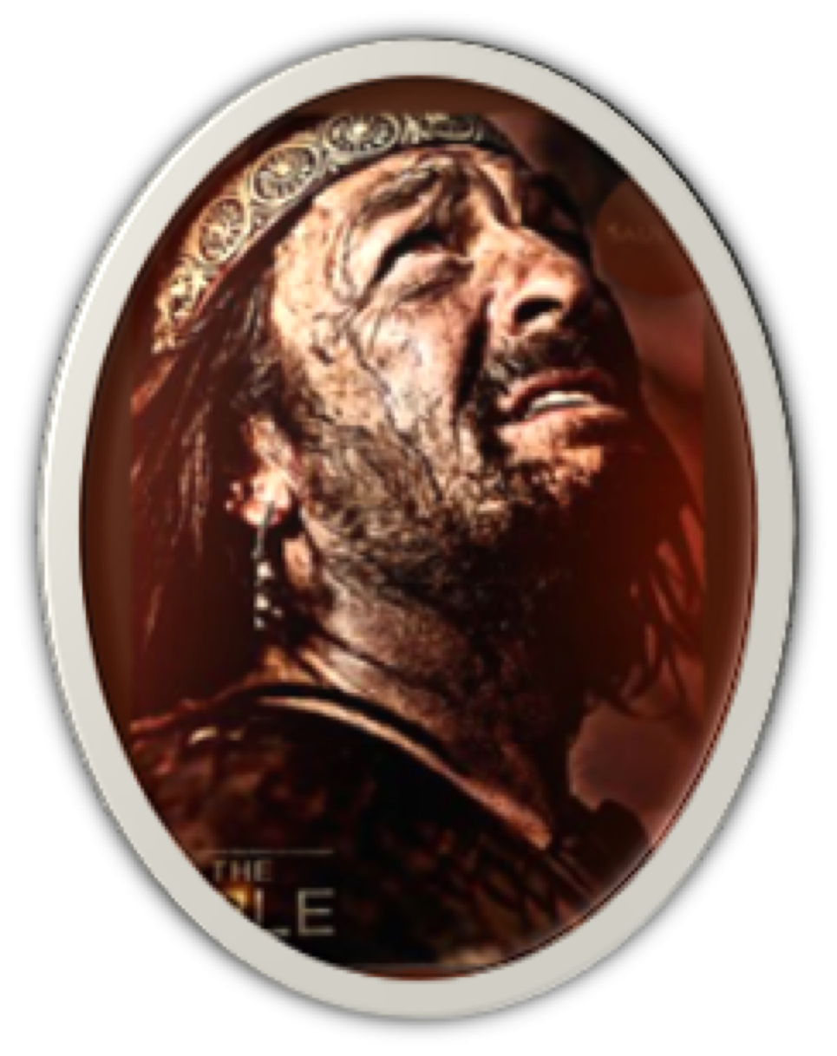
David trustingly places His life in the LORD’s hands — (vv. 1–8)
David declares his deliberate trust in God, even in a time of severe trouble (1).
David pleads with Yahweh that he never be “ashamed,” for placing his trust in Him before his enemies and adversaries (1).
David knew that for God to desert his servant would reflect negatively upon God's righteousness (1; Ps 5:8)
¹ In You, O Lord, I put my trust; Let me never be ashamed; Deliver me in Your righteousness.

Slide 5
David trustingly places His life in the LORD’s hands — (vv. 1–8)
David ask God to hear His plea in his time of distress and weakness (2).
He prayed for the Lord to come quickly to his rescue (cf. 69:17; 70:1, 5; 71:12; 79:8; 102:2; 141:1; 143:7)
David trusts fully in Yahweh’s strength and defense for His people - He therefore asks for God to so consider him (2; cf. Ps 17:2; 20:6; 23:3; 25:21)
² Bow down Your ear to me, Deliver me speedily; Be my rock of refuge, A fortress of defense to save me..

Slide 6
David trustingly places His life in the LORD’s hands — (vv. 1–8)
David declares His reliance upon God’s faithfulness as his “ROCK” and protection as his “FORTRESS” (3; cf. 1–2; 18:2).
For the sake of “his name,” i.e., his self-revelation; David desires Yahweh to show himself to be all that he had revealed himself to be (3; 23:2, 3; 25:11; 79:9; Ep. 1:12)
David is willing to follow God’s instructions & guidance (Ps. 25:5, 9; 139:24; 143:10,11; etc.).
³ For You are my rock and my fortress; Therefore, for Your name’s sake, Lead me and guide me.

Slide 7
David trustingly places His life in the LORD’s hands — (vv. 1–8)
David asks that God rescue him from his enemies who are compared to hunters or fowlers trying to catch him in their net (4; Ps. 25:15; 35:7; 57:6; 124:7; 140:5. Pr. 29:5. 2 Ti. 2:26).
David does not rely upon his own strength, but God’s (4; Ps. 19:14. 2 Co. 12:9).
David confesses his hope in the LORD as his redeemer by committing his spirit into God’s hand (5; cf. Lk 23:46; Ac 7:59)
⁴ Pull me out of the net which they have secretly laid for me, For You are my strength. ⁵ Into Your hand I commit my spirit; You have redeemed me, O Lord God of truth.

Slide 8
David trustingly places His life in the LORD’s hands — (vv. 1–8)
In order to “stand” upon God's strength & to be “protected” by His deliverance, one MUST stand with God against that which is evil (6; Ps. 24:4; 26:5; Ro. 1:21; 1 Co. 10:20)
Compromisers do not stand upon God, nor trust in His provisions, but rather manifest a lack of faith in God (6; Rom. 1:31; Eph. 5:6-18).
David proclaims his undivided trust in the Lord (6; Mat. 6:19-33)
⁶ I have hated those who regard useless idols; But I trust in the Lord.

Slide 9
David trustingly places His life in the LORD’s hands — (vv. 1–8)
David knew whatever deliverance God granted was undeserved, therefore he “rejoiced in the Lord’s mercy” (7; cf. James 1:2-12)
David knew God was aware of his condition and knew the very thoughts of his heart in his trials (7; Ps. 1:6; 142:3; Rom. 8:17-28; 1 Co. 8:3. Ga. 4:9. 2 Ti. 2:19)
⁷ I will be glad and rejoice in Your mercy, For You have considered my trouble; You have known my soul in adversities,

Slide 10
David trustingly places His life in the LORD’s hands — (vv. 1–8)
David knew whatever deliverance God granted was undeserved, therefore he “rejoiced in the Lord’s mercy” (7; cf. James 1:2-12)
David knew God was aware of his condition and knew the very thoughts of his heart in his trials (7; Ps. 1:6; 142:3; Rom. 8:17-28; 1 Co. 8:3. Ga. 4:9. 2 Ti. 2:19)
By God granting David victories over his enemies before, he was both confident and grateful (8)
⁸ And have not shut me up into the hand of the enemy; You have set my feet in a wide place.

Slide 11
David pleads for the LORD’s deliverance from distress — (9–18)
Psalm 31:9–10 (NKJV)
⁹ Have mercy on me, O Lord, for I am in trouble; My eye wastes away with grief, Yes, my soul and my body! ¹⁰ For my life is spent with grief, And my years with sighing; My strength fails because of my iniquity, And my bones waste away.
David describes the depth of his distress as being:
1) Emotional ; 2) spiritual; & 3) Physical

Slide 12
David pleads for the LORD’s deliverance from distress — (9–18)
Psalm 31:9–10 (NKJV)
⁹ Have mercy on me, O Lord, for I am in trouble; My eye wastes away with grief, Yes, my soul and my body! ¹⁰ For my life is spent with grief, And my years with sighing; My strength fails because of my iniquity, And my bones waste away.
David reiterates his total dependence upon God’s mercy (7; Titus 3:4,5)
He knows he deserves the suffering he is experiencing!

Slide 13
David pleads for the LORD’s deliverance from distress — (9–18)
Psalm 31:11–13 (NKJV)
¹¹ I am a reproach among all my enemies, But especially among my neighbors, And am repulsive to my acquaintances; Those who see me outside flee from me. ¹² I am forgotten like a dead man, out of mind; I am like a broken vessel. ¹³ For I hear the slander of many; Fear is on every side; While they take counsel together against me, They scheme to take away my life.
David feels totally isolated.
Enemies hold him in disdain.
Neighbors avoid him.
He is forgotten, a “broken” vessel never to rise again

Slide 14
David pleads for the LORD’s deliverance from distress — (9–18)
Psalm 31:14–18 (NKJV)
¹⁴ But as for me, I trust in You, O Lord; I say, “You are my God.” ¹⁵ My times are in Your hand; Deliver me from the hand of my enemies, And from those who persecute me. ¹⁶ Make Your face shine upon Your servant; Save me for Your mercies’ sake.
In the midst of all his trouble, David again declares his trust in God. (cf. 1-3)

Slide 15
David pleads for the LORD’s deliverance from distress — (9–18)
Psalm 31:14–18 (NKJV)
¹⁴ But as for me, I trust in You, O Lord; I say, “You are my God.” ¹⁵ My times are in Your hand; Deliver me from the hand of my enemies, And from those who persecute me. ¹⁶ Make Your face shine upon Your servant; Save me for Your mercies’ sake.
David could not bear the thought of falling into the hands of his enemies,(2 Samuel 24:14)
But was at peace with the knowledge, “My times are in Your hand.” (cf. 5; Ecc. 3:1-8)

Slide 16
David pleads for the LORD’s deliverance from distress — (9–18)
Psalm 31:14–18 (NKJV)
¹⁴ But as for me, I trust in You, O Lord; I say, “You are my God.” ¹⁵ My times are in Your hand; Deliver me from the hand of my enemies, And from those who persecute me. ¹⁶ Make Your face shine upon Your servant; Save me for Your mercies’ sake.
David borrowed from the priestly blessing described in Numbers 6:23-27, asking for the goodness and the favor of God to be showered upon him.

Slide 17
David pleads for the LORD’s deliverance from distress — (9–18)
Psalm 31:14–18 (NKJV)
¹⁷ Do not let me be ashamed, O Lord, for I have called upon You; Let the wicked be ashamed; Let them be silent in the grave. ¹⁸ Let the lying lips be put to silence, Which speak insolent things proudly and contemptuously against the righteous.
David again appeals to God’s righteousness (1)
David asks for those who are God’s enemies to be the ones ashamed (1; cf. 2 Thes. 1:7-10)

Slide 18
David’s grateful celebration of God’s goodness (19–24)
Psalm 31:19–23 (NKJV)
¹⁹ Oh, how great is Your goodness, Which You have laid up for those who fear You, Which You have prepared for those who trust in You In the presence of the sons of men!
These words are spoken while in great distress - but hope sees through the clouds, and the faith of God’s saints experience the presence of God even in the storms.
(Rom. 8:17,18; 2 Cor. 4: 16-18)

Slide 19
David’s grateful celebration of God’s goodness (19–24)
Psalm 31:19–23 (NKJV)
²⁰ You shall hide them in the secret place of Your presence From the plots of man; You shall keep them secretly in a pavilion From the strife of tongues. ²¹ Blessed be the Lord, For He has shown me His marvelous kindness in a strong city!
David found security in the “secret place of God’s presence,” i.e., in God’s fellowship (20)
(Ps. 27:5; 32:7; 64:2; 91:1–4; Col. 3:1-4)

Slide 20
David’s grateful celebration of God’s goodness (19–24)
Psalm 31:19–23 (NKJV)
²² For I said in my haste, “I am cut off from before Your eyes”; Nevertheless You heard the voice of my supplications When I cried out to You. ²³ Oh, love the Lord, all you His saints! For the Lord preserves the faithful, And fully repays the proud person.
David, being absorbed in his current trouble, was too quick to question God’s presence …
Yet when David cried out to God, he was confident God heard him (22; Ps. 22)

Slide 21
David’s grateful celebration of God’s goodness (19–24)
Psalm 31:19–23 (NKJV)
²² For I said in my haste, “I am cut off from before Your eyes”; Nevertheless You heard the voice of my supplications When I cried out to You. ²³ Oh, love the Lord, all you His saints! For the Lord preserves the faithful, And fully repays the proud person.
David encourages us to LOVE the LORD, for He preserves the faithful (23; 1 Pet. 1:3-9; Rom. 8:28-39)
The wicked WILL BE DESTROYED! (23; 2 Thes. 1:7-9; 2 Pet. 3:1-15; Rev. 21:8)

Slide 22
David’s grateful celebration of God’s goodness (19–24)
Psalm 31:24 (NKJV)
²⁴ Be of good courage, And He shall strengthen your heart, All you who hope in the Lord.
(cf. Psalm 27:14; Is. 35:3, 4)

Slide 23
David’s grateful celebration of God’s goodness (19–24)
1 Peter 5:8–11 (NKJV)
⁸ Be sober, be vigilant; because your adversary the devil walks about like a roaring lion, seeking whom he may devour. ⁹ Resist him, steadfast in the faith, knowing that the same sufferings are experienced by your brotherhood in the world.

Slide 24
David’s grateful celebration of God’s goodness (19–24)
1 Peter 5:8–11 (NKJV)
¹⁰ But may the God of all grace, who called us to His eternal glory by Christ Jesus, after you have suffered a while, perfect, establish, strengthen, and settle you. ¹¹ To Him be the glory and the dominion forever and ever. Amen.

Slide 25
³ For You are my rock and my fortress; Therefore, for Your name’s sake, Lead me and guide me. — Psalm 31:3 (NKJV)
Psalm 31 depicts the ebb and flow of faith during a period of deep distress.
David trustingly placed His life in the LORD’s hands — (vv. 1–8)
David pleaded for the LORD’s mercy that he be delivered from his present distress — (vv. 9–18)
David gratefully celebrated of God’s goodness (vv. 19–24).

Slide 26
³ For You are my rock and my fortress; Therefore, for Your name’s sake, Lead me and guide me. — Psalm 31:3 (NKJV)
WHEN WE ARE IN DISTRESS
Do we trustingly place our life in the LORD’s hands? — (vv. 1–8)
Do we plead for the LORD’s mercy that we be delivered according to His will? — (vv. 9–18; Mat. 26:36-36)
Do we gratefully celebrate God’s goodness regardless of our circumstances? (vv. 19–24).

Slide 27
³ For You are my rock and my fortress; Therefore, for Your name’s sake, Lead me and guide me. — Psalm 31:3 (NKJV)
Colossians 3:1–4 (NKJV)
¹ If then you were raised with Christ, seek those things which are above, where Christ is, sitting at the right hand of God. ² Set your mind on things above, not on things on the earth. ³ For you died, and your life is hidden with Christ in God. ⁴ When Christ who is our life appears, then you also will appear with Him in glory.

Slide 28
SECURITY, COMFORT & PEACE
CAN ONLY BE FOUND
IN THE LORD
IS THE LORD YOUR ROCK & FORTRESS?
HE CAN BE!
(Gal. 3:26,27)

Slide 29
Don McClain
W. 65th St church of Christ - December 31, 2006

Slide 30
PSALM 31
Charts by Don McClain / Preached February 23, 2020 PM
West 65th Street church of Christ - P.O. Box 190062 - Little Rock AR 72219 - Phone — 501-568-1062 — Email – donmcclain@sbcglobal.net
Prepared using Keynote / More Keynote, PPT & Audio Sermons:
www.w65stchurchofchrist.com

Slide 31
2 Corinthians 12:7–10 (NKJV)
⁷ And lest I should be exalted above measure by the abundance of the revelations, a thorn in the flesh was given to me, a messenger of Satan to buffet me, lest I be exalted above measure. ⁸ Concerning this thing I pleaded with the Lord three times that it might depart from me. ⁹ And He said to me, “My grace is sufficient for you,

Slide 32
2 Corinthians 12:7–10 (NKJV)
for My strength is made perfect in weakness.” Therefore most gladly I will rather boast in my infirmities, that the power of Christ may rest upon me. ¹⁰ Therefore I take pleasure in infirmities, in reproaches, in needs, in persecutions, in distresses, for Christ’s sake. For when I am weak, then I am strong.

