Slide 1
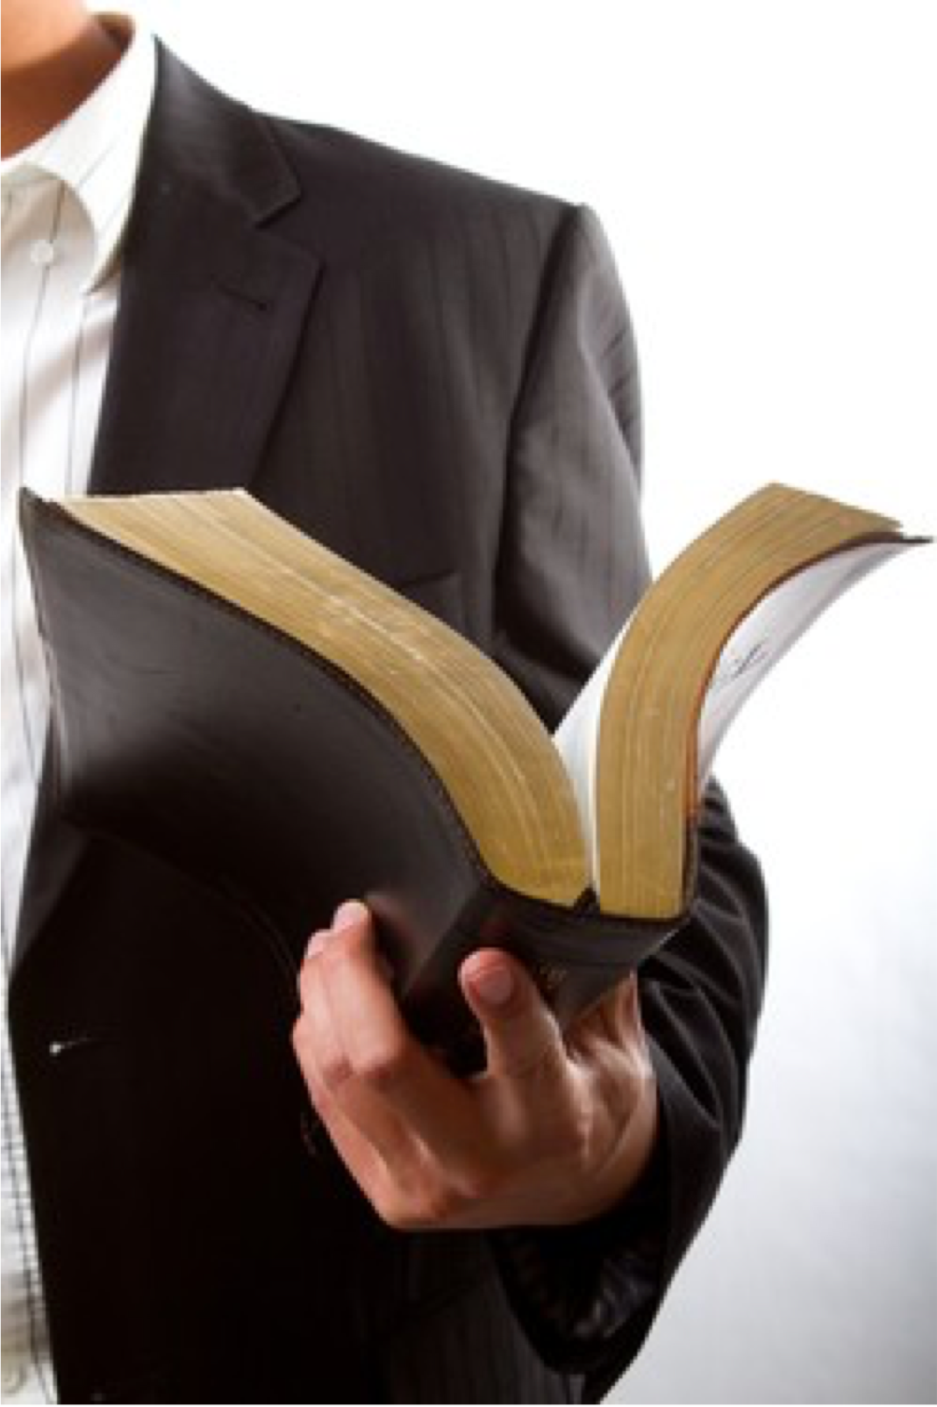
Why Do We Believe What We Believe?
THE SOURCE
THE SEARCH
THE METHOD
THE APPLICATION
THE RESULT
Acts 17:11,12

Slide 2
Why Do We Believe What We Believe?
I BELIEVE WHAT I DO …
NOT merely because of what I was taught as a child (Acts 22:3; 23:6; Phil. 3:4-10; 2 Tim. 1:5)
NOT because it is the “orthodox” position held by learned men (Acts 23:6; Phil. 3:4-10; Mat. 15:7-9; Rom. 1:22; 10:1-3; Gal. 1:6-9; 1 Co. 1:20-25; Col. 2:8-10)
NOT because it is what my family and friends believe (Luke 14:25-27; Mat. 10:37; Phi. 3:8)

Slide 3
Why Do We Believe What We Believe?
I BELIEVE WHAT I DO …
NOT Because it is convenient (Act 24:25; Luke 9:23-26; Mat. 7:13,14; 2 Tim 3:12)
NOT Because it is what I want to believe (Is. 30:9–11; Jer. 5:30; 10:23; Rom. 1:24, 25; 2 Tim. 4:3,4; 2 Thes 2:10-12)
NOT Because of my emotional feelings or current circumstances (Pr. 28:26; Jer. 17:9; Pr. 14:12; 16:25; Eph. 4:14; Rom. 16:17,18)

Slide 4
Why Do We Believe What We Believe?
I BELIEVE WHAT I DO …
Because I was taught as a child to believe what the scriptures teach, NOT what men teach (Acts 17:11,12; Jn 20:30,31; 1 Pt. 4:11)
Because I have searched, and continue to search the scriptures to prove what I believe (Acts 17:11,12; 2 Tim. 2:15; 3:16,17)
Because I know God’s word is TRUE and anything different from what God says is false (Rom 3:4; 10:17; John 17:17)

Slide 5
Why Do We Believe What We Believe?
THE BIBLE IS ONLY VALID SOURCE
2 Timothy 3:16–17 (NKJV)
¹⁶ All Scripture is given by inspiration of God, and is profitable for doctrine, for reproof, for correction, for instruction in righteousness, ¹⁷ that the man of God may be complete, thoroughly equipped for every good work.
SOURCE: GOD BREATHED The scriptures are from God
PURPOSE: OUR GUIDANCE in teaching, proving, correcting, instructing in what is right …
SUFFICIENT IN GUIDANCE Provides all God wants us to be, & equips for all He wants done.

Slide 6
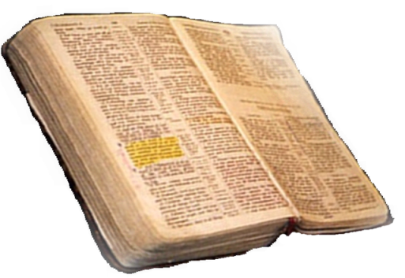
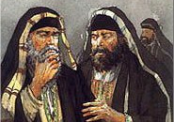
Why Do We Believe What We Believe?
THE BIBLE IS ONLY VALID SOURCE
The baptism of John—where was it from? From heaven or from men?
Matthew 21:25-26
From Heaven
Mt. 21:23-27
1 John 4:4-6
Gal. 1:6-9
Col. 2:6-10
2 Thess. 2:15
Only Two Possible Sources
From Men
Mt. 15:1-9
1 Cor. 4:6
Gal. 1:10-17
Col. 2:8
2 Thess. 2:2-4

Slide 7
Why Do We Believe What We Believe?
THE BIBLE IS ONLY VALID SOURCE
We cannot GO BEYOND what is written (1 Cor. 4:6; 2 Jn. 9-11)
We cannot ADD TO or TAKE FROM God’s revelation (Deut. 4:2; 12:32; Pr. 30:5-6; Gal. 3:15; Rev. 22:18-19; 1 Pet. 4:11)
We CANNOT believe, teach or practice that which God has NOT authorized by His revelation, (God’s silence is not permissive) (Col. 3:17; Rom. 10:17; 2 Cor. 5:7; Heb 7:11-14)

Slide 8
Why Do We Believe What We Believe?
THE BIBLE IS ONLY VALID SOURCE
Walking by faith means walking by what God has said
2 Cor. 5:7; 1 Cor. 4:6; Gal. 1:6-9; 1 Pet. 4:11
We cannot know the mind of God except through revelation
1 Cor 2:10, 11,14
Eph 3:3-5
Isaiah 55:8,9
Faith comes by hearing God’s WORD
ROMANS 10:17
God has revealed everything He wants us to believe, teach & practice
2 Pet 1:3;
2 Tim 3:16,17
Jude 3

Slide 9
Why Do We Believe What We Believe?
THE BIBLE IS ONLY VALID SOURCE
WE DARE NOT ACT WHERE GOD HAS NOT SPOKEN
2 Cor. 5:7; 1 Cor. 4:6; Gal. 1:6-9; 1 Pet. 4:11
Cain (Gen. 4:7) Heb 11:4
Nadab and Abihu (Lev. 10:1,2)
Moses (Num 20:8-24)
King Saul (1 Sam. 13 & 15)
David’s ox cart (1 Chr. 13:7-12; 15:2)
Jeroboam (1 Kings 12:25-33)
Uzziah (2 Chr. 26:16-23)
Deut 4:2; 12:32;
Joshua 1:7;
Proverbs 30:6
Rev 22:18,19

Slide 10
Why Do We Believe What We Believe?
THE SEARCH FOR TRUTH
Acts 17:11–12 (NKJV)
¹¹ These were more fair-minded than those in Thessalonica, in that they received the word with all readiness, and searched the Scriptures daily to find out whether these things were so. ¹² Therefore many of them believed, and also not a few of the Greeks, prominent women as well as men.

Slide 11
Why Do We Believe What We Believe?
THE SEARCH FOR TRUTH
2 Timothy 2:15 (NKJV)
¹⁵ Be diligent to present yourself approved to God, a worker who does not need to be ashamed, rightly dividing the word of truth.

Slide 12
Why Do We Believe What We Believe?
THE SEARCH FOR TRUTH
We MUST READ God’s word (Deut 17:19; Josh. 8:34; Neh. 8:8; Luke 10:26; Eph. 3:4,5; Col. 4:16; etc.)
We MUST STUDY God’s word; i.e., we MUST HANDLE IT CORRECTLY (2 Tim. 2:15; Heb. 5:11–14)

Slide 13
Why Do We Believe What We Believe?
THE SEARCH FOR TRUTH
Realize TRUTH matters (John 8:32; 1 Pet. 1:22)
Humility / meekness (Mt 5:3-5; Ja 1:21; John 7:17)
Develop a love & hunger for God & His word (Mt 5:6)
Desire to please Him (Col. 1:10)
Zeal - Be diligent in your search for truth - being honest w/ the Bible (2 Tim 2:15; Acts 17:11)

Slide 14
Why Do We Believe What We Believe?
THE SEARCH FOR TRUTH
The totality of information revealed regarding any belief, teaching, or practice is the TRUTH regarding that belief, teaching, or practice.
Ps 119:160
2 Timothy 1:13;
2 Peter 1:3;

Slide 15
Why Do We Believe What We Believe?
THE SEARCH FOR TRUTH
Truth is not contingent upon one's belief in it, altered by ones rejection of it, or nullified if no one accepts it
TRUTH IS TRUTH
(John 17:17; Psalm 19:7-9; 119:9,11,104)

Slide 16
Why Do We Believe What We Believe?
THE SEARCH FOR TRUTH
If you feel that the truth is NOT the truth - no matter how strong those feelings may be –
THE TRUTH IS STILL THE TRUTH!
(John 17:17; Psalm 19:7-9; 119:9,11,104)

Slide 17
Why Do We Believe What We Believe?
THE SEARCH FOR TRUTH
If you feel that a LIE is the truth - no matter how strong that feeling may be –
A LIE IS STILL A LIE
& THE TRUTH IS STILL THE TRUTH!
(John 17:17; Psalm 19:7-9; 119:9,11,104)

Slide 18
Why Do We Believe What We Believe?
THE SEARCH FOR TRUTH
Anything different from the truth – is NOT the truth –
TRUTH IS NARROW! (Mat 7:13,14)
TRUTH IS ABSOLUTE! (Ps 119:151;152)
TRUTH IS VALUABLE! (Prov. 23:23)
(John 17:17; Psalm 19:7-9; 119:9,11,104)

Slide 19
Why Do We Believe What We Believe?
WHAT SHOULD WE BELIEVE ABOUT:
How a lost sinner can be saved? (Rom. 10:17; 10:9,10; Acts 17:30; 2:38; Heb. 3:14)
The church Jesus built? (Mat. 16:18; Acts 2:47; Eph. 5:24)
What God accepts as true worship? (Jn 4:24; Acts 20:7; Eph. 5:19)
The organization and work of the church (Phil. 1:1; Acts 20:28; Eph. 4:11-16; 1 Cor 11:22,34)

Slide 20
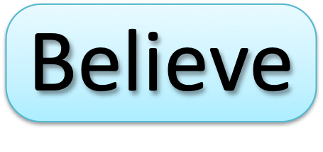
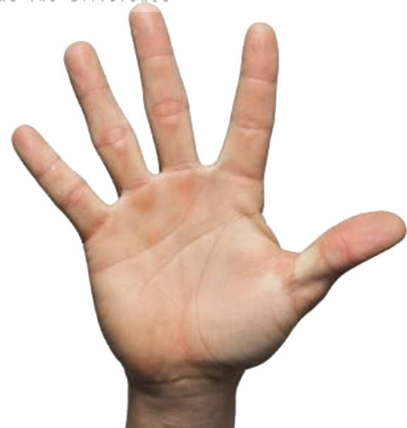
Why Do We Believe What We Believe?
WHAT MUST I DO TO BE SAVED?
Luke 8:11; Rom. 10:17
John 8:24; Heb 11:6
Luke 13:3,5; Acts 17:30
Mat. 10:32,33; Rom 10:9
Acts 2:38; 22:16; 1 Pet 3:21
Heb 4:11; Col 1:23

Slide 21
Why Do We Believe What We Believe?
When we believe, teach and practice ONLY what is taught in the Bible, we KNOW we are pleasing to God!
THE SOURCE
THE SEARCH
THE METHOD
THE APPLICATION
THE RESULT
Acts 17:11,12

Slide 23
Why Do We Believe What We Believe?
THE SOURCE
THE SEARCH
THE METHOD
THE APPLICATION
THE RESULT
When we believe, teach and practice ONLY what is taught in the Bible, we KNOW we are pleasing to God!
Acts 17:11,12

Slide 24
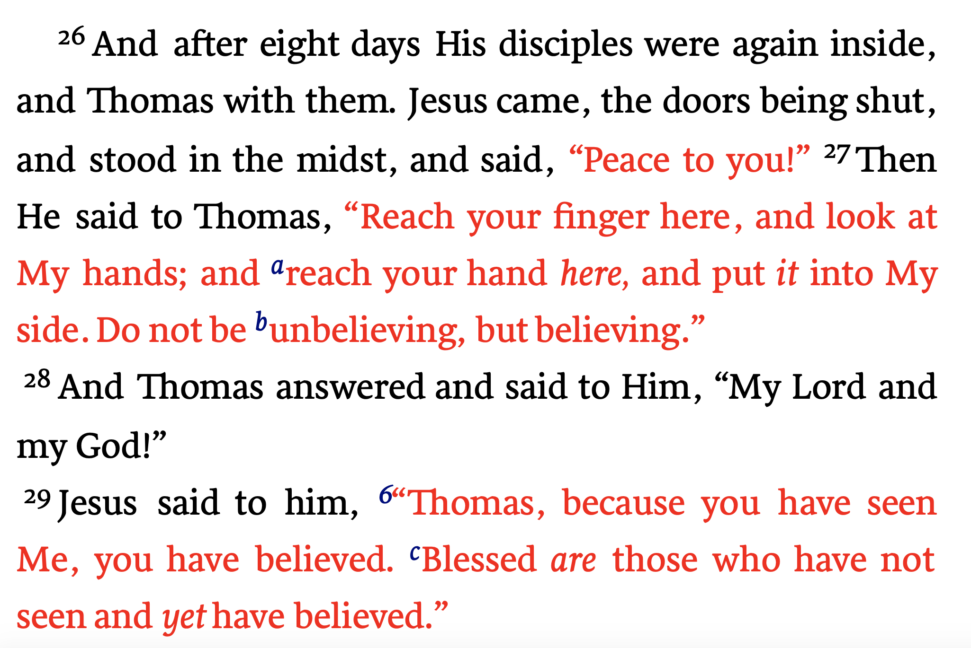
John 20:26–29 (NKJV)

Slide 25
How Faith Relates to Your Feelings
Bill Scott, a West Virginia preacher, relates an incident told by a helicopter pilot who flew from an aircraft carrier in the Pacific.
“I was flying the helicopter back to the ship when a blinding fog rolled in. Flying at a low altitude, I knew that a single mistake would plunge my crew and me into the ocean. Worse yet, I was experiencing a complete loss of balance — which is common for pilots flying by instruments. This loss of balance was so bad that despite the instrument readings I was certain that I was lying on my side.”
“For 15 minutes.” the pilot agonized as he relied solely on his instruments. He admitted that he fought” the urge to turn it according to my feeling.” Then suddenly when they broke safely through the fog, he said, “I was deeply thankful I had been trained to rely upon my instruments rather than on my feelings.”
Religiously, too many people rely on undependable and fleeting feelings. Erwin W. Lutzer was right when he wrote, “A Christian life based on feeling is headed for a gigantic collapse.” Or crash.
I’ve had Christians say, “I don’t feel saved,” because the fog of doubt, discouragement or even despair has enveloped them. They’re allowing a temporary emotion to cloud what they know is true.
On the other hand, I’ve heard of people basing their salvation on some hyper-emotional experience. One lady described her salvation experience at a religious revival as an out of body experience. She said she felt like she was floating on air. She felt as light as a feather. She felt something she’d never experienced. She felt like she was saved.
When a preacher questioned if she really was floating, she admitted she wasn’t. He delicately asked the slightly over-weight woman, if she was as light as a feather, she curtly replied, “No.” “Well maybe you’re not saved either, the preacher suggested.
The Bible teaches that “we walk by faith and not by sight” (2 Cor. 5:7). Faith is the solid foundation of our eternal hope. The Bible says, “Now faith is the assurance of things hoped for, the conviction of things not seen” (Heb. 11:1).
Furthermore, our faith is founded on facts. We’re not flying blindly into clouds. We have our “instruments,” to guide us. God’s revealed Word. The Bible tells us that we’ve all sinned and fallen short of God’s glory (Rom. 3:23). But He loves us and wants us to be saved (Jn 3:16). That’s why Jesus Christ died for our sins (Rom 5:8). And his triumphant victory over death through his resurrection assures us that we too will be raised (1 Cor. 15).
The book of Acts tells the story of salvation. People who received God’s saving grace heard the Gospel of Christ. Believed. Repented of their sins. And were baptized for the remission of sins (Acts 2). As a result, God added them to the body of the saved, called the church (Acts 2:47). Those are the facts.
Interestingly, when people by faith obeyed the gospel, a good feeling followed. Sinners saved like the Ethiopian Treasurer “went on their way rejoicing.” Your conscience will be clean and clear (1 Peter 3:21). Like the man who found the lost sheep or the woman who found the lost coin, you will share your excitement with others (Lk. 15:7-10).
Faith generates joy (Phil. 1:25). And even allows us to face life’s troubles and trials with a joyful spirit (1 Pet. 1:7-9). There will even be occasions, like in the parable of the prodigal son, where a Christian goes astray. Leaves the Father. And goes into the far country of sin. But when the wayward one returns there will be tears of joy. And a celebration when they come home.
True Christianity is not devoid of emotion. But our feelings are based on faith and rooted in the reliable facts of the gospel. Objective Truth must be subordinate to our feelings, moods, and opinions.
The connection between these concepts is summed up in this short verse by an unknown author.
Three men were walking on a wall,
Feeling, Faith and Fact,
When Feeling got an awful fall,
And Faith was taken back.
So close was Faith to Feeling
He stumbled and fell too,
But Fact remained and pulled Faith back,
And Faith brought Feeling too.
–Ken Weliever, The Preacherman

