Slide 1
Essential Attitudes of A Living Faith
Our Attitude Towards GOD MATTERS
(Acts 17:22-32)

Slide 2
Our Attitude Towards GOD MATTERS
Stanford Research Institute reports that only 12.5 percent of our success in life is determined by knowledge; the other 87.5 percent comes from attitude. More than skill, knowledge, or aptitude, our attitude dictates our success in life.
This lesson is NOT about promoting a “positive mental attitude” approach to life, but rather a balanced, informed, and godly approach to life.

Slide 3
Our Attitude Towards GOD MATTERS
Acts 17:22–32 (NKJV)
²² Then Paul stood in the midst of the Areopagus and said, “Men of Athens, I perceive that in all things you are very religious; ²³ for as I was passing through and considering the objects of your worship, I even found an altar with this inscription: TO THE UNKNOWN GOD Therefore, the One whom you worship without knowing, Him I proclaim to you: ²⁴ God, who made the world and everything in it, since He is Lord of heaven and earth, does not dwell in temples made with hands. ²⁵ Nor is He worshiped with men’s hands, as though He needed anything, since He gives to all life, breath, and all things.

Slide 4
Our Attitude Towards GOD MATTERS
Acts 17:22–32 (NKJV)
²⁶ And He has made from one blood every nation of men to dwell on all the face of the earth, and has determined their preappointed times and the boundaries of their dwellings, ²⁷ so that they should seek the Lord, in the hope that they might grope for Him and find Him, though He is not far from each one of us; ²⁸ for in Him we live and move and have our being, as also some of your own poets have said, ‘For we are also His offspring.’ ²⁹ Therefore, since we are the offspring of God, we ought not to think that the Divine Nature is like gold or silver or stone, something shaped by art and man’s devising.

Slide 5
Our Attitude Towards GOD MATTERS
Acts 17:22–32 (NKJV)
³⁰ Truly, these times of ignorance God overlooked, but now commands all men everywhere to repent, ³¹ because He has appointed a day on which He will judge the world in righteousness by the Man whom He has ordained. He has given assurance of this to all by raising Him from the dead.” ³² And when they heard of the resurrection of the dead, some mocked, while others said, “We will hear you again on this matter.”

Slide 6
Our Attitude Towards GOD MATTERS
"A settled way of thinking or feeling about someone or something, typically one that is reflected in a person's behavior.”
“Beliefs, emotions, and behaviors toward a particular object, person, thing, or event”

Slide 7
Our Attitude Towards GOD MATTERS
“For as he thinks in his heart, so is he.”
Proverbs 23:7
Cognitive: Your thoughts and beliefs about the subject.
Affective: How the object, person, issue, or event makes you feel.
Behavioral: How attitude influences your behavior.

Slide 8
Our Attitude Towards GOD MATTERS
{
FAMILIAR BIBLE TERMS

Slide 9
Our Attitude Towards GOD MATTERS
MUST LEARN OF HIM : “Him I proclaim to you” (23)
HIS POWER: “made the world and everything in it, since He is Lord of heaven and earth” (24)
HIS NATURE: “does not dwell in temples made with hands. ²⁵ Nor is He worshiped with men’s hands, as though He needed anything” (24,25, 29)
HIS PROVISIONS: “He gives to all life, breath, and all things.” (25)
HIS AUTHORITY: “determined their preappointed times and the boundaries of their dwellings.” (26)

Slide 10
Our Attitude Towards GOD MATTERS
HIS DESIRE : “that they should seek the Lord, in the hope that they might grope for Him and find Him, though He is not far from each one of us” (27)
HE MADE US: “in Him we live and move and have our being, as also some of your own poets have said, ‘For we are also His offspring” (28)
HIS DEMANDS : “now commands all men everywhere to repent” (30)
HIS JUDGMENT : “He has appointed a day on which He will judge the world in righteousness by the Man whom He has ordained …” (31)

Slide 11
Our Attitude Towards GOD MATTERS
FEAR / REVERENCE / AWE
Proverbs 1:7 (NKJV)
⁷ The fear of the Lord is the beginning of knowledge, But fools despise wisdom and instruction.
Proverbs 9:10 (NKJV)
¹⁰ “The fear of the Lord is the beginning of wisdom, And the knowledge of the Holy One is understanding.

Slide 12
Our Attitude Towards GOD MATTERS
FEAR / REVERENCE / AWE
Psalm 111:10 (NKJV)
¹⁰ The fear of the Lord is the beginning of wisdom; A good understanding have all those who do His commandments. His praise endures forever.
Ecclesiastes 12:13–14 (NKJV)
¹³ Let us hear the conclusion of the whole matter: Fear God and keep His commandments, For this is man’s all. ¹⁴ For God will bring every work into judgment, Including every secret thing, Whether good or evil.

Slide 13
Our Attitude Towards GOD MATTERS
FEAR / REVERENCE / AWE
Psalm 89:7–11 (NKJV)
⁷ God is greatly to be feared in the assembly of the saints, And to be held in reverence by all those around Him. ⁸ O Lord God of hosts, Who is mighty like You, O Lord? Your faithfulness also surrounds You. ⁹ You rule the raging of the sea; When its waves rise, You still them. ¹⁰ You have broken Rahab in pieces, as one who is slain; You have scattered Your enemies with Your mighty arm. ¹¹ The heavens are Yours, the earth also is Yours; The world and all its fullness, You have founded them.
BECAUSE OF WHO HE IS

Slide 14
Our Attitude Towards GOD MATTERS
FEAR / REVERENCE / AWE
Psalm 100:2–4 (NKJV)
² Serve the Lord with gladness; Come before His presence with singing. ³ Know that the Lord, He is God; It is He who has made us, and not we ourselves; We are His people and the sheep of His pasture. ⁴ Enter into His gates with thanksgiving, And into His courts with praise. Be thankful to Him, and bless His name.
BECAUSE OF WHO HE IS
BECAUSE OF WHO WE ARE

Slide 15
Our Attitude Towards GOD MATTERS
FEAR / REVERENCE / AWE
Ecclesiastes 12:13,14 (NKJV)
¹³ Let us hear the conclusion of the whole matter: Fear God and keep His commandments, For this is man’s all. ¹⁴ For God will bring every work into judgment, Including every secret thing, Whether good or evil.
cf. Romans 5:6-11; 2 Corinthians 5:10; Hebrews 9:27
BECAUSE OF WHO HE IS
BECAUSE OF WHO WE ARE

Slide 16
Our Attitude Towards GOD MATTERS
FEAR / REVERENCE / AWE
Romans 3:9, 23 (NKJV)
⁹ What then? Are we better than they? Not at all. For we have previously charged both Jews and Greeks that they are all under sin. … ²³ for all have sinned and fall short of the glory of God
Romans 6:23 (NKJV)
²³ For the wages of sin is death, but the gift of God is eternal life in Christ Jesus our Lord.
BECAUSE OF WHO HE IS
BECAUSE OF WHO WE ARE
BECAUSE OF HIS LOVE & MERCY

Slide 17
Our Attitude Towards GOD MATTERS
FEAR / REVERENCE / AWE
Psalm 111:9 (NKJV)
⁹ He has sent redemption to His people; He has commanded His covenant forever: Holy and awesome is His name.
John 3:16 (NKJV)
¹⁶ For God so loved the world that He gave His only begotten Son, that whoever believes in Him should not perish but have everlasting life.
BECAUSE OF WHO HE IS
BECAUSE OF WHO WE ARE
BECAUSE OF HIS LOVE & MERCY

Slide 18
Our Attitude Towards GOD MATTERS
FEAR / REVERENCE / AWE
Romans 5:8–10 (NKJV)
⁸ But God demonstrates His own love toward us, in that while we were still sinners, Christ died for us. ⁹ Much more then, having now been justified by His blood, we shall be saved from wrath through Him. ¹⁰ For if when we were enemies we were reconciled to God through the death of His Son, much more, having been reconciled, we shall be saved by His life.
BECAUSE OF WHO HE IS
BECAUSE OF WHO WE ARE
BECAUSE OF HIS LOVE & MERCY

Slide 19
Our Attitude Towards GOD MATTERS
FEAR / REVERENCE / AWE
Titus 3:3–5 (NKJV)
³ For we ourselves were also once foolish, disobedient, deceived, serving various lusts and pleasures, living in malice and envy, hateful and hating one another. ⁴ But when the kindness and the love of God our Savior toward man appeared, ⁵ not by works of righteousness which we have done, but according to His mercy He saved us, through the washing of regeneration and renewing of the Holy Spirit,
BECAUSE OF WHO HE IS
BECAUSE OF WHO WE ARE
BECAUSE OF HIS LOVE & MERCY

Slide 20
Our Attitude Towards GOD MATTERS
FEAR / REVERENCE / AWE
HIS GRACIOUS GIFT DOES NOT CANCEL OUR OBLIGATION TO HOLD HIM IN REVERENCE!
Hebrews 12:28–29 (NKJV)
²⁸ Therefore, since we are receiving a kingdom which cannot be shaken, let us have grace, by which we may serve God acceptably with reverence and godly fear. ²⁹ For our God is a consuming fire.
IF WE DO NOT REVERENCE HIM IN OUR SERVICE TO HIM, WE WILL BE DESTROYED!

Slide 21
Our Attitude Towards GOD MATTERS
FEAR / REVERENCE / AWE
Psalm 119:38 (NKJV)
³⁸ Establish Your word to Your servant, Who is devoted to fearing You.
Psalm 119:161 (NKJV)
¹⁶¹ Princes persecute me without a cause, But my heart stands in awe of Your word.
IF WE FEAR GOD WE WILL RESPECT HIS WORD!

Slide 22
Our Attitude Towards GOD MATTERS
FEAR / REVERENCE / AWE
Our respect for God and His Word, (or lack thereof) will affect our:
Desire to know and understand what God has said!
Our diligence in learning and understanding what God has said!
Our acceptance and adherence to what He has said!
Our approach to the need for divine authority in all we do (Mat. 21:25; Col. 3:17)
IF WE FEAR GOD WE WILL RESPECT HIS WORD!

Slide 23
Our Attitude Towards GOD MATTERS
LOVE / OBEY
Matthew 22:37–38 (NKJV)
³⁷ Jesus said to him, “ ‘You shall love the Lord your God with all your heart, with all your soul, and with all your mind.’ ³⁸ This is the first and great commandment.
Mark 12:29–30 (NKJV)
²⁹ Jesus answered him, “The first of all the commandments is: ‘Hear, O Israel, the Lord our God, the Lord is one. ³⁰ And you shall love the Lord your God with all your heart, with all your soul, with all your mind, and with all your strength.’ This is the first commandment.
LOVE

Slide 24
Our Attitude Towards GOD MATTERS
LOVE / OBEY
1 John 5:2–3 (NKJV)
² By this we know that we love the children of God, when we love God and keep His commandments. ³ For this is the love of God, that we keep His commandments. And His commandments are not burdensome.
2 John 6 (NKJV)
⁶ This is love, that we walk according to His commandments. This is the commandment, that as you have heard from the beginning, you should walk in it.
LOVE
OBEY

Slide 25
Our Attitude Towards GOD MATTERS
LOVE / OBEY
John 14:15,23,24 (NKJV)
¹⁵ “If you love Me, keep My commandments.
²³ Jesus answered and said to him, “If anyone loves Me, he will keep My word; and My Father will love him, and We will come to him and make Our home with him.
²⁴ He who does not love Me does not keep My words; and the word which you hear is not Mine but the Father’s who sent Me.
LOVE
OBEY

Slide 26
Our Attitude Towards GOD MATTERS
LOVE / OBEY
Psalm 119:97 (NKJV)
⁹⁷ Oh, how I love Your law! It is my meditation all the day.
John 13:35 (NKJV)
³⁵ By this all will know that you are My disciples, if you have love for one another.”
Matthew 22:39 (NKJV)
³⁹ And the second is like it: ‘You shall love your neighbor as yourself.’
LOVE
OBEY
IF WE LOVE GOD WE WILL HIS WORD HIS PEOPLE & THE LOST

Slide 27
Our Attitude Towards GOD MATTERS
TRUST / OBEY
Hebrews 6:18–19 (NKJV)
¹⁸ that by two immutable things, in which it is impossible for God to lie, we might have strong consolation, who have fled for refuge to lay hold of the hope set before us. ¹⁹ This hope we have as an anchor of the soul, both sure and steadfast …
Hebrews 11:1 (NKJV)
¹ Now faith is the substance of things hoped for, the evidence of things not seen.

Slide 28
Our Attitude Towards GOD MATTERS
TRUST / OBEY
Hebrews 11:6,13 (NKJV)
⁶ But without faith it is impossible to please Him, for he who comes to God must believe that He is, and that He is a rewarder of those who diligently seek Him.
¹³ These all died in faith, not having received the promises, but having seen them afar off were assured of them, embraced them and confessed that they were strangers and pilgrims on the earth.

Slide 29
Our Attitude Towards GOD MATTERS
TRUST / OBEY
James 2:14–17 (NKJV)
¹⁴ What does it profit, my brethren, if someone says he has faith but does not have works? Can faith save him? ¹⁵ If a brother or sister is naked and destitute of daily food, ¹⁶ and one of you says to them, “Depart in peace, be warmed and filled,” but you do not give them the things which are needed for the body, what does it profit? ¹⁷ Thus also faith by itself, if it does not have works, is dead.

Slide 30
Our Attitude Towards GOD MATTERS
TRUST / OBEY
James 2:18–20 (NKJV)
¹⁸ But someone will say, “You have faith, and I have works.” Show me your faith without your works, and I will show you my faith by my works. ¹⁹ You believe that there is one God. You do well. Even the demons believe—and tremble! ²⁰ But do you want to know, O foolish man, that faith without works is dead?

Slide 31
Our Attitude Towards GOD MATTERS
TRUST / OBEY
James 2:21–24 (NKJV)
²¹ Was not Abraham our father justified by works when he offered Isaac his son on the altar? ²² Do you see that faith was working together with his works, and by works faith was made perfect? ²³ And the Scripture was fulfilled which says, “Abraham believed God, and it was accounted to him for righteousness.” And he was called the friend of God. ²⁴ You see then that a man is justified by works, and not by faith only.

Slide 32
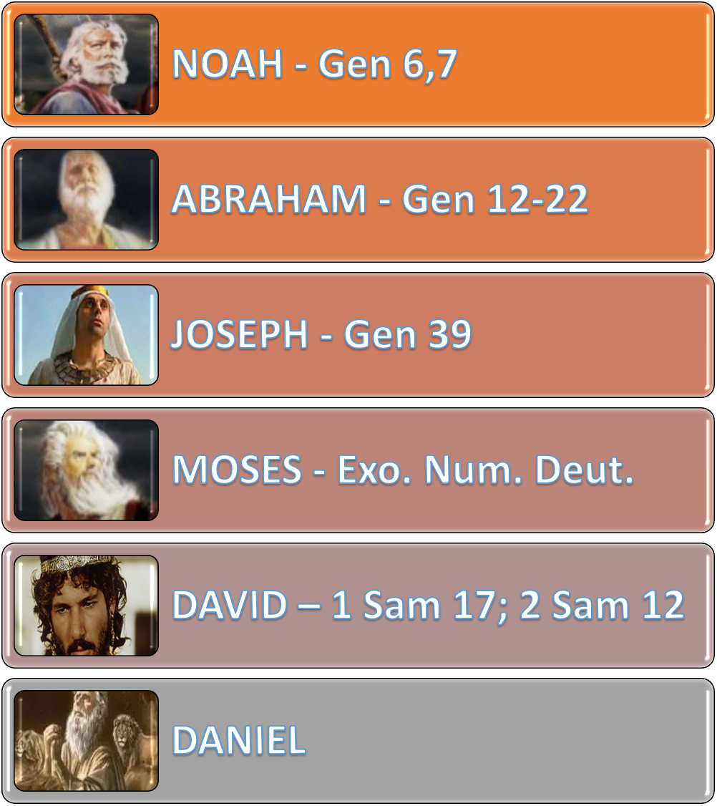
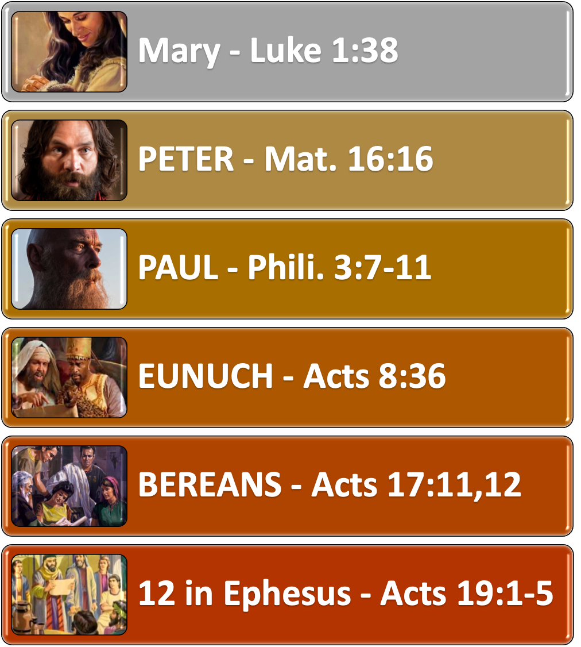
Our Attitude Towards GOD MATTERS
FEAR / LOVE / TRUST / OBEY

Slide 33
Our Attitude Towards GOD MATTERS
TRUST / OBEY
Fear / anxiety (Mt. 6:25-33; 8:23-27)
Temptation / Sin (Eph. 6:16; Heb. 11:24-34)
Discouragement (2 Cor. 4:7-17)
The world (1 John 5:4)
FAITH / TRUST ENABLES US TO OVERCOME

Slide 34
Our Attitude Towards GOD MATTERS
GRATITUDE
In all we do in compliance with the authority of Christ (Col. 3:17)
“Giving thanks always for all things to God the Father in the name of our Lord Jesus Christ” (Eph. 5:20)
“Be anxious for nothing, but in everything by prayer and supplication, with thanksgiving, let your requests be made known to God” (Phil. 4:6)
“In everything give thanks; for this is the will of God in Christ Jesus for you. (1 Thes. 5:18)
Psalms 126:3
The LORD has done great things for us, And we are glad.

Slide 35
Our Attitude Towards GOD MATTERS
Romans 1:18–21 (NKJV)
¹⁸ For the wrath of God is revealed from heaven against all ungodliness and unrighteousness of men, who suppress the truth in unrighteousness, ¹⁹ because what may be known of God is manifest in them, for God has shown it to them. ²⁰ For since the creation of the world His invisible attributes are clearly seen, being understood by the things that are made, even His eternal power and Godhead, so that they are without excuse, ²¹ because, although they knew God, they did not glorify Him as God, nor were thankful, but became futile in their thoughts, and their foolish hearts were darkened.
THOSE WHO DO NOT HAVE THE PROPER ATTITUDE TOWARDS GOD WILL BE THE RECIPIENTS OF HIS WRATH!

Slide 36
GRATITUDE
TRUSTING OBEDIENCE
LOVING SUBMISSION
FEAR / REVERENCE / AWE
(Ephesians 4:17-32)

Slide 37
Our Attitude Towards GOD MATTERS
In order to be pleasing to God, we must have an attitude of complete trust & surrender.
DO WE HAVE AN ATTITUDE TOWARDS GOD THAT PROMOTES A LIVING FAITH?
(Acts 17:22-32)

Slide 39
Essential Attitudes of A Living Faith
(Acts 17:22-32)
Charts by Don McClain
Preached May 16, 2021 / West 65th Street church of Christ P.O. Box 190062 / Little Rock AR 72219 / Phone: 501-568-1062 / Email – donmcclain@sbcglobal.net
More Keynote, PPT & Audio Sermons
w65stchurchofchrist.com

Slide 40
Psalm 78:1–8 (NKJV)
¹ Give ear, O my people, to my law; Incline your ears to the words of my mouth. ² I will open my mouth in a parable; I will utter dark sayings of old, ³ Which we have heard and known, And our fathers have told us. ⁴ We will not hide them from their children, Telling to the generation to come the praises of the Lord, And His strength and His wonderful works that He has done. ⁵ For He established a testimony in Jacob, And appointed a law in Israel, Which He commanded our fathers, That they should make them known to their children; ⁶ That the generation to come might know them, The children who would be born, That they may arise and declare them to their children, ⁷ That they may set their hope in God, And not forget the works of God, But keep His commandments; ⁸ And may not be like their fathers, A stubborn and rebellious generation, A generation that did not set its heart aright, And whose spirit was not faithful to God.

