Slide 1
Essential Attitudes of A Living Faith
Our Attitude Towards SCRIPTURE MATTERS
(Acts 17:11,12; John 5:39-47)

Slide 2
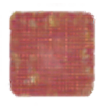
Our Attitude Towards SCRIPTURE MATTERS
Stanford Research Institute reports that only 12.5 percent of our success in life is determined by knowledge; the other 87.5 percent comes from attitude. More than skill, knowledge, or aptitude, our attitude dictates our success in life.
This lesson is NOT about promoting a “positive mental attitude” approach to life, but rather a balanced, informed, and godly approach to life.

Slide 3

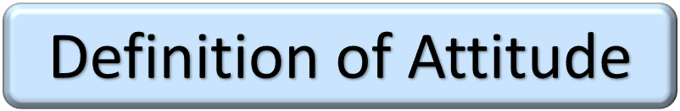
Our Attitude Towards SCRIPTURE MATTERS
"A settled way of thinking or feeling about someone or something, typically one that is reflected in a person's behavior.”
“Beliefs, emotions, and behaviors toward a particular object, person, thing, or event”

Slide 4

Our Attitude Towards SCRIPTURE MATTERS
“For as he thinks in his heart, so is he.”
Proverbs 23:7
Cognitive: Your thoughts and beliefs about the subject.
Affective: How the object, person, issue, or event makes you feel.
Behavioral: How attitude influences your behavior.

Slide 5






Our Attitude Towards SCRIPTURE MATTERS
{
FAMILIAR BIBLE TERMS

Slide 6
Our Attitude Towards SCRIPTURE MATTERS
Acts 17:10–13 (NKJV)
¹⁰ Then the brethren immediately sent Paul and Silas away by night to Berea. When they arrived, they went into the synagogue of the Jews. ¹¹ These were more fair-minded than those in Thessalonica, in that they received the word with all readiness, and searched the Scriptures daily to find out whether these things were so. ¹² Therefore many of them believed, and also not a few of the Greeks, prominent women as well as men. ¹³ But when the Jews from Thessalonica learned that the word of God was preached by Paul at Berea, they came there also and stirred up the crowds.

Slide 7
Our Attitude Towards SCRIPTURE MATTERS
Acts 17:10–13 (NKJV)
¹¹ These were more fair-minded than those in Thessalonica, in that they received the word with all readiness, and searched the Scriptures daily to find out whether these things were so. ¹² Therefore many of them believed, …
ACCEPTED / EVIDENCE CHANGED THEIR MINDS - BELIEVED / REPENTED / OBEYED
VALUED TRUTH /
NOT GULLIBLE - EXAMINED EVIDENCE OBJECTIVELY.
MEEK / WILLING TO BE CHANGED BY THE TRUTH IF INFORMATION CONFIRMED.
HONEST / WILLING TO HAVE BELIEFS CHALLENGED - LISTENED TO EVIDENCE.

Slide 8
Our Attitude Towards SCRIPTURE MATTERS
We will not believe more than we know, and we will not live higher than our beliefs.
The many fronts of moral compromise in this generation can be directly traced to biblical illiteracy in the pews and the absence of biblical preaching and teaching in our homes and churches.

Slide 9
Our Attitude Towards SCRIPTURE MATTERS
“No NEED to READ or STUDY the Bible!”
“It doesn’t MATTER what I believe!”
“I am educated & smart enough to determine what is true for ME!”
“I have the Holy Spirit dwelling in me - I don’t need to study the Bible …”

Slide 10
Our Attitude Towards SCRIPTURE MATTERS
A belief that truth is subjective & relative - (no moral absolutes / doctrine & theology inconsequential) - (Judg 21:25; Jer. 6:16-19)
The emphasis of feelings & emotion over, & instead of, a “thus saith the Lord.” - (Prov 14:12; Jer. 10:23; )
A rejection of the reliability & absolute authority of the scriptures - (2 Tim 3:16,17; 2 Pet 1:19-21; Mat 24:35; Luke 21:33)

Slide 11
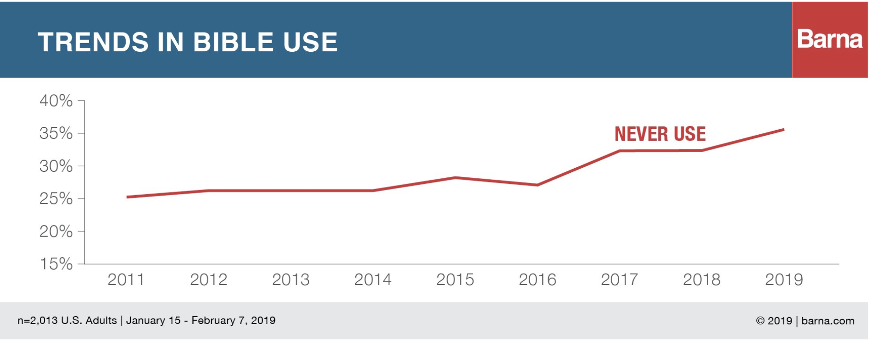
Our Attitude Towards SCRIPTURE MATTERS
Trends have been trending in the wrong direction for a long time …

Slide 12
Our Attitude Towards SCRIPTURE MATTERS

Slide 13
Our Attitude Towards SCRIPTURE MATTERS

Slide 14
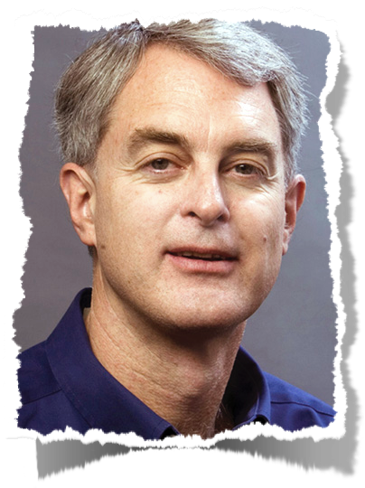
Our Attitude Towards SCRIPTURE MATTERS
“Bible reading has become the religious equivalent of sound-bite journalism. When people read from the Bible they typically open it, read a brief passage without much regard for the context, and
consider the primary thought or feeling that the passage provided. If they are comfortable with it, they accept it; otherwise, they deem it interesting but irrelevant to their life, and move on. There is shockingly little growth evident in people’s understanding of the fundamental themes of the scriptures and amazingly little interest in deepening their knowledge and application of biblical principles . . .
https://www.barna.org/barna-update/article/12-faithspirituality/325-barna-studies-the-research-offers-a-year-in-review-perspective#.UinrSRaTy0s

Slide 15
Our Attitude Towards SCRIPTURE MATTERS

Slide 16
Our Attitude Towards SCRIPTURE MATTERS
“The problem facing the Christian Church is not that people lack a complete set of beliefs; the problem is that they have a full slate of beliefs in mind, which they think are consistent with
biblical teachings, and they are neither open to being proven wrong nor to learning new insights. Our research suggests that this challenge initially emerges in the late adolescent or early teenage years . . . In a culture driven by the desire to receive value, more Bible teaching is generally not viewed as an exercise in providing such value.”
https://www.barna.org/barna-update/article/12-faithspirituality/325-barna-studies-the-research-offers-a-year-in-review-perspective#.UinrSRaTy0s

Slide 17
Our Attitude Towards SCRIPTURE MATTERS
2 Timothy 3:1–9 (NKJV)
¹ But know this, that in the last days perilous times will come: ² For men will be lovers of themselves, lovers of money, boasters, proud, blasphemers, disobedient to parents, unthankful, unholy, ³ unloving, unforgiving, slanderers, without self-control, brutal, despisers of good, ⁴ traitors, headstrong, haughty, lovers of pleasure rather than lovers of God, ⁵ having a form of godliness but denying its power. And from such people turn away!

Slide 18
Our Attitude Towards SCRIPTURE MATTERS
2 Timothy 4:1–5 (NKJV)
¹ I charge you therefore before God and the Lord Jesus Christ, who will judge the living and the dead at His appearing and His kingdom: ² Preach the word! Be ready in season and out of season. Convince, rebuke, exhort, with all longsuffering and teaching. ³ For the time will come when they will not endure sound doctrine, but according to their own desires, because they have itching ears, they will heap up for themselves teachers; ⁴ and they will turn their ears away from the truth, and be turned aside to fables. ⁵ But you be watchful in all things, endure afflictions, do the work of an evangelist, fulfill your ministry.

Slide 19
Our Attitude Towards SCRIPTURE MATTERS
2 Thessalonians 2:10–12 (NKJV)
¹⁰ and with all unrighteous deception among those who perish, because they did not receive the love of the truth, that they might be saved. ¹¹ And for this reason God will send them strong delusion, that they should believe the lie, ¹² that they all may be condemned who did not believe the truth but had pleasure in unrighteousness.

Slide 20
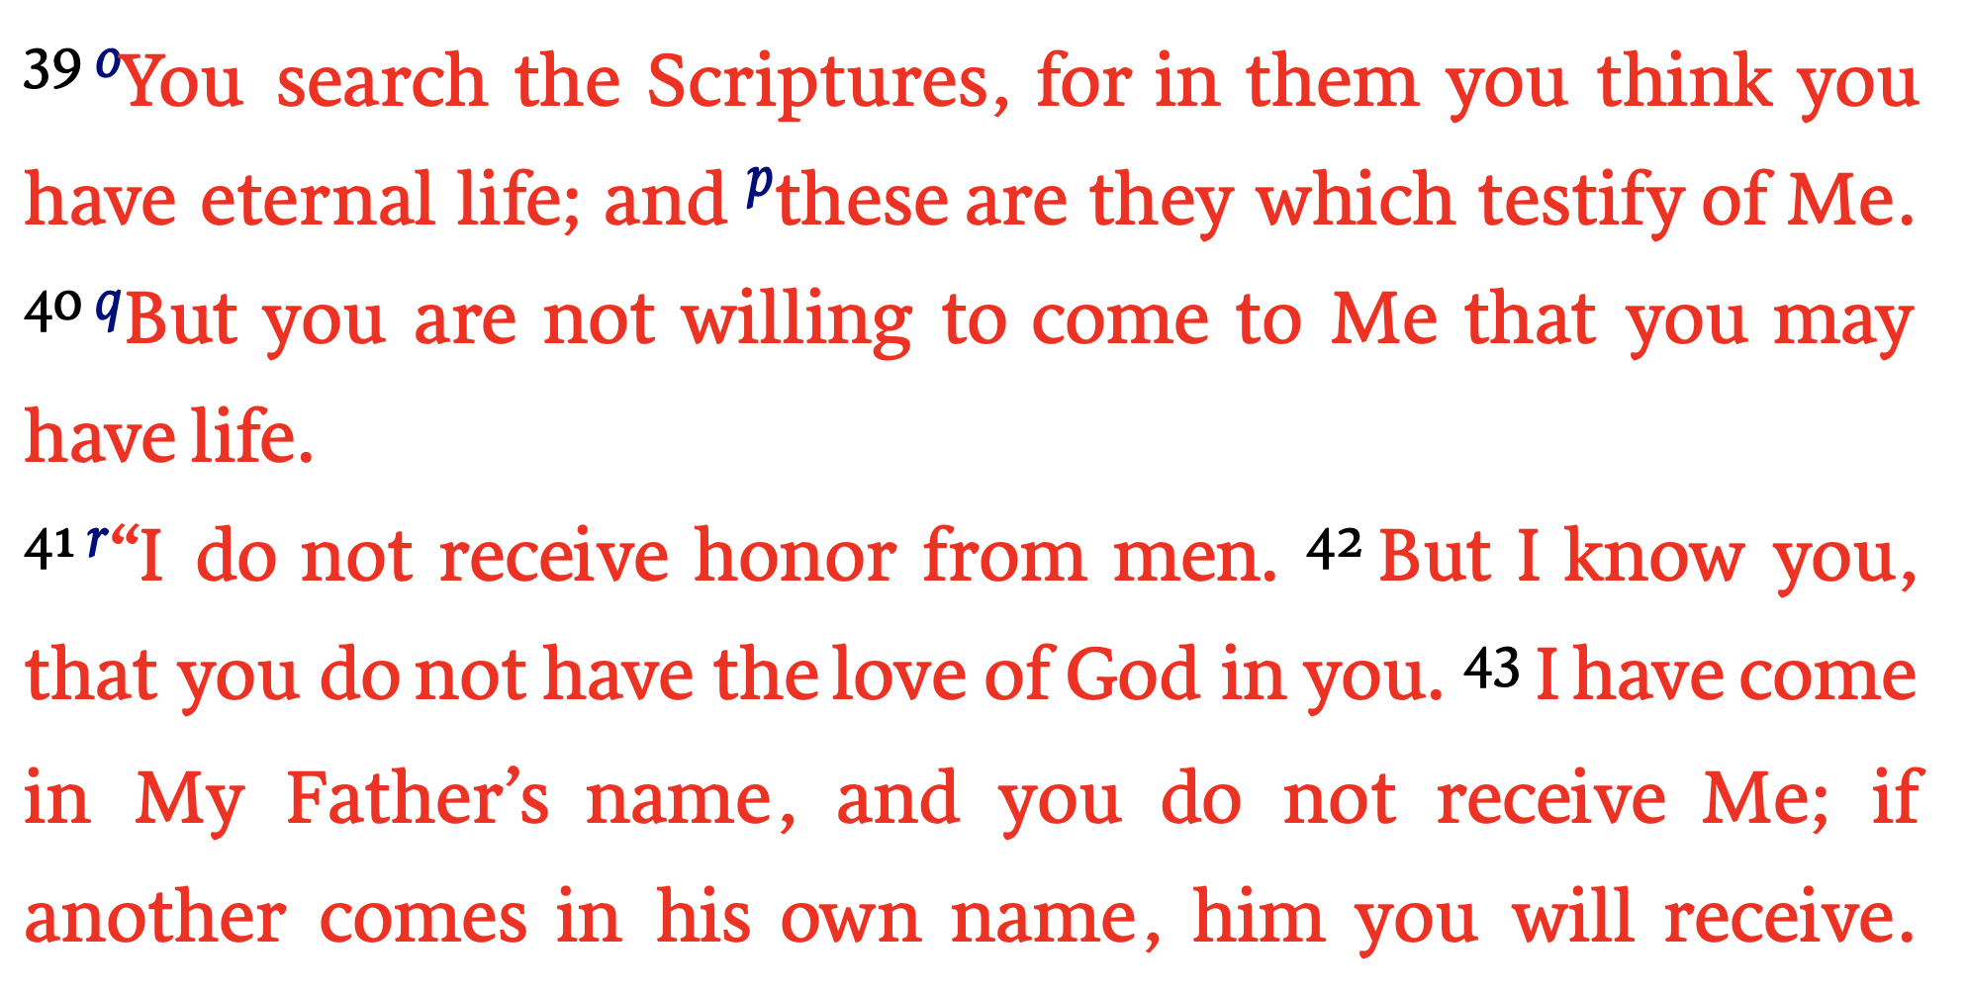
Our Attitude Towards SCRIPTURE MATTERS
John 5:39-47 (NKJV)

Slide 21
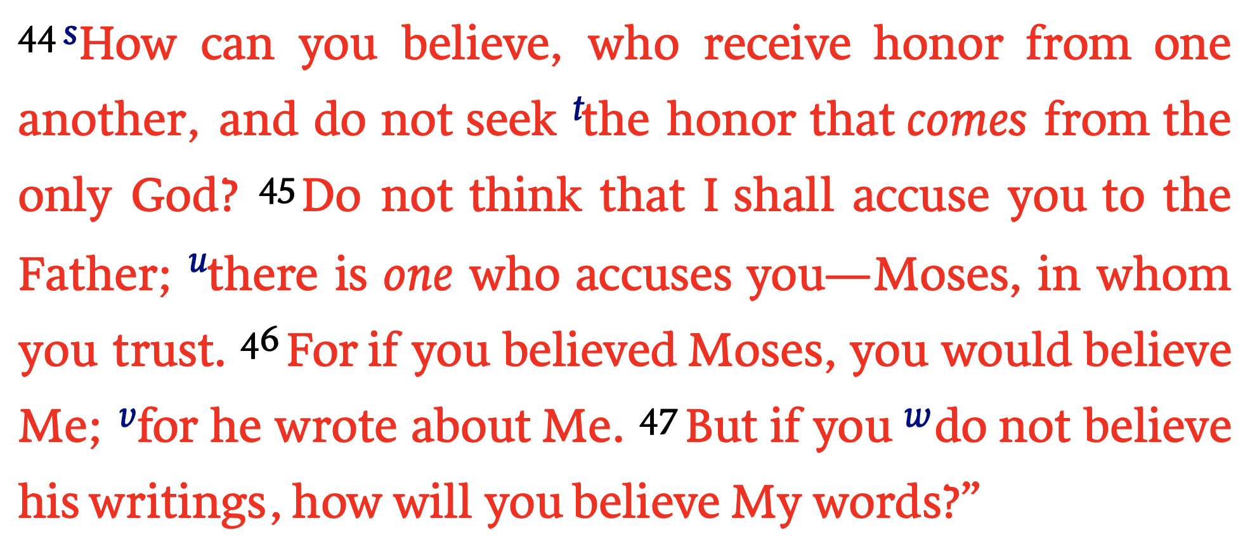
Our Attitude Towards SCRIPTURE MATTERS
John 5:39-47 (NKJV)

Slide 22

Our Attitude Towards SCRIPTURE MATTERS
MUST READ God’s word : “You search the scriptures” (39)
MUST TRUST IN God’s word: “in them you think you have eternal life” (39)
MUST BE WILLING TO BELIEVE & OBEY GOD’s word: “which testify of Me” (40; 7:17)
MUST FEAR, LOVE & SEEK TO HONOR GOD : “⁴⁴How can you believe, who receive honor from one another, and do not seek the honor that comes from the only God?” (41-44; Mat. 15:1-9; )
How can someone say “I love God and I want to please Him,” but yet refuse to believe and obey what He has SAID to us IN HIS WORD?

Slide 23
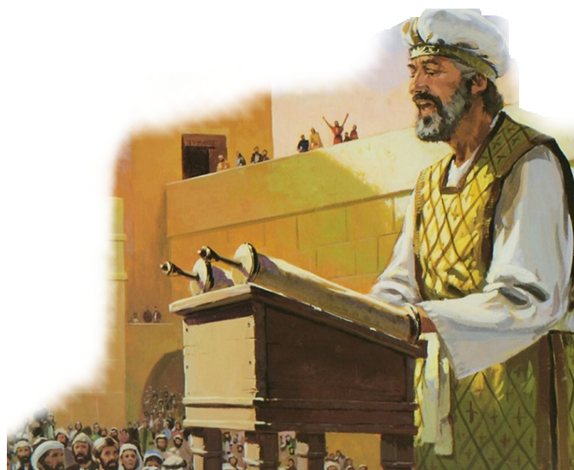

Our Attitude Towards SCRIPTURE MATTERS
NEHEMIAH 8:1-9
They Wanted To Learn [ . . . all the people gathered together as one man] (Neh. 8:1)
They gave God’s word their undivided attention [all the people were attentive to the Book of the Law] (Neh. 8:3)
They demonstrated respect for God’s word [which they had made for the purpose . . . when he opened it, all the people stood up] (Neh. 8:4,5)
They sought accurate understanding [they understood the words that were declared to them] (Neh. 8:12)
They repented and obeyed it [For all the people wept, when they heard the words of the Law] (Neh. 8:9)

Slide 24
Our Attitude Towards SCRIPTURE MATTERS
Acts 17:10–13 (NKJV)
¹¹ These were more fair-minded than those in Thessalonica, in that they received the word with all readiness, and searched the Scriptures daily to find out whether these things were so. ¹² Therefore many of them believed, …
ACCEPTED / EVIDENCE CHANGED THEIR MINDS - BELIEVED / REPENTED / OBEYED
VALUED TRUTH /
NOT GULLIBLE - EXAMINED EVIDENCE OBJECTIVELY.
MEEK / WILLING TO BE CHANGED BY THE TRUTH IF INFORMATION CONFIRMED.
HONEST / WILLING TO HAVE BELIEFS CHALLENGED - LISTENED TO EVIDENCE.

Slide 25
Our Attitude Towards SCRIPTURE MATTERS
ACCEPT / ALLOW EVIDENCE TO CHANGE OUR MINDS - BELIEVE / REPENT / OBEY
FEAR / RESPECT
Proverbs 1:7 (NKJV)
⁷ The fear of the Lord is the beginning of knowledge, But fools despise wisdom and instruction.
VALUE TRUTH /
NOT GULLIBLE - EXAMINE EVIDENCE OBJECTIVELY.
BE MEEK / WILLING TO BE CHANGED BY THE TRUTH IF INFORMATION CONFIRMED.
Proverbs 9:10 (NKJV)
¹⁰ “The fear of the Lord is the beginning of wisdom, And the knowledge of the Holy One is understanding.
BE HONEST / ALLOW OUR BELIEFS TO BE CHALLENGED - LISTEN TO GOD’S WORD.

Slide 26
Our Attitude Towards SCRIPTURE MATTERS
ACCEPT / ALLOW EVIDENCE TO CHANGE OUR MINDS - BELIEVE / REPENT / OBEY
FEAR / RESPECT
Psalm 119:161 (NKJV)
¹⁶¹ Princes persecute me without a cause, But my heart stands in awe of Your word.
VALUE TRUTH /
NOT GULLIBLE - EXAMINE EVIDENCE OBJECTIVELY.
BE MEEK / WILLING TO BE CHANGED BY THE TRUTH IF INFORMATION CONFIRMED.
Isaiah 66:2 (NKJV)
² For all those things My hand has made, And all those things exist,” Says the Lord. “But on this one will I look: On him who is poor and of a contrite spirit, And who trembles at My word.
BE HONEST / ALLOW OUR BELIEFS TO BE CHALLENGED - LISTEN TO GOD’S WORD.

Slide 27
Our Attitude Towards SCRIPTURE MATTERS
ACCEPT / ALLOW EVIDENCE TO CHANGE OUR MINDS - BELIEVE / REPENT / OBEY
FEAR / RESPECT
John 12:47–48 (NKJV)
⁴⁷ And if anyone hears My words and does not believe, I do not judge him; for I did not come to judge the world but to save the world. ⁴⁸ He who rejects Me, and does not receive My words, has that which judges him—the word that I have spoken will judge him in the last day.
VALUE TRUTH /
NOT GULLIBLE - EXAMINE EVIDENCE OBJECTIVELY.
BE MEEK / WILLING TO BE CHANGED BY THE TRUTH IF INFORMATION CONFIRMED.
BE HONEST / ALLOW OUR BELIEFS TO BE CHALLENGED - LISTEN TO GOD’S WORD.

Slide 28
Our Attitude Towards SCRIPTURE MATTERS
ACCEPT / ALLOW EVIDENCE TO CHANGE OUR MINDS - BELIEVE / REPENT / OBEY
TRUST / OBEY
Romans 3:3–4 (NKJV)
³ For what if some did not believe? Will their unbelief make the faithfulness of God without effect? ⁴ Certainly not! Indeed, let God be true but every man a liar. As it is written: “That You may be justified in Your words, And may overcome when You are judged.”
VALUE TRUTH /
NOT GULLIBLE - EXAMINE EVIDENCE OBJECTIVELY.
BE MEEK / WILLING TO BE CHANGED BY THE TRUTH IF INFORMATION CONFIRMED.
BE HONEST / ALLOW OUR BELIEFS TO BE CHALLENGED - LISTEN TO GOD’S WORD.

Slide 29
Our Attitude Towards SCRIPTURE MATTERS
ACCEPT / ALLOW EVIDENCE TO CHANGE OUR MINDS - BELIEVE / REPENT / OBEY
TRUST / OBEY
Plan of salvation
(Mk 16:16; Acts 2:38)
The CHURCH
(Acts 2:47; Eph. 4:5; 5:22-25; Rom. 16:16)
Danger of apostasy
(1 Cor. 10:1-13; Gal. 5:1-4; 2 Peter 2:20-22)
Eschatology
(Jn 5:28,29; 2 Pt. 3:10-14)
VALUE TRUTH /
NOT GULLIBLE - EXAMINE EVIDENCE OBJECTIVELY.
BE MEEK / WILLING TO BE CHANGED BY THE TRUTH IF INFORMATION CONFIRMED.
BE HONEST / ALLOW OUR BELIEFS TO BE CHALLENGED - LISTEN TO GOD’S WORD.

Slide 30

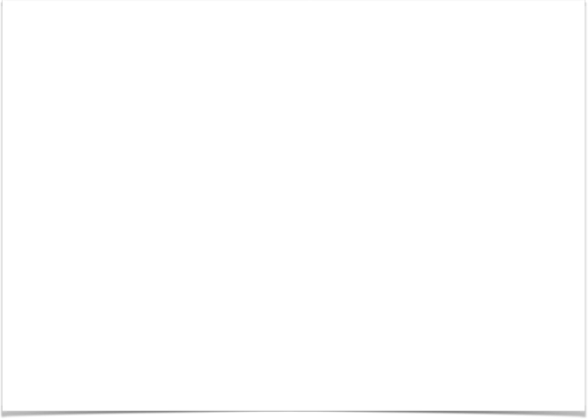
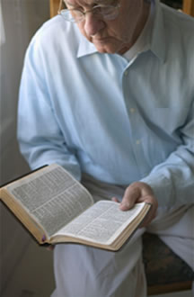
Our Attitude Towards SCRIPTURE MATTERS
¹⁵ Be diligent to present yourself approved to God, a worker who does not need to be ashamed, rightly dividing the word of truth. — 2 Timothy 2:15 (NKJV)
Develop A Genuine Love For The Truth - 2 Thes 2:10-12; Ps 119:97-104; 2 Pet 2:2
Read & Study God’s Word Daily - Acts 17:11,12; Psalm 1:2
Use God’s Word To Mold & Control Our Thoughts, Lives & Homes! - 2 Cor. 10:3-5; Eph 6:1-4
Be Active & Supportive Of The Church and the proclamation of God’s word - Heb 10:24,25; Col 1:28,29; 4:2-4

Slide 31
Our Attitude Towards SCRIPTURE MATTERS
¹⁵ Be diligent to present yourself approved to God, a worker who does not need to be ashamed, rightly dividing the word of truth. — 2 Timothy 2:15 (NKJV)
The importance of establishing Divine authority for ALL we do.
We will accept everything the Bible teaches as truth and follow the teaching of Jesus accurately.
We will recognize our need to study & follow the Bible AS GIVEN!

Slide 32
Our Attitude Towards SCRIPTURE MATTERS
OUR WAY or GOD’S WAY?
IT DOES MATTER!
DO WE LOVE GOD’S WORD? – Ps 119:97-104
Do we believe and stand upon what God teaches in His word? – Jer 6:16; Ep 6:10-17; 2 Tim 3:15-17
ARE we always seeking to make the proper application of scripture? – 2 Tim 2:15; Heb 5:11-14
Will we seek to share our faith - Eph 4:15; 1 Thes 1:8
Psalm 119:97 (NKJV)
⁹⁷ Oh, how I love Your law! It is my meditation all the day.

Slide 33
GRATITUDE
TRUSTING OBEDIENCE
LOVING SUBMISSION
FEAR / RESPECT

Slide 34
Our Attitude SCRIPTURE MATTERS
In order to be pleasing to God, we must have an attitude of complete trust & surrender.
DO WE HAVE AN ATTITUDE TOWARDS SCRIPTURE THAT PROMOTES A LIVING FAITH?
(Acts 17:11,12; John 5:39-47)

Slide 36
Essential Attitudes of A Living Faith
Our Attitude Towards SCRIPTURE MATTERS
(Acts 17:11,12; John 5:39-47)
Charts by Don McClain
Preached May 23, 2021 / West 65th Street church of Christ P.O. Box 190062 / Little Rock AR 72219 / Phone: 501-568-1062 / Email – donmcclain@sbcglobal.net
More Keynote, PPT & Audio Sermons
w65stchurchofchrist.com

Slide 37
Psalm 119:97–104 (NKJV)
⁹⁷ Oh, how I love Your law! It is my meditation all the day. ⁹⁸ You, through Your commandments, make me wiser than my enemies; For they are ever with me. ⁹⁹ I have more understanding than all my teachers, For Your testimonies are my meditation. ¹⁰⁰ I understand more than the ancients, Because I keep Your precepts. ¹⁰¹ I have restrained my feet from every evil way, That I may keep Your word. ¹⁰² I have not departed from Your judgments, For You Yourself have taught me. ¹⁰³ How sweet are Your words to my taste, Sweeter than honey to my mouth! ¹⁰⁴ Through Your precepts I get understanding; Therefore I hate every false way.

