Slide 1
Essential Attitudes of A Living Faith
Our Attitude Towards AUTHORITY MATTERS
(Matthew 8:5-13; 21:23-27; Colossians 3:17)

Slide 2
Our Attitude Towards AUTHORITY MATTERS
"A settled way of thinking or feeling about someone or something, typically one that is reflected in a person's behavior.”
“Beliefs, emotions, and behaviors toward a particular object, person, thing, or event”

Slide 3
Our Attitude Towards AUTHORITY MATTERS
“For as he thinks in his heart, so is he.”
Proverbs 23:7
Cognitive: Your thoughts and beliefs about the subject.
Affective: How the object, person, issue, or event makes you feel.
Behavioral: How attitude influences your behavior.

Slide 4
Our Attitude Towards AUTHORITY MATTERS
{
FAMILIAR BIBLE TERMS

Slide 5
Our Attitude Towards AUTHORITY MATTERS
OUR ATTITUDE MATTERS
OUR ATTITUDE TOWARDS GOD MATTERS
OUR ATTITUDE TOWARDS SCRIPTURE MATTERS
“For as he thinks in his heart, so is he.”
Proverbs 23:7

Slide 6
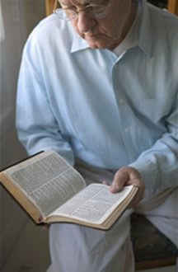
Our Attitude Towards AUTHORITY MATTERS
¹⁵ Be diligent to present yourself approved to God, a worker who does not need to be ashamed, rightly dividing the word of truth. — 2 Timothy 2:15 (NKJV)
IF WE RESPECT, BELIEVE & LOVE GOD’S WORD …
We will accept everything the Bible teaches as truth and strive to follow the teaching of Jesus accurately.
We will recognize our need to study & follow the Bible AS GIVEN!
We will STRIVE to establish Divine authority for ALL we do.

Slide 7
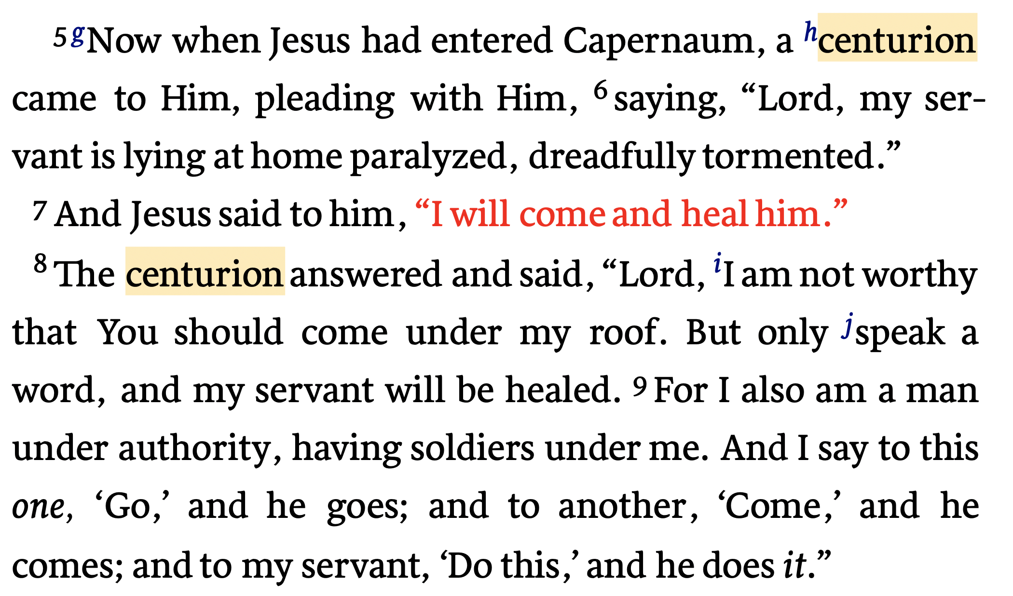
Our Attitude Towards AUTHORITY MATTERS
Matthew 8:5–13 (NKJV)

Slide 8
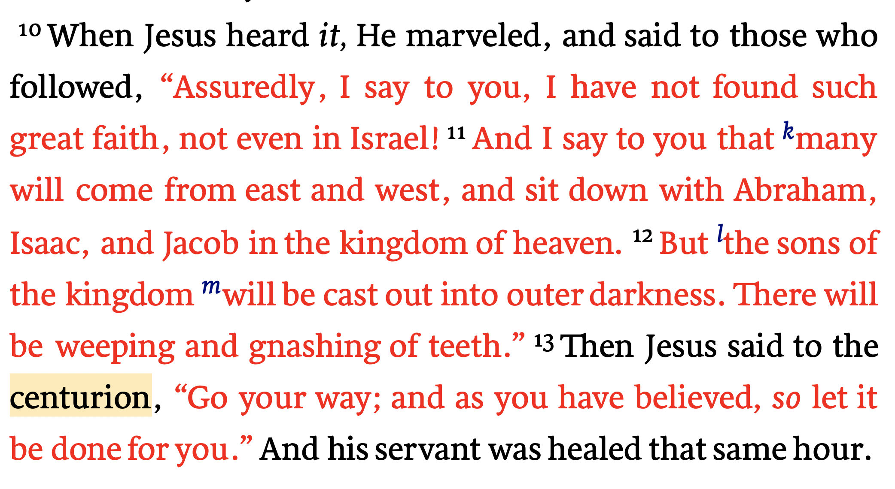
Our Attitude Towards AUTHORITY MATTERS
Matthew 8:5–13 (NKJV)

Slide 9
Our Attitude Towards AUTHORITY MATTERS
Matthew 8:5–7 (NKJV)
⁵ Now when Jesus had entered Capernaum, a centurion came to Him, pleading with Him, ⁶ saying, “Lord, my servant is lying at home paralyzed, dreadfully tormented.” ⁷ And Jesus said to him, “I will come and heal him.”
HE RECOGNIZED JESUS’S AUTHORITY

Slide 10
Our Attitude Towards AUTHORITY MATTERS
Matthew 8:8 (NKJV)
⁸ The centurion answered and said, “Lord, I am not worthy that You should come under my roof. But only speak a word, and my servant will be healed.
HE RECOGNIZED JESUS’S AUTHORITY
HE HUMBLED HIMSELF BEFORE JESUS

Slide 11
Our Attitude Towards AUTHORITY MATTERS
Matthew 8:9 (NKJV)
⁹ For I also am a man under authority, having soldiers under me. And I say to this one, ‘Go,’ and he goes; and to another, ‘Come,’ and he comes; and to my servant, ‘Do this,’ and he does it.”
HE RECOGNIZED JESUS’S AUTHORITY
HE HUMBLED HIMSELF BEFORE JESUS
HE UNDERSTOOD THE NATURE OF AUTHORITY

Slide 12
Our Attitude Towards AUTHORITY MATTERS
Matthew 8:10–11 (NKJV)
¹⁰ When Jesus heard it, He marveled, and said to those who followed, “Assuredly, I say to you, I have not found such great faith, not even in Israel! ¹¹ And I say to you that many will come from east and west, and sit down with Abraham, Isaac, and Jacob in the kingdom of heaven.
HE RECOGNIZED JESUS’S AUTHORITY
HE HUMBLED HIMSELF BEFORE JESUS
HE UNDERSTOOD THE NATURE OF AUTHORITY
AUTHORITY & FAITH ARE INSEPERABLY CONNECTED

Slide 13
Our Attitude Towards AUTHORITY MATTERS
Luke 13:28 (NKJV)
²⁸ There will be weeping and gnashing of teeth, when you see Abraham and Isaac and Jacob and all the prophets in the kingdom of God, and yourselves thrust out.
Matthew 8:12 (NKJV)
¹² But the sons of the kingdom will be cast out into outer darkness. There will be weeping and gnashing of teeth.”
Luke 6:46 (NKJV)
⁴⁶ “But why do you call Me ‘Lord, Lord,’ and not do the things which I say?

Slide 14
Our Attitude Towards AUTHORITY MATTERS
HE RECOGNIZED JESUS’S AUTHORITY
JESUS IS LORD (Mat. 28:18-20; Col. 1:13-20; Heb. 1:1-3)
HUMILITY (Mat. 5:3; James 4:6-10)
SUBMISSION (Lk 6:46; Mat. 28:19,20; Heb. 5:8,9; 2 Thes. 1:7-9)
WALK BY FAITH (2 Cor. 5:7; Rom. 10:17; Jer. 6:16; 1 Cor. 4:6;)
HE HUMBLED HIMSELF BEFORE JESUS
HE UNDERSTOOD THE NATURE OF AUTHORITY
AUTHORITY & FAITH ARE INSEPERABLY CONNECTED

Slide 15
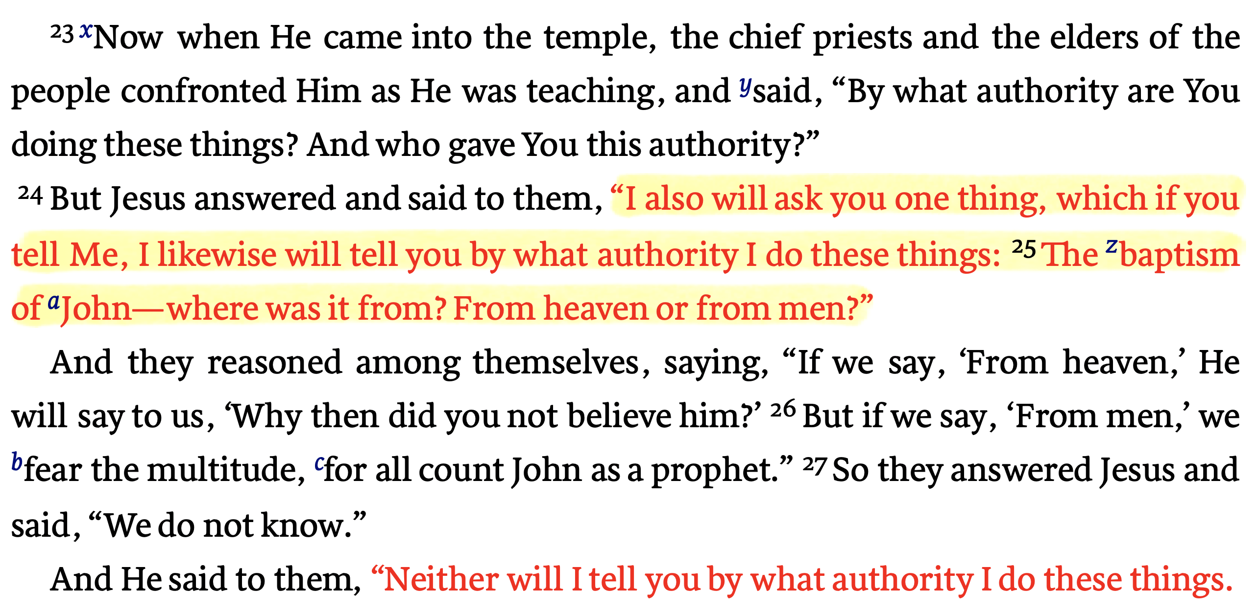
Our Attitude Towards AUTHORITY MATTERS
Matthew 21:23–27 (NKJV)

Slide 16
Our Attitude Towards AUTHORITY MATTERS
Matthew 21:25 (NKJV)
²⁵ The baptism of John—where was it from? From heaven or from men?” And they reasoned among themselves, saying, “If we say, ‘From heaven,’ He will say to us, ‘Why then did you not believe him?’
From Heaven
Mt. 21:23-27
1 John 4:4-6
Gal. 1:6-9
Col. 2:6-10
2 Thess. 2:15
From Men
Mt. 15:1-9
1 Cor. 4:6
Gal. 1:10-17
Col. 2:8
2 Thess. 2:2-4
Walking by faith means walking by what God has said
2 Cor. 5:7; 1 Cor. 4:6; Gal. 1:6-9

Slide 17
Our Attitude Towards AUTHORITY MATTERS
2 Timothy 3:16–17 (NKJV)
¹⁶ All Scripture is given by inspiration of God, and is profitable for doctrine, for reproof, for correction, for instruction in righteousness, ¹⁷ that the man of God may be complete, thoroughly equipped for every good work.
We cannot know the mind of God except through revelation
1 Cor 2:10, 11,14
Eph 3:3-5
Isaiah 55:8,9
Faith comes by hearing the word of CHRIST
Romans 10:17
God has revealed everything He wants us to know & do –
2 Pet 1:3;
2 Tim 3:16,17
Jude 3
Walking by faith means walking by what God has said
2 Cor. 5:7; 1 Cor. 4:6; Gal. 1:6-9

Slide 18
Our Attitude Towards AUTHORITY MATTERS
¹⁵ Be diligent to present yourself approved to God, a worker who does not need to be ashamed, rightly dividing the word of truth. — 2 Timothy 2:15 (NKJV)
Cain & Abel (Gen. 4:1-7; Heb. 11:4)
Noah Built The Ark (Gen. 6; Heb. 11:7)
Nadab and Abihu (Lev. 10:1,2)
Moses Strikes A Rock (Num 20:8-24)
King Saul (1 Sam. 13 & 15)
David’s Ox Cart (1 Chron 13:5-8)
Jeroboam (1 Kings 12:25-33)
Uzziah (2 Chr. 26:16-23)
Walking by faith means walking by what God has said
2 Cor. 5:7; 1 Cor. 4:6

Slide 19
Our Attitude Towards AUTHORITY MATTERS
God STILL means what HE SAYS
(God’s silence is NOT permissive!)
“BECAUSE YOU BELIEVED ME NOT!” — Num. 20:12

Slide 20
Our Attitude Towards AUTHORITY MATTERS
God STILL means what HE SAYS
(God’s silence is NOT permissive!)
Aids & Expedients do not change, by either addition or subtraction, that which God commands! Additions do!
AIDES: Tools to build ark - (saws / ropes / etc.) Gen 6
UNAUTHORIZED: Changes in: size / number of stories / type of wood / more boats
In order for a thing to be an aide or expedient it must first be lawful!
“BECAUSE YOU BELIEVED ME NOT!” — Num. 20:12

Slide 21
Our Attitude Towards AUTHORITY MATTERS
God STILL means what HE SAYS
(God’s silence is NOT permissive!)
Commands | Aids | Expedients | Strange Fire
Assemble (Heb. 10:24-25) | House, Hall, Church Building, | Time on Sunday, , own, rent, how often … | Family Life Center, Gymnasium, Etc.
Lord’s Supper (1 Cor. 11:23-29) | Cups, Plates, Table, Etc. | AM or PM, Homemade? Bought? | Social Meal (1 Co. 11:17-22, 34)
Give (1 Cor. 16:1-2) | Collection Baskets | Order in service, cash, checks, … | Raffles, Chili Suppers, Cake Walks, Etc.
Preaching (Acts 20:7) | Mics, projectors, chalk boards … | Which Biblical subject, order in service … | Politics / Bind Opinions / Entertainers / Women
Sing (Eph. 5:19; etc.) | Song Book, PPT Leader, Pitch Pipe, | # of songs, which songs, On screen, book, memory / stand, sit … | Man made instruments / Praise bands / Clapping

Slide 22
Our Attitude Towards AUTHORITY MATTERS
The AUTHORITY of JESUS MUST BE RESPECTED
Colossians 3:17 (NKJV)
¹⁷ And whatever you do in word or deed, do all in the name of the Lord Jesus, giving thanks to God the Father through Him.

Slide 23
Our Attitude Towards AUTHORITY MATTERS
The AUTHORITY of JESUS MUST BE RESPECTED
2 John 9–11 (NKJV)
⁹ Whoever transgresses and does not abide in the doctrine of Christ does not have God. He who abides in the doctrine of Christ has both the Father and the Son. ¹⁰ If anyone comes to you and does not bring this doctrine, do not receive him into your house nor greet him; ¹¹ for he who greets him shares in his evil deeds.

Slide 24
Our Attitude Towards AUTHORITY MATTERS
The AUTHORITY of JESUS MUST BE RESPECTED
The God of the O.T. and the God of the N.T. is the same God (Acts 5:1-11; Col. 3:17; Heb. 10:26-31).
If we truly respect, love & trust God we will seek to praise and serve Him AS HE HAS spoken (John 4:22-24; 2 Tim 3:16,17; 1 Cor. 4:6).

Slide 25
Our Attitude Towards AUTHORITY MATTERS
The AUTHORITY of JESUS MUST BE RESPECTED
The revealed way of salvation (John 8:24; Luke 13:3,5; Matt. 10:32,33; Mark 16:16; Acts 2:38; 4:12; 10:43,47,48; 22:16; etc.)
The revealed teaching to believe and follow (Acts 2:42; Phil. 3:16; Ga. 6:16; 2 Ti. 3:17)
The revealed church which Christ built (Mat. 16:18; Acts 2:47; Rom. 16:16; Eph. 4:5; 5:23-27; 1 Tim. 3:15)

Slide 26
Our Attitude Towards AUTHORITY MATTERS
The AUTHORITY of JESUS MUST BE RESPECTED
The organization of the church - Acts 14:23; 20:14,28; Phili 1:1; 1 Tim 3:1-8; etc.
The work of the church - (evangelism - 1 Thes. 1:8; edification - Eph. 4:11-16; Benevolence - Acts 11:29)
Worship of the church - (Praying - Acts 4:23-31; L.S. - Acts 20:7; Giving - 1 Cor. 16:1,2; Preaching - Acts 20:7; Singing - Eph 5:19; Col. 3:16)

Slide 27
Our Attitude Towards AUTHORITY MATTERS
The AUTHORITY of JESUS MUST BE RESPECTED
What is OUR attitude towards the need to establish authority for all that we do?
Is the NT the ONLY source for our faith, teaching & practice?
If we add to or take away from the teaching of the NT, are we walking by faith?
If we do only those things we know are authorized in the NT, how confident can we be that we are doing what is right?

Slide 28
Our Attitude Towards AUTHORITY MATTERS
We CANNOT Ignore the AUTHORITY of JESUS’S word and think we will escape His judgment!
2 Thes. 1:7-9; Heb. 10:26-30

Slide 29
Our Attitude AUTHORITY MATTERS
In order to be pleasing to God, we must have an attitude of complete trust & surrender.
DO WE HAVE AN ATTITUDE TOWARDS AUTHORITY THAT PROMOTES A LIVING FAITH?
(Acts 17:11,12; John 5:39-47)

Slide 31
Essential Attitudes of A Living Faith
Our Attitude Towards AUTHORITY MATTERS
(Matthew 8:5-13; 21:23-27; Colossians 3:17)
Charts by Don McClain
Preached May 23, 2021 / West 65th Street church of Christ P.O. Box 190062 / Little Rock AR 72219 / Phone: 501-568-1062 / Email – donmcclain@sbcglobal.net
More Keynote, PPT & Audio Sermons
w65stchurchofchrist.com

Slide 32
Psalm 119:97–104 (NKJV)
⁹⁷ Oh, how I love Your law! It is my meditation all the day. ⁹⁸ You, through Your commandments, make me wiser than my enemies; For they are ever with me. ⁹⁹ I have more understanding than all my teachers, For Your testimonies are my meditation. ¹⁰⁰ I understand more than the ancients, Because I keep Your precepts. ¹⁰¹ I have restrained my feet from every evil way, That I may keep Your word. ¹⁰² I have not departed from Your judgments, For You Yourself have taught me. ¹⁰³ How sweet are Your words to my taste, Sweeter than honey to my mouth! ¹⁰⁴ Through Your precepts I get understanding; Therefore I hate every false way.

