Slide 1
“The Bishop’s Qualifications”
(1 Timothy 3:1-7)

Slide 2
“The Bishop’s Qualifications”
Introduction / Greeting (1:1-7)
Jesus Christ OUR Hope (1:1,2)
The value & necessary commitment to the doctrine of Christ (1:3-7)
The Lawful Use of the Law (1:5-11)
Paul : A Pattern (1:12-17)
If Paul can be saved ANYONE can be saved!
Fight the good fight (1:18-20)
Pray for leaders (2:1-7)
Behavior of men & women in the church (2:8-15)

Slide 3
“The Bishop’s Qualifications”
Chapter 3 deals primarily with the qualifications of elders, (3:1-7) and deacons, (3:8-14).
Our study will focus on the qualifications of bishops (elders, pastors) (cf. Titus 1:5-9)
These are both absolute & relative.
Absolute - One either has them or he does not (husband, father …)
Relative - possessed in varying degrees, (hospitable, teacher, etc.)
All qualifications MUST be possessed to the degree of proficiency or in an appreciable measure.

Slide 4
1 Timothy 3:1–7 (NKJV)
¹ This is a faithful saying: If a man desires the position of a bishop, he desires a good work. ² A bishop then must be blameless, the husband of one wife, temperate, sober-minded, of good behavior, hospitable, able to teach; ³ not given to wine, not violent, not greedy for money, but gentle, not quarrelsome, not covetous; ⁴ one who rules his own house well, having his children in submission with all reverence

Slide 5
1 Timothy 3:1–7 (NKJV)
⁵ (for if a man does not know how to rule his own house, how will he take care of the church of God?); ⁶ not a novice, lest being puffed up with pride he fall into the same condemnation as the devil. ⁷ Moreover he must have a good testimony among those who are outside, lest he fall into reproach and the snare of the devil.

Slide 6
“The Bishop’s Qualifications”
What Is A Bishop?
The terms bishop, elder, & pastor are descriptive terms emphasizing a different aspect of the work and function pertaining to the same office.
“Bishops” (episkopeo)
“Elders” (presbuteros)
“Pastors” (poimaino)
1 Timothy 3:1 (NKJV)
¹ This is a faithful saying: If a man desires the position of a bishop, he desires a good work.

Slide 7
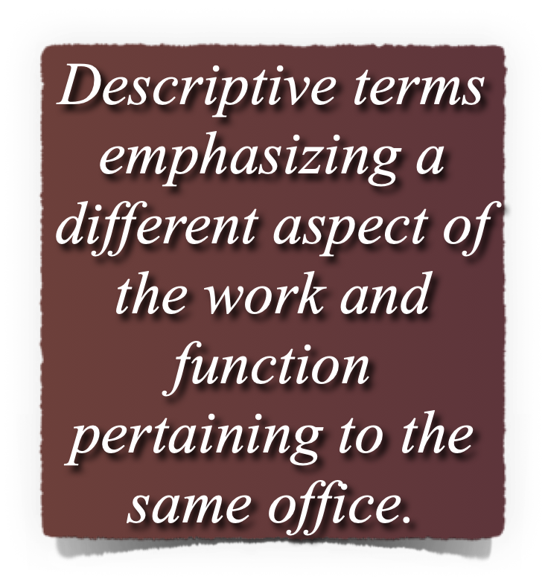
“The Bishop’s Qualifications”
What Is A Bishop?
1 Peter 5:1-2 (NKJV)
¹The elders (presbuteros), who are among you I exhort, I who am a fellow elder and a witness of the sufferings of Christ, and also a partaker of the glory that will be revealed: ²Shepherd (poimen), the flock of God which is among you, serving as overseers, (episkopos),

Slide 8
“The Bishop’s Qualifications”
What Is A Bishop?
Bishop [episkopos (n); episkopeo (v)] – Denotes the overseeing function – not legislative, but leading and enforcing within the Law of God (Acts 20:28; 1 Pet 5:2; Heb 13:7,17)
Pastor, shepherd [poimen (n); poimaino (v)] Emphasizes the care, watching & feeding of the flock of God over which they have been appointed. (Act 20:28; Ep 4:11; 1 Pet 5:2)
Elder - [presbuteros (n)] denotes age & seasoned wisdom that belong to its experiences (Ac 14:23; 20:17; 1 Pt 5:1)

Slide 9
“The Bishop’s Qualifications”
What Is A Bishop?
The NT reveals a pattern of a plurality of such men in each local church (Acts 14:23; 1 Pet. 5:2).
The elders had authority (rule, oversight, responsibility) only in the local church that appointed them and did not extend beyond the “flock among them!” (Acts 20:28; 1 Pet 5:1-3)
The absence of elders was considered by Paul as that which was “lacking.” (Titus 1:5)

Slide 10
“The Bishop’s Qualifications”
A Devoted Man
“If a man desires the position of a bishop”
This is not the desire to possess authority according to self will, but to serve God and brethren as a conscientious steward (Titus 1:7; I Peter 5:2, 3).
The objective of his work is the glory of God and the salvation of souls.
1 Timothy 3:1 (NKJV)
¹ This is a faithful saying: If a man desires the position of a bishop, he desires a good work.

Slide 11
“The Bishop’s Qualifications”
A Godly Man
“Blameless” (1 Tim 3:2)
“Of Good Behavior” (1 Tim 3:2)
“Just” (Tit 1:8)
“Holy, NKJV / Devout ASV” (Tit 1:8)
1 Timothy 3:2 (NKJV)
² A bishop then must be blameless, the husband of one wife, temperate, sober-minded, of good behavior, hospitable, able to teach;

Slide 12
“The Bishop’s Qualifications”
A Godly Man
Elders are to be examples to the flock (I Peter 5:3).
They should be men worthy of imitation (Heb. 13:7).
Their example in the community will reflect even more powerfully on the entire congregation.
They need to be known in the community as men of integrity.
1 Timothy 3:2 (NKJV)
² A bishop then must be blameless, the husband of one wife, temperate, sober-minded, of good behavior, hospitable, able to teach;

Slide 13
“The Bishop’s Qualifications”
A Family Man
“The husband of one wife” (I Tim 3:2).
One must be married (True, . . .)
A man cannot be an adulterer or polygamist (True, . . .)
Literally, in the Greek the phrase may be rendered as a “one woman man.” - An overseer must have demonstrated faithfulness in his marriage.
Not merely that he is a husband, but that he is a devoted husband.
1 Timothy 3:2 (NKJV)
² A bishop then must be blameless, the husband of one wife, temperate, sober-minded, of good behavior, hospitable, able to teach;

Slide 14
“The Bishop’s Qualifications”
A Qualified Man
“One who rules his own house well” (I Tim 3:4).
He must have submissive and obedient children (I Tim. 3:3, 4; Titus 1:6).
Child/Children argument - [The Greek word “teknon” is comprehensive / plural, but inclusive of the singular; cf Gen. 21:7; Deut. 25:5; Mat. 22:24; Luke 20:28-33; I Tim. 5:4,9,10).
1 Timothy 3:2 (NKJV)
² A bishop then must be blameless, the husband of one wife, temperate, sober-minded, of good behavior, hospitable, able to teach;

Slide 15
“The Bishop’s Qualifications”
A Qualified Man
“One who rules his own house well” (I Tim 3:4).
Often lost in all of the discussions over “plurality of children” and “faithful children” is the basic qualification –
A man MUST have demonstrated the ability to keep his children “under control with all dignity.”
The Family teaches and gives evidence of one’s leadership abilities.
1 Timothy 3:2 (NKJV)
² A bishop then must be blameless, the husband of one wife, temperate, sober-minded, of good behavior, hospitable, able to teach;

Slide 16
“The Bishop’s Qualifications”
A Qualified Man
“One who rules his own house well” (I Tim 3:4).
The reason for the qualification is explicitly stated (I Timothy 3:5)
Has he demonstrated the ability to be a servant / leader, to be tender, but also to administer discipline and correction?
Does he have the relational skills to work with people / provide wise counsel & guidance / provide discipline.
1 Timothy 3:2 (NKJV)
² A bishop then must be blameless, the husband of one wife, temperate, sober-minded, of good behavior, hospitable, able to teach;

Slide 17
“The Bishop’s Qualifications”
A Peaceful Man
He is to be a man of self control, not quick tempered (Titus 1:7-8)
He is not contentious (I Timothy 3:3).
He is not self-willed (Titus 1:7).
1 Timothy 3:2 (NKJV)
² A bishop then must be blameless, the husband of one wife, temperate, sober-minded, of good behavior, hospitable, able to teach;

Slide 18
“The Bishop’s Qualifications”
A Peaceful Man
Elders find themselves counseling brethren in highly emotional and volatile situations.
They often have to mediate situations where numerous parties are involved in sin.
They must confront brethren in sin and stop the efforts of false teachers.
They must bear up under false accusations by some who will criticize without knowing all the facts about a situation.
1 Timothy 3:2 (NKJV)
² A bishop then must be blameless, the husband of one wife, temperate, sober-minded, of good behavior, hospitable, able to teach;

Slide 19
“The Bishop’s Qualifications”
A Capable Man
“Able to teach” (1 Tim. 3:2)
The Greek term here is didaktikon which means “skilled in teaching” (Vine).
Not a novice, but mature Christian (1 Tim 3:6), Able to lead by example and take oversight with humility (I Pet. 5:2, 3).
Equipped to Protect (Titus 1:9-11; cf. Acts 20:28-29; I Tim 3:5; Titus 1:9-11).
1 Timothy 3:2 (NKJV)
² A bishop then must be blameless, the husband of one wife, temperate, sober-minded, of good behavior, hospitable, able to teach;

Slide 20
“The Bishop’s Qualifications”
A Sensible Man
Elders are to be temperate and sober minded, prudent (I Tim. 3:2).
Eyes open to the way things are.
He must be careful, wise and use good judgment - able to see the big picture.
He is not to be led by emotion, but sound reason.
He is committed to truth even under pressure.
1 Timothy 3:2 (NKJV)
² A bishop then must be blameless, the husband of one wife, temperate, sober-minded, of good behavior, hospitable, able to teach;

Slide 21
“The Bishop’s Qualifications”
A Caring Man
Elders are to “take care of the church of God” - (I Tim. 3:5).
Encourage & support weak members - (Gal. 6:1; James 5:13-16)
Approachable - (1 Tim 3:3)
He needs to know the flock - (Jn 10:3,14)
Elders are to be “hospitable” - (I Tim. 3:2).
Providing for the needs of others - (Heb. 13:1-3)
1 Timothy 3:2 (NKJV)
² A bishop then must be blameless, the husband of one wife, temperate, sober-minded, of good behavior, hospitable, able to teach;

Slide 22
“The Bishop’s Qualifications”
A Bishop Must Be
A Godly Man
A Family Man
A Qualified Leader
A Peaceful Man
A Capable Man
A Sensible Man
A Caring Man
1 Timothy 3:2 (NKJV)
² A bishop then must be blameless, the husband of one wife, temperate, sober-minded, of good behavior, hospitable, able to teach;

Slide 23
“The Bishop’s Qualifications”
The church of today & tomorrow NEEDS godly leadership!
Godly leadership is extremely important in a local church!
Every father & mother should strive to raise their sons and daughters in a way that will equip them to be faithful servants of God -
Every young man should strive to grow and mature in the faith - make wise decisions - that will prepare him so that one day he will be able to serve & help shepherd the Lord’s flock.
1 Timothy 3:2 (NKJV)
² A bishop then must be blameless, the husband of one wife, temperate, sober-minded, of good behavior, hospitable, able to teach;

Slide 25
“The Bishop’s Qualifications”
(1 Timothy 3:1-7)
Charts by Don McClain
Preached April 18, 2021 / West 65th Street church of Christ P.O. Box 190062 / Little Rock AR 72219 / Phone: 501-568-1062
Email – donmcclain@sbcglobal.net
More Keynote, PPT & Audio Sermons
w65stchurchofchrist.com

Slide 26
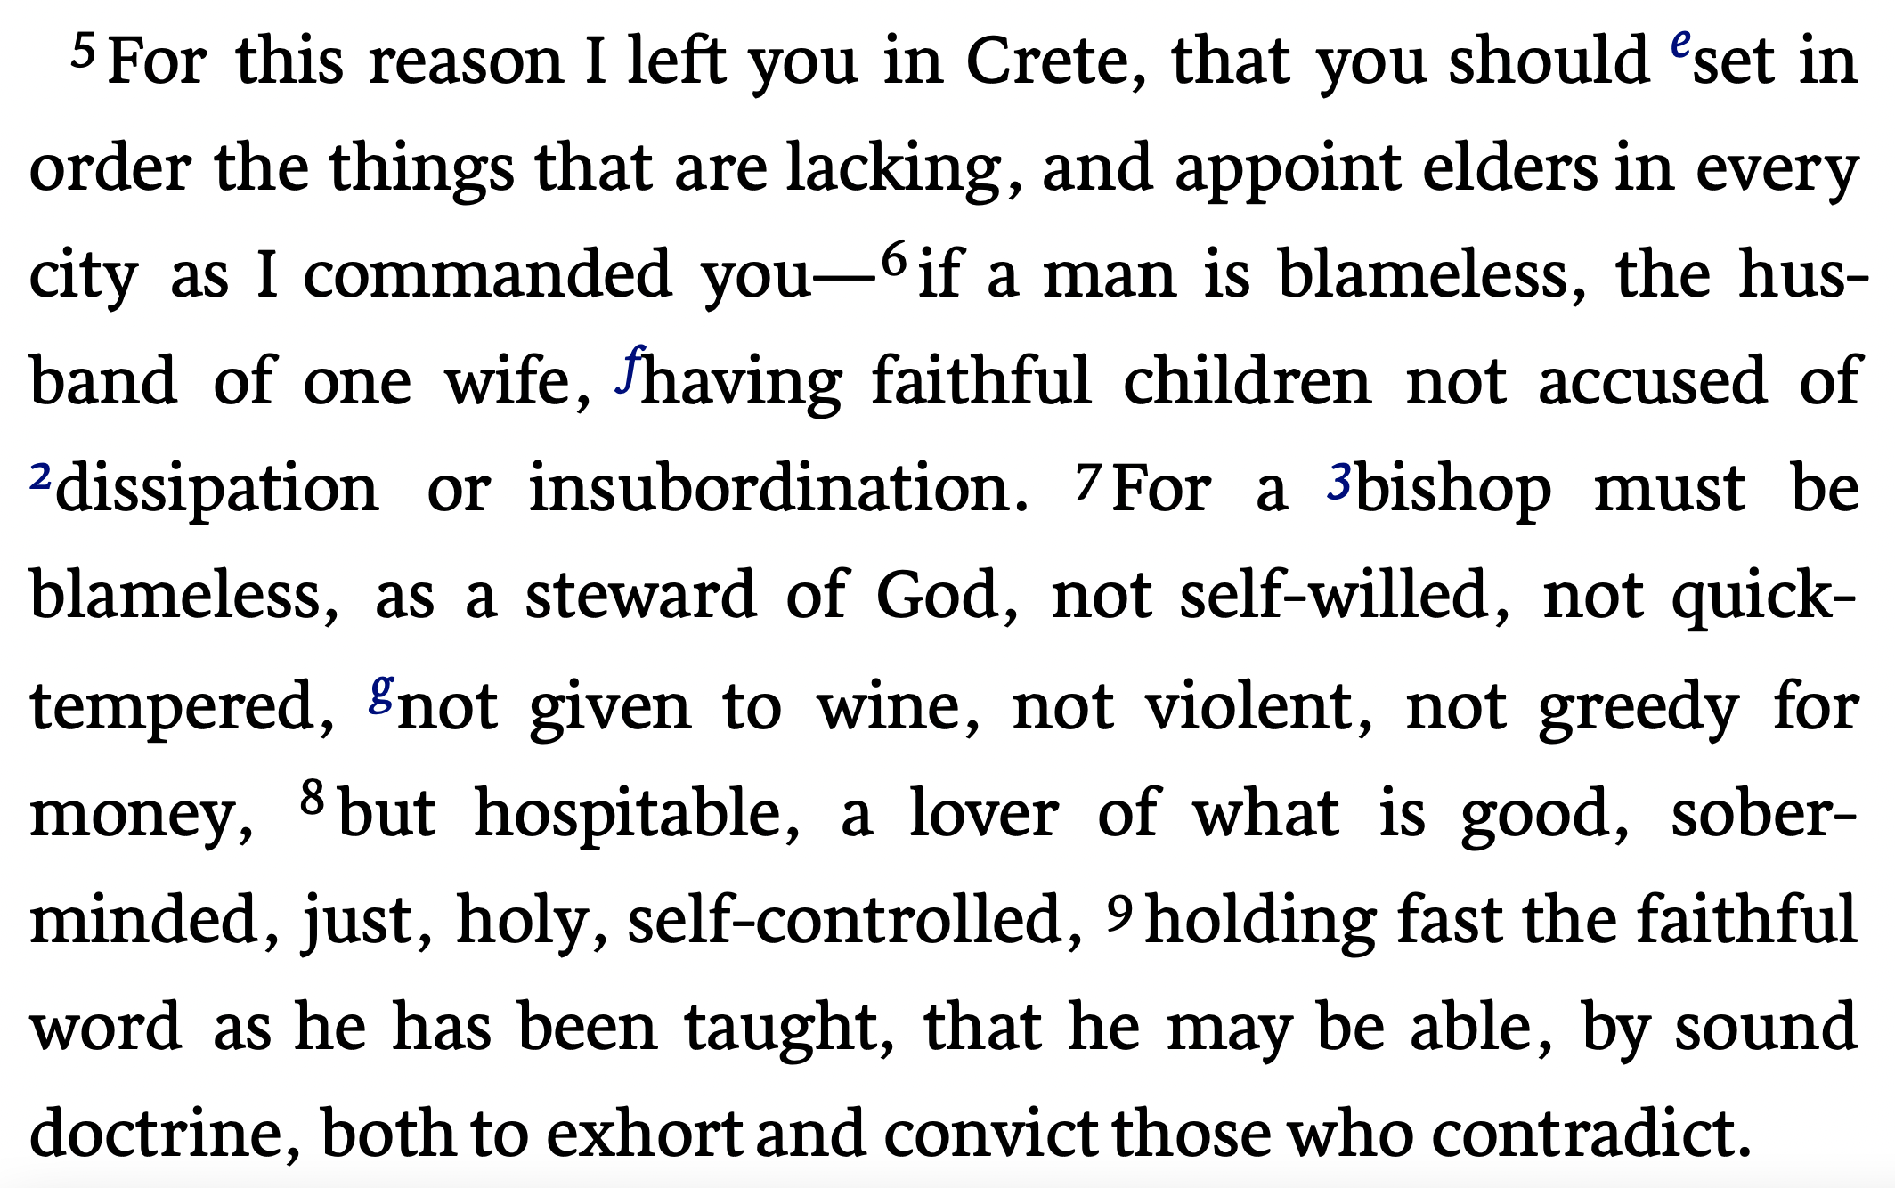
Titus 1:5–9 (NKJV)

