Slide 1
(2 Peter 3:1-15)
“CERTAINTY OF THE DAY OF THE LORD”

Slide 2
“The DANGER of False Teachers”
THE DANGER CAN BE OVERCOME
KNOW THE TRUTH
RECEIVE AND USE GOD’S PROVISION (1:3)
GIVE ALL DILIGENCE TO GROW (1:5-10)
BE AWARE OF THE DANGER OF FALSE TEACHERS - OF THEIR TACTICS, METHODS, AND THE CONSEQUENCES OF BEING DECEIVED (2:1-22)

Slide 3
The Certainty of
2 Peter 3:1-15
“But the day of the Lord will come as a thief in the night, in which the heavens will pass away with a great noise, and the elements will melt with fervent heat; both the earth and the works that are in it will be burned up.” — 2 Peter 3:10 (NKJV)

Slide 4
The Certainty of
“The Day of the LORD”
Various Views of Eschatology
VIEWS | Pre millennial | Post millennial | A millennial | Trans millennial
Resurrection | Future - 2 or 3 | Future - 1 | Future - 1 | Past - Spiritual
Reign | Future Material 1K yr. reign | 1k Yr Current / Spiritual | 1k Yr Current / Spiritual | Spiritual / Completed
Kingdom | Future / Earthly 1K yr. reign | Current / Spiritual | Current / Spiritual | Past / Present / Eternal NOW
Coming | 2 - Future | 1 - Future | 1 - Future | 1 - Past
Judgment | 2 - Future | 1 - Future | 1 - Future | 1 - Past
World | Antichrist / Trib / Wars … | Improves Into Glory | Digresses unto Destruction | Never Destroyed

Slide 5
The Certainty of
“The Day of the LORD”
Various Views of Eschatology
VIEWS | Pre millennial | Post millennial | A millennial | Trans millennial
Resurrection | Future - 2 or 3 | Future - 1 | Future - 1 | Past - Spiritual
Reign | Future Material 1K yr. reign | 1k Yr Current / Spiritual | 1k Yr Current / Spiritual | Spiritual / Completed
Kingdom | Future / Earthly 1K yr. reign | Current / Spiritual | Current / Spiritual | Past / Present / Eternal NOW
Coming | 2 - Future | 1 - Future | 1 - Future | 1 - Past
Judgment | 2 - Future | 1 - Future | 1 - Future | 1 - Past
World | Antichrist / Trib / Wars … | Improves Into Glory | Digresses unto Destruction | Never Destroyed

Slide 6
2 Peter 3:1–15 (NKJV)
¹ Beloved, I now write to you this second epistle (in both of which I stir up your pure minds by way of reminder), ² that you may be mindful of the words which were spoken before by the holy prophets, and of the commandment of us, the apostles of the Lord and Savior, ³ knowing this first: that scoffers will come in the last days, walking according to their own lusts, ⁴ and saying, “Where is the promise of His coming? For since the fathers fell asleep, all things continue as they were from the beginning of creation.”

Slide 7
2 Peter 3:1–15 (NKJV)
⁵ For this they willfully forget: that by the word of God the heavens were of old, and the earth standing out of water and in the water, ⁶ by which the world that then existed perished, being flooded with water. ⁷ But the heavens and the earth which are now preserved by the same word, are reserved for fire until the day of judgment and perdition of ungodly men. ⁸ But, beloved, do not forget this one thing, that with the Lord one day is as a thousand years, and a thousand years as one day. ⁹ The Lord is not slack concerning His promise, as some count slackness, but is longsuffering toward us, not willing that any should perish but that all should come to repentance.

Slide 8
2 Peter 3:1–15 (NKJV)
¹⁰ But the day of the Lord will come as a thief in the night, in which the heavens will pass away with a great noise, and the elements will melt with fervent heat; both the earth and the works that are in it will be burned up. ¹¹ Therefore, since all these things will be dissolved, what manner of persons ought you to be in holy conduct and godliness, ¹² looking for and hastening the coming of the day of God, because of which the heavens will be dissolved, being on fire, and the elements will melt with fervent heat? ¹³ Nevertheless we, according to His promise, look for new heavens and a new earth in which righteousness dwells.

Slide 9
2 Peter 3:1–15 (NKJV)
¹⁴ Therefore, beloved, looking forward to these things, be diligent to be found by Him in peace, without spot and blameless; ¹⁵ and consider that the longsuffering of our Lord is salvation—as also our beloved brother Paul, according to the wisdom given to him, has written to you,

Slide 10
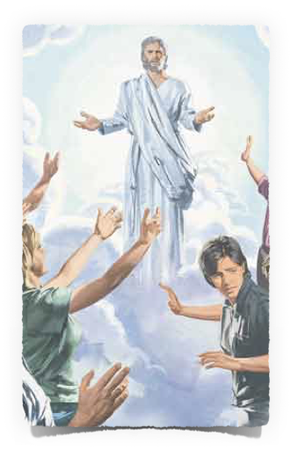
The Certainty of
“The Day of the LORD”
¹ Beloved, I now write to you this second epistle (in both of which I stir up your pure minds by way of reminder), — 2 Peter 3:1 (NKJV)
We NEED TO BE REMINDED
Of the truth taught by God’s messengers — God will judge the wicked! — (2-7)
This world will be destroyed — (7, 10,11)
God’s will is that men not perish but come to repentance — (9,14)
In view of God’s judgment, we must live in “holy conduct and godliness” — (11)
Be diligent that we be found by Him in peace, without spot & blameless — (14)
To GROW in knowledge — (17-18)

Slide 11
The Certainty of
“The Day of the LORD”
“Where is the promise of His coming?” 2 PETER 3:3,4
What would the “mockers” and “scoffers” DENIY?
2 Peter 3:3–4 (NKJV)
³ … scoffers will come in the last days, walking according to their own lusts, ⁴ and saying, “Where is the promise of His coming? For since the fathers fell asleep, all things continue as they were from the beginning of creation.”
The future fulfillment of God’s promise — “the promise of His coming” — i.e., universal judgment (4)
They reject God’s judgment because they are determined to live according “to their own lust.” (3)
Their assertion was based on the absence of God’s historical judgment upon sinful men (4)

Slide 12
The Certainty of
“The Day of the LORD”
“this they willfully forget” — 2 PETER 3:5-7
What would the “mockers” and “scoffers” FORGET?
2 Peter 3:5–6 (NKJV)
⁵ For this they willfully forget: that by the word of God the heavens were of old, and the earth standing out of water and in the water, ⁶ by which the world that then existed perished, being flooded with water.
They forget about the past judgments of God (5,6; cf. 2:4-7)
God fulfilled His promise to judge the wickedness of men when he flooded the earth with water which He had previously created (5,6)
They forget God does not view time like we do (8)

Slide 13
The Certainty of
“The Day of the LORD”
“the day of the Lord will come” — 2 PETER 3:7-13
2 Peter 3:7 (NKJV)
⁷ But the heavens and the earth which are now preserved by the same word, are reserved for fire until the day of judgment and perdition of ungodly men.
The present heavens and earth are reserved for FIRE …
The word of God brought forth the physical “heavens & earth” (5; Gen. 1:1-2).
The word of God is preserving the same “heavens and earth” (7)
The phrase “heavens & earth” of 3:7, 10-12 is just as literal as the phrase “heavens & earth” of 3:5.

Slide 14
The Certainty of
“The Day of the LORD”
“the day of the Lord will come” — 2 PETER 3:7-13
2 Peter 3:7 (NKJV)
⁷ But the heavens and the earth which are now preserved by the same word, are reserved for fire until the day of judgment and perdition of ungodly men.
The present heavens and earth are reserved for FIRE …
The judgment of this context is a universal judgment that affects all creation — against all ungodly men,(6,7,10-12; cf. Jn 5:28,29; Ac 17:30-31)
The entire “literal” world was flooded therefore the literal "heavens & earth” will be destroyed with fire (Gen. 7:11; 9:11, 15; 2 Pet. 3:7,10-12).

Slide 15
The Certainty of
“The Day of the LORD”
“the day of the Lord will come” — 2 PETER 3:7-13
DESTRUCTION WILL BE AS UNIVERSAL AS CREATION!
CREATION
VERSES 3,4
FLOOD
VERSES 5,6
COMING
VERSES 7,10-12
all continues just as it was from the beginning of creation.”
UNIVERSAL JUDGMENT WITH WATER
UNIVERSAL JUDGMENT WITH FIRE
DESTRUCTION WILL BE AS UNIVERSAL AS THE FLOOD!

Slide 16
The Certainty of
“The Day of the LORD”
“the day of the Lord will come” — 2 PETER 3:7-13
2 Peter 3:8–9 (NKJV)
⁸ But, beloved, do not forget this one thing, that with the Lord one day is as a thousand years, and a thousand years as one day. ⁹ The Lord is not slack concerning His promise, as some count slackness, …
The present heavens and earth are reserved for FIRE …
“One day being as 1,000 years and 1,000 years as one day” is NOT a statement of “this is equal to that.”
Instead, Peter is stating God is outside of time and is not bound by time.

Slide 17
The Certainty of
“The Day of the LORD”
“the day of the Lord will come” — 2 PETER 3:7-13
2 Peter 3:9 (NKJV)
⁹ The Lord is not slack concerning His promise, as some count slackness, but is longsuffering toward us, not willing that any should perish but that all should come to repentance.
The present heavens and earth are reserved for FIRE …
“One day being as 1,000 years and 1,000 years as one day” is NOT a statement of “this is equal to that.”
Instead, Peter is stating God is outside of time and is not bound by time.
God’s delay in judging men is not an indication of His unwillingness to punish the wicked, but rather His willingness to save the penitent (9)

Slide 18
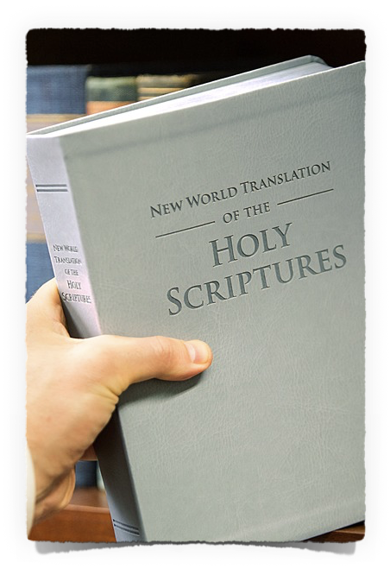
The Certainty of
“The Day of the LORD”
“the day of the Lord will come” — 2 PETER 3:7-13
Future of The Earth?
The phrase “the end of the world,” which appears in many Bible translations, can also be rendered as “the conclusion of the system of things,” or “the close of the age.” … It refers, not to the destruction of the earth or of all humanity, but to the end of the framework of human society. —1 John 2: 17. The Bible teaches that “evil men will be done away with” so that good people can enjoy life on earth.—
(Jehovah’s Witnesses, When Will the World End? / https://www.jw.org/en/bible-teachings/questions/end-of-the-world/

Slide 19
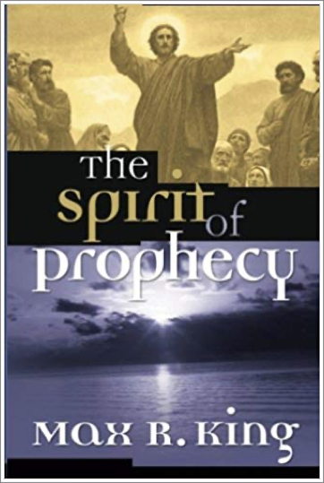
The Certainty of
“The Day of the LORD”
“the day of the Lord will come” — 2 PETER 3:7-13
Future of The Earth?
Max King: “The Holy Scriptures teach the second coming of Christ, including the establishment of the eternal kingdom, the day of judgment, the end of the world, and the resurrection of the dead, occurred with the fall of Judaism in 70 A.D.” (The Nichols-King Debate, 1)

Slide 20
The Certainty of
“The Day of the LORD”
“the day of the Lord will come” — 2 PETER 3:7-13
⁴ and saying, “Where is the promise of His coming? For ever since the fathers fell asleep, all continues just as it was from the beginning of creation.” (3:4)
⁷ But by His word the present heavens and earth are being reserved for fire, kept for the day of judgment and destruction of ungodly men. (3:7)
¹⁰ But the day of the Lord will come like a thief,
in which the heavens will pass away with a roar
and the elements will be destroyed with intense heat,
and the earth and its works will be burned up.

Slide 21
The Certainty of
“The Day of the LORD”
“the day of the Lord will come” — 2 PETER 3:7-13
2 Peter 3:10 (NKJV)
¹⁰ But the day of the Lord will come as a thief in the night, in which the heavens will pass away with a great noise, and the elements will melt with fervent heat; both the earth and the works that are in it will be burned up.
“Heavens will pass away with a great noise” (10)
ROAR - 14.85 ῥοιζηδόν: … pertaining to a sudden noise made by swift movement—‘with a shrill noise, with a rushing noise.’ οἱ οὐρανοὶ ῥοιζηδὸν παρελεύσονται ‘the heavens will disappear with a rushing noise’ 2 Pe 3:10. The expression ‘with a rushing noise’ may be rendered as ‘suddenly and with a roar’ or ‘quickly and with a lot of noise.’ —

Slide 22
The Certainty of
“The Day of the LORD”
“the day of the Lord will come” — 2 PETER 3:7-13
2 Peter 3:10 (NKJV)
¹⁰ But the day of the Lord will come as a thief in the night, in which the heavens will pass away with a great noise, and the elements will melt with fervent heat; both the earth and the works that are in it will be burned up.
“Elements will melt with fervent heat” (10)
Elements - stoicheion (στοιχει̂ον, 4747),
In the NT it is used of
(a) the substance of the material world, 2 Pet. 3:10, 12;
(b) the speculations of gentile cults and of Jewish theories, … Col. 2:8,
(c) the rudimentary principles of religion, Jewish or Gentile, … Col. 2:20, and … Gal. 4:3, 9,
(d) the “elementary” principles (the A.B.C.’s) of God’s word … Heb. 5:12,

Slide 23
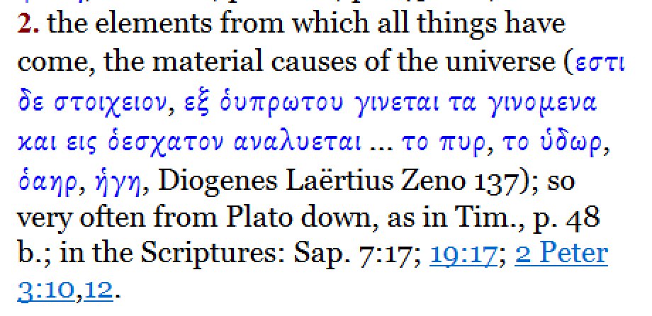
The Certainty of
“The Day of the LORD”
“the day of the Lord will come” — 2 PETER 3:7-13
2 Peter 3:10 (NKJV)
¹⁰ But the day of the Lord will come as a thief in the night, in which the heavens will pass away with a great noise, and the elements will melt with fervent heat; both the earth and the works that are in it will be burned up.
“Elements will melt with fervent heat” (10)
ELEMENTS στοιχεῖα^{c}, ων n: <G4747>,
Thayer / Greek-English Lexicon of the New Testament.

Slide 24
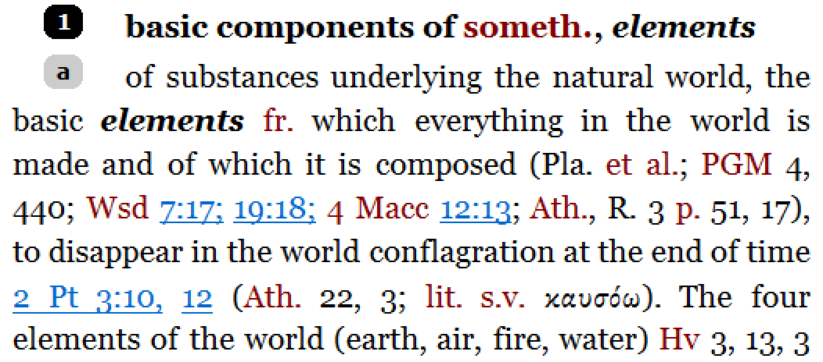
The Certainty of
“The Day of the LORD”
“the day of the Lord will come” — 2 PETER 3:7-13
2 Peter 3:10 (NKJV)
¹⁰ But the day of the Lord will come as a thief in the night, in which the heavens will pass away with a great noise, and the elements will melt with fervent heat; both the earth and the works that are in it will be burned up.
“Elements will melt with fervent heat” (10)
ELEMENTS στοιχεῖα^{c}, ων n: <G4747>,
BDAG / A Greek-English Lexicon of the New Testament and Other Early Christian Literature.

Slide 25
The Certainty of
“The Day of the LORD”
“the day of the Lord will come” — 2 PETER 3:7-13
LITERAL
LITERAL
LITERAL
The creation of the material world (4,5)
The flood of the material world (6)
The present material heavens & earth reserved for fire (7)
ALSO LITERAL
¹⁰ But the day of the Lord will come like a thief, in which the heavens will pass away with a roar and the elements will be destroyed with intense heat, and the earth and its works will be burned up. ¹¹ Since all these things are to be destroyed … ¹² ….because of which the heavens will be destroyed by burning, and the elements will melt with intense heat!

Slide 26
The Certainty of
“The Day of the LORD”
“the day of the Lord will come” — 2 PETER 3:7-13
JUDGMENT SHADOWS
FUTURE REALITY
The angels who sinned (2:4)
The Flood (2:5)
Sodom & Gomorrah (2:6-8)
Egypt (Ez. 32:7-8)
Assyria (Nah. 1:1-5)
Israel (Amos 8:1-2, 9)
Jerusalem (Jer. 4:1-6)
Babylon (Isa. 13:10, 13)
Edom (Isa. 34:4-6)
Jerusalem (Mat. 24:1-34)
"The Scriptures teach that Jesus of Nazareth will come again in our future to raise both the wicked and righteous for eternal judgment."
John 5:28,29
1 Cor. 15
2 Cor. 4,5
1 Thes 4:13-18
1 & 2 Peter

Slide 27
The Certainty of
“The Day of the LORD”
“the day of the Lord will come” — 2 PETER 3:7-13
THEREFORE
FUTURE REALITY
2 Peter 3:11–12 (NKJV)
¹¹ Therefore, since all these things will be dissolved, what manner of persons ought you to be in holy conduct and godliness, ¹² looking for and hastening the coming of the day of God, because of which the heavens will be dissolved, being on fire, and the elements will melt with fervent heat?
"The Scriptures teach that Jesus of Nazareth will come again in our future to raise both the wicked and righteous for eternal judgment."
John 5:28,29
1 Cor. 15
2 Cor. 4,5
1 Thes 4:13-18
1 & 2 Peter

Slide 28
The Certainty of
“The Day of the LORD”
“the day of the Lord will come” — 2 PETER 3:7-13
“Looking for new heavens and a new earth” (3:13)
2 Peter 3:13 (NKJV)
¹³ Nevertheless we, according to His promise, look for new heavens and a new earth in which righteousness dwells.
Isa. 65:17-25; cf. Isa. 11:6-16
Isa. 66:22-24
2 Pet. 3:11-13
Rev. 21:1-4
Same Language
Different Contexts
Different Things

Slide 29
The Certainty of
“The Day of the LORD”
“the day of the Lord will come” — 2 PETER 3:7-13
“Looking for new heavens and a new earth” (3:13)
2 Peter 3:13 (NKJV)
¹³ Nevertheless we, according to His promise, look for new heavens and a new earth in which righteousness dwells.
Peter has mentioned the material creation - the universal judgment of the flood - and the same material heavens & earth reserved for fire & destruction.
The material universe will be destroyed - the new heavens and new earth will be the eternal habitation reserved for God’s people in heaven (1 Peter 1:4; Col. 1:5; 2 Cor. 5:1-5; 1 Thes. 4:13-18)

Slide 30
The Certainty of
“The Day of the LORD”
“the day of the Lord will come” — 2 PETER 3:7-13
“New Heavens & New Earth”
Judgment on JUDAH & RESTORATION (Isaiah 65,66) | UNIVERSAL Judgment & ETERNAL LIFE (2 Peter 3:1-13) | FUTURE FULL GLORIFICATION of the CHURCH (Revelation 21:1-4)
LITERAL RESTORATION OF JUDAH - 536 BC ESTABLISHMENT OF THE CHURCH | The literal world will be destroyed. As new creatures in Christ they were to look to their eternal reward. | As children of God - we will have something much better than what we currently have! God’s people will be with Him in HEAVEN.

Slide 31
The Certainty of
“The Day of the LORD”
“the day of the Lord will come” — 2 PETER 3:7-13
WE HAVE …
Sanctified
Cleansed
Grace & Peace
Born Again
Living Hope
Our faith
Trials / Testing
We LOOK FOR …
Final Inheritance
Final Salvation
Final Glorification
Final Revelation
Faith REALIZED
Hope REALIZED
End of TRIALS
In Heaven
AD 30
“Current Heavens & Earth”
reserved for fire until the day of judgment and perdition of ungodly men
END
New Heavens & Earth
in which righteousness dwells

Slide 32
The Certainty of
“The Day of the LORD”
“the day of the Lord will come” — 2 PETER 3:7-13
WE HAVE …
Sanctified
Cleansed
Grace & Peace
Born Again
Living Hope
Our faith
Trials / Testing
We LOOK FOR …
Final Inheritance
Final Salvation
Final Glorification
Final Revelation
Faith REALIZED
Hope REALIZED
End of TRIALS
In Heaven
FULL & ETERNAL SALVATION IN HEAVEN
ACCORDING TO HIS PROMISE
AD 30
“Current Heavens & Earth”
reserved for fire until the day of judgment and perdition of ungodly men
END
New Heavens & Earth
in which righteousness dwells

Slide 33
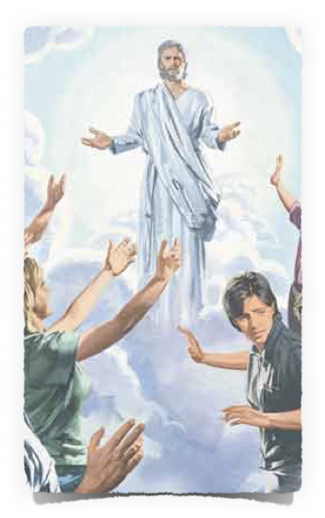
The Certainty of
“The Day of the LORD”
“But the day of the Lord will come as a thief in the night, in which the heavens will pass away with a great noise, and the elements will melt with fervent heat; …” — 2 Peter 3:10 (NKJV)
JESUS Is Coming AGAIN:
Personally — Acts 1:11; 1 Thes. 4:16;
Visibly — Acts 1:11; Rev. 1:7
Audibly — 1 Thes. 4:16; 1 Cor. 15:52
With angels — 2 Thes. 1:7-9
With power & glory — 2 Thes. 1:7-10
To judge the world — Acts 17:30-33
Destroy present world & establish new heavens and new earth - 2 Pet. 3:10-13
Glorify Saints - Col. 3:4; Phil. 3:20-21

Slide 34
The Certainty of
“The Day of the LORD”
There Will Be No Hiding / No Escape
All will hear his voice and come forth – (Jn 5:28,29; (2 Cor 5:10))
Every work will be brought into judgment / all made known / Judgment impartial – (Eccl 12:7,13,14; Heb 4:13; Rom 2:5-12; Phili 2:9-11)
The righteous will receive everlasting life in heaven, but the wicked, everlasting punishment in hell – (Matthew 25:46)

Slide 35
The Certainty of
“The Day of the LORD”
WHEN? ??? — ARE YOU READY?
Matthew 24:36–39 (NKJV)
³⁶ “But of that day and hour no one knows, not even the angels of heaven, but My Father only. ³⁷ But as the days of Noah were, so also will the coming of the Son of Man be. ³⁸ For as in the days before the flood, they were eating and drinking, marrying and giving in marriage, until the day that Noah entered the ark, ³⁹ and did not know until the flood came and took them all away, so also will the coming of the Son of Man be.

Slide 36
The Certainty of
“The Day of the LORD”
WHEN? ??? — ARE YOU READY?
Mt 24:42,44 — Watch therefore, for you do not know what hour your Lord is coming. 44 Therefore you also be ready, for the Son of Man is coming at an hour you do not expect.
Mt 25:13 — Watch therefore, for you know neither the day nor the hour in which the Son of Man is coming.
Mk 13:32 — "But of that day and hour no one knows, not even the angels in heaven, nor the Son, but only the Father.

Slide 37
The Certainty of
“The Day of the LORD”
WHEN? ??? — ARE YOU READY?
1Th 5:2 — For you yourselves know perfectly that the day of the Lord so comes as a thief in the night.
2Pe 3:10 — But the day of the Lord will come as a thief in the night, . . .
Rev 16:15 — "Behold, I am coming as a thief. Blessed is he who watches, and keeps his garments, lest he walk naked and they see his shame.”

Slide 38
The Certainty of
“The Day of the LORD”
WHEN? ??? — ARE YOU READY?
2 Peter 3:14–15 (NKJV)
¹⁴ Therefore, beloved, looking forward to these things, be diligent to be found by Him in peace, without spot and blameless; ¹⁵ and consider that the longsuffering of our Lord is salvation—

Slide 39
The Certainty of
“The Day of the LORD”
WHEN? ??? — ARE YOU READY?
Requires intent – Mat 7:13,14
Requires faith – John 8:24; Heb 11:6
Requires repentance – Acts 17:30,31
Requires confession – Rom 10:9,10
Requires baptism & continued obedience – Mark 16:16; Acts 2:38; Rom. 6:3-6,16,17; Heb. 5:8,9
Requires purpose – Acts 11:23
Requires diligence – 2 Pet 3:5-11

Slide 40
The Certainty of
“The Day of the LORD”
WHEN? ??? — ARE YOU READY?
We can mock the warnings of scripture . . . We can ignore the warnings of scripture . . . we can delay obedience, and be found unprepared . . . (2Pt 3:1-7)
OR — We can humbly heed the warnings & promises of God by obeying the gospel and being diligent in serving God — (2Pt 3:8-14)

Slide 41
The Certainty of
(2 Peter 3:1-15)
“But the day of the Lord will come as a thief in the night, in which the heavens will pass away with a great noise, and the elements will melt with fervent heat; both the earth and the works that are in it will be burned up.” — 2 Peter 3:10 (NKJV)
JESUS IS COMING AGAIN READY OR NOT!

Slide 42
Don McClain
W. 65th St church of Christ - December 31, 2006

Slide 43
The Certainty of
(2 Peter 3:1-15)
“But the day of the Lord will come as a thief in the night, in which the heavens will pass away with a great noise, and the elements will melt with fervent heat; both the earth and the works that are in it will be burned up.” — 2 Peter 3:10 (NKJV)

Slide 44
1 Thessalonians 5:1–10 (NKJV)
⁵ You are all sons of light and sons of the day. We are not of the night nor of darkness. ⁶ Therefore let us not sleep, as others do, but let us watch and be sober. ⁷ For those who sleep, sleep at night, and those who get drunk are drunk at night. ⁸ But let us who are of the day be sober, putting on the breastplate of faith and love, and as a helmet the hope of salvation. ⁹ For God did not appoint us to wrath, but to obtain salvation through our Lord Jesus Christ, ¹⁰ who died for us, that whether we wake or sleep, we should live together with Him.

