Slide 1
“The Church - Pillar & Ground of The Truth”
(1 Timothy 3:14–16)

Slide 2
“The Church - Pillar & Ground of The Truth”
Introduction / Greeting (1:1-7)
Jesus Christ OUR Hope (1:1,2)
The value & necessary commitment to the doctrine of Christ (1:3-7)
The Lawful Use of the Law (1:5-11)
Paul : A Pattern (1:12-17)
If Paul can be saved ANYONE can be saved!
Fight the good fight (1:18-20)
Pray for leaders (2:1-7)
Behavior of men & women in the church (2:8-15)
Qualifications of elders (3:1-7)
Qualifications of Deacons (3:8-13)
Behavior in God’s House (3:14-16)

Slide 3
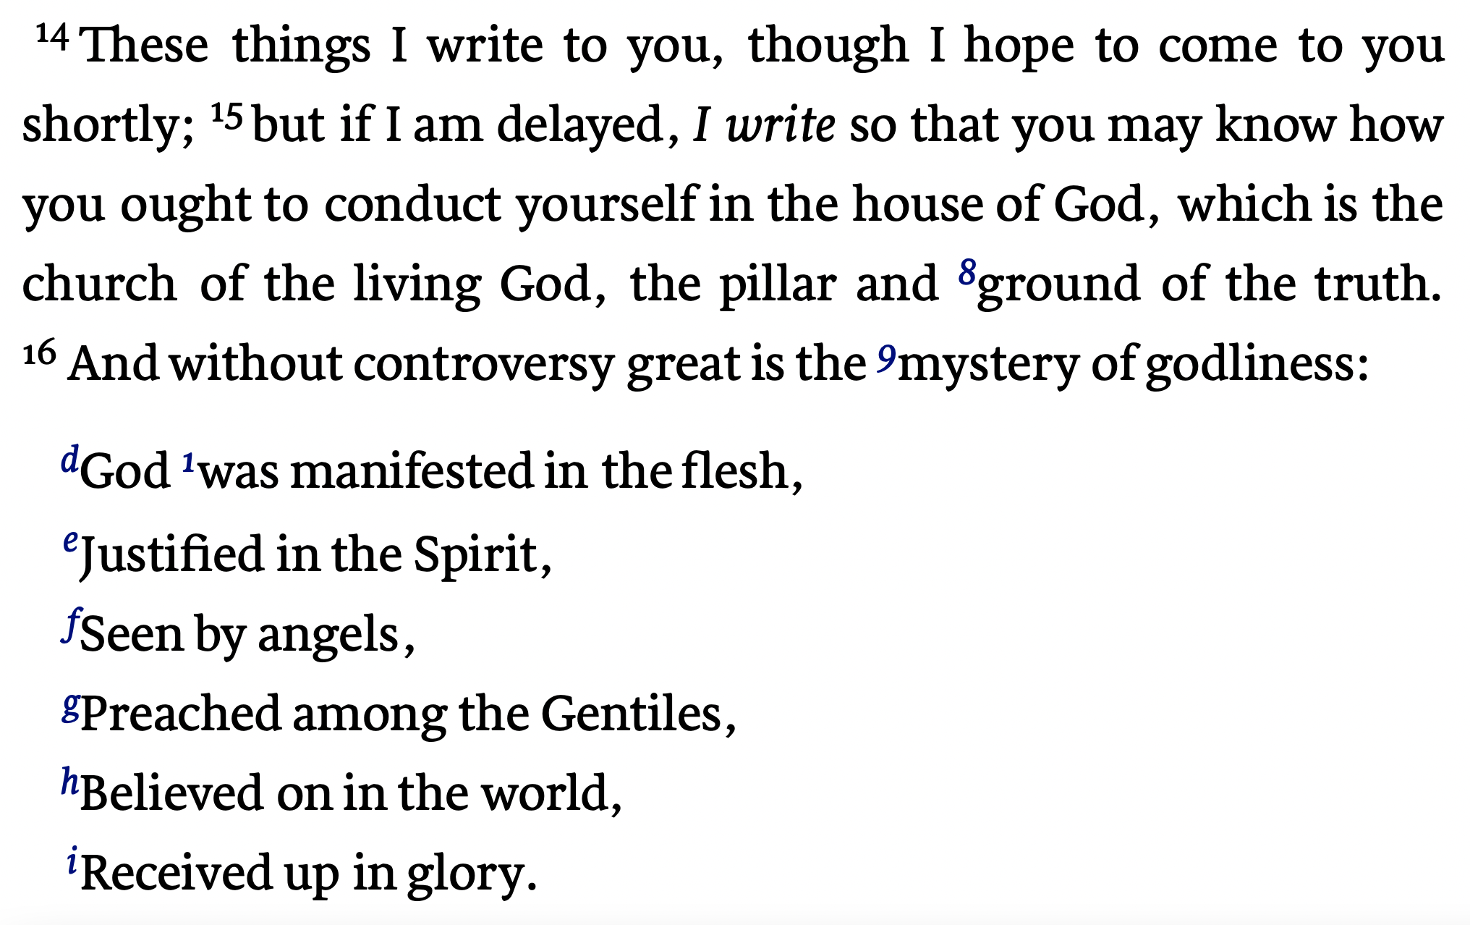
1 Timothy 3:14–16 (NKJV)

Slide 4
“The Church - Pillar & Ground of The Truth”
Purpose For The Epistle
These things I write to you : “These things” would most likely refer specifically to the instructions and qualifications just mentioned, (Prayer, role distinctions, qualifications of elders & deacons) but could be inclusive of the entire letter as well.
“though I hope to come to you shortly; ¹⁵ but if I am delayed” : Paul knew circumstances might delay his hoped for reunion with Timothy. Paul had been hindered on other trips (Romans 15:22; 1 Th. 2:18).
1 Timothy 3:14–15 (NKJV)
¹⁴ These things I write to you, though I hope to come to you shortly; ¹⁵ but if I am delayed, …

Slide 5
“The Church - Pillar & Ground of The Truth”
Purpose For The Epistle
“I write so that you may know” : If Paul is hindered in his reunion with Timothy, this letter would provide him with an authoritative standard.
“how you ought to conduct yourself in the house of God” : This epistle would provide and authorized standard to guide in managing the order and organization of the local church.
Other passages stress the fact that the church is the family of God, God’s household (Heb 3:6; 12:22,23; 1 Peter 2:5; 1 Cor. 3:16; Eph. 2:19).
1 Timothy 3:14–15 (NKJV)
¹⁵ … I write so that you may know how you ought to conduct yourself in the house of God,

Slide 6
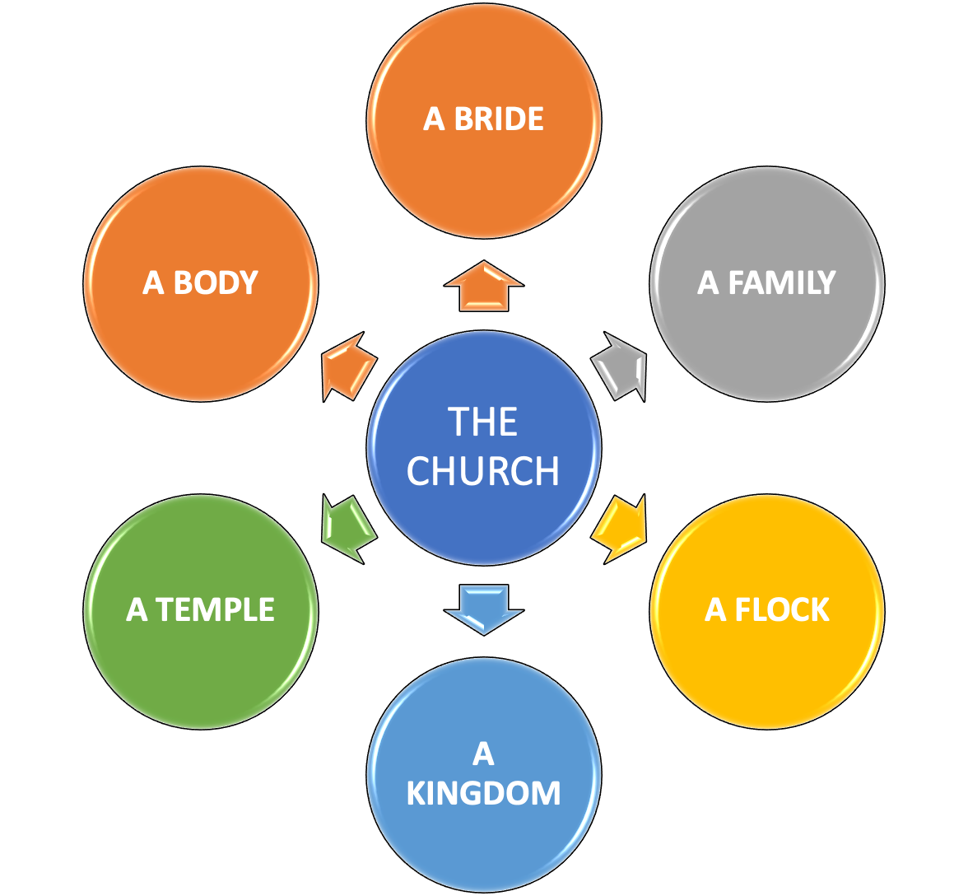
“The Church - Pillar & Ground of The Truth”
The CHURCH Described In Different Ways
¹⁵ … I write so that you may know how you ought to conduct yourself in the house of God,
(1 Timothy 3:15; 2 Corinthians 6:14-7:1; Galatians 6:10; Ephesians 2:19)

Slide 7
“The Church - Pillar & Ground of The Truth”
The Mission of the CHURCH
“which is the church …” : the “called out” (ecclesia) the saved (Acts 2:47)
“of the living God” : Let us always remember that the church does not belong to us, but to God, therefore let us resist any temptation to make the church “what we want it to be.”
“the pillar and ground of the truth” : the local church is to support, defend, maintain, and propagate the truth (cf. Gal. 2:9; Rev. 3:12). (This passage does NOT infer that the church is the source or determiner of truth!)
1 Timothy 3:15 (NKJV)
¹⁵ … which is the church of the living God, the pillar and ground of the truth.

Slide 8
“The Church - Pillar & Ground of The Truth”
The Message of the CHURCH
“without controversy” : without doubt, or beyond all question. — Truth is absolute, objective & defensible.
“great is the mystery of godliness:” : Of great weight, sublime, majestic, important. — The term “mystery” does not refer to something that can never been known, but rather to something that at one time had been hidden in God’s plan, but is now revealed in the gospel. (Ro. 16:25,26).
In the next line Paul will define this mystery of godliness.
1 Timothy 3:16 (NKJV)
¹⁶ And without controversy great is the mystery of godliness: …

Slide 9
“The Church - Pillar & Ground of The Truth”
The Message of the CHURCH
1 Timothy 3:16 (NKJV)
¹⁶ : … God was manifested in the flesh, Justified in the Spirit, Seen by angels, Preached among the Gentiles, Believed on in the world, Received up in glory.
“God was manifested in the flesh” : That is Jesus, who became flesh (John 1:14; Phil. 2:6,7; Heb. 2:9-17). This is a tremendous and sublime truth, the fact that God became man and yet was still God at the same time
“Justified in the Spirit” : While in the flesh, He was persecuted, maligned, and hated. He was put to death as a common criminal, yet He was vindicated to be the Son of God through His resurrection (Romans 1:3-4; Acts 3:14; 7:52; 4:10-12; 5:31).

Slide 10
“The Church - Pillar & Ground of The Truth”
The Message of the CHURCH
1 Timothy 3:16 (NKJV)
¹⁶ : … God was manifested in the flesh, Justified in the Spirit, Seen by angels, Preached among the Gentiles, Believed on in the world, Received up in glory.
“Seen by angels” : The mighty angelic hosts were witnesses to Christ during His earthly ministry at various times (birth, temptations, agony in the garden, resurrection) — (Mat. 28:2)
“Preached among the Gentiles” : the gospel had been preached for over 20 years to the nations. (Mat 28:18-20; Mark 16:15-16; Col. 1:6,23).
“Believed on in the world” : people throughout the world believed in Him, both Jews & Gentiles (Acts 2:41; 4:4; 5:14; 6:7; 11:21; 17:6).

Slide 11
“The Church - Pillar & Ground of The Truth”
The Message of the CHURCH
1 Timothy 3:16 (NKJV)
¹⁶ : … God was manifested in the flesh, Justified in the Spirit, Seen by angels, Preached among the Gentiles, Believed on in the world, Received up in glory.
“Received up in glory” : He was received up into heaven, and [there] sat down at the right hand of God, fulfilling John 17:5. (Lk 24:51; Mark 16:19; Acts 1:9–11; 2:36)
Ephesians 4:9–10 (NKJV)
⁹ (Now this, “He ascended”—what does it mean but that He also first descended into the lower parts of the earth? ¹⁰ He who descended is also the One who ascended far above all the heavens, that He might fill all things.)

Slide 12
“The Church - Pillar & Ground of The Truth”
“Then, too, there is the joy of victory—and what a victory! Besides this, it had to be a thrilling experience just to see him ascend, and to behold the clouds receiving him out of sight. However, the heavenly view of his homecoming, foreseen and foretold by the Psalmist (Ps. 24:7-10) and the prophet Daniel (Dan. 7:13, 14), by far excels the earthly view, and impresses us with the majesty, pomp, and grandeur of the welcoming host and coronation ceremonies when he sat down at the right hand of God in that world of immortal glory. Truly, he was glorified with the glory he had with the Father before the world was.” (pg. 108)

Slide 13
“The Church - Pillar & Ground of The Truth”
The Mission & Message of the CHURCH
Adhere to the pattern given by God (2 Tim. 1:13)
The local church is to support, defend, maintain, and propagate the truth (cf. Gal. 2:9; Rev. 3:12)
Believe in, teach and defend the TRUTH of Jesus’s incarnation, victory over death, authority in heaven and on earth - is currently the King of kings and Lord of Lord’s. (1 Tim 6:15; Rev. 19:16)

Slide 15
“The Church - Pillar & Ground of The Truth”
(1 Timothy 3:14–16)
Charts by Don McClain
Preached April 25, 2021 / West 65th Street church of Christ P.O. Box 190062 / Little Rock AR 72219 / Phone: 501-568-1062
Email – donmcclain@sbcglobal.net
More Keynote, PPT & Audio Sermons
w65stchurchofchrist.com

Slide 16
Hebrews 12:22–29 (NKJV)
²² But you have come to Mount Zion and to the city of the living God, the heavenly Jerusalem, to an innumerable company of angels, ²³ to the general assembly and church of the firstborn who are registered in heaven, to God the Judge of all, to the spirits of just men made perfect, ²⁴ to Jesus the Mediator of the new covenant, and to the blood of sprinkling that speaks better things than that of Abel. ²⁵ See that you do not refuse Him who speaks.

Slide 17
Hebrews 12:22–29 (NKJV)
For if they did not escape who refused Him who spoke on earth, much more shall we not escape if we turn away from Him who speaks from heaven, ²⁶ whose voice then shook the earth; but now He has promised, saying, “Yet once more I shake not only the earth, but also heaven.” ²⁷ Now this, “Yet once more,” indicates the removal of those things that are being shaken, as of things that are made, that the things which cannot be shaken may remain. ²⁸ Therefore, since we are receiving a kingdom which cannot be shaken, let us have grace, by which we may serve God acceptably with reverence and godly fear. ²⁹ For our God is a consuming fire.

