Slide 1
Romans 2:1-29

Slide 3
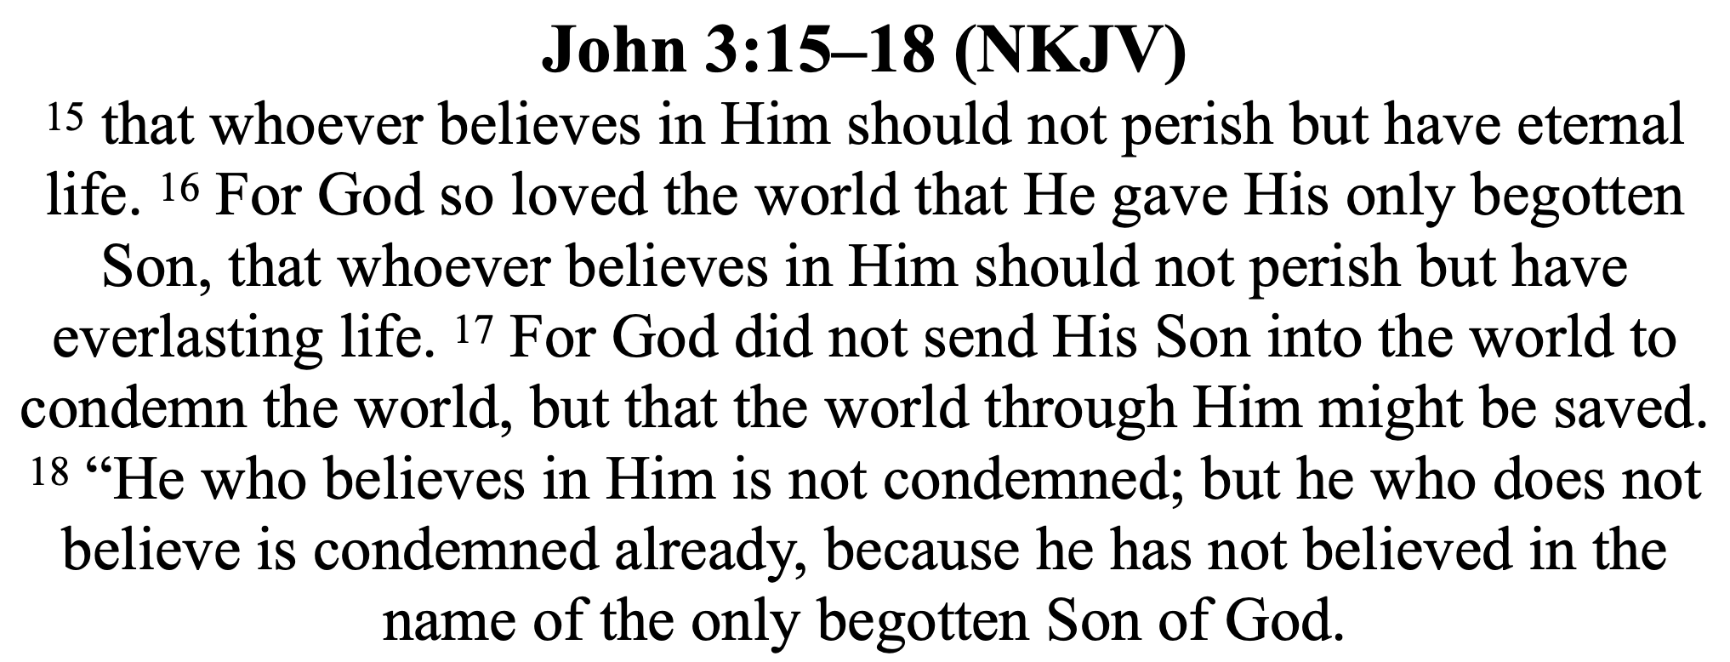

Slide 7
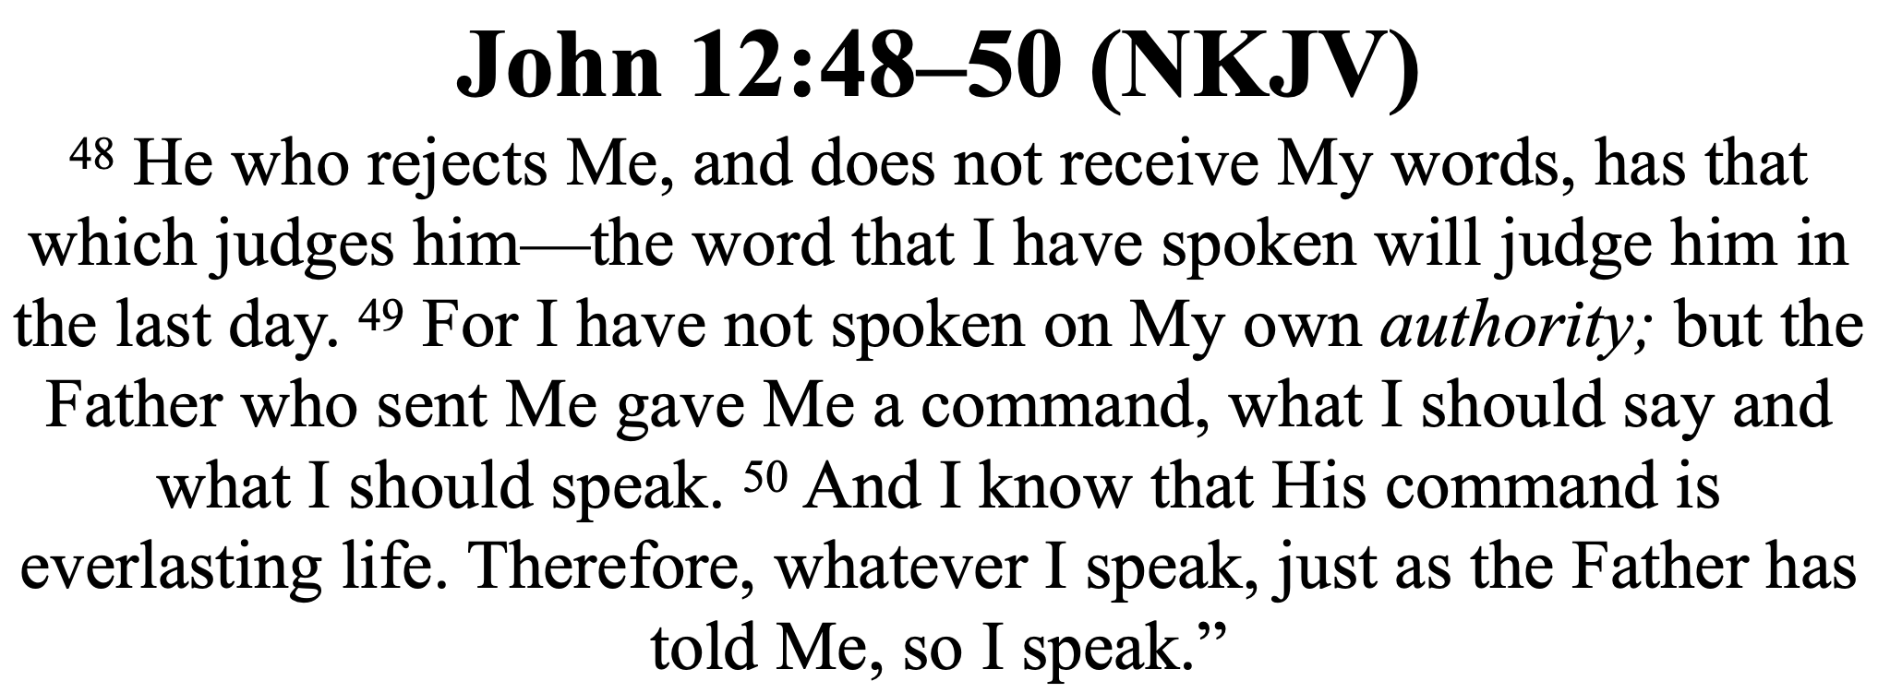

Slide 14
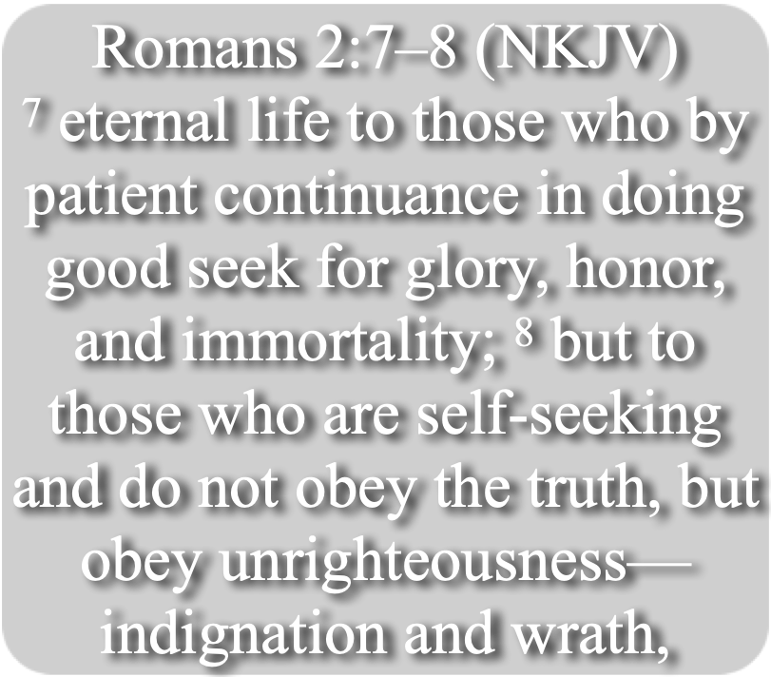
HYPOCRITES WILL NOT …
Romans 2:1–3 (NKJV)
¹ Therefore you are inexcusable, O man, whoever you are who judge, for in whatever you judge another you condemn yourself; for you who judge practice the same things. ² But we know that the judgment of God is according to truth against those who practice such things. ³ And do you think this, O man, you who judge those practicing such things, and doing the same, that you will escape the judgment of God?

Slide 15
OUR ASSUMPTIONS COULD BE WRONG
Romans 2:17–24 (NKJV)
¹⁷ Indeed you are called a Jew, and rest on the law, and make your boast in God, ¹⁸ and know His will, and approve the things that are excellent, being instructed out of the law, ¹⁹ and are confident that you yourself are a guide to the blind, a light to those who are in darkness, ²⁰ an instructor of the foolish, a teacher of babes, having the form of knowledge and truth in the law.

Slide 16
OUR ASSUMPTIONS COULD BE WRONG
Romans 2:17–24 (NKJV)
²¹ You, therefore, who teach another, do you not teach yourself? You who preach that a man should not steal, do you steal? ²² You who say, “Do not commit adultery,” do you commit adultery? You who abhor idols, do you rob temples? ²³ You who make your boast in the law, do you dishonor God through breaking the law? ²⁴ For “the name of God is blasphemed among the Gentiles because of you,” as it is written.

Slide 17
OUR ASSUMPTIONS COULD BE WRONG
The Jews saw themselves as RIGHTEOUS and the Gentiles as unrighteous (1-3; Mat. 6:1-18; 7:13,14, 21-23; Luke 18:9)
The Jews trusted in their PERCEIVED relationship with God (17-24; Matt. 3:9; John 8:33)
The Jews were ZEALOUS for God, but NOT according to TRUTH (Rom. 10:1-3)

Slide 18
OUR ASSUMPTIONS COULD BE WRONG
We can FORFEIT eternal life by being SELF-RIGHTEOUSNESS just as the Jews did. (Luke 10:29; 16:15; 18:9-14; Rom. 10:1-3)
There will be MANY PEOPLE who THINK they are going to heaven but be wrong (Mt 7:21-23; Jam 1:22-25; 2 Thes. 2:10-12)
It is NOT enough to be zealously religious — we MUST have and follow the TRUTH (Jn 8:32)

Slide 19
GOD’S JUDGMENT WILL BE ACCORDING TO TRUTH
Romans 2:4–11 (NKJV)
⁴ Or do you despise the riches of His goodness, forbearance, and longsuffering, not knowing that the goodness of God leads you to repentance? ⁵ But in accordance with your hardness and your impenitent heart you are treasuring up for yourself wrath in the day of wrath and revelation of the righteous judgment of God,

Slide 20
GOD’S JUDGMENT WILL BE ACCORDING TO TRUTH
Romans 2:4–11 (NKJV)
⁶ who “will render to each one according to his deeds”: ⁷ eternal life to those who by patient continuance in doing good seek for glory, honor, and immortality; ⁸ but to those who are self-seeking and do not obey the truth, but obey unrighteousness—indignation and wrath, ⁹ tribulation and anguish, on every soul of man who does evil, of the Jew first and also of the Greek;

Slide 21
GOD’S JUDGMENT WILL BE ACCORDING TO TRUTH
Romans 2:4–11 (NKJV)
¹⁰ but glory, honor, and peace to everyone who works what is good, to the Jew first and also to the Greek. ¹¹ For there is no partiality with God.

Slide 22
GOD’S JUDGMENT WILL BE ACCORDING TO TRUTH
Many erroneously think God’s “goodness” & “patience” allows them to continue in sin (Rom. 6:1,2, 23; 9:22; 1 Jn. 1:5-10; 2:1-6).
God desires & requires REPENTANCE in the heart! Impenitent sinners will experience His wrath (4,5; 1 Co. 6:9-11; Ga. 5:19-21; 6:7-9; 2 Pet. 3:9)
Eternal life is dependent upon our DEEDS! (6,7; 2 Cor. 5:10; Rev. 20:12, 13; 1 Cor. 15:58)

Slide 23
GOD’S JUDGMENT WILL BE ACCORDING TO TRUTH
Those who DO NOT OBEY THE TRUTH will not live with God forever! ONLY THOSE WHO DO OBEY THE TRUTH WILL (8-10; 2 The. 1:7-9; 1 Pt. 1:22,23)
God’s judgment will be according to the TRUTH He has revealed, and IN TRUTH, (i.e., our ACTUAL submission to the truth)! (5,7-11; Heb. 4:12,13; Eccl. 12:13,14)

Slide 24
GOD’S JUDGMENT WILL BE IMPARTIAL
Have you OBEYED the truth (the gospel), or NOT? (Mk 16:15,16; Acts 2:38; Rom. 6:16-18; 1 Pet. 1:22; 1 Thes. 1:7-9)
Are you following the truth or NOT? (2 Chr. 16:9; Ps. 33:13–15; 90:8; 1 Co. 4:5. Re. 2:23)
The “but God knows my heart” defense to justify our ungodly deeds will NOT help on the day of God’s wrath! (Acts 23:1)

Slide 25
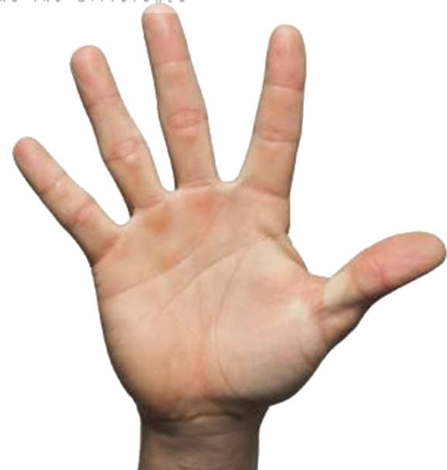
WHAT MUST I DO TO LIVE FOREVER??
the truth
Luke 8:11; Rom. 10:17
John 8:24; Heb 11:6
Luke 13:3,5; Acts 17:30
Mat. 10:32,33; Rom 10:9
Acts 2:38; 22:16; 1 Pet 3:21
Heb 4:11; Col 1:23

Slide 26
our assumptions of being righteous must be accurate…
our assumptions about God must be accurate …

Slide 27
We must never take advantage of God’s kindness, patience & long-suffering BY CONTINUING IN SIN…
We must take advantage of God’s goodness by repenting and obeying the truth …

Slide 28
the true condition of our hearts must be godly in accordance with the truth …
our actual actions and deeds must be according to the truth …

Slide 30
Charts by Don McClain
Preached October 10, 2021 PM
West 65th Street church of Christ - P.O. Box 190062 - Little Rock AR 72219 - Phone — 501-568-1062 — Email – donmcclain@sbcglobal.net
Prepared using Keynote / More Keynote, PPT & Audio Sermons:
www.w65stchurchofchrist.com

