Slide 1
2 KINGS 5; ACTS 2:36-41

Slide 2
Naaman nearly rejected the prospect of physical healing because the conditions did not conform to his expectations (2 Kings 5:1-14).
In like manner, many reject God’s terms of spiritual pardon as expressed through the gospel (Acts 2:36-38; 22:6-16; Gal. 3:26-27; 1 Pet. 3:20-21).

Slide 3
Isaiah 55:8–9 (NKJV)
⁸ “For My thoughts are not your thoughts, Nor are your ways My ways,” says the Lord. ⁹ “For as the heavens are higher than the earth, So are My ways higher than your ways, And My thoughts than your thoughts.

Slide 4
Jeremiah 10:23 (NKJV)
²³ O Lord, I know the way of man is not in himself; It is not in man who walks to direct his own steps.

Slide 5
Proverbs 14:12 (NKJV)
¹² There is a way that seems right to a man, But its end is the way of death.

Slide 6
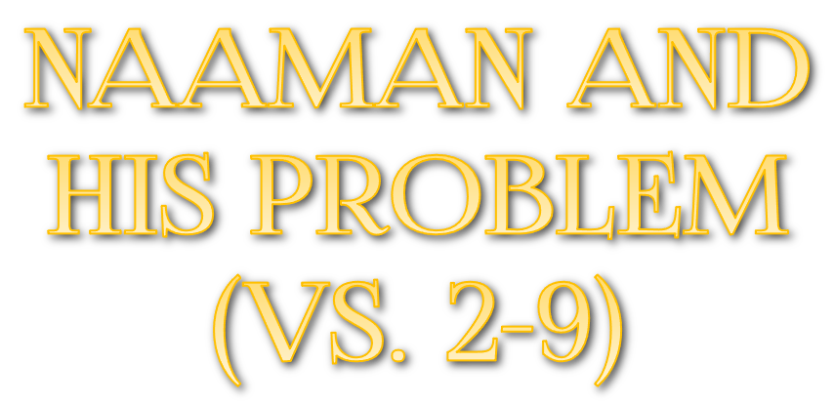
2 Kings 5:1 (NKJV)
¹ Now Naaman, commander of the army of the king of Syria, was a great and honorable man in the eyes of his master, because by him the Lord had given victory to Syria. He was also a mighty man of valor, but a leper.

Slide 7
Naaman, commander of the army of Benhadad I the king of Syria
Naaman’s was a great and honorable man in the eyes of his master (cf. Acts 10:1,2)
Naaman was used by the Lord to give victory to Syria.
Naaman’s problem - he was a Leper.

Slide 8
The term leprosy referred to several types of skin diseases rooted in the blood stream.
Leprosy stood as a picture of sin -

Slide 9
Sin, like leprosy in Bible times, is incurable by man (Eph. 2:1-13)
Sin, like leprosy, is loathsome & defiling (Mat. 15:19; Ep. 5:3–6)
Sin, like leprosy, causes separation (Isa. 59:1,2)
Sin, like leprosy, unless cured - causes death (Jam. 1:13-16; Rom. 6:23)

Slide 10
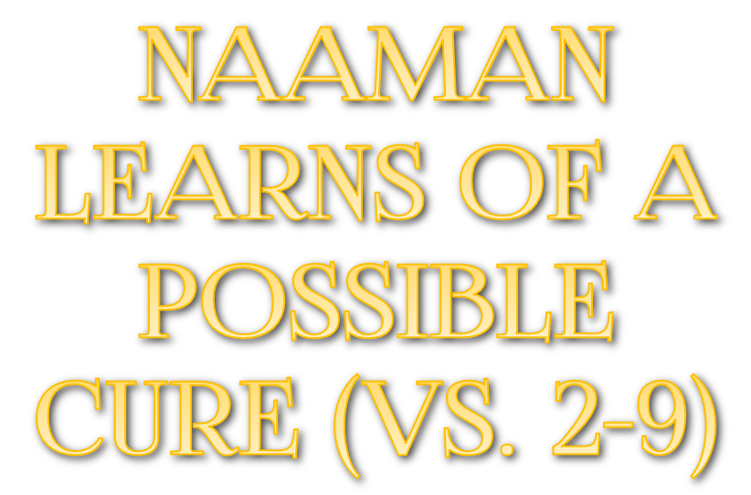
A young captive girl from Israel (2,3) – tells Naaman’s wife of a prophet in Israel who could heal him (do we share the gospel with those who are lost like this young girl shared her knowledge of the prophet?)
Naaman approaches the king – Benhadad I , who sends Naaman to Joram, the king of Israel with a letter (4-6)

Slide 11
Naaman goes to the wrong person - the king of Israel (7) – Joram thought Benhadad was trying to pick a fight –
Elisha calls for Joram to send Naaman to him (8) –
Naaman goes to see Elisha with his loaded horses and chariots (9) –

Slide 12
2 Kings 5:9–12 (NKJV)
⁹ Then Naaman went with his horses and chariot, and he stood at the door of Elisha’s house. ¹⁰ And Elisha sent a messenger to him, saying, “Go and wash in the Jordan seven times, and your flesh shall be restored to you, and you shall be clean.” ¹¹ But Naaman became furious, and went away and said, “Indeed, I said to myself, ‘He will surely come out to me, and stand and call on the name of the Lord his God, and wave his hand over the place, and heal the leprosy.’ ¹² Are not the Abanah and the Pharpar, the rivers of Damascus, better than all the waters of Israel? Could I not wash in them and be clean?” So he turned and went away in a rage.

Slide 13
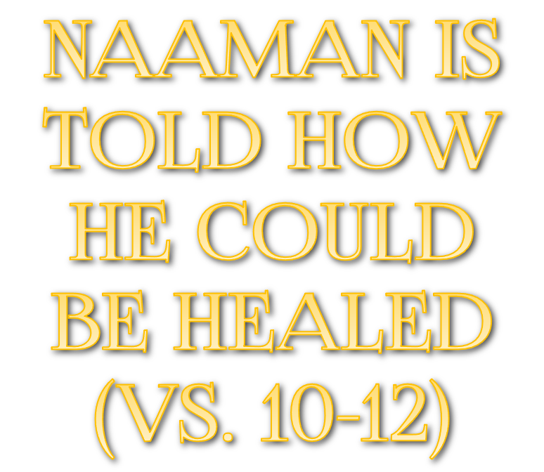
Elisha sends a servant out to Naaman (10a)
Naaman is told to "Go and wash in the Jordan seven times, and your flesh shall be restored to you, and you shall be clean." (10b)
Naaman became furious – because God’s plan didn’t fit his plan “behold I thought!” (11)

Slide 14
Naaman’s pride was insulted (10a)
Naaman had preconceived ideas (11)
Naaman thought that substituting for God’s specific instruction would be OK (12a)
Naaman leaves ANGRY at the prophet (12b)

Slide 15
God has offered salvation from sin through His Son Jesus Christ (Mt 11:28-30; Mk 16:16; Jn 8:24; Ac 2:38; 22:16)
No substitute for God’s way will cleanse us from our sins! (2 Thes 1:7-9)
Why are people today so resistant to God’s way?

Slide 16
2 Kings 5:13-14 (NKJV)
¹³ And his servants came near and spoke to him, and said, "My father, if the prophet had told you to do something great, would you not have done it? How much more then, when he says to you, 'Wash, and be clean'?" ¹⁴ So he went down and dipped seven times in the Jordan, according to the saying of the man of God; and his flesh was restored like the flesh of a little child, and he was clean.

Slide 17
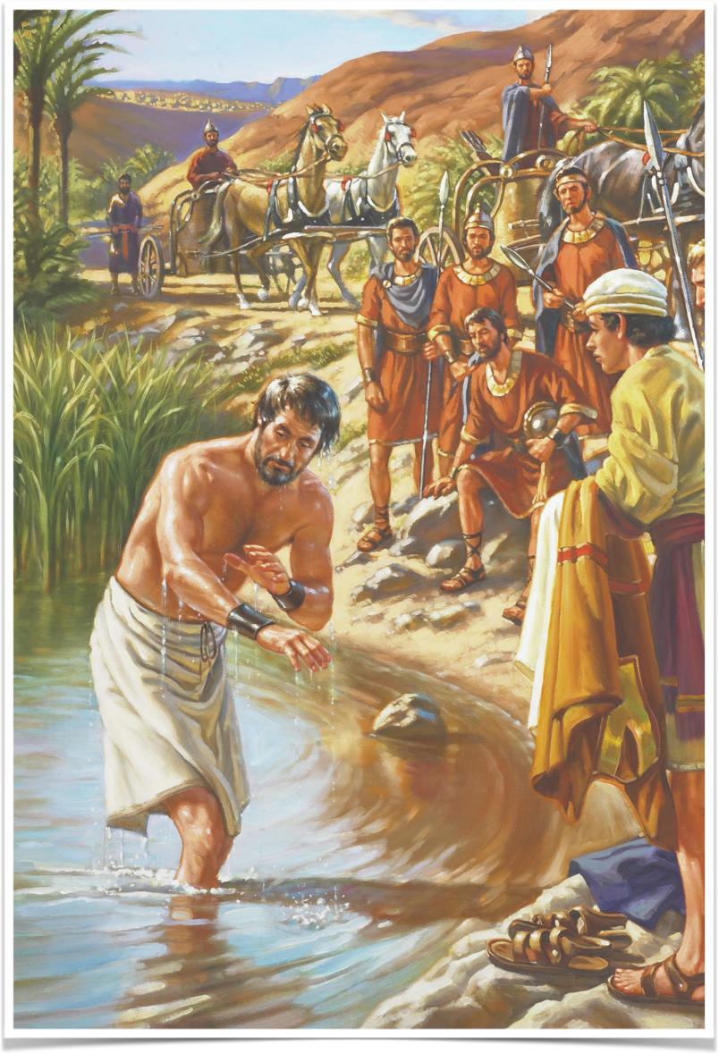
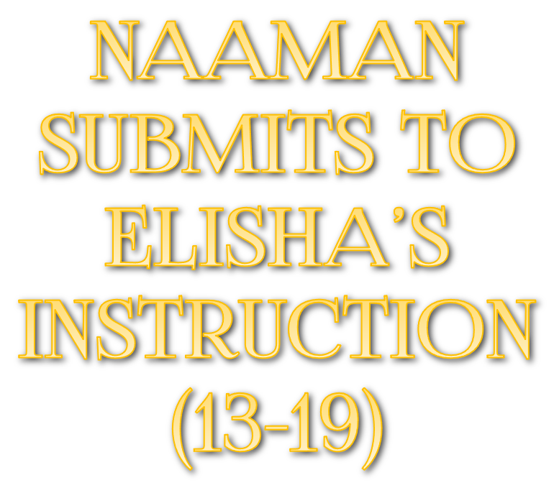
Naaman is approached by his servants - “If the prophet had told you to do some great thing would you not have done it?” (13)
Naaman humbles himself, changes his mind, obeys God’s instructions & receives God’s gift of healing (14)
Naaman was cleansed by grace through faith - He heard, believed and obeyed (Eph. 2:8-10; Rom. 10:9-17)

Slide 18
Naaman confesses the one true God (15)
Elisha wouldn’t receive Naaman’s payment for healing (16; Eph 2:8-10; Rev 21:6; 22:17)
Naaman still demonstrated a lack of understanding (17-19)

Slide 19
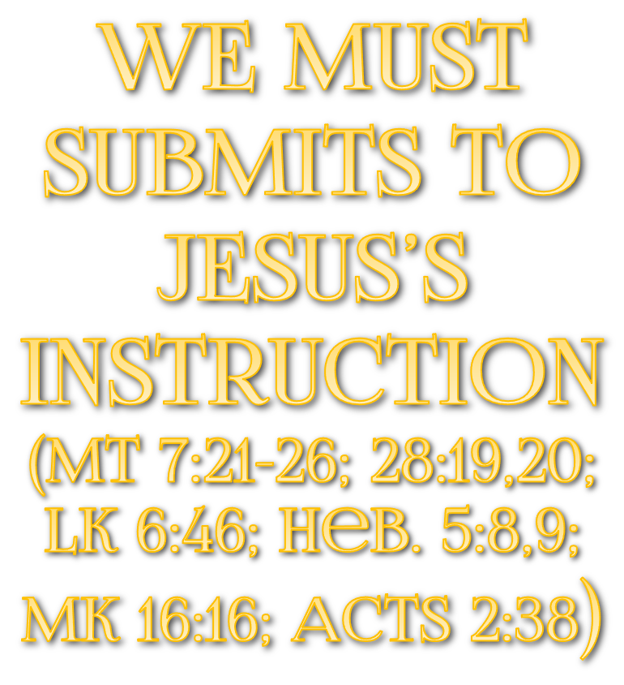
We must humbly submit to God’s way (1 Pet 5:5-7; Is 55:8,9; Jer 10:23; Heb 5:8,9)
Like Naaman, when we humbly do all that God commands through Jesus, salvation is still a free gift - we can’t pay for it or earn it (Luke 17:10; Acts 10:47,48; Rom 6:23; Eph 2:8,9; Tit. 3:3-5)

Slide 20
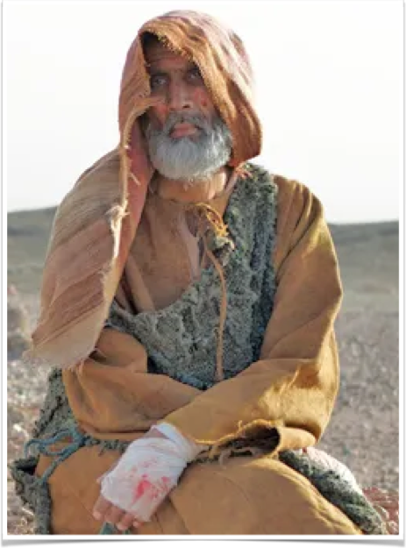
Gehazi greedily pursues Naaman (20,21)
Gehazi lies to Naaman & receives two talents of silver & two changes of clothing (22-24)
Gehazi becomes a leper (25-27)

Slide 21
It is possible to be a believer in God, and to engage in the work of God but then turn from God and do evil (v. 20)
Our “sin will find us out” and the sinner shall die (26; Nu. 32:23; Ez. 18:20ff; Rom. 6:23)
The God who heals the trusting also punishes the erring (27; Heb 10:30,31)

Slide 22
Do we recognize the seriousness of sin? (Rom 3:23; 6:23)
Do you seek deliverance God’s way? (Acts 2:37; Acts 4:12; Rom 1:16; Col. 2:11-13)
You can be healed today!!! (Mat 11:28-30; Acts 2:38; 1 Pet 3:21)
We all need to grow in Christ (Col. 1:9,10; 2 Pet 3:18)
We must remain faithful (1 Cor 15:58; Col. 1:23)

Slide 23
HEARED
BELIEVED
TURNED
OBEYED
CONFESSED
FAITHFULNESS
HEAR
BELIEVE
REPENT
CONFESS
BAPTISM
FAITHFULNESS
2 KINGS 5; ACTS 2:36-41

Slide 24
Acts 22:16 (NKJV)
¹⁶ And now why are you waiting? Arise and be baptized, and wash away your sins, calling on the name of the Lord.’

Slide 27
Acts 22:6–16 (NKJV)
⁶ “Now it happened, as I journeyed and came near Damascus at about noon, suddenly a great light from heaven shone around me. ⁷ And I fell to the ground and heard a voice saying to me, ‘Saul, Saul, why are you persecuting Me?’ ⁸ So I answered, ‘Who are You, Lord?’ And He said to me, ‘I am Jesus of Nazareth, whom you are persecuting.’ ⁹ “And those who were with me indeed saw the light and were afraid, but they did not hear the voice of Him who spoke to me. ¹⁰ So I said, ‘What shall I do, Lord?’ And the Lord said to me, ‘Arise and go into Damascus, and there you will be told all things which are appointed for you to do.’ ¹¹ And since I could not see for the glory of that light, being led by the hand of those who were with me, I came into Damascus.

Slide 28
Acts 22:6–16 (NKJV)
¹² “Then a certain Ananias, a devout man according to the law, having a good testimony with all the Jews who dwelt there, ¹³ came to me; and he stood and said to me, ‘Brother Saul, receive your sight.’ And at that same hour I looked up at him. ¹⁴ Then he said, ‘The God of our fathers has chosen you that you should know His will, and see the Just One, and hear the voice of His mouth. ¹⁵ For you will be His witness to all men of what you have seen and heard. ¹⁶ And now why are you waiting? Arise and be baptized, and wash away your sins, calling on the name of the Lord.’

