Slide 1
IS IT WISE?
Proverbs 1:1–7; 4:5–9; Ephesians 5:15–21

Slide 2
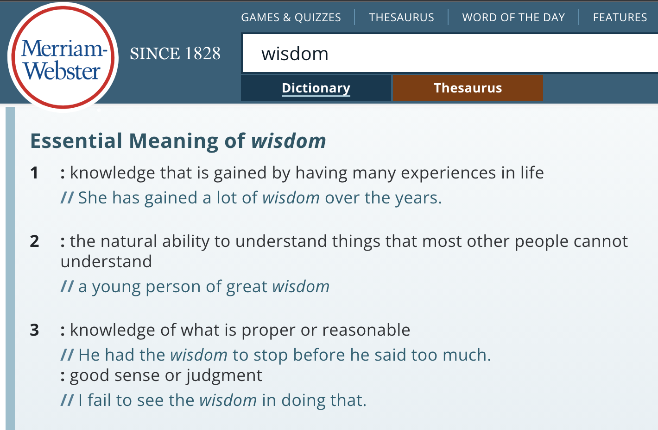
IS IT WISE?
(The world’s definition)

Slide 3
Proverbs 1:1–7 (NKJV)
¹ The proverbs of Solomon the son of David, king of Israel: ² To know wisdom and instruction, To perceive the words of understanding, ³ To receive the instruction of wisdom, Justice, judgment, and equity; ⁴ To give prudence to the simple, To the young man knowledge and discretion— ⁵ A wise man will hear and increase learning, And a man of understanding will attain wise counsel, ⁶ To understand a proverb and an enigma, The words of the wise and their riddles. ⁷ The fear of the Lord is the beginning of knowledge, But fools despise wisdom and instruction.

Slide 4
Proverbs 4:5–9 (NKJV)
⁵ Get wisdom! Get understanding! Do not forget, nor turn away from the words of my mouth. ⁶ Do not forsake her, and she will preserve you; Love her, and she will keep you. ⁷ Wisdom is the principal thing; Therefore get wisdom. And in all your getting, get understanding. ⁸ Exalt her, and she will promote you; She will bring you honor, when you embrace her. ⁹ She will place on your head an ornament of grace; A crown of glory she will deliver to you.”

Slide 5
IS IT WISE?
The foundation of all true wisdom is respecting God for being God! (Prov. 1:7; 9:10; 15:33; Job 28:28; Ps. 111:10; Eccl. 12:13)
One has TRUE wisdom when they HEAR, UNDERSTAND, PROPERLY APPLY, and OBEY God’s word. (Mat. 7:24-27)

Slide 6
IS IT WISE?
Psalm 119:97–104 (NKJV)
⁹⁷ Oh, how I love Your law! It is my meditation all the day. ⁹⁸ You, through Your commandments, make me wiser than my enemies; For they are ever with me. ⁹⁹ I have more understanding than all my teachers, For Your testimonies are my meditation. ¹⁰⁰ I understand more than the ancients, Because I keep Your precepts.

Slide 7
IS IT WISE?
Psalm 119:97–104 (NKJV)
¹⁰¹ I have restrained my feet from every evil way, That I may keep Your word. ¹⁰² I have not departed from Your judgments, For You Yourself have taught me. ¹⁰³ How sweet are Your words to my taste, Sweeter than honey to my mouth! ¹⁰⁴ Through Your precepts I get understanding; Therefore I hate every false way.

Slide 8
IS IT WISE?
To defend a practice by saying “God doesn’t say we CAN’T?” (cf. Col. 3:17; 2 Tim. 3:16,17; Lev. 10:1-4)
To neglect Biblical exhortations by saying “God doesn’t say we have to?” (Heb. 10;24,25; 2 Pet. 1:5-11)
To engage in a thing that can hinder my spiritual growth, damage my influence, or could cause another to stumble? (Heb. 12:1-3; Mt. 5:13-16; Rom. 14)

Slide 9
IS IT WISE?
It is NEVER wise to commit SIN! (1 Jn 3:4; Rom. 6:23)
It is NEVER wise to engage in a practice which we cannot affirm as being authorized from the scriptures (Col. 3:17; 1 Chron. 13:7; 15:2,12,13)
It is NEVER wise to place ourselves in spiritual danger (Gen. 13:11-12; 1 Co. 6:18; 10:14; 1 Ti. 6:11; 2 Ti. 2:22)
It is NEVER wise to put someone else in spiritual danger (Mat. 18:7; Lu. 17:2; Rom 14:13)

Slide 10
IS IT WISE?
James 3:13 (NKJV)
¹³ Who is wise and understanding among you? Let him show by good conduct that his works are done in the meekness of wisdom.

Slide 11
IS IT WISE?
FOUR QUESTIONS
IS IT SINFUL?
IS IT AUTHORIZED?
IS IT DANGEROUS?
IS IT GOOD?

Slide 12
IS IT WISE?
TO “MAKE OUT”
IS IT SINFUL?
Sex outside of marriage is SIN! (1 Co. 6:9; Gal. 5:19, 21; Heb. 13:4)
Some try to defend fornication by claiming “everyone does it!”
The danger of “making out” (Job 31:1; Mat. 5:28; 1 Co. 6:18)
Run from temptation (Ge. 39:12–18; Pr. 5:3–15; 6:24–32; 7:5)
IS IT AUTHORIZED?
IS IT DANGEROUS?
IS IT GOOD?

Slide 13
IS IT WISE?
TO “GAMBLE”
IS IT SINFUL?
Covetousness is sin! (1 Co. 6:10; Ep. 5:5; Co. 3:5; 1 Ti. 6:9, 10)
Some try to defend moderate gambling (Acts 1:26)
It violates Biblical principles (Ep. 4:28; Pr. 13:11; 2 Th. 3:11, 12)
It is dangerous on multiple levels (1 Ti. 6:9,10; 2 Ki. 5:27; Pr. 1:31)
IS IT AUTHORIZED?
IS IT DANGEROUS?
IS IT GOOD?

Slide 14
IS IT WISE?
TO “DRINK ALCOHOL”
IS IT SINFUL?
Drunkenness is a sin! (1 Cor. 6:10; Gal. 5:21; Ep. 5:18)
Social drinking is also condemned (1 Pet. 4:3)
Many try to defend moderate drinking (John 2;6-10; 1 Tim. 3:8)
It is dangerous on multiple levels (Prov. 23:29-35)
IS IT AUTHORIZED?
IS IT DANGEROUS?
IS IT GOOD?

Slide 15
IS IT WISE?
TO “DRINK ALCOHOL”
IS IT SINFUL?
Proverbs 23:29–35 (NKJV)
²⁹ Who has woe? Who has sorrow? Who has contentions? Who has complaints? Who has wounds without cause? Who has redness of eyes? ³⁰ Those who linger long at the wine, Those who go in search of mixed wine. ³¹ Do not look on the wine when it is red, When it sparkles in the cup, When it swirls around smoothly; ³² At the last it bites like a serpent, …
IS IT AUTHORIZED?
IS IT DANGEROUS?
IS IT GOOD?

Slide 16
IS IT WISE?
TO “DRINK ALCOHOL”
IS IT SINFUL?
Proverbs 23:29–35 (NKJV)
And stings like a viper. ³³ Your eyes will see strange things, And your heart will utter perverse things. ³⁴ Yes, you will be like one who lies down in the midst of the sea, Or like one who lies at the top of the mast, saying: ³⁵ “They have struck me, but I was not hurt; They have beaten me, but I did not feel it. When shall I awake, that I may seek another drink?”
IS IT AUTHORIZED?
IS IT DANGEROUS?
IS IT GOOD?

Slide 17
IS IT WISE?
TO “DRINK ALCOHOL”
IS IT SINFUL?
Proverbs 20:1 (NKJV)
¹ Wine is a mocker, Strong drink is a brawler, And whoever is led astray by it is not wise.
IS IT AUTHORIZED?
IS IT DANGEROUS?
IS IT GOOD?

Slide 18
IS IT WISE?
To go to bars, night clubs, or casinos? (Prov. 23:20)
To view sexually explicit material, (print / TV / Internet) (Job 31:1; Mat. 5:28)
To have worldly friends? (Pro. 1:10,14,15; 1 Cor. 15:33)
For a Christian to marry a non-Christian (1 Cor. 7:12-16)
To move to a place where there is no spiritual support (Gen. 13:11-12)
To skip Bible classes? (Heb. 3:12,13; 2 Tim. 2:15; etc.)

Slide 19
Ephesians 5:15–21 (NKJV)
¹⁵ See then that you walk circumspectly, not as fools but as wise, ¹⁶ redeeming the time, because the days are evil. ¹⁷ Therefore do not be unwise, but understand what the will of the Lord is. ¹⁸ And do not be drunk with wine, in which is dissipation; but be filled with the Spirit, ¹⁹ speaking to one another in psalms and hymns and spiritual songs, singing and making melody in your heart to the Lord, ²⁰ giving thanks always for all things to God the Father in the name of our Lord Jesus Christ, ²¹ submitting to one another in the fear of God.

Slide 20
IT IS WISE
To Walk In Wisdom (Ep. 5:15-21)
Making good use of our time (16)
Growing in the knowledge of God's word - (being filled with the Spirit) (17,18)
Busy in worship and praise (19)
Busy in prayer giving thanks (20)
Submitting to one another (21)

Slide 21
Matthew 7:24–27 (NKJV)
²⁴ “Therefore whoever hears these sayings of Mine, and does them, I will liken him to a wise man who built his house on the rock: ²⁵ and the rain descended, the floods came, and the winds blew and beat on that house; and it did not fall, for it was founded on the rock. ²⁶ “But everyone who hears these sayings of Mine, and does not do them, will be like a foolish man who built his house on the sand: ²⁷ and the rain descended, the floods came, and the winds blew and beat on that house; and it fell. And great was its fall.”a

Slide 22
IT IS WISE
TO SEEK THE LORD’S WILL (John 7:17)
TO OBEY THE GOSPEL (2 Thes 1:7-9; Mark 16:15,16; Acts 2:38)
TO CONTINUE TO OBEY THE LORD (Mat. 7:2427; Heb. 5:8,9)
James 3:13 (NKJV)
¹³ Who is wise and understanding among you? Let him show by good conduct that his works are done in the meekness of wisdom.

Slide 24
IT IS WISE
Charts by Don McClain
Preached October 24, 2021 AM
West 65th Street church of Christ - P.O. Box 190062 - Little Rock AR 72219 - Phone — 501-568-1062 — Email – donmcclain@sbcglobal.net
Prepared using Keynote / More Keynote, PPT & Audio Sermons:
www.w65stchurchofchrist.com

Slide 25
Ephesians 5:15–21 (NKJV)
¹⁵ See then that you walk circumspectly, not as fools but as wise, ¹⁶ redeeming the time, because the days are evil. ¹⁷ Therefore do not be unwise, but understand what the will of the Lord is. ¹⁸ And do not be drunk with wine, in which is dissipation; but be filled with the Spirit, ¹⁹ speaking to one another in psalms and hymns and spiritual songs, singing and making melody in your heart to the Lord, ²⁰ giving thanks always for all things to God the Father in the name of our Lord Jesus Christ, ²¹ submitting to one another in the fear of God.

