Slide 3
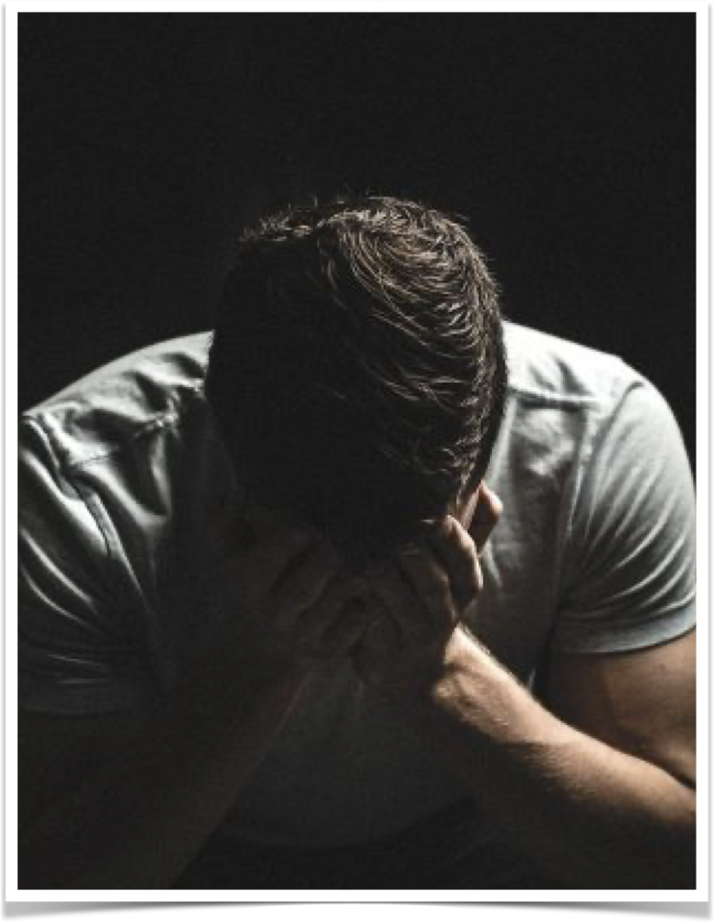
We are sojourners, pilgrims through a world full of hardship, trouble & pain– (the troubles & occasional pain of this life should prompt us to seek something better) Heb 11:13-16; 1 Pet 2:11
REALITY helps us realize EVERYTHING in this world is temporary (including its troubles & pain) Eccl. 7:2; 1 Jn 2:15-17; 2 Cor 4:8-9,16-18

Slide 4
All face trials, hardships, sufferings & pain — Matthew 5:45
Many seek comfort in all the wrong places (alcohol & drugs / wealth, power, control / anger, bitterness / callousness / rebellion / false religion)
Let us to turn to GOD and each other (2 Cor 1:3; 1 Thes 4:18; Heb 10:24,25)

Slide 5
2 Corinthians 1:1–11 (NKJV)
¹ Paul, an apostle of Jesus Christ by the will of God, and Timothy our brother, To the church of God which is at Corinth, with all the saints who are in all Achaia: ² Grace to you and peace from God our Father and the Lord Jesus Christ. ³ Blessed be the God and Father of our Lord Jesus Christ, the Father of mercies and God of all comfort, ⁴ who comforts us in all our tribulation, that we may be able to comfort those who are in any trouble, with the comfort with which we ourselves are comforted by God.

Slide 6
2 Corinthians 1:1–11 (NKJV)
⁵ For as the sufferings of Christ abound in us, so our consolation also abounds through Christ. ⁶ Now if we are afflicted, it is for your consolation and salvation, which is effective for enduring the same sufferings which we also suffer. Or if we are comforted, it is for your consolation and salvation. ⁷ And our hope for you is steadfast, because we know that as you are partakers of the sufferings, so also you will partake of the consolation.

Slide 7
2 Corinthians 1:1–11 (NKJV)
⁸ For we do not want you to be ignorant, brethren, of our trouble which came to us in Asia: that we were burdened beyond measure, above strength, so that we despaired even of life. ⁹ Yes, we had the sentence of death in ourselves, that we should not trust in ourselves but in God who raises the dead, ¹⁰ who delivered us from so great a death, and does deliver us; in whom we trust that He will still deliver us, ¹¹ you also helping together in prayer for us, that thanks may be given by many persons on our behalf for the gift granted to us through many.

Slide 8
God is the ONLY true source of mercy & comfort (1:3; Ps. 86:17; 23; 103:13)
The term comfort means more than “soothing sympathy”— it bestows courage, enabling us to cope with our pain & sufferings, that we may persevere. (Heb 12:12)
² Grace to you and peace from God our Father and the Lord Jesus Christ. ³ Blessed be the God and Father of our Lord Jesus Christ, the Father of mercies and God of all comfort,

Slide 9
James 1:17–20 (NKJV)
¹⁷ Every good gift and every perfect gift is from above, and comes down from the Father of lights, with whom there is no variation or shadow of turning. ¹⁸ Of His own will He brought us forth by the word of truth, that we might be a kind of firstfruits of His creatures.
² Grace to you and peace from God our Father and the Lord Jesus Christ. ³ Blessed be the God and Father of our Lord Jesus Christ, the Father of mercies and God of all comfort,

Slide 10
James 1:17–20 (NKJV)
¹⁹ So then, my beloved brethren, let every man be swift to hear, slow to speak, slow to wrath; ²⁰ for the wrath of man does not produce the righteousness of God.
² Grace to you and peace from God our Father and the Lord Jesus Christ. ³ Blessed be the God and Father of our Lord Jesus Christ, the Father of mercies and God of all comfort,

Slide 11
1 Peter 5:6-10 (NKJV)
⁶ Therefore humble yourselves under the mighty hand of God, that He may exalt you in due time, ⁷ casting all your care upon Him, for He cares for you.
² Grace to you and peace from God our Father and the Lord Jesus Christ. ³ Blessed be the God and Father of our Lord Jesus Christ, the Father of mercies and God of all comfort,

Slide 12
Able (Gen 4; Heb. 11:4)
Job (Job 1:20-22; 2:10; 13:15; James 5:11)
Joseph (Gen 37:23-36; 39:1-41:14)
Paul (2 Cor. 11:22-30; 12:7-10)
Jesus! (Phili 2:5-9)
² Grace to you and peace from God our Father and the Lord Jesus Christ. ³ Blessed be the God and Father of our Lord Jesus Christ, the Father of mercies and God of all comfort,

Slide 13
Job — he FELT no comfort as he was suffering, (Job 7), but his trust in God and His eventual vindication helped him persevere (28:20-28) — God did INDEED deliver & comfort Job (42:12-17)
Joseph — was sold into slavery by his own brothers, falsely accused and imprisoned, forgotten for two years, (Gen. 37;28; 39:1-41:1), but God delivered and comforted him (Gen. 41:14-45)
⁴ who comforts us in all our tribulation, that we may be able to comfort those who are in any trouble, with the comfort with which we ourselves are comforted by God.

Slide 14
Paul — suffered greatly for the cause of Christ (2 Cor 11:22-29; 12:7-10) — God did INDEED deliver & comfort Paul (2 Tim. 3:10; 1:10-12; 4:6-8)
JESUS — His incarnation (Jn 1:14; Phili. 2:6,7; Heb. 2:9), the garden (Luke 22:39-46), His betrayal, (John 18:2–11), on trial, (Matt. 26:57-68; 27:1,2,11-28), His crucifixion (Matt. 27:31–56; Mark 15:20–41; Luke 23:26–33; John 19:16–30).
⁴ who comforts us in all our tribulation, that we may be able to comfort those who are in any trouble, with the comfort with which we ourselves are comforted by God.

Slide 15
Psalm 22:19–26 (NKJV)
¹⁹ But You, O Lord, do not be far from Me; O My Strength, hasten to help Me! ²⁰ Deliver Me from the sword, My precious life from the power of the dog. ²¹ Save Me from the lion’s mouth And from the horns of the wild oxen! You have answered Me.
⁴ who comforts us in all our tribulation, that we may be able to comfort those who are in any trouble, with the comfort with which we ourselves are comforted by God.

Slide 16
Psalm 22:19–26 (NKJV)
²⁴ For He has not despised nor abhorred the affliction of the afflicted; Nor has He hidden His face from Him; But when He cried to Him, He heard. ²⁵ My praise shall be of You in the great assembly; I will pay My vows before those who fear Him. ²⁶ The poor shall eat and be satisfied; Those who seek Him will praise the Lord. Let your heart live forever!
⁴ who comforts us in all our tribulation, that we may be able to comfort those who are in any trouble, with the comfort with which we ourselves are comforted by God.

Slide 17
Philippians 2:9–11 (NKJV)
⁹ Therefore God also has highly exalted Him and given Him the name which is above every name, ¹⁰ that at the name of Jesus every knee should bow, of those in heaven, and of those on earth, and of those under the earth, ¹¹ and that every tongue should confess that Jesus Christ is Lord, to the glory of God the Father.
⁴ who comforts us in all our tribulation, that we may be able to comfort those who are in any trouble, with the comfort with which we ourselves are comforted by God.

Slide 18
God promisees to provide comfort in all our tribulation (1:4; 1 Cor 10:13; 2 Thes 2:16,17; Heb 13:5)
When we receive God’s comfort, we are better able to comfort others (the comfort of God is channeled through people) (cf. Rom. 12:15; 2 Cor. 7:6)
⁴ who comforts us in all our tribulation, that we may be able to comfort those who are in any trouble, with the comfort with which we ourselves are comforted by God.

Slide 19
Our comfort is found in Christ (1:5,6; Eph 1:3)
His sacrifice, though which we can be reconciled to God (2 Cor 5:18-21; Eph 2:16)
Through faith, God equips us to endure whatever trouble may come our way (James 1:2-7; 1 Pet. 1:3-9; 1 Cor. 10:13)
⁵ For as the sufferings of Christ abound in us, so our consolation also abounds through Christ. ⁶ Now if we are afflicted, it is for your consolation and salvation, which is effective for enduring the same sufferings which we also suffer. Or if we are comforted, it is for your consolation and salvation.

Slide 20
We can experience more pain than we can bear on our own! (2 Co. 1:8; 4:7-18)
Our trust in God and His promises (Titus 1:2; Heb. 6:11,12,18,19; 13:6)
Our understanding of the purpose of trials (Jam. 1:2-7; 1 Pet. 1:6-9; Rom. 5:1-5; 8:17-25, 28-39)
⁸ For we do not want you to be ignorant, brethren, of our trouble which came to us in Asia: that we were burdened beyond measure, above strength, so that we despaired even of life. ⁹ Yes, we had the sentence of death in ourselves, that we should not trust in ourselves but in God who raises the dead,

Slide 21
PURPOSE OF SUFFERING
Deepen & purify our faith
Detach Our FOCUS From This world
Direct Our FOCUS Towards God
Develop Our Sympathy
Help Others In Crisis
Distinguish Us From The World
⁸ For we do not want you to be ignorant, brethren, of our trouble which came to us in Asia: that we were burdened beyond measure, above strength, so that we despaired even of life. ⁹ Yes, we had the sentence of death in ourselves, that we should not trust in ourselves but in God who raises the dead,

Slide 22
When bad things happen we have three choices …
We can let them define us
Let them destroy us -
Let them strengthen & perfect us so we become more effective in serving the Lord (James 1:2-12; 1 Pet 1:3-9; 5:6-10)
¹⁰ who delivered us from so great a death, and does deliver us; in whom we trust that He will still deliver us, ¹¹ you also helping together in prayer for us, that thanks may be given by many persons on our behalf for the gift granted to us through many.

Slide 23
Prepare For Storms before they come! (Mat. 7:24-27; Luke 21:36; 2 Pet. 1:5-10)
Guard against anxiety / worry (Mat. 6:25-34; Phili. 4:4-13; 1 Co. 10:13)
Enjoy the good times & be thankful! (Eccl. 5:18; 1 Tim 6:17; James 1:17)

Slide 24
We must live godly no matter our circumstance - let our light shine (Mat 5:13-16; Phili. 2:14-16)
Our trust in God and the peace we receive from Him is attractive to those who do not have God (Acts 16:23-25)
Focus on the glorious eternal reward, not the temporary pain (Rom. 8:17,18; 2 Cor. 4:14-16; Rev. 2:10; 1 Cor. 15:58)
Pray for one another (1:11; Rom. 15:30; Phil. 1:19; Philem. 22)

Slide 25
As long as the world stands, there will be evil, injustice, hardship, suffering pain and death. (1 Thes. 4:17-18)
But God has prepared a better world for the righteous! (Hebrews 11:13-16)

Slide 26
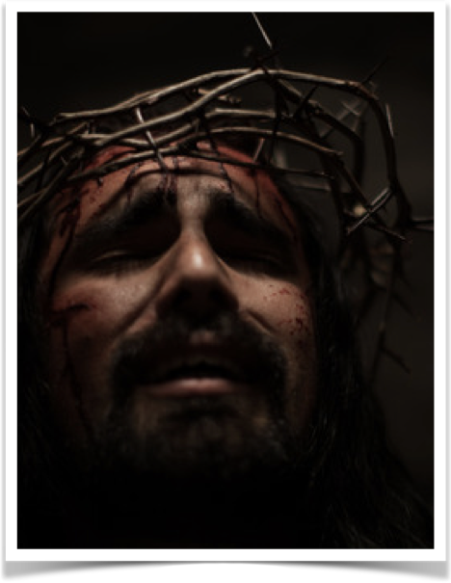
Matthew 11:28–30 (NKJV)
²⁸ Come to Me, all you who labor and are heavy laden, and I will give you rest. ²⁹ Take My yoke upon you and learn from Me, for I am gentle and lowly in heart, and you will find rest for your souls. ³⁰ For My yoke is easy and My burden is light.”
Acts 2:36-41; 1 Peter 3:14-22

Slide 27
“An obedient faith in Jesus Christ does not guarantee a trouble free life, but a perfect eternity.”

Slide 28
“God washes the eyes by tears until they can behold the invisible land where tears shall come no More.” - Henry Ward Beecher

