Slide 1
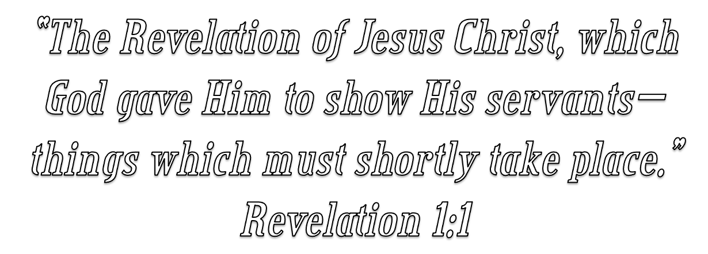

Slide 2
Introduction to John’s Book of Revelation
WHY IS STUDYING REVELATION SO DIFFICULT?
WHAT ARE SOME DANGERS WE NEED TO AVOID?
WHAT CAN BE GAINED FROM STUDYING REVELATION?

Slide 3
Introduction to John’s Book of Revelation
What Do We Know about the Writer?
What Can We Say about the Place of Writing?
What Do We Know about the Setting and Date of Composition?
To Whom Was it Penned?

Slide 4
Introduction to John’s Book of Revelation
The Writer?
The earliest evidence supports the apostle John, the brother of James, as being the author [Papias (circa AD 70-163); Irenaeus; Justin Martyr; Tertullian).
The name John appears four times in the book. The first three are at the beginning (1:1, 4, 9), and a fourth occurrence is at the end (22:8).

Slide 5
Introduction to John’s Book of Revelation
The Writer?
The writer of this document was John, the son of Zebedee, who also wrote the Gospel that bears his name and the three small letters entitled, 1-3 John.
All of the available external and internal evidence points to him as the writer.
There is no good reason to rule out the apostle John as the author of this material.

Slide 6
Introduction to John’s Book of Revelation
Place Written?
Revelation 1:9 (NKJV)
⁹ I, John, both your brother and companion in the tribulation and kingdom and patience of Jesus Christ, was on the island that is called Patmos for the word of God and for the testimony of Jesus Christ.

Slide 7
Introduction to John’s Book of Revelation
Island called Patmos
Patmos was but 63 miles from Ephesus, and about 37 miles southwest of Miletus. off the southwest coast of Asia Minor.
The tiny island is around 7.5 miles long and about six miles broad along the northern coast, and contains an area of but 13.15 square miles.
Patmos itself is a barren, almost treeless, rocky mountainous, and rugged island.

Slide 8
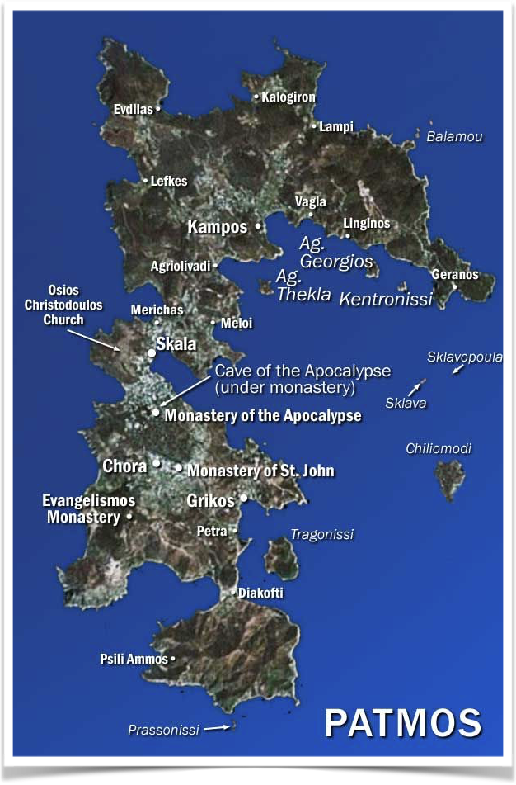
Introduction to John’s Book of Revelation
Place Written?
Island called Patmos
Early tradition is unanimous (Irenaeus, Eusebius, Jerome, and others) that the apostle was exiled there during the 14th year of Domitian’s reign (AD 95) and was released during the reign of Nerva (AD 96) about eighteen months later, after the death of the dreaded Domitian.
He was then permitted to return to Ephesus, where he lived out the remainder of his long life.

Slide 9
Introduction to John’s Book of Revelation
When Was The Revelation Written?
Most expositors hold to one of two dates:
A date shortly after the persecution of Nero (A.D. 54-68), and before the destruction of Jerusalem (A.D. 70).
A date during or shortly after the persecution by Domitian (95,96 A.D.)
An accurate understanding of the MAIN points & lessons in this book are not dependent upon establishing the date, but correctly understanding many symbols is.

Slide 10
Introduction to John’s Book of Revelation
When Was The Revelation Written?
The earliest evidence suggests that John “saw the revelation . . . at the close of Domitian’s reign” (Irenaeus, Against Heresies 5.30.3; Eusebius, Church History 3.18).
Domitian (Titus Flavius Domitianus) was emperor during the period AD 81-96. Born on October 24, AD 51 and ascending to the throne on September 14, 81.
In Domitian’s later years he became increasingly paranoid - including persecuting Christians.

Slide 11
Introduction to John’s Book of Revelation
When Was The Revelation Written?
It was during Domitian’s latter years he began severely persecuting Christians. — John was not the first or only Christian to suffer persecution at the hands of Domitian.
“Under Domitian, who … claimed divine worship for himself as emperor during his lifetime, persecution of Christians by the state on purely religious grounds took place for the first time. Moreover, in the province of Asia the cult of the emperor was promoted with special zeal.” (Dan King; I Saw The Heavens Opened - pg. 40)

Slide 12
Introduction to John’s Book of Revelation
When Was The Revelation Written?
Reason for accepting the later date:
External evidence (Irenaeus; Clement; Eusebius, Jerome, and others)
Internal evidence
The seven churches of Asia (1:4,9; 2:4,10,13; 3:1,10,15,16, 17; etc.)
John is banished to the Isle of Patmos (1:9)
The 7 Hills and the 7 Kings (17:9-10).
Emperor worship in Roman Asia (2:13)

Slide 13
Introduction to John’s Book of Revelation
To WHOM Is Revelation Written?
Revelation 1:4–6 (NKJV)
⁴ John, to the seven churches which are in Asia: Grace to you and peace from Him who is and who was and who is to come, and from the seven Spirits who are before His throne, ⁵ and from Jesus Christ, the faithful witness, the firstborn from the dead, and the ruler over the kings of the earth. To Him who loved us and washed us from our sins in His own blood, ⁶ and has made us kings and priests to His God and Father, to Him be glory and dominion forever and ever. Amen.

Slide 14
Introduction to John’s Book of Revelation
What is this Strange and Mysterious Book?
The Type of Literature
What Is Purpose of the Book?
How Do You Read This Book of Symbols?
What Does It All MEAN?

Slide 16
Charts by Don McClain
Preached January 23, 2022
West 65th Street church of Christ - P.O. Box 190062 - Little Rock AR 72219 - Phone — 501-568-1062 — Email – donmcclain@sbcglobal.net
Prepared using Keynote
More Keynote, PPT & Audio Sermons:
https://www.w65stchurchofchrist.com

Slide 17
1 John 1:1–4 (NKJV)
¹ That which was from the beginning, which we have heard, which we have seen with our eyes, which we have looked upon, and our hands have handled, concerning the Word of life—² the life was manifested, and we have seen, and bear witness, and declare to you that eternal life which was with the Father and was manifested to us—³ that which we have seen and heard we declare to you, that you also may have fellowship with us; and truly our fellowship is with the Father and with His Son Jesus Christ. ⁴ And these things we write to you that your joy may be full.

