Slide 1
THE VALUE & IMPORTANCE OF GODLINESS
ATTITUDES FOUND IN FAITHFUL CHILDREN OF GOD
(Hebrews 11; Matthew 5:3-12; Ephesians 4:1-3; Galatians 5:22,23)

Slide 2
THE VALUE & IMPORTANCE OF GODLINESS
HAVING THE RIGHT ATTITUDE IS ESSENTIAL TO SERVING GOD
NOT MERELY ADVOCATING A POSITIVE ATTITUDE, BUT A GODLY ATTITUDE!
OUR ATTITUDE: “Our beliefs, emotions, and behaviors toward a particular object, person, thing, or event”
“For as he thinks in his heart, so is he.”
Proverbs 23:7

Slide 3
THE VALUE & IMPORTANCE OF GODLINESS
TOWARD GOD
TOWARD SCRIPTURE
TOWARD GOD’S AUTHORITY
TOWARD UNIVERSAL CHURCH
TOWARD OURSELF
TOWARD THE LOCAL CHURCH
TOWARD SIN
TOWARD TRUTH & ERROR
TOWARD THE WORLD & HEAVEN

Slide 4
OF THE FAITHFUL
Cognitive: Your thoughts and beliefs about the subject.
Affective: How the object, person, issue, or event makes you feel.
Behavioral: How attitude influences your behavior.

Slide 5
OF THE FAITHFUL
Cognitive: FAITH
Affective: HOPE
Behavioral: LOVE
1 Corinthians 13:13 (NKJV)
¹³ And now abide faith, hope, love, these three; but the greatest of these is love.

Slide 6
OF THE FAITHFUL
Matthew 5:3–10 (NKJV)
³ “Blessed are the poor in spirit, For theirs is the kingdom of heaven. ⁴ Blessed are those who mourn, For they shall be comforted. ⁵ Blessed are the meek, For they shall inherit the earth. ⁶ Blessed are those who hunger and thirst for righteousness, For they shall be filled. ⁷ Blessed are the merciful, For they shall obtain mercy. ⁸ Blessed are the pure in heart, For they shall see God. ⁹ Blessed are the peacemakers, For they shall be called sons of God. ¹⁰ Blessed are those who are persecuted for righteousness’ sake, For theirs is the kingdom of heaven.
HUMILITY
PENITENT
MEEKNESS
DESPERATE TO BE RIGHT W/ GOD
MERCIFUL
HONESTY
LOVE
ENDURANCE

Slide 7
OF THE FAITHFUL
Ephesians 4:1–3 (NKJV)
¹ I, therefore, the prisoner of the Lord, beseech you to walk worthy of the calling with which you were called, ² with all lowliness and gentleness, with longsuffering, bearing with one another in love, ³ endeavoring to keep the unity of the Spirit in the bond of peace.
HUMILITY
MEEKNESS
LONG-SUFFERING
SUPPORTIVE
LOVING
ZEAL FOR UNITY IN TRUTH & PEACE

Slide 8
OF THE FAITHFUL
MERCIFUL
KINDHEARTED
HUMILITY
MEEKNESS
LONG-SUFFERING
SUPPORTIVE
FORGIVING
LOVING
AT PEACE
GRATEFUL
Colossians 3:12–15 (NKJV)
¹² Therefore, as the elect of God, holy and beloved, put on tender mercies, kindness, humility, meekness, longsuffering; ¹³ bearing with one another, and forgiving one another, if anyone has a complaint against another; even as Christ forgave you, so you also must do. ¹⁴ But above all these things put on love, which is the bond of perfection. ¹⁵ And let the peace of God rule in your hearts, to which also you were called in one body; and be thankful.

Slide 9
OF THE FAITHFUL
PURE / HOLY
PEACEABLE
WILLING TO YIELD
MERCIFUL & HELPFUL
FAIR / IMPARTIAL
GENUINE
A HEART THAT IS RIGHT
James 3:13–18 (NKJV)
¹³ Who is wise and understanding among you? Let him show by good conduct that his works are done in the meekness of wisdom. ¹⁴ But if you have bitter envy and self-seeking in your hearts, do not boast and lie against the truth. ¹⁵ This wisdom does not descend from above, but is earthly, sensual, demonic. ¹⁶ For where envy and self-seeking exist, confusion and every evil thing are there. ¹⁷ But the wisdom that is from above is first pure, then peaceable, gentle, willing to yield, full of mercy and good fruits, without partiality and without hypocrisy. ¹⁸ Now the fruit of righteousness is sown in peace by those who make peace.

Slide 10
OF THE FAITHFUL
Galatians 5:22–23 (NKJV)
²² But the fruit of the Spirit is love, joy, peace, longsuffering, kindness, goodness, faithfulness, ²³ gentleness, self-control. Against such there is no law.

Slide 11
OF THE FAITHFUL
To Define
But the fruit of the Spirit is
FRUIT: In the natural world, fruit is the result of a healthy plant producing what it was designed to produce (Genesis 1:11–12).
Metaphorically, it describes the attitude and resulting actions produced by the Spirit’s controlling influences of the heart.

Slide 12
OF THE FAITHFUL
Necessary Prerequisites
The actual result of repentance and true union with Christ will be the transformation of the heart which brings about the natural produce of GODLINESS — Rom. 12:1,2; Col. 3:1,2
Having died with Christ and raised to walk in newness of life —Rom 6:1-23; 8:1,2
Abiding in CHRIST by abiding in the teachings of Christ — John 15:1-12; Colossians 3:12-17

Slide 13
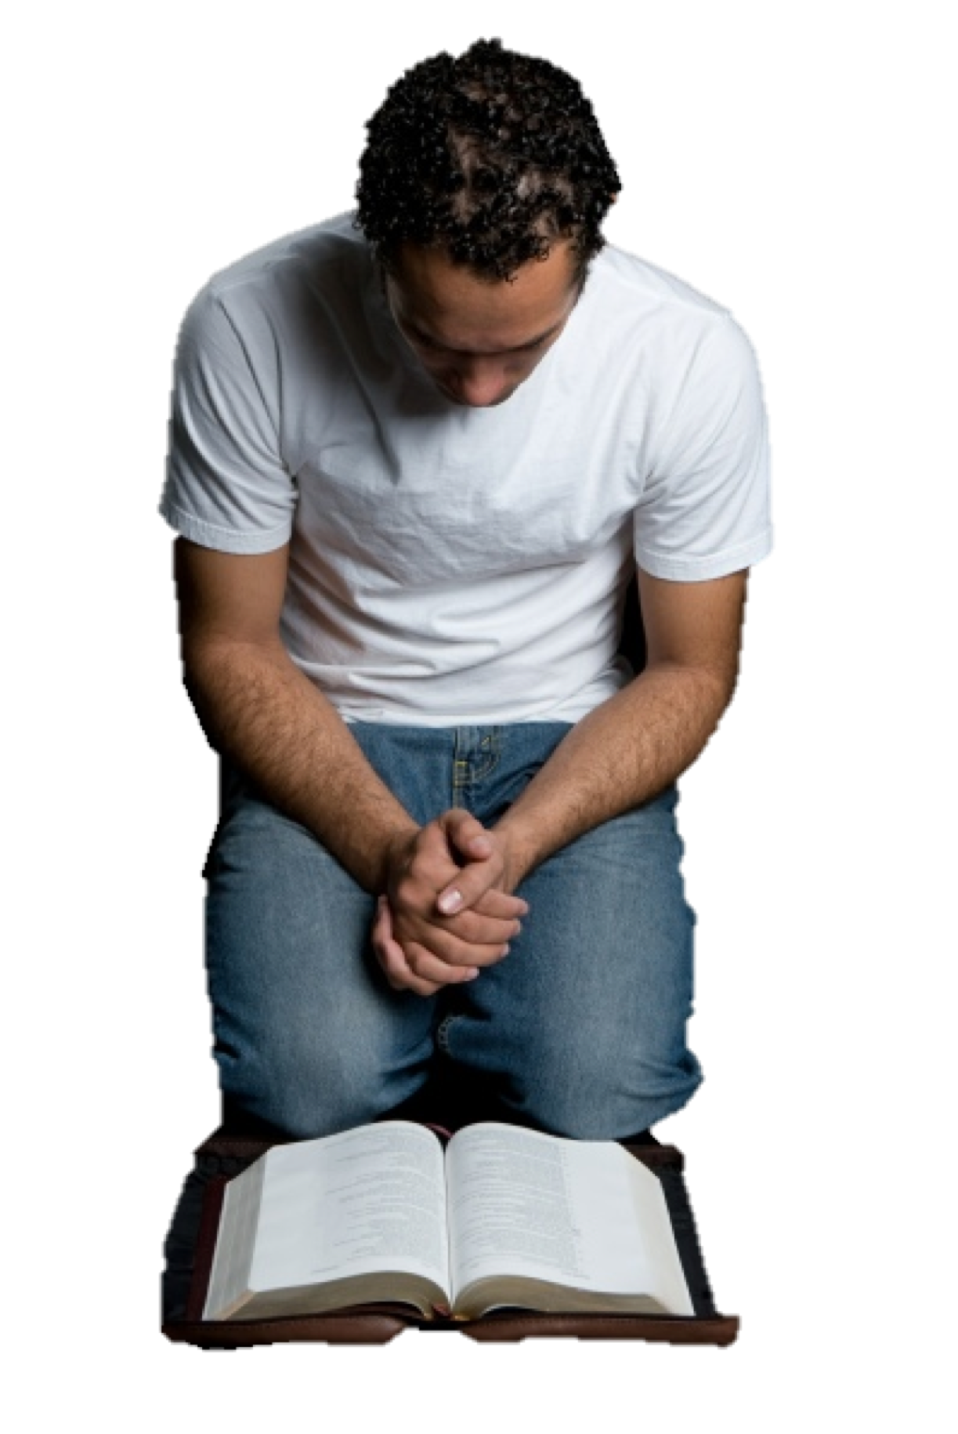
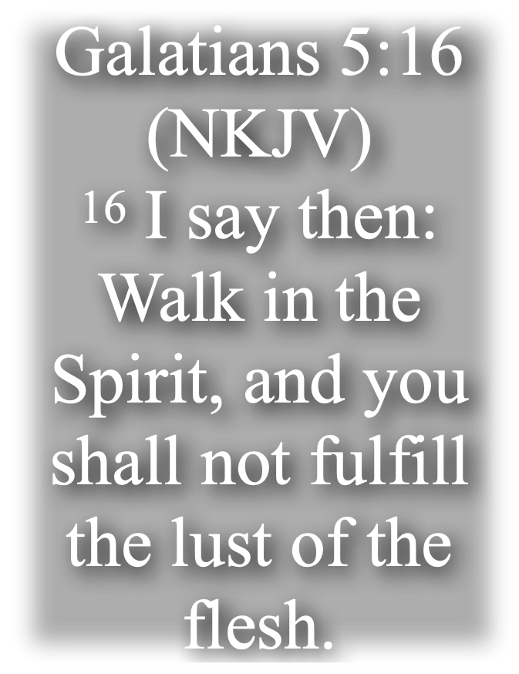
OF THE FAITHFUL
The Spirit’s Fruit — (Gal. 5:22,23)
LOVE
LOVE: Of God & man - Seeking the Welfare of Others - unselfishness!
JOY: Delight, Rejoicing in Things Right & Good - Not based on externals but rather the “delight of love satisfied”(Contrast with Momentary Pleasure of Sin) - Phili 4:4; 1 John 1:4
Peace: Contentment due to a right relationship w/ God (Phili 4:7)
JOY
PEACE

Slide 14
OF THE FAITHFUL
The Spirit’s Fruit — (Gal. 5:22,23)
LOVE
Longsuffering: Forbearance, Patience, Restraint When Provoked, Enduring Trials (Jam 5:7-9)
Kindness, -“Sweet Reasonableness” - An approachable disposition – Not caustic (Eph. 2:7; Col. 3:12)
Goodness, - Uprightness of heart & life, doing good - Beneficence, Acting with Kindness (Eph. 5:9; 2 Thes 1:11)
JOY
PEACE
LONGSUFFERING
KINDNESS
GOODNESS

Slide 15
OF THE FAITHFUL
The Spirit’s Fruit — (Gal. 5:22,23)
LOVE
Faithfulness, - Complete trust in God producing fidelity - Luke 16:10-12
Gentleness, - Suffers wrong without resentment – strong, firm, but under control. – Eph. 4:2; Col. 3:12; Gal. 6:1
Self-control. - Bringing all thoughts and actions into harmony with the divine standard – Acts 24:25; 1 Cor. 9:25-27; 2 Cor. 10:5
JOY
PEACE
LONGSUFFERING
KINDNESS
GOODNESS
FAITHFULNESS
GENTLENESS
SELF-CONTROL

Slide 16
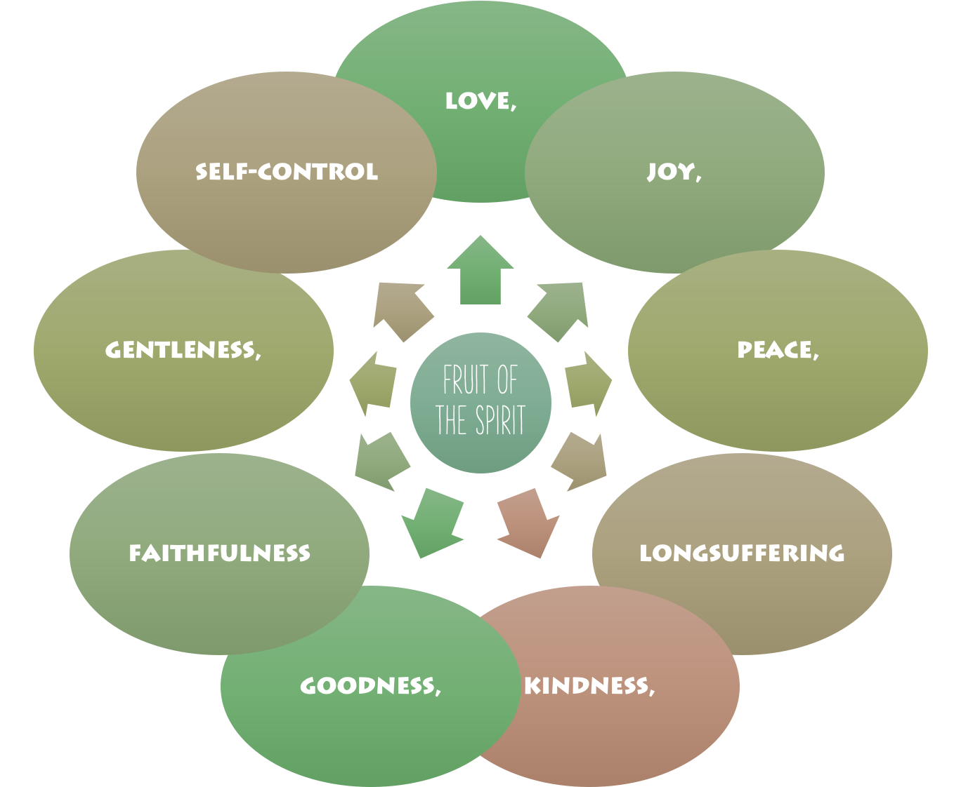
OF THE FAITHFUL
These characteristics combined describe the character & attitude of the one in Christ.
The “FRUIT of the SPIRIT” destroys, replaces, & prevents the WORKS of the FLESH!

Slide 17
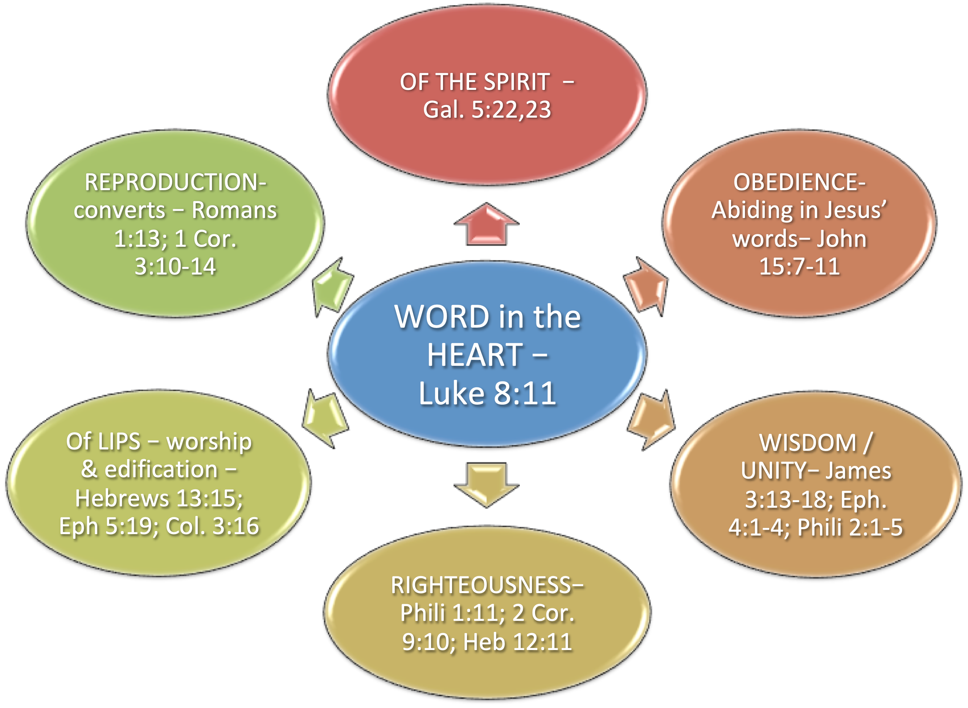
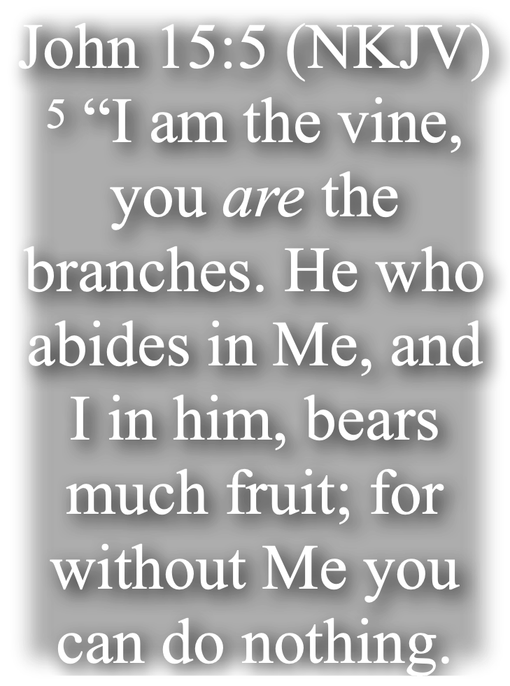
OF THE FAITHFUL
To APPLY
He who abides in Me, and I in him, bears much fruit

Slide 18
OF THE FAITHFUL
To APPLY
He who abides in Me, and I in him, bears much fruit
FAMILY MATTERS –
Marriage — Mat 19:3-9; Eph. 5:22-32; 1 Cor. 7; 1 Pet 3:1-7 …
Parents — Eph 6:4; Col. 3:21; Prov. 22:6; 23:13,14
Children — Eph 6:1-3; Prov. 6:20; 23:22; Col. 3:20

Slide 19
OF THE FAITHFUL
To APPLY
He who abides in Me, and I in him, bears much fruit
NEIGHBOR MATTERS –
Love them - Mark 12:31; Matt. 22:39; Gal. 5:14; James 2:8
Do good for them — Rom 12:17; Luke 10:29-37
Teach by word & deed — Acts 8:4; 1 Thes 1:8; Mat. 5:13,14

Slide 20
OF THE FAITHFUL
To APPLY
He who abides in Me, and I in him, bears much fruit
CHURCH MATTERS –
Love one another - 1 Pet 1:22; Rom. 12:10; 1 Thess. 4:9; Heb. 13:1
Serve one another — Rom 12:17; Phili 2:4;
Hold up one another — Rom. 15:1; 1 Thess. 5:14; Gal. 6:2

Slide 21
OF THE FAITHFUL
To APPLY
He who abides in Me, and I in him, bears much fruit
CHURCH MATTERS –
Growing & Serving (Eph 4:11-16)
Teaching — Heb 5:12
Leading worship (Praying / singing / preaching / serving …)
Deacons — 1 Tim 3:8-13
Elders — 1 Tim 3:1-7

Slide 22
OF THE FAITHFUL
To APPLY
He who abides in Me, and I in him, bears much fruit
You become what you SOW –
Galatians 6:7–8 (NKJV)
⁷ Do not be deceived, God is not mocked; for whatever a man sows, that he will also reap. ⁸ For he who sows to his flesh will of the flesh reap corruption, but he who sows to the Spirit will of the Spirit reap everlasting life.

Slide 23
OF THE FAITHFUL
To APPLY
He who abides in Me, and I in him, bears much fruit
You ARE what You Think –
Proverbs 4:23 (NKJV)
²³ Keep your heart with all diligence, For out of it spring the issues of life.

Slide 24
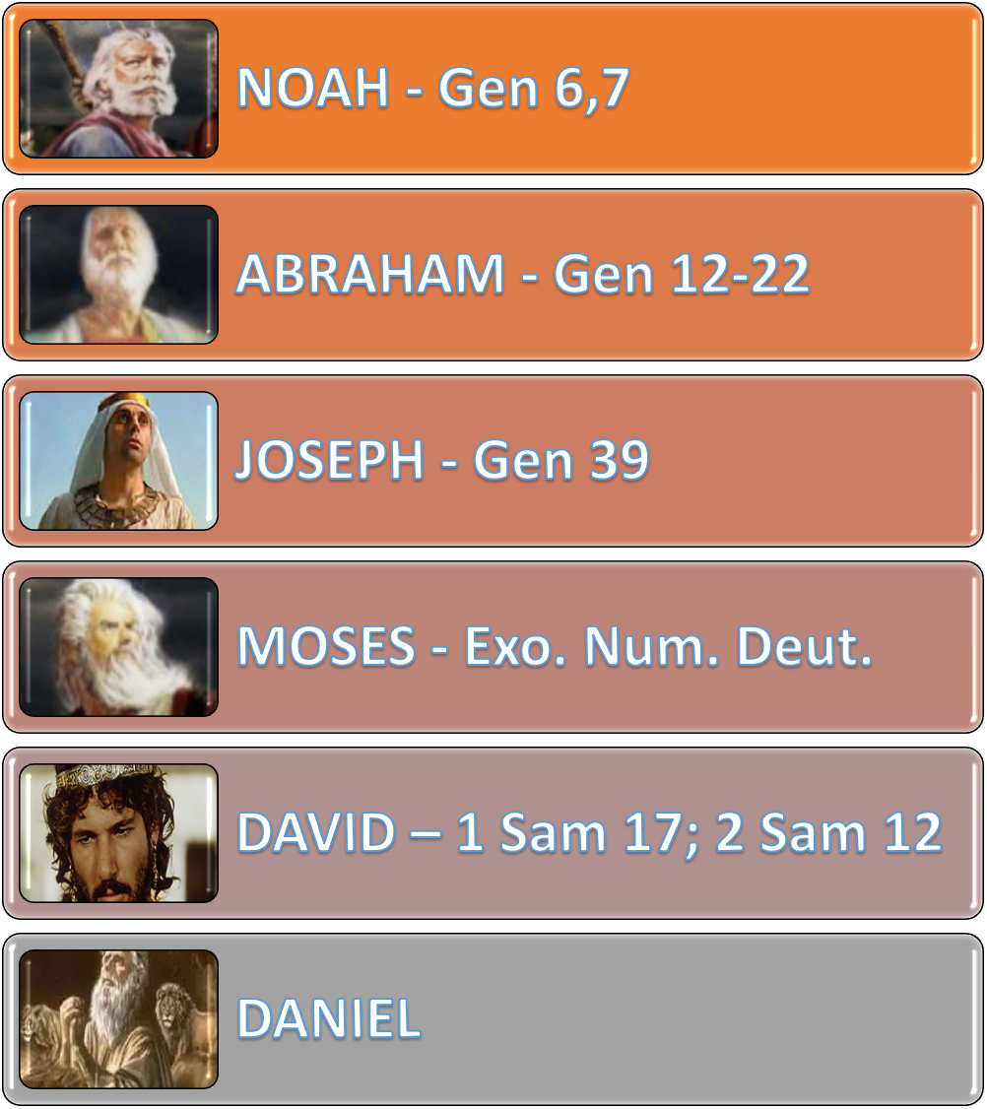
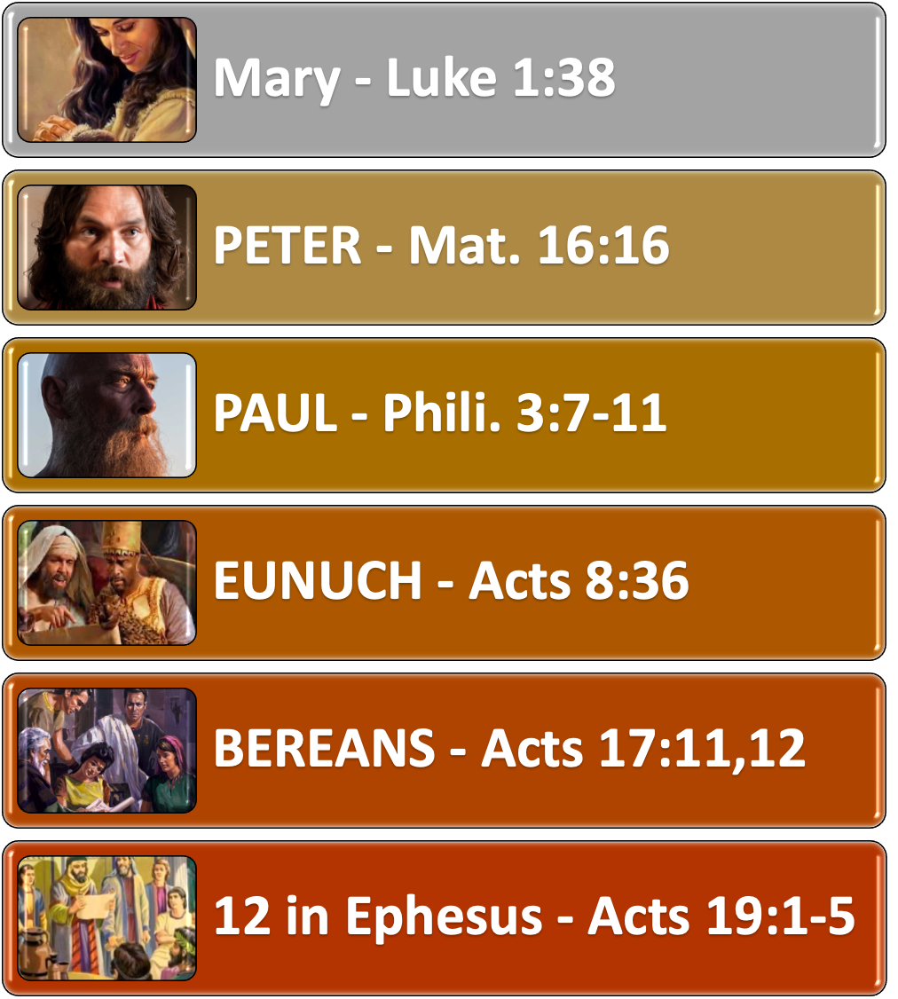
OF THE FAITHFUL

Slide 25
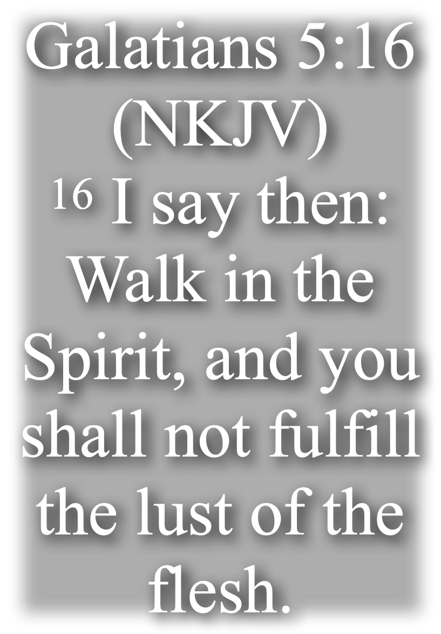
OF THE FAITHFUL
Godly Attitudes Must be developed!
WEEDS JUST GROW
Faith / Trusting
Humble,
Meek,
Merciful / Forgiving
Kind,
Long-suffering;
Forbearing,
Peaceful / Joyful
Loving
Doubt / Skeptic
Proud
Stubborn
Vengeful / Bitter
Angry
Impatient
Critical
@ War / Anxious
Selfish

Slide 26
OF THE FAITHFUL
GOD (Reverence / Trust / Honor/ Love)
SCRIPTURE (Believe / Study / Follow)
GOD’S AUTHORITY (Submissive)
THE UNIVERSAL CHURCH (Thankful)
OURSELF (Humble / Unworthy)
THE LOCAL CHURCH (Love / Support)
SIN (Hate / Flee)
TRUTH (Love / Seek / Buy / Defend)
ERROR (Hate / Expose / Defeat w/ Truth)
THE WORLD (Be separate / Not our home)
HEAVEN (Long for / Sacrifice for / Live for)

Slide 27
OF THE FAITHFUL
HUMILITY
MOURN OVER SIN
MEEKNESS
DESPERATE TO BE RIGHT W/ GOD
MERCIFUL
HONESTY
LOVING
ENDURANCE
LONG-SUFFERING
SUPPORTIVE
ZEAL FOR UNITY IN TRUTH & PEACE
KINDHEARTED
FORGIVING
GRATEFUL
PURE / HOLY
PEACEABLE
WILLING TO YIELD
FAIR / IMPARTIAL
GENUINE
RIGHTEOUS IN HEART
Romans 8:28–29 (NKJV)
²⁸ And we know that all things work together for good to those who love God, to those who are the called according to His purpose. ²⁹ For whom He foreknew, He also predestined to be conformed to the image of His Son, that He might be the firstborn among many brethren.

Slide 28
OF THE FAITHFUL
HUMILITY
MOURN OVER SIN
MEEKNESS
DESPERATE TO BE RIGHT W/ GOD
MERCIFUL
HONESTY
LOVING
ENDURANCE
LONG-SUFFERING
SUPPORTIVE
ZEAL FOR UNITY IN TRUTH & PEACE
KINDHEARTED
FORGIVING
GRATEFUL
PURE / HOLY
PEACEABLE
WILLING TO YIELD
FAIR / IMPARTIAL
GENUINE
RIGHTEOUS IN HEART
ARE THE ATTITUDES FOUND IN CHRIST FOUND IN YOU?

Slide 30
THE VALUE & IMPORTANCE OF GODLINESS
ATTITUDES FOUND IN FAITHFUL CHILDREN OF GOD
(Hebrews 11; Matthew 5:3-12; Ephesians 4:1-3; Galatians 5:22,23)
Charts by Don McClain
Preached January 29, 2023 / 9500 HWY 5 church of Christ / Alexander AR 72002 / Phone: 501-568-1062 / Email – donmcclain@sbcglobal.net
More Keynote, PPT & Audio Sermons
w65stchurchofchrist.com / https://www.bryantchurchofchrist.com

Slide 31
James 3:11–18 (NKJV)
¹¹ Does a spring send forth fresh water and bitter from the same opening? ¹² Can a fig tree, my brethren, bear olives, or a grapevine bear figs? Thus no spring yields both salt water and fresh. ¹³ Who is wise and understanding among you? Let him show by good conduct that his works are done in the meekness of wisdom. ¹⁴ But if you have bitter envy and self-seeking in your hearts, do not boast and lie against the truth. ¹⁵ This wisdom does not descend from above, but is earthly, sensual, demonic. ¹⁶ For where envy and self-seeking exist, confusion and every evil thing are there. ¹⁷ But the wisdom that is from above is first pure, then peaceable, gentle, willing to yield, full of mercy and good fruits, without partiality and without hypocrisy. ¹⁸ Now the fruit of righteousness is sown in peace by those who make peace.

