Slide 2
Healing of a paralytic
All three synoptic gospels - Mt 9:1-8; Mk 2:1-12; Lk 5:17-26
THE TEXT / LESSONS / APPLICATIONS

Slide 3
Healing of a paralytic
Mt 9:1-8; Mk 2:1-12; Lk 5:17-26
Healed the centurion's servant (Mt 8:5-13)
Healed Peter's mother-in-law (Mt 8:14-15)
Cast out many demons (Mt 8:16)
From Cana He healed the nobleman's son at Capernaum (Jn 4:46-54)
Occurs in Capernaum
[Jesus' "own city”] (Mk 2:1,2; Mt 9:1)
He did many miracles there

Slide 4
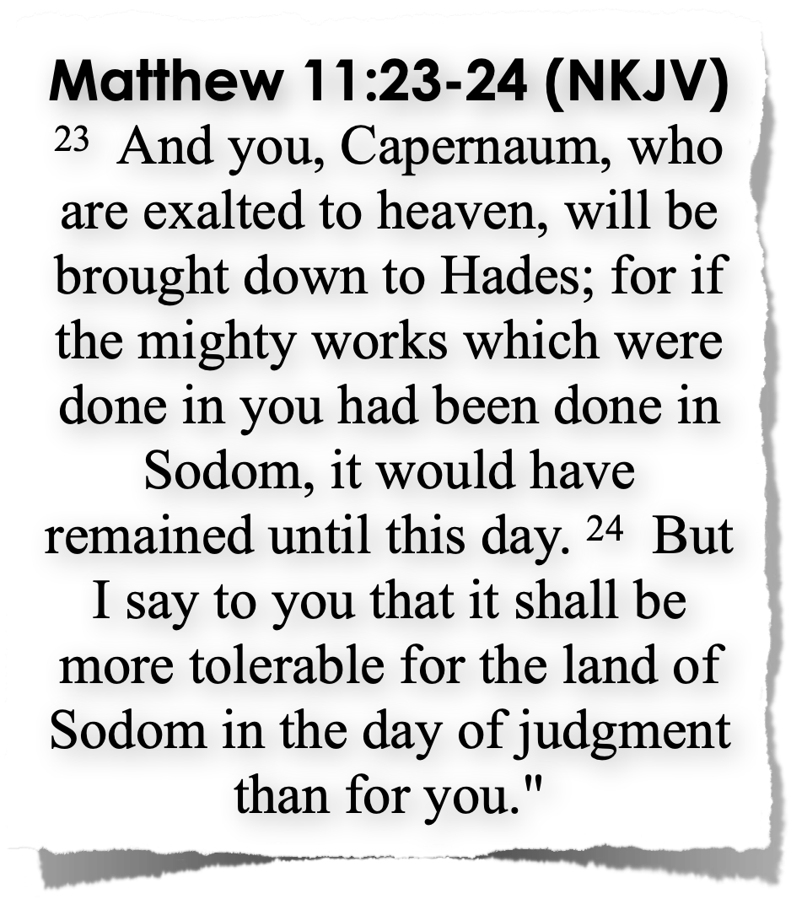
Healing of a paralytic
Mt 9:1-8; Mk 2:1-12; Lk 5:17-26
Yet those in the city brought judgment upon themselves (cf. Mt 11:23-24)
Occurs in Capernaum
[Jesus' "own city”] (Mk 2:1,2; Mt 9:1)
He did many miracles there

Slide 5
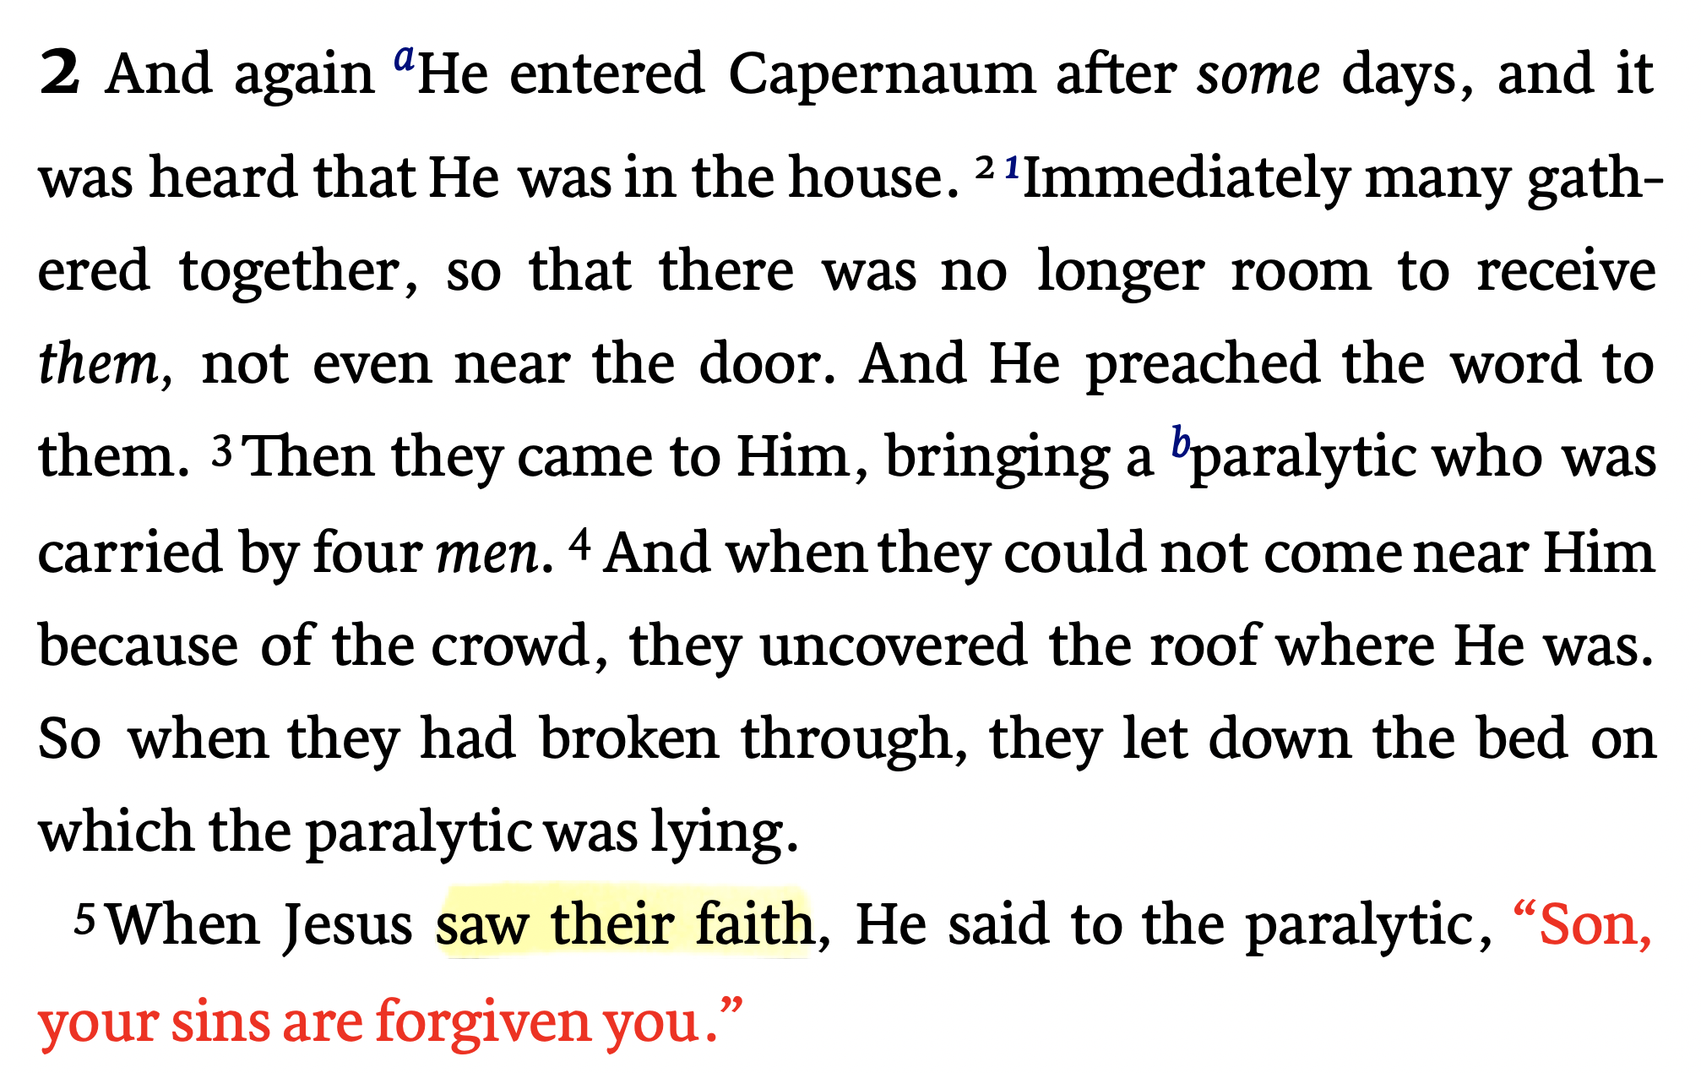
Mark 2:1–12 (NKJV)

Slide 6
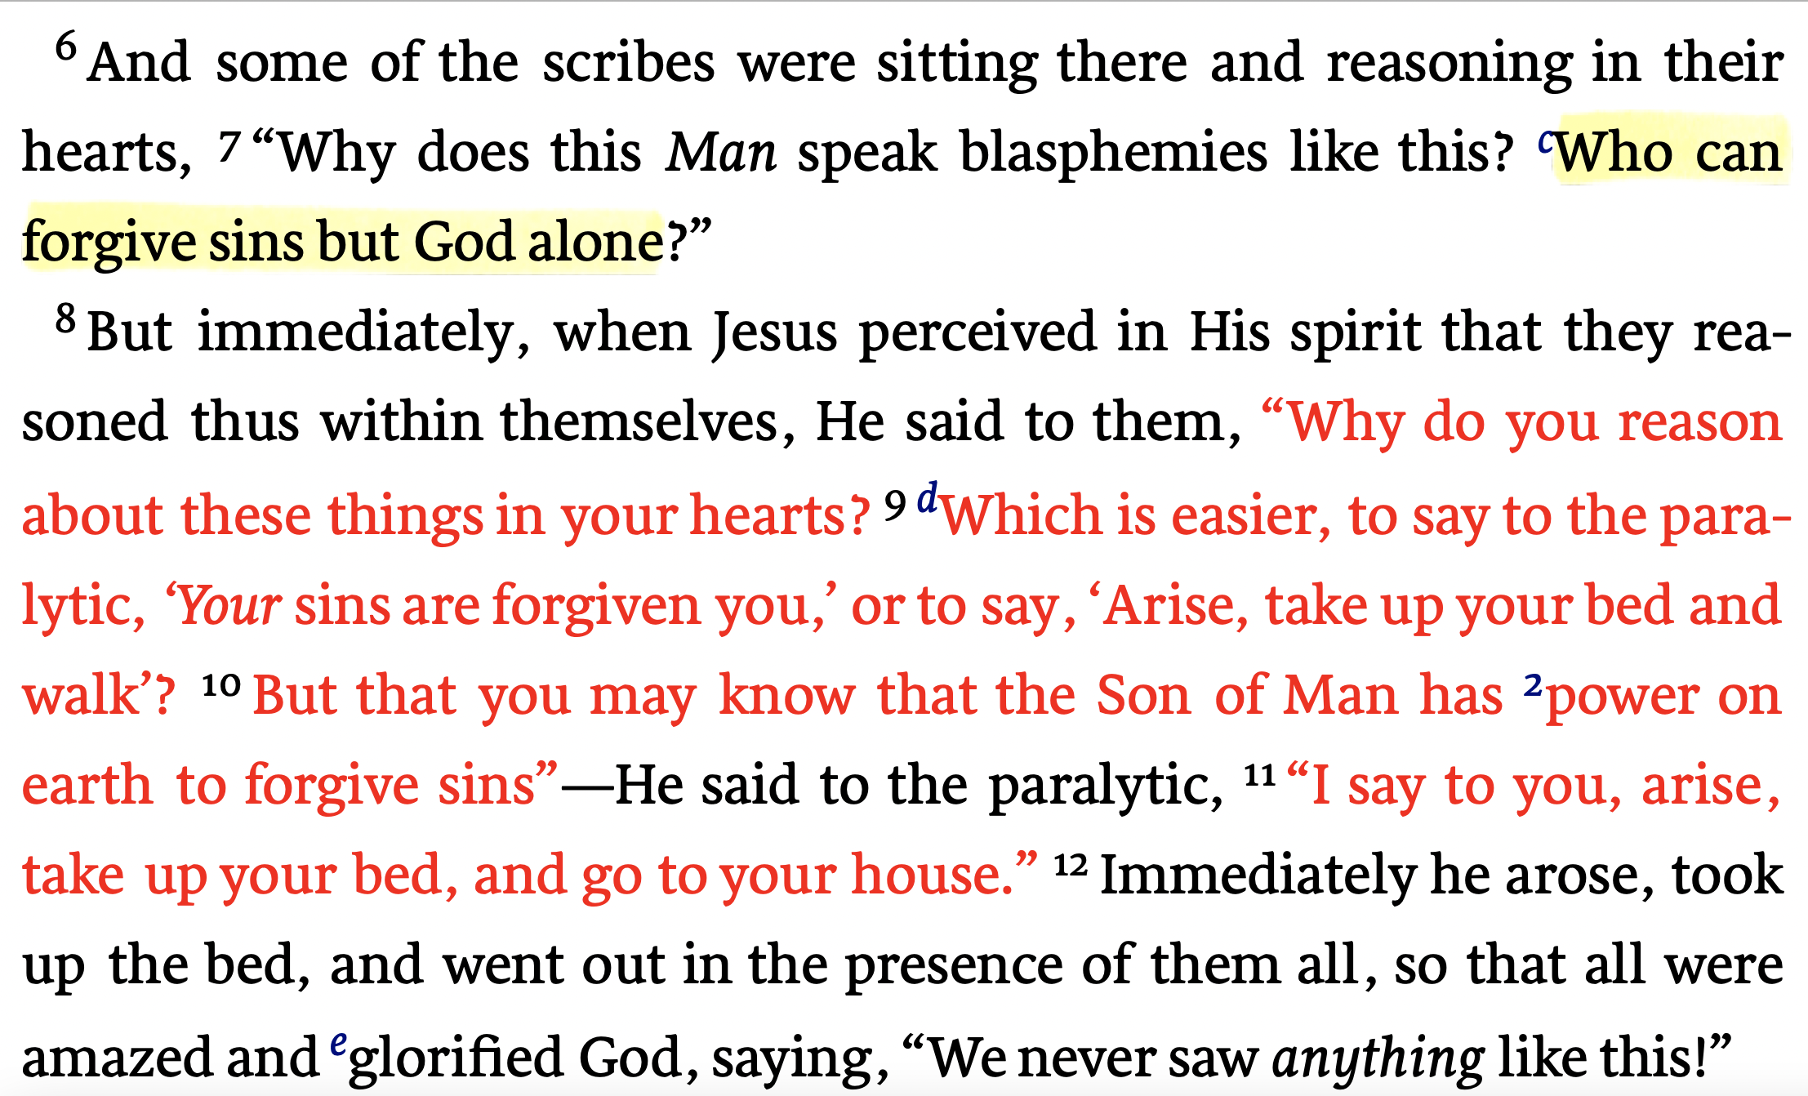
Mark 2:1–12 (NKJV)

Slide 7
Healing of a paralytic
Mt 9:1-8; Mk 2:1-12; Lk 5:17-26
The value of friends who care enough to help in time of need (3-5)
Spiritual illness is more serious than physical illness (8-12)
Jesus has the power to forgive sins / The deity of Christ (5-12)
Some reject the truth regardless of the evidence (6-8; Mt 11:23,24)
Real FAITH is visible and persistent (4,5; James 2:18)
Lessons from the text

Slide 8
Healing of a paralytic
Mt 9:1-8; Mk 2:1-12; Lk 5:17-26
We cannot deal with our sin apart from Jesus (John 14:6)
The greatest service we can provide another human being in this life is to bring them to Christ!
We should be willing to do everything in our power to bring others to Jesus
Lessons from the text

Slide 9
Healing of a paralytic
Mt 9:1-8; Mk 2:1-12; Lk 5:17-26
The Lord:
His Authority (Mat 28:18-20)
His Sacrifice for mankind (2 Cor 5:14)
Ourselves:
The actual condition of our Faith / our love for the Lord / our commitment to the Lord / Hope.
The Lost.
Our efforts to bring others to Christ DECLARE our true attitude towards:

Slide 10
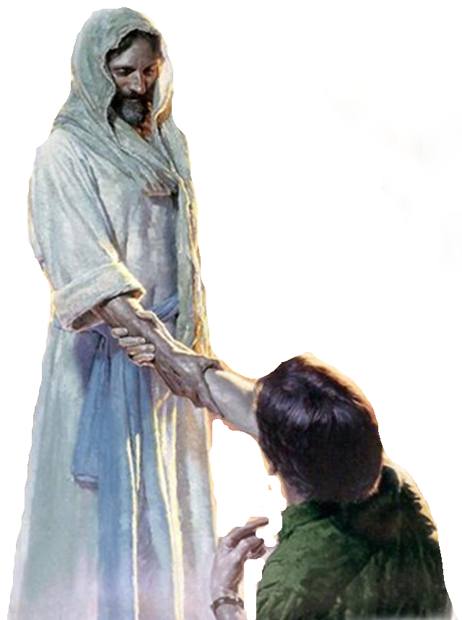
Leading Them To Christ
We are to point them to Jesus and His teaching. Not ourselves, what we believe, or the “church of Christ” teaching (2 Cor 4:5)
When converted to Christ, they become a member of His church! (Acts 2:47; Ep. 5:23)
We should not be out to make proselytes, only Christians (Mat 23:15; Acts 11:26)
Must lead them to the REAL Jesus (Jn 8:32; 14:6; Ac 4:12; 2 Cor. 11:4)

Slide 11
Exhibits Faith In Jesus
Jesus saw their faith
They truly believed that Jesus would be able to help their friend - thus they ACTED (3,4; cf. James 1:21-25; 2:14-19)
Do we trust in the power of Jesus & the gospel? [JESUS SEES!!!] (Rom 1:16; James 1:21; Isa. 55:11)

Slide 12
Exhibits Love & Compassion
They must have cared for this man and desired to see his need met (3,4)
God so loved us that he gave His Son (Jn 3:16; Rom. 5:8-10)
We should love others as God loves (Mt 5:43-48; 1 Jn 4:7-21; Mk 6:34)
We are commissioned to sow seed, not pre-judge the soil (Mat 13:3-8; 1 Cor. 3:5,6)

Slide 13
Exhibits Love & Compassion
They must have cared for this man and desired to see his need met (3,4)
Our love for God, Jesus & those who are lost motivates us to do whatever we can to lead them to Jesus who can save their souls (4; cf. Rom 9:1-3; 10:1-3)
Love covers a multitude of sins when our love for the lost leads them Christ by the gospel (1 Pet 4:8; James 5:20; 2 Thes 2:14)

Slide 14
They Worked Together
Four men worked together to get this man to Jesus (3,4)
Jesus sent out his disciples in pairs to preach the kingdom of heaven (Mark 6:7)
Paul had help on his preaching journeys (Acts 13:1-3; 15:40)
We can work together to bring people to Jesus – utilizing one another’s individual talents and resources (Eccl. 4:9,10)

Slide 15
They Were Determined
The trouble to which they went (3,4)
Carried the man to the house
Fought through the crowd,
Got up on the roof,
Removed roofing, made a hole
Let him down thru the hole.
Unless we are willing to be inconvenienced, we will NOT bring many people to Christ! (2 Cor. 11:22-28)

Slide 16
They Were Determined
Demonstrates the value they had placed upon their friend!
There will always be obstacles & resistance.
Do we care enough about another’s soul that we will not quickly give up on them? (Mat 16:26)

Slide 17
Christians Are Evangelistic
Every Person Needs Jesus (Jn 14:6; Acts 4:12)
The greatest service we can provide another person is to bring them to Christ! (Acts 8:4)
Are We willing to do everything in our power to bring others to Jesus? (1 Thes. 1:8; 2 Cor. 12:15)

Slide 18
Christians Are Evangelistic
Internet:
Website / Facebook / Email / Online articles & sermons.
Live stream: LIVE Facebook & You Tube Videos / Archives
Correspondent Courses
In home Bible studies

Slide 19
If you have never obeyed the gospel of Jesus Christ, you are lost, you need to have your sins forgiven!

Slide 20
Will you allow us to help you know Jesus?
We will point you to the teachings of Jesus
if you believe that Jesus is the Christ, repent of your sins, we can baptize you into Him today!
(John 8:24; Romans 10:9,10; Acts 2:38; Gal 3:27)

Slide 22
Charts by Don McClain
Preached April 17, 2022
West 65th Street church of Christ - P.O. Box 190062 - Little Rock AR 72219 - Phone — 501-568-1062 — Email – donmcclain@sbcglobal.net
Prepared using Keynote
More Keynote, PPT & Audio Sermons:
https://www.w65stchurchofchrist.com

Slide 23
Matthew 9:1–8 (NKJV)
¹ So He got into a boat, crossed over, and came to His own city. ² Then behold, they brought to Him a paralytic lying on a bed. When Jesus saw their faith, He said to the paralytic, “Son, be of good cheer; your sins are forgiven you.” ³ And at once some of the scribes said within themselves, “This Man blasphemes!” ⁴ But Jesus, knowing their thoughts, said, “Why do you think evil in your hearts? ⁵ For which is easier, to say, ‘Your sins are forgiven you,’ or to say, ‘Arise and walk’? ⁶ But that you may know that the Son of Man has power on earth to forgive sins”—then He said to the paralytic, “Arise, take up your bed, and go to your house.” ⁷ And he arose and departed to his house. ⁸ Now when the multitudes saw it, they marveled and glorified God, who had given such power to men.

