Slide 1
(Romans 2:6)

Slide 2
What does Paul mean in Romans 2:6? Is he saying we will be given back according to what we have done? If someone does not do a lot of deeds/works they will not get to heaven?
The concept of good works and salvation has confused me, because we cannot work our way or earn salvation based on all the good we have done, as we are saved by grace through faith, but that verse, as well as Eph. 2:10, Titus 2:14, 3:8, Hebrews 10:24, Matthew 5:16, confuse me, because they all talk about good works.
I feel if I am not doing enough as a Christian then I will not get to heaven. That sounds like works salvation to a lot of people and makes me put a lot of pressure on myself which makes me feel like I am relying on myself to get to heaven instead of God.

Slide 3
The misunderstanding of Biblical terms such as, “salvation,” “grace,” “faith,” and “works,” has resulted in many FALSE conclusions, FALSE explanations, and FALSE applications of scripture.
Much confusion exists due to a failure to recognize how these terms are used differently in various contexts.
The result is the inappropriate conflation of Bible passages, thereby creating contradictory concepts & teaching.

Slide 4
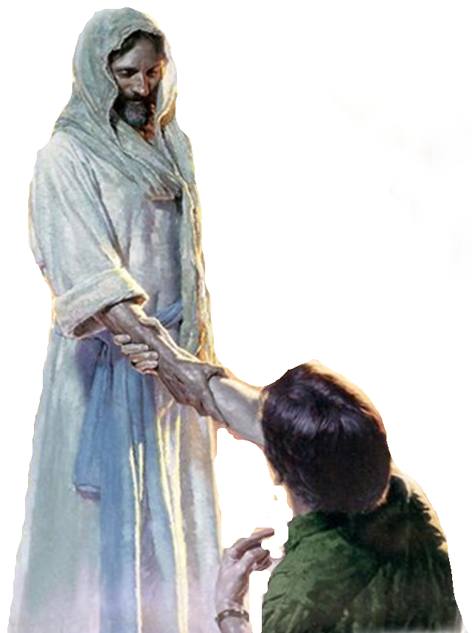
Things commanded by God:
HEARING, BELIEVING, & OBEYING JESUS!
NECESSARY / REQUIRED
IN ORDER TO / UNTO:
INITIAL JUSTIFICATION
CURRENT STANDING W/ GOD
ETERNAL GLORIFICATION

Slide 5
YES!
John 6:29; John 8:24
Luke 13:3,5; Acts 17:30
Mat. 7:21-26; Heb. 5:8,9
Ja. 2:14-26; Titus 2:11-14
Romans 2:3-11; 2 Cor. 5:10;
Matthew 25:31-46
2 Thes. 1:7-9; 1 Pet. 4:17

Slide 6
What does Paul mean in Romans 2:6? Is he saying we will be given back according to what we have done? If someone does not do a lot of deeds/works they will not get to heaven?
Romans 2:3–11 (NKJV)
³ And do you think this, O man, you who judge those practicing such things, and doing the same, that you will escape the judgment of God? ⁴ Or do you despise the riches of His goodness, forbearance, and longsuffering, not knowing that the goodness of God leads you to repentance? ⁵ But in accordance with your hardness and your impenitent heart you are treasuring up for yourself wrath in the day of wrath and revelation of the righteous judgment of God,
SIN (disobedience) results in condemnation.
practicing
THE GOSPEL REQUIRES REPENTANCE!
repentance
THE IMPENITENT WILL RECEIVE GOD’S WRATH!
impenitent

Slide 7
What does Paul mean in Romans 2:6? Is he saying we will be given back according to what we have done? If someone does not do a lot of deeds/works they will not get to heaven?
Romans 2:3–11 (NKJV)
⁶ who “will render to each one according to his deeds”: ⁷ eternal life to those who by patient continuance in doing good seek for glory, honor, and immortality; ⁸ but to those who are self-seeking and do not obey the truth, but obey unrighteousness—indignation and wrath, ⁹ tribulation and anguish, on every soul of man who does evil, of the Jew first and also of the Greek; ¹⁰ but glory, honor, and peace to everyone who works what is good, to the Jew first and also to the Greek. ¹¹ For there is no partiality with God.
Ps. 62:12; Prov. 24:12; Jer. 17:10; 2 Cor. 5:10; Rev. 20:12, 13
continuance in doing good
OBEDIENCE RESULTS IN SALVATION / DISOBEDIENCE RESULTS IN CONDEMNATION
who does evil
EVIL = WRATH
OBEDIENCE OF FAITH = GLORY, HONOR, PEACE
who works what is good

Slide 8
The concept of good works and salvation has confused me, because we cannot work our way or earn salvation based on all the good we have done, as we are saved by grace through faith, but that verse, as well as Eph. 2:10, Titus 2:14, 3:8, Hebrews 10:24, Matthew 5:16, confuse me, because they all talk about good works.
Ephesians 2:10 - “created in Christ Jesus for good works”
Titus 2:14 - “zealous for good works.”
Hebrews 10:24 - “consider one another in order to stir up love and good works”
Saved people MUST continue to believe, (i.e., obey and serve), the one who saved them!
We should understand that faithfulness can NEVER repay the debt we owe - we can NEVER earn our salvation! (Mt 20:1-16)

Slide 9
The concept of good works and salvation has confused me, because we cannot work our way or earn salvation based on all the good we have done, as we are saved by grace through faith, but that verse, as well as Eph. 2:10, Titus 2:14, 3:8, Hebrews 10:24, Matthew 5:16, confuse me, because they all talk about good works.
Luke 17:10 (NKJV)
¹⁰ So likewise you, when you have done all those things which you are commanded, say, ‘We are unprofitable servants. We have done what was our duty to do.’ ”

Slide 10
The concept of good works and salvation has confused me, because we cannot work our way or earn salvation based on all the good we have done, as we are saved by grace through faith, but that verse, as well as Eph. 2:10, Titus 2:14, 3:8, Hebrews 10:24, Matthew 5:16, confuse me, because they all talk about good works.
Many argue, “we do good works BECAUSE we are saved, NOT to be saved.”
This is partially true, in that being saved from our past sins should motivate us unto good works - BUT, being saved from our past sins will not benefit us if we fail to “do good works,” i.e., obey Jesus, striving to live a faithful life, and growing in our faith (Mat. 25:31-46; Col. 3:1-17; 2 Peter 1:5-11; etc.)
Eternal glory is conditioned on our “patient continuance in doing good” (Heb. 3:14ff)

Slide 11
The concept of good works and salvation has confused me, because we cannot work our way or earn salvation based on all the good we have done, as we are saved by grace through faith, but that verse, as well as Eph. 2:10, Titus 2:14, 3:8, Hebrews 10:24, Matthew 5:16, confuse me, because they all talk about good works.
Meeting the conditions established by God, such as faith, repentance, baptism, or “doing good,” does not, (nor can it), earn, merit, or pay for the forgiveness of our sins and the GIFT of eternal life (Luke 17:10; Eph. 2:8; Titus 3:4,5; Rom. 4:1-12; 5:8,9; 6:3-23; etc.)
The premise that “if we have to do anything at all to receive salvation we would earn salvation,” is a premise that despises the value of salvation and the value of the sacrifice of Christ (Heb. 10:26-31).

Slide 12
The concept of good works and salvation has confused me, because we cannot work our way or earn salvation based on all the good we have done, as we are saved by grace through faith, but that verse, as well as Eph. 2:10, Titus 2:14, 3:8, Hebrews 10:24, Matthew 5:16, confuse me, because they all talk about good works.
Romans 6:16–18 (NKJV)
¹⁶ Do you not know that to whom you present yourselves slaves to obey, you are that one’s slaves whom you obey, whether of sin leading to death, or of obedience leading to righteousness? ¹⁷ But God be thanked that though you were slaves of sin, yet you obeyed from the heart that form of doctrine to which you were delivered. ¹⁸ And having been set free from sin, you became slaves of righteousness.

Slide 13
I feel if I am not doing enough as a Christian then I will not get to heaven. That sounds like works salvation to a lot of people and makes me put a lot of pressure on myself which makes me feel like I am relying on myself to get to heaven instead of God.
What about all of the passages that plainly state we are “NOT SAVED BY WORKS?”
First, the term works is used differently:
Law of Moses (Rom. 3:28; 4; Gal. 2:18)
Of merit (Rom 11:6; Eph 2:8)
Of our righteousness (Tit 3:5; Rom. 101-3)
Of God’s righteousness (Jn 6:28,29; Acts 10:35; 1 John. 2:29; 3:7; 3:10)
Works of faith (1 Th. 1:3; Ja. 2:14-26)
Good Works (Eph. 2:10; Tit. 3:8-14)

Slide 14
I feel if I am not doing enough as a Christian then I will not get to heaven. That sounds like works salvation to a lot of people and makes me put a lot of pressure on myself which makes me feel like I am relying on myself to get to heaven instead of God.
What about all of the passages that plainly state we are “NOT SAVED BY WORKS?”
Secondly, we need to understand the difference between the basis of our salvation, the means of our salvation, and the conditions God has required for us to be saved from our sins.

Slide 15
we need to understand the difference between …
Basis
(Not of
WORKS)
The Gracious
Gift of God’s Son & The Gospel -
God's Universal Kindness, Love &
Mercy.
Salvation
Provision
(Not of
WORKS)
Conditions
We MUST meet
(WORKS)
Faith – (Repent – Confess – Be baptized - Persevere in Good Works)

Slide 16
I feel if I am not doing enough as a Christian then I will not get to heaven. That sounds like works salvation to a lot of people and makes me put a lot of pressure on myself which makes me feel like I am relying on myself to get to heaven instead of God.
What about all of the passages that plainly state we are “NOT SAVED BY WORKS?”
Secondly, we need to understand the difference between the basis of our salvation, the means of our salvation, and the conditions God has required for us to be saved from our sins.
Many FALSELY teach that salvation is WHOLLY, from start to finish, “ALL OF GOD, AND NONE of MAN.” — This view stems from Calvinistic theology and is OPPOSED to Biblical truth!

Slide 17
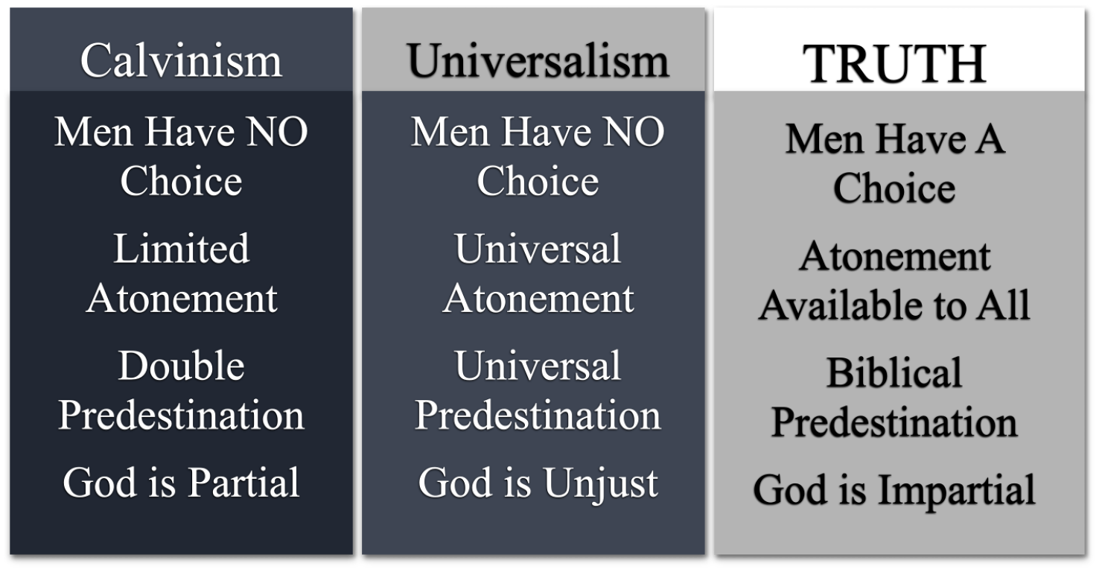
IF salvation is WHOLLY, from start to finish,
“ALL OF GOD, AND NONE of MAN.”

Slide 18
I feel if I am not doing enough as a Christian then I will not get to heaven. That sounds like works salvation to a lot of people and makes me put a lot of pressure on myself which makes me feel like I am relying on myself to get to heaven instead of God.
James 4:17 (NKJV)
¹⁷ Therefore, to him who knows to do good and does not do it, to him it is sin.
2 Peter 1:5–9 (NKJV)
⁵ But also for this very reason, giving all diligence, add to your faith … ⁸ For if these things are yours and abound, you will be neither barren nor unfruitful … he who lacks these things is shortsighted, even to blindness, and has forgotten that he was cleansed from his old sins.

Slide 19
I feel if I am not doing enough as a Christian then I will not get to heaven. That sounds like works salvation to a lot of people and makes me put a lot of pressure on myself which makes me feel like I am relying on myself to get to heaven instead of God.
Ephesians 2:8–9 (NKJV)
⁸ For by grace you have been saved through faith, and that not of yourselves; it is the gift of God, ⁹ not of works, lest anyone should boast.
Salvation is a gift of God which no man deserves (Rom 3:23)
Salvation is received through the means of our faith (John 3:16; 8:24; Heb 11:6; Rom 10:17)
Salvation cannot be earned by our own efforts (Rom. 11:6)
No man can boast before God (Rom. 4:2; 3:23)

Slide 20
I feel if I am not doing enough as a Christian then I will not get to heaven. That sounds like works salvation to a lot of people and makes me put a lot of pressure on myself which makes me feel like I am relying on myself to get to heaven instead of God.
Noah saved by grace through faith (Gen. 6:8; Heb 11:7)
Naaman healed by grace through faith (2 Kings 5:1-19; Lk 4:27)
Walls of Jericho fell by grace through faith (Joshua 6:2,15,16,20; Heb 11:30)
The FAITH that obeys does not nullify God’s grace or earn it - but receives it! (Mk 16:16; Gal. 2:20; Acts 2:38; 22:16; Rom 6:3-19; Col. 2:12,13)
Ephesians 2:8–9 (NKJV)
⁸ For by grace you have been saved through faith, and that not of yourselves; it is the gift of God, ⁹ not of works, lest anyone should boast.

Slide 21
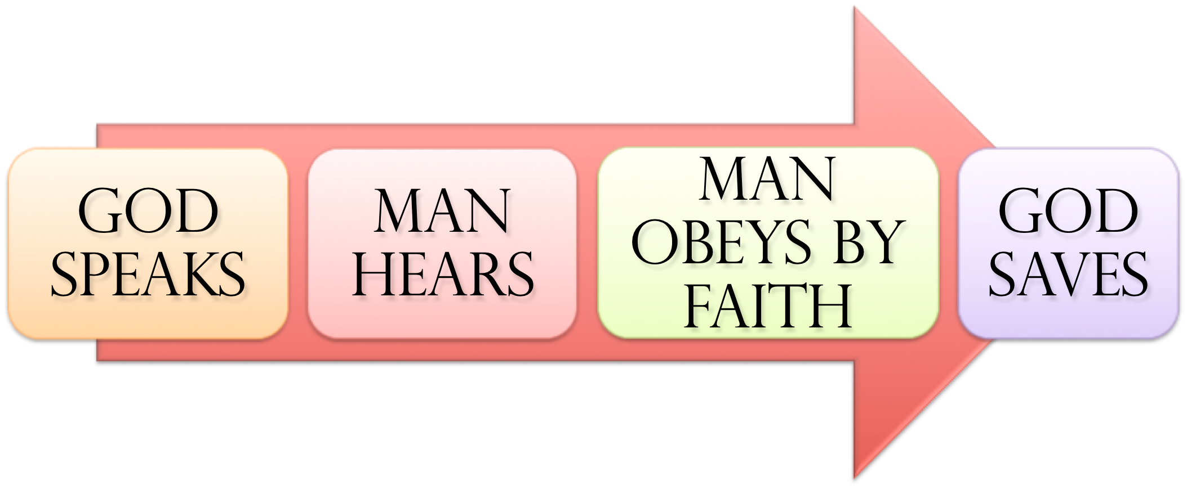
Noah - Gen. 6:8,13-17; 22; 7:5; Heb 11:7
Abraham – Gen 12:4; 15:6; 17:10,23; 22:3,16-18
Israel – Ex. 12:13; 14:30; Dt 30:15-19; Jos 6; 1 Cor 10:1-13
Us – Mark 16:16; Acts 2:38; 8:12,37; Rom 6:3-6; 10:9-13; Gal. 3:26,27; Col. 2:11-13; 1 Pet 3:21; 1 Jn 1:9; Rom. 2:5-11

Slide 22
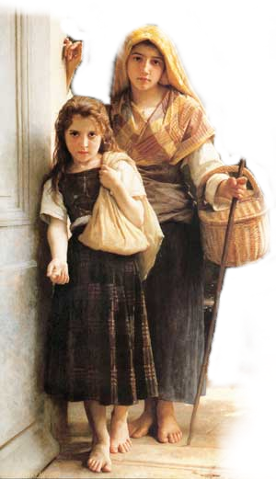
James 2:14–26 (NKJV)
¹⁴ What does it profit, my brethren, if someone says he has faith but does not have works? Can faith save him? ¹⁵ If a brother or sister is naked and destitute of daily food, ¹⁶ and one of you says to them, “Depart in peace, be warmed and filled,” but you do not give them the things which are needed for the body, what does it profit?
Faith ALONE CANNOT Save!!

Slide 23
James 2:14–26 (NKJV)
¹⁷ Thus also faith by itself, if it does not have works, is dead. ¹⁸ But someone will say, “You have faith, and I have works.” Show me your faith without your works, and I will show you my faith by my works. ¹⁹ You believe that there is one God. You do well. Even the demons believe—and tremble!
What value is a faith that does not work?

Slide 24
James 2:14–26 (NKJV)
²⁰ But do you want to know, O foolish man, that faith without works is dead? ²¹ Was not Abraham our father justified by works when he offered Isaac his son on the altar? ²² Do you see that faith was working together with his works, and by works faith was made perfect?
What kind of faith did Abraham have?
(Genesis 22:16-19
Rom. 4:12-24)

Slide 25
James 2:14–26 (NKJV)
²³ And the Scripture was fulfilled which says, “Abraham believed God, and it was accounted to him for righteousness.” And he was called the friend of God. ²⁴ You see then that a man is justified by works, and not by faith only.
The Faith That Saves Is The Faith That Obeys!

Slide 26
The only effectual faith is the faith that obeys God! —
(James 2:14-26; Heb. 11)

Slide 27
The Gospel is NOT a system based on MERIT – but forgiveness through Jesus Christ when we by faith obey Him –

Slide 28
Salvation is either merited or it is unmerited – It can’t be both! (Romans 11:6)
Forgiveness is unmerited through Jesus Christ when we, by faith, obey Him (Heb. 5:8.9; Act 2:38; Gal. 3:26,27)

Slide 29
What kind of FAITH / WORKS do you have?
(Mk 16:16; Acts 2:37,38,41; Gal. 3:26,27)

Slide 30
The BIBLE SAYS YES!
NOT TO EARN - BUT TO RECEIVE
Will you BELIEVE GOD’S WORD?
(Romans 2:6)

Slide 31
Don McClain
W. 65th St church of Christ / May 6, 2007

Slide 32
(Romans 2:6)
Charts by Don McClain
Preached April 3, 2022
West 65th Street church of Christ - P.O. Box 190062 - Little Rock AR 72219 - Phone — 501-568-1062 — Email – donmcclain@sbcglobal.net
Prepared using Keynote
More Keynote, PPT & Audio Sermons:
https://www.w65stchurchofchrist.com

Slide 33
Revelation 20:11–15 (NKJV)
¹¹ Then I saw a great white throne and Him who sat on it, from whose face the earth and the heaven fled away. And there was found no place for them. ¹² And I saw the dead, small and great, standing before God, and books were opened. And another book was opened, which is the Book of Life. And the dead were judged according to their works, by the things which were written in the books. ¹³ The sea gave up the dead who were in it, and Death and Hades delivered up the dead who were in them. And they were judged, each one according to his works. ¹⁴ Then Death and Hades were cast into the lake of fire. This is the second death. ¹⁵ And anyone not found written in the Book of Life was cast into the lake of fire.

