Slide 2
Psalm 39:1 (NKJV)
¹ I said, “I will guard my ways, Lest I sin with my tongue; I will restrain my mouth with a muzzle, While the wicked are before me.”

Slide 3
James 1:26 (NKJV)
²⁶ If anyone among you thinks he is religious, and does not bridle his tongue but deceives his own heart, this one’s religion is useless.

Slide 4
Your Tongue Is Powerful!
Your Tongue Is Dangerous!
Your Tongue Can Be Used To Sin & Harm Others!
Your Tongue Can Be Controlled & Used For Good!

Slide 5
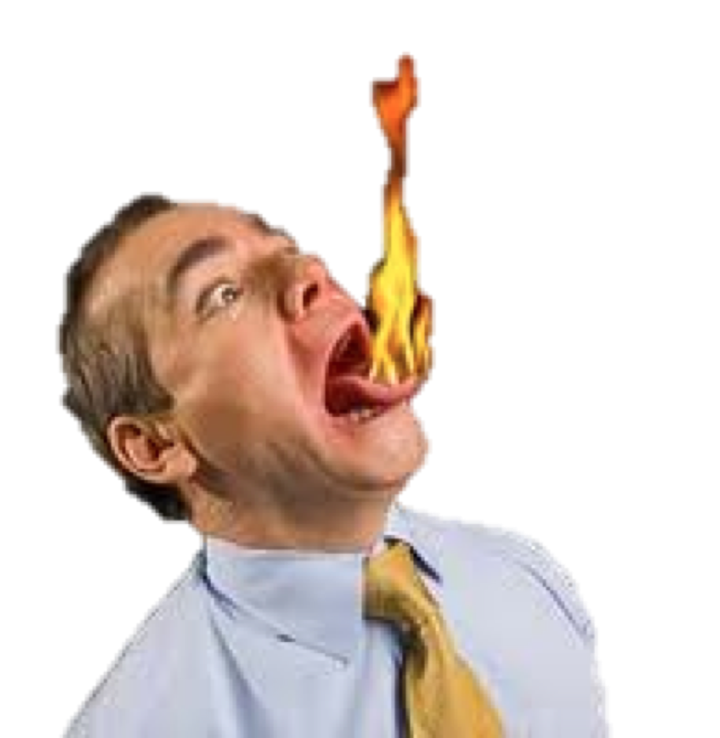
Tremendous Power For Good & Evil
(Proverbs 15:1-7; Jam. 3:1-6)
Proverbs 15:1–7 (NKJV)
¹ A soft answer turns away wrath, But a harsh word stirs up anger. ² The tongue of the wise uses knowledge rightly, But the mouth of fools pours forth foolishness. ³ The eyes of the Lord are in every place, Keeping watch on the evil and the good. ⁴ A wholesome tongue is a tree of life, But perverseness in it breaks the spirit.

Slide 6
Tremendous Power For Good & Evil
(Proverbs 15:1-7; Jam. 3:1-6)
Proverbs 15:1–7 (NKJV)
⁵ A fool despises his father’s instruction, But he who receives correction is prudent. ⁶ In the house of the righteous there is much treasure, But in the revenue of the wicked is trouble. ⁷ The lips of the wise disperse knowledge, But the heart of the fool does not do so.

Slide 7
Tremendous Power For Good & Evil
(Proverbs 15:1-7; Jam. 3:1-6)
James 3:1–2 (NKJV)
¹ My brethren, let not many of you become teachers, knowing that we shall receive a stricter judgment. ² For we all stumble in many things. If anyone does not stumble in word, he is a perfect man, able also to bridle the whole body.

Slide 8
Tremendous Power For Good & Evil
(Proverbs 15:1-7; Jam. 3:1-6)
“let not many of you become teachers”
An IMPORTANT & NECESSARY function (Acts 13:1; Eph. 4:11; 1 Cor. 12:28; 1 Peter 3:15)
A great RESPONSIBILITY & comes with great ACCOUNTABILITY (Acts 20:25-28; 1 Timothy 1:7)
Requires great self-control, thus a spiritual, purified heart (Mat 12:35)

Slide 9
Tremendous Power For Good & Evil
(Proverbs 15:1-7; Jam. 3:1-6)
James 3:3–5 (NKJV)
³ Indeed, we put bits in horses’ mouths that they may obey us, and we turn their whole body. ⁴ Look also at ships: although they are so large and are driven by fierce winds, they are turned by a very small rudder wherever the pilot desires. ⁵ Even so the tongue is a little member and boasts great things. See how great a forest a little fire kindles!

Slide 10
Tremendous Power For Good & Evil
(Proverbs 15:1-7; Jam. 3:1-6)
The tongue is small but …
Like a small bit or rudder …
Like a small fire that can spread out of control and destroy much
Can defile and destroy us and our relationships,
Can destroy the reputations and lives of others, as well as their souls.
Can destroy homes, churches, communities & nations …

Slide 11
Tremendous Power For Good & Evil
(Proverbs 15:1-7; Jam. 3:1-6)
James 3:6 (NKJV)
⁶ And the tongue is a fire, a world of iniquity. The tongue is so set among our members that it defiles the whole body, and sets on fire the course of nature; and it is set on fire by hell.

Slide 12
Is Never Fully Tamed
(James 3:7-8)
James 3:7–8 (NKJV)
⁷ For every kind of beast and bird, of reptile and creature of the sea, is tamed and has been tamed by mankind. ⁸ But no man can tame the tongue. It is an unruly evil, full of deadly poison.

Slide 13
Is Never Fully Tamed
(James 3:7-8)
Must be CONSTANTLY guarded
Proverbs 10:19 "he who restrains his lips is wise”
Ps 141:3 “Set a guard, O Lord, over my mouth; Keep watch over the door of my lips.
Psa. 34:13 “Keep your tongue from evil, And your lips from speaking deceit”

Slide 14
Is Never Fully Tamed
(James 3:7-8)
Must be CONSTANTLY guarded
Ep 4:29 “²⁹ Let no corrupt word proceed out of your mouth, but what is good for necessary edification, that it may impart grace to the hearers.”
Co 4:6 ⁶ Let your speech always be with grace, seasoned with salt, that you may know how you ought to answer each one.

Slide 15
Is Never Fully Tamed
(James 3:7-8)
James 1:26 (NKJV)
²⁶ If anyone among you thinks he is religious, and does not bridle his tongue but deceives his own heart, this one’s religion is useless.

Slide 16
THESES THINGS OUGHT NOT TO BE SO
(James 3:9-12)
James 3:9–12 (NKJV)
⁹ With it we bless our God and Father, and with it we curse men, who have been made in the similitude of God. ¹⁰ Out of the same mouth proceed blessing and cursing. My brethren, these things ought not to be so. ¹¹ Does a spring send forth fresh water and bitter from the same opening? ¹² Can a fig tree, my brethren, bear olives, or a grapevine bear figs? Thus no spring yields both salt water and fresh.

Slide 17
THESES THINGS OUGHT NOT TO BE SO
(James 3:9-12)
A HEART ISSUE
How can a good and pure heart produce words that are evil, hurtful, and destructive?
In order for polluted water to come out of a faucet, the water in the tank, (source), must first be polluted!
Our words come from our thoughts, (heart).

Slide 18
THESES THINGS OUGHT NOT TO BE SO
(James 3:9-12)
A HEART ISSUE
Proverbs 10:11–14 (NKJV)
¹¹ The mouth of the righteous is a well of life, But violence covers the mouth of the wicked. ¹² Hatred stirs up strife, But love covers all sins. ¹³ Wisdom is found on the lips of him who has understanding, But a rod is for the back of him who is devoid of understanding. ¹⁴ Wise people store up knowledge, But the mouth of the foolish is near destruction.

Slide 19
THESES THINGS OUGHT NOT TO BE SO
(James 3:9-12)
A HEART ISSUE
Matthew 12:33–37 (NKJV)
³³ “Either make the tree good and its fruit good, or else make the tree bad and its fruit bad; for a tree is known by its fruit. ³⁴ Brood of vipers! How can you, being evil, speak good things? For out of the abundance of the heart the mouth speaks. ³⁵ A good man out of the good treasure of his heart brings forth good things, and an evil man out of the evil treasure brings forth evil things.

Slide 20
CURSING
ROM. 12:14; JA. 3:9.
WHISPERS
ROM 1:29
FOOLISH
EPH. 5:4
FLATTERY
PSALM 12:3
BACKBITING
ROM 1:30
JESTING
EPH. 5:4
EVIL SPEECH
EPH. 3:31
BOASTING
ROM 1:39
IDLE WORDS
MAT. 12:36
LYING / DECEIT
REV. 21:8; ROM 3:13
COMPLAINING
1 COR. 10:10
BLASPHEMY
COL. 3:8
TALE BEARING
LEV. 19:16
REVILING
1 COR. 6:10
FALSE DOC.
TITUS 1:10,11
FILTHINESS
COL. 3:8
HARSH
MAT. 5:22
SILENT
JOHN 12:42

Slide 21
THESES THINGS OUGHT TO BE SO
(HEB 10:24; )
USE YOUR TONGUE TO:
Praise God (James 3:9)
Pray to God(James 1:5-6; 5:13-16; 5:14-20).
Sing to the Lord (James 5:13).
Build up and strengthen one another (1 Cor. 14:26; 1 Th. 5:11).
Encourage one another (Acts 11:23; 20:2)
Speak the truth in love (Eph. 4:15)

Slide 22
THESES THINGS OUGHT TO BE SO
(HEB 10:24; )
USE YOUR TONGUE TO:
EXPOSE ERROR WITH TRUTH
INSTRUCT IN RIGHTEOUSNESS
RESTORE THE ERRING
EXPRESS GRATITUDE
COMPLIMENT OTHERS FOR THEIR EFFORTS
COMFORT THE WEAK AND SUFFERING.
TEACH THE LOST

Slide 23
THESES THINGS OUGHT TO BE SO
(HEB 10:24; )
DETERMINE TO TRUST AND OBEY THE LORD (1 PET. 3:15)
PURIFY YOUR HEART (PROV. 4:23,34)
LEARN TO LOVE GOD SUPREMELY, AND OTHERS AS YOURSELF (MAR. 12:29-31)
LET YOUR SPEECH BE SEASONED WITH SALT (COL. 4:6)

Slide 25
Don McClain
W 65th church of Christ - December 10,2006

Slide 26
Charts by Don McClain / Preached september 18, 2020 AM
West 65th Street church of Christ - P.O. Box 190062 - Little Rock AR 72219 - Phone — 501-568-1062 — Email – donmcclain@sbcglobal.net
Prepared using Keynote / More Keynote, PPT & Audio Sermons:
www.w65stchurchofchrist.com

Slide 27
Matthew 12:33–37 (NKJV)
³³ “Either make the tree good and its fruit good, or else make the tree bad and its fruit bad; for a tree is known by its fruit. ³⁴ Brood of vipers! How can you, being evil, speak good things? For out of the abundance of the heart the mouth speaks. ³⁵ A good man out of the good treasure of his heart brings forth good things, and an evil man out of the evil treasure brings forth evil things. ³⁶ But I say to you that for every idle word men may speak, they will give account of it in the day of judgment. ³⁷ For by your words you will be justified, and by your words you will be condemned.”

