Slide 1
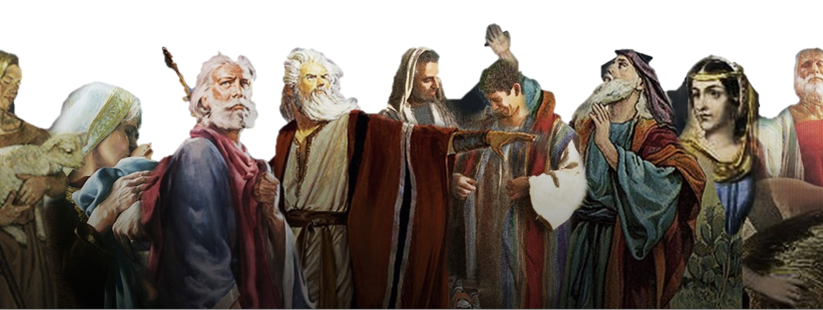
“And all these, having gained approval through their faith” (HEBREWS 11:39 NASB)
Hebrews 11:1-12:2

Slide 2
“And all these, having gained approval through their faith” (HEBREWS 11:39 NASB)
Hebrews 11:1–2 (NKJV)
¹ Now faith is the substance of things hoped for, the evidence of things not seen. ² For by it the elders obtained a good testimony.

Slide 3
“And all these, having gained approval through their faith” (HEBREWS 11:39 NASB)
Hebrews 11:1–2 (NASB95)
¹ Now faith is the assurance of things hoped for, the conviction of things not seen. ² For by it the men of old gained approval.

Slide 4
“And all these, having gained approval through their faith” (HEBREWS 11:39 NASB)
Faith stands under, and supports our hope, because we TRUST GOD!
Through faith, we are assured God will do what He has promised.
Even though we have not physically seen God, and all of His glory and power, we are convinced by what we have seen and heard and therefore we TRUST HIM.

Slide 5
“And all these, having gained approval through their faith” (HEBREWS 11:39 NASB)
Hebrews 11:6 (NKJV)
⁶ But without faith it is impossible to please Him, for he who comes to God must believe that He is, and that He is a rewarder of those who diligently seek Him.

Slide 6
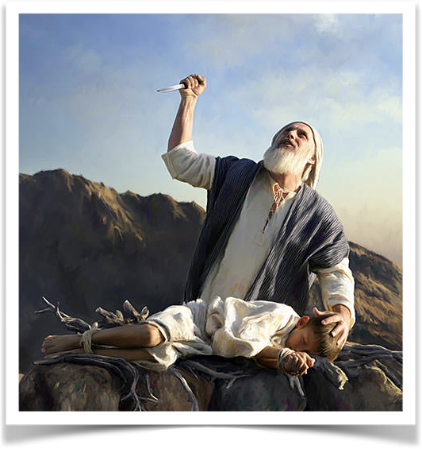
“And all these, having gained approval through their faith” (HEBREWS 11:39 NASB)
Hebrews 11:6 (NKJV)
⁶ But without faith it is impossible to please Him, for he who comes to God must believe that He is, and that He is a rewarder of those who diligently seek Him.
CONVICTION
believe that He is
He is a rewarder
TRUST
OBEDIENCE
diligently seek Him

Slide 7
“And all these, having gained approval through their faith” (HEBREWS 11:39 NASB)
James 2:21–22 (NKJV)
²¹ Was not Abraham our father justified by works when he offered Isaac his son on the altar? ²² Do you see that faith was working together with his works, and by works faith was made perfect?
FAITH

Slide 8
“And all these, having gained approval through their faith” (HEBREWS 11:39 NASB)
The type of faith that does not obey is an incomplete faith.
Faith that does not obey will NOT receive God’s approval or acceptance. (John 12:42, 43; Mt 7:21-23; Lk 6:46; Ja 2:19)
The faith that obeys is the only faith that will save! (Rom. 10:13-17; Ja. 2:24)
FAITH

Slide 9
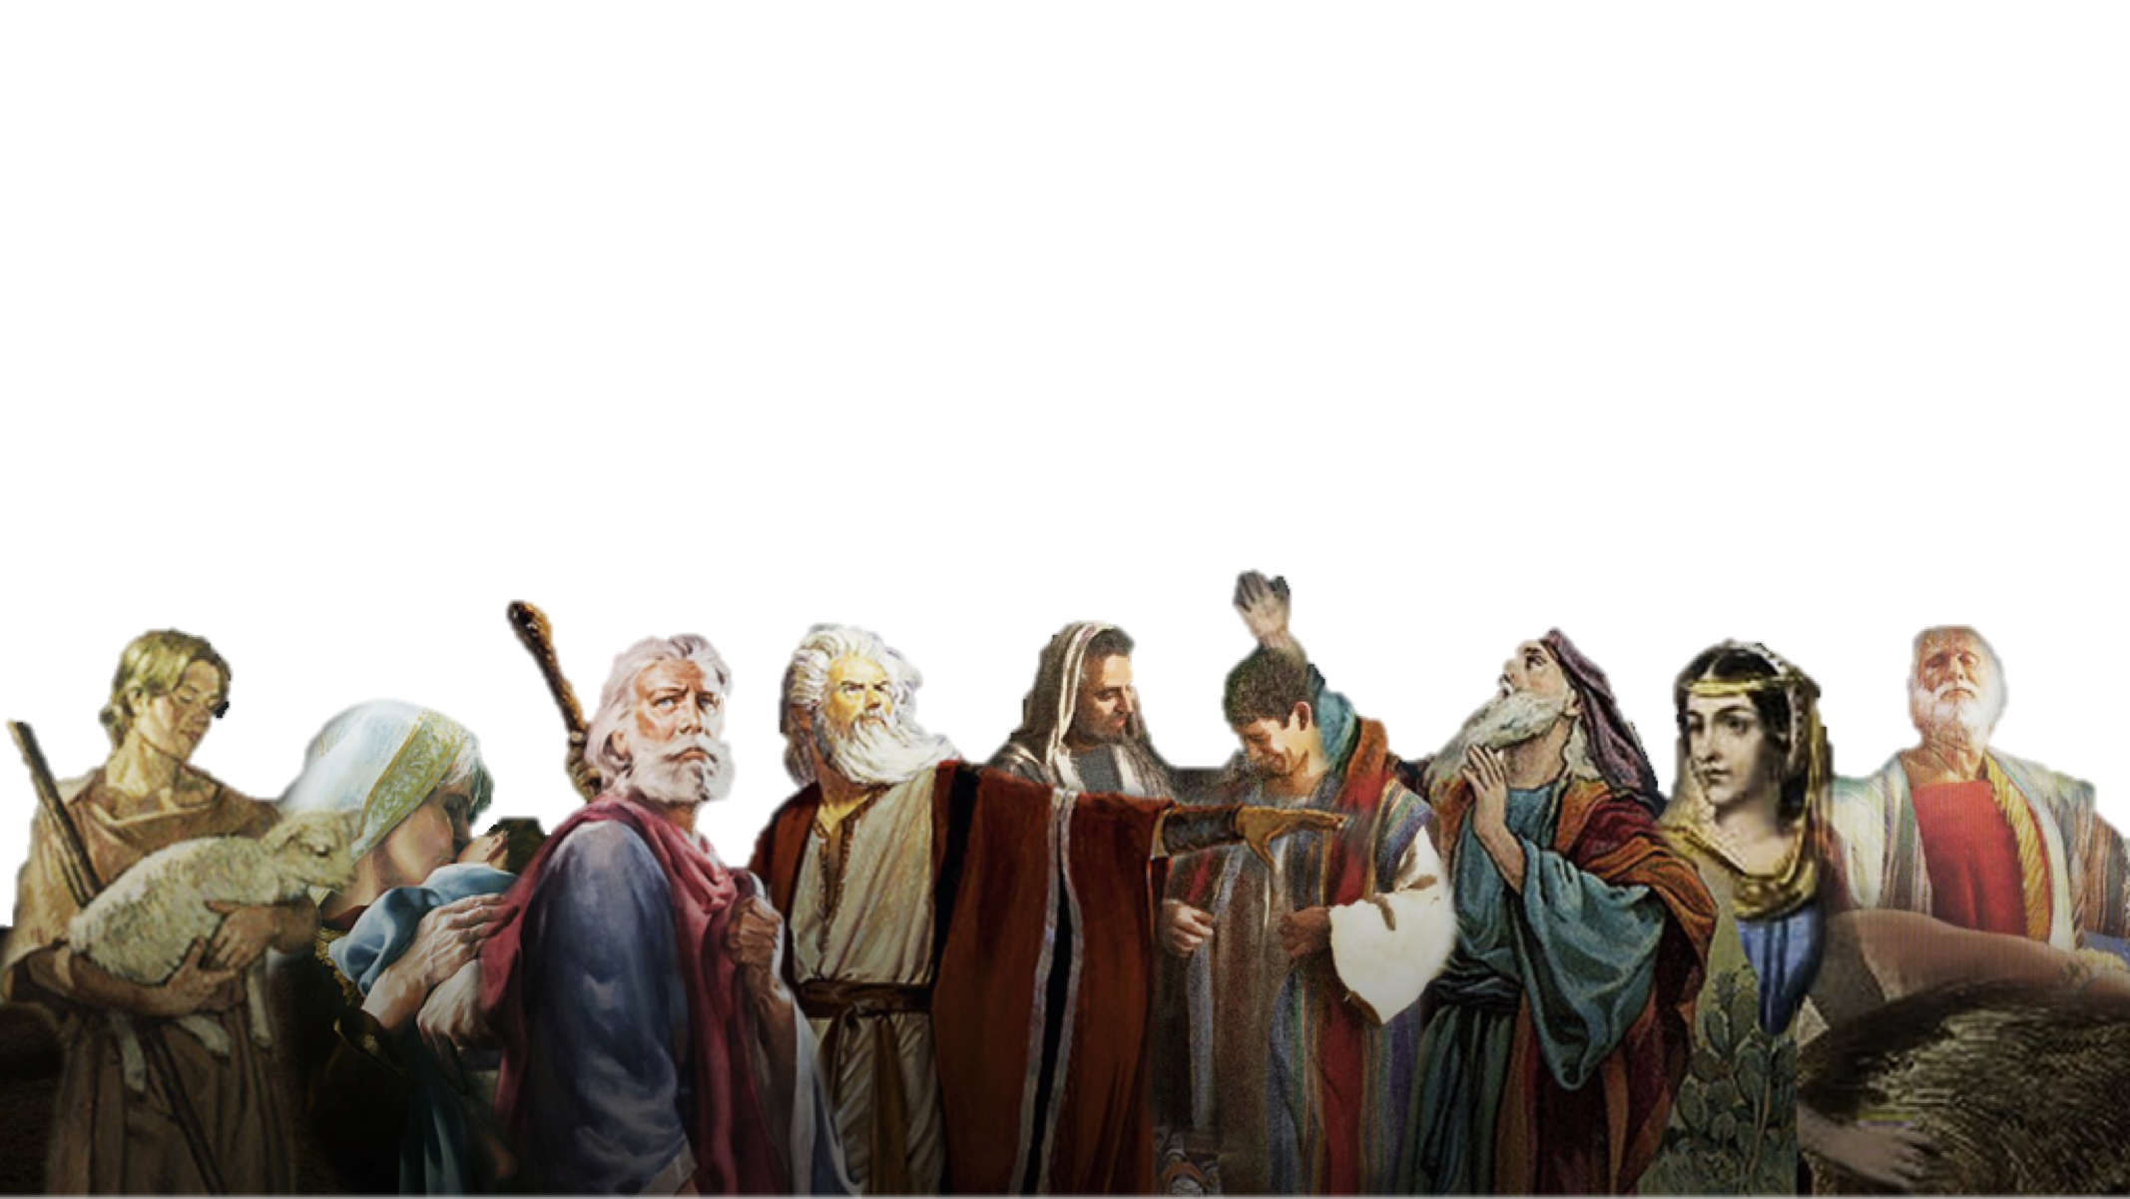
“And all these, having gained approval through their faith” (HEBREWS 11:39 NASB)
Abel offered - (4)
Enoch pleased God - (5)
Noah built the ark - (7)
Abraham obeyed - (8-10)
Sarah conceived - (11,12)
Abraham’s sacrifice - (17-19)
Isaac Blessed sons - (20)
Jacob blessed Joseph’s sons - (21)
Moses spurned Egypt - (23-27)
Kept passover - (28)
Israel crossed R. S. - (29)
Wall of Jericho fell- (30)
Rahab Spared- (31)
MANY others- (32-38)
Hebrews 11:1-12:2

Slide 10
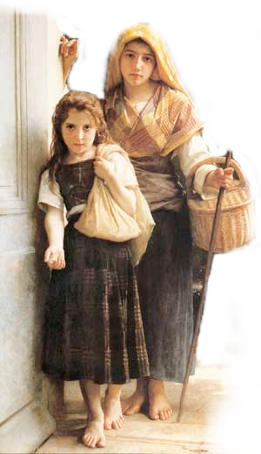
“And all these, having gained approval through their faith” (HEBREWS 11:39 NASB)
NOT ALL FAITH is SAVING FAITH
James 2:14 (NKJV)
¹⁴ What does it profit, my brethren, if someone says he has faith but does not have works? Can faith save him?

Slide 11
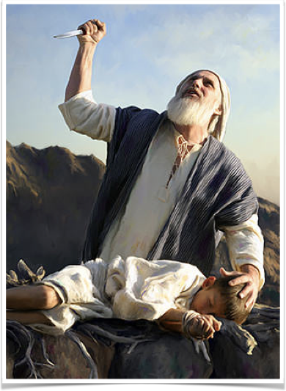
“And all these, having gained approval through their faith” (HEBREWS 11:39 NASB)
NOT ALL FAITH is SAVING FAITH
Hearers but not doers? Ja. 1:22-25
Believers who will not confess? John 12:42; (Rom. 10:9,10)
Professors who will not obey? (Luke 6:46; Mat 7:21-23)
Is it saving faith if it will not confess? repent? be baptized? (Luke 7:7:29,30; 2 Thes. 1:7-9)
James 2:17 (NKJV)
Thus also faith by itself, if it does not have works, is dead.

Slide 12
“And all these, having gained approval through their faith” (HEBREWS 11:39 NASB)
NOT ALL FAITH is SAVING FAITH
Demons believe in the one true God (Mk 1:24; 5:7; Lk 4:34; Ac. 19:15)
Demons believe in the deity of Jesus (Mk 3:11,12; Lk 8:30,31)
Demons believe in hell (Mt 8:29)
Demons believe Jesus is judge and will condemn (Mk 5:1-13)
James 2:19–20 (NKJV)
¹⁹ You believe that there is one God. You do well. Even the demons believe—and tremble! ²⁰ But do you want to know, O foolish man, that faith without works is dead?

Slide 13
“And all these, having gained approval through their faith” (HEBREWS 11:39 NASB)
NOT ALL FAITH is SAVING FAITH
Faith motivated Abraham’s obedience, rendering his faith complete, therefore effectual (22; Heb 11:17-19; Gal 5:6)
James 2:22 (NKJV)
²² Do you see that faith was working together with his works, and by works faith was made perfect?

Slide 14
“And all these, having gained approval through their faith” (HEBREWS 11:39 NASB)
NOT ALL FAITH is SAVING FAITH
Faith motivated Abraham’s obedience, rendering his faith complete, therefore effectual (22; Heb 11:17-19; Gal 5:6)
Faith was credited to Abraham as righteousness as he obeyed! (23a; Gen 15:6; Rom 4:3; Gal. 3:6-8)
Abraham was called the friend of God! (23b; Is 41:8; 2 Chron 20:7)
James 2:23 (NKJV)
²³ And the Scripture was fulfilled which says, “Abraham believed God, and it was accounted to him for righteousness.” And he was called the friend of God.

Slide 15
“And all these, having gained approval through their faith” (HEBREWS 11:39 NASB)
NOT ALL FAITH is SAVING FAITH
James 2:24 (NKJV)
²⁴ You see then that a man is justified by works, and not by faith only.
James 2:23 (NKJV)
²³ And the Scripture was fulfilled which says, “Abraham believed God, and it was accounted to him for righteousness.” And he was called the friend of God.

Slide 16
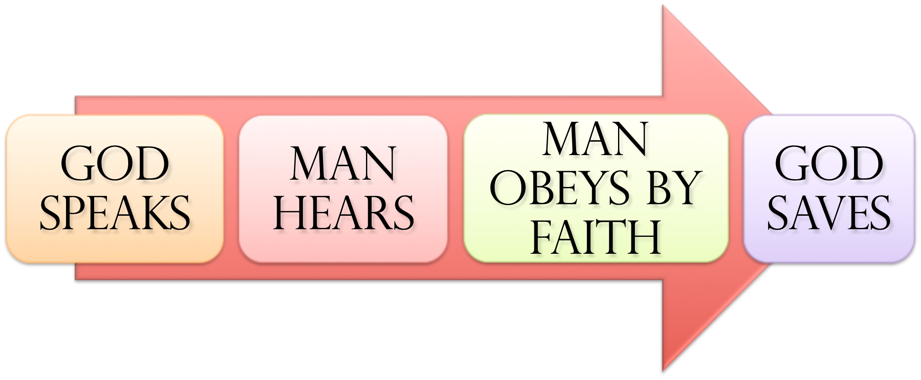
“And all these, having gained approval through their faith” (HEBREWS 11:39 NASB)
SAME principle In EVERY Age …
Noah - Gen. 6:8,13-17; 22; 7:5; Heb 11:7
Abraham – Gen 12:4; 15:6; 17:10,23; 22:3,16-18
Israel – Ex. 12:13; 14:30; Dt 30:15-19; Jos 6; 1 Cor 10:1-13
Us – Mark 16:16; Acts 2:38; 8:12,37; Rom 6:3-6; 10:9-13; Gal. 3:26,27; Col. 2:11-13; 1 Pet 3:21; 1 Jn 1:9

Slide 17
“And all these, having gained approval through their faith” (HEBREWS 11:39 NASB)
SAME principle In EVERY Age …
Romans 10:13–17 (NKJV)
¹³ For “whoever calls on the name of the Lord shall be saved.” ¹⁴ How then shall they call on Him in whom they have not believed? And how shall they believe in Him of whom they have not heard? And how shall they hear without a preacher? ¹⁵ And how shall they preach unless they are sent? As it is written: “How beautiful are the feet of those who preach the gospel of peace, Who bring glad tidings of good things!” ¹⁶ But they have not all obeyed the gospel. For Isaiah says, “Lord, who has believed our report?” ¹⁷ So then faith comes by hearing, and hearing by the word of God.

Slide 18
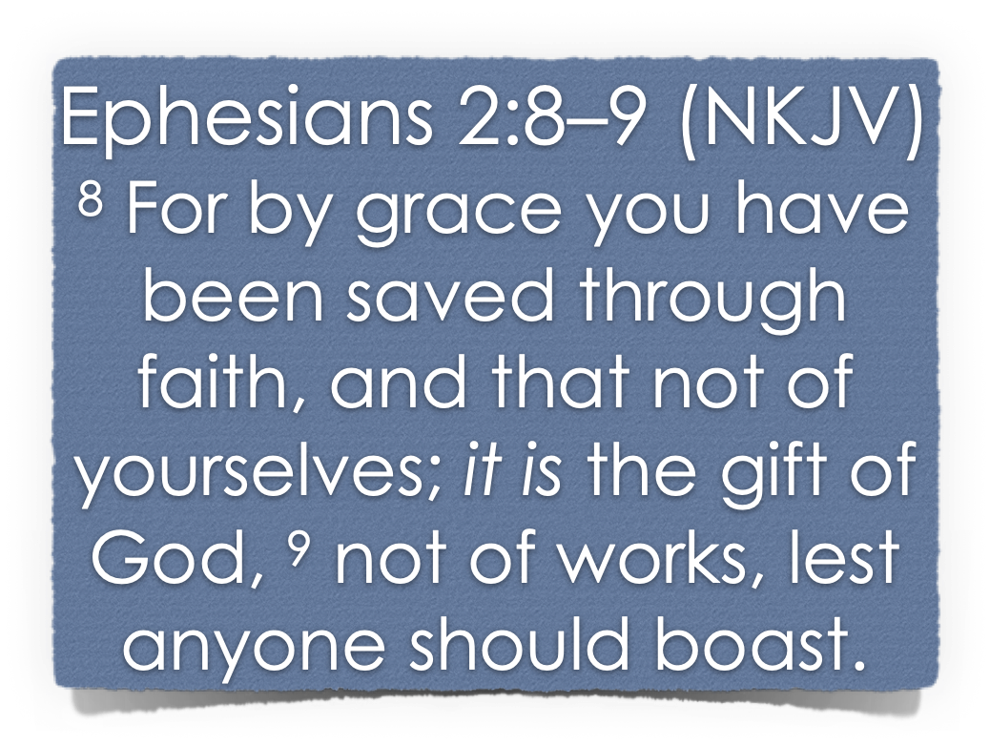
“And all these, having gained approval through their faith” (HEBREWS 11:39 NASB)
SAME principle In EVERY Age …
Salvation is a gift of God which no man deserves (Ro. 3:23)
Salvation is received through the means of our faith (John 3:16; 8:24; Heb 11:6; Ro. 10:17)
Salvation not earned through our own merits (Ro. 11:6; Lk 17:10)
No man can boast before God (Ro. 4:2; 3:23; Ep. 2:8,9)

Slide 19
“And all these, having gained approval through their faith” (HEBREWS 11:39 NASB)
SAME principle In EVERY Age …
Noah saved by grace through faith (Gen. 6:8; Heb 11:7)
Naaman healed by grace through faith (2 Kings 5:1-19; Lk 4:27)
Walls of Jericho fell by grace through faith (Joshua 6:2,15,16,20; Heb 11:30)

Slide 20
“And all these, having gained approval through their faith” (HEBREWS 11:39 NASB)
SAME principle In EVERY Age …
We are saved by grace through faith when we by faith obey the gospel. (Mk. 16:16; Acts 2:38; 8:12-16; 10:43,47,48; 19:1-4; etc.)
The FAITH that obeys does not nullify God’s grace - but receives it!! (Gal. 2:20-21; Acts 22:16; Rom. 6:3-7,16-18)

Slide 21
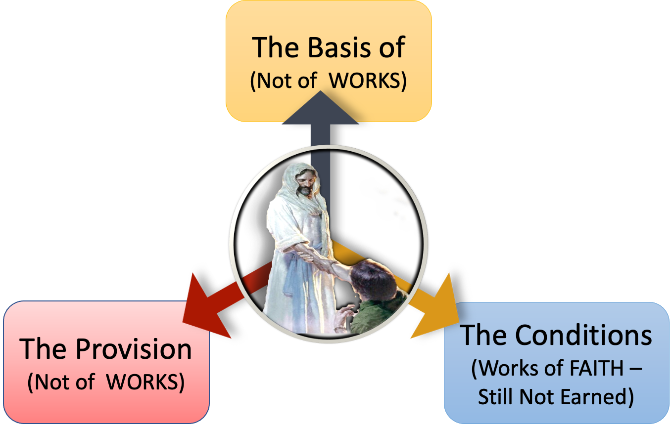
“And all these, having gained approval through their faith” (HEBREWS 11:39 NASB)
Salvation is BY GRACE (unmerited favor) … A GIFT of GOD
Ep. 2:8,9
2 Timothy 1:9
Titus 2:11,12; 3:5
Rom. 5:8-10
Salvation is received through our faith when we by faith, confess Christ, repent, and are baptized into Christ
Ep. 2:8,9
Rom. 5:1; 6:3-6; 16-18; Mk 16:16

Slide 22
“And all these, having gained approval through their faith” (HEBREWS 11:39 NASB)
The only viable faith is the faith that obeys God! (James 2:14-26; Heb. 11; Rom. 10:16; 2 Thes. 1:7-9; 1 Pet. 4:17)
What KIND of FAITH did Abraham and all of the other examples of faith have? (Heb. 11; Gen 12-22; Rom 4:12,23)

Slide 23
“And all these, having gained approval through their faith” (HEBREWS 11:39 NASB)
Hebrews 12:1–2 (NKJV)
¹ Therefore we also, since we are surrounded by so great a cloud of witnesses, let us lay aside every weight, and the sin which so easily ensnares us, and let us run with endurance the race that is set before us, ² looking unto Jesus, the author and finisher of our faith, who for the joy that was set before Him endured the cross, despising the shame, and has sat down at the right hand of the throne of God.
Hebrews 11:1-12:2

Slide 24
“And all these, having gained approval through their faith” (HEBREWS 11:39 NASB)
WE ARE SAVED BY GRACE THROUGH FAITH WHEN WE BY FAITH OBY THE LORD’S INSTRUCTIONS.
What kind of FAITH do you have? (Mk 16:16; Acts 2:37,38,41; Gal. 3:26,27; 2 Cor. 5:7; Rom. 1:16-17)
Hebrews 11:1-12:2

Slide 25
Don McClain
W. 65th St church of Christ / May 6, 2007

Slide 26
“And all these, having gained approval through their faith” (HEBREWS 11:39 NASB)
Charts by Don McClain
Preached JULY 3, 2022
West 65th Street church of Christ / P.O. Box 190062 Little Rock AR 72219 / 501-568-1062
Prepared using Keynote / Email – donmcclain@sbcglobal.net
More Keynote, PPT & Audio Sermons:
https://www.w65stchurchofchrist.com

Slide 27
Genesis 6:13–22 (NKJV)
¹³ And God said to Noah, “The end of all flesh has come before Me, for the earth is filled with violence through them; and behold, I will destroy them with the earth. ¹⁴ Make yourself an ark of gopherwood; make rooms in the ark, and cover it inside and outside with pitch. ¹⁵ And this is how you shall make it: The length of the ark shall be three hundred cubits, its width fifty cubits, and its height thirty cubits. ¹⁶ You shall make a window for the ark, and you shall finish it to a cubit from above; and set the door of the ark in its side. You shall make it with lower, second, and third decks. ¹⁷ And behold, I Myself am bringing floodwaters on the earth, to destroy from under heaven all flesh in which is the breath of life; everything that is on the earth shall die.

Slide 28
Genesis 6:13–22 (NKJV)
¹⁸ But I will establish My covenant with you; and you shall go into the ark—you, your sons, your wife, and your sons’ wives with you. ¹⁹ And of every living thing of all flesh you shall bring two of every sort into the ark, to keep them alive with you; they shall be male and female. ²⁰ Of the birds after their kind, of animals after their kind, and of every creeping thing of the earth after its kind, two of every kind will come to you to keep them alive. ²¹ And you shall take for yourself of all food that is eaten, and you shall gather it to yourself; and it shall be food for you and for them.” ²² Thus Noah did; according to all that God commanded him, so he did.

