Slide 1
“IMAGINE THAT”
TWO PEOPLE STAY TOGETHER, THE WAY IT OUGHT TO BE

Slide 2
Genesis 2:18–25 (NKJV)
¹⁸ And the Lord God said, “It is not good that man should be alone; I will make him a helper comparable to him.” ¹⁹ Out of the ground the Lord God formed every beast of the field and every bird of the air, and brought them to Adam to see what he would call them. And whatever Adam called each living creature, that was its name. ²⁰ So Adam gave names to all cattle, to the birds of the air, and to every beast of the field. But for Adam there was not found a helper comparable to him.

Slide 3
Genesis 2:18–25 (NKJV)
²¹ And the Lord God caused a deep sleep to fall on Adam, and he slept; and He took one of his ribs, and closed up the flesh in its place. ²² Then the rib which the Lord God had taken from man He made into a woman, and He brought her to the man. ²³ And Adam said: “This is now bone of my bones And flesh of my flesh; She shall be called Woman, Because she was taken out of Man.” ²⁴ Therefore a man shall leave his father and mother and be joined to his wife, and they shall become one flesh. ²⁵ And they were both naked, the man and his wife, and were not ashamed.

Slide 4
God’s ORIGINAL plan is STILL the PLAN! (Mat. 19:3-8)
God still HATES divorce (Mal. 2:14-16; Mat. 5:31,32; 19:9; 1 Cor. 7:10,11)
Divorce RESULTS in MORE, and MORE SIN … (Mal. 2:15; Mat. 18:6-10; 5:31,32; 19:9; Rom. 7:1-4)

Slide 5
Sin Involved In Every Divorce (Mat. 5:31,32)
Dishonors God (Gen 2:21-24; Mat 19:4-6; Prov. 14:2)
Violates the law of love (Eph 5:25; Col. 3:19; 1 Pet 3:7; Tit. 2:4)
Harms put away spouse (Mal. 2:14,16; Mat 5:31,32)
Harms self (Is. 59,1,2; Gal 6:7-9)
Harms children (Mal. 2:15)
Harms society as a whole (Mal. 2:15; Prov. 14:34; Mat. 19:9)

Slide 6
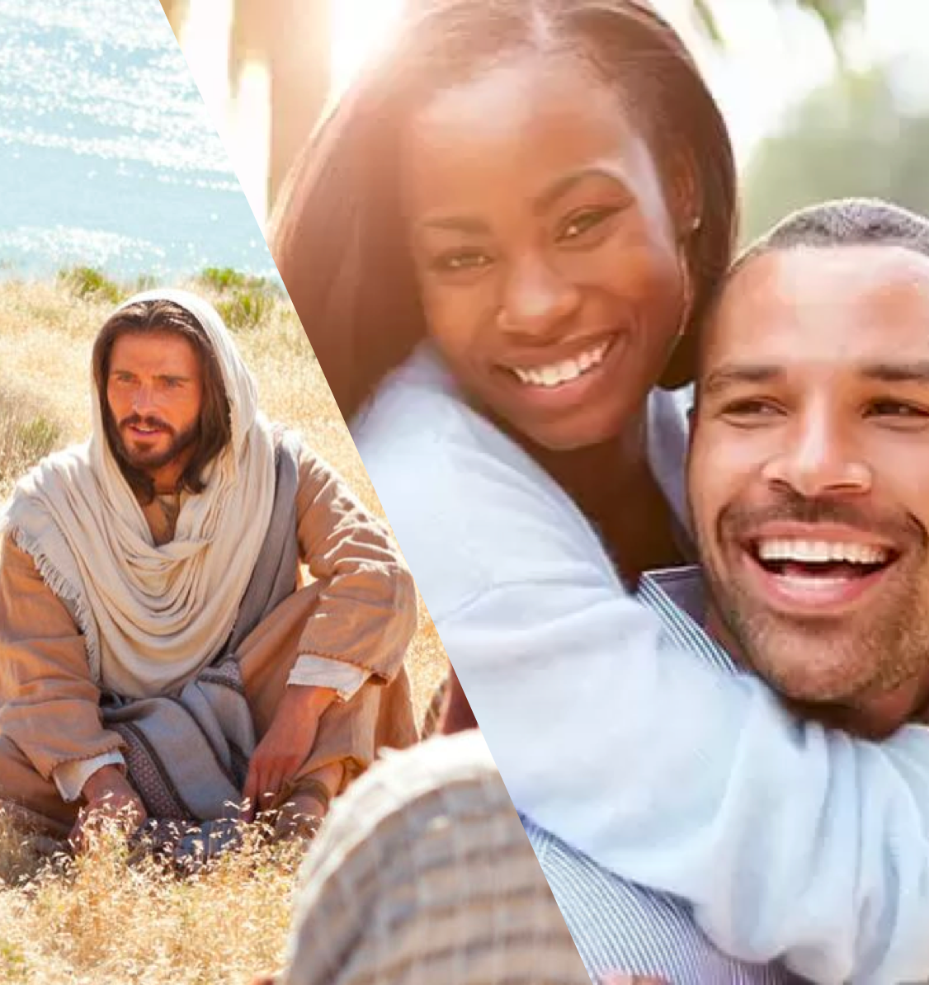
A GOOD, LASTING, JOYFUL MARRIAGE DOESN’T TAKE 2 —
IT TAKES 3

Slide 8
Marriage Is A Divine Institution & Governed By The Laws Of God –
Marriage Is To Be A Life-Long Union Between One Man and One Woman -

Slide 9
A Happy & Successful Marriage is not determined by the perfection of our partner, but the level of OUR COMMITMENT to the LORD & OUR SPOUSE.

Slide 10
Serving God In Our Marriage Means That We Become The Husbands & Wives God Wants Us to Become.

Slide 11
NOT
UNREALISTIC EXPECTATIONS
SELFISHNESS
RESENTMENT
CONDITIONAL LOVE
WANDERING DESIRES
COMMUNICATION
FINANCES
WRECKING BALLS OF MARRIAGE

Slide 12
WARNING / DANGER SIGNS WE NEED TO TAKE SERIOUSLY
Don’t listen
Can’t just talk
Never laugh
Prefer others
Confrontational
Easily irritated
Always critical
Angry / bitter
Loss of respect
WHO IS TO BLAME IF YOU FEEL THESE THINGS, OR ARE GUILTY OF THESE THINGS?

Slide 13
PROBLEMS ARISE AS ONE, OR BOTH, DRIFT AWAY FROM GOD
BAD ADVISORS
DESTRUCTIVE
ANGER / BITTERNESS
HURTFUL ACTS
DISAPPOINTMENT
DISCONNECTED
DISCONTENTMENT

Slide 14
Put GOD First (Mt. 6:33; 7:24-27; Mk 12:29-31)
Worship God together (Acts 2:42; Heb. 10:24,25)
Serve God together (Rom. 12:1,2; Eph. 4:16)
Grow spiritually together (1 Pet. 3:7; 2 Pet. 1:5-11)

Slide 15
Having a BLESSED Marriage (Matthew 5:3-12)
Humility (3)
Sorrow for wrongs (4)
Submissive (5)
Seek righteousness (6)
Merciful, forgiving (7)
Purity, sincere, holy (8)
Seek path of peace (9)
Endurance (10-12)

Slide 16
Having a FRUITFUL Marriage (Galatians 5:22,23)
Love (value & commitment)
Joy (Phili. 4:6-13)
Peace (Mt. 6:19-33; Ro 15:13)
Longsuffering (Heb. 6:12)
Kindness (benevolent, merciful)
Goodness (virtuous generosity)
Faithfulness (trustworthy)
Gentleness (humble submission)
Self-Control (thought & deed)

Slide 17
Having a LOVING Marriage (1 Corinthians 13:4-8)
LOVE suffers long and is kind;
LOVE does not envy; does not parade itself, Is not puffed up; Does not behave rudely, Does not seek its own, Is not provoked,
LOVE thinks no evil; Does not rejoice in iniquity, but rejoices in the truth;
LOVE bears all things, believes all things, hopes all things, endures all things.
LOVE NEVER FAILS!

Slide 18
Having a LOVING Marriage (1 Corinthians 13:4-8)
When two people TRULY choose to love one another in marriage – they are ensuring the permanency of their relationship!

Slide 19
SUBMIT to God’s order - (Eph. 5:21-31; 1 Pet. 3:1-7)
Learn to be CONTENT WITHIN God’s will – (Phili. 4:11-13; Ep. 5:21-31; 1 Pt 3:1-7)
HONOR our VOWS, commitment, covenant – (Prov 2:17; Eccl. 5:4,5)

Slide 20
The Rule of Protection - (Guard against anything that weakens relationship)
The Rule of Care - (Provide emotional support)
The Rule of Time - (Undivided attention)
The rule of Honesty - (Historic, emotional, current, future)

Slide 21
We exalt God when we exalt His authority over our lives! (1 Pet. 3:15)
We honor God by valuing His institutions (Mal. 2:14-17)
We submit to God when we fulfill our roles (Eph. 5:22-25; 1 Pet. 3:1-7)
We should be very afraid of the consequences of rejecting God’s will (1 Cor. 6:9-10; Rev. 21:8)

Slide 22
God’s ORIGINAL plan is STILL the PLAN! (Mat. 19:3-8)
God still HATES divorce (Mal. 2:14-16; Mat. 5:31,32; 19:9; 1 Cor. 7:10,11)
Divorce RESULTS in MORE, and MORE SIN … (Mal. 2:15; Mat. 18:6-10; 5:31,32; 19:9; Rom. 7:1-4)

Slide 23
True blessedness & success is ONLY achieved by the godly!
Our character and behavior will determine whether we will enjoy the fruit of true blessedness or the bitterness of ultimate failure!
IF a husband & wife apply the Lord’s teachings to their own lives, they will experience true success - including a successful life together!

Slide 24
Problems will come!
Agree beforehand that divorce will NEVER be an option!
ANY MARRIAGE CAN BE SAVED IF … !
CHOOSE THE LORD, CHOOSE LOVE, CHOOSE JOY!

Slide 26
Charts by Don McClain
Preached July 10, 2022
West 65th Street church of Christ - P.O. Box 190062 - Little Rock AR 72219 - Phone — 501-568-1062 — Email – donmcclain@sbcglobal.net
Prepared using Keynote / More Keynote, PPT & Audio Sermons:
www.w65stchurchofchrist.com

Slide 27
Matthew 19:3–9 (NKJV)
³ The Pharisees also came to Him, testing Him, and saying to Him, “Is it lawful for a man to divorce his wife for just any reason?” ⁴ And He answered and said to them, “Have you not read that He who made them at the beginning ‘made them male and female,’ ⁵ and said, ‘For this reason a man shall leave his father and mother and be joined to his wife, and the two shall become one flesh’? ⁶ So then, they are no longer two but one flesh. Therefore what God has joined together, let not man separate.”

Slide 28
Matthew 19:3–9 (NKJV)
⁷ They said to Him, “Why then did Moses command to give a certificate of divorce, and to put her away?” ⁸ He said to them, “Moses, because of the hardness of your hearts, permitted you to divorce your wives, but from the beginning it was not so. ⁹ And I say to you, whoever divorces his wife, except for sexual immorality, and marries another, commits adultery; and whoever marries her who is divorced commits adultery.”

