Slide 2
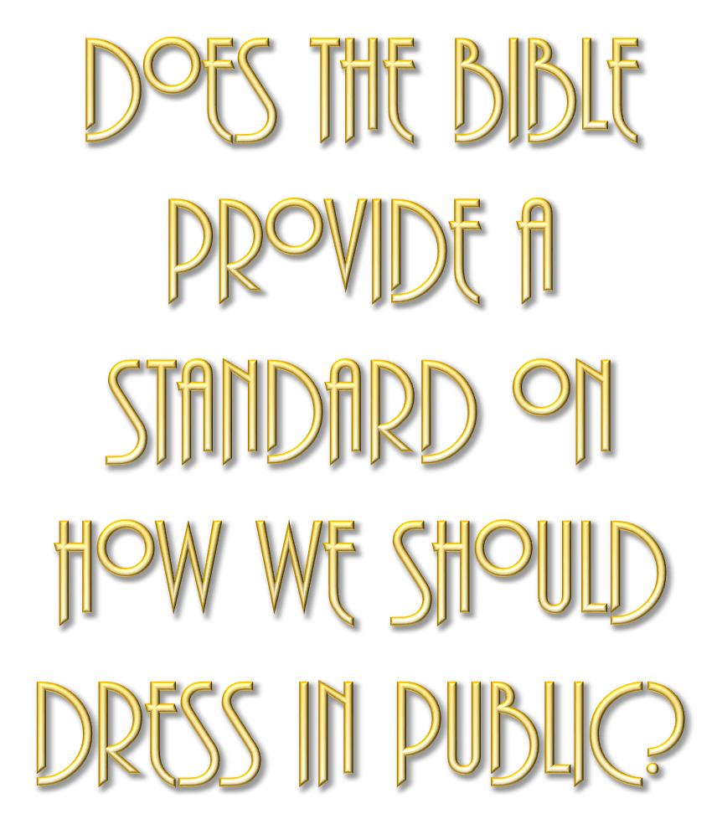

Slide 3
A MESSAGE for BOTH MEN & WOMEN
Mat. 5:27-30; 18:6-11; 1 Pet. 3:1-4; 1 Tim. 2:9-10

Slide 4
WHY IS “IMMODESTY” such a problem in our culture?
1. Lack of knowledge and understanding.
2. Lack of concern / No godly fear.
3. Ungodliness / Worldliness

Slide 5
The solution is NOT EXTREMISM
1. Modesty does not mean unattractive!
2. Extremism can actually cause one to be IMMODEST!

Slide 6
The solution is:
1. A GODLY attitude.
2. Understanding what God’s will is.
3. A genuine concern regarding our influence.

Slide 7
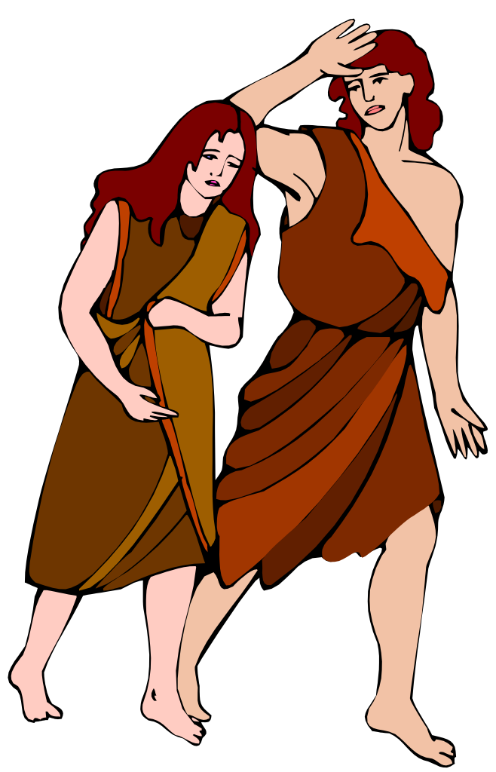
Does The Bible Provide A Standard On How We Should Dress In Public?
Genesis 3:7 (NKJV)
7 Then the eyes of both of them were opened, and they knew that they were naked; and they sewed fig leaves together and made themselves coverings. …
Genesis 3:10–11 (NKJV)
10 So he said, “I heard Your voice in the garden, and I was afraid because I was naked; and I hid myself.” 11 And He said, “Who told you that you were naked? Have you eaten from the tree of which I commanded you that you should not eat?”
Genesis 3:21 (NKJV)
21 Also for Adam and his wife the Lord God made tunics of skin, and clothed them.
Apron
V. 7 Naked (Nude)
V. 10,11,21
Not Sufficiently Clothed

Slide 8
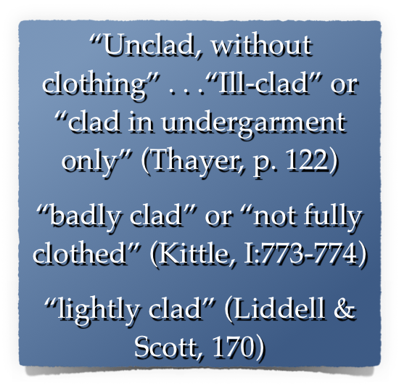
Does The Bible Provide A Standard On How We Should Dress In Public?
V. 7 (Nude)
Apron
V. 10,11,21
Not Sufficiently Clothed
Still Naked

Slide 9
Does The Bible Provide A Standard On How We Should Dress In Public?
4189 כֻּתֹּנֶת (kǔt·tō·něṯ): n.fem.; ≡ Str 3801; TWOT 1058a—1. LN 6.152–6.187 tunic, garment, i.e., clothing as a covering more complete than a loincloth, a basic garment reaching the knees and so a common garment for common wear and work (Ge 3:21; SS 5:3)
Swanson, J. (1997). Dictionary of Biblical Languages with Semantic Domains : Hebrew (Old Testament) (electronic ed.). Oak Harbor: Logos Research Systems, Inc.

Slide 10
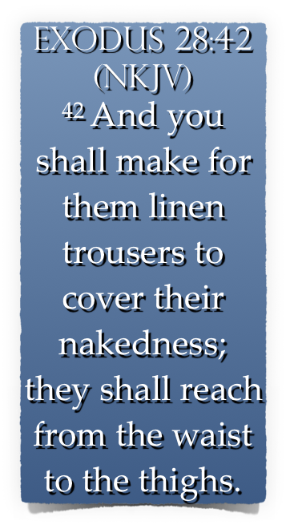
Does The Bible Provide A Standard On How We Should Dress In Public?

Slide 11
WHAT DOES OUR CLOTHING REVEAL?
1 Peter 3:1–4 (NKJV)
1 Wives, … 2 when they observe your chaste conduct accompanied by fear. 3 Do not let your adornment be merely outward—arranging the hair, wearing gold, or putting on fine apparel—4 rather let it be the hidden person of the heart, with the incorruptible beauty of a gentle and quiet spirit, which is very precious in the sight of God.

Slide 12
WHAT DOES OUR CLOTHING REVEAL?
Titus 2:3–5 (NKJV)
3 the older women likewise, that they be reverent in behavior, not slanderers, not given to much wine, teachers of good things—4 that they admonish the young women to love their husbands, to love their children, 5 to be discreet, chaste, homemakers, good, obedient to their own husbands, that the word of God may not be blasphemed.

Slide 13
WHAT DOES OUR CLOTHING REVEAL?
1 Timothy 2:9–10 (NKJV)
9 in like manner also, that the women adorn themselves in modest apparel, with propriety and moderation, not with braided hair or gold or pearls or costly clothing, 10 but, which is proper for women professing godliness, with good works.

Slide 14
WHAT DOES OUR CLOTHING REVEAL?
"Respectable; honorable" — (Arndt and Gingrich, 445).
"Orderly; well-arranged; decent" — (Vine)
"The well-ordering is not of dress and demeanor only, but the inner life’s uttering indeed, and expressing itself in the outward conversation" — (Trench’s Syn. 346).

Slide 15
WHAT DOES OUR CLOTHING REVEAL?
“In simple attire which doesn’t attract attention.” — The People’s New Testament Commentary
“An appearance that is simple, moderate, judicious, and free from ostentation. . . . Christians must be careful about letting a pagan culture set their fashions.” — Bible Knowledge Commentary

Slide 16
WHAT DOES OUR CLOTHING REVEAL?
Reserved
Humble
Respectable
Decent
Orderly

Slide 17
WHAT DOES OUR CLOTHING REVEAL?
(aidos) (αἰδώς, 127), “a sense of shame, modesty,” is used regarding the demeanor of women in the church, 1 Tim. 2:9 — Shamefastness is that modesty which is ‘fast’ or rooted in the character — (Vine’s Complete Expository Dictionary of Old and New Testament Words (Vol. 2, p. 568).
(aidos) – “bashfulness, reverence, regard for others, respect” - "A sense of shame" — (Thayer, 14).
MANY have lost the ability to blush! — (Jeremiah 6:15; 8:12)

Slide 18
WHAT DOES OUR CLOTHING REVEAL?
sophrosune (σωφροσύνη, 4997) denotes “soundness of mind”, Acts 26:25, “soberness”; 1 Tim. 2:9, 15, “sobriety”; “sound judgment” practically expresses the meaning; “it is that habitual inner self-government, with its constant rein on all the passions and desires, which would hinder the temptation to these from arising, or at all events from arising in such strength as would overbear the checks and barriers which aidos (shamefastness) opposed to it” (Trench Syn. Sec.xx, end) - (Vine’s Complete Expository Dictionary of Old and New Testament Words (Vol. 2, p. 583).

Slide 19
WHAT DOES OUR CLOTHING REVEAL?
88.93 σωφρονισμόςb, οῦ m; σωφροσύνηb, ης f: to behave in a sensible manner, with the implication of thoughtful awareness of what is best—‘moderation, sensibility.’ — (Louw, J. P., & Nida, E. A. (1996). Greek-English lexicon of the New Testament: based on semantic domains (electronic ed. of the 2nd edition., Vol. 1, p. 752).
To behave discreetly, to be in harmony with the will of God, being thoughtful of how our actions affect others.

Slide 20
WHAT DOES OUR CLOTHING REVEAL?
theosebeia (θεοσέβεια, 2317) denotes “the fear or reverence of God,” — (Vine’s Complete Expository Dictionary of Old and New Testament Words (Vol. 2, p. 273).
53.1 θρησκεία, … f: appropriate beliefs and devout practice of obligations relating to supernatural persons and powers—‘religion, piety.’ … ‘if he does not control his tongue, he deceives himself, and his religion is worthless’ Jas 1:26. Louw, J. P., & Nida, E. A. (1996). Greek-English lexicon of the New Testament: based on semantic domains

Slide 21
WHAT DOES OUR CLOTHING REVEAL?
Attention Drawing APPAREL - Wearing fancy clothes & jewelry in order to make a fashion statement! - (1 Tim 2:9; 1 Pet 3:2)
It CAN BE just as IMMODEST to go to the other extreme FOR the PURPOSE of drawing attention to ourselves!
Immodesty is a pride issue. —“Look at how RICH I am,” / “Look how trendy I am,” / “Look how SEXY I am / or even, “LOOK AT HOW GODLY I AM”

Slide 22
WHAT DOES OUR CLOTHING REVEAL?
REVEALING APPAREL - When a woman wears short shorts, low cut dresses, mini skirts, bikinis — she is communicating pride in her body. — When a man goes without a shirt & wears short shorts, he too is communicating pride.
Christians should NOT conduct themselves in such a way!

Slide 23
WHAT DOES OUR CLOTHING REVEAL?
REVEALING APPAREL -
Too short, (revealing the thighs).
Too low off the shoulders, (showing cleavage/ chest/ back).
Too sheer (can see through).
Too tight (Too suggestive - leaving nothing for the imagination).

Slide 24
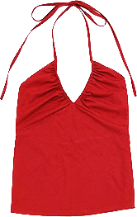
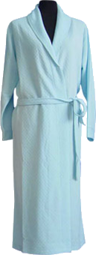
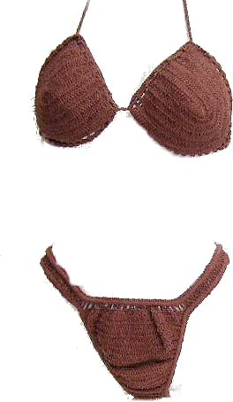
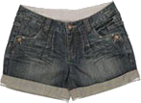
Someone’s at the door – Could someone answer it – I’m not dressed!
I’m dressed – I’ll get it
It’s probably my friends – we are going to Magic Springs
Don McClain
W. 65th St church of Christ / May 17, 2009

Slide 25
WHAT DOES OUR CLOTHING REVEAL?
REVEALING APPAREL -
“I WANT THE OPPOSITE SEX TO NOTICE ME” - Mat 5:28-30; 18:6-10
“I look good in this and I’m going to wear it REGARDLESS of how it affects others.” - Rom 12:3,9,10; 13:10
“Everyone else is wearing this” - Deut 23:2; Prov 4:14
Let us REVEAL godliness with humility and love for others!

Slide 26
WHAT DOES OUR CLOTHING REVEAL?
The GODLY woman’s attire will be her “good works.”
“The hidden person of the heart, with the incorruptible beauty of a gentle and quiet spirit, which is very precious in the sight of God.” (1 Pet 3:4)
“Loving their husbands, their children, homemakers, good, obedient to their own husbands, that the word of God may not be blasphemed.” (Tit 2:4,5)

Slide 27
WHAT DOES OUR CLOTHING REVEAL?
Note To Parents -
Begin early - don't allow immodesty until 12 or 13, and then expect sudden correction.
Teach your children; don't wait for someone else to do it.
Teach children in both word & deed - - inconsistency is destructive!
Mothers, do not undermine godly fathers as they teach.

Slide 28
I AM WEARING THIS –
Because it is the latest fashion …
Because everyone else is …
So I can stand out …
Because it makes me look attractive / sexy …
Because I want to please God, and not cause others to stumble …

Slide 29
Be Modest – reserved, decent, respectable
Exhibit Propriety – have shame, discretion
Use Good Judgment – Think of others
Show Godliness – devoted to God / Holiness
Respect Others – If someone stumbles over your beauty, let it not be your fault!

Slide 31
Do the CLOTHES we wear in public REVEAL GODLINESS or UNGODLINESS?

Slide 32
Don McClain
W. 65th St church of Christ / May 17, 2009

Slide 33
Charts by Don McClain
Preached April 24, 2022
West 65th Street church of Christ - P.O. Box 190062 - Little Rock AR 72219 - Phone — 501-568-1062 — Email – donmcclain@sbcglobal.net
Prepared using Keynote
More Keynote, PPT & Audio Sermons:
https://www.w65stchurchofchrist.com

Slide 34
1 Timothy 2:1–10 (NKJV)
¹ Therefore I exhort first of all that supplications, prayers, intercessions, and giving of thanks be made for all men, ² for kings and all who are in authority, that we may lead a quiet and peaceable life in all godliness and reverence. ³ For this is good and acceptable in the sight of God our Savior, ⁴ who desires all men to be saved and to come to the knowledge of the truth. ⁵ For there is one God and one Mediator between God and men, the Man Christ Jesus,

Slide 35
1 Timothy 2:1–10 (NKJV)
⁶ who gave Himself a ransom for all, to be testified in due time, ⁷ for which I was appointed a preacher and an apostle—I am speaking the truth in Christ and not lying—a teacher of the Gentiles in faith and truth. ⁸ I desire therefore that the men pray everywhere, lifting up holy hands, without wrath and doubting; ⁹ in like manner also, that the women adorn themselves in modest apparel, with propriety and moderation, not with braided hair or gold or pearls or costly clothing, ¹⁰ but, which is proper for women professing godliness, with good works.

