Slide 1
Ephesians 4:1-16

Slide 2
forgetting those things which are behind
WHY IS THE WINDSHIELD SO MUCH LARGER THAN THE REAR VIEW MIRROR?

Slide 3
Not Satisfied with his current state … 12a
Determined to press forward … 12b
Focussed on the task of moving forward …13
Diligent, continuous effort to gain the prize … 14
His plea for them, (us) to be likeminded … 15,16

Slide 4
“SIX THINGS MOST NEEDED IN THE CHURCH”
by Gus Nichols
The conversion of the members
Regular Attendance
Sanctification
Liberality
Unity
Informed leadership

Slide 5
Ephesians 4:1–16 (NKJV)
¹ I, therefore, the prisoner of the Lord, beseech you to walk worthy of the calling with which you were called, ² with all lowliness and gentleness, with longsuffering, bearing with one another in love, ³ endeavoring to keep the unity of the Spirit in the bond of peace. ⁴ There is one body and one Spirit, just as you were called in one hope of your calling; ⁵ one Lord, one faith, one baptism; ⁶ one God and Father of all, who is above all, and through all, and in you all. ⁷ But to each one of us grace was given according to the measure of Christ’s gift. ⁸ Therefore He says: “When He ascended on high, He led captivity captive, And gave gifts to men.” ⁹ (Now this, “He ascended”—what does it mean but that He also first descended into the lower parts of the earth? ¹⁰ He who descended is also the One who ascended far above all the heavens, that He might fill all things.)

Slide 6
Ephesians 4:1–16 (NKJV)
¹¹ And He Himself gave some to be apostles, some prophets, some evangelists, and some pastors and teachers, ¹² for the equipping of the saints for the work of ministry, for the edifying of the body of Christ, ¹³ till we all come to the unity of the faith and of the knowledge of the Son of God, to a perfect man, to the measure of the stature of the fullness of Christ; ¹⁴ that we should no longer be children, tossed to and fro and carried about with every wind of doctrine, by the trickery of men, in the cunning craftiness of deceitful plotting, ¹⁵ but, speaking the truth in love, may grow up in all things into Him who is the head—Christ—¹⁶ from whom the whole body, joined and knit together by what every joint supplies, according to the effective working by which every part does its share, causes growth of the body for the edifying of itself in love.

Slide 7
Ephesians 4:1-16
WALKING WORTHY of GOSPEL (4:1)
¹ I, therefore, the prisoner of the Lord, beseech you to walk worthy of the calling with which you were called,

Slide 8
Ephesians 4:1-16
WALKING WORTHY of GOSPEL (4:1)
GODLY ATTITUDES (4:2)
² with all lowliness and gentleness, with longsuffering, bearing with one another in love,

Slide 9
Ephesians 4:1-16
WALKING WORTHY of GOSPEL (4:1)
GODLY ATTITUDES (4:2)
STRENUOUS EFFORT (4:3)
³ endeavoring to keep the unity of the Spirit in the bond of peace.

Slide 10
Ephesians 4:1-16
WALKING WORTHY of GOSPEL (4:1)
GODLY ATTITUDES (4:2)
STRENUOUS EFFORT (4:3)
TRUTH (4:4-6)
⁴ There is one body and one Spirit, just as you were called in one hope of your calling; ⁵ one Lord, one faith, one baptism; ⁶ one God and Father of all, who is above all, and through all, and in you all.

Slide 11
Ephesians 4:1-16
WALKING WORTHY of GOSPEL (4:1)
GODLY ATTITUDES (4:2)
STRENUOUS EFFORT (4:3)
TRUTH (4:4-6)
SCRIPTURAL LEADERSHIP (4:7-12)
⁷ But to each one of us grace was given according to the measure of Christ’s gift. … ¹¹ And He Himself gave some to be apostles, some prophets, some evangelists, and some pastors and teachers,

Slide 12
Ephesians 4:1-16
WALKING WORTHY of GOSPEL (4:1)
GODLY ATTITUDES (4:2)
STRENUOUS EFFORT (4:3)
TRUTH (4:4-6)
SCRIPTURAL LEADERSHIP (4:7-12)
¹² for the equipping of the saints for the work of ministry, for the edifying of the body of Christ,

Slide 13
Ephesians 4:1-16
WALKING WORTHY of GOSPEL (4:1)
GODLY ATTITUDES (4:2)
STRENUOUS EFFORT (4:3)
TRUTH (4:4-6)
SCRIPTURAL LEADERSHIP (4:7-12)
INDIVIDUALS FULFILLING THEIR ROLES (4:13-16)
¹³ till we all come to the unity of the faith and of the knowledge of the Son of God, to a perfect man, to the measure of the stature of the fullness of Christ;

Slide 14
Ephesians 4:1-16
WALKING WORTHY of GOSPEL (4:1)
GODLY ATTITUDES (4:2)
STRENUOUS EFFORT (4:3)
TRUTH (4:4-6)
SCRIPTURAL LEADERSHIP (4:7-12)
INDIVIDUALS FULFILLING THEIR ROLES (4:13-16)
¹⁴ that we should no longer be children, tossed to and fro and carried about with every wind of doctrine, by the trickery of men, in the cunning craftiness of deceitful plotting,

Slide 15
Ephesians 4:1-16
WALKING WORTHY of GOSPEL (4:1)
GODLY ATTITUDES (4:2)
STRENUOUS EFFORT (4:3)
TRUTH (4:4-6)
SCRIPTURAL LEADERSHIP (4:7-12)
INDIVIDUALS FULFILLING THEIR ROLES (4:13-16)
¹⁵ but, speaking the truth in love, may grow up in all things into Him who is the head—Christ—

Slide 16
Ephesians 4:1-16
WALKING WORTHY of GOSPEL (4:1)
GODLY ATTITUDES (4:2)
STRENUOUS EFFORT (4:3)
TRUTH (4:4-6)
SCRIPTURAL LEADERSHIP (4:7-12)
INDIVIDUALS FULFILLING THEIR ROLES (4:13-16)
¹⁶ from whom the whole body, joined and knit together by what every joint supplies, according to the effective working by which every part does its share, causes growth of the body for the edifying of itself in love.

Slide 17
Ephesians 4:1-16
WALKING WORTHY of GOSPEL (4:1)
GODLY ATTITUDES (4:2)
STRENUOUS EFFORT (4:3)
TRUTH (4:4-6)
SCRIPTURAL LEADERSHIP (4:7-12)
INDIVIDUALS FULFILLING THEIR ROLES (4:13-16)

Slide 18
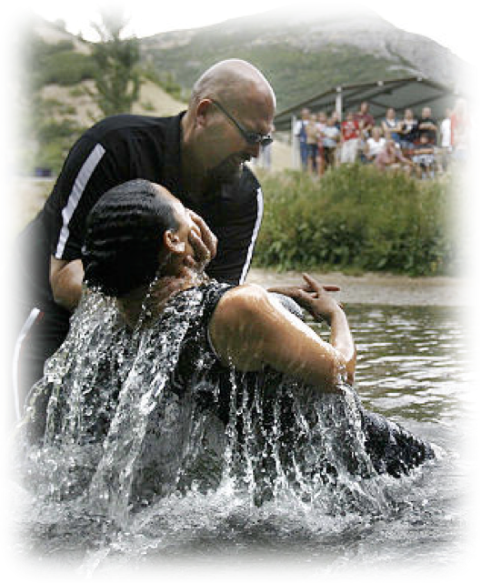
It starts with doing what we know to be true - then growing in knowledge & service?
First we must obey the first principles of the gospel (Heb 5:8,9; Mk 16:16; Acts 2:38).
Growing in faith, diligently serving the Lord (2 Pet 1:5-10).
WE WILL GROW and find Eternal joy (Rom 8:18; 1 Cor 15:58).

Slide 20
Charts by Don McClain
Preached November 6, 2022
Church of Christ Meeting @ 9500 HWY 5 / Bryant AR 72002 / 501-568-1062
Email – donmcclain@sbcglobal.net
More Keynote, PPT & Audio Sermons:
http://w65stchurchofchrist.org/coc/sermons/
Ephesians 4:1-16

