Slide 1
“Only let your conduct be worthy of the gospel of Christ, so that whether I come and see you or am absent, I may hear of your affairs, that you stand fast in one spirit, with one mind striving together for the faith of the gospel,”
Philippians 1:27 (NKJV)
WHAT DOES BEING UNITED IN CHRIST MEAN?
WHEN IS UNITY IN CHRIST ACHIEVED?
HOW IS UNITY IN CHRIST MAINTAINED?
WHY IS ACTUAL UNITY IN CHRIST IMPORTANT?

Slide 2
UNITY IN CHRIST
John 17:20–23 (NKJV)
²⁰ “I do not pray for these alone, but also for those who will believe in Me through their word; ²¹ that they all may be one, as You, Father, are in Me, and I in You; that they also may be one in Us, that the world may believe that You sent Me.
BY FAITH IN CHRIST
THROUGH THE TRUTH
WITH / IN DEITY

Slide 3
UNITY IN CHRIST
John 17:20–23 (NKJV)
²² And the glory which You gave Me I have given them, that they may be one just as We are one: ²³ I in them, and You in Me; that they may be made perfect in one, and that the world may know that You have sent Me, and have loved them as You have loved Me.
BY FAITH IN CHRIST
THROUGH THE TRUTH
WITH / IN DEITY
SAME AS DIVINE UNITY
COMPLETE UNITY
EVIDENCE OF GOD’S LOVE

Slide 4
UNITY IN CHRIST
Acts 2:42–44 (NKJV)
⁴² And they continued steadfastly in the apostles’ doctrine and fellowship, in the breaking of bread, and in prayers. ⁴³ Then fear came upon every soul, and many wonders and signs were done through the apostles. ⁴⁴ Now all who believed were together, and had all things in common,
SUSTAINED BY CONTINUANCE IN APOSTLES’ TEACHING
STRENGTHENED BY WORSHIP & REVERENCE
SHARING TOGETHER

Slide 5
UNITY IN CHRIST
1 Corinthians 1:10 (NKJV)
¹⁰ Now I plead with you, brethren, by the name of our Lord Jesus Christ, that you all speak the same thing, and that there be no divisions among you, but that you be perfectly joined together in the same mind and in the same judgment.
SUBMISSION TO THE AUTHORITY OF CHRIST
TEACHING SAME THING PRODUCING UNITY IN THOUGHT AND APPLICATION.

Slide 6
UNITY IN CHRIST
Ephesians 4:1–6 (NKJV)
¹ I, therefore, the prisoner of the Lord, beseech you to walk worthy of the calling with which you were called, ² with all lowliness and gentleness, with longsuffering, bearing with one another in love, ³ endeavoring to keep the unity of the Spirit in the bond of peace.
HONORING THE GOSPEL BY LIVING UP TO IT’S STANDARDS
ACCOMPLISHED BY GODLY CHARACTER
DEMANDS GREAT EFFORT

Slide 7
UNITY IN CHRIST
ACCOMPLISHED BY ACCEPTING THE TRUTH
ONE CHURCH
ONE SOURCE OF TRUTH
ONE EXPECTATION
ONE MASTER
ONE STANDARD
ONE ENTRANCE
ONE SOURCE OF EXISTENCE AND LIFE.
Ephesians 4:1–6 (NKJV)
⁴ There is one body and one Spirit, just as you were called in one hope of your calling; ⁵ one Lord, one faith, one baptism; ⁶ one God and Father of all, who is above all, and through all, and in you all.

Slide 8
UNITY IN CHRIST
ACCOMPLISHED BY FOLLOWING THE TRUTH
UNITED BY ACCEPTING THE TRUTH
GROWING IN FAITH & SERVICE - UNITED
BECOMING MORE AND MORE LIKE CHRIST
Ephesians 4:11–16 (NKJV)
¹¹ And He Himself gave some to be apostles, some prophets, some evangelists, and some pastors and teachers, ¹² for the equipping of the saints for the work of ministry, for the edifying of the body of Christ, ¹³ till we all come to the unity of the faith and of the knowledge of the Son of God, to a perfect man, to the measure of the stature of the fullness of Christ;

Slide 9
UNITY IN CHRIST
ACCOMPLISHED BY FOLLOWING THE TRUTH
PROTECTION FROM DECEPTION
GROWING CLOSER TO THE LORD AND ONE ANOTHER BY SPEAKING THE TRUTH.
Ephesians 4:11–16 (NKJV)
¹⁴ that we should no longer be children, tossed to and fro and carried about with every wind of doctrine, by the trickery of men, in the cunning craftiness of deceitful plotting, ¹⁵ but, speaking the truth in love, may grow up in all things into Him who is the head—Christ—

Slide 10
UNITY IN CHRIST
ACCOMPLISHED BY FOLLOWING THE TRUTH
UNITY IN CHRIST PRODUCES GROWTH OF THE BODY.
WE WILL ONLY BE AS STRONG AS THE SUM OF OUR PARTS FAITHFULLY FOLLOW JESUS!
Ephesians 4:11–16 (NKJV)
¹⁶ from whom the whole body, joined and knit together by what every joint supplies, according to the effective working by which every part does its share, causes growth of the body for the edifying of itself in love.

Slide 11
UNITY IN CHRIST
Encouragement from being united with Christ
ComfortED BY THE RECEPTION OF His love
Fellowship with the Spirit OF TRUTH
RECIPIENTS OF HIS Tenderness and compassion
WHAT JESUS PROVIDES FOR US, WE SHOULD EXTEND TO OTHERS! (2-4)
Philippians 2:1–5 (NKJV)
¹ Therefore if there is any consolation in Christ, if any comfort of love, if any fellowship of the Spirit, if any affection and mercy, ² fulfill my joy by being like-minded, having the same love, being of one accord, of one mind.

Slide 12
UNITY IN CHRIST
Encouragement from being united with Christ
WE SHOULD EXALT THE NEEDS OF OTHERS ABOVE OUR OWN DESIRES!
OUR ACTIONS & CHOICES SHOULD BE IN THE BEST INTEREST OF OTHERS!
IMITATING CHRIST BY OUR LOYALTY TO THE FATHER BY LIVING OBEDIENT, SACRIFICIAL LIVES!
Philippians 2:1–5 (NKJV)
³ Let nothing be done through selfish ambition or conceit, but in lowliness of mind let each esteem others better than himself. ⁴ Let each of you look out not only for his own interests, but also for the interests of others. ⁵ Let this mind be in you which was also in Christ Jesus,

Slide 13
UNITY IN CHRIST
Respecting the conscience of others (Rom.14:12,13, 19-23; 1 Cor. 8:8-13)
Being patient while we learn & grow (Rom. 15:1-6)
Do things that will lead to edification (Rom 14:19; 1 Cor. 14:26; 2 Tim 4:2)
Walk in love (Rom 14:15; 1 Cor. 13)

Slide 14
Matthew 12:25–26 (NKJV)
²⁵ But Jesus knew their thoughts, and said to them: “Every kingdom divided against itself is brought to desolation, and every city or house divided against itself will not stand. ²⁶ If Satan casts out Satan, he is divided against himself. How then will his kingdom stand?

Slide 15
3:14 - Bitter envy and self-seeking in your hearts,
3:15 - Earthly, sensual, demonic - wisdom
4:1 - From your desires for pleasure that war in your members?
4:2 - You lust and do not have - You murder and covet and cannot obtain.
4:3 - you ask amiss, that you may spend it on your pleasures.
4:4 - Friendship with the world is enmity with God?
“Where do wars and fights come from among you?” - James 3:14-4:4

Slide 16
Teaching a different gospel / doctrine (Gal 1:6-9; Rom 16:17)
Not abiding in the doctrine of Christ (2 John 9,10; Rev 2:15)
Acceptance of immoral practices (2 Cor. 5:1-7; Re 2:14)
Greed (Jos 7; Acts 5:1-4)
The unfaithful (Numbers 14; Heb. 3:16-18; 2 Thes 3:14,15)
Sinful attitudes - (pride; selfishness; hatred; jealousy; worldliness; etc.) - (James 3:14-16; 4:4; 2 Cor 12:20)
“Where do wars and fights come from among you?” - James 3:14-4:4

Slide 18
UNITY IN CHRIST
Unity IN CHRIST is dependent upon two primary things –
Our submission to the authority of Jesus the Christ in doctrine & practice.
The application of the attitudes commanded by Jesus that we are to have toward one another.

Slide 19
There Is Great Power In UNITY
Division ULTIMATELY Brings FAILURE
Matthew 12:30 (NKJV)
³⁰ He who is not with Me is against Me, and he who does not gather with Me scatters abroad.

Slide 20
There Is Great Power In UNITY
Division ULTIMATELY Brings FAILURE
When all men will lay down their creeds, disciplines, manuals, confessions of faith, catechisms, think-so's, maybe's, and subjective feelings, and with an unprejudiced and receptive heart turn to the Word of God, then, and ONLY then, will unity result.

Slide 21
“Only let your conduct be worthy of the gospel of Christ, so that whether I come and see you or am absent, I may hear of your affairs, that you stand fast in one spirit, with one mind striving together for the faith of the gospel,”
Philippians 1:27 (NKJV)
We must be committed to being nothing, calling ourselves nothing, obeying nothing, and saying nothing except that which is authorized by the Word of God. 1 Peter 4:11; Colossians 3:17

Slide 22
“Only let your conduct be worthy of the gospel of Christ, so that whether I come and see you or am absent, I may hear of your affairs, that you stand fast in one spirit, with one mind striving together for the faith of the gospel,”
Philippians 1:27 (NKJV)
By developing the attitude of Christ Eph 4:1-3; Col 3:12-15; Phili 2:1-5; Rom 14-15:6

Slide 23
“Only let your conduct be worthy of the gospel of Christ, so that whether I come and see you or am absent, I may hear of your affairs, that you stand fast in one spirit, with one mind striving together for the faith of the gospel,”
Philippians 1:27 (NKJV)
IN CHRIST (Acts 2:38; Gal. 3:26,27)

Slide 25
“Only let your conduct be worthy of the gospel of Christ, so that whether I come and see you or am absent, I may hear of your affairs, that you stand fast in one spirit, with one mind striving together for the faith of the gospel,”
Philippians 1:27 (NKJV)
Charts by Don McClain
Preached June 19, 2022
West 65th Street church of Christ - P.O. Box 190062 - Little Rock AR 72219 - Phone — 501-568-1062 — Email – donmcclain@sbcglobal.net
Prepared using Keynote / More Keynote, PPT & Audio Sermons:
www.w65stchurchofchrist.com

Slide 26
Ephesians 4:1–6 (NKJV)
¹ I, therefore, the prisoner of the Lord, beseech you to walk worthy of the calling with which you were called, ² with all lowliness and gentleness, with longsuffering, bearing with one another in love, ³ endeavoring to keep the unity of the Spirit in the bond of peace. ⁴ There is one body and one Spirit, just as you were called in one hope of your calling; ⁵ one Lord, one faith, one baptism; ⁶ one God and Father of all, who is above all, and through all, and in you all.

Slide 27
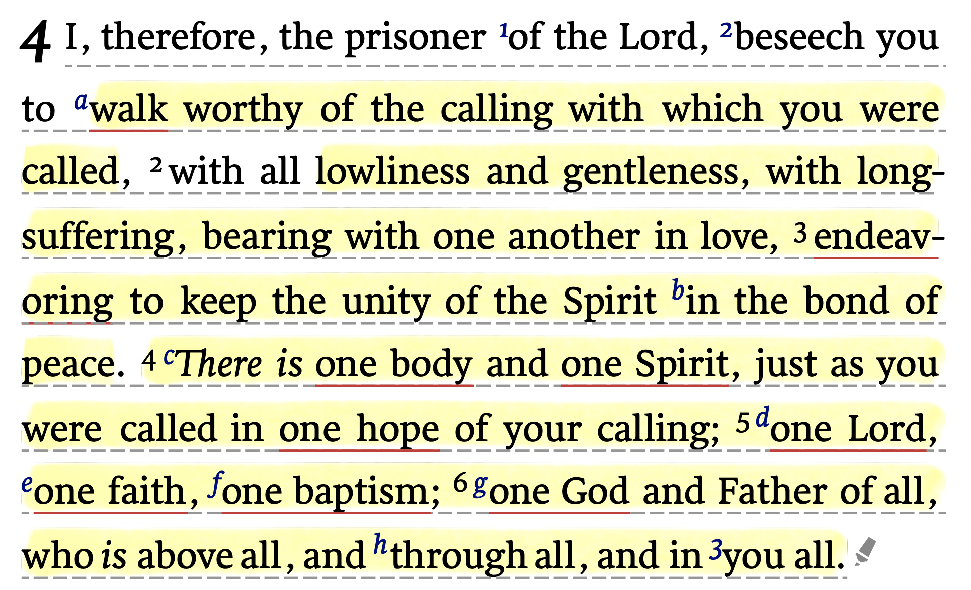
Ephesians 4:1–6 (NKJV)

