Slide 1
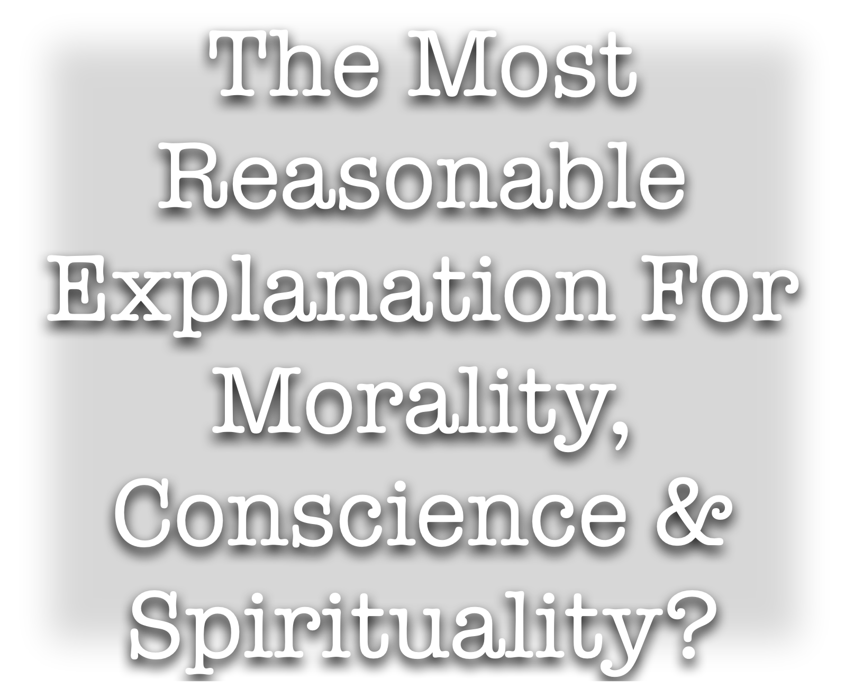

Slide 2
The Most Reasonable Cause For The Material Universe?
The Most Reasonable Cause For Organization of The Universe?
The Most Reasonable Cause of Life & its complexities?
The Most Reasonable Explanation For Reason, Ethics, Consciousness?
The Most Reasonable Explanation For Man’s desire to Worship, Seek God, & The Bible?

Slide 3
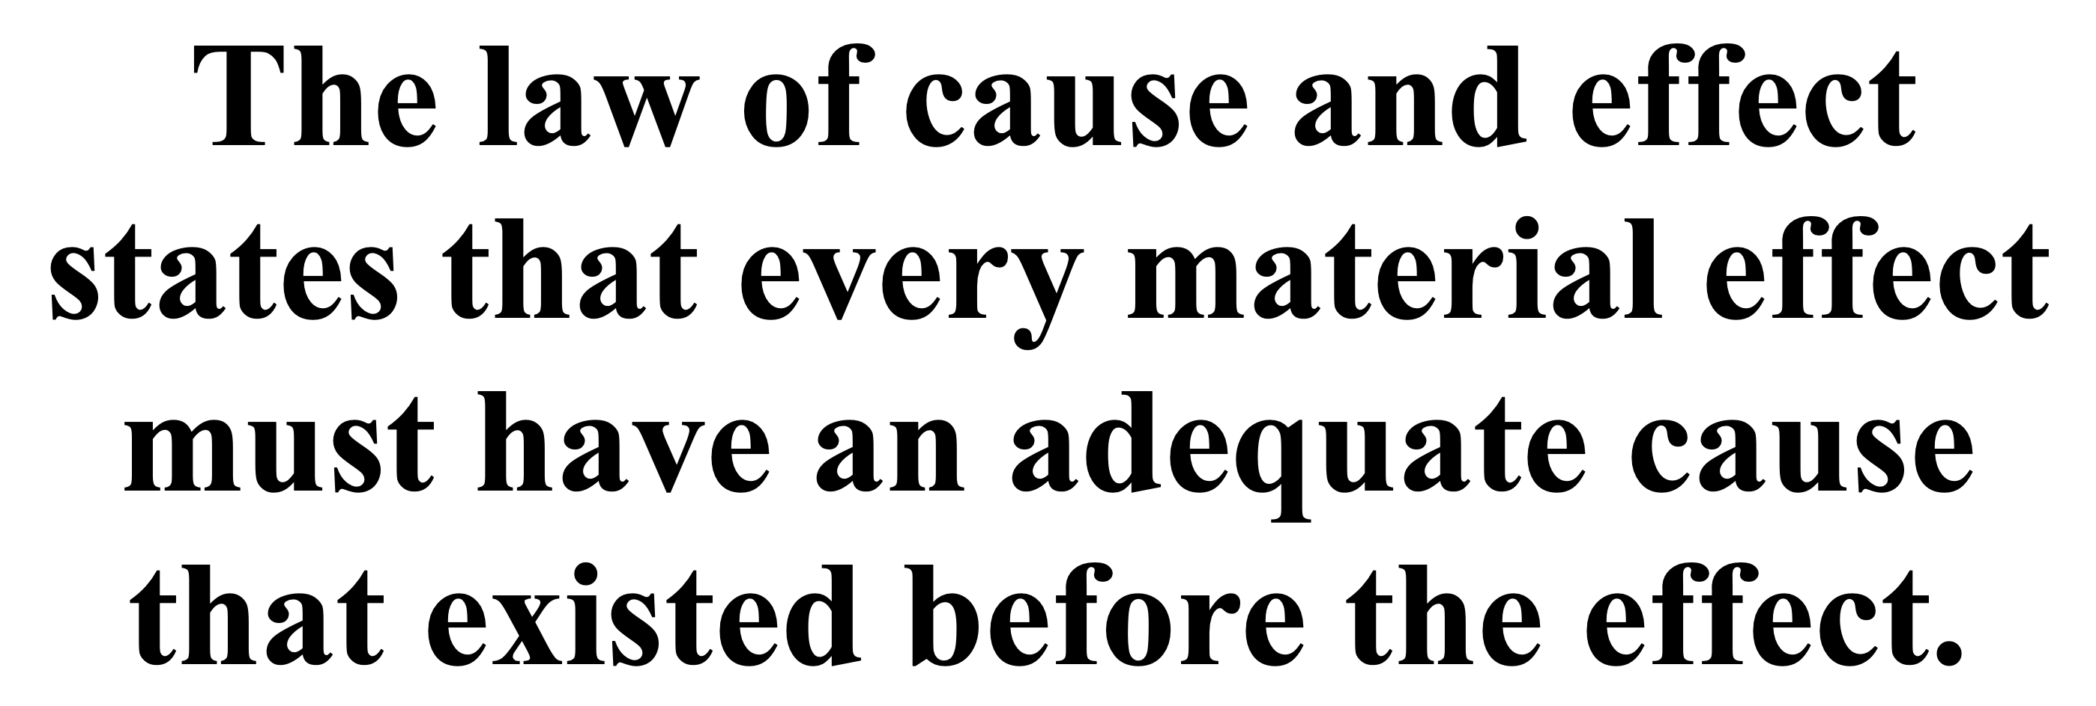
Intelligent design, or “chance?”
UNIVERSE
EARTH
LIFE
MIND
RELIGION

Slide 4
WHY ARE HUMANS THE ONLY CREATURES WITH THE ABILITY TO REASON?

Slide 5
The Most Reasonable Explanation For:
Sense of Morality?
Ability to Reason?
Consciousness?
Emotions?
Compassion? Fear? Love? Guilt?
Religion?

Slide 6
Genesis 1:26–27 (NKJV)
²⁶ Then God said, “Let Us make man in Our image, according to Our likeness; let them have dominion over the fish of the sea, over the birds of the air, and over the cattle, over all the earth and over every creeping thing that creeps on the earth.” ²⁷ So God created man in His own image; in the image of God He created him; male and female He created them.

Slide 7
Romans 2:14–15 (NKJV)
¹⁴ for when Gentiles, who do not have the law, by nature do the things in the law, these, although not having the law, are a law to themselves, ¹⁵ who show the work of the law written in their hearts, their conscience also bearing witness, and between themselves their thoughts accusing or else excusing them)

Slide 8
Ecclesiastes 3:11 (NKJV)
¹¹ He has made everything beautiful in its time. Also He has put eternity in their hearts, except that no one can find out the work that God does from beginning to end.

Slide 9
1. Man has rational intelligence. He has ability to reason, invent, communicate, etc.
2. Man has a will, and a power to choose. He is a free moral agent.
3. Man has emotions. He can experience joy, love, fear, anger, hatred, sorrow, etc.
4. Man has a conscience. He is able, not only to distinguish right from wrong, but also to have an inherent sense of guilt when he has done wrong and a sense of approval when he has done right.

Slide 10
In an interview with a CNN news reporter, Libresco noted that her conversion from atheism to theism was “kinda the same thing with any scientific theory, almost, that it had more explanatory power to explain something I was really sure of. I’m really sure that morality is objective, human independent; something we uncover like archaeologists not something we build like architects” (Merica, 2012, emp. added).
Leah Libresco

Slide 11
NATURAL EVOLUTION CANNOT ACCOUNT FOR OBJECTIVE MORALITY
If God exists, then we have a sound foundation for objective moral values and duties.
If God does not exist, then we do not have a sound foundation for objective moral values and duties.

Slide 12
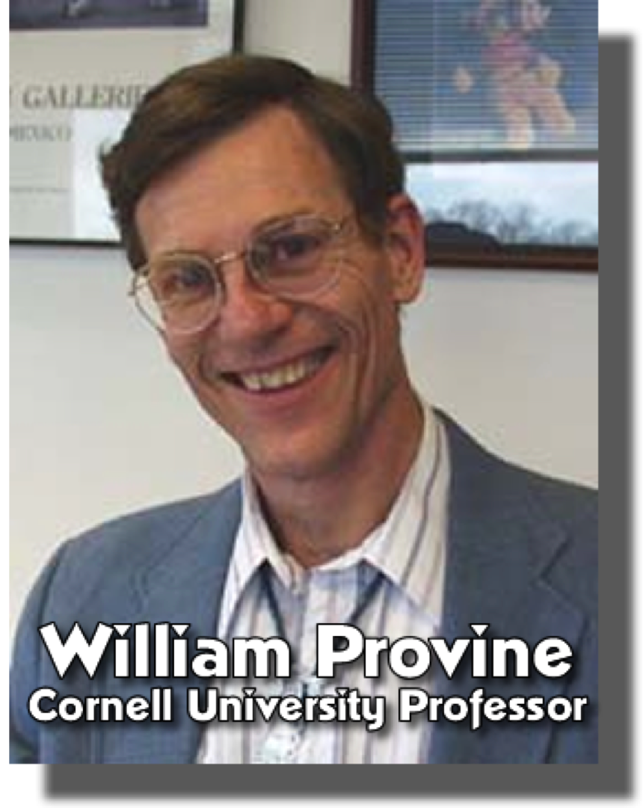
NATURAL EVOLUTION CANNOT ACCOUNT FOR OBJECTIVE MORALITY
“There are no purposive principles whatsoever in nature. There are no gods and no designing forces that are rationally detectable. . . Second, modern science directly implies that there are no moral or ethical laws, no absolute guiding principles for human society.”
(Darwin On Trial, pg 124)

Slide 13
NATURAL EVOLUTION CANNOT ACCOUNT FOR OBJECTIVE MORALITY
“Third, human beings are marvelously complex machines. The individual human becomes an ethical person by means of two primary mechanisms; heredity and environmental influences. That is all there is. Fourth, we must conclude that when we die, we die and that is the end of us.”
(Darwin On Trial, pg 124, 125)

Slide 14
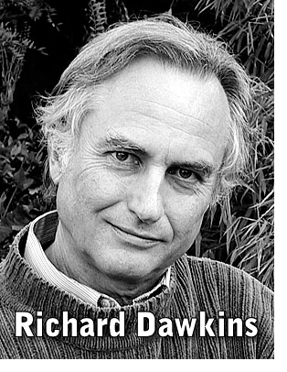
FROM INANIMATE MATTER TO MORAL CONSCIOUSNESS?
Biologists understand that the driving force in evolution is the survival and propagation of our genes. They may impel us to instinctive acts of goodness...even when it seems counterproductive to our own interests—say, by risking our life to save someone else. Evolutionary psychology can explain how selfless behavior might have evolved (pp. 48-49,).
“New Naysayers” . . . atheism is smarter” (2006, p. 47-49).

Slide 15
FROM INANIMATE MATTER TO MORAL CONSCIOUSNESS?
(1) “The recipient may be a blood relation who carries some of our own genes.” (2) “Or our acts may earn us future gratitude, or reputation for bravery that makes us more desirable as mates.” (3) “The impulse for generosity must have evolved while humans lived in small bands in which almost everyone was related, so that goodness became the default human aspiration” (p. 49).
“New Naysayers” . . . atheism is smarter” (2006, p. 47-49).

Slide 16
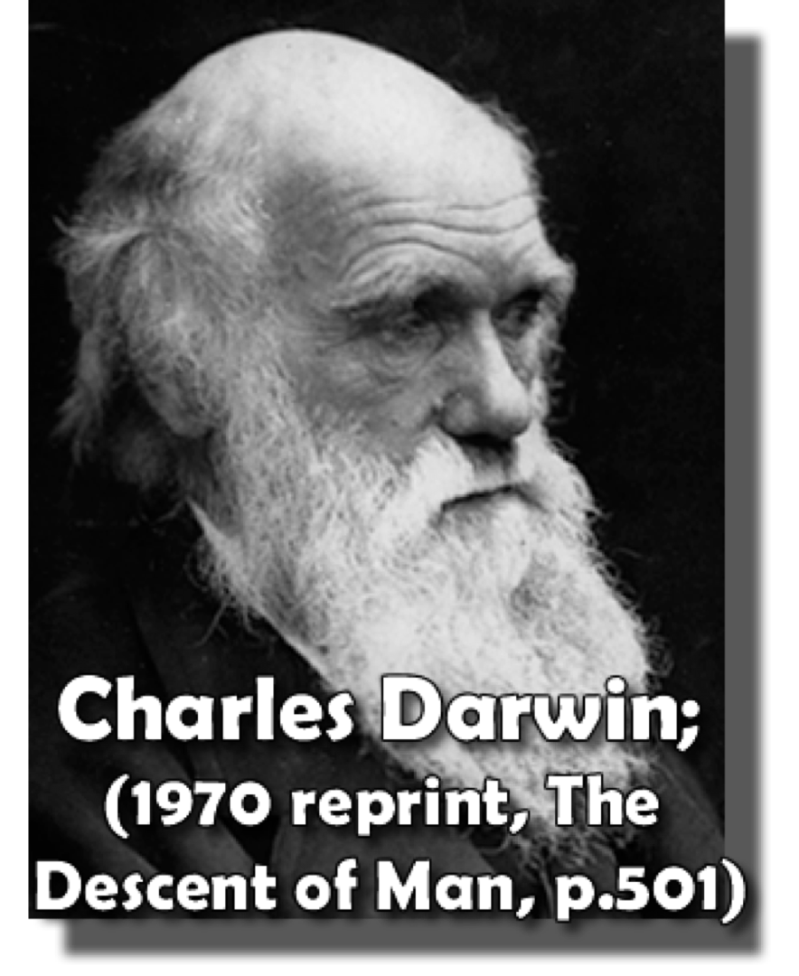
FROM INANIMATE MATTER TO MORAL CONSCIOUSNESS?
“With savages, the weak in body or mind are soon eliminated; and those that survive commonly exhibit a vigorous state of health. We civilised men, on the other hand, do our utmost to check the process of elimination; we build asylums for the imbecile, the maimed, and the sick; we institute poor-laws; and our medical men exert their utmost skills to save the life of everyone to the last moment.”

Slide 17
FROM INANIMATE MATTER TO MORAL CONSCIOUSNESS?
Our sense of moral “oughtness” allegedly comes (1) from wanting to pass on our genes, (2) from a desire to be a hero and gain popularity, and/or (3) by default.
The “driving force” of evolution—natural selection—runs contrariwise to such moral, human impulses as empathy, charity, and pity,
The desire to pass on one’s genes or to be a hero fails to explain the origins of human morality.

Slide 18
Moral Standards OF Atheism?
Relativism: there are no universal, objective criteria for determining morals and ethics.
Hedonism: the aim of “moral” conduct is the attainment of the greatest possible pleasure with the greatest possible avoidance of pain.
Utilitarianism: “good” is that which ultimately gives the greatest amount of pleasure to the greatest number of people.
Situationism: something is “right” because the individual determines it is right on a case-by-case basis.
Determinism: man is not responsible for his actions.

Slide 19
Moral Standards OF Atheism?
Religions: Atheism / Agnosticism / Humanism / New Age Movement / Woke
Governments: Germany, WWI, Fascism and Hitler's Nazism WW2
Politics: Dictatorships, Communism –
Societies: Humanistic Influence in Psychology
Erosion of constitutional right to religious freedoms –
Works of the flesh are socially acceptable – (adultery, fornication, pornography, drunkenness, gambling, homosexuality . . .) The ONLY SIN is to say such things are wrong!!!
Abortion / Euthanasia

Slide 20
FROM INANIMATE MATTER TO MORAL CONSCIOUSNESS?
To suggest that the morality inherent in all mankind evolved from a warm pool of inorganic slime in the great long ago is an inadequate explanation.
Morals could only have been placed in mankind by a Being who understood, even to a greater degree than men, the difference between right and wrong.

Slide 21
The Most Reasonable Explanation For Man’s desire to Worship, Seek God, & The Bible?

Slide 22
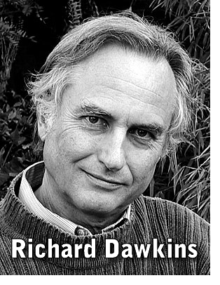
THE ORIGIN OF RELIGION
“Why, if it is false, does every culture in the world have religion? True or false, religion is ubiquitous, so where does it come from?” (p. 159).
“Though the details differ across the world, no known culture lacks some version of the time-consuming, wealth-consuming, hostility-provoking rituals, the anti-factual, counter-productive fantasies of religion” (p. 166).
Dawkins, Richard (2006), The God Delusion (New York: Houghton Mifflin).

Slide 23
THE ORIGIN OF RELIGION
“Similarly, several experiments suggest that children are predisposed to assume design and intention behind natural events—leaving many psychologists and anthropologists to believe that children, left entirely to their own devices, would invent some conception of God” (2010, p. 151).
Sam Harris
(2010), The Moral Landscape: How Science Can Determine Human Values (New York: Free Press).

Slide 24
THE ORIGIN OF RELIGION
“the proposal that children might be intuitive theists becomes increasingly viable,” … “together, these research findings tentatively suggest that children’s explanatory approach may be accurately characterized as intuitive theism” (2004, 15:299).
Deborah Kelemen
Psychological & Brain Sciences
Are Children ‘Intuitive Theists’?” Reasoning About Purpose and Design in Nature,” Psychological Science, 15[5]:295-301.

Slide 25
THE ORIGIN OF RELIGION
“Creatures are not born with desires unless satisfaction for these desires exists. A baby feels hunger; well, there is such a thing as food. . . . If I find in myself a desire which no experience in this world can satisfy, the most probable explanation is that I was made for another world.
(C. S. Lewis, Mere Christianity, Bk. III, chap. 10, "Hope")

Slide 26
THE ORIGIN OF RELIGION
“Man alone possesses a unique, inherent religious inclination; he has both the desire and the ability to worship. Regard- less of how “primitive” or “advanced” he may be, and despite living isolated from all other humans, man always has sought to worship a higher being. And even when man de- parts from the true God, he still worships something. It might be a tree, a rock, or even himself.
Apologetics Press :: IN THE “IMAGE AND LIKENESS OF GOD” [PART II] Eric Lyons, M.Min. and Bert Thompson, Ph.D. APRIL 2002 REASON & REVELATION 22(4):25
https://apologeticspress.org/wp-content/uploads/2021/08/0204.pdf

Slide 27
THE ORIGIN OF RELIGION
First, the ability of Speaking.
Second, desire to improve his education, accumulate knowledge, and build on past achievements.
Third, man is creative.
Fourth, gift of reasoning.
Fifth, man’s free-will capacity to make rational choices.
Sixth, the ability to choose between right and wrong.
Seventh, man possesses a conscience.
Eighth, can experience heart-felt emotions.
Ninth, inherent religious inclination;.
Tenth, man bears the spiritual imprint of God due to the fact that he possesses an immortal soul.
Apologetics Press :: IN THE “IMAGE AND LIKENESS OF GOD” [PART II] Eric Lyons, M.Min. and Bert Thompson, Ph.D. APRIL 2002 REASON & REVELATION 22(4):25
https://apologeticspress.org/wp-content/uploads/2021/08/0204.pdf

Slide 28
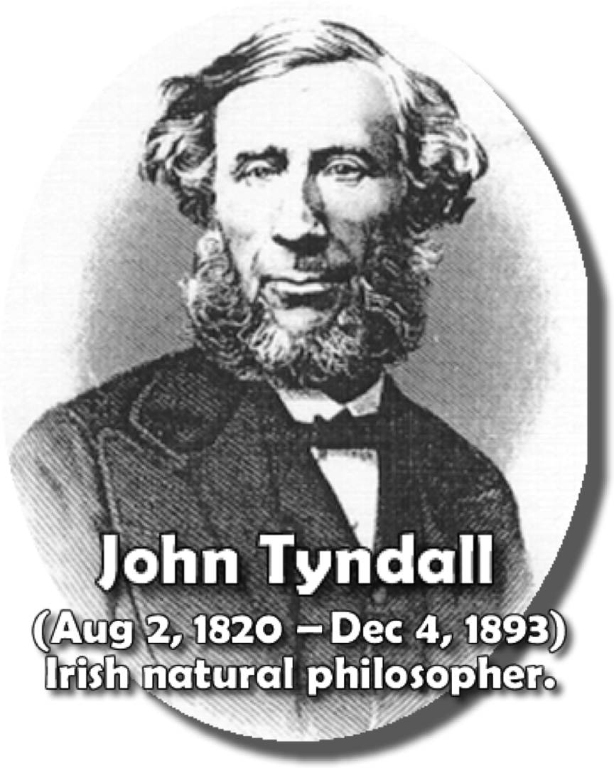
THE ORIGIN OF RELIGION
“Religion lives not by the force and aid of dogma, but because it is ingrained in the nature of man. To draw a metaphor from metallurgy, the moulds have been broken and reconstructed over and over again, but the molten ore abides in the ladle of humanity. An influence so deep and permanent is not likely soon to disappear.”
(Clarence Darrow and Wallace Rice/ “Infidels and Heretics: An Agnostic’s Anthology”, 1929, p. 146).

Slide 29
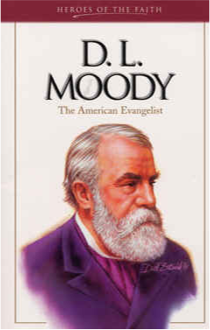
THE ORIGIN OF RELIGION
“[p]hilosophers [have] agreed that even the most primitive races of mankind reach out beyond the world of matter to a superior Being. It is as natural for man to feel after God as it is for the ivy to feel after a support. Hunger and thirst drive man to seek for food, and there is a hunger of the soul that needs satisfying, too. Man does not need to be commanded to worship, as there is not a race so high or so low in the scale of civilization but has some kind of god. What he needs is to be directed aright.”

Slide 30
THE ORIGIN OF RELIGION
“Reason and experience both FORBID us to expect that national morality can prevail in exclusion of religious principle”

Slide 31
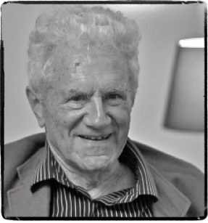
THE ORIGIN OF RELIGION
“There is "widely admitted to be a crisis in contemporary Western debate about ethical foundations.
Ultimately, this crisis is the result of approaching ethics without reference to God. When morality is severed from its theological roots, secular ethics cannot sustain itself - it withers and dies.”
John Rist, Real Ethics (Cambridge: Cambridge University Press, 2003), p. 1.

Slide 32
THE ORIGIN OF RELIGION
"Without a moral framework, there is nothing left but immediate self-indulgence by some and the path of least resistance by others. Neither can sustain a free society.”
Thomas Sowell
Proverbs 14:34 (NKJV)
34 Righteousness exalts a nation, But sin is a reproach to any people.

Slide 33
Ecclesiastes 3:11 (NKJV)
¹¹ He has made everything beautiful in its time. Also He has put eternity in their hearts, except that no one can find out the work that God does from beginning to end.

Slide 34
Origin
Order –
Religion –
Ethics –
Identity –
Eschatology -

Slide 35
Acts 17:30–31 (NKJV)
³⁰ Truly, these times of ignorance God overlooked, but now commands all men everywhere to repent, ³¹ because He has appointed a day on which He will judge the world in righteousness by the Man whom He has ordained. He has given assurance of this to all by raising Him from the dead.”

Slide 36
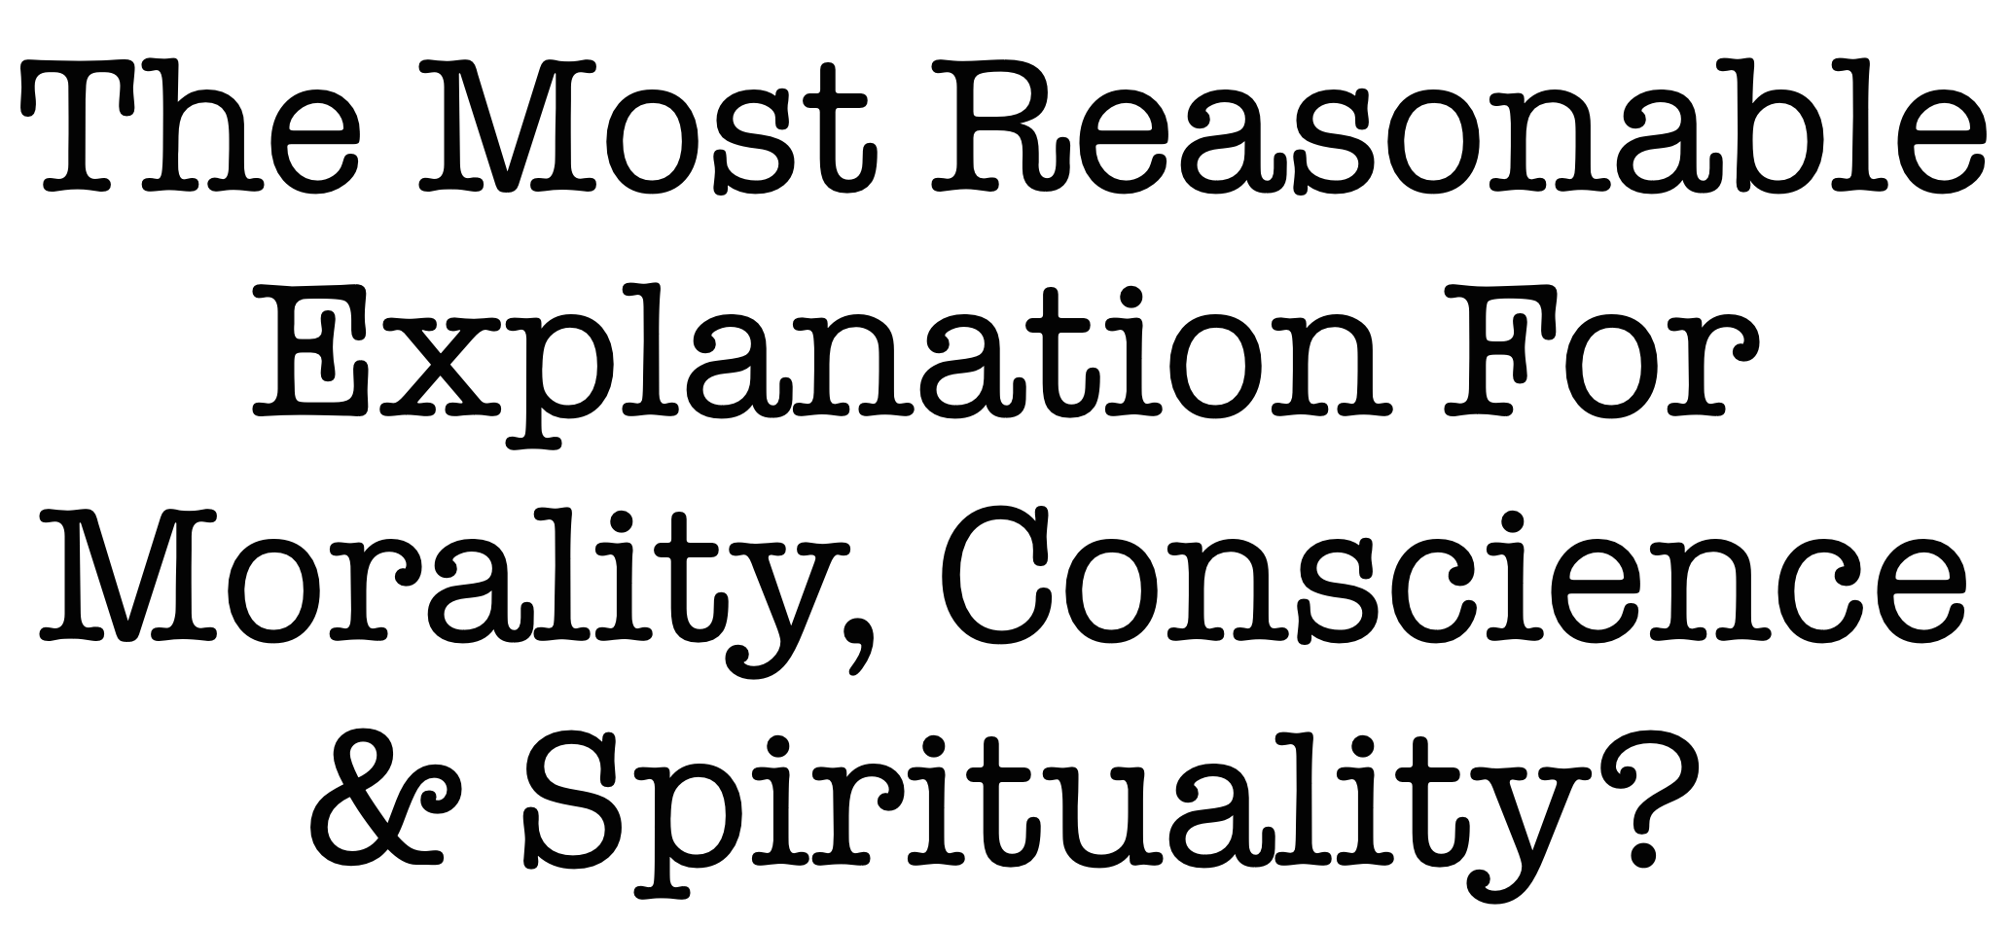

Slide 37
NOT ONLY IS IT REASONABLE TO BELIEVE IN GOD,
IT IS UNREASONABLE NOT TO

Slide 38
Meeting @ 9500 Hwy 5, Bryant AR
BRYANTCHURCHOFCHRIST.COM
ENTER TO WORSHIP
LEAVE TO SERVE
July 21, 2024

Slide 40
Charts by Don McClain
Preached October 13, 2013 W 65th Street church of Christ / July 20, 2024, Bryant church of Christ
9500 AR 5, Aexander AR, 72002 - 501-568-1062 / Email – donmcclain@sbcglobal.net
More Keynote, PPT & Audio Sermons:
BRYANTCHURCHOFCHRIST.COM

Slide 41
Romans 2:14–16 (NKJV)
¹⁴ for when Gentiles, who do not have the law, by nature do the things in the law, these, although not having the law, are a law to themselves, ¹⁵ who show the work of the law written in their hearts, their conscience also bearing witness, and between themselves their thoughts accusing or else excusing them) ¹⁶ in the day when God will judge the secrets of men by Jesus Christ, according to my gospel.

