Slide 1
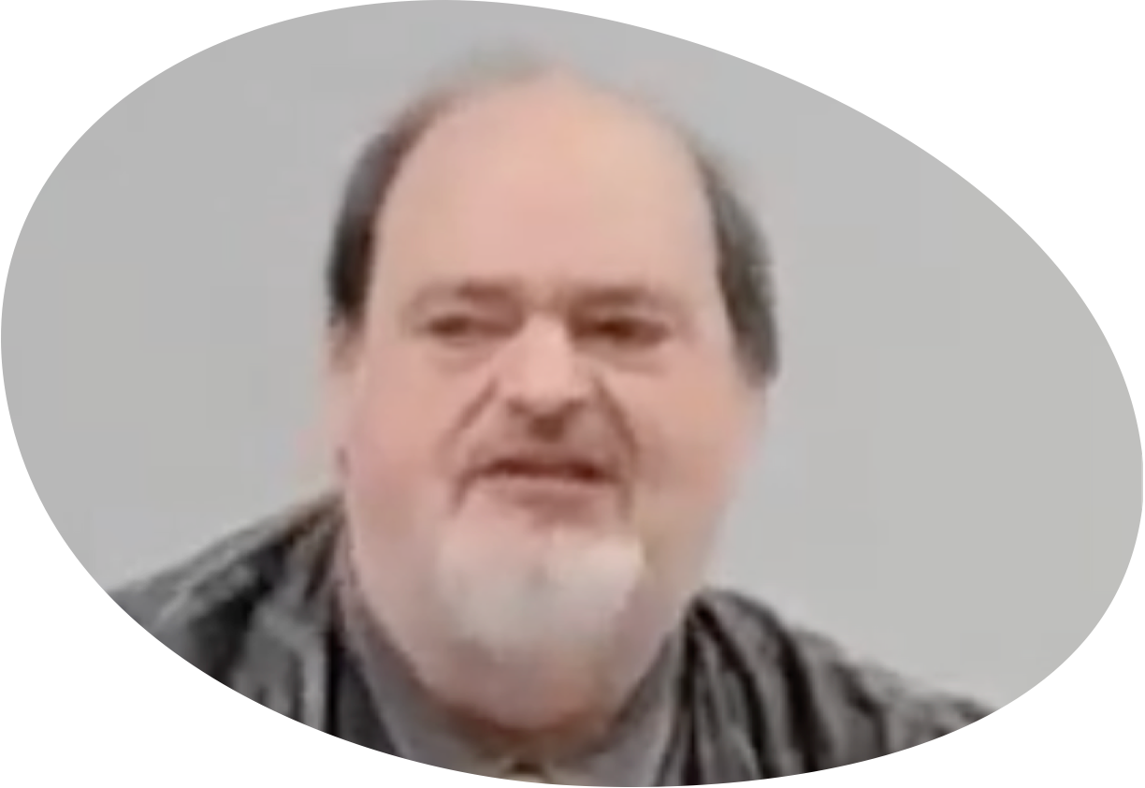
“Church of Christ MEETING @ 9500 AR 5, Alexander AR. 72002”
TODAY’S LESSON
Sunday Morning lesson live stream 9:00 AM ^{CT} February 4, 2024
https://www.youtube.com/user/donmcclain11/live / https://www.bryantchurchofchrist.com

Slide 2
DAILY RENEWING THE HEART WITH GENEROSITY
2 CORINTHIANS 8:1-9

Slide 3
Giving in Faith, Hope, and Love
How did God teach the Thessalonians to love one another (1 Th 4:9)?
By loving us and proving His love for us by GIVING to us (John 3:16; 1 John 3:16; 4:16)
How do we show love for God and for others?
By word and deed (1 Jn 3:17-18)

Slide 4
1 John 3:16-18
16 By this we know love, because He laid down His life for us. And we also ought to lay down our lives for the brethren. 17 But whoever has this world's goods, and sees his brother in need, and shuts up his heart from him, how does the love of God abide in him? 18 My little children, let us not love only in word or in tongue, but also in deed and in truth.

Slide 5
Giving in Faith, Hope, and Love
How did God teach the Thessalonians to love one another (1 Th 4:9)?
By loving us and proving His love for us by GIVING to us (John 3:16; 1 John 3:16; 4:16)
How do we show love for God and for others?
By deed and word (GIVING 1 Jn 3:17-18)
Show faith and hope this way (Proverbs 3:9-10; 19:17)

Slide 6
Proverbs 3:9-10
9 Honor the LORD with your possessions, and with the firstfruits of all your increase;
10 So your barns will be filled with plenty, and your vats will overflow with new wine.
Proverbs 19:17
He who has pity on the poor lends to the LORD, and He will pay back what he has given.

Slide 7
Giving is Living By Grace
New disciples responded to receiving God’s grace by offering worship and sharing with needy Christians Acts 2:42-47

Slide 8
Acts 2:42-47
42 And they continued steadfastly in the apostles' doctrine and the fellowship, the breaking of the bread, and the prayers. 43 Then fear came upon every soul by many wonders and signs done through the apostles. 44 Now all who believed were together, and had all things in common, 45 and sold their possessions and goods, and divided them among all, as anyone had need. 46 So continuing daily with one accord in the temple, and breaking bread from house to house, they ate their food with gladness and simplicity of heart, 47 praising God and having favor with all the people. And the Lord added to the church daily those who were being saved.

Slide 9
Giving is Living By Grace
New disciples responded to receiving God’s grace Acts 2:42-47
Fellowship is contribution Rom. 15:26
Fellowship in all assembly activities Acts 2:42, 47
Fellowship of goods with others v.44-45
Fellowship in time spent outside the assembly v.46
Fulfilled John 13:35 in v.47

Slide 10
How Much Do I Have To Give?
Wrong question to ask
How much grace do I have to give cheerfully? 2 Cor. 8:7; 9:7
How much love do I have to give cheerfully? 2 Cor. 8:8
Not under law to tithe 2 Cor. 8:8,12; 9:7
Planned proportion is implied 1 Cor. 16:2; 2 Cor. 9:7
Generosity is encouraged 2 Cor. 9:10-15

Slide 11
2 Corinthians 9:10-15
10 Now He who supplies seed to the sower and bread for food, supply and multiply the seed you have sown and increase the fruits of your righteousness, 11 while you are enriched in everything for all generosity, which causes thanksgiving through us to God. 12 For the administration of this service not only supplies the needs of the saints, but also is abounding through many thanksgivings to God, 13 while, through the proof of this ministry, they glorify God for the obedience of your confession to the gospel of Christ, and for your generous fellowship with them and all, 14 and by their prayer for you, who long for you because of the exceeding grace of God in you. 15 Thanks be to God for His indescribable gift!

Slide 12
Hebrews 7
Melchizedek a type of Christ v.3
Melch (“king”) i zedek (“righteousness”) v.2
Jesus rules with righteousness Heb. 1:6-7
Melch. was king of Salem (peace) v.1
Jesus is the Prince of Peace Isaiah 9:6
Melchizedek was priest of God v.1
Jesus is king and priest Hebrews 8:1
Abraham is a type of us Rom. 4:12

Slide 13
Hebrews 7
Abraham-Melchizedek relationship is a type of our relationship with Christ Heb. 7
Melchizedek brought Abraham bread and wine Gen. 14:18
Christ gave us the Lord’s Supper 1 Cor.11:23…
Melchizedek blessed Abraham with his word v.6-7; Gen. 14:19-20
Jesus blesses us with His word John 8:31-34
Abraham paid tithes to Melchizedek v.2
What are we to give? Romans 15:4

Slide 14
Hebrews 7
Abraham gave of the spoils of war v.4
We are to give as prospered 1 Cor. 16:2
Abraham was not commanded
We give not by command 2 Cor. 8:8; 9:7
Abraham voluntarily gave a tenth of all v.2
Abraham refused the king of Sodom’s offer of reward Genesis 14:21-24
We must refuse Satan’s offer of enrichment James 4:4

Slide 15
Hebrews 7:8
Here mortal men receive tithes, but there he receives them, of whom it is witnessed that he lives. (parallelism to contrast)
Here dying men receive tithes, But There the One of whom is testified that He is living
“Here” vs. “There” Earth vs. Heaven
“Dying Men” vs. “The Testified Living One”
Levites & Priests vs. Christ the High Priest
“Receive tithes” vs. ?

Slide 16
Hebrews 7:8
Hebrew requires inferential verbs
Prov. 11:22: A ring of gold in a swine’s snout, a lovely woman who lacks discretion.
Prov. 14:14: The backslider in heart will be filled with his own ways, but a good man will be satisfied from above.
Hebrews 7:8: Here (on earth) dying men (Levites and priests) are receiving tithes; but there (in heaven) the one testified (by God- see v.17!) that He is living (Christ) (is receiving tithes)

Slide 17
Hebrews 7:8
Here mortal men receive tithes, but there he receives them, of whom it is witnessed that he lives. (parallelism to contrast)
Here dying men receive tithes, But There the One of whom is testified that He is living
“Here” vs. “There” Earth vs. Heaven
“Dying Men” vs. “The Testified Living One”
Levites & Priests vs. Christ the High Priest
“Receive tithes” vs. ?

Slide 18
Hebrews 7:8
Here mortal men receive tithes, but there he receives them, of whom it is witnessed that he lives. (parallelism to contrast)
Here dying men receive tithes, But There the One of whom is testified that He is living
“Here” vs. “There” Earth vs. Heaven
“Dying Men” vs. “The Testified Living One”
Levites & Priests vs. Christ the High Priest
“Receive tithes” implies Christ in heaven receives tithes from us as Melchizedek did from Abraham

Slide 19
Daily Renewing the Heart with Generosity
Genesis 14:17-24; Psalm 110:1-4; Hebrews 7:1-28 example of volunteer Abraham to Melchizedek for us
Exodus 25:1-9; 36:1-7 Israelites were told give and then told to stop giving because they gave too much
Exodus 35:4-36:38 gave talent as well as precious materials
I Kings 12:1-16; 2 Chronicles 24:1-14 treasury at the temple
Luke 21:1-4 the poor widow who gave more than the wealthy
Romans 5:1-11 God’s example of giving to us while we were His enemies because of His love for us
2 Corinthians 8:1-9:15 motivations to give

Slide 20
Daily Renewing the Heart with Generosity
Job 29 Job’s concern for the poor
Deuteronomy 15:1-18 laws taught mercy and generosity
Proverbs 11:24-26; 14:31; 19:17; 21:13; 22:9; 28:27; 29:7
Psalm 112 the man who fears the LORD is generous
Acts 2:42-47; 4:32-37; 11:27-30 example of early Christians responding to grace by giving much
Acts 20:32-35; Ephesians 4:28 advice for the Ephesians
3 John contrast of Christians who show hospitality and those that hurt faithful Christians

