Slide 1
Acts 2:38; 22:16; Romans 6:3-6; Galatians 3:26,27; Colossians 2:11-13; 1 Peter 3:21

Slide 2
βαπτίζω baptizō, v.,
LALS: dip in or under water; immerse. (Lexham Analytical Lexicon of the Septuagint)
NASB: to dip, sink
MGLNT: to dip, immerse, sink; (Manual Greek Lexicon of the NT)
MCEDONTW: to dip, immerse; to cleanse or purify by washing;

Slide 3
Metaphorically used in reference to immersion in the Holy Spirit, (Mat. 3:11; Acts 1:4-8), and to be overwhelmed with suffering (Mat. 20:22,23)
Baptism in the name of Jesus Christ is immersion in water, by the authority of Jesus Christ Is a prominent teaching & practice in the New Testament (Mat. 28:19; Mark 16:16; Acts 2:38; 8:12-16; 10:47,48; 19:4,5)

Slide 4
Included in the “GREAT COMMISSION”(Mat. 28:19,20; Mark 16:15,16).
Commanded of those who believe the facts of the gospel and repent (Acts 2:38; 10:47,48; 19:4,5; 22:16).

Slide 5
Infant baptism (Mark 16:16; Acts 8:36,37)
Sprinkling or pouring water on someone (Acts 8:38,39)
Because one has already been saved (Mark 16:16)
As an outward sign of an inward grace (Acts 2:38; Col. 2:11-13)
To become a member of a denomination (Acts 2:38,41,47)

Slide 7
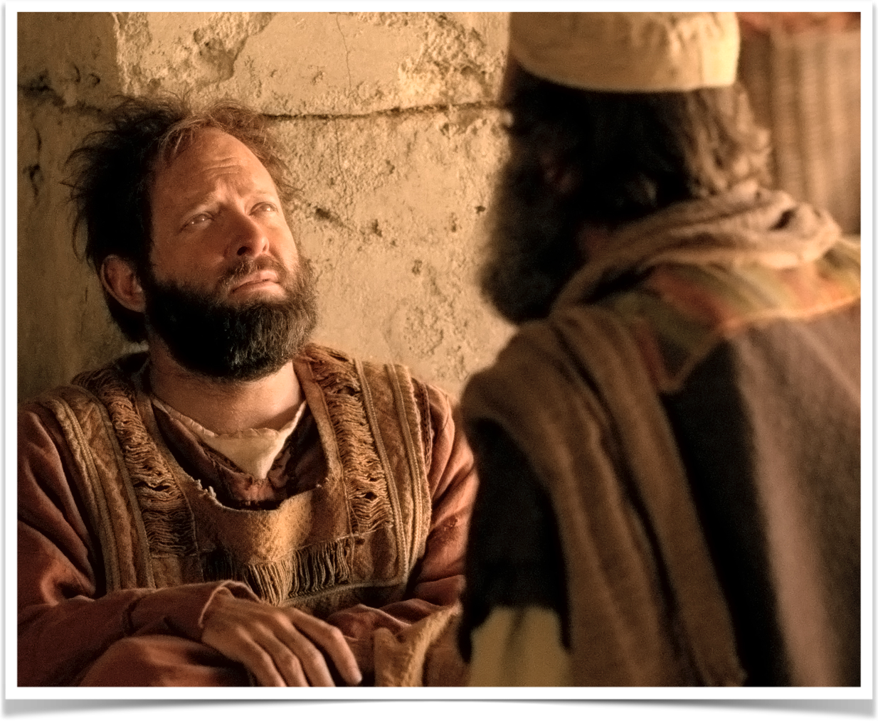
JUSTIFICATION: ONE IS CLEANSED OF PAST SINS
“Repent, and let every one of you be baptized in the name of Jesus Christ for (εἰς) the remission of sins” (Acts 2:38)
“Arise and be baptized, and wash away your sins, calling on the name of the Lord.’” (Acts 22:16)

Slide 8
JUSTIFICATION: ONE IS CLEANSED OF PAST SINS
The blood of Jesus is the cleansing agent – NOT the water (Ep. 1:7; Col 1:14; 1 Pet 1:18-22)
Our hearts are purified by His blood when we by faith are baptized into His death (Rom. 6:3-6; Col. 2:12,13)

Slide 9
JUSTIFICATION: ONE IS CLEANSED OF PAST SINS
Prior to baptism
After to baptism
One needs to be washed (Acts 22:16; Titus 3:5).
One is impure, unclean, and separated from God in their sins. (Is. 59:1,2; Eph. 2:1-4).
One is condemned (Mk 16:16; 1 Pet. 3:19-21)
One’s sins are washed away (Acts 22:16; Heb. 10:22).
One is declared pure & clean of sin, i.e., forgiven, righteous (cf. Isa. 1:18; Rom. 6:16-18; 1 Pet 1:22).
SAVED (Mk 16:16; 1 Pet. 3:21)

Slide 10
SANCTIFICATION: ONE IS PLACED INTO CHRIST
“³ Or do you not know that as many of us as were baptized into Christ Jesus were baptized into His death?” (Rom. 6:3)
“²⁷ For as many of you as were baptized into Christ have put on Christ.” (Gal. 3:27)
Added to the body of Christ, His church, the saved (Acts 2:38,41,47; 1 Cor. 12:13; Eph. 1:22,23; 5:23)

Slide 11
SANCTIFICATION: ONE IS PLACED INTO CHRIST
Prior to baptism
After to baptism
Not in Christ / Lost / No Hope
NO spiritual blessings –
NOT chosen –
NOT children of God –
NOT accepted -
NO redemption –
NO forgiveness –
NO heavenly Inheritance
In Christ / Saved / Hope
ALL spiritual blessings
Chosen.
Adopted child of God.
Accepted.
Redeemed.
Forgiven.
A Heavenly Inheritance.

Slide 12
REGENERATION: Made Alive With Christ
“¹² buried with Him in baptism, in which you also were raised with Him through faith in the working of God, who raised Him from the dead. ¹³ And you, being dead in your trespasses and the uncircumcision of your flesh, He has made alive together with Him, having forgiven you all trespasses, “ (Col. 2:12,13)

Slide 13
REGENERATION: Made Alive With Christ
The circumcision of Christ is without hands [the Divine act of the removal of our sins] (Col. 2:11)
Buried and raised with Jesus through faith in the working of God (Col. 2:12) [when God works; Josh 6; 2 Kgs 5:14; Acts 2:38]
Made alive together with Christ – having our sins forgiven (Col. 2:13)

Slide 14
REGENERATION: Made Alive With Christ
³ … “Most assuredly, I say to you, unless one is born again, he cannot see the kingdom of God … ⁵ Jesus answered, “Most assuredly, I say to you, unless one is born of water and the Spirit, he cannot enter the kingdom of God.” (John 3:5)
Baptism marks the point in time at which one is born into the family of God and receives the benefits of being a child of God (Gal. 3:26,27)

Slide 15
REGENERATION: Made Alive With Christ
John 3:5
Ephes. 5:26
Heb 10:22
1 Pet. 2:22,23
Titus 3:5
born of water
and the Spirit
washing of regeneration
and renewing of the Holy Spirit
washing of water
by the word,
Bodies washed
Hearts sprinkled
Purified your souls by obeying the truth
Born again . . . Of the word of God,

Slide 16
SANCTIFICATION: ONE IS PLACED INTO CHRIST
Prior to baptism
After to baptism
One is dead in sin and separated from God. (Isa. 59:1,2; Heb 8:12)
One is outside the family of God (Eph. 2:12).
Outside the kingdom of God (John 3:5).
Made alive by God with Christ (Eph 2:1-6; Acts 13:38,39; Heb 8:12)
One is a part of the family of God (Eph. 2:13, 19).
One is in the kingdom of God (John 3:5; Col. 1:13).

Slide 17
REDEEMED: Freed From Bondage of Sin
³⁴ Jesus answered them, “Most assuredly, I say to you, whoever commits sin is a slave of sin.… ³⁶ Therefore if the Son makes you free, you shall be free indeed.” (Jn. 8:34; Rom. 7:23-24; 1 John 3:8).
^{17 “}But God be thanked that though you were slaves of sin, yet you obeyed from the heart that form of doctrine to which you were delivered.” (Rom. 6:17; 6:3-19)

Slide 18
REDEEMED: Freed From Bondage of Sin
1 Corinthians 10:1–4 (NKJV)
¹ Moreover, brethren, I do not want you to be unaware that all our fathers were under the cloud, all passed through the sea, ² all were baptized into Moses in the cloud and in the sea, ³ all ate the same spiritual food, ⁴ and all drank the same spiritual drink. For they drank of that spiritual Rock that followed them, and that Rock was Christ.
Exodus 14:30–31 (NKJV)
³⁰ So the Lord saved Israel that day out of the hand of the Egyptians, and Israel saw the Egyptians dead on the seashore. ³¹ Thus Israel saw the great work which the Lord had done in Egypt; so the people feared the Lord, and believed the Lord and His servant Moses.

Slide 19
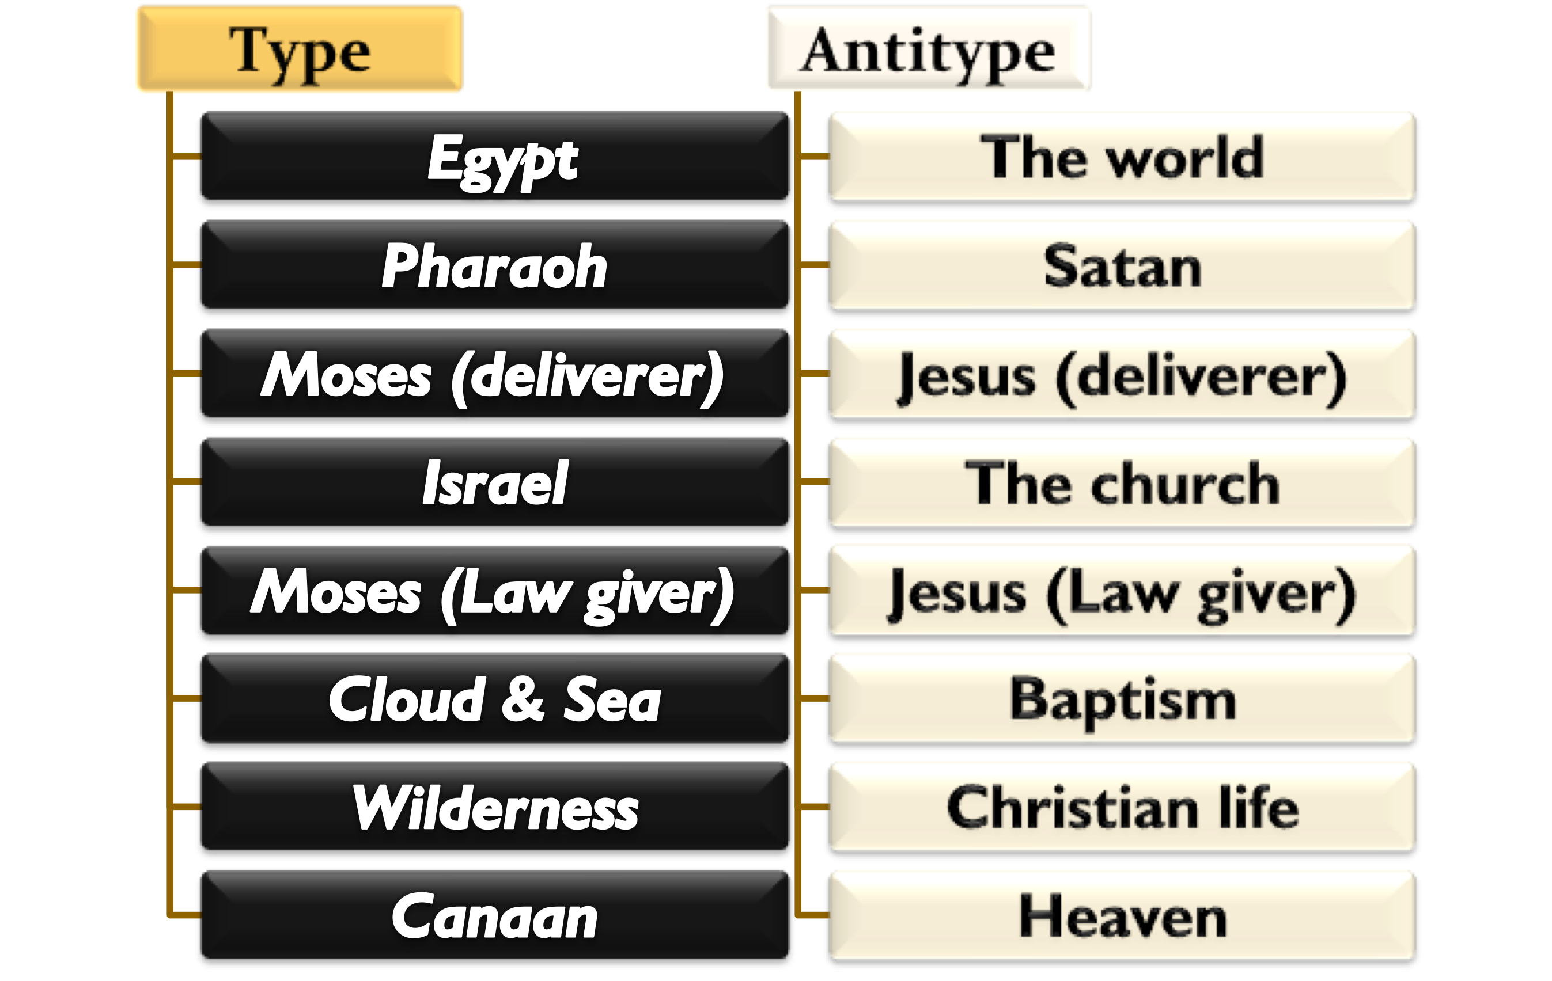
REDEEMED: Freed From Bondage of Sin
1 Corinthians 10:1–4 (NKJV)
¹ Moreover, brethren, I do not want you to be unaware that all our fathers were under the cloud, all passed through the sea, ² all were baptized into Moses in the cloud and in the sea, ³ all ate the same spiritual food, ⁴ and all drank the same spiritual drink. For they drank of that spiritual Rock that followed them, and that Rock was Christ.

Slide 20
REDEEMED: Freed From Bondage of Sin
Prior to baptism
After to baptism
One is a slave to sin – held captive by Satan (John 8:34; Rom. 6:16; 7:14-24; 2 Pet. 2:19; 1 John 3:8).
Living and operating in Satan’s realm of darkness (Eph. 2:1-4)
One is set free from sin (Romans 6:17-18; 3,7).
Delivered from the realm and bondage of Satan into the kingdom of Christ (Col. 1:13; Acts 26:18; 1 Peter 2:9)

Slide 21
SAVED: Delivered From Destruction
Corresponding to Noah’s salvation – ²¹ There is also an antitype which now saves us—baptism (not the removal of the filth of the flesh, but the answer of a good conscience toward God), through the resurrection of Jesus Christ, (1 Pet 3:21)
Different from the “fleshly ordinances imposed until the time of reformation” (Hebrews 9:9,10;10:22,23)

Slide 22
SAVED: Delivered From Destruction
Noah was saved (physically delivered) from God’s judgment by faith when he “moved with godly fear” and built the ark (Gen 6,7; Heb. 11:7)
We are spiritually delivered from God’s judgment upon a sinful world when we by faith are baptized into Christ through the His resurrection (Mark 16:16; 2 Thes 1:6-9)

Slide 23
SANCTIFICATION: ONE IS PLACED INTO CHRIST
Prior to baptism
After to baptism
Condemned with the wicked world (Eph. 2:1-4; 2 Pet. 3:1-9).
Facing the coming destruction for all not in Christ (Acts 17:30,31; Rom. 2:5-11; 2 Thes. 1:6-9;)
One is “translated” into the kingdom of light, i.e. of Christ (Col. 1:13-14)
Saved from the coming judgment, wrath, and condemnation (1 Pet 3:21; Mark 16:15,16)

Slide 24
Have you been Spiritual Cleansed by the blood of Christ? (Acts 22:16)
Are You A Child of God By Faith In Christ? (Gal. 3:26,27)
Have You Been Made Alive With Christ? (Col. 2:11-13; John 3:3-5)
Have You Been Freed From The Bondage of Sin? (1 Cor. 10:1-13)
Have You Been Delivered From Destruction? (1 Pet 3:21)

Slide 26
Charts by Don McClain
Preached January 29, 2011 / West 65th Street church of Christ
Preached June 30, 2024 @ Bryant church of Christ
Email – donmcclain@sbcglobal.net
More Keynote, PPT & Audio Sermons - w65stchurchofchrist.com

Slide 27
Romans 6:3–6 (NKJV)
³ Or do you not know that as many of us as were baptized into Christ Jesus were baptized into His death? ⁴ Therefore we were buried with Him through baptism into death, that just as Christ was raised from the dead by the glory of the Father, even so we also should walk in newness of life. ⁵ For if we have been united together in the likeness of His death, certainly we also shall be in the likeness of His resurrection, ⁶ knowing this, that our old man was crucified with Him, that the body of sin might be done away with, that we should no longer be slaves of sin.

