Slide 1
Genesis 6-9; Matthew 24:36–39; 1 Peter 3:18-21; 2 Peter 3:5-7

Slide 2
QUESTIONS OFTEN RAISED BY SKEPTICS
³ … scoffers will come in the last days …2 Peter 3:3
What evidence is there of a major flood?
Worldwide or Local?
Where Did All the Water Come From?
How Could the Ark Have Been Seaworthy?
How Could All the Animals Fit on the Ark?

Slide 3
Genesis 6:5–8 (NKJV)
⁵ Then the Lord saw that the wickedness of man was great in the earth, and that every intent of the thoughts of his heart was only evil continually. ⁶ And the Lord was sorry that He had made man on the earth, and He was grieved in His heart. ⁷ So the Lord said, “I will destroy man whom I have created from the face of the earth, both man and beast, creeping thing and birds of the air, for I am sorry that I have made them.” ⁸ But Noah found grace in the eyes of the Lord.

Slide 4
Genesis 6:13-17 (NKJV)
¹³ And God said to Noah, “The end of all flesh has come before Me, for the earth is filled with violence through them; and behold, I will destroy them with the earth … ¹⁷ And behold, I Myself am bringing floodwaters on the earth, to destroy from under heaven all flesh in which is the breath of life; everything that is on the earth shall die …

Slide 5
Genesis 7:4-12 (NKJV)
^{7:4} For after seven more days I will cause it to rain on the earth forty days and forty nights, and I will destroy from the face of the earth all living things that I have made … ¹⁰ And it came to pass after seven days that the waters of the flood were on the earth. ¹¹ In the six hundredth year of Noah’s life, in the second month, the seventeenth day of the month, on that day all the fountains of the great deep were broken up, and the windows of heaven were opened. ¹² And the rain was on the earth forty days and forty nights.

Slide 6
Genesis 7:16–24 (NKJV)
¹⁶ So those that entered, male and female of all flesh, went in as God had commanded him; and the Lord shut him in. ¹⁷ Now the flood was on the earth forty days. The waters increased and lifted up the ark, and it rose high above the earth. ¹⁸ The waters prevailed and greatly increased on the earth, and the ark moved about on the surface of the waters. ¹⁹ And the waters prevailed exceedingly on the earth, and all the high hills under the whole heaven were covered. ²⁰ The waters prevailed fifteen cubits upward, and the mountains were covered.

Slide 7
Genesis 7:16–24 (NKJV)
²¹ And all flesh died that moved on the earth: birds and cattle and beasts and every creeping thing that creeps on the earth, and every man. ²² All in whose nostrils was the breath of the spirit of life, all that was on the dry land, died. ²³ So He destroyed all living things which were on the face of the ground: both man and cattle, creeping thing and bird of the air. They were destroyed from the earth. Only Noah and those who were with him in the ark remained alive. ²⁴ And the waters prevailed on the earth one hundred and fifty days.

Slide 8
Matthew 24:36–39 (NKJV)
³⁶ “But of that day and hour no one knows, not even the angels of heaven, but My Father only. ³⁷ But as the days of Noah were, so also will the coming of the Son of Man be. ³⁸ For as in the days before the flood, they were eating and drinking, marrying and giving in marriage, until the day that Noah entered the ark, ³⁹ and did not know until the flood came and took them all away, so also will the coming of the Son of Man be.

Slide 9
Hebrews 11:7 (NKJV)
⁷ By faith Noah, being divinely warned of things not yet seen, moved with godly fear, prepared an ark for the saving of his household, by which he condemned the world and became heir of the righteousness which is according to faith.

Slide 10
1 Peter 3:18–20 (NKJV)
¹⁸ For Christ also suffered once for sins, the just for the unjust, that He might bring us to God, being put to death in the flesh but made alive by the Spirit, ¹⁹ by whom also He went and preached to the spirits in prison, ²⁰ who formerly were disobedient, when once the Divine longsuffering waited in the days of Noah, while the ark was being prepared, in which a few, that is, eight souls, were saved through water.

Slide 11
2 Peter 2:5 (NKJV)
⁵ and did not spare the ancient world, but saved Noah, one of eight people, a preacher of righteousness, bringing in the flood on the world of the ungodly;

Slide 12
2 Peter 3:5–7 (NKJV)
⁵ For this they willfully forget: that by the word of God the heavens were of old, and the earth standing out of water and in the water, ⁶ by which the world that then existed perished, being flooded with water. ⁷ But the heavens and the earth which are now preserved by the same word, are reserved for fire until the day of judgment and perdition of ungodly men.

Slide 13
Did It Happen? Worldwide or Local?
The Bible says it was worldwide (Genesis 6:7,13,17; 7:4,18-20; Mat. 24:36–39; Heb. 11:7; 1 Peter 3:18–20; 2 Peter 2:5; 3:5-7)

Slide 14
Did It Happen? Worldwide or Local?
The Bible says it was worldwide (Genesis 6:7,13,17; 7:4,18-20; Mat. 24:36–39; Heb. 11:7; 1 Peter 3:18–20; 2 Peter 2:5; 3:5-7)
Global sediment layers and fossils deposits (marine life mixed with land animals worldwide)

Slide 15
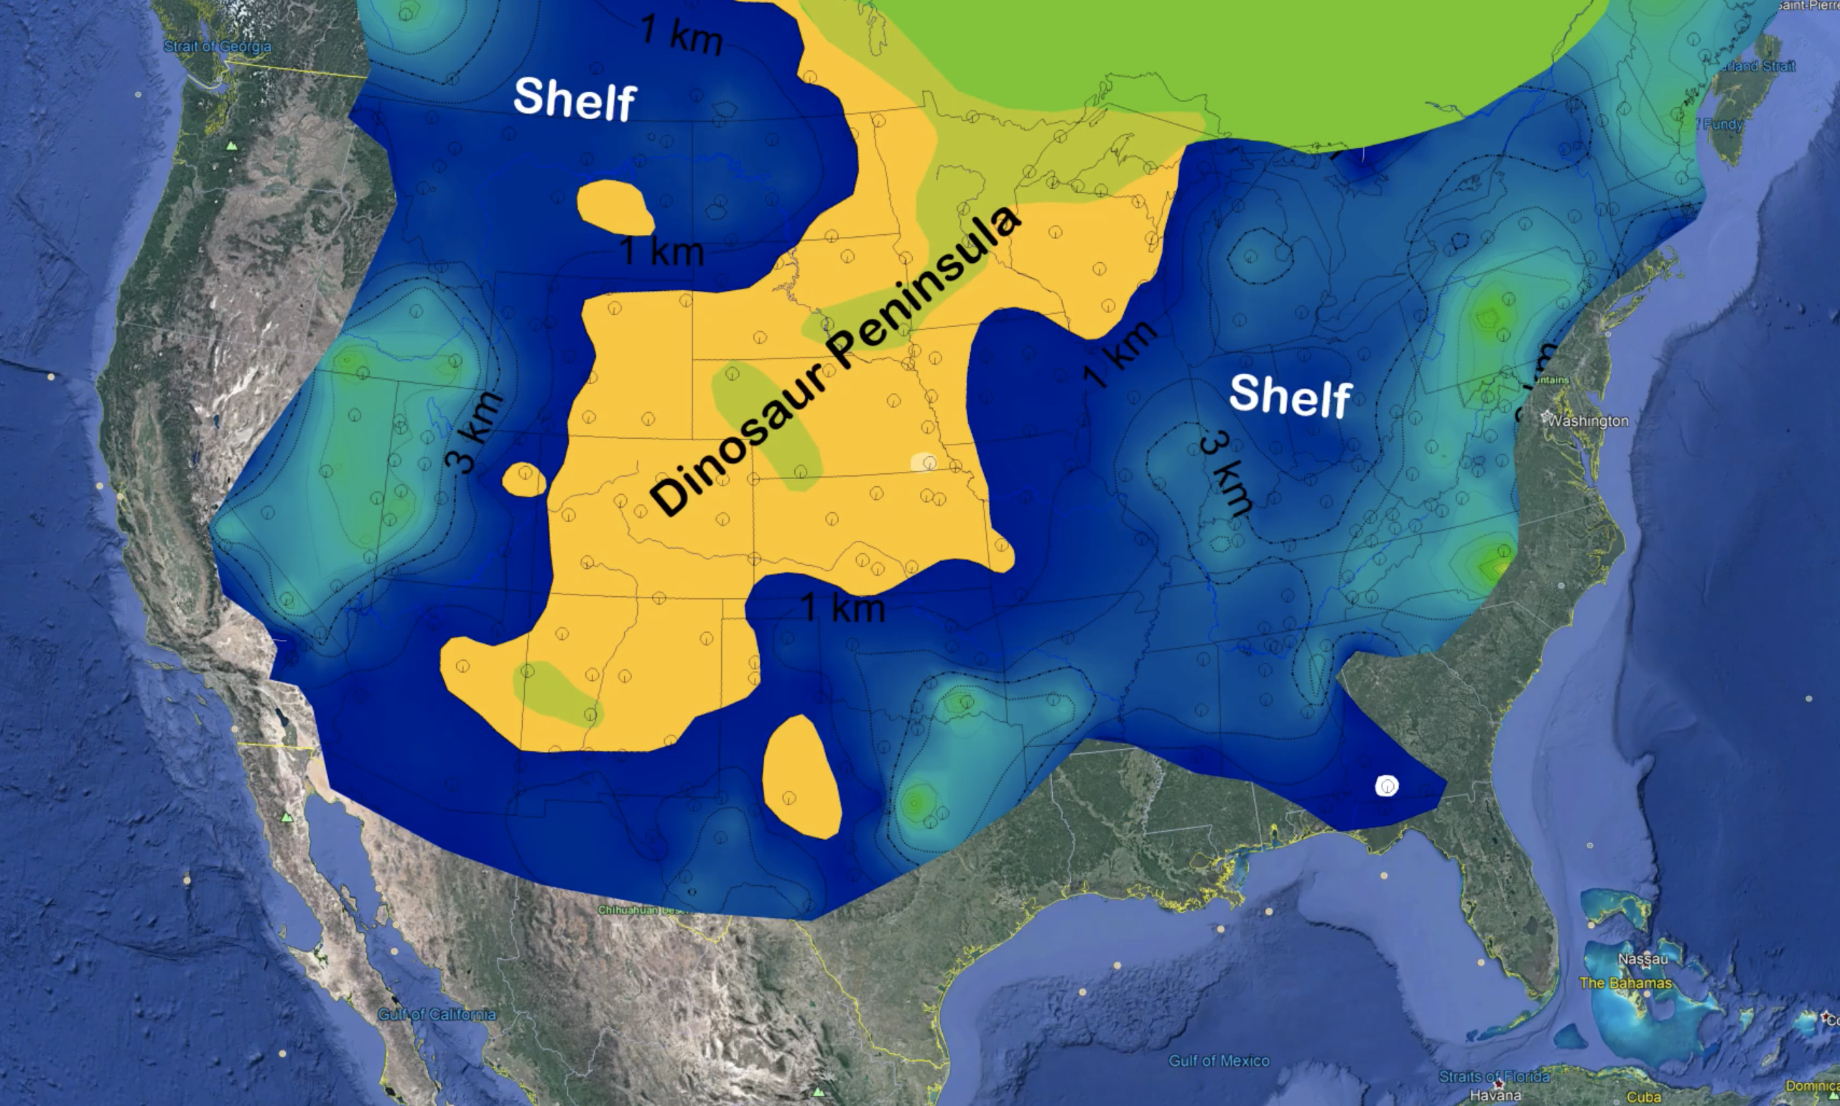

Slide 17
Did It Happen? Worldwide or Local?
The Bible says it was worldwide (Genesis 6:7,13,17; 7:4,18-20; Mat. 24:36–39; Heb. 11:7; 1 Peter 3:18–20; 2 Peter 2:5; 3:5-7)
Global sediment layers and fossils deposits (marine life mixed with land animals worldwide)
Formation of fossil fuel deposits …

Slide 18
THE CATASTROPHIC EVENT OF THE BIBLICAL FLOOD PROVIDES THE MOST REASONABLE EXPLANATION!

Slide 19
Did It Happen? Worldwide or Local?
The Bible says it was worldwide (Genesis 6:7,13,17; 7:4,18-20; Mat. 24:36–39; Heb. 11:7; 1 Peter 3:18–20; 2 Peter 2:5; 3:5-7)
Global sediment layers and fossils deposits (marine life mixed with land animals worldwide)
Formation of fossil fuel deposits …
Extra Biblical accounts …
The Epic of Gilgamesh
c. 2150 - 1400 BCE) the great Sumerian/Babylonian poetic work

Slide 20
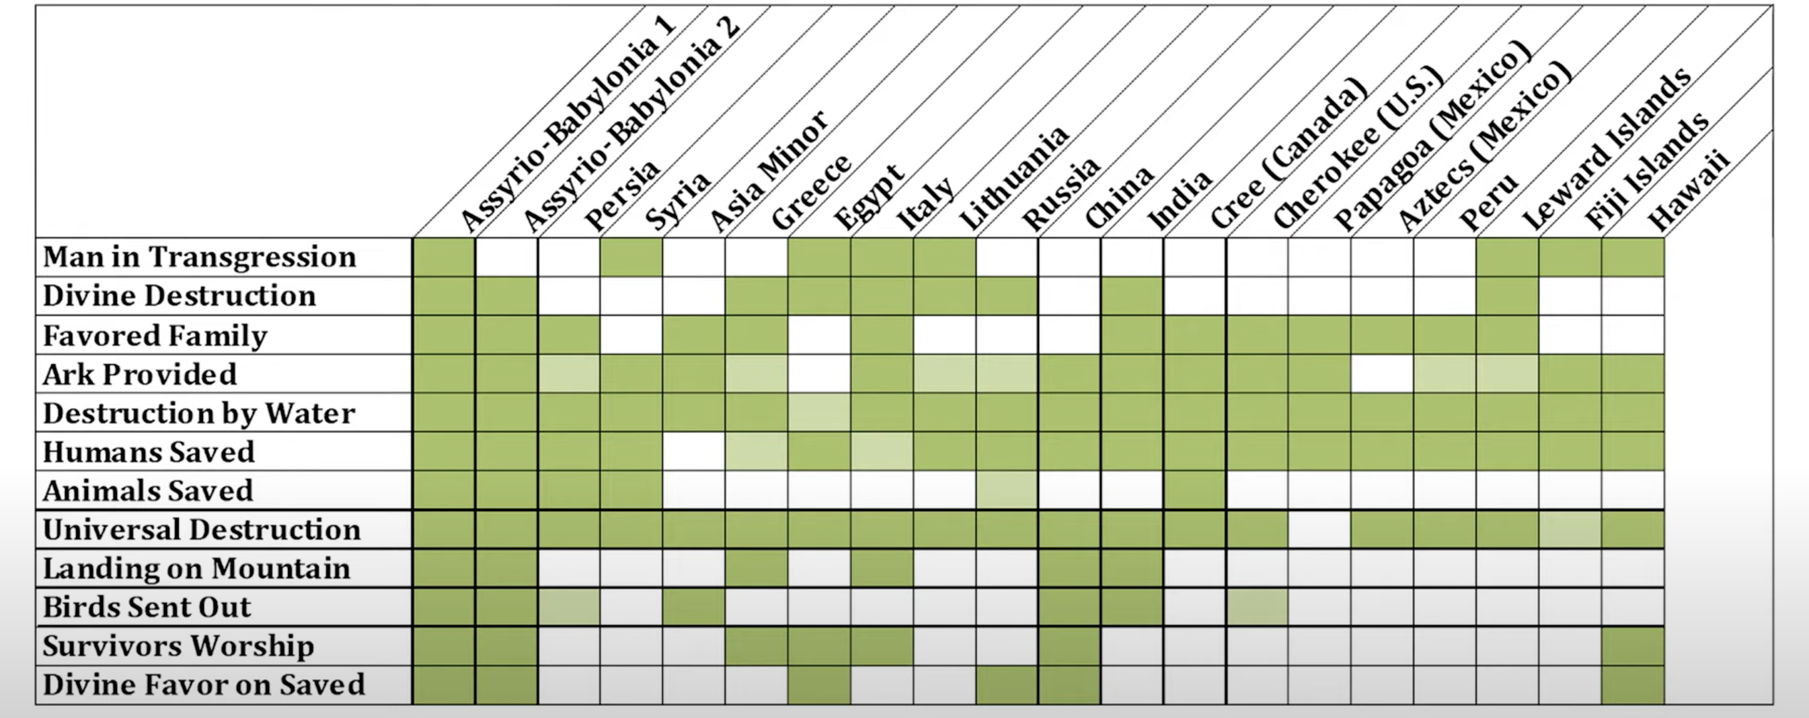
Did It Happen? Worldwide or Local?

Slide 21
Where Did All the Water Come From?
The Bible says “the fountains of the great deep were broken up, and the windows of heaven were opened.” (Genesis 7:11; cf. 8:2)
Water makes up about 71% of the Earth's surface, while the other 29% consists of continents and islands.

Slide 22
Where Did All the Water Come From?
a reasonable and plausible answer
Genesis 7:11 (NKJV)
¹¹ … on that day all the fountains of the great deep were broken up, and the windows of heaven were opened.
Fissures in the earth’s crust, causing massive amounts of steam to enter the atmosphere.
The rise of the ocean floor,
Plate tectonics, plate subduction, continental movement,
All producing huge tsunamis.

Slide 23
Apologetics Press
https://apologeticspress.org/what-happened-in-the-flood-5645/

Slide 25
How Could the Ark Have Been Seaworthy?
In 1993 Dr. Seon Won Hong conducted a scientific study which showed the Ark could have handled up to 100-foot waves.
The length-to-width ratio of the Ark (about 7-to-1) was ideal for such a massive, non-powered sea vessel, (Peter Jansen of Holland, 17th Century).
GOD’S PROTECTION!
Notes:
S.W. Hong, S. S. Na, B.S. Hyun, S.Y. Hong, D.S. Gong, K.J. Kang, S.H. Suh, K.H. Lee, & Y.G. Je, “Safety investigation of Noah’s Ark in a seaway,” Creation.com: www.creation.com/safety-investigation-of-noahs-ark-in-a-seaway (January 1, 2014). https://genesisapologetics.com/faqs/noahs-flood-how-could-the-ark-have-been-seaworthy/#_ednref5

Slide 26
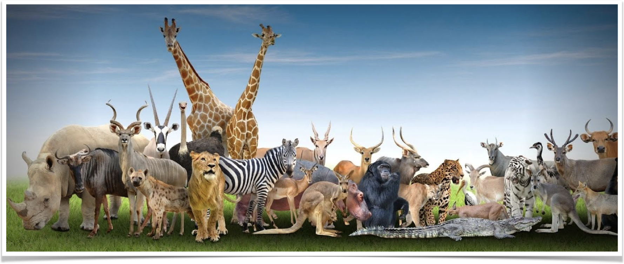
How Could All the Animals Fit on the Ark?
Notes:
S.W. Hong, S. S. Na, B.S. Hyun, S.Y. Hong, D.S. Gong, K.J. Kang, S.H. Suh, K.H. Lee, & Y.G. Je, “Safety investigation of Noah’s Ark in a seaway,” Creation.com: www.creation.com/safety-investigation-of-noahs-ark-in-a-seaway (January 1, 2014). https://genesisapologetics.com/faqs/noahs-flood-how-could-the-ark-have-been-seaworthy/#_ednref5

Slide 27
How Could All the Animals Fit on the Ark?
two of every sort into the ark, to keep them alive with you; they shall be male and female. ²⁰ Of the birds after their kind, of animals after their kind, and of every creeping thing of the earth after its kind (6:19,20)
The size given of the ark could contain the equivalent of 450 semi-trailers of cargo or about 1.88 million cubic feet (53,200 m3).
A generous estimate would be that there were around 1,400 animal kinds on the ark. That would mean there were fewer than 7,000 animals on board the ark.
What about dinosaurs, elephants, etc? Juveniles would take little space.
Notes:
S.W. Hong, S. S. Na, B.S. Hyun, S.Y. Hong, D.S. Gong, K.J. Kang, S.H. Suh, K.H. Lee, & Y.G. Je, “Safety investigation of Noah’s Ark in a seaway,” Creation.com: www.creation.com/safety-investigation-of-noahs-ark-in-a-seaway (January 1, 2014). https://genesisapologetics.com/faqs/noahs-flood-how-could-the-ark-have-been-seaworthy/#_ednref5

Slide 28
A MAJOR CATASTROPHIC EVENT
Second month, the seventeenth day of the month
Seventh month, the seventeenth day of the month
Second month, the twenty-seventh day of the month
150 DAYS
225 DAYS
Genesis 7:11 (NKJV)
¹¹ … on that day all the fountains of the great deep were broken up, and the windows of heaven were opened.
Genesis 8:2 (NKJV)
² The fountains of the deep and the windows of heaven were also stopped, and the rain from heaven was restrained.
Genesis 8:14 (NKJV)
¹⁴ … the earth was dried. ¹⁵ Then God spoke to Noah, saying, ¹⁶ “Go out of the ark,

Slide 31
“Where is the promise of His coming?”
2 Peter 3:3–4 (NKJV)
³ … scoffers will come in the last days, walking according to their own lusts, ⁴ and saying, “Where is the promise of His coming? For since the fathers fell asleep, all things continue as they were from the beginning of creation.”

Slide 32
“Where is the promise of His coming?”
2 Peter 3:5–6 (NKJV)
⁵ For this they willfully forget: that by the word of God the heavens were of old, and the earth standing out of water and in the water, ⁶ by which the world that then existed perished, being flooded with water.
They forgot about the past judgments of God (5,6; cf. 2:4-7)
God fulfilled His promise to judge the wickedness of men when he flooded the earth with water which He had previously created (5,6)

Slide 33
“Where is the promise of His coming?”
2 Peter 3:7 (NKJV)
⁷ But the heavens and the earth which are now preserved by the same word, are reserved for fire until the day of judgment and perdition of ungodly men.
DESTRUCTION WILL BE AS UNIVERSAL AS CREATION!
CREATION
VERSES 3,4
FLOOD
VERSES 5,6
COMING
VERSES 7,10-12
all continues just as it was from the beginning of creation.”
UNIVERSAL JUDGMENT WITH WATER
UNIVERSAL JUDGMENT WITH FIRE
DESTRUCTION WILL BE AS UNIVERSAL AS THE FLOOD!

Slide 34
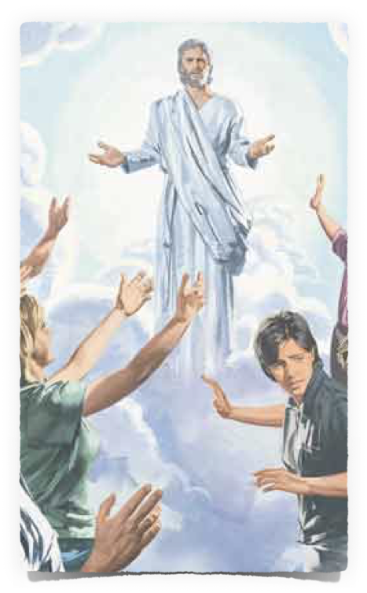
JESUS Is Coming AGAIN:
Matthew 24:36–39 (NKJV)
³⁶ “But of that day and hour no one knows, not even the angels of heaven, but My Father only. ³⁷ But as the days of Noah were, so also will the coming of the Son of Man be. ³⁸ For as in the days before the flood, they were eating and drinking, marrying and giving in marriage, until the day that Noah entered the ark, ³⁹ and did not know until the flood came and took them all away, so also will the coming of the Son of Man be.

Slide 35
JESUS Is Coming AGAIN:
Personally — Acts 1:11; 1 Thes. 4:16;
Visibly — Acts 1:11; Rev. 1:7
Audibly — 1 Thes. 4:16; 1 Cor. 15:52
With angels — 2 Thes. 1:7-9
With power & glory — 2 Thes. 1:7-10
To judge the world — Acts 17:30-33
Destroy present world & establish new heavens and new earth - 2 Pet. 3:10-13
Glorify Saints - Col. 3:4; Phil. 3:20-21

Slide 36
JESUS Is Coming AGAIN:
All will hear his voice and come forth (Jn 5:28,29; (2 Cor 5:10))
Every work will be brought into judgment / all made known / Judgment impartial (Eccl 12:7,13,14; Heb 4:13; Rom 2:5-12; Phili 2:9-11)
The righteous will receive everlasting life in heaven, but the wicked, everlasting punishment in hell (Matthew 25:46)

Slide 37
JESUS Is Coming AGAIN:
Requires intent – Mat 7:13,14
Requires faith – John 8:24; Heb 11:6
Requires repentance – Acts 17:30,31
Requires confession – Rom 10:9,10
Requires baptism & continued obedience – Mark 16:16; Acts 2:38; Rom. 6:3-6,16,17; Heb. 5:8,9
Requires purpose – Acts 11:23
Requires diligence – 2 Pet 3:5-11

Slide 38
JESUS Is Coming AGAIN:
2 Peter 3:14–15 (NKJV)
¹⁴ Therefore, beloved, looking forward to these things, be diligent to be found by Him in peace, without spot and blameless; ¹⁵ and consider that the longsuffering of our Lord is salvation—

Slide 39
JESUS Is Coming AGAIN:
We can mock the warnings of scripture . . . We can ignore the warnings of scripture . . . we can delay obedience, and be found unprepared . . . (2Pt 3:1-7)
OR — We can by faith heed the warnings & promises of God and humbly obey the gospel and be diligent in serving God (2Pt 3:8-14)

Slide 40
1 Peter 3:20–22 (NKJV)
²⁰ who formerly were disobedient, when once the Divine longsuffering waited in the days of Noah, while the ark was being prepared, in which a few, that is, eight souls, were saved through water. ²¹ There is also an antitype which now saves us—baptism (not the removal of the filth of the flesh, but the answer of a good conscience toward God), through the resurrection of Jesus Christ, ²² who has gone into heaven and is at the right hand of God, angels and authorities and powers having been made subject to Him.

Slide 42
Charts by Don McClain
Preached July 14, 2024, Bryant Church of Christ, 9500 AR 5, Alexander AR 72002
501-568-1062; 501-749-6928
Prepared using Keynote
Email – donmcclain@sbcglobal.net
More Keynote, PPT & Audio Sermons:
BRYANTCHURCHOFCHRIST.COM

Slide 43
2 Peter 3:1–7 (NKJV)
¹ Beloved, I now write to you this second epistle (in both of which I stir up your pure minds by way of reminder), ² that you may be mindful of the words which were spoken before by the holy prophets, and of the commandment of us, the apostles of the Lord and Savior, ³ knowing this first: that scoffers will come in the last days, walking according to their own lusts, ⁴ and saying, “Where is the promise of His coming?

Slide 44
2 Peter 3:1–7 (NKJV)
For since the fathers fell asleep, all things continue as they were from the beginning of creation.” ⁵ For this they willfully forget: that by the word of God the heavens were of old, and the earth standing out of water and in the water, ⁶ by which the world that then existed perished, being flooded with water. ⁷ But the heavens and the earth which are now preserved by the same word, are reserved for fire until the day of judgment and perdition of ungodly men.

Slide 45
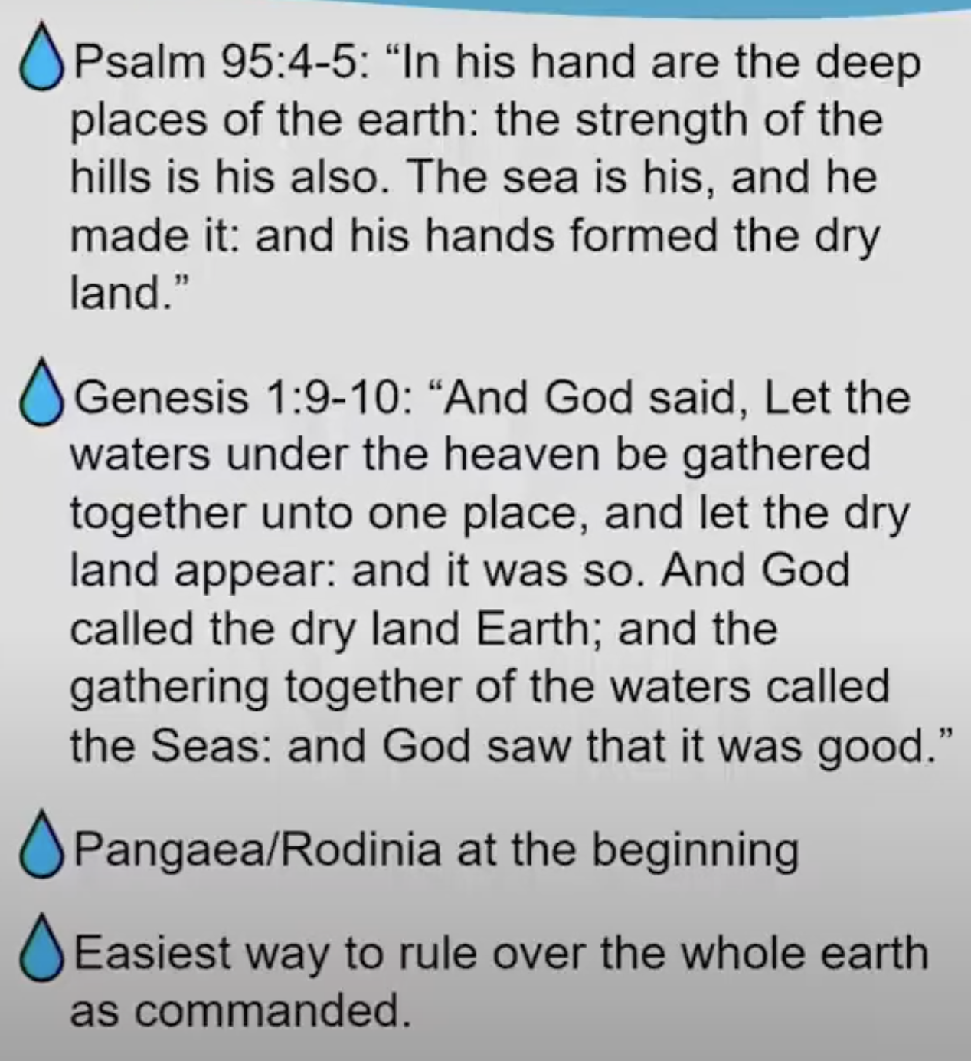
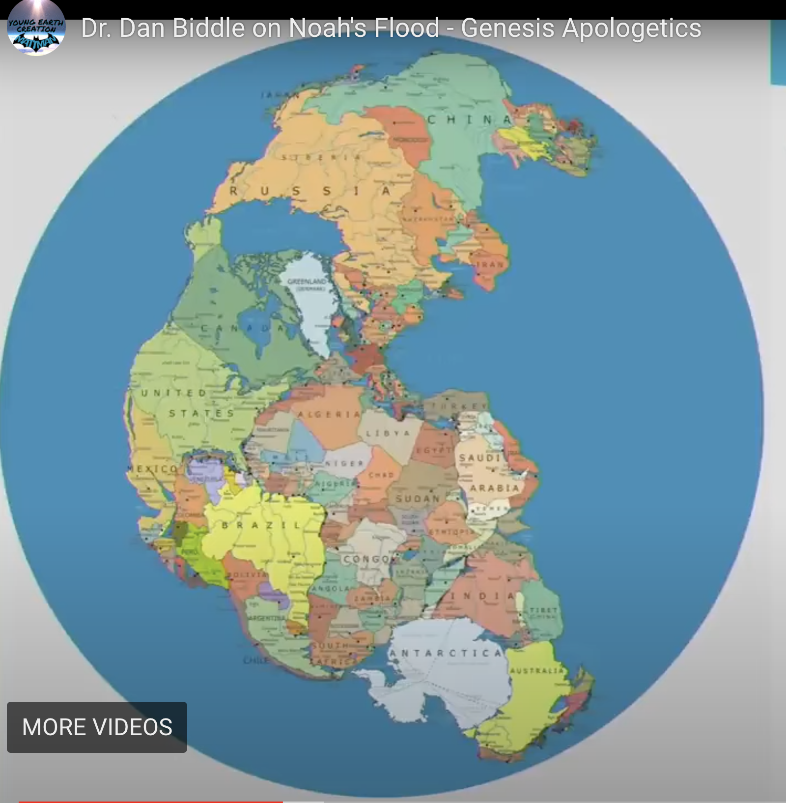

Slide 46
