Slide 1
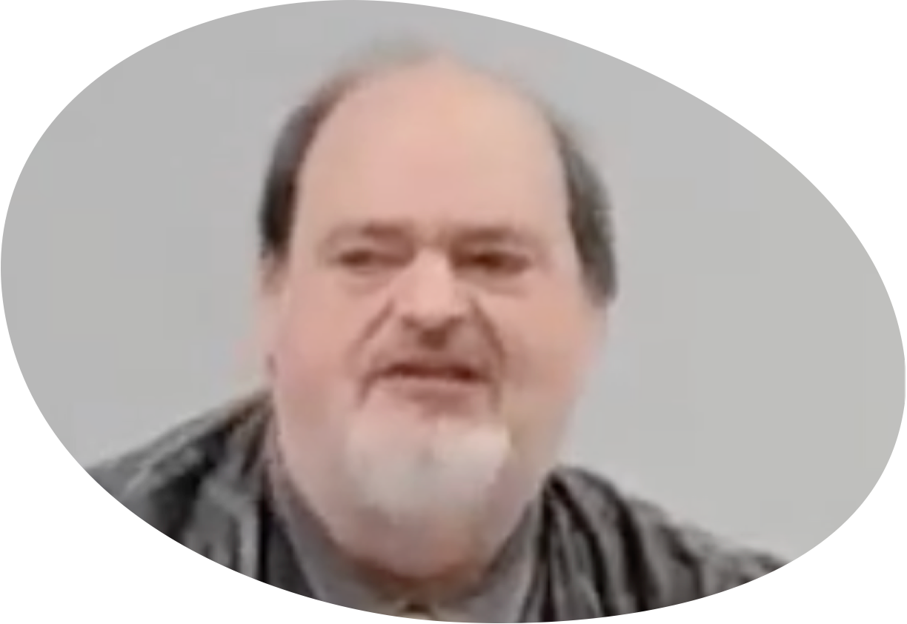
“Church of Christ MEETING @ 9500 AR 5, Alexander AR. 72002”
TODAY’S LESSON
Sunday Evening lesson live stream 4:00 PM ^{CT} February 11, 2024
https://www.youtube.com/user/donmcclain11/live / https://www.bryantchurchofchrist.com

Slide 2
CONDUCT IN THE HOUSE OF GOD
1 TIMOTHY 3:14-16

Slide 3
Timothy
Son of a Jewess and a Greek in Lystra Acts 16:1
Joined Paul on his second preaching trip 16:2-3; 1 Tim. 1:18; 4:14; Ephesians 4:11
Was despised because of youth 1 Cor. 16:10-11; 1 Tim. 4:12 this order includes Timothy himself
Did not attract persecutors’ attention Ac 16:19
Silas replaced Barnabas; Timothy replaced Mark

Slide 4
Timothy
Paul made Timothy his trainee 2 Tim. 2:2
Was sent to Thessalonica when Paul was in Achaia 1 Thess. 3:2
Was sent to Macedonia when Paul was in Ephesus Acts 19:22
Went with Paul to Troas Acts 20:4

Slide 5
Timothy
Was with Paul in Corinth when he wrote to the Romans Rom. 16:21
Was with Paul in Ephesus when he wrote to the Corinthians the second time 2 Cor. 1:1,8
Was with Paul in Rome when he wrote Colossians, Philippians, Philemon (verse 1 of each epistle)
In Ephesus when Paul wrote to him from Macedonia 1 Tim. 1:3

Slide 6
1 Timothy
Purpose for the letter: 2 Tim. 3:14-15
These things I write to you, though I hope to come to you shortly; 15 but if I am delayed, I write so that you may know how you ought to conduct yourself in the house of God, which is the church of the living God, the pillar and ground of the truth.

Slide 7
Simple Outline of 1 Timothy
Timothy’s Charge Concerning Doctrine 1:3-20
Conduct in the House of God 2:1-5:20
Worship 2:1-15
Organization 3:1-13
His relationship to the church 3:14-5:2
Support from the church 5:3-22
Timothy’s Charge Concerning Conduct 5:21-6:21

Slide 8
Charge Concerning Doctrine-1 Timothy 1:3-20
Charge others to teach no other teaching v.3
Limitations of the law (v.4-11) in contrast with the blessings of the gospel (v.11-17)
Law to educate need for love from pure heart, good conscience, sincere faith v.5
Law to restrain evildoers v.8-10
Blessings of Gospel v.11-17
Mercy in abundant grace with faith & love in Christ v.14
Ministry of gratitude and display of grace v.12
Charge to Timothy to fight the good fight v.18

Slide 9
Conduct in God’s House-1 Timothy 2:1-5:20
Worship 2:1-15
Prayer: what v.1-2, why v.3-7, how v.8
Conduct: holy hands v.8; Prov. 28:9
Attire: modest v.9
Attitude: propriety, sobriety, godliness, submission, quietness v.9-12
Fruit: good works v.10
Organization 3:1-13
Elders v.1-7
Deacons v.8-13

Slide 10
Conduct in God’s House-1 Timothy 2:1-5:20
Evangelist’s Responsibilities to the Church 3:14-5:2
Warning about apostasy 4:1-5
Instruct the brethren 4:6-11 (how to in 5:1-2)
Be an example to the believers 4:12-16
Support from the church 5:3-22
Qualified vs. unqualified widows v.2-16
Elders v.17-22
Honor for elders includes support v.17-18
Be fair, slow to accuse or judge v.19-20

Slide 11
Charge Concerning Conduct-1 Timothy 5:21-6:21
Don’t be prejudiced for or against any 5:21-22
Take care of yourself 5:23
By their actions you will know them 5:24-25
Teach responsibilities of slaves to masters 6:1-2
Withdraw from false teachers 6:3-10
Often motivated by money v.5-10
Pursue spiritual goals 6:11-16
Teach wealthy not to trust in riches 6:17-19
Guard the trust 6:20-21

