Slide 1
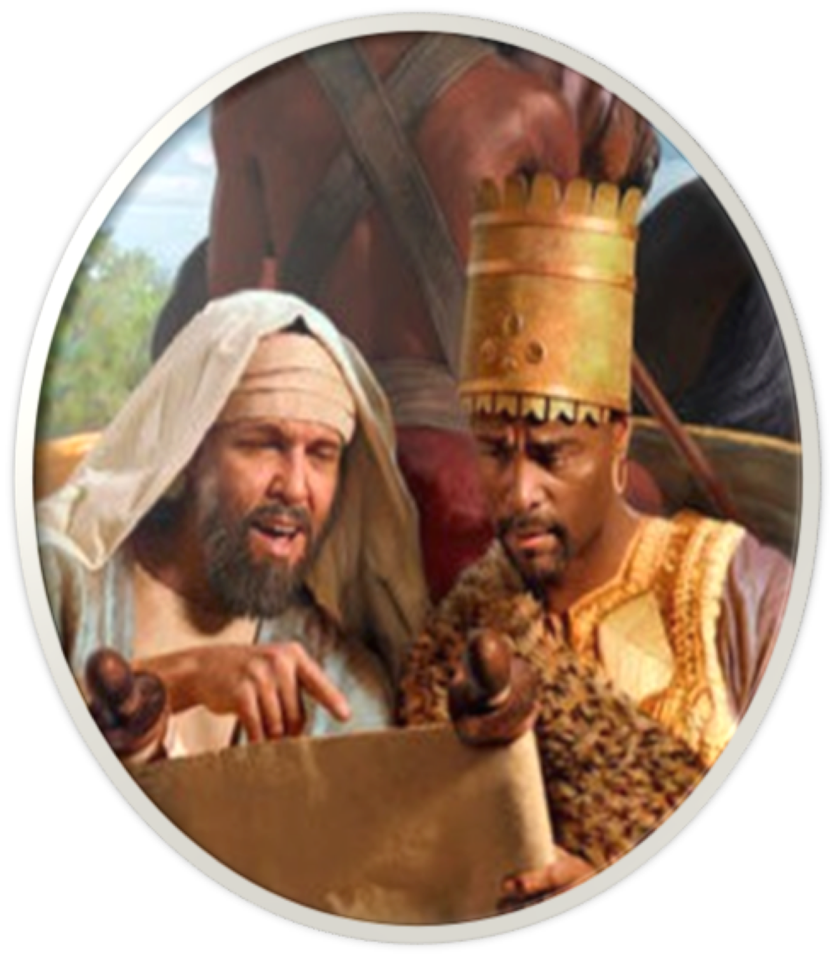
Lessons From The Conversion of The Ethiopian Eunuch
Acts 8:26-40

Slide 2
Lessons From The Conversion of The Ethiopian Eunuch
“HOW CAN I BE SAVED?”
THERE ARE MANY WRONG ANSWERS MEN GIVE TO THIS QUESTION :
SOME SAY: “NOTHING” (Atheist; Calvinist; universalist …)
SOME SAY: “SOMETHING” (but inaccurate or incomplete - Just Be good / Say Sinners prayer / Faith Only; just ask Jesus …)

Slide 3
Lessons From The Conversion of The Ethiopian Eunuch
Seeking The TRUTH …
How were people “SAVED” in the New Testament?
When were people “SAVED” according to the New Testament?
The TRUTH can be known and determined by examining ALL of the NT statements and examples regarding salvation.

Slide 4
Acts 8:26–40 (NKJV)
²⁶ Now an angel of the Lord spoke to Philip, saying, “Arise and go toward the south along the road which goes down from Jerusalem to Gaza.” This is desert. ²⁷ So he arose and went. And behold, a man of Ethiopia, a eunuch of great authority under Candace the queen of the Ethiopians, who had charge of all her treasury, and had come to Jerusalem to worship, ²⁸ was returning. And sitting in his chariot, he was reading Isaiah the prophet. ²⁹ Then the Spirit said to Philip, “Go near and overtake this chariot.” ³⁰ So Philip ran to him, and heard him reading the prophet Isaiah, and said, “Do you understand what you are reading?” ³¹ And he said, “How can I, unless someone guides me?” And he asked Philip to come up and sit with him.

Slide 5
Acts 8:26–40 (NKJV)
³² The place in the Scripture which he read was this: “He was led as a sheep to the slaughter; And as a lamb before its shearer is silent, So He opened not His mouth. ³³ In His humiliation His justice was taken away, And who will declare His generation? For His life is taken from the earth.” ³⁴ So the eunuch answered Philip and said, “I ask you, of whom does the prophet say this, of himself or of some other man?” ³⁵ Then Philip opened his mouth, and beginning at this Scripture, preached Jesus to him.

Slide 6
Acts 8:26–40 (NKJV)
³⁶ Now as they went down the road, they came to some water. And the eunuch said, “See, here is water. What hinders me from being baptized?” ³⁷ Then Philip said, “If you believe with all your heart, you may.” And he answered and said, “I believe that Jesus Christ is the Son of God.” ³⁸ So he commanded the chariot to stand still. And both Philip and the eunuch went down into the water, and he baptized him. ³⁹ Now when they came up out of the water, the Spirit of the Lord caught Philip away, so that the eunuch saw him no more; and he went on his way rejoicing. ⁴⁰ But Philip was found at Azotus. And passing through, he preached in all the cities till he came to Caesarea.

Slide 7
Lessons From The Conversion of The Ethiopian Eunuch
characters
Philip (Acts 6:5; 8:5-13)
Ethiopian Eunuch (Acts 8:26-40)
The Holy Spirit (John 14:26; 15:26; 16:7-14; 1 Cor. 2:10-13; Ep. 3:3-5)
Angel (vs. 26; Acts 10:3; Heb 1:4,6)

Slide 8
Lessons From The Conversion of The Ethiopian Eunuch
PHILLIP THE EVANGELIST
instructed by an angel & the Holy Spirit (26,29)
OBEYS INSTRUCTION (27,29,30)
preaches Christ to the Ethiopian STARTING from the O.T. scripture (30-35; Is. 53)
BAPTIZES The EUNUCH (36-39)

Slide 9
Lessons From The Conversion of The Ethiopian Eunuch
THE ROLE OF THE SPIRIT
Sent the preacher (29)
Had inspired the O.T. text which Phillip used (Is. 53:7,8; 1 Pt. 1:10-12; 2 Pt. 1:19-20
Did NOT MIRACULOUSLY NOR DIRECTLY CONVICT OR CONVERT THE EUNUCH, but used Phillip to explain the scripture & preach Christ (Rom. 10:17; 1 Pet. 1:22,23)

Slide 10
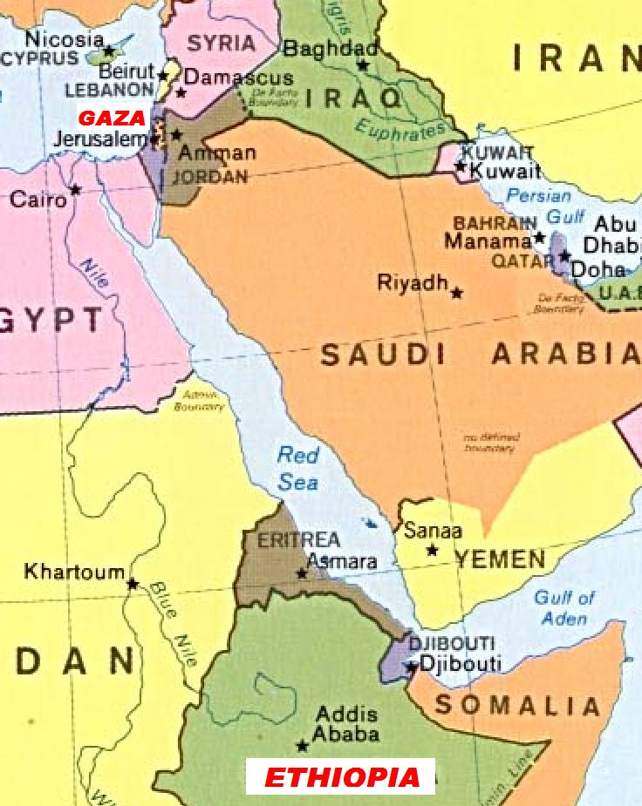
Lessons From The Conversion of The Ethiopian Eunuch
The Ethiopian Eunuch:
Honorable (27)
Religious (27)
A truth seeker (28)
humble (30,31,34)
WILLING TO LEARN (31, 34)
Over 1.000 Miles

Slide 11
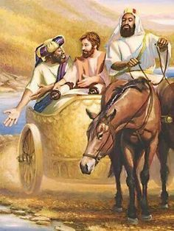
Lessons From The Conversion of The Ethiopian Eunuch
The Ethiopian Eunuch:
WILLING TO COMPLY (37)
OBEYS JESUS: CONFESSES JESUS AS THE CHRIST, THE SON OF GOD & IS BAPTIZED BY PHILLIP (38)
A joyful man (39)
³⁶ Now as they went down the road, they came to some water. And the eunuch said, “See, here is water. What hinders me from being baptized?”

Slide 12
Lessons From The Conversion of The Ethiopian Eunuch
ONE IS NOT SAVED JUST BY:
BEING RELIGIOUS & SINCERE
BEING ZEALOUS
GOING TO CHURCH
READING THE SCRIPTURES
HEARING THE TRUTH
INTELLECTUALLY ACCEPTING TRUTH

Slide 13
Lessons From The Conversion of The Ethiopian Eunuch
THing’s not taught HERE
(or anywhere else in the n.t.)
To pray and be saved …
To confess he was a sinner …
Tell experience & be voted on …
Sprinkling / pouring = baptism …
Baptism only an outward sign …
Be baptized to join denomination!

Slide 14
Lessons From The Conversion of The Ethiopian Eunuch
THing’s not taught HERE
(or anywhere else in the n.t.)
Direct operation of the Holy Spirit upon the heart of the sinner? – (30-37; John 16:13; Acts 2;3;8:12,13; 1 Cor. 1:18-23)
Holy Spirit must directly enlighten one in order for them to understand the scriptures? – (31,35; Ps. 119:97-104; Acts 17:11,12; Eph. 5:17; 3:3-5)

Slide 15
Lessons From The Conversion of The Ethiopian Eunuch
Faith ALONE … Ask Jesus to come into your heart . . . Say the sinners prayer!
There is ABSOLUTELY NOTHING you can do to be saved!
WHEN THERE ARE TWO OPPOSING OR CONTRADICTORY VIEWS -
BOTH CAN BE WRONG - BUT
BOTH CANNOT BE RIGHT

Slide 16
Lessons From The Conversion of The Ethiopian Eunuch
You must be born of water & the Spirit
John 3:5
“Baptism has nothing to do with salvation!”
The Bible doesn’t teach different ways for people to be saved!
TRUTH MATTERS!

Slide 17
Lessons From The Conversion of The Ethiopian Eunuch
He who believes and is baptized will be saved
Mark 16:16
“Baptism has nothing to do with salvation!”
The Bible doesn’t teach different ways for people to be saved!
TRUTH MATTERS!

Slide 18
Lessons From The Conversion of The Ethiopian Eunuch
Repent, and let every one of you be baptized in the name of Jesus Christ for the remission of sins - Acts 2:38
“Baptism has nothing to do with salvation!”
The Bible doesn’t teach different ways for people to be saved!
TRUTH MATTERS!

Slide 19
Lessons From The Conversion of The Ethiopian Eunuch
47 “Can anyone forbid water, … 48 And he commanded them to be baptized in the name of the Lord. - Acts 10:47,28, cf. 43
“Baptism has nothing to do with salvation!”
The Bible doesn’t teach different ways for people to be saved!
TRUTH MATTERS!

Slide 20
Lessons From The Conversion of The Ethiopian Eunuch
There is also an antitype which now saves us—baptism
1 Peter 3:21
“Baptism has nothing to do with salvation!”
The Bible doesn’t teach different ways for people to be saved!
TRUTH MATTERS!

Slide 21
Lessons From The Conversion of The Ethiopian Eunuch
“for as many of you as have been baptized into Christ …”
Rom. 6:3-6; Gal. 3:26,27
“Baptism has nothing to do with salvation!”
The Bible doesn’t teach different ways for people to be saved!
TRUTH MATTERS!

Slide 22
Lessons From The Conversion of The Ethiopian Eunuch
“buried with Him in baptism, in which you also were raised with Him through faith in the working of God …” Col. 2:12,13
“Baptism has nothing to do with salvation!”
The Bible doesn’t teach different ways for people to be saved!
TRUTH MATTERS!

Slide 23
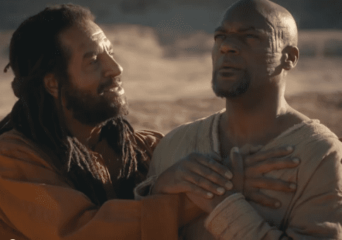
Lessons From The Conversion of The Ethiopian Eunuch
WHEN THE EUNUCH WAS BAPTIZED
He was saved (Acts 16:32; Mark 16:16; 1 Pet. 3:21)
He had his sins forgiven (Acts 2:37,38; 9:6; 22:10,16; Col. 2:12,13)
He entered into Christ, i.e., into His body which is His church (Rom. 6:3; Gal. 3:27; Acts 2:47; 1 Cor. 12:13; Eph. 1:3-13, 22,23; 5:26)
³⁸ … And both Philip and the eunuch went down into the water, and he baptized him.

Slide 24
Lessons From The Conversion of The Ethiopian Eunuch
WHEN THE EUNUCH WAS BAPTIZED
He received the benefits of Christ’s death (Rom. 6:3; Col. 2:12,13)
He put on Jesus Christ (Rom 6:3,4; Gal 3:26,27)
He became a child of God by faith (John 3:3-5; Gal 3:26,27)
³⁸ … And both Philip and the eunuch went down into the water, and he baptized him.

Slide 25
Lessons From The Conversion of The Ethiopian Eunuch
WHEN THE EUNUCH WAS BAPTIZED
He became a citizen of Jesus’s kingdom (John 3:5; Col. 1:13)
He became a disciple of Jesus (Mat 28:18-20; Acts 2:41,42)
He became a Christian! (Acts 11:26; Rom 6:3-6)
³⁸ … And both Philip and the eunuch went down into the water, and he baptized him.

Slide 26
Lessons From The Conversion of The Ethiopian Eunuch
Examples
Pentecost – 2:14-41
Samaria – 8:5-13
Eunuch – 8:35-39
Saul – 9,22,26
Cornelius - 10:34-48
Lydia – 16:13-15
Jailor – 16:30-34
Corinthians - 18:8
Ephesians - 19:3-5
Believed
Implied
12
36,37
Implied
43
14
31
8
Implied
Repented
37,38
Implied
Implied
Implied
Implied
Implied
Implied
Implied
Implied
Confessed
Implied
Implied
37
Implied
Implied
Implied
Implied
Implied
Implied
Baptized
38,41
12,13
38
22:16
48
15
33
8
5

Slide 27
Lessons From The Conversion of The Ethiopian Eunuch
PREACHING CHRIST INCLUDES PREACHING ABOUT THE KINGDOM, THE NAME OF CHRIST & BAPTISM (36; 2:21-41; 8:5,12,13,14,16; MAT. 28:19; MK 16:15,16)

Slide 28
Lessons From The Conversion of The Ethiopian Eunuch
bAPTISM IN THE NAME OF CHRIST AND OF THE GREAT COMMISSION IS IMMERSION IN WATER
(36-39; 2:38,41; 10:43, 47,48; 19:5; MAT. 28:19; MK 16:15,16; Eph. 4:5)

Slide 29
Lessons From The Conversion of The Ethiopian Eunuch
Before one can be scripturally baptized one must believe Jesus is the christ, the son of god!
(37; MAT. 28:19; MK 16:15,16; Acts 8:12,13; 16:32,33)

Slide 30
Lessons From The Conversion of The Ethiopian Eunuch
BAPTISM (IMMERSION IN WATER) WAS ALWAYS AN IMMEDIATE RESPONSE TO THE GOSPEL - NEVER DELAYED
(36-38; Acts 2:38-41; 8:12,13; 10:43,47,48; 16:32,33; 19:4,5; 22:16)

Slide 31
Lessons From The Conversion of The Ethiopian Eunuch
ONE MUST BE BAPTIZED INTO CHRIST TO BE SAVED
(Merely believing in God, worshipping God, being zealous, sincere and good is NOT enough!)
(27-39; Acts 2:1-41; 4:12; 10:1-48; 16:13-15; 19:4,5; 22:1-16; Jn 14:6)

Slide 32
Lessons From The Conversion of The Ethiopian Eunuch
Romans 6:3–4 (NKJV)
³ Or do you not know that as many of us as were baptized into Christ Jesus were baptized into His death? ⁴ Therefore we were buried with Him through baptism into death, that just as Christ was raised from the dead by the glory of the Father, even so we also should walk in newness of life.

Slide 33
Lessons From The Conversion of The Ethiopian Eunuch
Colossians 2:12–13 (NKJV)
¹² buried with Him in baptism, in which you also were raised with Him through faith in the working of God, who raised Him from the dead. ¹³ And you, being dead in your trespasses and the uncircumcision of your flesh, He has made alive together with Him, having forgiven you all trespasses,

Slide 34
Lessons From The Conversion of The Ethiopian Eunuch
Galatians 3:26–27 (NKJV)
²⁶ For you are all sons of God through faith in Christ Jesus. ²⁷ For as many of you as were baptized into Christ have put on Christ.

Slide 35
Lessons From The Conversion of The Ethiopian Eunuch
1 Peter 3:21 (NKJV)
²¹ There is also an antitype which now saves us—baptism (not the removal of the filth of the flesh, but the answer of a good conscience toward God), through the resurrection of Jesus Christ,

Slide 36
Acts 8:26-40
Lessons From The Conversion of The Ethiopian Eunuch
Believe, repent, confess, and be baptized into Christ – Mark 16:16; Acts 2:38; Rom. 10:9; Rom. 6:3-6; Col. 2:11-13
Are you receptive to the truth like the Eunuch!
Will you Believe, repent, confess and be baptized like the Eunuch!

Slide 37
Acts 8:26-40
Lessons From The Conversion of The Ethiopian Eunuch
WHAT HINDERS YOU?
Will you leave here this morning rejoicing like the Eunuch?

Slide 39
Acts 8:26-40
Lessons From The Conversion of The Ethiopian Eunuch
Charts by Don McClain
Preached August 1, 2021 / West 65th Street church of Christ /
Preached January 28, 2024 / Bryant church of Christ / 9500 AR 5, Bryant AR 72002
Phone: 501-568-1062 / Email – donmcclain@sbcglobal.net
More Keynote, PPT & Audio Sermons
w65stchurchofchrist.com

Slide 40
Acts 8:4–13 (NKJV)
⁴ Therefore those who were scattered went everywhere preaching the word. ⁵ Then Philip went down to the city of Samaria and preached Christ to them. ⁶ And the multitudes with one accord heeded the things spoken by Philip, hearing and seeing the miracles which he did. ⁷ For unclean spirits, crying with a loud voice, came out of many who were possessed; and many who were paralyzed and lame were healed. ⁸ And there was great joy in that city. ⁹ But there was a certain man called Simon, who previously practiced sorcery in the city and astonished the people of Samaria, claiming that he was someone great,

Slide 41
Acts 8:4–13 (NKJV)
¹⁰ to whom they all gave heed, from the least to the greatest, saying, “This man is the great power of God.” ¹¹ And they heeded him because he had astonished them with his sorceries for a long time. ¹² But when they believed Philip as he preached the things concerning the kingdom of God and the name of Jesus Christ, both men and women were baptized. ¹³ Then Simon himself also believed; and when he was baptized he continued with Philip, and was amazed, seeing the miracles and signs which were done.

