Slide 1
GODLINESS

Slide 2
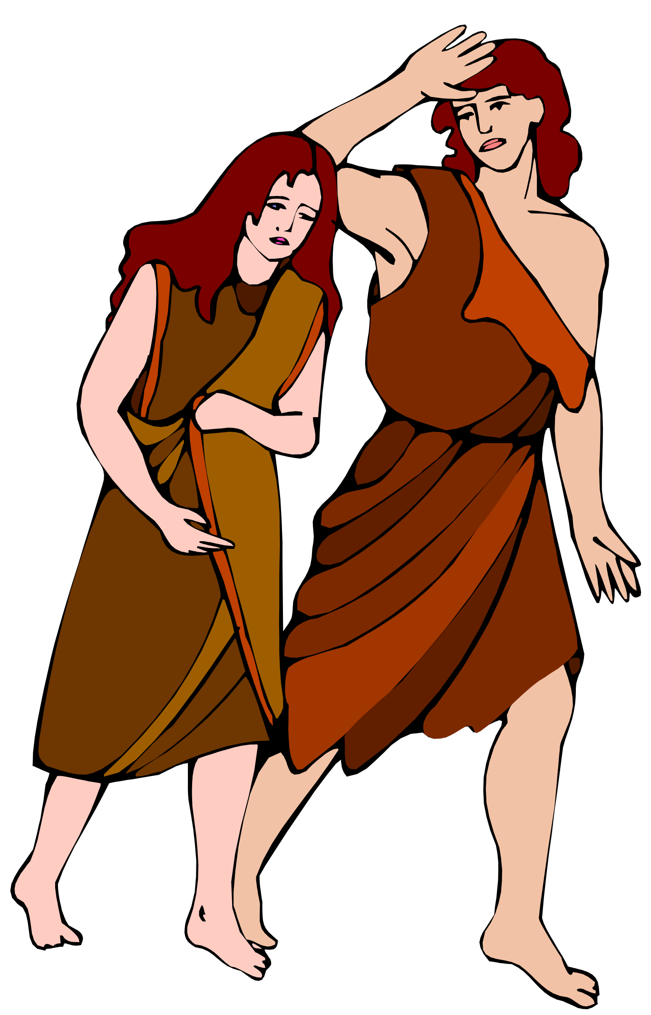
Does The Bible Give Guidelines On How We Should Dress In Public?
Genesis 3:7 (NKJV)
⁷ Then the eyes of both of them were opened, and they knew that they were naked; and they sewed fig leaves together and made themselves coverings. …
Genesis 3:10–11 (NKJV)
¹⁰ So he said, “I heard Your voice in the garden, and I was afraid because I was naked; and I hid myself.” ¹¹ And He said, “Who told you that you were naked? Have you eaten from the tree of which I commanded you that you should not eat?”
Genesis 3:21 (NKJV)
²¹ Also for Adam and his wife the Lord God made tunics of skin, and clothed them.
Apron
V. 7 Naked (Nude)
V. 10,11,21
Not Sufficiently Clothed

Slide 3
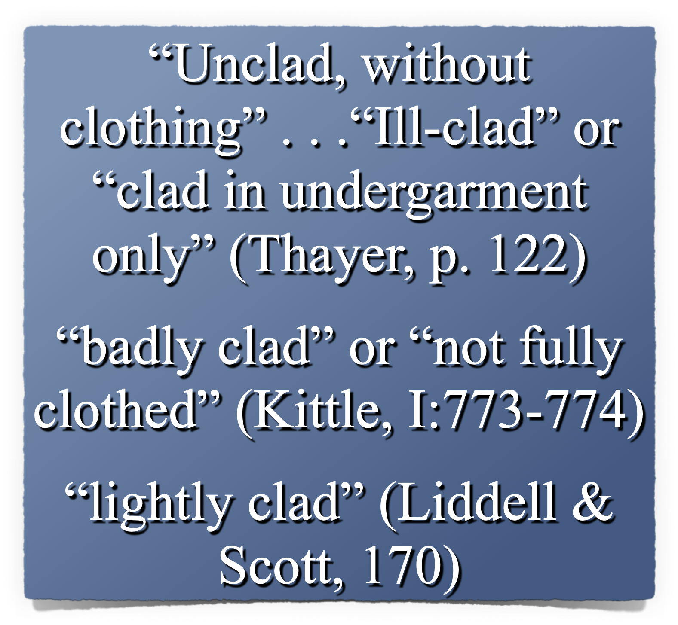
Does The Bible Give Guidelines On How We Should Dress In Public?
V. 7 (Nude)
Apron
V. 10,11,21
Not Sufficiently Clothed
Still Naked

Slide 4
Does The Bible Give Guidelines On How We Should Dress In Public?
4189 כֻּתֹּנֶת (kǔt·tō·něṯ): n.fem.; ≡ Str 3801; TWOT 1058a—1. LN 6.152–6.187 tunic, garment, i.e., clothing as a covering more complete than a loincloth, a basic garment reaching the knees and so a common garment for common wear and work (Ge 3:21; SS 5:3)
Swanson, J. (1997). Dictionary of Biblical Languages with Semantic Domains : Hebrew (Old Testament) (electronic ed.). Oak Harbor: Logos Research Systems, Inc.

Slide 5
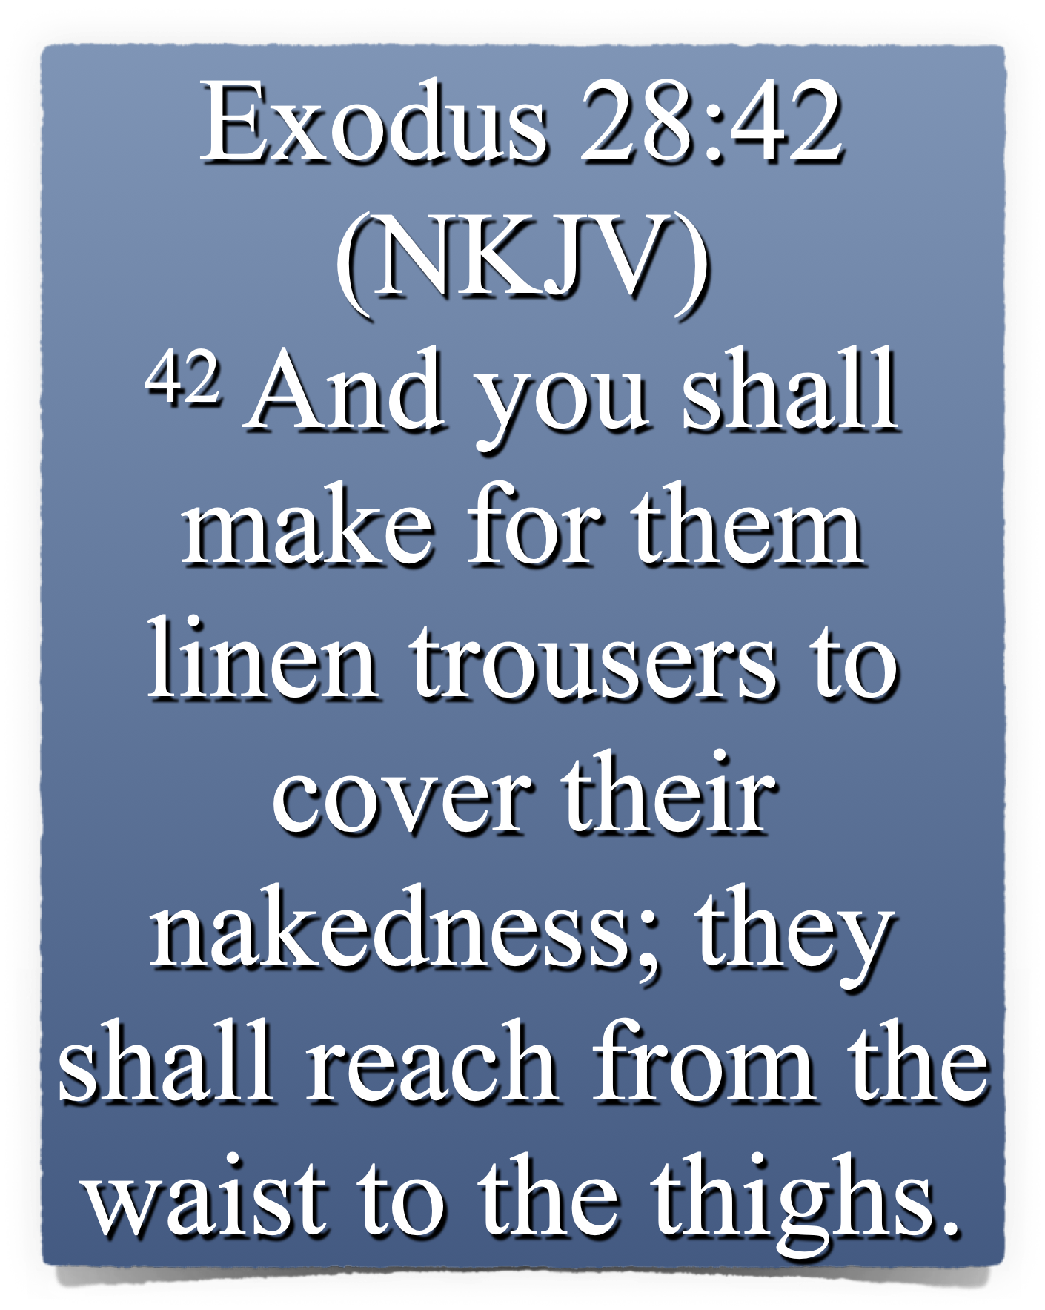
Does The Bible Give Guidelines On How We Should Dress In Public?

Slide 6
Biblical Principles Governing Dress!
1 Peter 3:1–4 (NKJV)
¹ Wives, … ² when they observe your chaste conduct accompanied by fear. ³ Do not let your adornment be merely outward—arranging the hair, wearing gold, or putting on fine apparel—⁴ rather let it be the hidden person of the heart, with the incorruptible beauty of a gentle and quiet spirit, which is very precious in the sight of God.

Slide 7
Biblical Principles Governing Dress!
Titus 2:3–5 (NKJV)
³ the older women likewise, that they be reverent in behavior, not slanderers, not given to much wine, teachers of good things—⁴ that they admonish the young women to love their husbands, to love their children, ⁵ to be discreet, chaste, homemakers, good, obedient to their own husbands, that the word of God may not be blasphemed.

Slide 8
Biblical Principles Governing Dress!
1 Timothy 2:9–10 (NKJV)
⁹ in like manner also, that the women adorn themselves in modest apparel, with propriety and moderation, not with braided hair or gold or pearls or costly clothing, ¹⁰ but, which is proper for women professing godliness, with good works.

Slide 9
Biblical Principles Governing Dress!
"Respectable; honorable" (Arndt and Gingrich, 445).
"Orderly; well-arranged; decent" (Vines)
"The well-ordering is not of dress and demeanor only, but the inner life’s uttering indeed, and expressing itself in the outward conversation" (Trench’s Syn. 346).

Slide 10
Biblical Principles Governing Dress!
“In simple attire which doesn’t attract attention.” — The People’s New Testament Commentary
“An appearance that is simple, moderate, judicious, and free from ostentation. . . . Christians must be careful about letting a pagan culture set their fashions.” — BKC

Slide 11
Biblical Principles Governing Dress!
Reserved (not aggressive)
Humble (not ostentatious)
Respectable (not dishonorable)
Decent (not revealing)
Orderly (not chaotic / wild)

Slide 12
Biblical Principles Governing Dress!
(aidos) (αἰδώς, 127), “a sense of shame, modesty,” is used regarding the demeanor of women in the church, 1 Tim. 2:9 — Shamefastness is that modesty which is ‘fast’ or rooted in the character (Vine’s Complete Expository Dictionary of Old and New Testament Words (Vol. 2, p. 568).
(aidos) – “bashfulness, reverence, regard for others, respect” - "A sense of shame” (Thayer, 14).
MANY have lost the ability to blush! (Jer. 6:15; 8:12)

Slide 13
Biblical Principles Governing Dress!
sophrosune (σωφροσύνη, 4997) denotes “soundness of mind”, Acts 26:25, “soberness”; 1 Tim. 2:9, 15, “sobriety”; “sound judgment” practically expresses the meaning; “it is that habitual inner self-government, with its constant rein on all the passions and desires, which would hinder the temptation to these from arising, or at all events from arising in such strength as would overbear the checks and barriers which aidos (shamefastness) opposed to it” (Trench Syn. Sec.xx, end) (Vine’s Complete Expository Dictionary of Old and New Testament Words (Vol. 2, p. 583).

Slide 14
Biblical Principles Governing Dress!
88.93 σωφρονισμόςb, οῦ m; σωφροσύνηb, ης f: to behave in a sensible manner, with the implication of thoughtful awareness of what is best—‘moderation, sensibility.’ (Louw, J. P., & Nida, E. A. (1996). Greek-English lexicon of the New Testament: based on semantic domains (electronic ed. of the 2nd edition., Vol. 1, p. 752).
To behave discreetly, to be in harmony with the will of God, being thoughtful of how our actions affect others.

Slide 15
Biblical Principles Governing Dress!
theosebeia (θεοσέβεια, 2317) denotes “the fear or reverence of God,” (Vine’s Complete Expository Dictionary of Old and New Testament Words (Vol. 2, p. 273).
53.1 θρησκεία, … f: appropriate beliefs and devout practice of obligations relating to supernatural persons and powers—‘religion, piety.’ … ‘if he does not control his tongue, he deceives himself, and his religion is worthless’ Jas 1:26. (Louw, J. P., & Nida, E. A. (1996). Greek-English lexicon of the New Testament: based on semantic domains)

Slide 16
Biblical Principles Governing Dress!
Attention Drawing APPAREL
Wearing fancy clothes & jewelry in order to make a fashion statement! (1 Tim 2:9; 1 Pet 3:2)
It CAN BE just as IMMODEST to go to the other extreme FOR the PURPOSE of drawing attention to ourselves!
Immodesty is a pride issue. —“Look how RICH I am,” or, “Look how trendy I am,” or “Look how pretty I am,” or “LOOK HOW GODLY I AM.”

Slide 17
Biblical Principles Governing Dress!
REVEALING APPAREL - When a woman wears short shorts, low cut dresses, mini skirts, bikinis — she is communicating pride in her body. — When a man goes without a shirt & wears short shorts, he too is communicating pride.
Christians should NOT conduct themselves in such a way!

Slide 18
Biblical Principles Governing Dress!
REVEALING APPAREL -
Too short, (revealing the thighs).
Too low off the shoulders, (showing cleavage/ chest/ back).
Too sheer (can see through).
Too tight (Too suggestive - leaving nothing for the imagination).

Slide 19
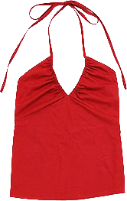
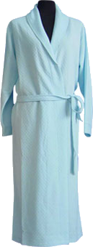
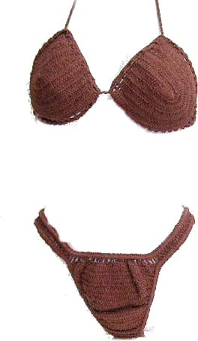
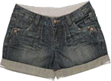
Biblical Principles Governing Dress!
I’m dressed – I’ll get it
Someone’s at the door – Could someone answer it – I’m not dressed!
It’s probably my friends – we are going to Magic Springs

Slide 20
Biblical Principles Governing Dress!
REVEALING APPAREL -
“I look good in this and I’m going to wear it REGARDLESS of how it affects others.” (Rom 12:3,9,10; 13:10)
“I WANT THE OPPOSITE SEX TO NOTICE ME” (Mat 5:28-30; 18:6-10)
“Everyone else is wearing this” (Exo. 23:2; Prov. 1:10, 11, 15; 4:14)
RevealS your Ungodliness & PRIDE!

Slide 21
Biblical Principles Governing Dress!
The Christian woman’s attire should be her “good works.”
“The hidden person of the heart, with the incorruptible beauty of a gentle and quiet spirit, which is very precious in the sight of God.” (1 Pet 3:4)
“Loving their husbands, their children, homemakers, good, obedient to their own husbands, that the word of God may not be blasphemed.” (Tit 2:4,5)

Slide 22
Biblical Principles Governing Dress!
Note To Parents -
Begin early! Don’t allow immodesty until 12 or 13, and then expect sudden correction.
Teach your children; or the WORLD will!
Teach children in both word & deed - - inconsistency is destructive!
Mothers, do not undermine godly husbands & fathers as they teach.

Slide 23
Biblical Principles Governing Dress!
BETTER Than
others

Slide 24
Biblical Principles Governing Dress!
SEXY

Slide 25
Biblical Principles Governing Dress!

Slide 26
Biblical Principles Governing Dress!

Slide 27
Biblical Principles Governing Dress!
Be Modest – reserved, decent, respectable
Exhibit Propriety – have shame, discretion
Use Good Judgment – Think of others
Show Godliness – devoted to God / Holiness
Respect Others – If someone stumbles over your beauty, let it not be your fault!

Slide 28
Biblical Principles Governing Dress!

Slide 29
Biblical Principles Governing Dress!
GODLY

Slide 31
Biblical Principles Governing Dress!

Slide 32
1 Timothy 2:8–15 (NKJV)
⁸ I desire therefore that the men pray everywhere, lifting up holy hands, without wrath and doubting; ⁹ in like manner also, that the women adorn themselves in modest apparel, with propriety and moderation, not with braided hair or gold or pearls or costly clothing, ¹⁰ but, which is proper for women professing godliness, with good works. ¹¹ Let a woman learn in silence with all submission.

Slide 33
1 Timothy 2:8–15 (NKJV)
¹² And I do not permit a woman to teach or to have authority over a man, but to be in silence. ¹³ For Adam was formed first, then Eve. ¹⁴ And Adam was not deceived, but the woman being deceived, fell into transgression. ¹⁵ Nevertheless she will be saved in childbearing if they continue in faith, love, and holiness, with self-control.

