Slide 1
Luke 8:11; 2 Timothy 1:13; Hebrews 8:3–6

Slide 2
Hebrews 8:3–6 (NKJV)
³ For every high priest is appointed to offer both gifts and sacrifices. Therefore it is necessary that this One also have something to offer. ⁴ For if He were on earth, He would not be a priest, since there are priests who offer the gifts according to the law; ⁵ who serve the copy and shadow of the heavenly things, as Moses was divinely instructed when he was about to make the tabernacle. For He said, “See that you make all things according to the pattern shown you on the mountain.” ⁶ But now He has obtained a more excellent ministry, inasmuch as He is also Mediator of a better covenant, which was established on better promises.

Slide 3
“Progressive Christianity may be defined as follows: This is a post-liberal theological movement within Christianity that seeks to reform the faith via the insights of post-modernism and a reclaiming of the truth beyond the verifiable historicity and factuality of the passages in the Bible … They have been indoctrinated to oppose pattern theology, traditionalism, perfectionism, and a Pharisaic approach to faith. Instead of recognizing that there is, indeed, a pattern for the work, worship, and organization of the church, and seeking to conform to the biblical standard, they adopt the inclusive language of progressivism, without acknowledging their evolving mindset (at least in the early stages). The progressive mindset inevitably leads to broad-based cultural accommodation, and an increasing tolerance
for doctrinal error. … in the cultural arena, if a person self-identifies as a “Purple-Headed-Puppy” and their chosen pronouns are “It/That,” I must refer to them accordingly, or be condemned as unloving and judged guilty of having committed a thought/speech crime. In the spiritual arena, if a person manifests an increasing tolerance for doctrinal error, I am at fault for pointing out his digression and warning others about it.” (By Mark Mayberry - Progressive Perverseness - EDITORIAL: Truth Magazine / February, 2024 | No. 2 | Vol. 68)

Slide 4
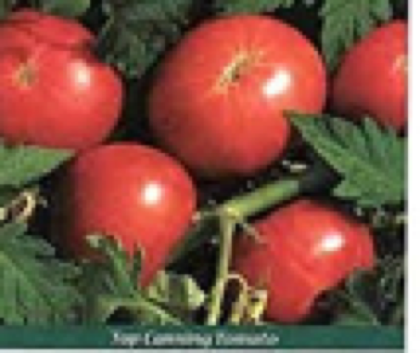
THE SEED, PATTERN & BLUEPRINT PRINCIPLE
Gensis 1:11; 2 Timothy 1:13; Hebrews 8:3–6
“yields fruit according to its kind, whose seed is in itself” (Genesis 1:11)
Corn SEEDS
Tomato SEEDS
Watermelon SEEDS

Slide 5
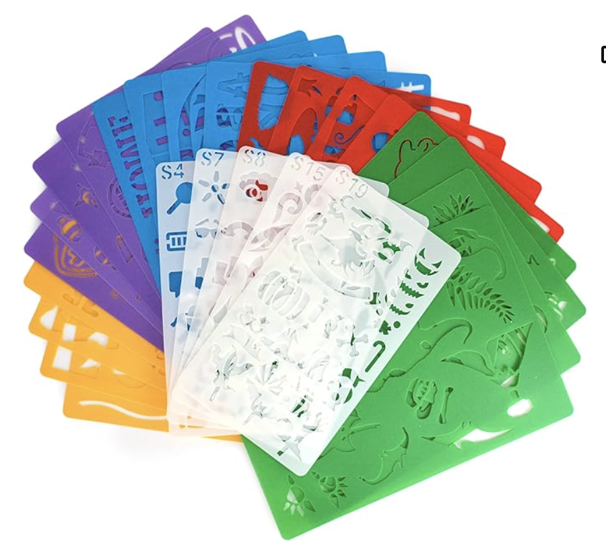
THE SEED, PATTERN & BLUEPRINT PRINCIPLE
Luke 8:11; 2 Timothy 1:13; Hebrews 8:3–6
“Hold fast the pattern of sound words which you have heard from me” (2 Timothy 1:13)
When original patterns are followed, the SAME results are reproduced over and over again!

Slide 6
THE SEED, PATTERN & BLUEPRINT PRINCIPLE
Luke 8:11; 2 Timothy 1:13; Hebrews 8:3–6
“See that you make all things according to the pattern …” (Hebrews 8:5)
Blueprints, when followed, will always result in a building being what its designer intended it to be!

Slide 7
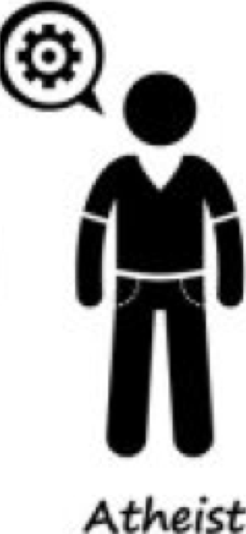
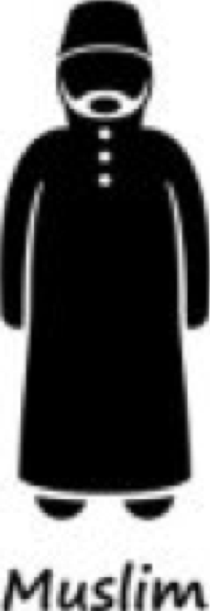
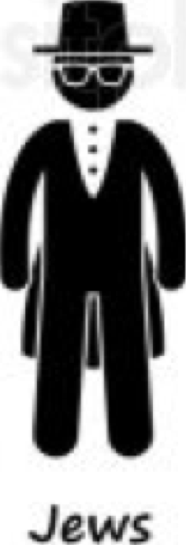
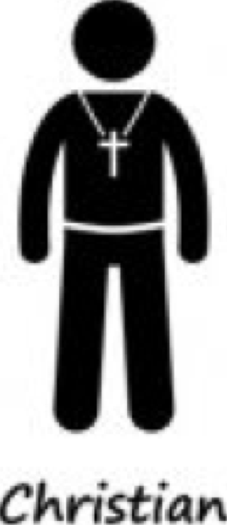
DIFFERENT SEEDS / PATTERNS RESULT IN DIFFERENT BELIEF SYSTEMS
Buddhavacana - The Word of the Buddha
The Vedas (/ˈveɪdəz, ˈviː-/;^{[1]} Sanskrit
The Koran - And The Ḥadīth
The Torah - Law of Moses
The Bible - - Followers of Jesus

Slide 8
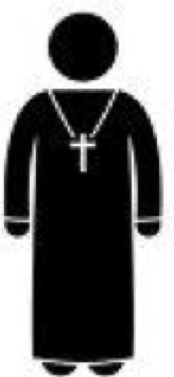
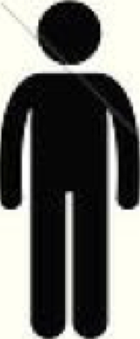
DIFFERENT SEEDS / PATTERNS RESULT IN DIFFERENT BELIEF SYSTEMS
Catholic
J. Witness
Mormon
Presb.
Methodist
Baptist
The Lord’s

Slide 9
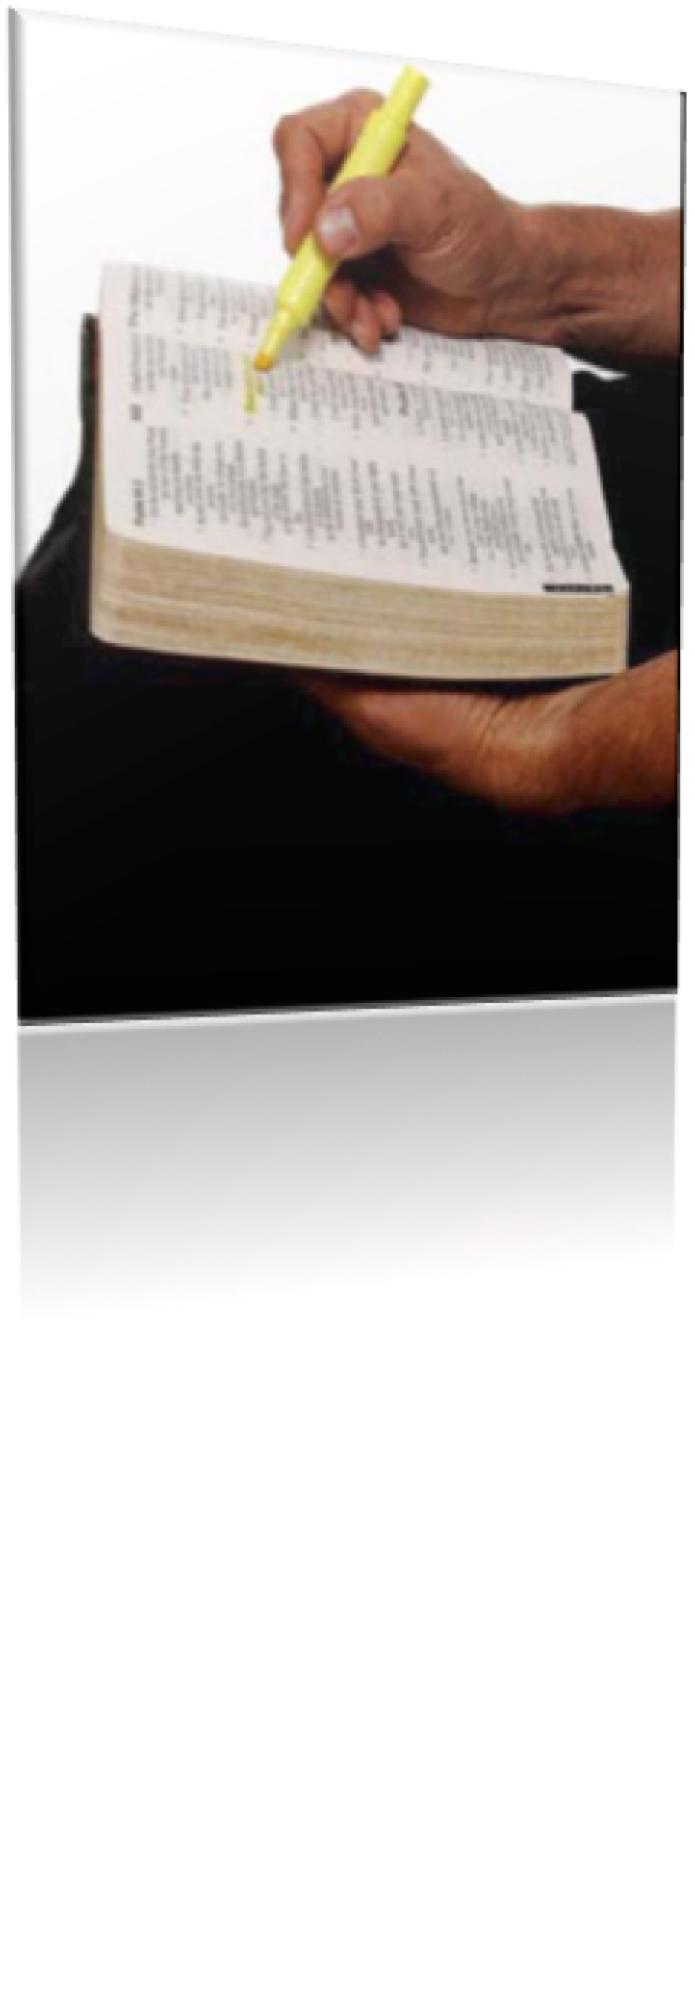
RIGHT PATTERN = CHRIST’S ECCLESIA (CHURCH)
The LORD’S CHURCH Uses ONLY GOD’S WORD as its Guide in FAITH, TEACHING, ORGANIZATION, WORSHIP, & WORK,
(2 Tim 3:16,17; 1 Pet 4:16; Col 3:17)

Slide 10
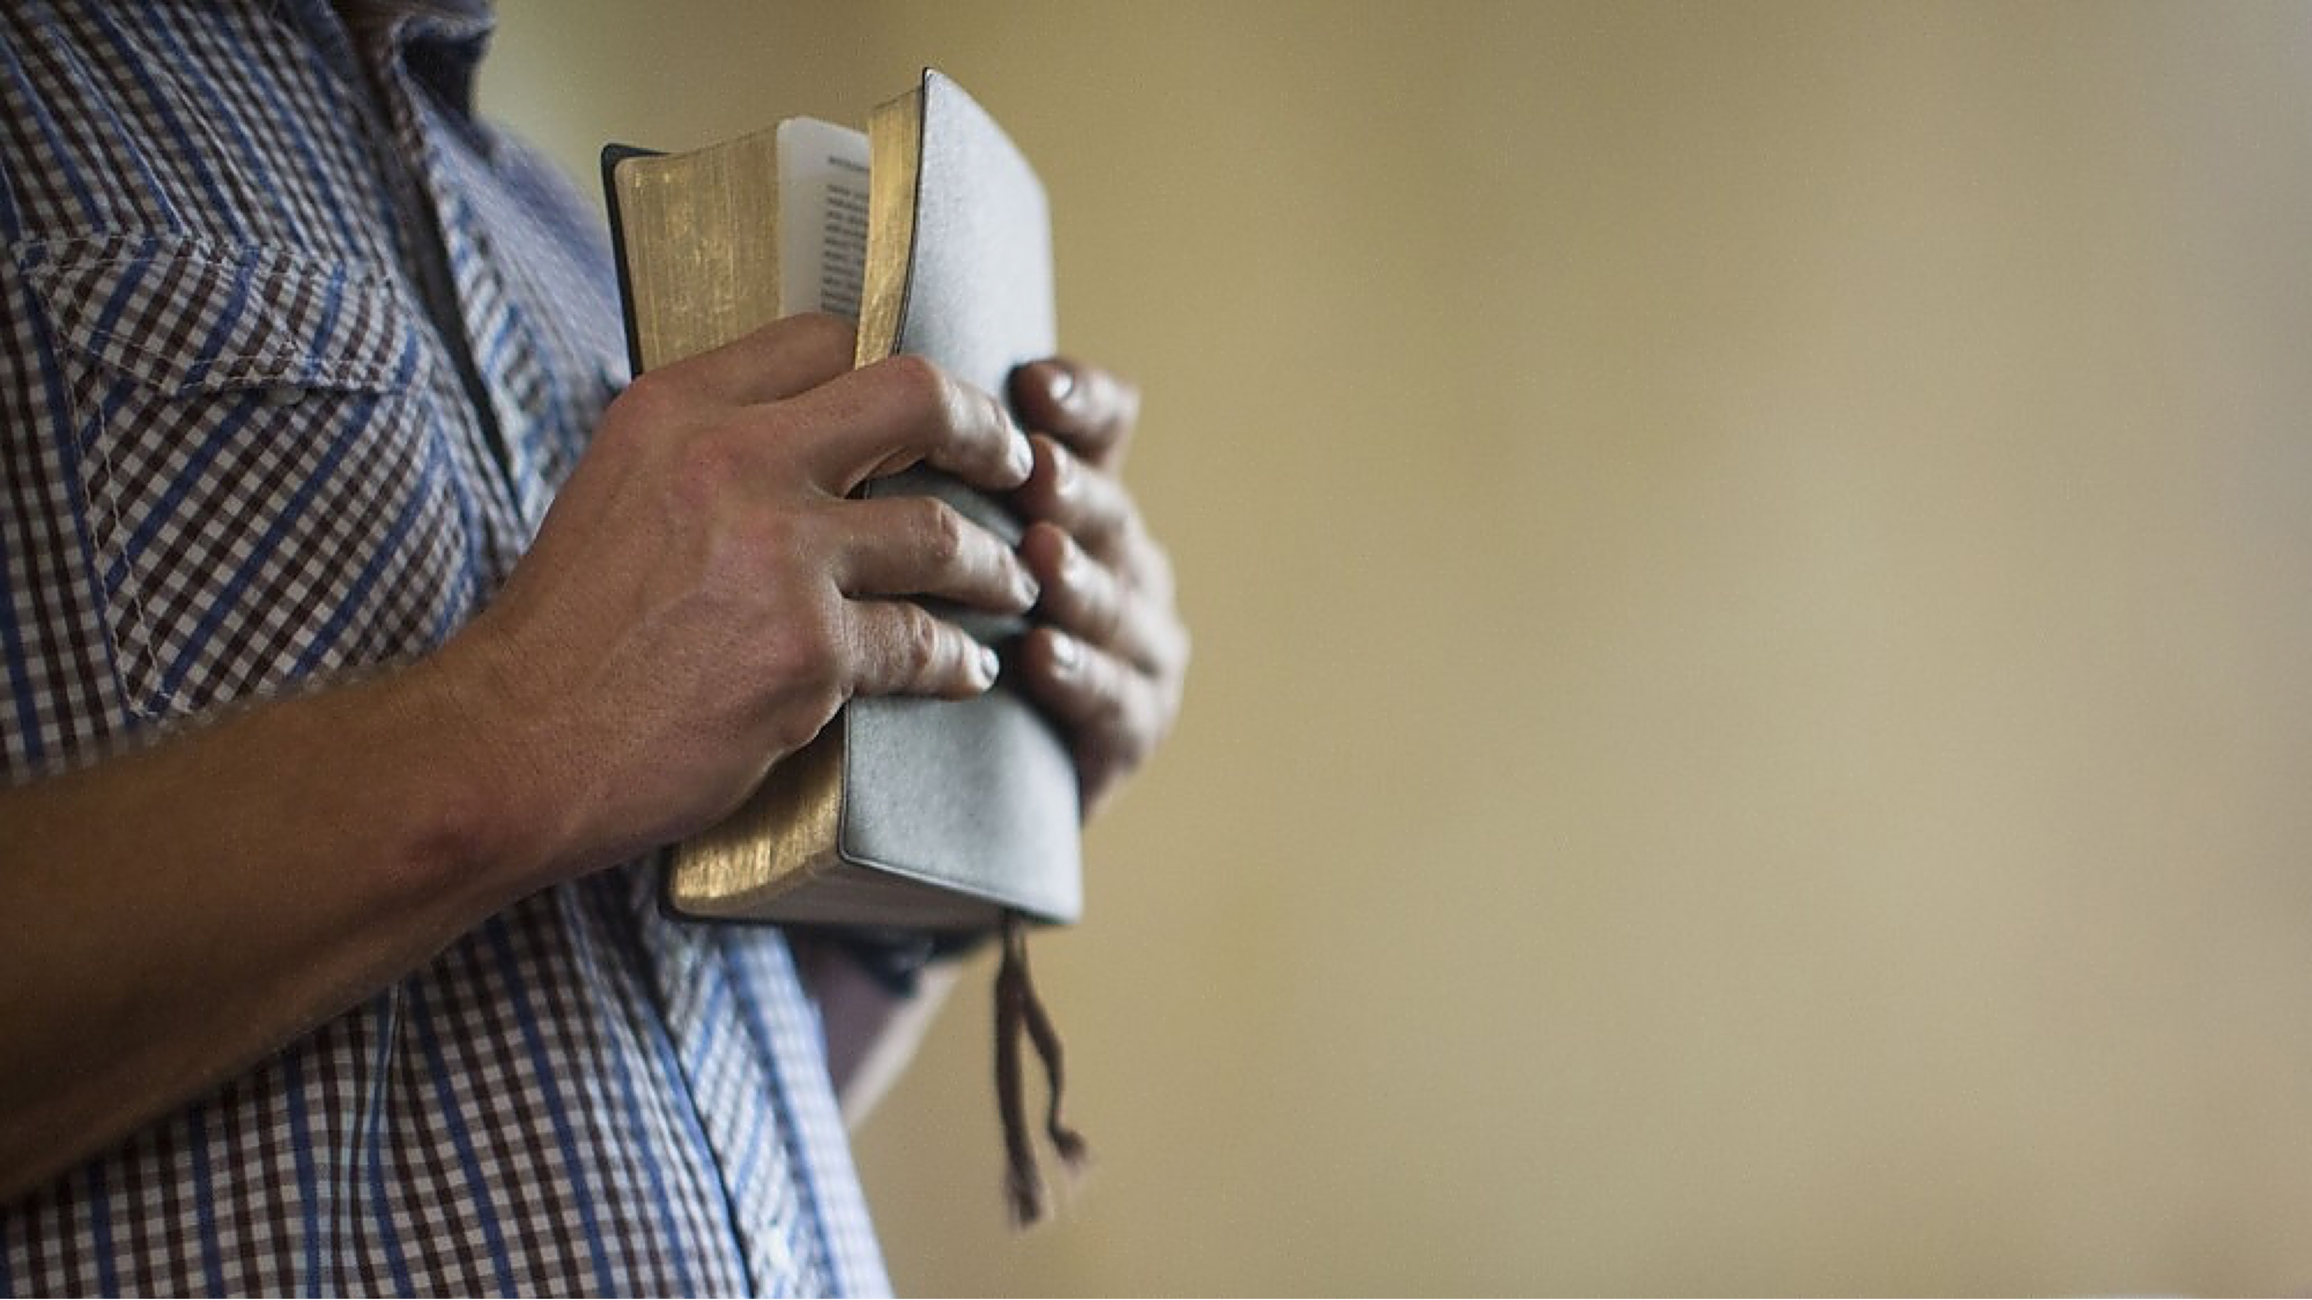
RIGHT PATTERN = CHRIST’S ECCLESIA (CHURCH)
When GOD’S PATTERN for His church is followed, the result will always be what GOD intends for it to be!

Slide 11
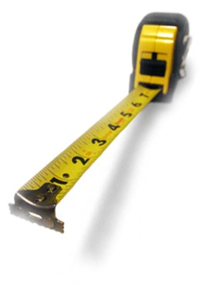
THE WORD OF GOD IS THE STANDARD BY WHICH OUR EVERY WORD AND DEED IS TO BE MEASURED.

Slide 12
THE BIBLE / GOD’S WORD IS ENOUGH
The Comprehensive Nature of The New Testament Scriptures
Sufficiently Instructs (2 Tim 3:16,17)
Cannot Be Transgressed (2 John 9)
Understandable (Eph 3:3-5)
The totality of information revealed regarding any act of righteousness forms the pattern for that act (2 Tim 1:13; 3:16,17; 2 Pet 1:3; etc.)

Slide 13
Only one
Individual Christians
All the saved
No earthly organization
U
N
I
V
E
R
S
A
L
ORIGIN (Eph 3:10; Acts 2)
FOUNDATION (1 Cor 3:11)
BUILDER (Mat 16:18; Acts 2:47)
HEAD (Eph 1:22; Col 1:18)
STANDARD (2 Tim 3:16,17; 1 Pet 4:11)
DOCTRINE – (Acts 2:42; 1 John 9)
ORGANIZATION (Acts 20:28; Phili 1:1)
WORSHIP (John 4:24; Acts 2:42)
WORK (Ephesians 4:11-16)
LOCAL
Christians who join together in a location

Slide 14
JESUS ONLY BUILT ONE CHURCH!!!
“Built by Jesus” (Matt. 16:18)
“Only One” (Eph. 4:4)
“Jesus head of the BODY, the CHURCH” (Col. 1:18; Eph. 1:22-23)
The Saved (Acts 2:47; Eph 5:23-27)
No earthly organization (Ep. 2:19-22; 1 Pet. 2:25)
Those who have obeyed the gospel (Acts 2:38-47)

Slide 15
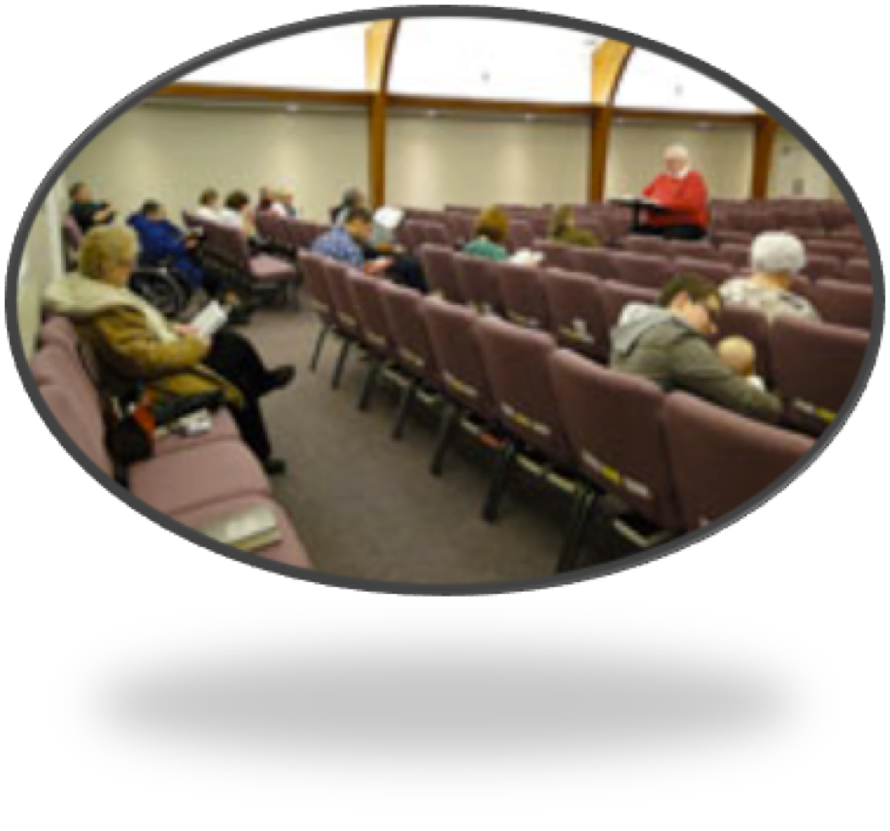
CHURCHES of CHRIST FOLLOW CHRIST — Eph 5:24
Those who have obeyed the gospel (Acts 2:38-47; 8:4-16,32-36; 10:47,48; etc.)
Who agree to join together in fellowship (Acts 9:26).
Who worship in a common assembly (1 Cor. 11:18)
Who work out of a common treasury (1 Cor.16:1-3)
Who submit to a common oversight (Acts 14:23; 20:28)

Slide 16
CHURCHES of CHRIST FOLLOW CHRIST — Eph 5:24
A local church that follows the New Testament pattern can be identified by those who know what the scriptures teach about the church (Heb 8:1-5; 2 Tim 1:13; 1 Cor 1:10-13)
A N.T. church - What was it called? What did it teach? How was it organized? How & when did it worship? What work was it involved in? …

Slide 17
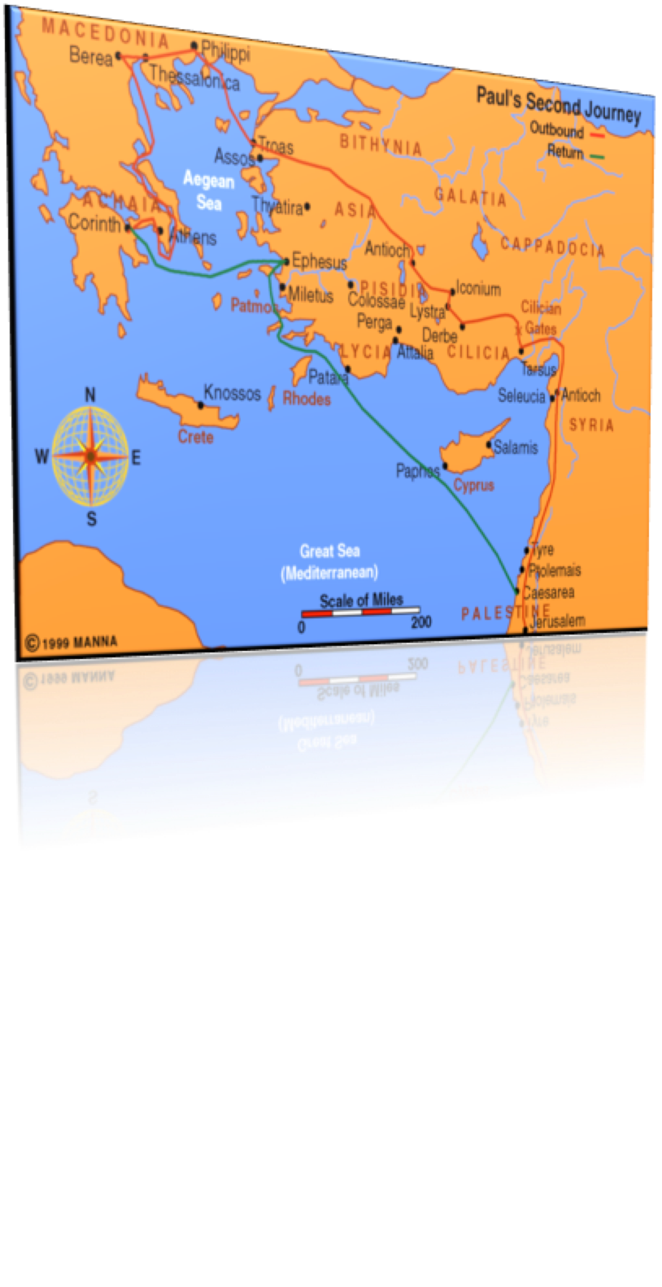
CHURCHES BELONGING TO CHRIST FOLLOW THE PATTERN
What IS IT CALLED?
Methodist Church
Presbyterian Church
Baptist Church
Catholic Church
Apostolic Church
Lutheran Church
Episcopalian Church
Pentecostal Church
Family Church
Etc. . . . .

Slide 18
CHURCHES BELONGING TO CHRIST FOLLOW THE PATTERN
What IS IT CALLED?
“the church of God which is at Corinth” - (1 Cor. 1:2)
“the church of the Thessalonians in God” - (1 Thess. 1:1).
“the churches of Galatia” - (1 Cor. 16:1).
“the churches of the saints” - (1 Cor. 14:33).
“the churches of Christ” - (Rom. 16:16).
“the churches” - (Acts 8:3; 15:41, etc., etc.).

Slide 19
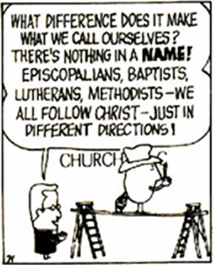
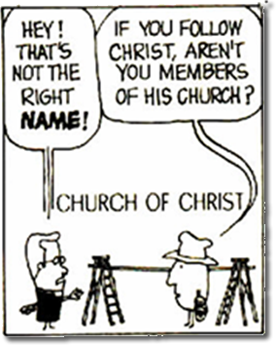
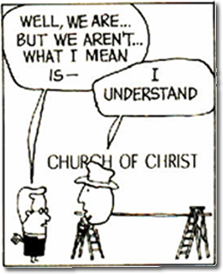
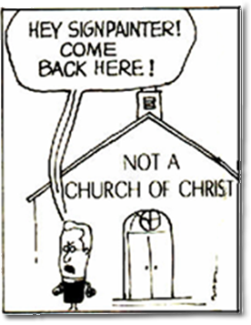
CHURCHES BELONGING TO CHRIST FOLLOW THE PATTERN
What IS IT CALLED?
Theophilus - Bob West

Slide 20
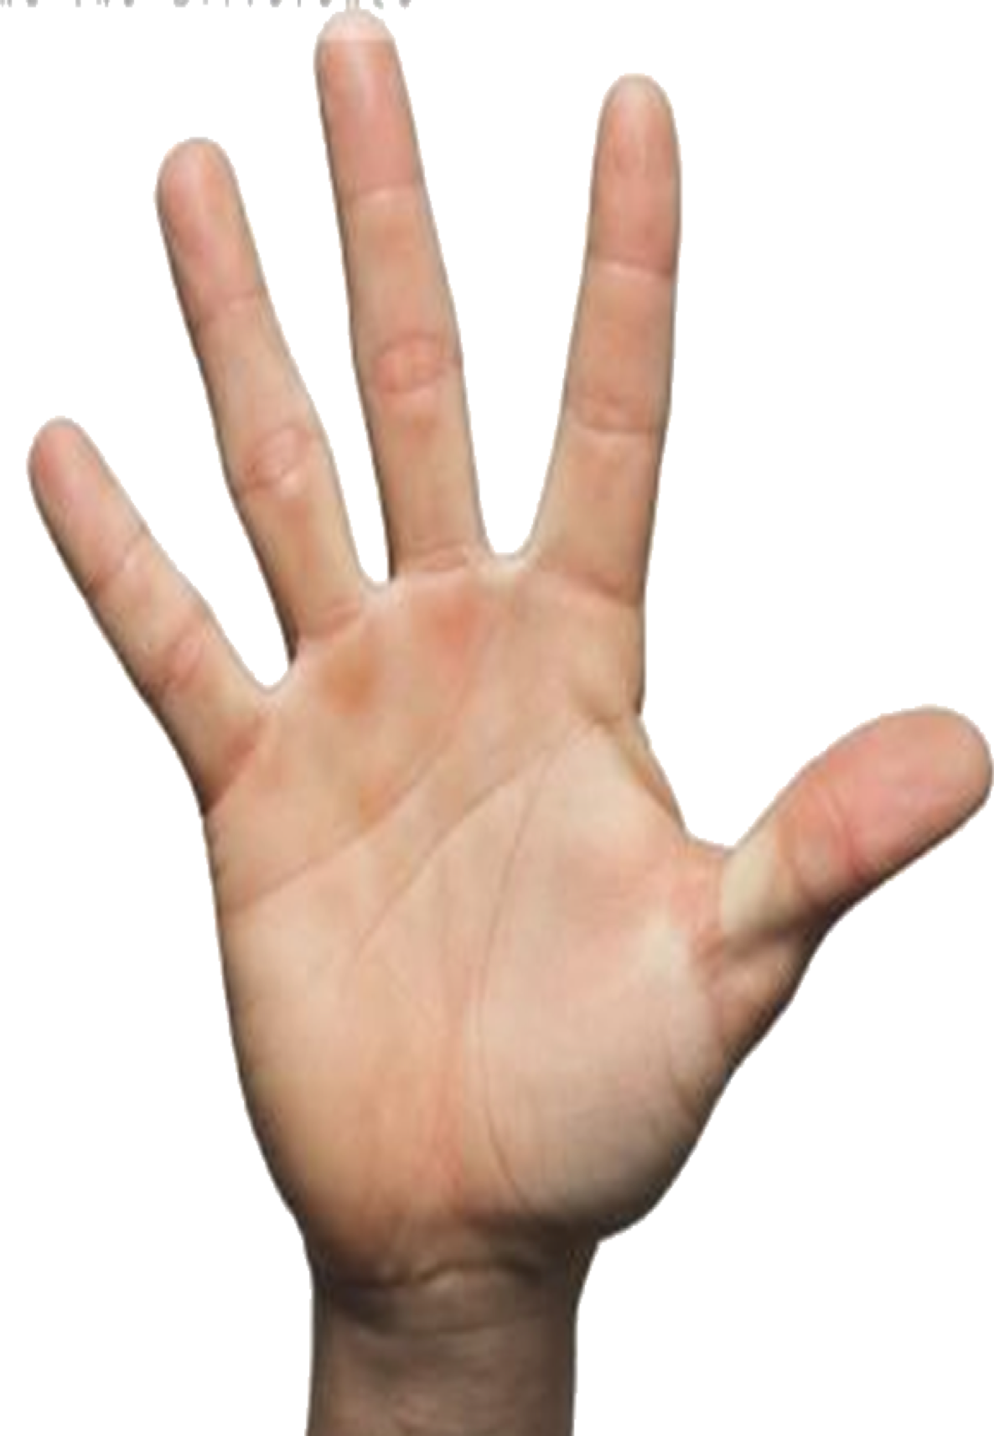
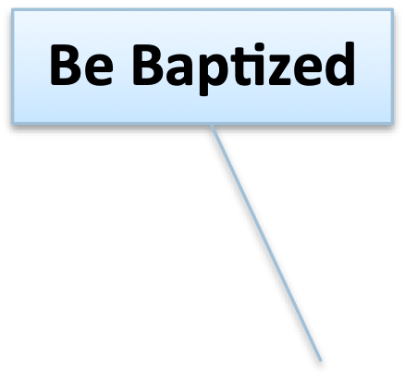
CHURCHES BELONGING TO CHRIST FOLLOW THE PATTERN
What DOES IT TEACH?
What A Person Must Do In Order To Be Saved In The Words of Inspired Men (1 Peter 4:11)
The Alien Sinner (Rom 10:17; John 8:24; Romans 10:9,10; Luke 13:3,5; Acts 17:30; Mark 16:15,16; Acts 2:38; 10:47; 22:16; Ro 6:3-6; 1 Pet 3:21)
The Christian (Col. 1:23; Rev 2:10; Acts 8:18-24; 1 John 1:9)

Slide 21
CHURCHES BELONGING TO CHRIST FOLLOW THE PATTERN
What DOES IT TEACH?
The Need To Live In Love & Purity (Mark 12:29-31; Col. 3:1-14; 2 Cor 6:14-7:1; Ephe 5:1-18; 1 Pet 1:13-18)
The Need For Positive Divine Authority For Everything Believed, Taught & Practiced (Mat 21:25; 1 Pet 4:11; Col. 3:17)
The Plea For Unity Upon What The Bible Says (1 Cor 1:10; John 17:20-22; Ephe 4:1-6)

Slide 22
CHURCHES BELONGING TO CHRIST FOLLOW THE PATTERN
Is It Scripturally Organized?
A church may be “scripturally unorganized” and still be a church of the Lord (Acts 14:27)
However - many churches are “Unscriptural” in how they are organized:
Pyramid Government -
Earthly Headquarters –
Regional Management -
Clergy / Laity – Pastor / Flock -

Slide 23
CHURCHES BELONGING TO CHRIST FOLLOW THE PATTERN
Is It Scripturally Organized?
Part of the structure through their writings
Ephesians 2:20
Apostles,
Prophets,
Evangelists,
Pastors
Teachers,
Ephesians 4:11 (NKJV)
11 And He Himself gave some to be apostles, some prophets, some evangelists, and some pastors and teachers,

Slide 24
CHURCHES BELONGING TO CHRIST FOLLOW THE PATTERN
Is It Scripturally Organized?
Philippians 1:1 (NKJV)
Paul and Timothy, bondservants of Jesus Christ, To all the saints in Christ Jesus who are in Philippi, with the bishops and deacons:
Elders / Pastors / Bishops (Acts 14:23; 20:17,28; 1 Pet. 5:1-5; 1 Tim 3:1-7; Titus 1:5-9)
Deacons (Phili 1:1; 1 Tim 3:8-13)
Saints (Phili 1:1; 1 Cor 1:2; 2 Cor. 1:1; Eph 1:1; Col 1:1)

Slide 25
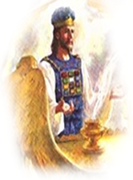
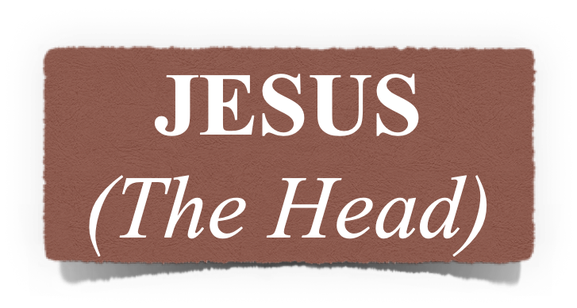
CHURCHES BELONGING TO CHRIST FOLLOW THE PATTERN
Is It Scripturally Organized?
Local church autonomy
Pastors (bishops; elders), over each local church (1 Pet 5:1,2; Acts 14:23; Tit 1:5)
Elders
Elders
Elders
Elders
Kyorori Kenya
65 Conway
Little Rock
Bryant

Slide 26
CHURCHES BELONGING TO CHRIST FOLLOW THE PATTERN
Is It Scriptural In How It Worships?
Studying God’s Word (Acts 20:7; Col 4:16; 1 Cor. 14)
Singing (Eph 5:19; Col. 3:16)
Praying (Acts 4:23-31; Eph 6:18)
Giving (First day of the week) (1 Cor 16:1,2)
Observing The Lord’s Supper (First day of the week) (Acts 20:7; 1 Cor 11:23-26)

Slide 27
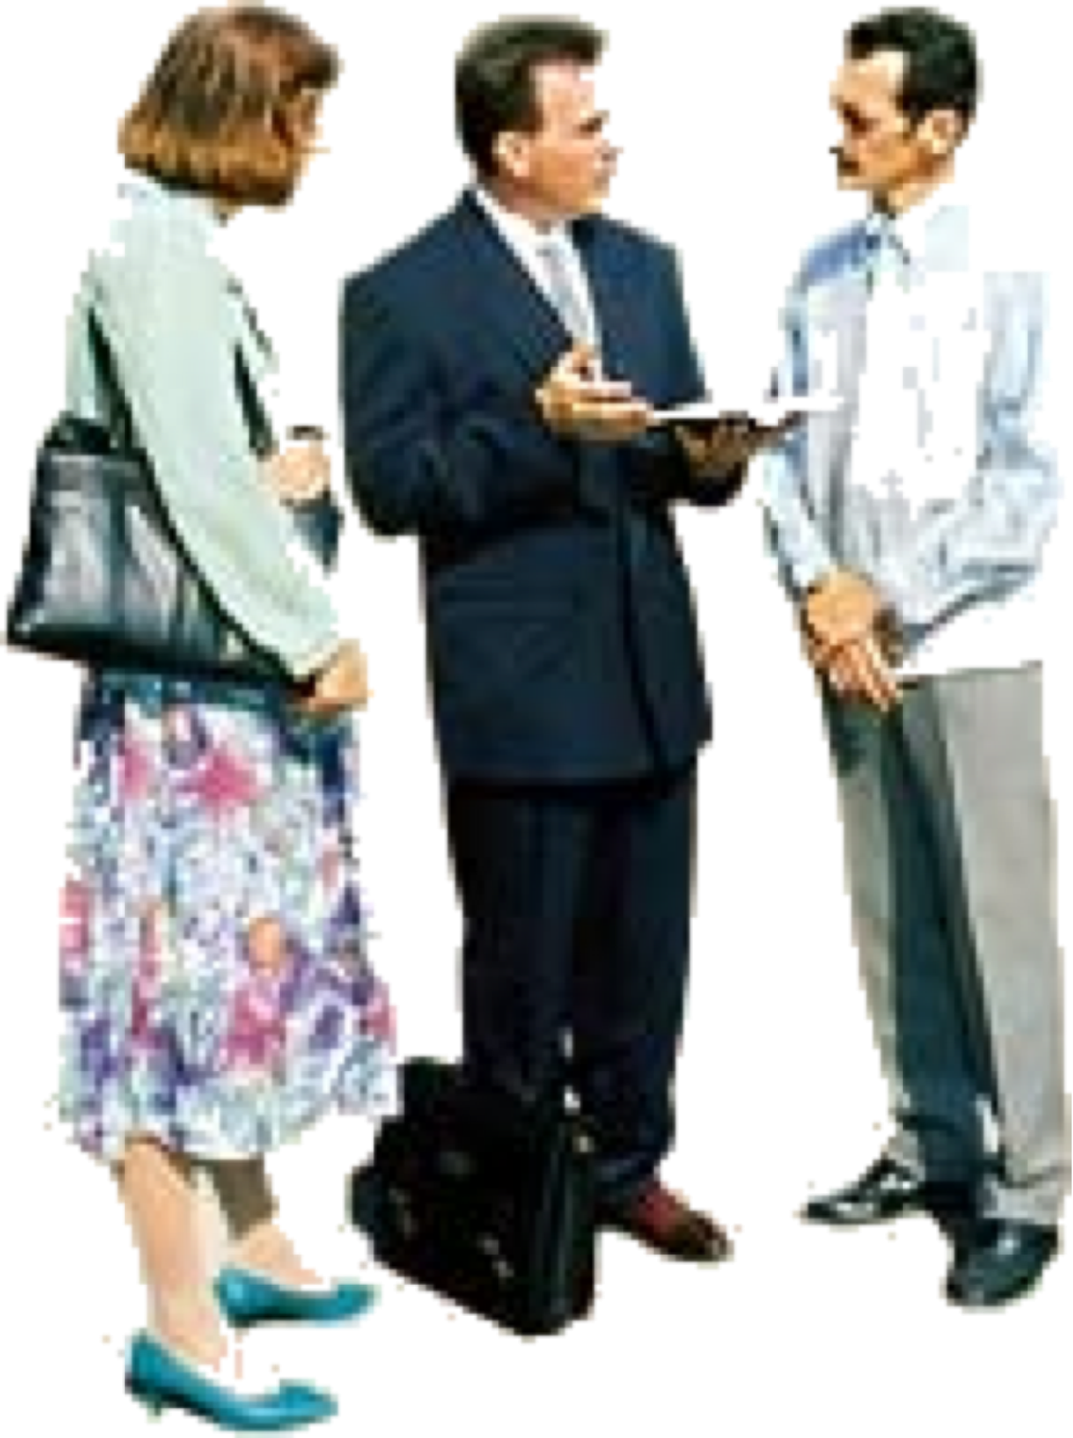
CHURCHES BELONGING TO CHRIST FOLLOW THE PATTERN
Is It Scriptural In Its Work?
Edification of the church (Eph 4:11-16)
Benevolence to needy saints (Ro 15:25-26)
Evangelism (Acts 13:1-3)
Nothing else (Col. 3:17)

Slide 28
CHURCHES BELONGING TO CHRIST FOLLOW THE PATTERN
Is It Scriptural In Its Work?
Many churches engage in things that can’t be found in the NT
Secular Education
Politics
Entertainment
Recreation (Family Life Centers)
Social / community Services

Slide 29
Luke 8:11; 2 Timothy 1:13; Hebrews 8:3–6
“See that you make all things according to the pattern …” (Hebrews 8:5)
We will embrace scriptural, God honoring descriptions!
We will teach and defend the teachings of Jesus! (Jude 3)
We will seek to be organized as the NT instructs! (Phili. 1:1)
We will worship in spirit & truth (John 4:23,24)
We will practice only what we can find in the NT! (Col. 3:17)
When GOD’S PATTERN for His church is followed, the result will always be what GOD intends for it to be!

Slide 30
Luke 8:11; 2 Timothy 1:13; Hebrews 8:3–6
“See that you make all things according to the pattern …” (Hebrews 8:5)
Our plea is for a complete return to the pattern revealed in the New Testament:
Book Chapter & Verse - Everything the scriptures teach - Nothing the scriptures do not authorize
Call Bible things by Bible names
Do Bible things in Bible ways
Back to the Bible
When GOD’S PATTERN for His church is followed, the result will always be what GOD intends for it to be!

Slide 31
CHURCHES BELONGING TO CHRIST FOLLOW THE PATTERN
HAS THE LORD ADDED YOU TO HIS CHURCH?
Have you heard? (Rom 10:17)
Have you believed? (John 8:24)
Have you confessed? (Rom 10:9,10)
Have you repented? (Luke 13:3,5; Acts 17:30)
Have you been baptized in the name of Jesus for the remission of your sins? (Mark 16:15,16; Acts 2:38; 10:47,48)

Slide 33
TODAY’S LESSON
594
368
390
213
330
362

