Slide 1
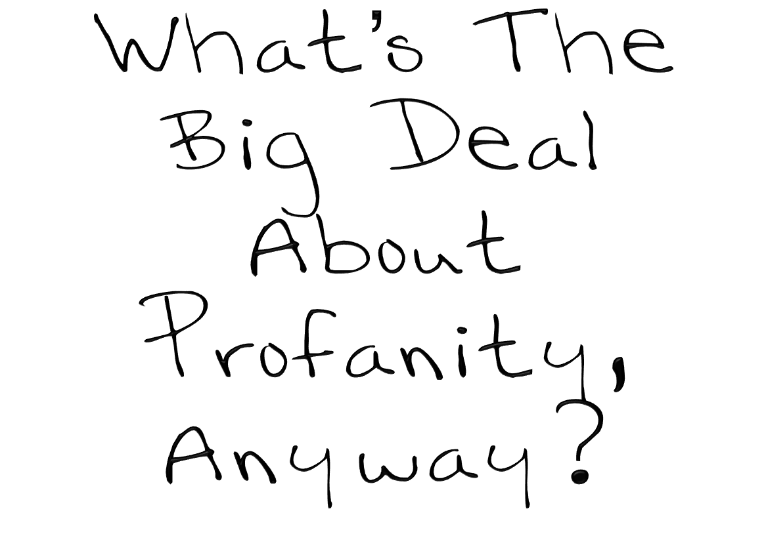
Leviticus 10:1–11

Slide 2
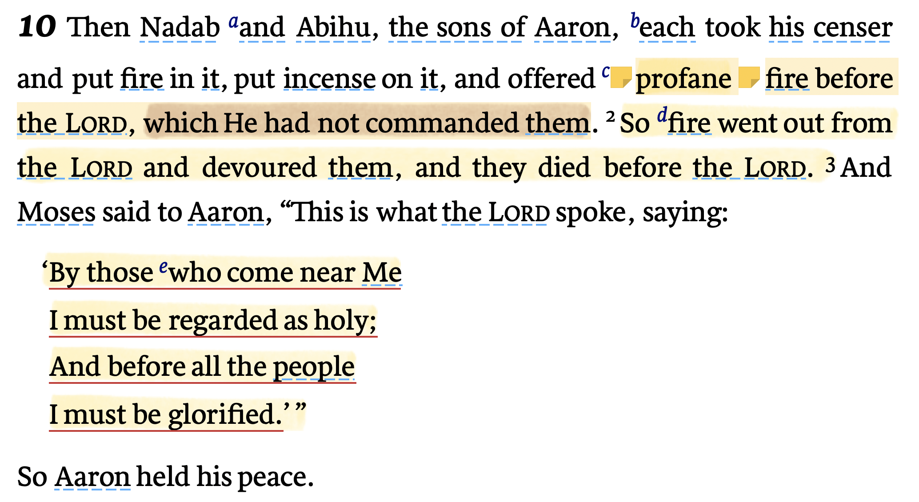
Leviticus 10:1–11

Slide 3
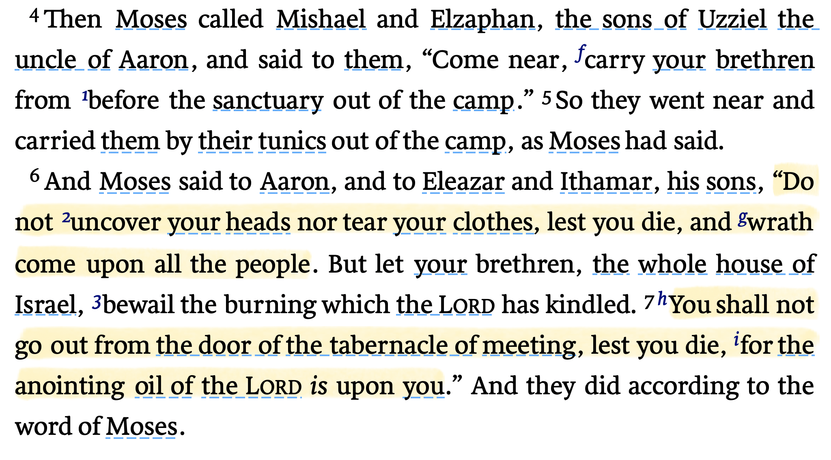
Leviticus 10:1–11

Slide 4
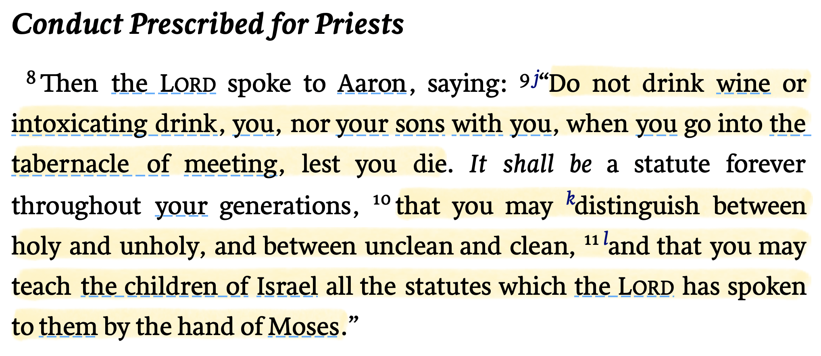
Leviticus 10:1–11

Slide 5
Disrespecting That Which Is Holy Is A Serious Matter
Numbers 4:15,20 (NKJV)
¹⁵ And when Aaron and his sons have finished covering the sanctuary and all the furnishings of the sanctuary, when the camp is set to go, then the sons of Kohath shall come to carry them; but they shall not touch any holy thing, lest they die. “These are the things in the tabernacle of meeting which the sons of Kohath are to carry. … ²⁰ But they shall not go in to watch while the holy things are being covered, lest they die.”

Slide 6
PROFANE IN THE OLD TESTAMENT
(Adjective.) 2: not holy because unconsecrated, impure, or defiled: unsanctified (Merriam Webster)
(Verb) 1. To treat (something sacred) with abuse, irreverence, or contempt: desecrate (Merriam Webster)
[2424] זָר zār 70× strange, foreign, alien, one of a different kind; unauthorized, illegitimate [2214*] See foreign(er); strange(r); unauthorized.
Mounce, W. D. (2006). In Mounce’s Complete Expository Dictionary of Old & New Testament Words. Zondervan.
[2725] 1 חָלַל ḥālal 135× [N] to defile oneself, be profaned, be desecrated; [P] to defile, profane, desecrate; to enjoy; [Pu] to be defiled; … See … defile; desecrate; proceed; profane.
Mounce, W. D. (2006). In Mounce’s Complete Expository Dictionary of Old & New Testament Words. Zondervan.

Slide 7
Disrespecting That Which Is Holy Is A Serious Matter
Leviticus 10:1–3 (NKJV)
¹ Then Nadab and Abihu, the sons of Aaron, each took his censer and put fire in it, put incense on it, and offered profane fire before the Lord, which He had not commanded them. ² So fire went out from the Lord and devoured them, and they died before the Lord. ³ And Moses said to Aaron, “This is what the Lord spoke, saying: ‘By those who come near Me I must be regarded as holy; And before all the people I must be glorified.’ ” So Aaron held his peace.
זָר zār 70× strange, foreign, alien, one of a different kind; unauthorized, illegitimate

Slide 8
Disrespecting That Which Is Holy Is A Serious Matter
Exodus 20:25 (NKJV)
²⁵ And if you make Me an altar of stone, you shall not build it of hewn stone; for if you use your tool on it, you have profaned it.
חָלַל ḥālal 135× [N] to defile oneself, be profaned, be desecrated;

Slide 9
Disrespecting That Which Is Holy Is A Serious Matter
Exodus 31:14 (NKJV)
¹⁴ You shall keep the Sabbath, therefore, for it is holy to you. Everyone who profanes it shall surely be put to death; for whoever does any work on it, that person shall be cut off from among his people.
חָלַל ḥālal 135× [N] to defile oneself, be profaned, be desecrated;

Slide 10
Disrespecting That Which Is Holy Is A Serious Matter
Leviticus 19:12 (NKJV)
¹² And you shall not swear by My name falsely, nor shall you profane the name of your God: I am the Lord.
חָלַל ḥālal 135× [N] to defile oneself, be profaned, be desecrated;

Slide 11
PROFANE IN THE NEW TESTAMENT
(Adjective.) 2: not holy because unconsecrated, impure, or defiled: unsanctified (Merriam Webster)
(Verb) 1. To treat (something sacred) with abuse, irreverence, or contempt: desecrate (Merriam Webster)
[1013] βέβηλος bebēlos 5× pr. what is open and accessible to all; hence, profane, not religious, not connected with religion; unholy; a despiser, scorner, [952]
Mounce, W. D. (2006). In Mounce’s Complete Expository Dictionary of Old & New Testament Words. Zondervan.
[1014] βεβηλόω bebēloō 2× to profane, pollute, violate, Mt. 12:5; Acts 24:6* [953]
Mounce, W. D. (2006). In Mounce’s Complete Expository Dictionary of Old & New Testament Words. Zondervan.

Slide 12
Disrespecting That Which Is Holy Is A Serious Matter
1 Timothy 1:9 (NKJV) ⁹ knowing this: that the law is not made for a righteous person, but for the lawless and insubordinate, for the ungodly and for sinners, for the unholy and profane, for murderers of fathers and murderers of mothers, for manslayers,
(ADJ.) [1013] βέβηλος bebēlos 5× pr. what is open and accessible to all; hence, profane, not religious, not connected with religion; unholy;

Slide 13
Disrespecting That Which Is Holy Is A Serious Matter
Hebrews 12:16 (NKJV) ¹⁶ lest there be any fornicator or profane person like Esau, who for one morsel of food sold his birthright.
(ADJ.) [1013] βέβηλος bebēlos 5× pr. what is open and accessible to all; hence, profane, not religious, not connected with religion; unholy;

Slide 14
Disrespecting That Which Is Holy Is A Serious Matter
Matthew 12:5–6 (NKJV)
⁵ Or have you not read in the law that on the Sabbath the priests in the temple profane the Sabbath, and are blameless? ⁶ Yet I say to you that in this place there is One greater than the temple.
(V) [1014] βεβηλόω bebēloō 2× to profane, pollute, violate, Mt. 12:5; Acts 24:6* [953]

Slide 15
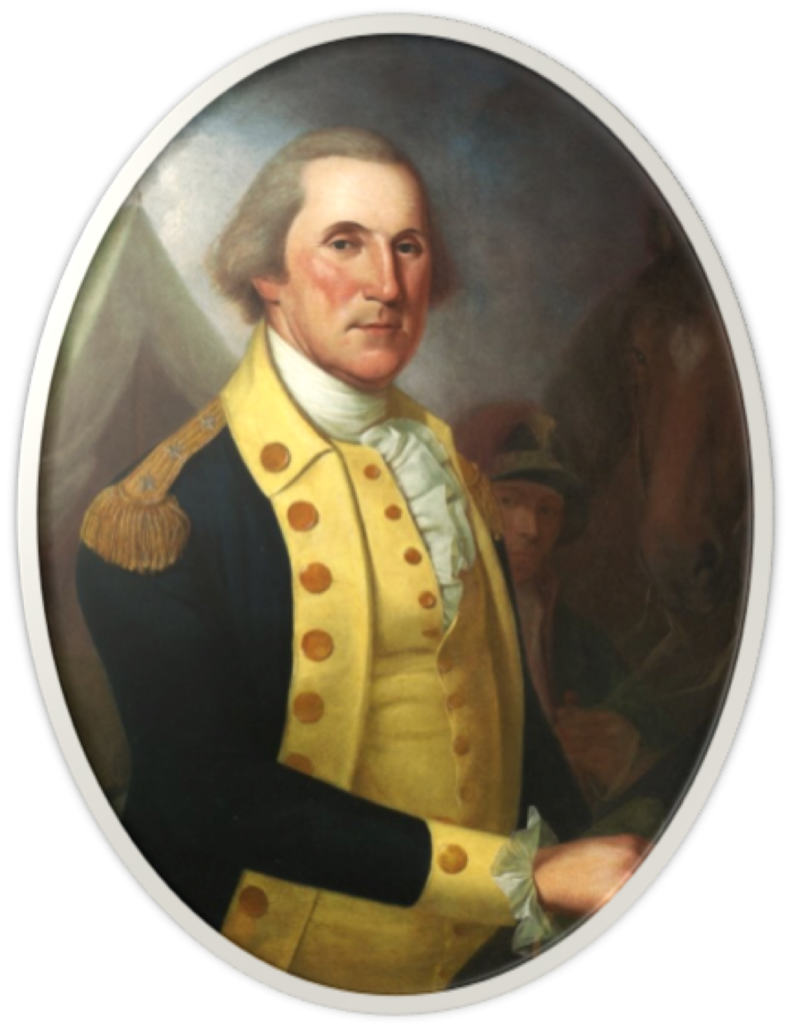
“The general is sorry to be informed that the foolish and wicked practice of profane swearing, a vice hitherto little known in the American Army, is growing in fashion. He hopes the officers will by example as well as influence endeavor to check it and that both they and the men will reflect that we can have little hope of the blessing of heaven on our arms if we insult it by our impiety and profanity.”
(George Washington)

Slide 16
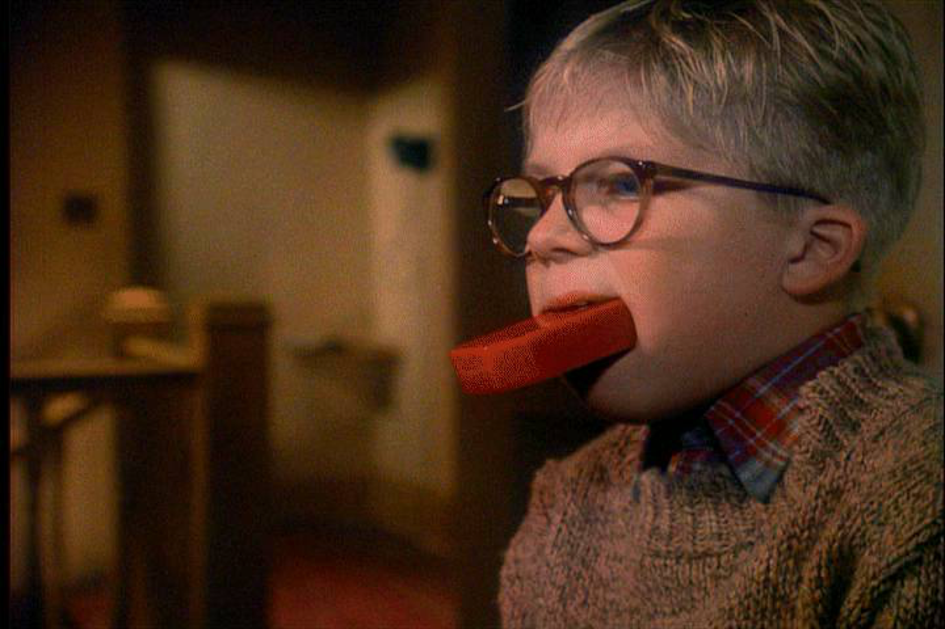
The Israelites were not to use God's name for any idle, frivolous, or insincere purpose - Ex 20:7 - (i.e., speaking His name when taking an oath with no intention of keeping it, Lev. 19:12; Mat 5:33-37; James 5:12).
To misuse God’s name means literally, “to lift it up to or attach it to emptiness.”
A Christian who uses God’s name flippantly or falsely demonstrates an irreverent attitude & dishonors God.

Slide 17
“Let no corrupt word proceed out of your mouth,” (Eph 4:29)
“Neither filthiness, nor foolish talking,” (Eph 5:4)
“Nor coarse jesting, which are not fitting,” (Eph 5:4)
“Put off all these: … blasphemy, filthy [abusive] language out of your mouth.” (Col 3:8)
1. aischrotes (αἰσχρότης, 151), “baseness” (from aischos, “shame, disgrace”), is used in Eph, 5:4, of obscenity, all that is contrary to purity

Slide 18
Matthew 12:34–37 (NKJV)
³⁴ Brood of vipers! How can you, being evil, speak good things? For out of the abundance of the heart the mouth speaks. ³⁵ A good man out of the good treasure of his heart brings forth good things, and an evil man out of the evil treasure brings forth evil things. ³⁶ But I say to you that for every idle word men may speak, they will give account of it in the day of judgment. ³⁷ For by your words you will be justified, and by your words you will be condemned.”

Slide 19
James 3:9–12 (NKJV)
⁹ With it we bless our God and Father, and with it we curse men, who have been made in the similitude of God. ¹⁰ Out of the same mouth proceed blessing and cursing. My brethren, these things ought not to be so. ¹¹ Does a spring send forth fresh water and bitter from the same opening? ¹² Can a fig tree, my brethren, bear olives, or a grapevine bear figs? Thus no spring yields both salt water and fresh.

Slide 20
The False Teaching Tongue
The Cursing & Filthy Tongue
The Lying Tongue
The Complaining Tongue
The Silent Tongue
The Flattering Tongue
The Overused Tongue
The Swift Tongue
The Backbiting, Tale bearing, & (Gossiping) Tongue

Slide 21
Jesus says our worship is VAIN when we believe, teach & practice the doctrines of men (Mat 15:1-9)
When we give God our leftovers (Mal 1:6-8, 10-14)
When we are unfaithful to God (Mal 2:10-12; Jn 9:31)

Slide 22
Those who worship God “must worship Him in spirit & truth” (John 4:24)
We do not have the right to change or take lightly God’s prescribed pattern for worship (Mat 15:1-9; 2 Jn 1:9,10)

Slide 23
Lord’s supper (1 Cor. 11:17-34)
Praying (Mat 6:5-13)
Preaching (2 Tim 4:2-4)
Giving (1 Cor 16:1,2; 2 Cor 8:1-9)
Music (Eph 5:19; Col. 3:16)

Slide 24
Our bodies belong to God - they are NOT for sinning (1 Cor 6:13-20; Rom 6:1,11)
Where we go, what we do, what we say - all cast a refection upon God - GOOD or BAD (Mat 5:13-16; Phili 2:14-16; Ro. 2:24; 1 Co. 10:32; Titus 2:5, 8, 10; 1 Pe. 2:12; 3:16)

Slide 25
We are to be holy (1 Pet 1:13ff; 2 Cor 6:14-7:1; Rom 12:1,2)
Do the clothes we wear profess holiness? (1 Tim 2:9,10; 1 Pt 3:1-4)
Do the places we frequent profess holiness? (1 Cor 10:20,21; 8:10)
Does the entertainment we enjoy and allow into our minds profess holiness? (Phili 4:8)

Slide 26
The Lord’s church (Mat 16:18; 1 Cor 3:16; Eph 5:23-27)
The Lord’s money (Acts 5:4; 1 Cor 16:1,2)
The Lord’s institution of marriage (Gen 2:24; Mat 19:3-9; Heb 13:4)
The Lord’s revelation of Himself (2 Tim 2:15; 4:2-5; 1 Pet 4:11; 2 Pet 3:16-18)

Slide 27
Disrespecting That Which Is Holy Is A Serious Matter
Hebrews 12:15–17 (NKJV)
¹⁵ looking carefully lest anyone fall short of the grace of God; lest any root of bitterness springing up cause trouble, and by this many become defiled; ¹⁶ lest there be any fornicator or profane person like Esau, who for one morsel of food sold his birthright. ¹⁷ For you know that afterward, when he wanted to inherit the blessing, he was rejected, for he found no place for repentance, though he sought it diligently with tears.

Slide 28
Do you truly seek to please God?
God demands we respect His person, word, & institutions
Disrespecting That Which Is Holy Is A Serious Matter

Slide 29
Disrespecting That Which Is Holy Is A Serious Matter

Slide 31
Hebrews 12:12–17 (NKJV)
¹² Therefore strengthen the hands which hang down, and the feeble knees, ¹³ and make straight paths for your feet, so that what is lame may not be dislocated, but rather be healed. ¹⁴ Pursue peace with all people, and holiness, without which no one will see the Lord: ¹⁵ looking carefully lest anyone fall short of the grace of God; lest any root of bitterness springing up cause trouble, and by this many become defiled; ¹⁶ lest there be any fornicator or profane person like Esau, who for one morsel of food sold his birthright. ¹⁷ For you know that afterward, when he wanted to inherit the blessing, he was rejected, for he found no place for repentance, though he sought it diligently with tears.

Slide 32
- Speech / Worship/ Behavior
pro•fane \prō-ˈfān, prə-\ verb transitive - pro•faned; pro•fan•ing [Middle English prophanen, from Anglo-French prophaner, from Latin profanare, from profanus] 14th century
1: to treat (something sacred) with abuse, irreverence, or contempt: desecrate
2: to debase by a wrong, unworthy, or vulgar use—pro•fan•er noun
²profane adjective
1: not concerned with religion or religious purposes: secular
2: not holy because unconsecrated, impure, or defiled: unsanctified
3 a: serving to debase or defile what is holy: irreverent
b: obscene, vulgar
4 a: not being among the initiated
b: not possessing esoteric or expert knowledge—pro•fane•ly adverb—pro•fane•ness \-ˈfān-nəs\ noun
Merriam-Webster, I. (2003). Merriam-Webster’s collegiate dictionary. (Eleventh ed.). Springfield, MA: Merriam-Webster, Inc.

