Slide 1
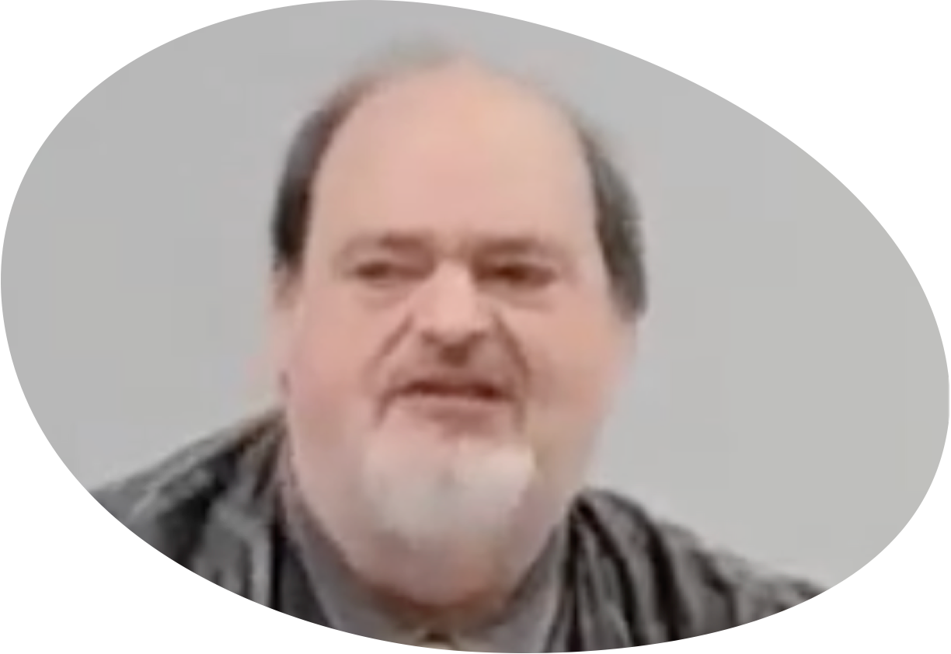
“Church of Christ MEETING @ 9500 AR 5, Alexander AR. 72002”
TODAY’S LESSON
Sunday Morning lesson live stream 9:00 AM ^{CT} February 18, 2024
https://www.youtube.com/user/donmcclain11/live / https://www.bryantchurchofchrist.com

Slide 2
DAILY RENEWING THE HEART WITH PATIENCE
JAMES 5:7-12

Slide 3
God’s Patience (Longsuffering)
The longsuffering of God waited patiently 1 Peter 3:20 (120 years Gen. 6:3-8)

Slide 4
Genesis 6:3-8
3 And the LORD said, “My Spirit shall not strive with man forever, for he is indeed flesh; yet his days shall be one hundred and twenty years.” 4 There were giants on the earth in those days, and also afterward, when the sons of God came in to the daughters of men and they bore children to them. Those were the mighty men who were of old, men of renown.

Slide 5
Genesis 6:3-8
5 Then the LORD saw that the wickedness of man was great in the earth, and that every intent of the thoughts of his heart was only evil continually. 6 And the LORD was sorry that He had made man on the earth, and He was grieved in His heart. 7 So the LORD said, “I will destroy man whom I have created from the face of the earth, both man and beast, creeping thing and birds of the air, for I am sorry that I have made them.” 8 But Noah found grace in the eyes of the LORD.

Slide 6
God’s Patience (Longsuffering)
The longsuffering of God waited patiently 1 Peter 3:20 (120 years Gen. 6:3-8)
2 Peter 3:8-15 the longsuffering of our Lord is salvation

Slide 7
2 Peter 3:8-15
8 But, beloved, do not forget this one thing, that with the Lord one day is as a thousand years, and a thousand years as one day. 9 The Lord is not slack concerning His promise, as some count slackness, but is longsuffering toward us, not willing that any should perish but that all should come to repentance.
10 But the day of the Lord will come as a thief in the night, in which the heavens will pass away with a great noise, and the elements will melt with fervent heat; both the earth and the works that are in it will be burned up.

Slide 8
2 Peter 3:8-15
11 Therefore, since all these things will be dissolved, what manner of persons ought you to be in holy conduct and godliness, 12 looking for and hastening the coming of the day of God, because of which the heavens will be dissolved, being on fire, and the elements will melt with fervent heat? 13 Nevertheless we, according to His promise, look for new heavens and a new earth in which righteousness dwells. 14 Therefore, beloved, looking forward to these things, be diligent to be found by Him in peace, without spot and blameless; 15 and consider that the longsuffering of our Lord is salvation…

Slide 9
God’s Patience (Longsuffering)
The longsuffering of God waited patiently 1 Peter 3:20 (120 years Gen. 6:3-8)
2 Peter 3:8-15 the longsuffering of our Lord is salvation

Slide 10
God’s Patience (Longsuffering)
The longsuffering of God waited patiently 1 Peter 3:20 (120 years Gen. 6:3-8)
2 Peter 3:8-15 the longsuffering of our Lord is salvation (explained in 1 Pt 2:18-25)

Slide 11
1 Peter 2:18-25
18 Servants, be submissive to your masters with all fear, not only to the good and gentle, but also to the harsh. 19 For this is commendable, if because of conscience toward God one endures grief, suffering wrongfully. 20 For what credit is it if, when you are beaten for your faults, you take it patiently? But when you do good and suffer, if you take it patiently, this is commendable before God. 21 For to this you were called, because Christ also suffered for you, leaving you an example, that you should follow His steps:

Slide 12
1 Peter 2:18-25
22 “Who committed no sin, nor was deceit found in His mouth;”
23 who, when He was reviled, did not revile in return; when He suffered, He did not threaten, but committed Himself to Him who judges righteously; 24 who Himself bore our sins in His own body on the tree, that we, having died to sins, might live for righteousness — by whose stripes you were healed. 25 For you were like sheep going astray, but have now returned to the Shepherd and Overseer of your souls.

Slide 13
God’s Patience (Longsuffering)
The longsuffering of God waited patiently 1 Peter 3:20 (120 years Gen. 6:3-8)
2 Peter 3:8-15 the longsuffering of our Lord is salvation (explained in 1 Pt 2:18-25)
God is love; He wants us to know that He is longsuffering and gracious as well as righteous Exodus 34:5-7

Slide 14
Exodus 34:5-7
5 Now the LORD descended in the cloud and stood with him there, and proclaimed the name of the LORD. 6 And the LORD passed before him and proclaimed, “the LORD, the LORD God, merciful and gracious, longsuffering, and abounding in goodness and truth, 7 keeping mercy for thousands, forgiving iniquity and transgression and sin, by no means clearing the guilty, visiting the iniquity of the fathers upon the children and the children's children to the third and the fourth generation.”

Slide 15
God’s Patience (Longsuffering)
The longsuffering of God waited patiently 1 Peter 3:20 (120 years Gen. 6:3-8)
2 Peter 3:8-15 the longsuffering of our Lord is salvation (explained in 1 Pt 2:18-25)
God is love; He wants us to know that He is longsuffering and gracious as well as righteous Exodus 34:5-7
Numbers 14:17; Nehemiah 9:17; Psalm 86:15; 103:8; 145; Jeremiah 15:15; Joel 2:13; Jonah 4:2; Nahum 1:3 (150 yr. delay)

Slide 16
God’s Longsuffering→ Our Longsuffering
Hebrew EREK “long” APAYIM “nosed”
EREK “long” RUACH “spirit” Ecclesiastes 7:8

Slide 17
Ecclesiastes 7:8-10
8 The end of a thing is better than its beginning;
The patient in spirit is better than the proud in spirit.
9 Do not hasten in your spirit to be angry,
For anger rests in the bosom of fools.
10 Do not say, “Why were the former days better than these?” for you do not inquire wisely concerning this.

Slide 18
God’s Longsuffering→ Our Longsuffering
Hebrew EREK “long” APAYIM “nosed”
EREK “long” RUACH “spirit” Ecclesiastes 7:8

Slide 19
God’s Longsuffering→ Our Longsuffering
Hebrew EREK “long” APAYIM “nosed”
EREK “long” RUACH “spirit” Ecclesiastes 7:8
Greek MAKROTHUMIA “long-tempered” James 5:7-11 (patience toward others)

Slide 20
James 5:7-11
7 Therefore BE PATIENT, brethren, until the coming of the Lord. See how the farmer waits for the precious fruit of the earth, WAITING PATIENTLY for it until it receives the early and latter rain. 8 You also BE PATIENT. Establish your hearts, for the coming of the Lord is at hand.
9 Do not grumble against one another, brethren, lest you be condemned. Behold, the judge is standing at the door! 10 My brethren, take the prophets, who spoke in the name of the Lord, as an example of suffering and PATIENCE. 11 Indeed we count them blessed who ENDURE. You have heard of the PERSEVERANCE of Job and seen the end intended by the Lord — that the Lord is very compassionate and merciful.

Slide 21
God’s Longsuffering→ Our Longsuffering
Hebrew EREK “long” APAYIM “nosed”
EREK “long” RUACH “spirit” Ecclesiastes 7:8
Greek MAKROTHUMIA “long-tempered” James 5:7-11 (patience toward others)

Slide 22
God’s Longsuffering→ Our Longsuffering
Hebrew EREK “long” APAYIM “nosed”
EREK “long” RUACH “spirit” Ecclesiastes 7:8
Greek MAKROTHUMIA “long-tempered” James 5:7-11 (patience toward others)
Greek HUPOMONE “remain under” v.11 (patience with self) endurance 1 Peter 2:20

Slide 23
God’s Longsuffering→ Our Longsuffering
Hebrew EREK “long” APAYIM “nosed”
EREK “long” RUACH “spirit” Ecclesiastes 7:8
Greek MAKROTHUMIA “long-tempered” James 5:7-11 (patience toward others)
Greek HUPOMONE “remain under” v.11 (patience with self) endurance 1 Peter 2:20
Greek ANOCHE “self-restraint” forbearance Romans 2:4; 3:25

Slide 24
Romans 2:4
4 Do you despise the riches of His goodness, FORBEARANCE, and longsuffering, not knowing that the goodness of God leads you to repentance?
Romans 3:23-25
23 For all have sinned and fall short of the glory of God, 24 being justified freely by His grace through the redemption that is in Christ Jesus, 25 whom God set forth as a propitiation by His blood, through faith, to demonstrate His righteousness, because in His FORBEARANCE God had passed over the sins that were previously committed

Slide 25
God’s Longsuffering→ Our Longsuffering
Hebrew EREK “long” APAYIM “nosed”
EREK “long” RUACH “spirit” Ecclesiastes 7:8
Greek MAKROTHUMIA “long-tempered” James 5:7-11 (patience toward others)
Greek HUPOMONE “remain under” v.11 (patience with self) endurance 1 Peter 2:20
Greek ANOCHE “self-restraint” forbearance Romans 2:4; 3:25

Slide 26
God’s Longsuffering→ Our Longsuffering
Hebrew EREK “long” APAYIM “nosed”
EREK “long” RUACH “spirit” Ecclesiastes 7:8
Greek MAKROTHUMIA “long-tempered” James 5:7-11 (patience toward others)
Greek HUPOMONE “remain under” v.11 (patience with self) endurance 1 Peter 2:20
Greek ANOCHE “self-restraint” forbearance Romans 2:4; 3:25
Greek EPIEIKES “mild, gentle” 1 Pt 2:18; James 3:17; 1 Timothy 3:3

Slide 27
Daily Renewing the Heart with Patience
Exodus 33:12-34:7 the LORD’s longsuffering
Psalm 27:1-14 wait on the LORD
Psalm 37:1-9,34-40 wait on the LORD
Luke 18:1-8 God suffers long with us
Ecclesiastes 7:1-14 the patient is spirit better than the proud in spirit Eccl. 10:4
Romans 5:1-11 troubles produce endurance
1 Peter 2:18-25 Christ’s supreme example of patient endurance

Slide 28
Daily Renewing the Heart with Patience
Proverbs 14:17,29; 15:18; 16:32; 19:11; 25:15 patience is wise
Colossians 3:12-17 forbearing and forgiving
Colossians 1:9-12 fruit of spiritual growth
2 Timothy 2:1-13 a spirit of power
1 Corinthians 13:4-8 love suffers long… bears all things…endures all things
Hebrews 12:1-17 endure the discipline of the Lord
James 1:2-11,19-21; 5:7-12 wise patience

