Slide 1
THE WORK OF THE LORD IN SOUTHEAST ROMANIA
ACTS 15:36-41

Slide 2
Acts 14:26-28
26 From there they sailed to Antioch, where they had been commended to the grace of God for the work which they had completed.
27 Now when they had come and gathered the church together, they reported all that God had done with them, and that He had opened the door of faith to the Gentiles. 28 So they stayed there a long time with the disciples.

Slide 3
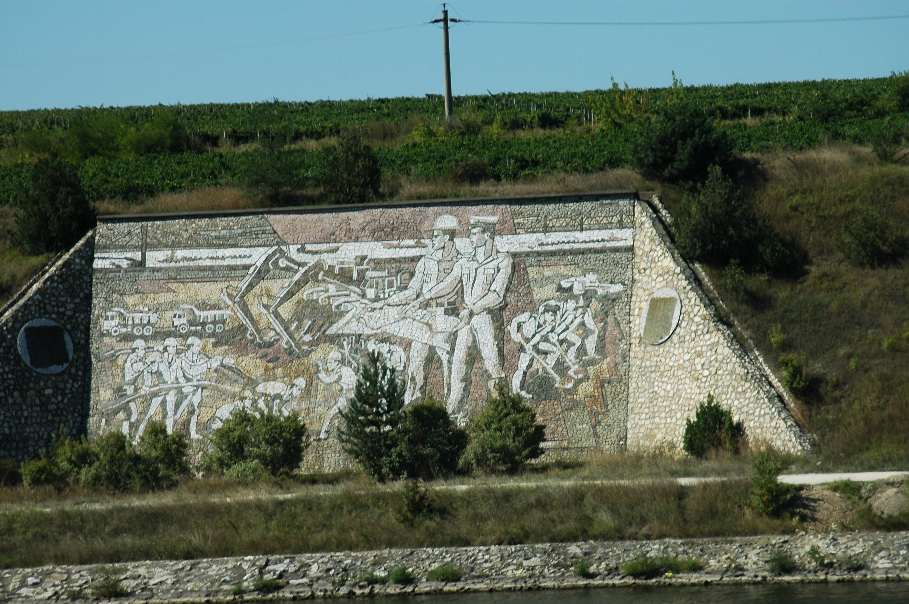
Canalul Dunăre-Marea Neagră

Slide 4
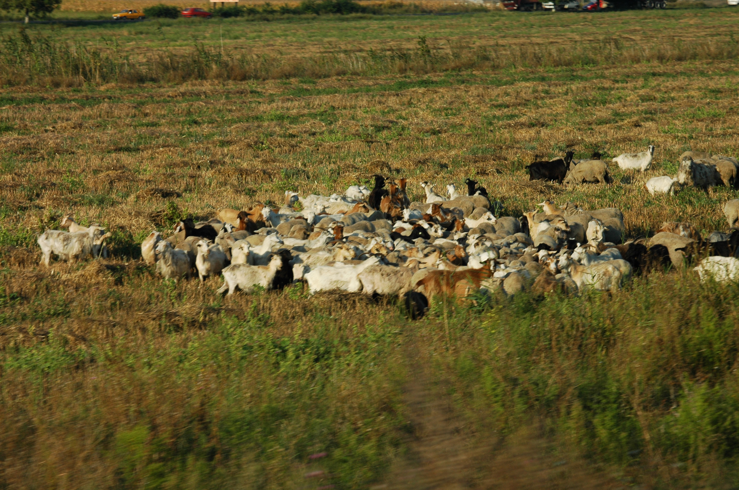
Matthew 25:32 (PRE-SEPARATION)

Slide 5
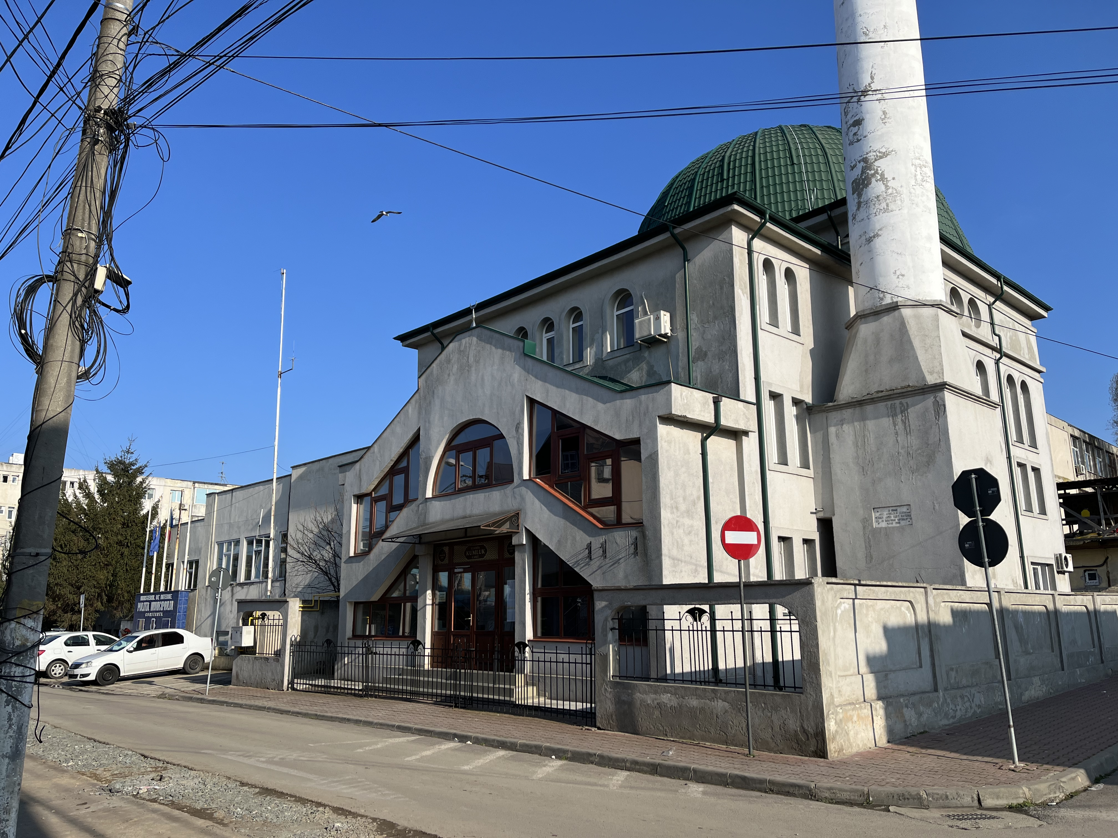

Slide 6
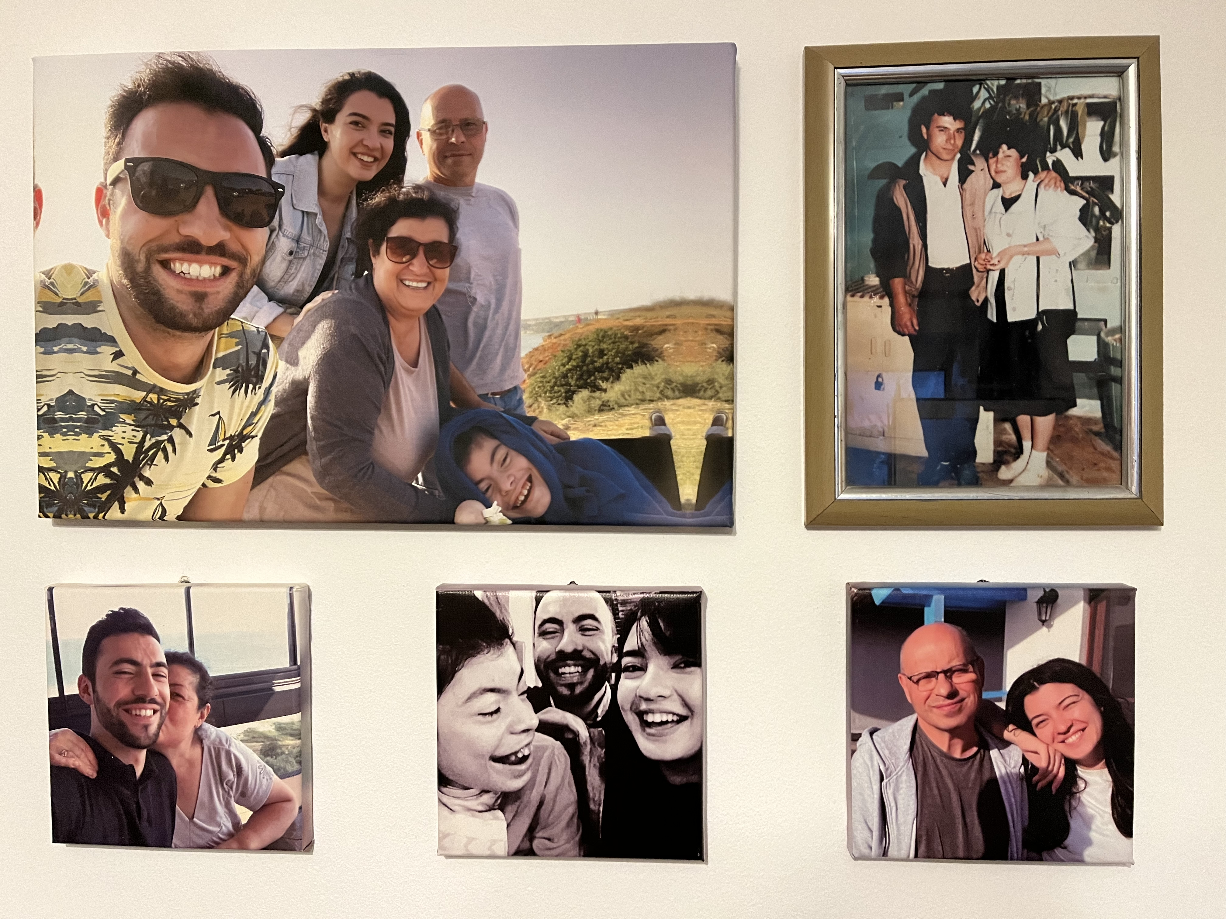
The Bădără Family
George and Rodica
were baptized in 1993
Florentina baptized by Orthodox at 3 months
Iulian was baptized into Christ 2007.
Arina is thinking about baptism.
Only Rodica remains of the Christians in 1993-1994

Slide 7
Doru Luța
Born in 1979
Orphan in Piatra Neamț
Met at Bible study in Buhuși, October 1994
Finished Vo-Tech in 1997
Came to Constanta to look for work.
Found shelter; found work.
Better shelter; better work.
Others followed him.
One followed me home from the train station.

Slide 8
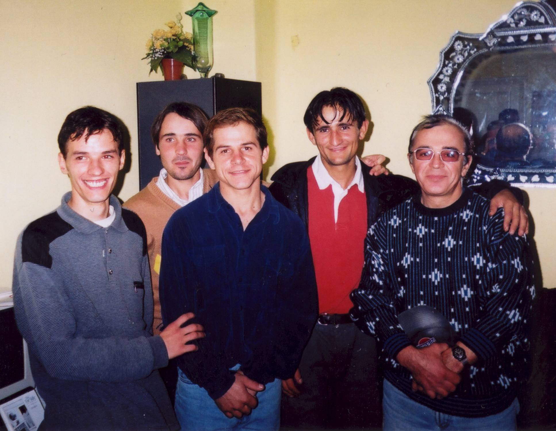
The Guys

Slide 9
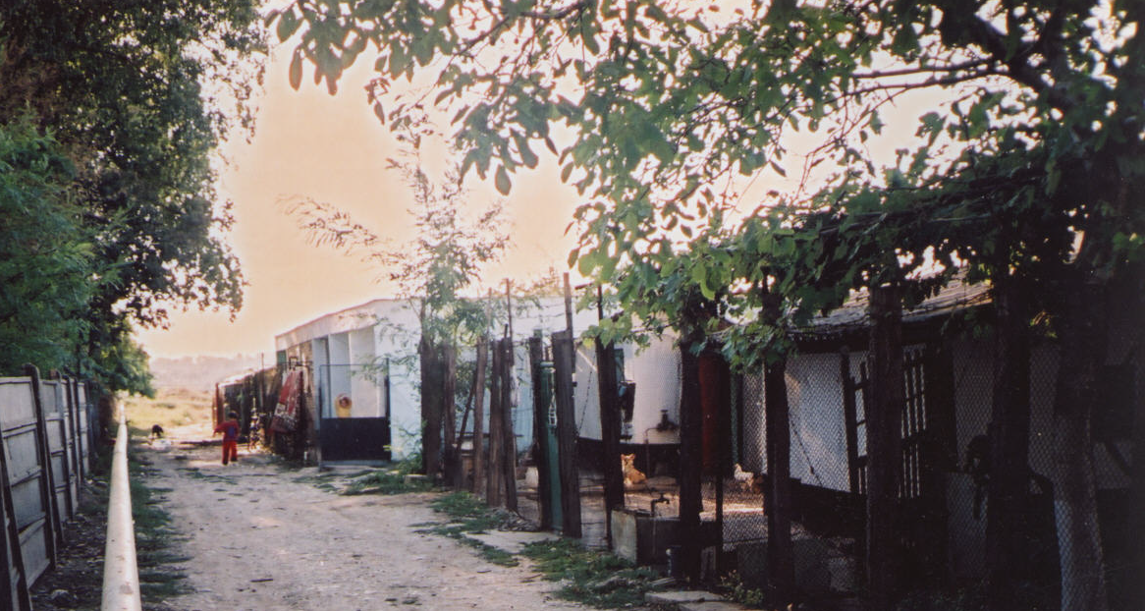

Slide 10
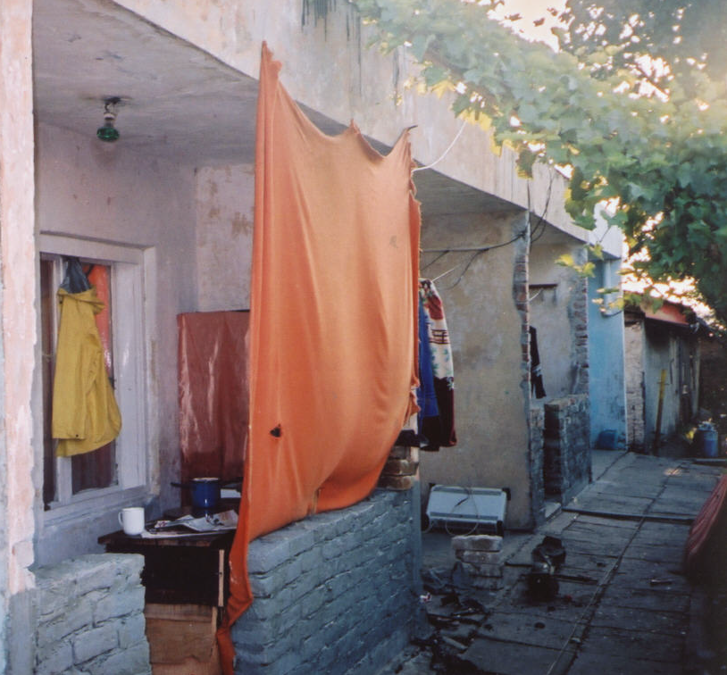

Slide 11
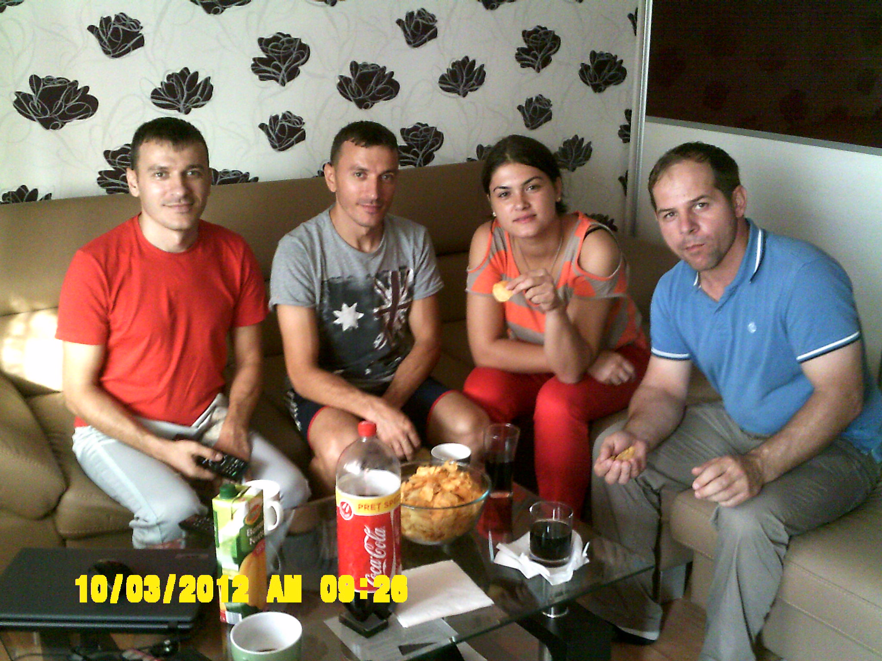
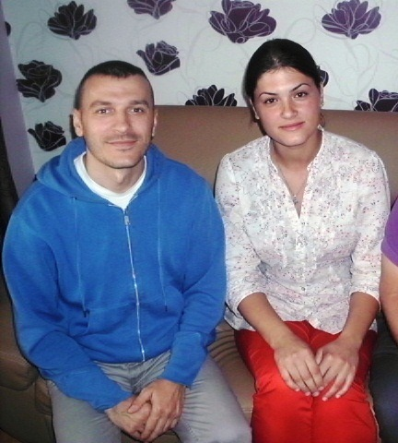

Slide 12
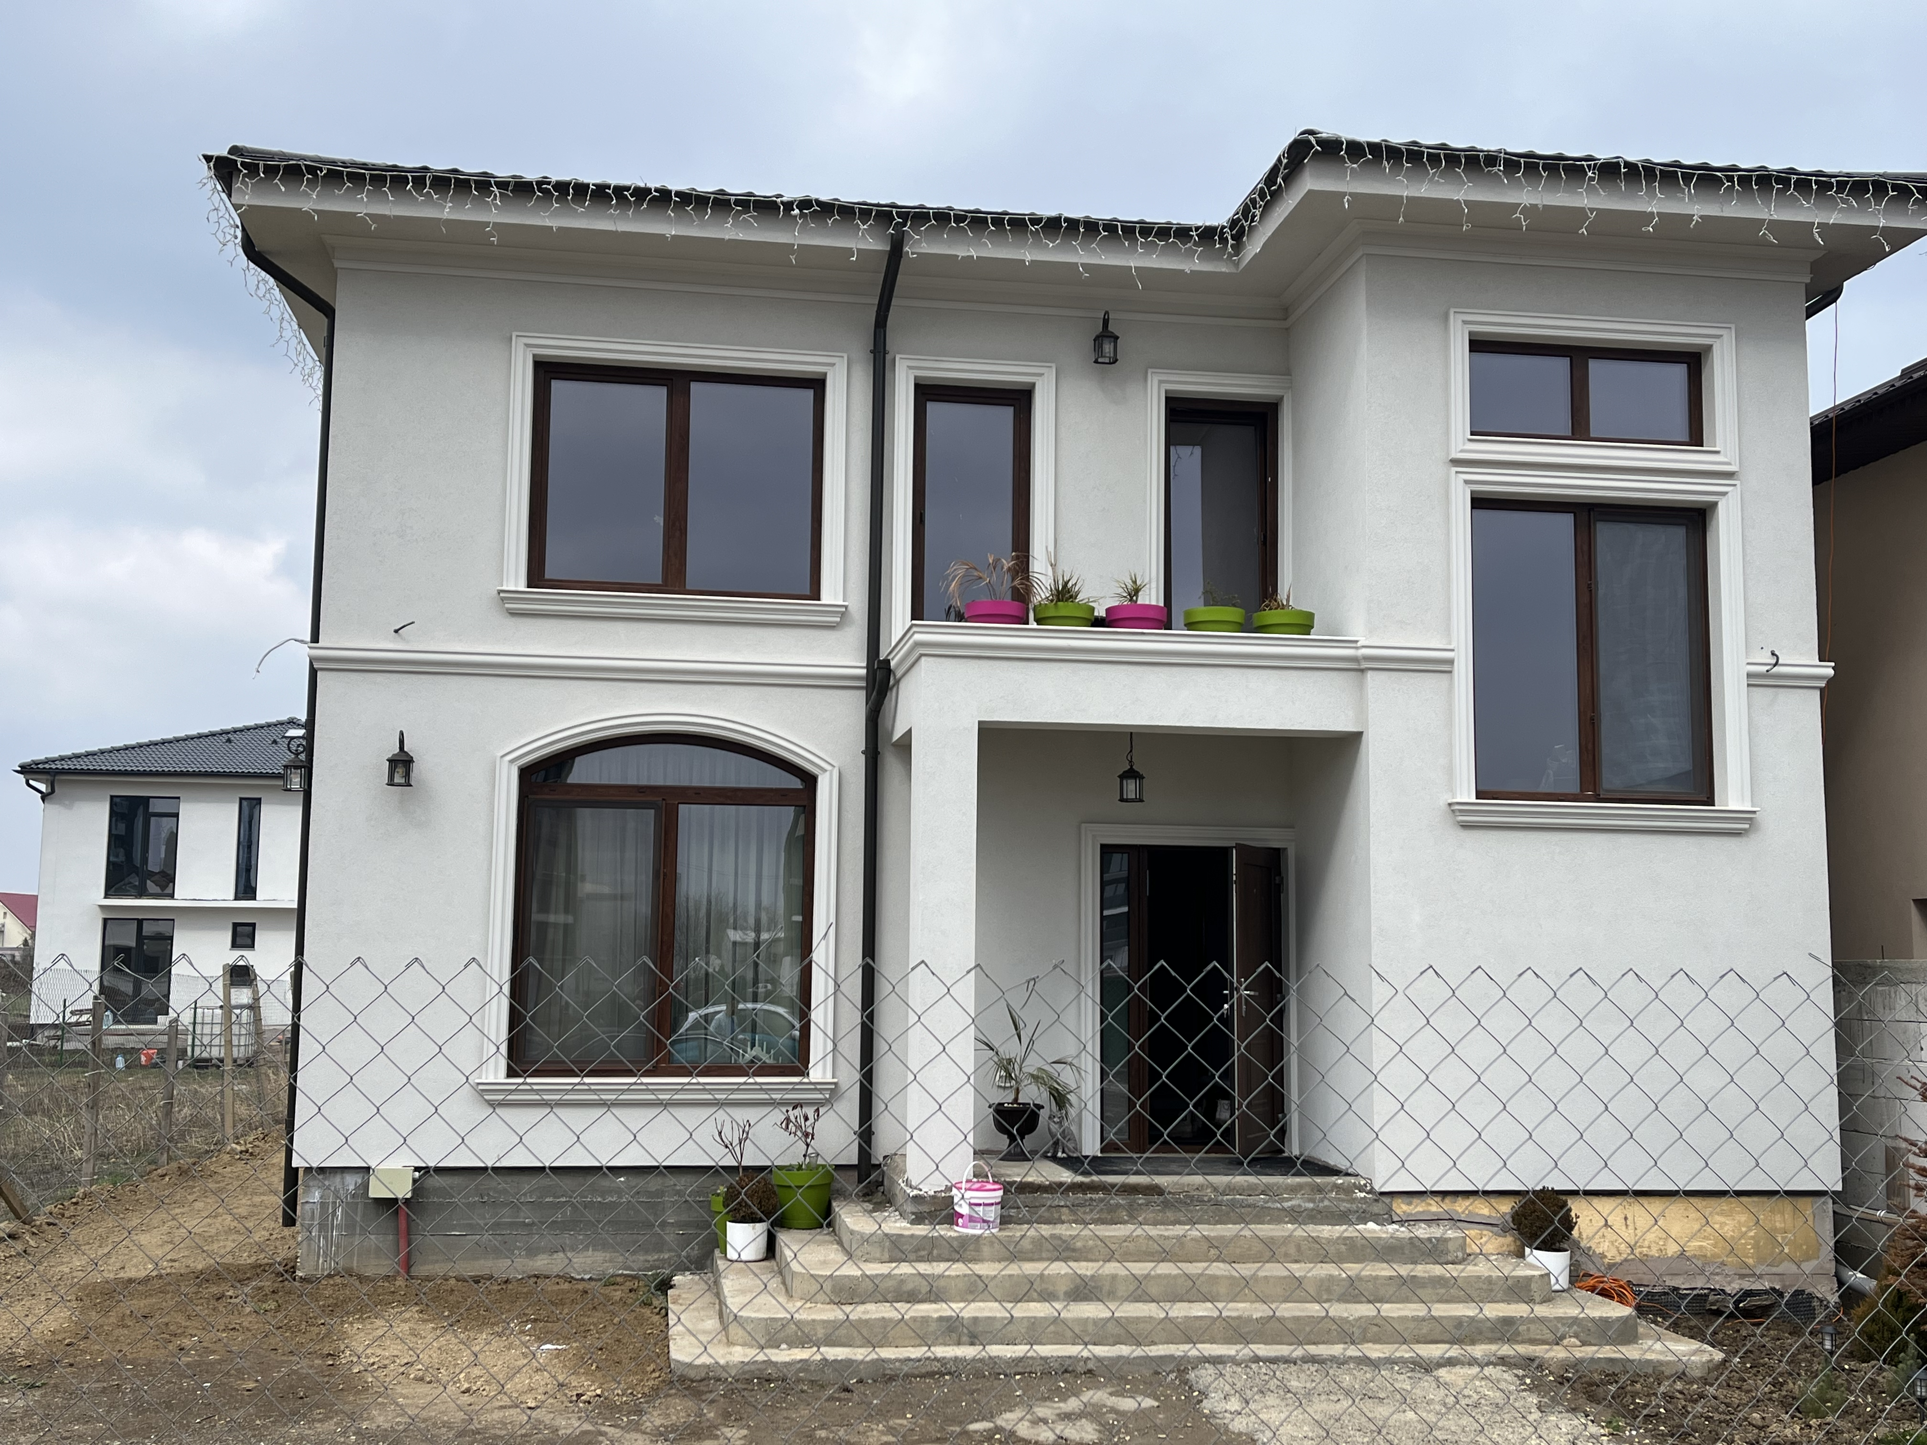

Slide 13
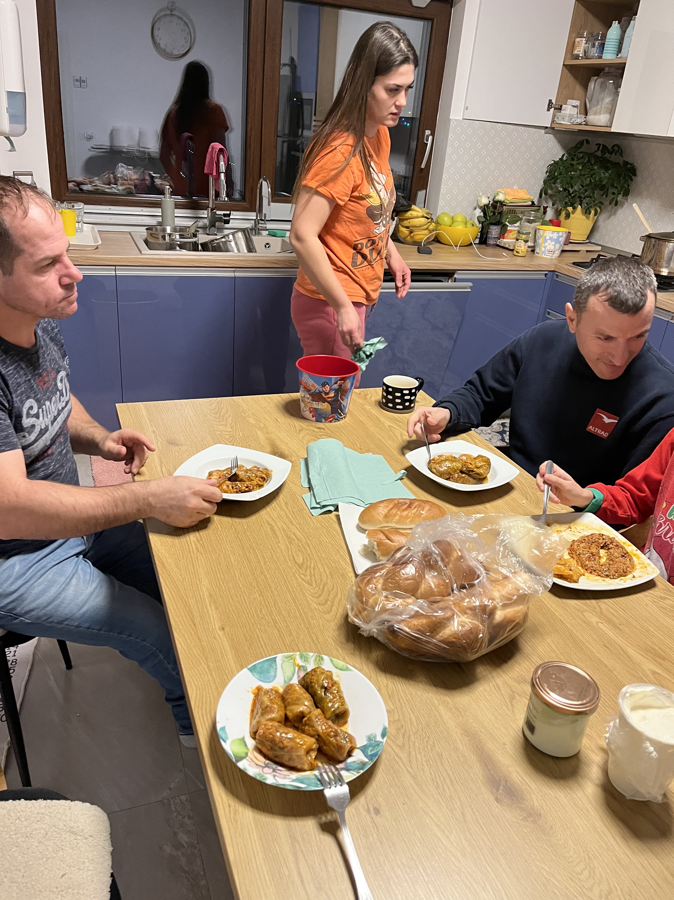
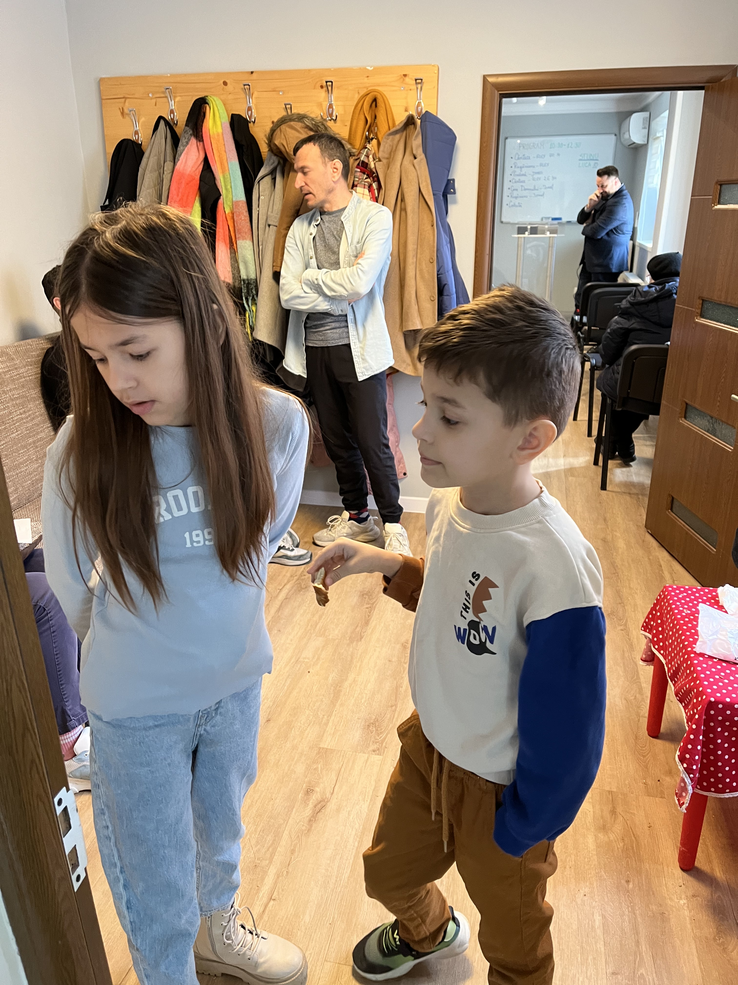
The Cristescu Family

Slide 14
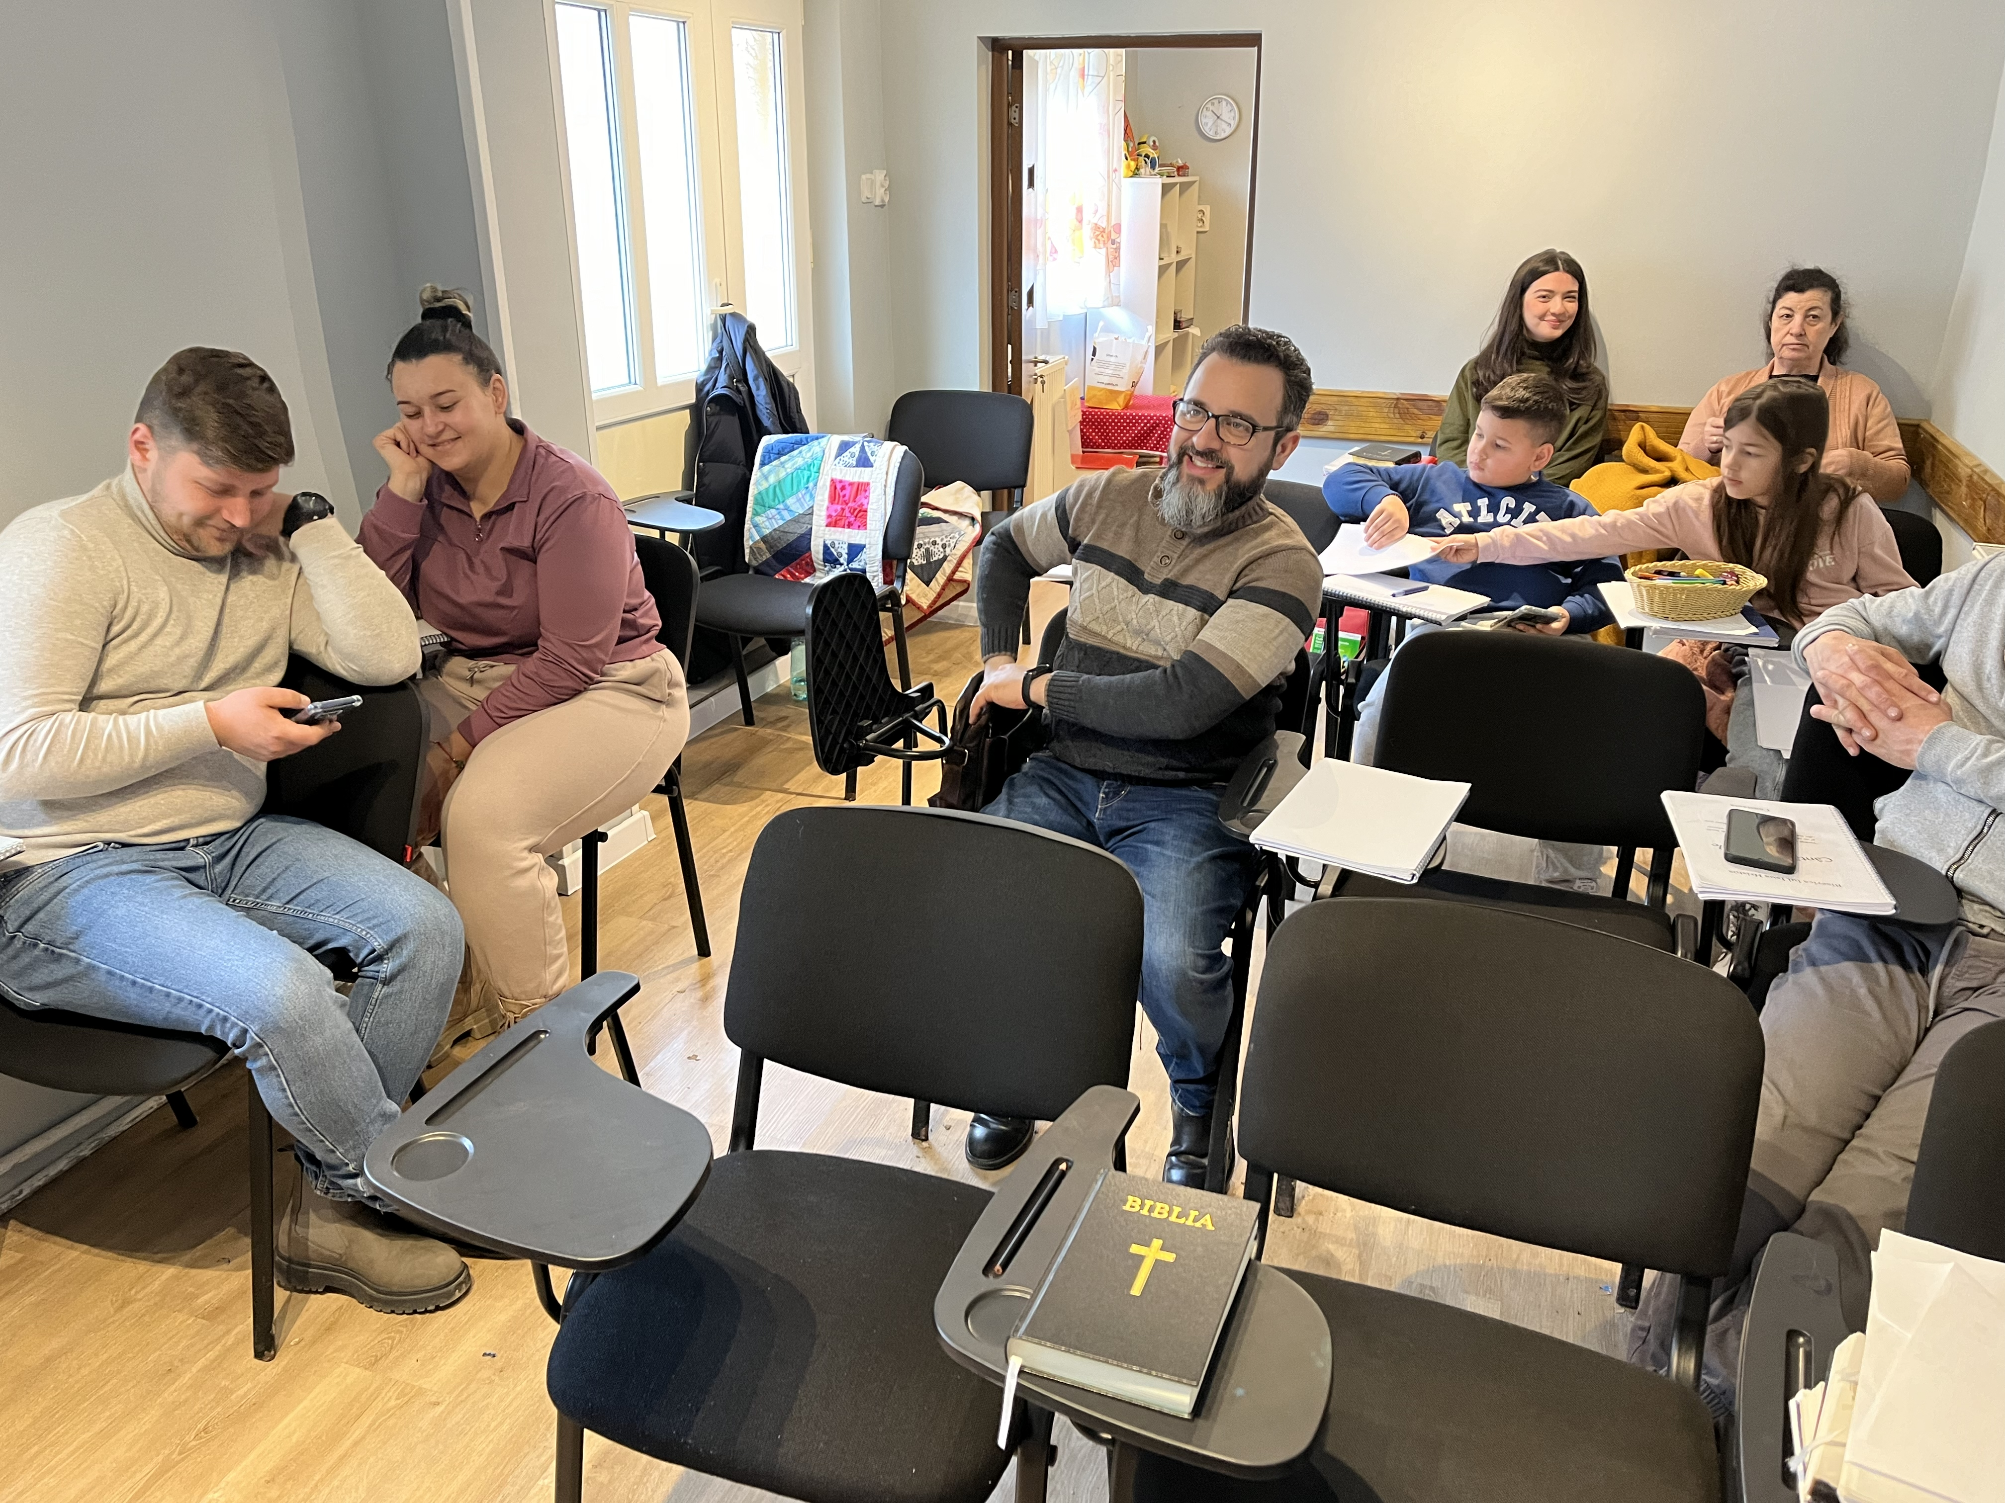

Slide 15
Catalin Ciobanu
was baptized several years ago.
He attends often…

Slide 16
Catalin Ciobanu
was baptized several years ago.
He attends often…
but was marked as an unfaithful member from the Lord and the church.
1 Cor. 5:1-13

Slide 17
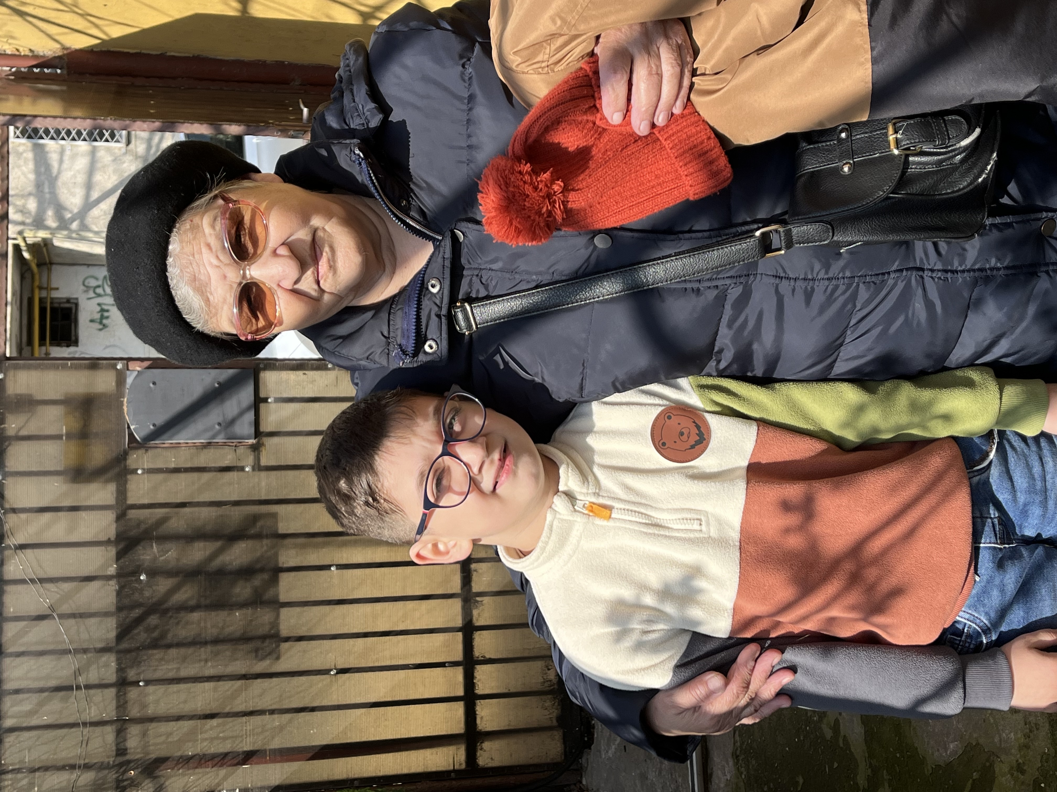
Ioana Tudor
Visited in 2019
She was baptized in May 2019 after a public Bible conference about how people became Christians in Acts.
Her grandson Andrei came with her; now lives with her because his mother passed away.

Slide 18
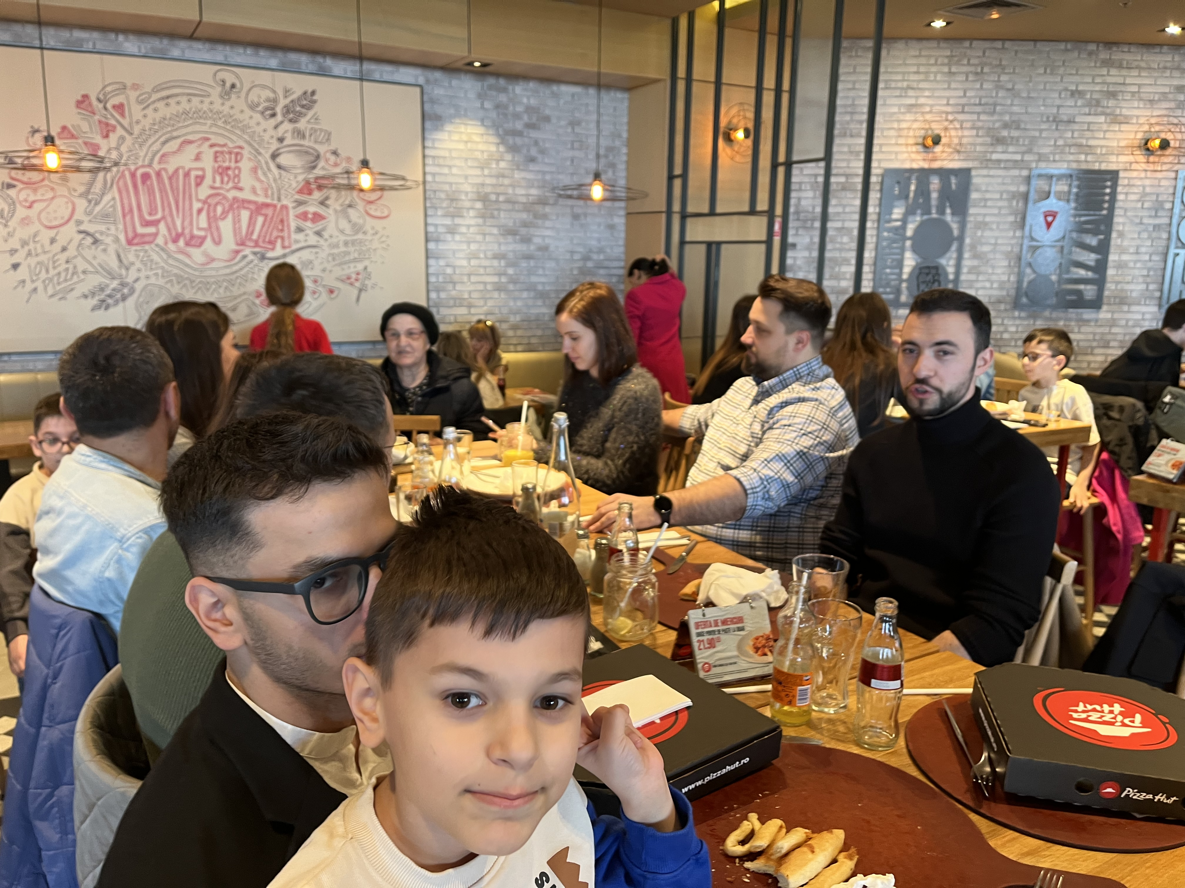

Slide 19
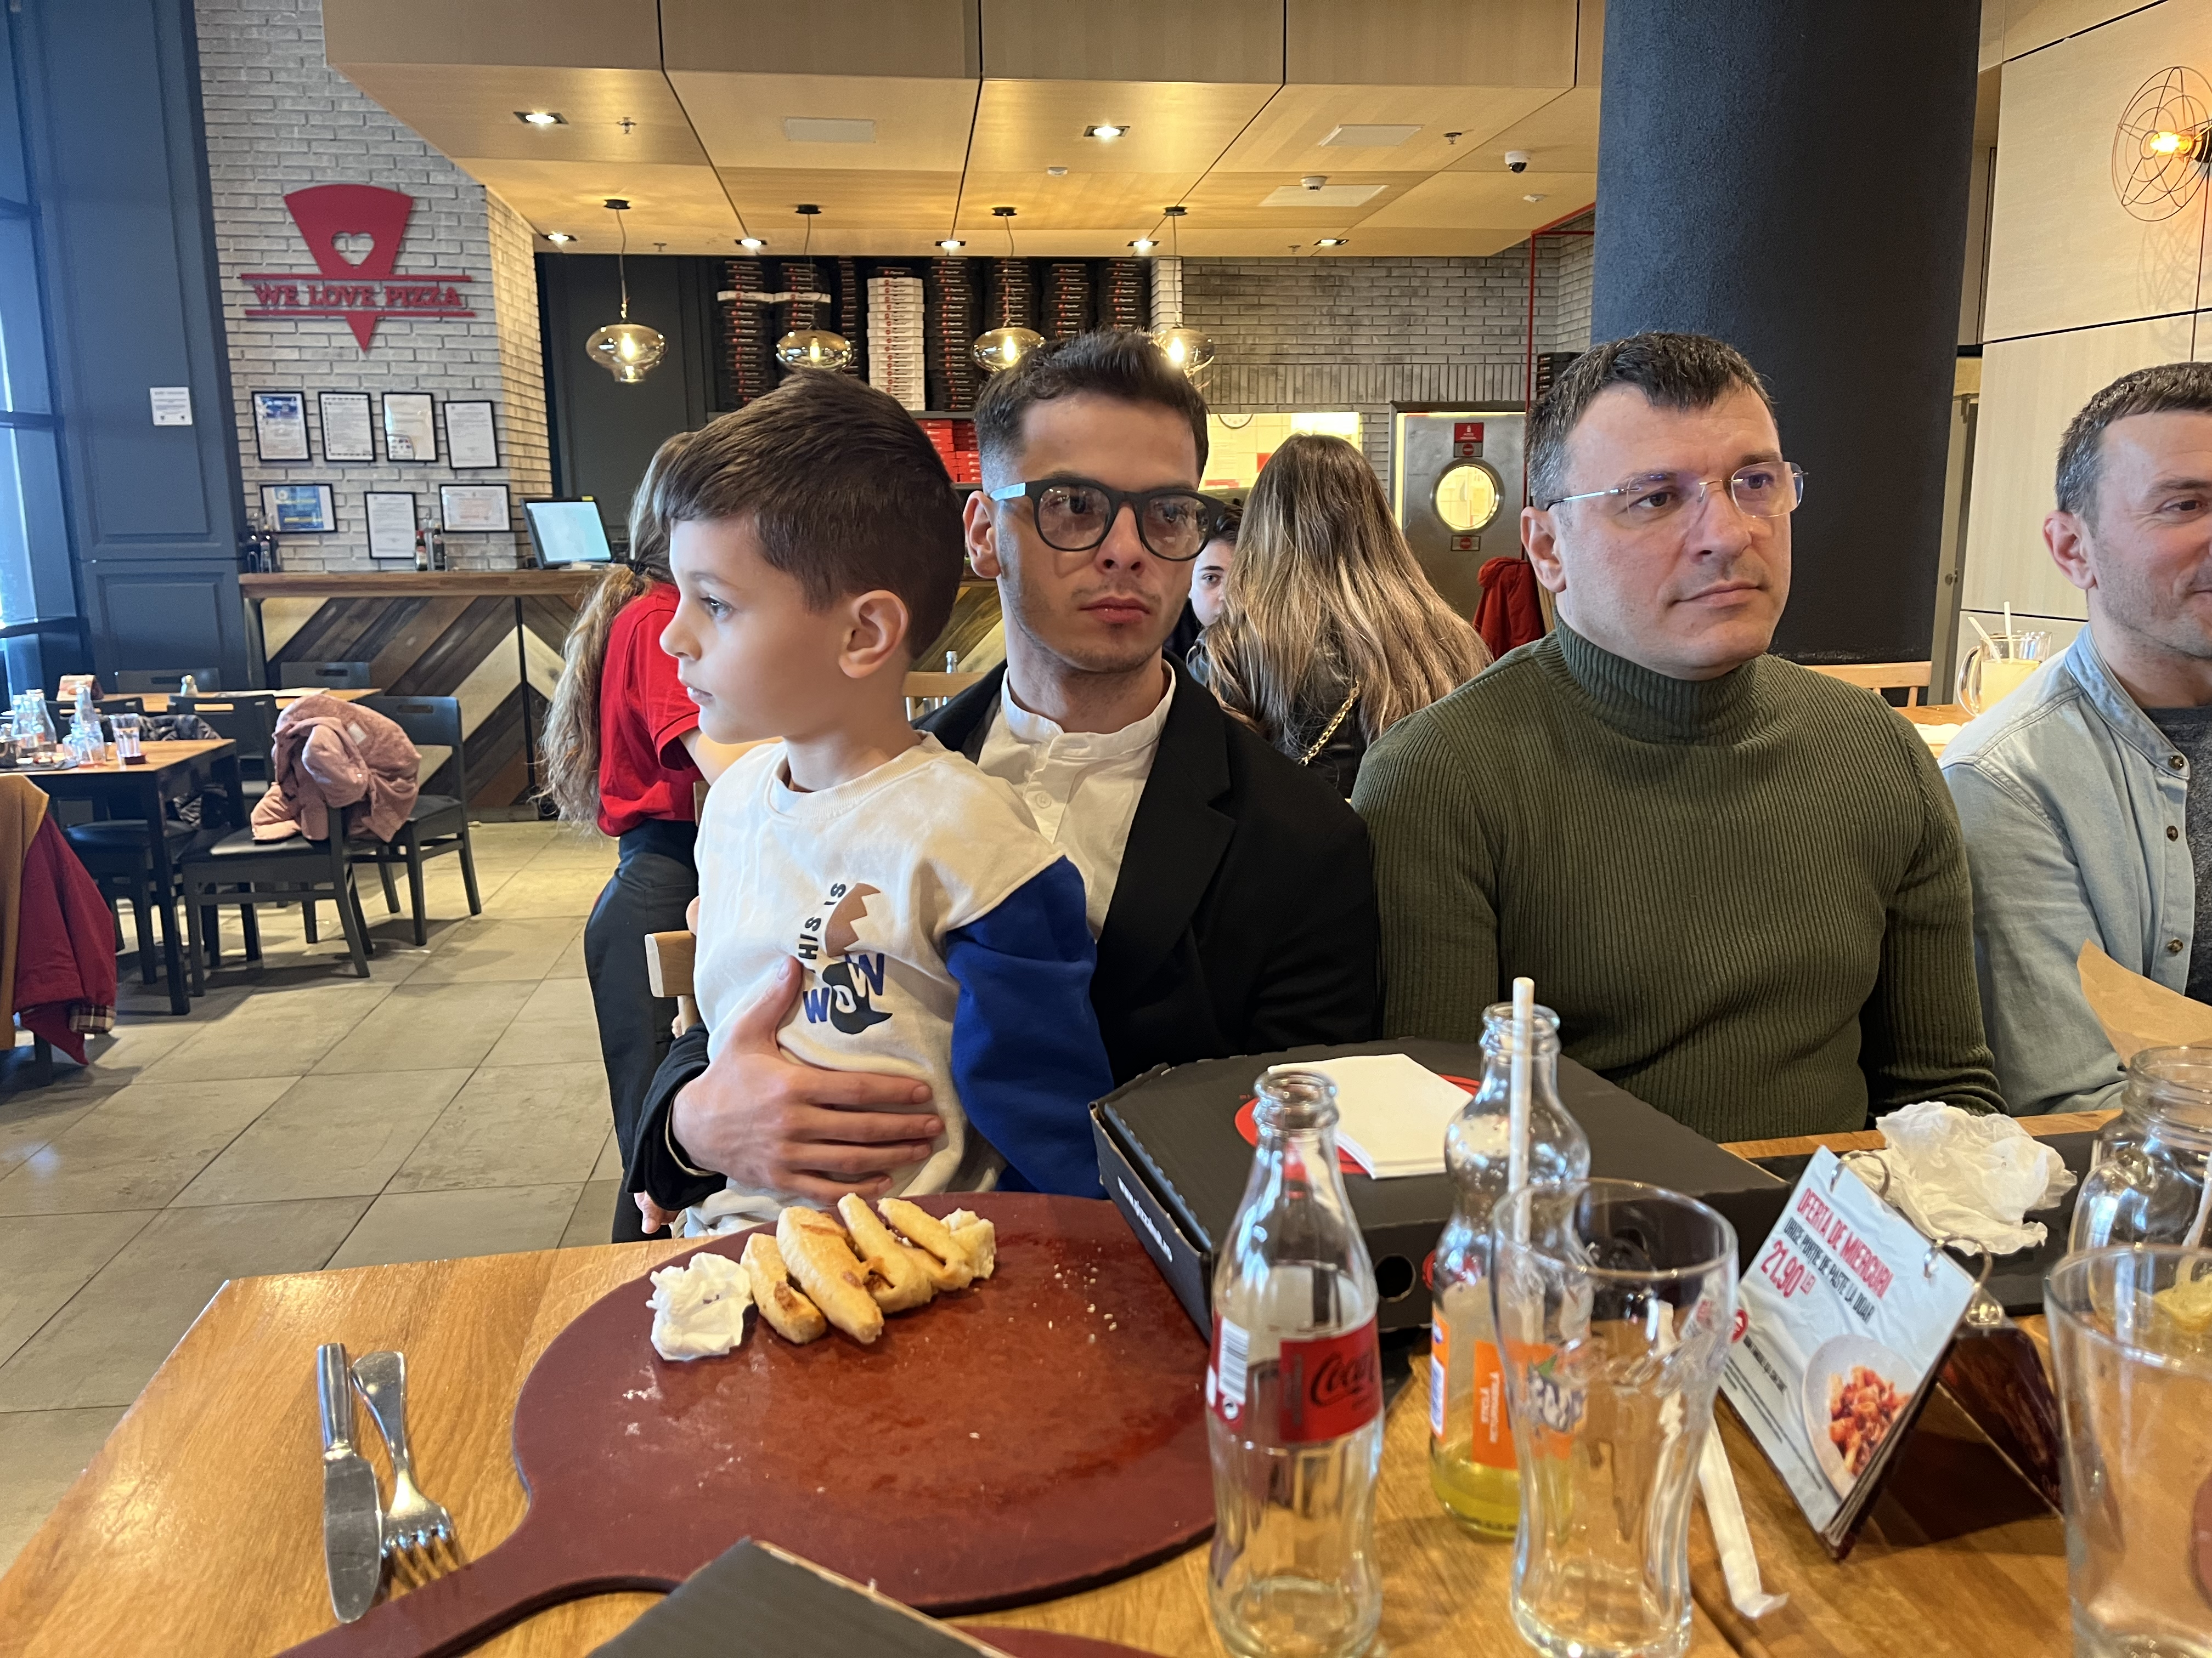

Slide 20
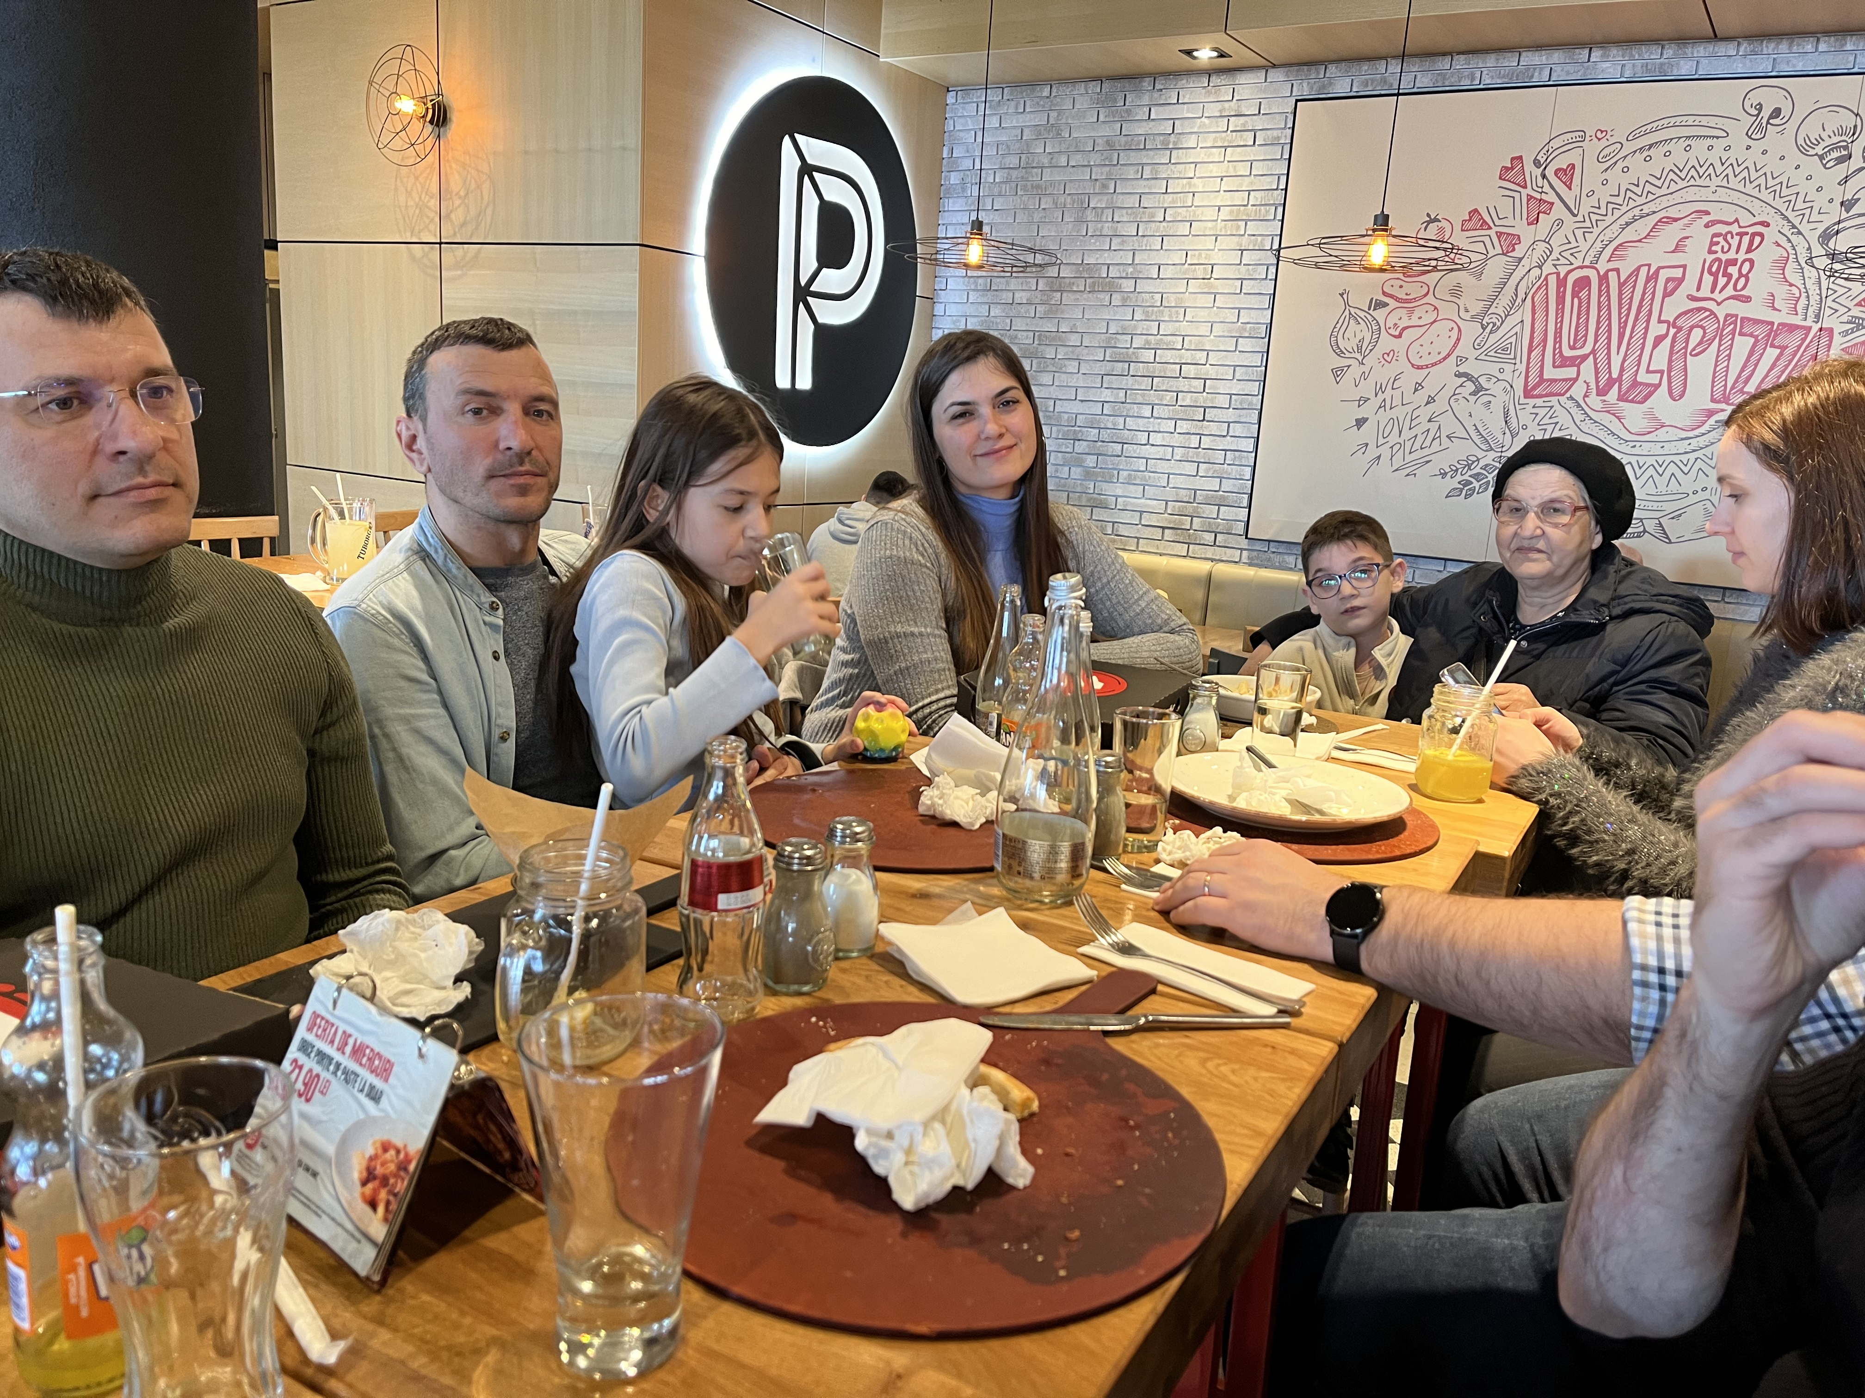

Slide 21
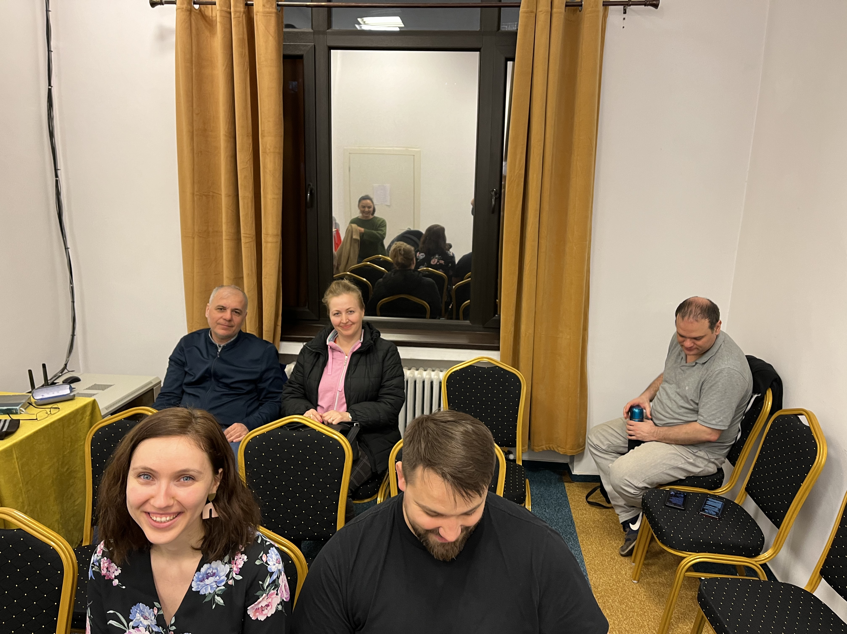
Thursday night Bible study in Bucureșți

Slide 22
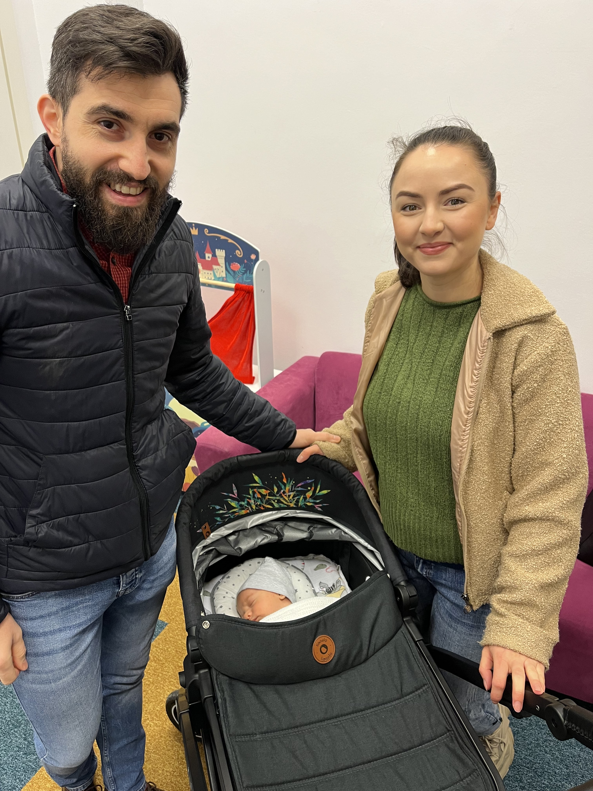
The Luța Family
Bogdan a Christian for 12 years in Bucharest
Wife Diana a more recent convert.
Bogdan is the full-time preacher.
(4 week-old Theo)

Slide 23
Bible Studies
At least one every day, usually two a day (5-10 each)
The Christians taught and baptized Flori six years ago.
Her husband Ionuț obeyed the gospel two or three years later. Eric is their son.
This small church has three eight year-old boys. Friendship in Bible classes, church, and life outside of the building is very important for every age.
Laura’s brother Gabriel was alone in the class when the teacher asked how many went to church weekly

Slide 24
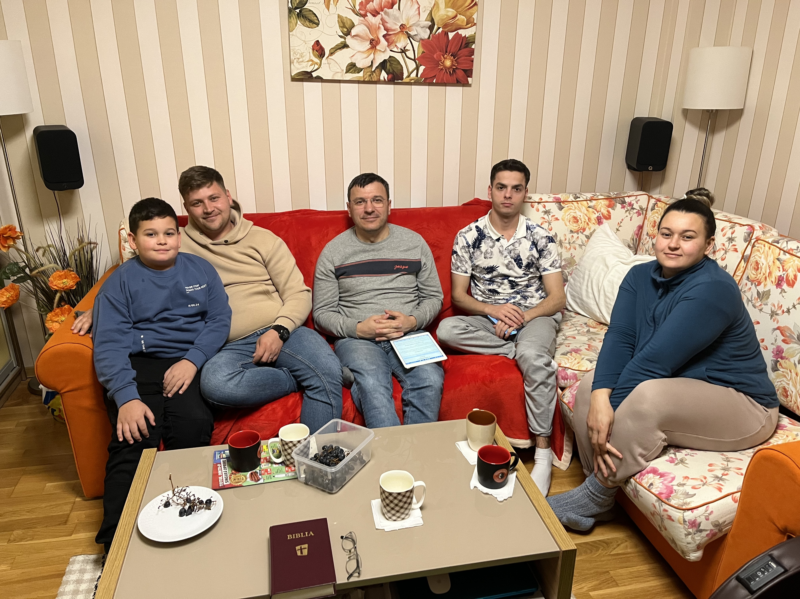

Slide 25
Lessons in Evangelism
1. The best evangelism is personal evangelism.
Acts 8:4
Methods come and go; adapt
Evangelism always requires love, zeal, personal involvement, knowledge, wisdom

Slide 26
Lessons in Evangelism
2. Sow more; water less
1 Corinthians 3:6
sowing = teaching one who has never heard the gospel before
watering = teaching one who has heard
2 Corinthians 9:6
sow sparingly reap sparingly
rarely teach new people; rarely convert

Slide 27
Lessons in Evangelism
3. Sacrifices for evangelism are worth it!
Physical sacrifices
Cultural, social sacrifices
Spiritual sacrifices
Even one faithful Christian is worth all the problems caused by rejection of others
Why did Jesus endure the cross?

Slide 28
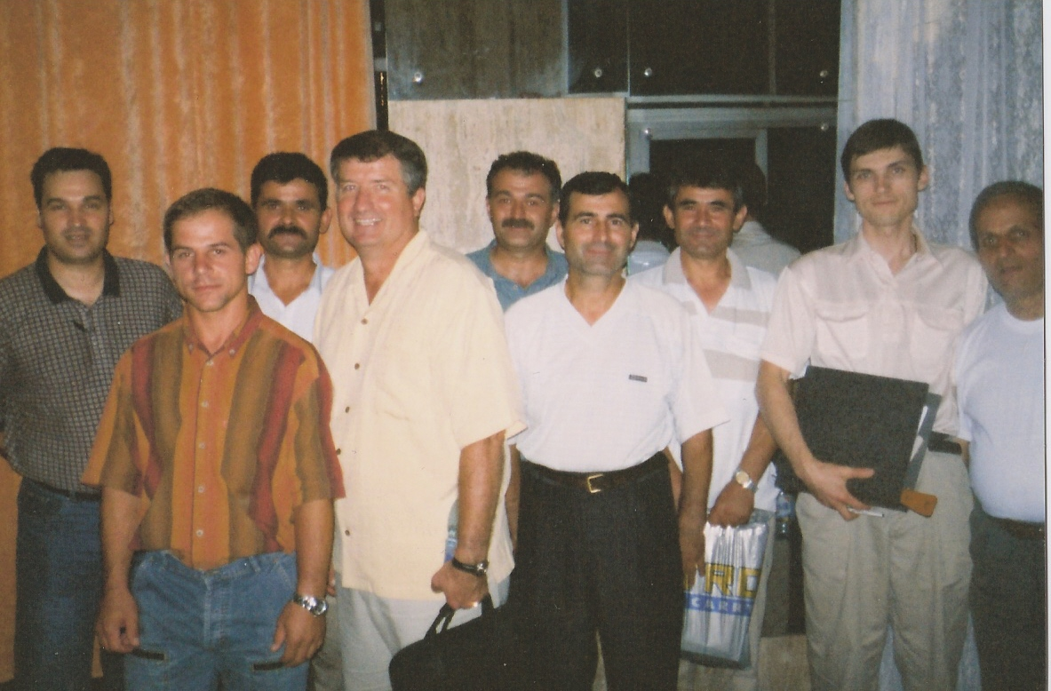

Slide 29
Lessons in Evangelism
4. “Here am I; send me”
Romanians must teach others
We can train and encourage teachers
We can work with them
We can support Romanian workers

Slide 31
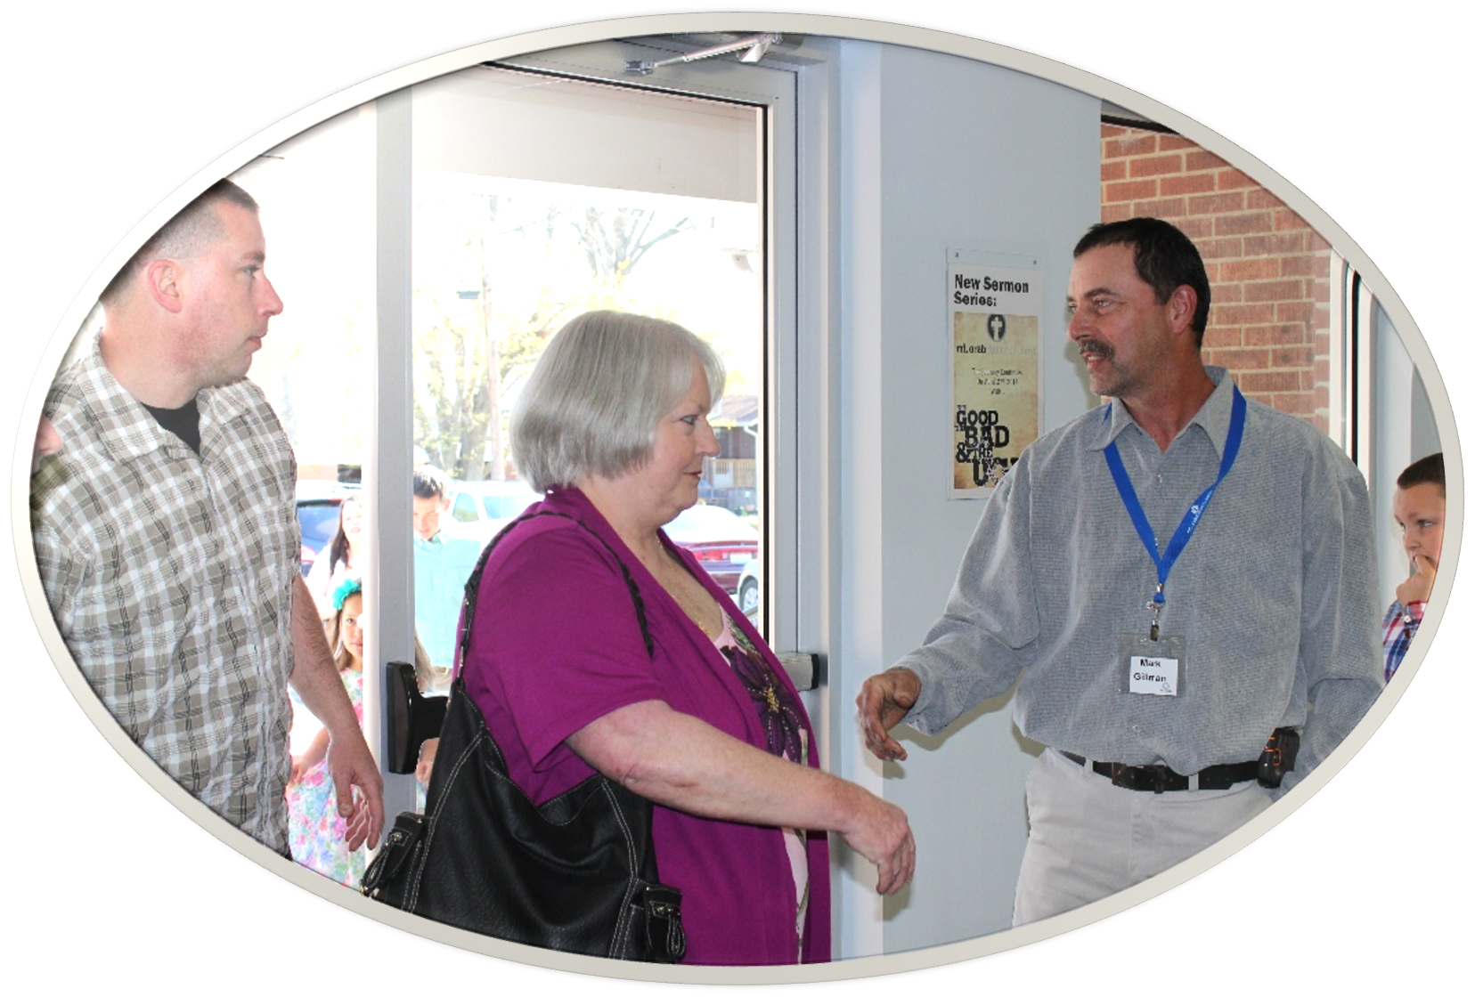
CHURCH of CHRIST
Meeting @ 9500 Hwy 5, Bryant AR
ENTER TO WORSHIP
LEAVE TO SERVE
March 31, 2024

