Slide 1
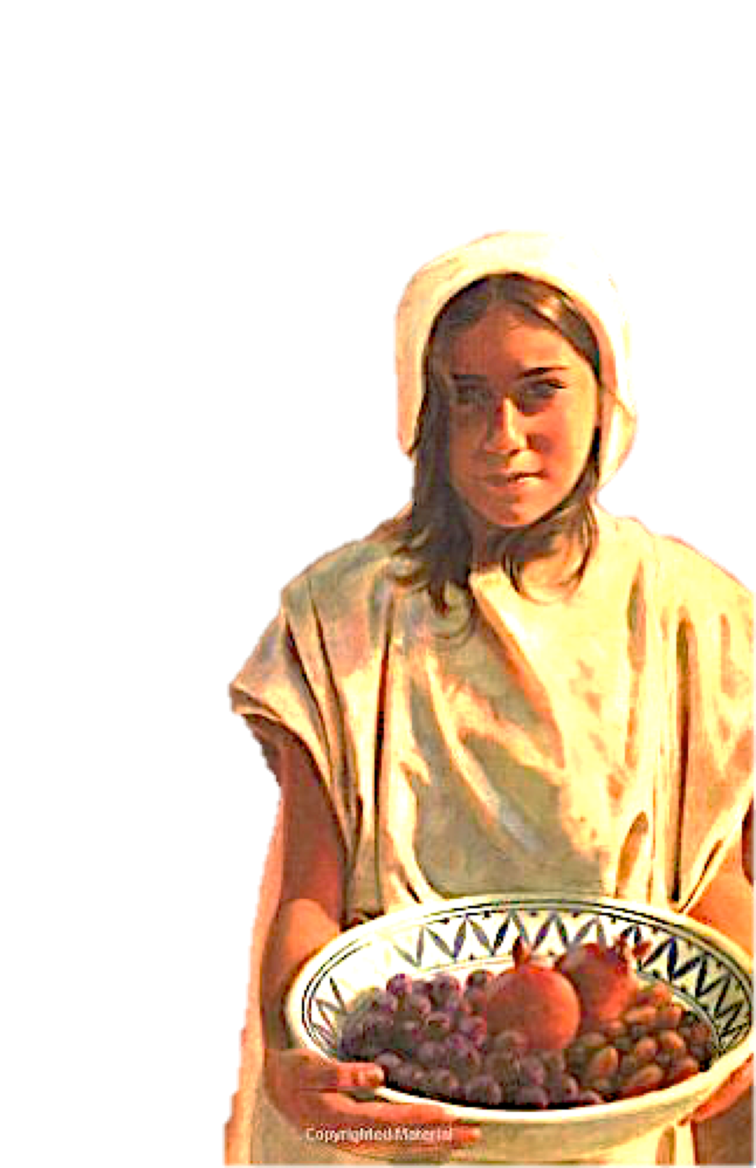
The Impact of Faithful Service In Small Things
(2 Kings 5:1-27)

Slide 2
2 Kings 5:1–4 (NKJV)
¹ Now Naaman, commander of the army of the king of Syria, was a great and honorable man in the eyes of his master, because by him the Lord had given victory to Syria. He was also a mighty man of valor, but a leper. ² And the Syrians had gone out on raids, and had brought back captive a young girl from the land of Israel. She waited on Naaman’s wife. ³ Then she said to her mistress, “If only my master were with the prophet who is in Samaria! For he would heal him of his leprosy.” ⁴ And Naaman went in and told his master, saying, “Thus and thus said the girl who is from the land of Israel.”

Slide 3
2 Kings 5:1–4 (NKJV)
¹ Now Naaman, commander of the army of the king of Syria, was a great and honorable man in the eyes of his master, because by him the Lord had given victory to Syria. He was also a mighty man of valor, but a leper. ² And the Syrians had gone out on raids, and had brought back captive a young girl from the land of Israel. She waited on Naaman’s wife. ³ Then she said to her mistress, “If only my master were with the prophet who is in Samaria! For he would heal him of his leprosy.” ⁴ And Naaman went in and told his master, saying, “Thus and thus said the girl who is from the land of Israel.”
קָטָן — adj. small, young, unimportant;—…— 1. small: especially a. of children, youth = young, Gn 44:20 (J) 2 S 9:12; 1 K 11:17; 2 K 2:23; 5:2.
Brown, F., Driver, S. R., & Briggs, C. A. (1977). Enhanced Brown-Driver-Briggs Hebrew and English Lexicon. Oxford: Clarendon Press

Slide 4
things that have become "great" have had small beginnings, and all great things are made up of smaller parts.

Slide 5
Almost without exception the greatest contribution to the success of any endeavor is due to little things and ordinary people.

Slide 6
The principle works two ways
Small things have great power both for Evil & good — “sin” & “righteousness”

Slide 7
From The Lesser To The Greater:
The kingdom - (Mustard seed & Leaven - Mat 13:31-33)
Faith - (Mustard seed - Mat 17:20)
False teaching - (Leaven - Mat 16:6,11,12; Gal 5:9)
Sin - (Leaven - 1 Cor 5:6)

Slide 8
Luke 16:10–13 (NKJV)
¹⁰ He who is faithful in what is least is faithful also in much; and he who is unjust in what is least is unjust also in much. ¹¹ Therefore if you have not been faithful in the unrighteous mammon, who will commit to your trust the true riches? ¹² And if you have not been faithful in what is another man’s, who will give you what is your own? ¹³ “No servant can serve two masters; for either he will hate the one and love the other, or else he will be loyal to the one and despise the other. You cannot serve God and mammon.”

Slide 9
The Israelites were guilty of “Despising the day of small things” (Zec 4:10)
The one-talent-man did not understand the value of small things (Matthew 25:14- 30)
Even a cup of water given in the name of a disciple will be rewarded (Matthew 10:42).

Slide 10
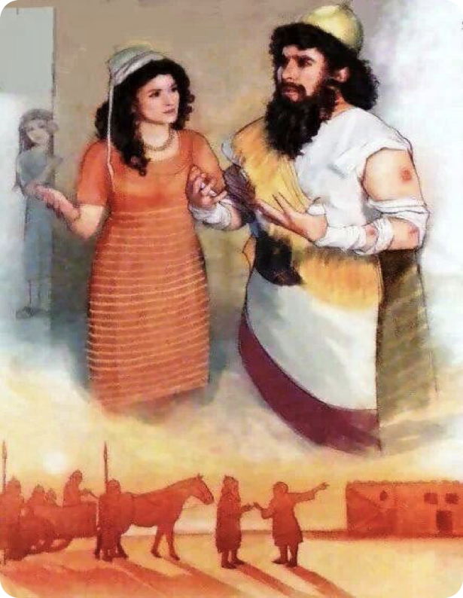
Naaman - Commander of the Syrian armies / SERVANT of the King of Syria - Ben-Hadad II (860–841 b.c.) (vs. 1)
A captive slave from Israel - a young girl who served Naaman’s wife (vs. 2,3)
King of Syria - Ben-Hadad II - is concerned enough for his servant to seek his well being (vs. 4-6)

Slide 11
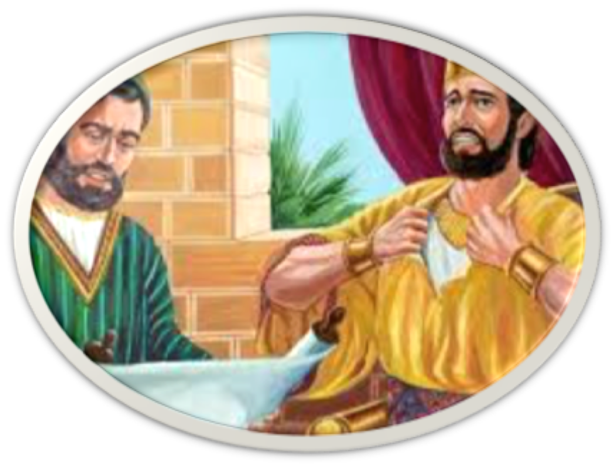
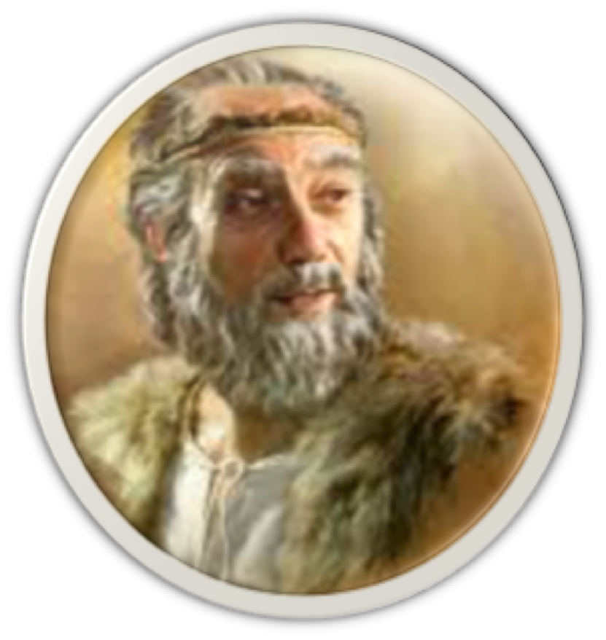
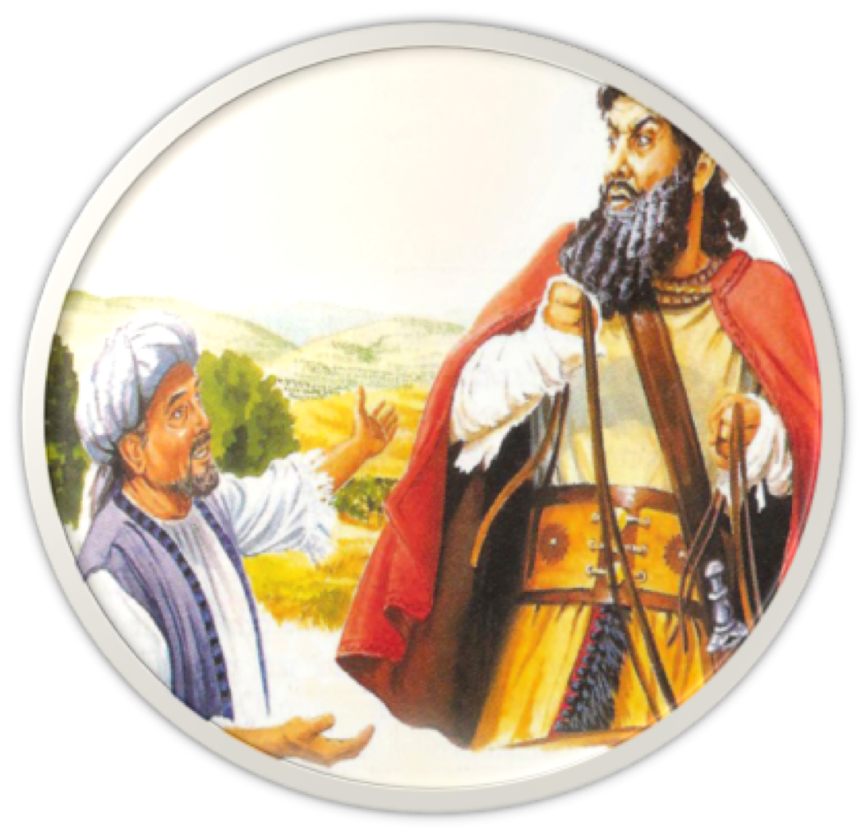
King Joram - son of Ahab - aware of Elisha, but could not see beyond himself, his inadequacies & insecurities (2 Kings 8:6,7; 9:24)
Elisha - prophet in Israel - The man of God - a farmer, a disciple first - 3,8-10; (1 Kings 19:19; 2 Kings 2:1-15)
Naaman - considered God’s command beneath him - wanted to pay (vs. 9-12)

Slide 12
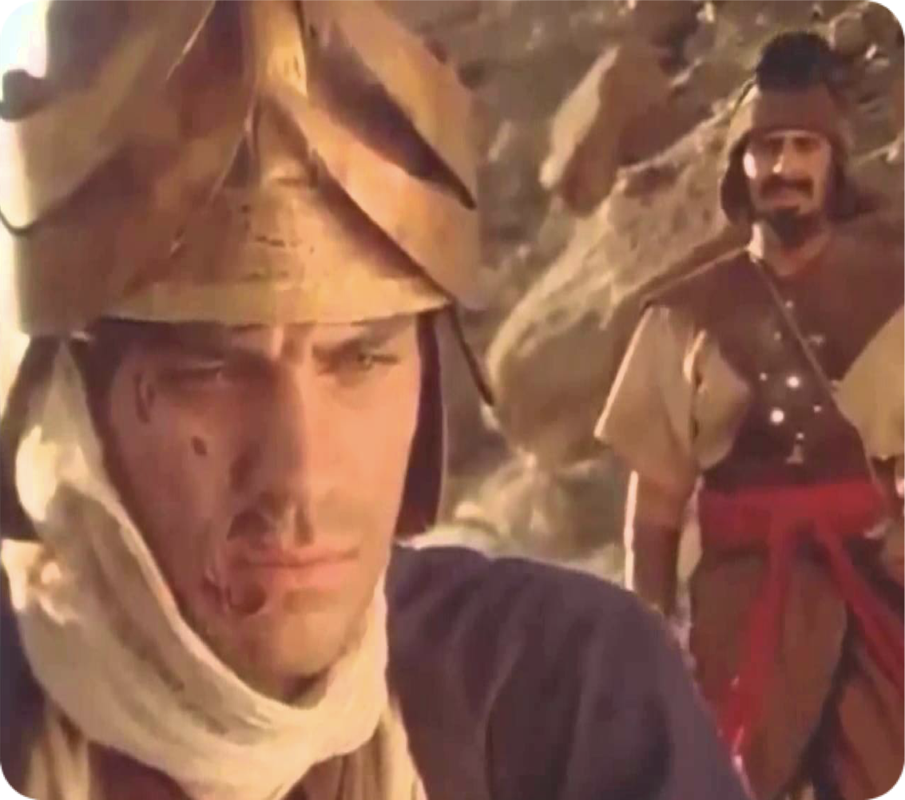
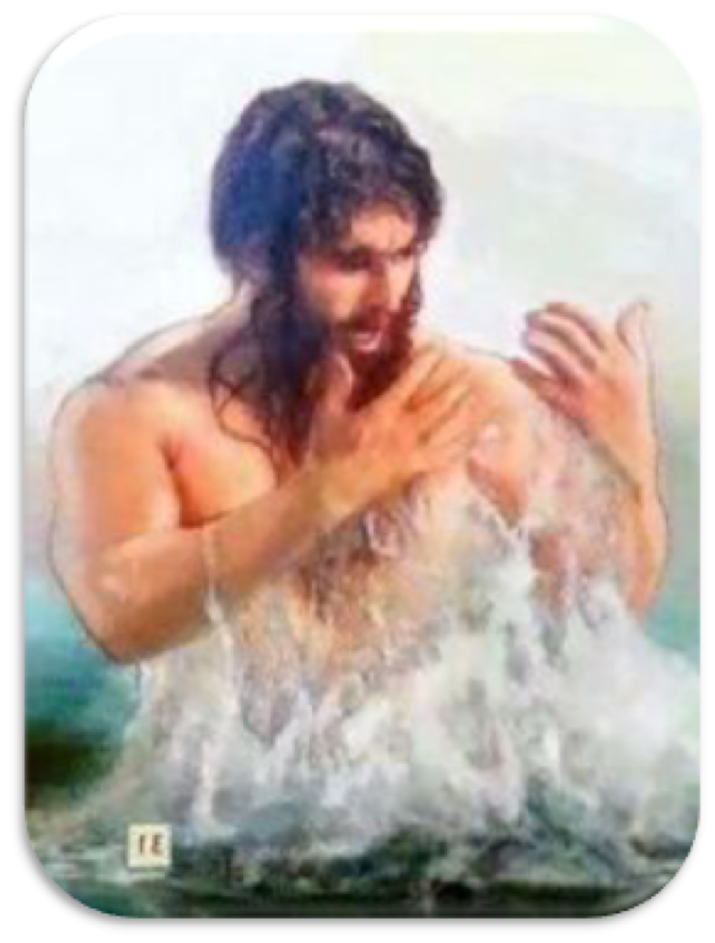
Naaman’s servants reproved him - spoke the truth - encouraged him to be humble and do as instructed (vs. 13)
Naaman - it wasn’t until he became little & obedient could he become whole (vs. 14)

Slide 13
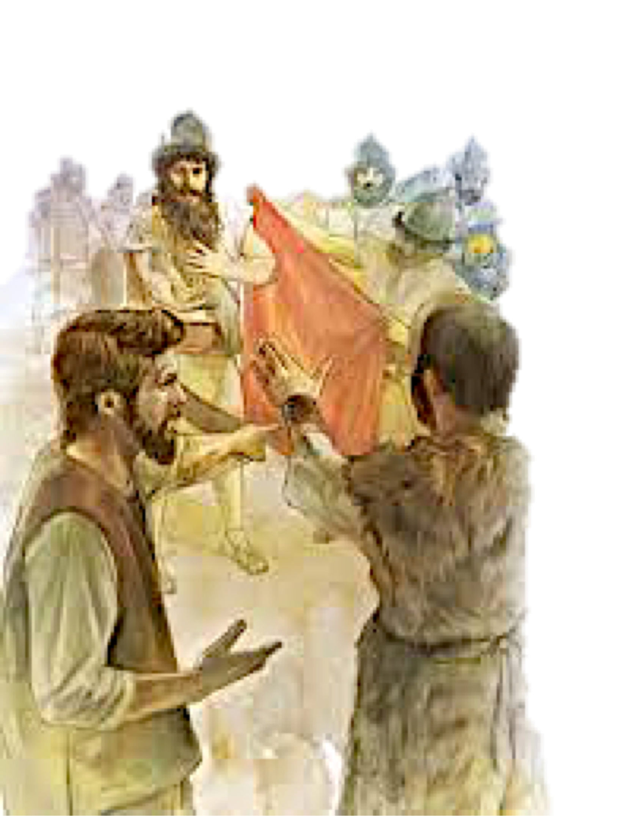
Naaman’s servants reproved him - spoke the truth - encouraged him to be humble and do as instructed (vs. 13)
Naaman - it wasn’t until he became little & obedient could he become whole (vs. 14)
NAAMAN learned God’s gifts cannot be purchased by ‘GREAT THINGS’ (15,16; Acts 8:18)
NAAMAN understood his need for God’s mercy (vs. 17-19)

Slide 14
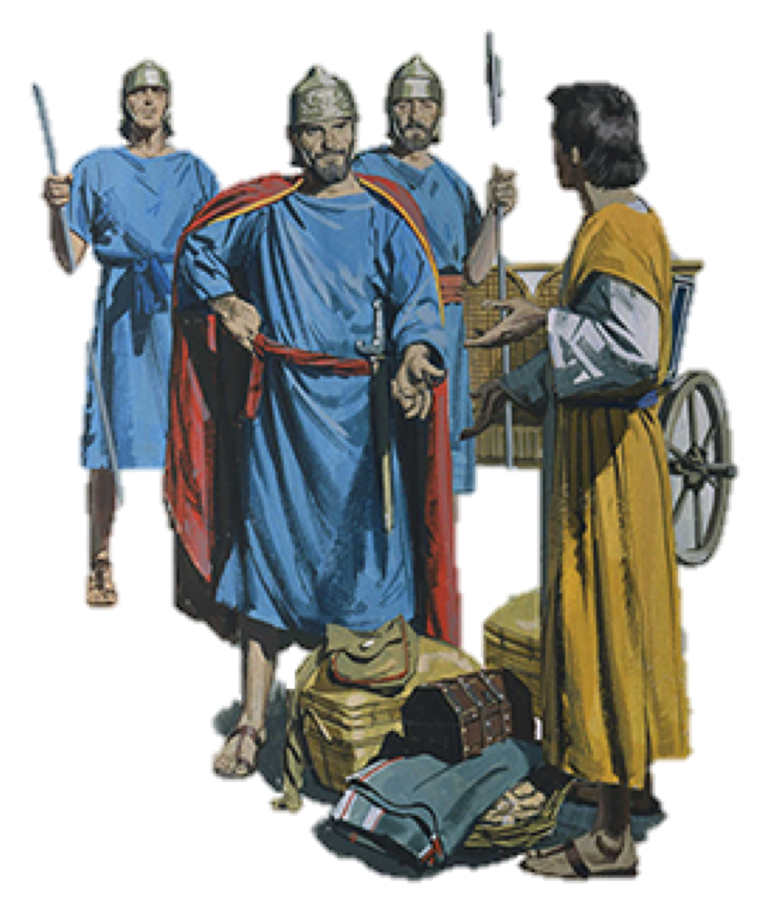
Gehazi’s Greed, Lies & Penalty
Gehazi greedily pursues Naaman (vs. 20,21)
Gehazi lies to Naaman & receives two talents of silver & two changes of clothing (vs. 22-24)
Gehazi lies to Elisha (vs. 25)

Slide 15
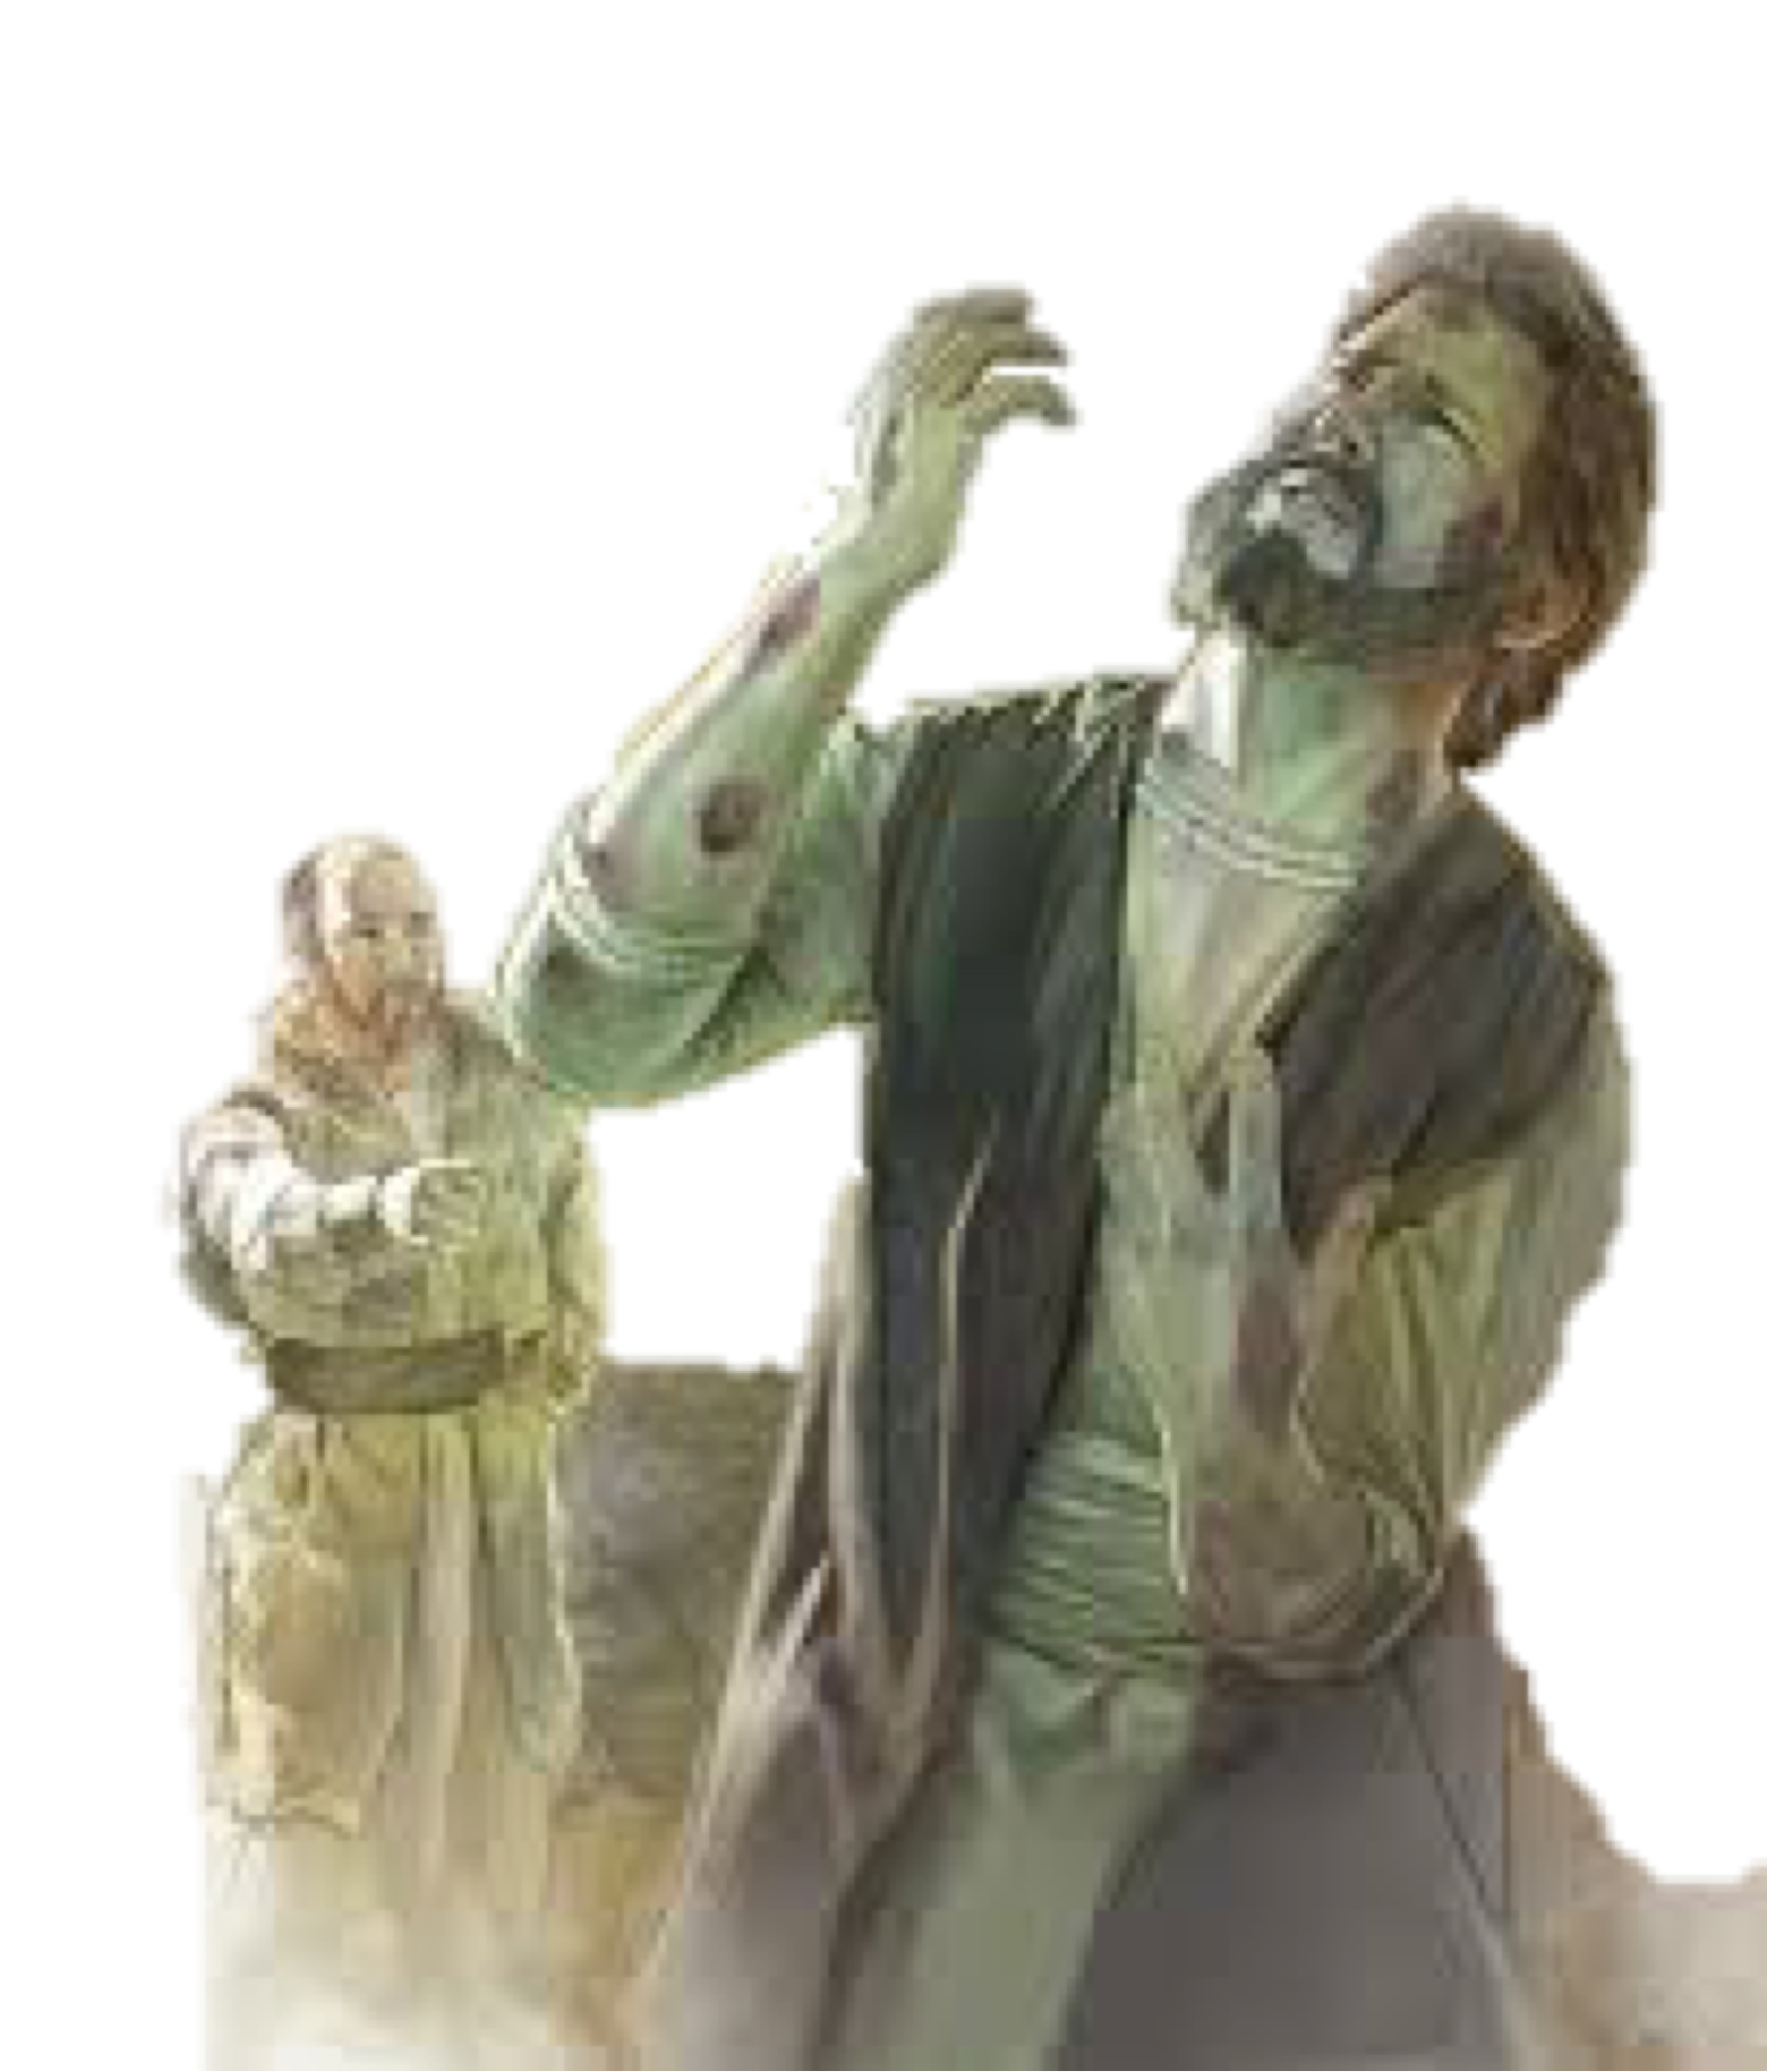
Gehazi’s Greed, Lies & Penalty
Gehazi becomes a leper (26-27)
2 Kings 5:25–27 (NKJV)
²⁵ Now he went in and stood before his master. Elisha said to him, “Where did you go, Gehazi?” And he said, “Your servant did not go anywhere.” ²⁶ Then he said to him, “Did not my heart go with you when the man turned back from his chariot to meet you? Is it time to receive money and to receive clothing, … ²⁷ Therefore the leprosy of Naaman shall cling to you and your descendants forever.” And he went out from his presence leprous, as white as snow.

Slide 16
Every Christian has ability, just in different ways and in different degrees (1 Cor 12:14—31)
We must use what we have, and thereby improve it (Mat 25:14-30)
It may be small in the beginning, but a lot of great things have had small beginnings (Mat 10:42; 13:31-33; 17:20; 2 Cor. 12:9)

Slide 17
David & Goliath (1 Sam 17)
Goliath = BIG (9’6” +) / Bronze helmet, coat of scale armor weighing 5,000 shekels, i.e., about 125 lbs. A bronze javelin, and a long spear with an iron tip weighing over 15-pounds!
David small in comparison, a youth / 5 stones & sling (4-7; 40-42)

Slide 18
1 Samuel 17:45–47 (NKJV)
⁴⁵ Then David said to the Philistine, “You come to me with a sword, with a spear, and with a javelin. But I come to you in the name of the Lord of hosts, the God of the armies of Israel, whom you have defied. ⁴⁶ This day the Lord will deliver you into my hand, and I will strike you and take your head from you.

Slide 19
1 Samuel 17:45–47 (NKJV)
And this day I will give the carcasses of the camp of the Philistines to the birds of the air and the wild beasts of the earth, that all the earth may know that there is a God in Israel. ⁴⁷ Then all this assembly shall know that the Lord does not save with sword and spear; for the battle is the Lord’s, and He will give you into our hands.”

Slide 20
The Israelites “Despised the day of small things (Zec 4:10)
The one-talent-man did not understand the value of small things (Mat 25:14- 30)
Even a cup of water given in the name of a disciple will be rewarded (Mat 10:42).
A SERVANT GIRL set in motion events resulting in NAAMAN being healed & becoming a believer in GOD (2 Kings 5:1-19).

Slide 21
“The end of a thing is better than the beginning” (Eccl 7:8)
"bread cast upon the waters returns after many days.” (Eccl 11:1)
“In the morning , sow your seed …” (Eccl 11:6)
Obey the LORD today - Do what you know - (take the NEXT step in the right direction) (2 Cor 6:2)

Slide 22
questionS:
Do you feel inadequate, unimportant, and your efforts won’t make a difference?
Are you available? ARE YOU WILLING?
WILL YOU USE WHAT YOU HAVE?
Who knows how God can use you to help someone else.

Slide 24
Charts by Don McClain
Preached
March 6, 2016 West 65th Street church of Christ -
March 10, 2024 - Bryant church of Christ
Phone 501-568-1062 / Email – donmcclain@sbcglobal.net
Prepared using Keynote
More Keynote, PPT & Audio Sermons:
BRYANTCHURCHOFCHRIST.COM

Slide 25
Luke 16:10–13 (NKJV)
¹⁰ He who is faithful in what is least is faithful also in much; and he who is unjust in what is least is unjust also in much. ¹¹ Therefore if you have not been faithful in the unrighteous mammon, who will commit to your trust the true riches? ¹² And if you have not been faithful in what is another man’s, who will give you what is your own? ¹³ “No servant can serve two masters; for either he will hate the one and love the other, or else he will be loyal to the one and despise the other. You cannot serve God and mammon.”

