Slide 1
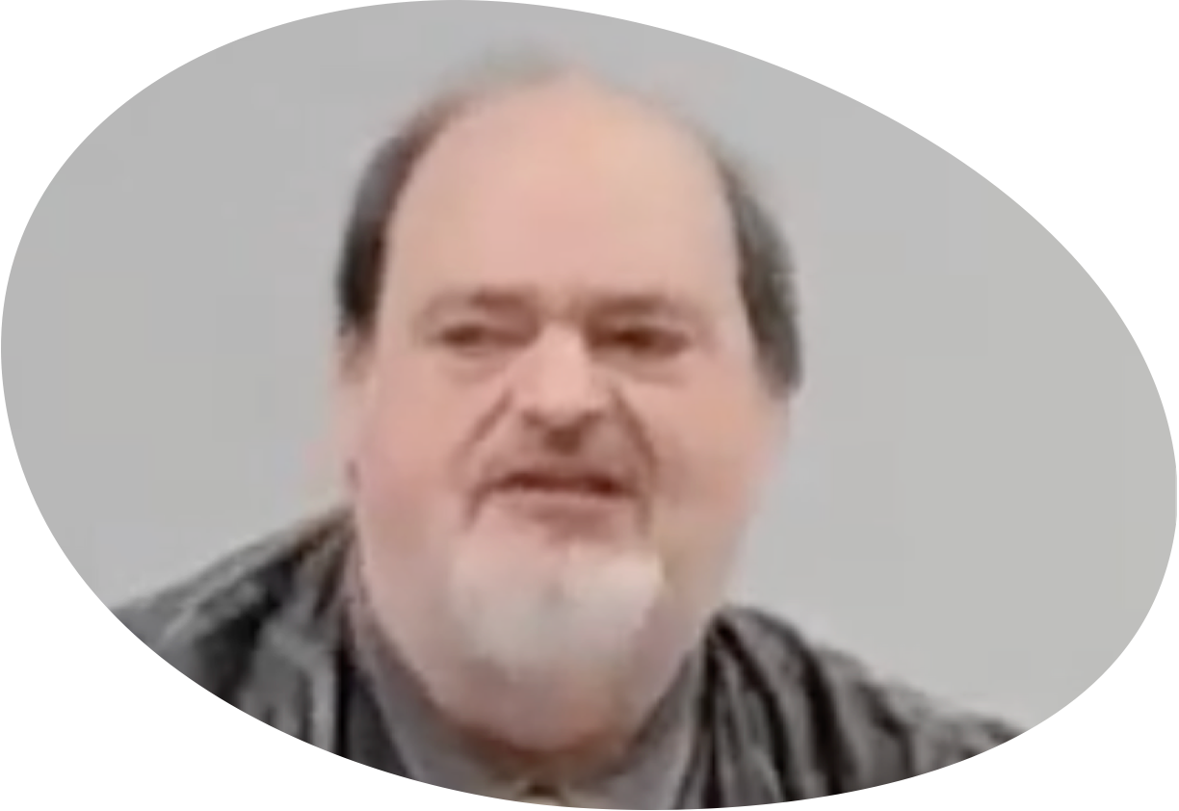
“Church of Christ MEETING @ 9500 AR 5, Alexander AR. 72002”
TODAY’S LESSON
Sunday Evening Live Stream 4:00 PM ^{CT} February 25, 2024
https://www.youtube.com/user/donmcclain11/live / https://www.bryantchurchofchrist.com

Slide 2
STIR UP THE GIFT OF GOD WHICH IS IN YOU
2 TIMOTHY 1:6-7

Slide 3
Final Words
Moses to Israel in Deuteronomy 1-34
Joshua to the same generation “Choose today whom you will serve!” Josh. 24:1-31
David to Solomon 1 Chronicles 22:6-16
David to Israel 1 Chron. 29:1-20
Jesus to His disciples John 13-17; Acts 1
Paul to the Ephesian elders Acts 20:17-38
Paul to Timothy in 2 Timothy

Slide 4
2 Timothy
The main idea: “stir up the gift of God which is in you through the laying on of my hands” 1:6
“stir up” literally means “revive fire”
“the gift of God” in 2 Tim. 1:6 through (by) Paul laying his hands on Timothy
“the gift of God” in 1 Tim. 4:14 is with (not by) the hands of the eldership; that gift was given through prophecy (1 Tm 1:18)
The gift in 1 Tim. 4:14 was the work of evangelist Ephesians 4:11

Slide 5
2 Timothy 1:6
“the gift of God” in 2 Tim. 1:6 is through Paul’s hands
Spiritual gift Romans 1:11
Acts 8:18 through the apostles’ hands
Acts 6:6 Philip received gift from apostles but could not give his gift to Samaritans
2 Cor.12:12 signs of an apostle
Temporary gifts 1 Cor.13:8-10
Permanent faith, hope, and love v.13

Slide 6
2 Timothy 1:7
1:7 is the outline: For God has not given us a spirit of fear, but of power, and of love, and of a sound mind.
Introduction 1:1-7
God has not given us a spirit of fear 1:8-18
But of power, and of love, and of a sound mind 2:1-4:8
Conclusion 4:9-22

Slide 7
Basic Outline for 2 Timothy
Introduction 1:1-7
God has not given us a spirit of fear 1:8-18
But of power, and love, and discipline 2:1-4:8
[God has given us a spirit] of power 2:1-13
[God has given us a spirit] of love 2:14-26
[God has given us a spirit] of discipline 3:1-4:8
Conclusion 4:9-22

Slide 8
God has not given us a spirit of fear 1:8-18
1:8-11 do not be ashamed of the testimony of the Lord Romans 10:5-10; 1 John 4:18
1:12 I am not ashamed Rom.1:16
1:13-14 faithfully keep the faithful word
1:15 All in Asia have turned away from me Phygelus and Hermogenes (nicknames?)
1:16-18 Onesiphorus was not ashamed

Slide 9
But [God has given us a spirit] of power 2:1-13
2:1-7 “Be strong in the grace that is in Christ Jesus” endurance, faithfulness
Hard work teaching, training others v.2
Metaphors for strong Christians v.3-7
Soldier v.3-4 share hardship; do not fraternize with the enemy; please Christ
Athlete v.5 follow the rules→win the prize
Farmer v.6 hard work rewarded; first to share the fruits of his labor

Slide 10
But [God has given us a spirit] of power 2:1-13
2:1-7 “Be strong in the grace that is in Christ Jesus” endurance, faithfulness
2:8-11 salvation by the resurrection of Christ is example of power Eph. 1:19-23
Resurrection from death is foundation v.8
The word of God is not chained v.9 Philippians 1:12-14; 4:22
Paul said, “I endure all things” for the elect to receive salvation in Christ v.10

Slide 11
But [God has given us a spirit] of power 2:1-13
2:1-7 “Be strong in the grace that is in Christ Jesus” endurance, faithfulness
2:8-11 salvation by the resurrection of Christ is example of power Eph. 1:19-23

Slide 12
But [God has given us a spirit] of power 2:1-13
2:1-7 “Be strong in the grace that is in Christ Jesus” endurance, faithfulness
2:8-11 salvation by the resurrection of Christ is example of power Eph. 1:19-23
2:11-13 a faithful saying about faithfulness
If died → also shall live Galatians 2:20
If we endure → we shall reign Rom. 8:17,37
If we deny → He will deny us Matt. 10:33
If we are disbelieving → He remains faithful

Slide 13
[God has given us a spirit] of love 2:14-26
2:14 Teach brethren not to fight
2:15 Love the word of truth with diligence and care
2:16-18 Avoid babblings that lead to ungodliness
Faith of some is overthrown

Slide 14
[God has given us a spirit] of love 2:14-26
2:14 Teach brethren not to fight
2:15 Love the word of truth with diligence and care
2:16-18 Avoid babblings that lead to ungodliness
2:19 Foundation of our relationships
The love of God for us Rom.5:1-11
The name of Christ 1 Cor. 1:10-13; 1 Pt 4:16
Motivation to avoid iniquity Titus 2:11-14

Slide 15
[God has given us a spirit] of love 2:14-26
2:19-22 Purity in God’s house
Cleanse yourself first
Flee youthful lusts 1 Thess. 4:3-8
Pursue righteousness, faith, love, peace
2:23-26 Do not cause strife
Gentleness, patience, humility, compassion to reach those trapped in sin
“able to teach” = “to cause to learn”

Slide 16
[God has given us a spirit] of discipline 3:1-4:8
But you be watchful in all things 4:5
But watch thou in all things (KJV)
But you, keep your head in all situations (NIV)
3:1-9 keep your head when everyone else is losing theirs
Last days of any society Genesis 6:5,8
The list begins and ends with SELF
Social problems also corrupt the church! v.5-9

Slide 17
[God has given us a spirit] of discipline 3:1-4:8
3:10-17 keep your head in the scriptures
Paul’s example v.10-13
Source of Timothy’s saving faith v.14-17
God’s profitable words v.16
For teaching us what to believe
For showing us our errors
For telling us how to be right again
For instructing us how to live righteously
Only source for good works v.17; 1 Cor. 4:6

Slide 18
[God has given us a spirit] of discipline 3:1-4:8
4:1-5 keep your head on your task
Preach the word (convict, rebuke, encourage)
In season and out of season
Do the work of an evangelist (study, know, meditate, live, preach the gospel of Christ 1 Tim. 4:12-16)
4:6-8 keep your head even when I will lose mine (Paul’s death was imminent)

Slide 19
Fully Use the Gifts God Has Given You
Heb.11:6 diligently seek God
Have a faith that pleases God
Acts 2:38 repentance is the most common meaning of how to seek God
Rom. 10:10-13 confessing Jesus is Lord is part of how to call on the name of the Lord
Acts 22:16 baptism in the name of the Lord is calling on the name of the Lord Acts 2:21,36-38,41,47; 1 Peter 3:21

Slide 20
Fully Use the Gifts God Has Given You
2 Peter 1:5-11 give all diligence to add to your faith 1 Cor. 3:21 All things are yours
Rev.2:10 Be faithful unto death
Matt. 22:37-39 love God with all your heart
Ephesians 4:16 unity based on degree of your and my connection to Christ
Percentage of effort to potential
Percentage of members working
Percentage of members working together

