Slide 1
HOW & WHEN CHRISTIANS ARE CLEANSED OF THEIR
When a Christian sins, what does the Bible teach he/she must do to be cleansed of his/her sin?

Slide 2
HOW & WHEN CHRISTIANS ARE CLEANSED OF THEIR
Our understanding of what the Scriptures teach about SIN significantly affects to our understanding the plan of salvation, our view of ourselves and others, and our attitude towards sin in striving to live for God.

Slide 3
HOW & WHEN CHRISTIANS ARE CLEANSED OF THEIR
False Views of Sin:
Sin is inherited from Adam
We are born sinners
Our very flesh is sinful
Sin is the natural product of the flesh
Sin is unavoidable
Sin is vague & unknowable
Sin is not sin
Things NOT sinful as sin

Slide 4
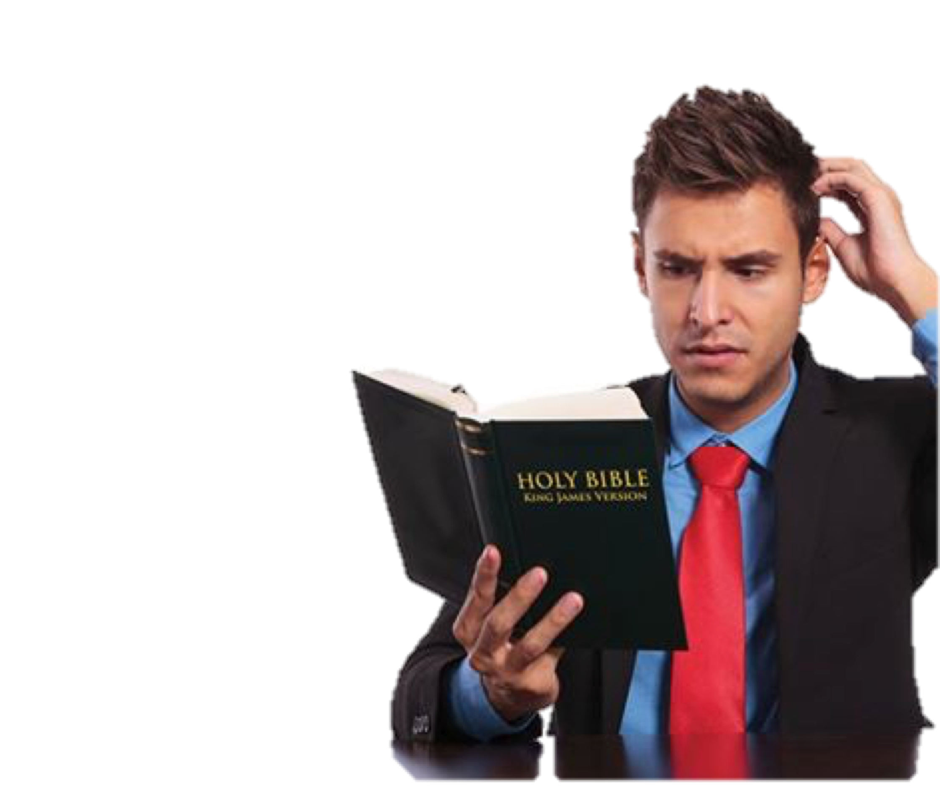
Defining What Sin Is
Lawlessness 1 John 3:4
To do that which is forbidden – OR to NOT do that which is commanded! - 1 Cor 6:9-11; Gal 5:19-21; 1 John 2:3-5
All Unrighteousness 1 John 5:17
Missing the mark Rom 3:23
If Not Of Faith Rom 14:23
Omitting Known Duty James 4:17

Slide 5
Defining What Sin Is
Thayer Definition: ἀδικία - Adikia
1) injustice, of a judge
2) unrighteousness of heart and life
3) a deed violating law and justice, act of unrighteousness
2 Tim 3:16,17; Heb. 5:14
Lawlessness 1 John 3:4
All Unrighteousness 1 John 5:17
Missing the mark Rom 3:23
If Not Of Faith Rom 14:23
Omitting Known Duty James 4:17

Slide 6
Defining What Sin Is
Thayer Definition:
G264 - ἁμαρτάνω - hamartanō
4) to miss or wander from the path of uprightness and honour, to do or go wrong
5) to wander from the law of God, violate God’s law,
Lawlessness 1 John 3:4
All Unrighteousness 1 John 5:17
Missing the mark Rom 3:23
If Not Of Faith Rom 14:23
Omitting Known Duty James 4:17

Slide 7
Defining What Sin Is
Lawlessness 1 John 3:4
Doing that which you believe to be wrong.
Even though it may not be sinful – if you believe that it is, and do it anyway – you have sinned.
All Unrighteousness 1 John 5:17
Missing the mark Rom 3:23
If Not Of Faith Rom 14:23
Omitting Known Duty James 4:17

Slide 8
Defining What Sin Is
Lawlessness 1 John 3:4
Requires a certain degree of knowledge & understanding
Luke 10:29-37
Opportunity
+
Ability
= Responsibility
All Unrighteousness 1 John 5:17
Missing the mark Rom 3:23
If Not Of Faith Rom 14:23
Omitting Known Duty James 4:17

Slide 9
Defining What Sin Is
Lawlessness 1 John 3:4
All Unrighteousness 1 John 5:17
Missing the mark Rom 3:23
If Not Of Faith Rom 14:23
Omitting Known Duty James 4:17

Slide 10
Defining What Sin Is
Commission
Omission
Doing what God Forbids (Gen 2:17,18; 3:6,17; 1 Cor 6:9-11).
Adding to God’s Word (Deut. 4:2; Rev. 22:19; 2 Sam. 6:3; Num. 4:1-15; Mat. 15:5,6).
Making substitutions (Gen. 4:4; Lev. 10; Heb 8:5).
Not doing what God Commands (1 Sam. 15; 1 Chro. 15:13).
Subtracting from God’s Word (Deut. 4:2; Rev. 22:19; Mat. 23:1-3).
Knowing to do good and not doing it (Jam. 4:17)

Slide 11
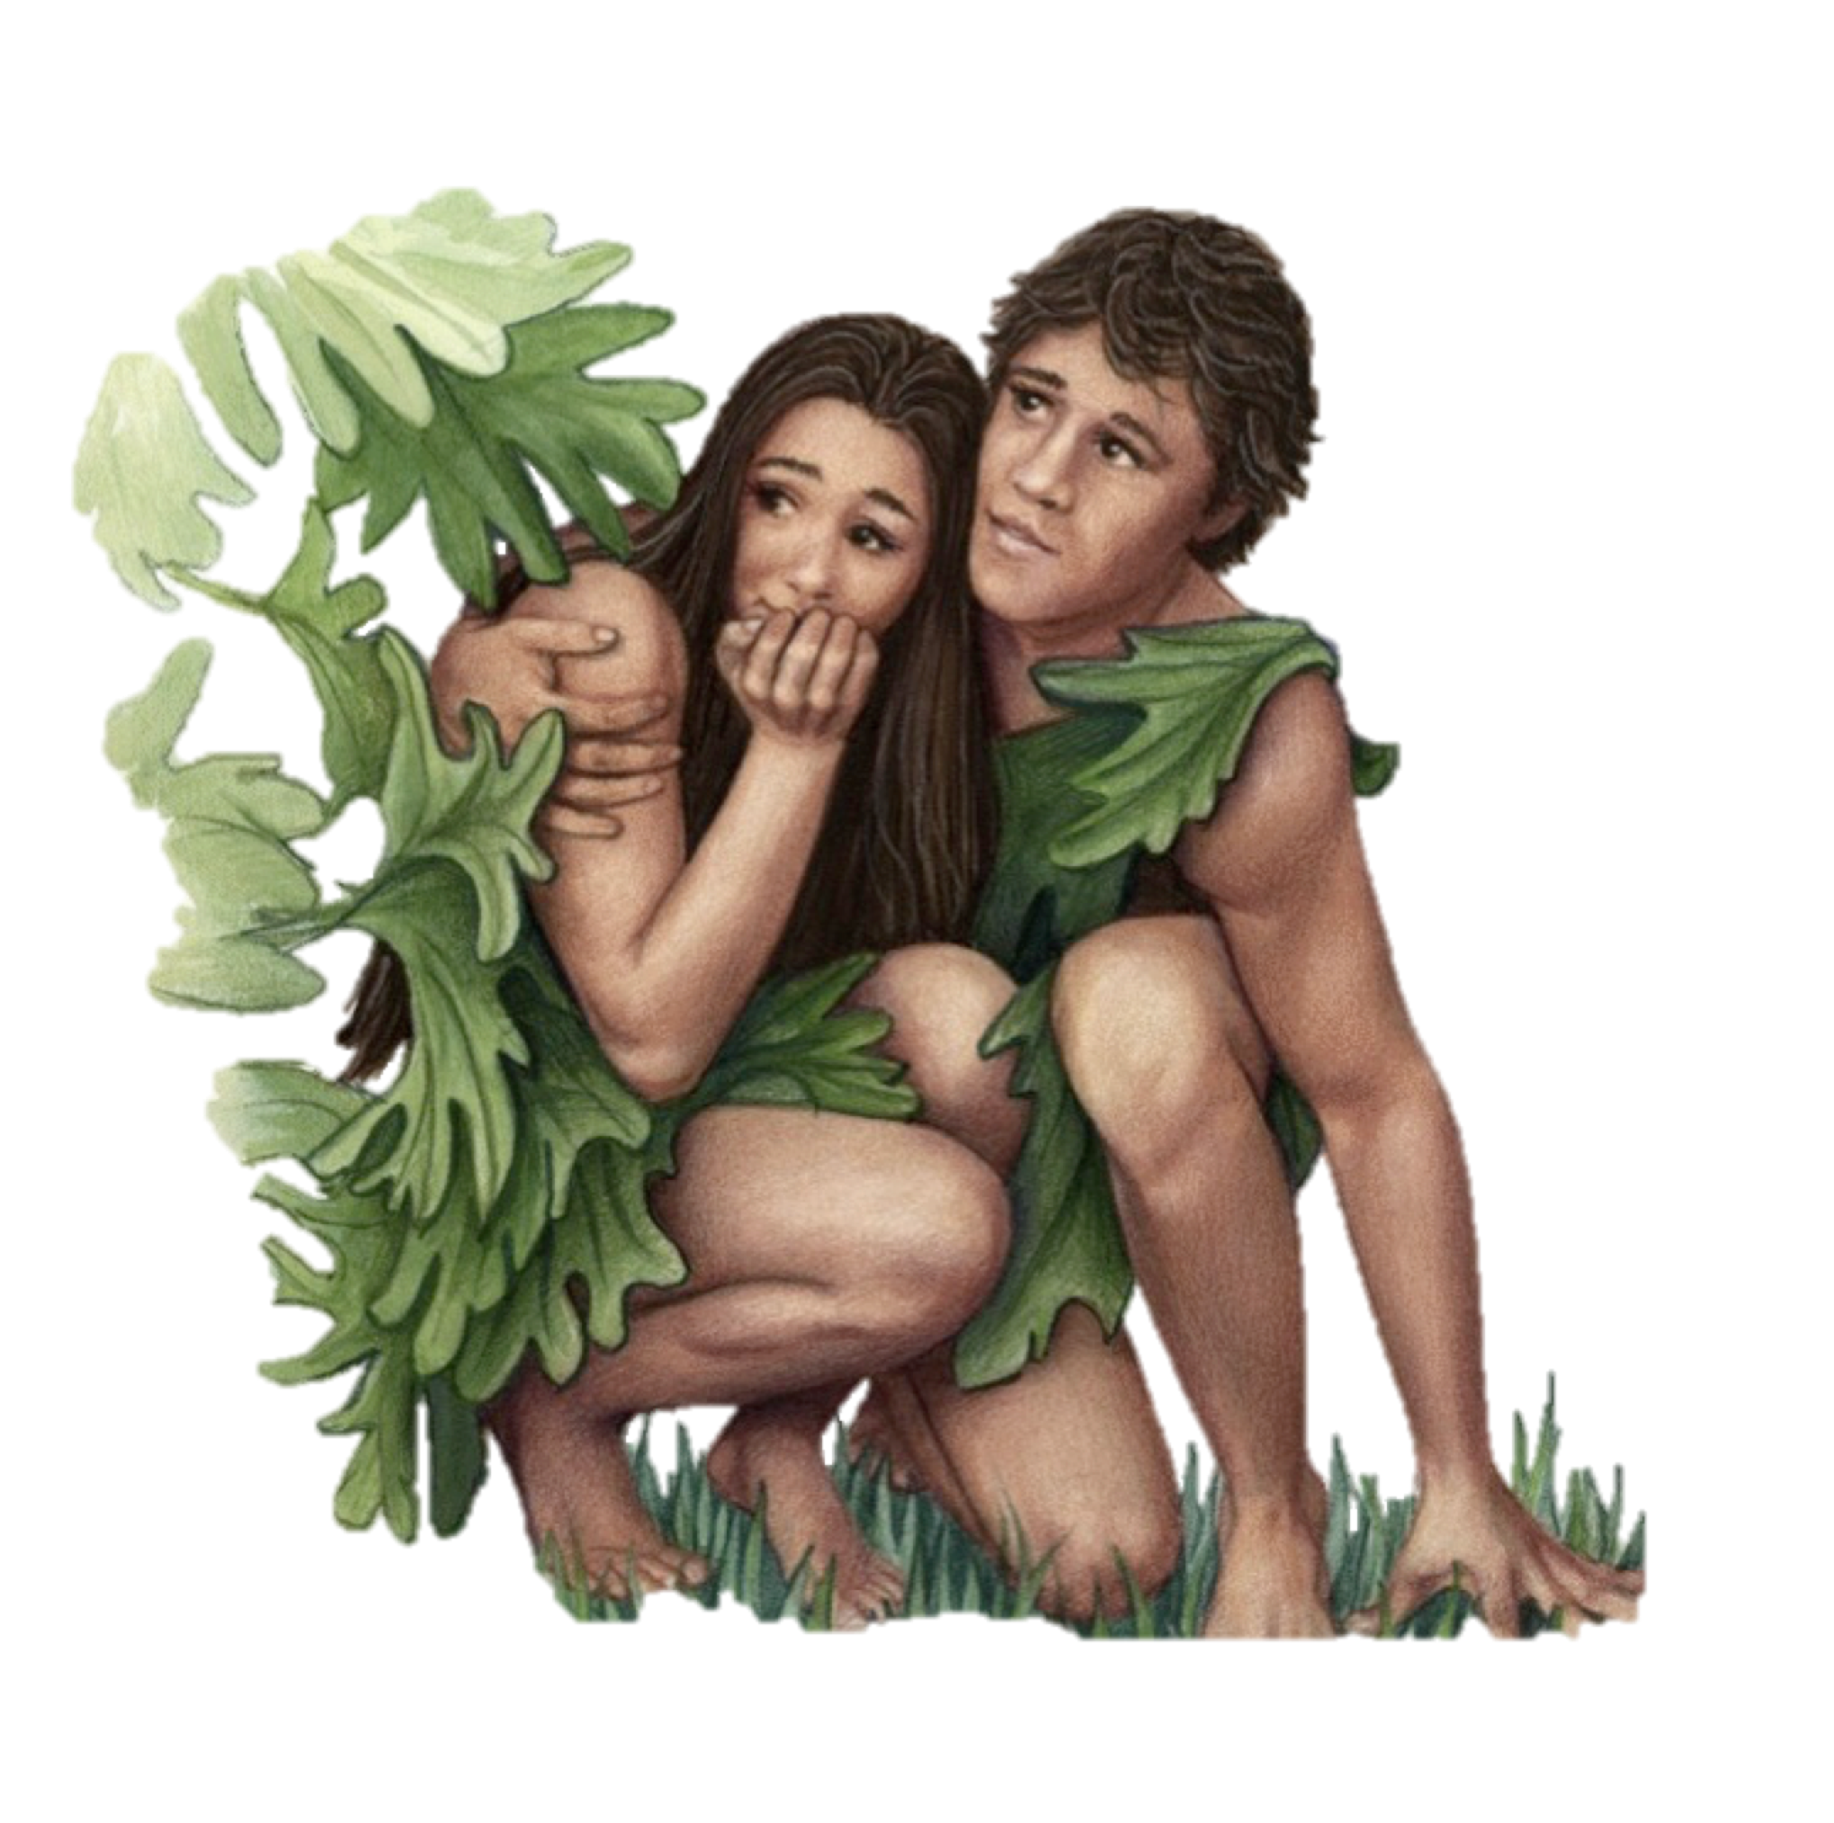
Understanding What Sin Is
The first sin is a case study of all sin - Gen. 3:1-6; 1 Jn 2:15,16
Jesus was tempted through the same avenues - Mat 4:1-11; Heb. 4:15
Sin OCCURS when desire is enticed and the will yields - James 1:13-16; 1 Cor 9:27

Slide 12
Understanding What Sin Is
Knowledge
Teaching
G
R
O
W
T
H
Patience
Service
No such thing as situational ethics!!
Christian Growth - 2 Peter 1:5-10
Adultery – Homosexuality
Fornication – Murder
Lying - Stealing, etc. . . .
Absolute, Immediately Condemns –
1 Cor 6:9-11;
Gal 5:19-21
All Sin Must be forgiven
years
5 10 15 20
No Time - Heb 13:4
Time - Heb 5:12

Slide 13
Understanding What Sin Is
SIN is NOT vague & unknowable!
SIN is NOT unavoidable!
Is our view of sin causing:
Undue fear?
A lack of concern regarding our sins?
Lack of confidence?

Slide 14
Understanding What Sin Is
Sin Is NOT:
Not knowing everything . . .
Being tempted . . .
Trying & failing at a task / Simply making a mistake . . .
Simply feeling depressed / Simply feeling discouraged / Simply feeling weak . . .
Simply feeling guilty . . .
Enjoying life . . .

Slide 15
WHY WE SIN …
We are not watchful (Mat. 26:41, Gal. 6:1).
We lack self-control (I Cor. 9:27).
We want to fit in with the crowd, (Prov. 1:10; 1 Cor. 15:33; 1 Tim. 5:22).
We do not control our thoughts (Prov. 22:3; 15:26, 23:7, Phil 4:8).
We don’t resist the devil (Jas. 4:7).
Selfishness (cp. Lk. 15:12; 18:22,23).
We do not have the word hidden in our heart – (Ps. 119:11).

Slide 16
WHY WE SIN …
It’s often easier to sin than to do what is right (Mat 7:13,14)
It’s our habit (2 Pet 2:14)
Of its momentary pleasure (Heb 11:25; Jas 5:5)
It’s deceptive (Heb 3:13)
We want to (Jas. 1: 14,15).
We do not fear the consequences of sin (Prov 1:7; 16:6; Jer 2:18; Rom 3:18; Mat 5:29,30)

Slide 17
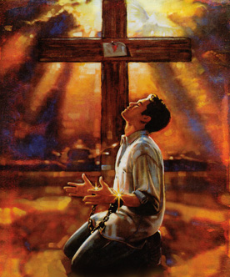
What Place Does Sin Have In The Life of A Child of God?
JOHN’S RESPONSE TO THE ERRORS OF GNOSTICISM
One of the special objects for which First John was written was to counteract the errors of the dangerous, deadly heresy of the day, later known as Gnosticism.
There were three sects whose heretical teachings began to influence the churches in the latter part of the 1 St century: The Ebionites, followers of Ebion; The Docetics; and Cerinthians.

Slide 18
What Place Does Sin Have In The Life of A Child of God?
JOHN’S RESPONSE TO THE ERRORS OF GNOSTICISM
The Ebonites declared that Jesus was a mere man, denying his deity.
One branch of the Cerinthian Gnostic maintained his body was, for a time, occupied by an aeon, eon, ("an emanation or phase of the supreme deity"), called Christ.
The Docetic Gnostic argued that he only appeared to posses a body, but only a shadowy phantom.

Slide 19
What Place Does Sin Have In The Life of A Child of God?
JOHN’S RESPONSE TO THE ERRORS OF GNOSTICISM
Claimed to have reached such an advanced stage of spiritual experience and knowledge that they were `beyond good and evil'.
They contended that once regenerated, they were pure in spirit, and it mattered not what the body did, since it was inherently evil anyway because it was material.

Slide 21
1 John 1:3-4 (NKJV) ³ that which we have seen and heard we declare to you, that you also may have fellowship with us; and truly our fellowship is with the Father and with His Son Jesus Christ. ⁴ And these things we write to you that your joy may be full.
Man was created to be in fellowship with God
Gen. 1:25-27; Acts 17:26,27;

Slide 22
1 John 1:3-4 (NKJV) ³ that which we have seen and heard we declare to you, that you also may have fellowship with us; and truly our fellowship is with the Father and with His Son Jesus Christ. ⁴ And these things we write to you that your joy may be full.
BUT - our fellowship with God is broken by our sin –
Isaiah 59:1,2;
Romans 3:23; 5:12
Romans 6:23;
1 Cor. 6:9-10

Slide 23
1 John 1:3-4 (NKJV) ³ that which we have seen and heard we declare to you, that you also may have fellowship with us; and truly our fellowship is with the Father and with His Son Jesus Christ. ⁴ And these things we write to you that your joy may be full.
Fellowship with God can only be regained IN JESUS –
Acts 2:38;
Romans 6:3-6;
Gal. 3:26-28;
Eph 2:14-17

Slide 24
1 John 1:5-7 (NKJV)
⁵ This is the message which we have heard from Him and declare to you, that God is light and in Him is no darkness at all. ⁶ If we say that we have fellowship with Him, and walk in darkness, we lie and do not practice the truth
God is absolute in truth, purity and holiness. There is NO amount of evil or sin in Him.

Slide 25
1 John 1:5-7 (NKJV)
⁷ But if we walk in the light as He is in the light, we have fellowship with one another, and the blood of Jesus Christ His Son cleanses us from all sin.
If we are to share with Him in the life He has to offer, our lives must reflect His nature.

Slide 26
If we are to share with Him in the life He has to offer, our lives must reflect His nature.
“Walk" - in the present tense indicates our manner of life, the way we live (John 8:12; Romans 6:4; 8:4; etc, . . .).
Light – (metaphorically, of moral and spiritual truth, righteousness and holiness).
Our manner of life should consist of faithfulness, godliness, purity, brotherly love, growth.

Slide 27
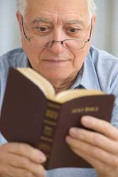
Our Sin Is Exposed
By God’s nature (1 Jn 1:5; Hab 1:12-13; 1 Pet. 1:13-16)
By God’s Word (Ps. 119:105; Prov. 6:23; Eph. 5:1-18; Gal. 5:19-21)
By nature (Rom. 1:26,27; Prov. 13:15; 14:34; Jer 2:19)

Slide 28
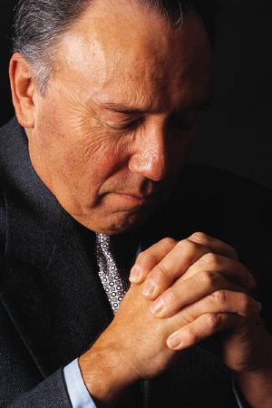
Our Sin Must Be Confessed
1 John 1:9–10 (NKJV)
⁹ If we confess our sins, He is faithful and just to forgive us our sins and to cleanse us from all unrighteousness. ¹⁰ If we say that we have not sinned, we make Him a liar, and His word is not in us.

Slide 29
Our Sin Must Be Confessed
Confess – Verb - Strong's Number: <G3670>
Original Word: ὁμολογέω, homologeō
lit., "to speak the same thing" (homōs, "same," legō, "to speak"), "to assent, accord, agree with," denotes, (a) "to confess, declare, admit," John 1:20; e.g., Acts 24:14; Heb. 11:13; (b) "to confess by way of admitting oneself guilty of what one is accused of, the result of inward conviction," 1 John 1:9;
—Vine's Expository Dictionary of Old and New Testament Words

Slide 30
Our Sin Must Be Confessed
Quickly (Isaiah 55:6,7; 2 Cor 6:2; Heb 3:13)
Specifically (confess our sins) - (Proverbs 28:13; Psalm 32:5; 51:1-4)
Confidently (He is faithful and just) (1 Cor 1:9; Heb 6:18; Rom 3:26)

Slide 31
WE MUST REPENT
Acts 8:20–24 (NKJV)
²⁰ But Peter said to him, “Your money perish with you, because you thought that the gift of God could be purchased with money! ²¹ You have neither part nor portion in this matter, for your heart is not right in the sight of God.

Slide 32
WE MUST REPENT
Acts 8:20–24 (NKJV)
²² Repent therefore of this your wickedness, and pray God if perhaps the thought of your heart may be forgiven you. ²³ For I see that you are poisoned by bitterness and bound by iniquity.” ²⁴ Then Simon answered and said, “Pray to the Lord for me, that none of the things which you have spoken may come upon me.”

Slide 33
WE MUST REPENT
Repent – 1. metanoeo (μετανοέω, 3340), lit., “to perceive afterwards” (meta, “after,” implying “change,” noeo, “to perceive”; nous, “the mind, the seat of moral reflection”), … hence signifies “to change one’s mind or purpose,” always, in the NT, involving a change for the better, an amendment, and always, except in Luke 17:3, 4, of “repentance” from sin.
—Vine's Expository Dictionary of Old and New Testament Words

Slide 34
WE MUST REPENT
Repent – 1. metanoeo (μετανοέω, 3340),
change one’s mind
feel remorse, repent, be converted … Failure to repent leads to destruction Lk 13:3, 5; Mt 11:20 … the negative impulse of turning away is dominant, …repent and turn away from someth. ἀπὸ τῆς κακίας (Jer 8:6; Just., D. 109, 1) Ac 8:22
Arndt, W., Danker, F. W., Bauer, W., & Gingrich, F. W. (2000). In A Greek-English lexicon of the New Testament and other early Christian literature (3rd ed.). University of Chicago Press.

Slide 35
WE MUST REPENT
From the case of Simon we learn that the forgiveness of the sins one commits after baptism is conditioned on repentance.
The unrepentant can expect no forgiveness. (Luke 13:3-5; Acts 17:30)
Peter told Simon to pray (1 Jn 1:9)

Slide 36
Our Sin Must Be Confessed
We can have victory over sin – We do not have to yield to temptation
1 Cor. 10:13
1 John 2:1-2 (NKJV) ¹ My little children, these things I write to you, so that you may not sin. And if anyone sins, we have an Advocate with the Father, Jesus Christ the righteous. ² And He Himself is the propitiation for our sins, and not for ours only but also for the whole world.

Slide 37
Our Sin Must Be Confessed
We can have victory over sin – We do not have to yield to temptation
1 Cor. 10:13
Sin no more – John 5:14
Go and sin no more – John 8:11
Not to continue in sin – Rom 6:1,2,6,7,11,12-15
Do not sin – 1 Cor. 15:34
Grace teaches us – Tit 2:11,12

Slide 38
Our Sin Must Be Confessed
If we sin – we can be forgiven through the sacrifice of Christ when we confess our sins (1:9)
1 John 2:1-2 (NKJV) ¹ My little children, these things I write to you, so that you may not sin. And if anyone sins, we have an Advocate with the Father, Jesus Christ the righteous. ² And He Himself is the propitiation for our sins, and not for ours only but also for the whole world.

Slide 39
"⁷But if we walk in the light as He is in the light, we have fellowship with one another, and the blood of Jesus Christ His Son cleanses us from all sin. ⁸If we say that we have no sin, we deceive ourselves, and the truth is not in us. ⁹If we confess our sins, He is faithful and just to forgive us our sins and to cleanse us from all unrighteousness." 1 John 1:7-9
"¹My little children, these things I write to you, so that you may not sin. And if anyone sins, we have an Advocate with the Father, Jesus Christ the righteous. ²And He Himself is the propitiation for our sins, and not for ours only but also for the whole world. ³Now by this we know that we know Him, if we keep His commandments." 1 John 2:1-3

Slide 40
"⁷But if we walk in the light as He is in the light, we have fellowship with one another, and the blood of Jesus Christ His Son cleanses us from all sin. ⁸If we say that we have no sin, we deceive ourselves, and the truth is not in us. ⁹If we confess our sins, He is faithful and just to forgive us our sins and to cleanse us from all unrighteousness." 1 John 1:7-9
"¹My little children, these things I write to you, so that you may not sin. And if anyone sins, we have an Advocate with the Father, Jesus Christ the righteous. ²And He Himself is the propitiation for our sins, and not for ours only but also for the whole world. ³Now by this we know that we know Him, if we keep His commandments." 1 John 2:1-3

Slide 41
"⁷But if we walk in the light as He is in the light, we have fellowship with one another, and the blood of Jesus Christ His Son cleanses us from all sin. ⁸If we say that we have no sin, we deceive ourselves, and the truth is not in us. ⁹If we confess our sins, He is faithful and just to forgive us our sins and to cleanse us from all unrighteousness." 1 John 1:7-9
"¹My little children, these things I write to you, so that you may not sin. And if anyone sins, we have an Advocate with the Father, Jesus Christ the righteous. ²And He Himself is the propitiation for our sins, and not for ours only but also for the whole world. ³Now by this we know that we know Him, if we keep His commandments." 1 John 2:1-3

Slide 42
"⁷But if we walk in the light as He is in the light, we have fellowship with one another, and the blood of Jesus Christ His Son cleanses us from all sin. ⁸If we say that we have no sin, we deceive ourselves, and the truth is not in us. ⁹If we confess our sins, He is faithful and just to forgive us our sins and to cleanse us from all unrighteousness." 1 John 1:7-9
"¹My little children, these things I write to you, so that you may not sin. And if anyone sins, we have an Advocate with the Father, Jesus Christ the righteous. ²And He Himself is the propitiation for our sins, and not for ours only but also for the whole world. ³Now by this we know that we know Him, if we keep His commandments." 1 John 2:1-3

Slide 43
" ⁵This is the message which we have heard from Him and declare to you, that God is light and in Him is no darkness at all. ⁶If we say that we have fellowship with Him, and walk in darkness, we lie and do not practice the truth. ⁷But if we walk in the light as He is in the light, we have fellowship with one another, and the blood of Jesus Christ His Son cleanses us from all sin." 1 John 1:5-7
"⁴He who says, “I know Him,” and does not keep His commandments, is a liar, and the truth is not in him. ⁵But whoever keeps His word, truly the love of God is perfected in him. By this we know that we are in Him. ⁶He who says he abides in Him ought himself also to walk just as He walked." 1 John 2:4-6

Slide 44
" ⁵This is the message which we have heard from Him and declare to you, that God is light and in Him is no darkness at all. ⁶If we say that we have fellowship with Him, and walk in darkness, we lie and do not practice the truth. ⁷But if we walk in the light as He is in the light, we have fellowship with one another, and the blood of Jesus Christ His Son cleanses us from all sin." 1 John 1:5-7
"⁴He who says, “I know Him,” and does not keep His commandments, is a liar, and the truth is not in him. ⁵But whoever keeps His word, truly the love of God is perfected in him. By this we know that we are in Him. ⁶He who says he abides in Him ought himself also to walk just as He walked." 1 John 2:4-6

Slide 45
" ⁵This is the message which we have heard from Him and declare to you, that God is light and in Him is no darkness at all. ⁶If we say that we have fellowship with Him, and walk in darkness, we lie and do not practice the truth. ⁷But if we walk in the light as He is in the light, we have fellowship with one another, and the blood of Jesus Christ His Son cleanses us from all sin." 1 John 1:5-7
"⁴He who says, “I know Him,” and does not keep His commandments, is a liar, and the truth is not in him. ⁵But whoever keeps His word, truly the love of God is perfected in him. By this we know that we are in Him. ⁶He who says he abides in Him ought himself also to walk just as He walked." 1 John 2:4-6

Slide 46
HOW & WHEN CHRISTIANS ARE CLEANSED OF THEIR
Sinners must recognize their desperate situation brought on by the devastating nature of sin.
Sinners must in faith appeal to Jesus for cleansing.
Jesus eagerly, compassionately grants deliverance from sin to ALL who by faith fully surrenders their will and life to His will & life.

Slide 47
HOW & WHEN CHRISTIANS ARE CLEANSED OF THEIR
Hear the Gospel (Rom. 10:17)
Believe that Jesus is the Son of God (John 8:24)
Repent of Your Sins (Acts 17:30)
Confess Jesus as God’s Son & the risen Lord (Rom. 10:9-10)
Be Baptized for Forgiveness of Sins (Acts 2:38; Rom. 6:3-6)
Live Faithfully in service to Jesus, (Col. 1:23; 1 Jn 1:9,10; Acts 8:22)

Slide 48
HOW & WHEN CHRISTIANS ARE CLEANSED OF THEIR
Imitate God as dear children (1 Jn 1:5,7; Eph 5:1,2)
Abstain from sin (1 Jn 2:1; Eph. 5:3-7)
Walk as children of light (1 Jn 1:7; Eph. 5:8-14)
If we sin - repent, confess and pray (1 Jn 1:9; Acts 8:22)

Slide 49
HOW & WHEN CHRISTIANS ARE CLEANSED OF THEIR
The Question for us today is:
What Will We Do With Our Sin?

Slide 51
HOW & WHEN CHRISTIANS ARE CLEANSED OF THEIR
When a Christian sins, what does the Bible teach he/she must do to be cleansed of his/her sin?

