Slide 1
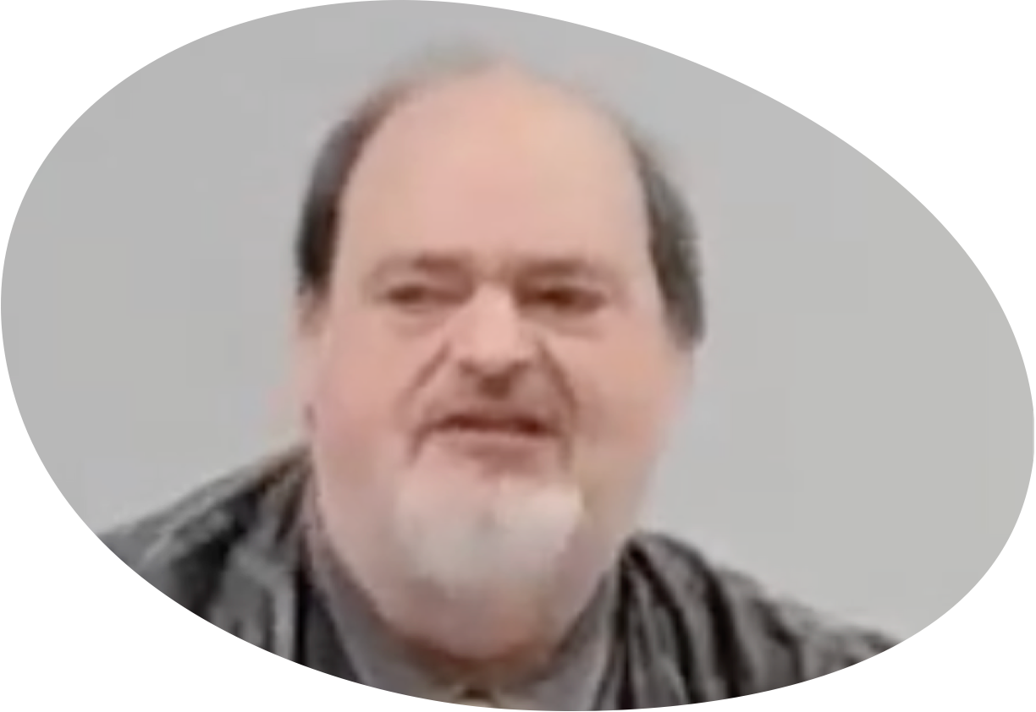
“Church of Christ MEETING @ 9500 AR 5, Alexander AR. 72002”
TODAY’S LESSON
Sunday evening lesson live stream 4:00 PM ^{CDT} July 14, 2024
https://www.youtube.com/user/donmcclain11/live / https://www.bryantchurchofchrist.com

Slide 2
THE TRUE GRACE OF GOD IN WHICH YOU MUST STAND
1 PETER 5:8-12

Slide 3
Background of 1 Peter
Author: Simon nicknamed Peter (an apostle of Jesus Christ) 1:1 through Silas 5:12
Recipients: strangers scattered throughout modern day Turkey 1:1 Christians 1:2a
Jewish terminology applied to church (2:9)
Greeting: Grace & peace be multiplied to you 1:2b
Purpose: 5:12

Slide 4
1 Peter 5:12
By Silvanus, a faithful brother unto you, as I suppose, I have written briefly, exhorting, and testifying that this is the true grace of God wherein ye stand.
“stand” is imperative (“you must stand”)
Peter testifies what is the true grace of God 1:1-2:10
Peter exhorts us to stand in the true grace of God 2:11-5:14

Slide 5
Testimony of the True Grace of God 1 Peter 1:1-2:10
We are blessed by God’s grace because of what God has done 1:1-12
Every word counts v.1-2
Praise to God for our living hope v.3-12
Basis for our hope v.3-5
Joy of our hope v.6-9
Assurance of our hope v.10-12

Slide 6
Testimony of the True Grace of God 1 Peter 1:1-2:10
People by God’s grace are holy 1:13-2:10
Holy mindset for holy conduct v.13-16
Holy purchase for holy purpose v.17-21
Holy birth by holy word 1:22-2:3
Holy foundation is Christ 2:4-8
Holy purpose from our holy God 2:9-10

Slide 7
Testimony of the True Grace of God 1 Peter 1:1-2:10
God’s grace glorifies God
God’s grace is seen in the life of Christ
God’s grace is seen in the death of Christ
God’s grace involves suffering
God’s grace blesses us
God’s grace has chosen, saved and sanctified us
God’s grace leads us…

Slide 8
Encouragement to Live in the True Grace of God 1 Peter 2:11-5:14
We are strangers in a sinful world 2:11-12
Glorify God by good conduct
Submission is the main conduct 2:13-3:17
To the government 2:13-17
In the workplace 2:18-25
At home 3:1-7
Among one another 3:8-12

Slide 9
Encouragement to Live in the True Grace of God 1 Peter 2:11-5:14
Suffering for doing good is the main way to show Christ’s rule in your heart 3:13-4:19
Sanctify Christ as Lord in heart 3:13-17
He suffered for us 3:18-22
Suffer by ceasing from sin 4:1-6
Love one another 4:7-11
Glorify God as Christian doing good 4:12-19

Slide 10
Encouragement to Live in the True Grace of God 1 Peter 2:11-5:14
Remaining faithful in this world 5:1-9
Elders are to shepherd their flock v.1-4
Younger Christians submit to elders v.6-7
Be alert and resist the devil v.8-9

Slide 11
1 Peter 5:10-14
Benediction: v.10 May the God of all grace, who called you to His eternal glory by Christ Jesus, after you have suffered a while, perfect, establish, strengthen, and settle you.
Doxology: v.11 To Him the glory and the dominion forever and ever. Amen.
Purpose for the epistle v.12
Greetings from the “church in Babylon” and Mark v.13
Greet one another with a kiss of love. Peace to you all who are in Christ Jesus. Amen. v.14

Slide 13
“Church of Christ MEETING @ 9500 AR 5, Alexander AR. 72002”
TODAY’S LESSON
Sunday evening lesson live stream 4:00 PM ^{CDT} July 14, 2024
https://www.youtube.com/user/donmcclain11/live / https://www.bryantchurchofchrist.com

